Slide 1


Connecting Rural Communities
The Future of Digital Connectivity/Economic Development
February 20, 2020
Washington, DC
© 2020 Harrison Edwards, Inc. All Rights Reserved.

Slide 2
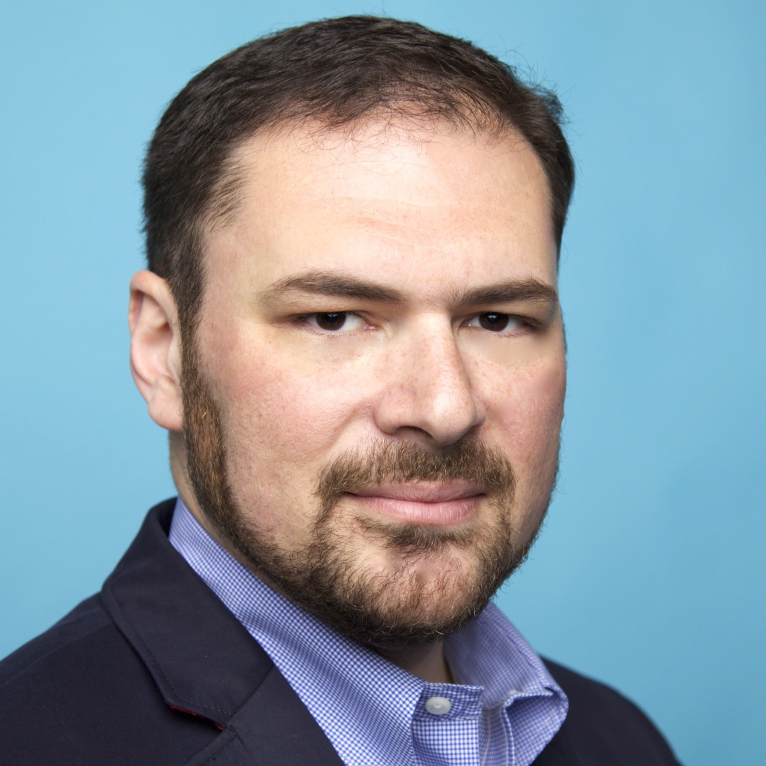

INTRODUCTION
Hello!
Bob Knight
Partner/Head of Broadband Practice, Harrison Edwards, Inc.
Regional Plan Association of NY, NJ & CT
Commissioner, Economic & Community Development, Town of Ridgefield, CT
Fiber-Broadband Association Marketing Committee, Washington, DC
@BobKnightTweet
© 2020 Harrison Edwards, Inc. All Rights Reserved.

Slide 3
About Harrison Edwards
Founded 1987
150+ Awards
Facebook Marketing Partner, 2019
Google Ads Certified, 2020
Certified-MWBE
prforbroadband.com
© 2020 Harrison Edwards, Inc. All Rights Reserved.

Slide 4
Why Did We Get Involved?
Economic Development
Healthcare
Government
Education
Nonprofits
High-Speed Connectivity
Ties our work together
© 2020 Harrison Edwards, Inc. All Rights Reserved.

Slide 5
Why Did We Get Involved?
Because:
90% of Fiber Projects Were Failing in the U.S.
Those that succeeded engaged the community properly.
prforbroadband.com
Source: SNG
© 2020 Harrison Edwards, Inc. All Rights Reserved.

Slide 6
What Does Harrison Edwards Do?
Community Engagement Specialists
1
2
3
4
5
6
Grow Community Support
Build Political Will
Drive Take Rates
Tell The Story Effectively
Protect Against Misinformation
Secure Customers
© 2020 Harrison Edwards, Inc. All Rights Reserved.

Slide 7
1
Context
Deploying Rural Broadband
© 2019 Harrison Edwards, Inc. All Rights Reserved.

Slide 8
Broadband is
Critical Infrastructure
1830s
1890s
1950s
1960s
Now
Railroads moved people and goods
Electricity enabled innovation, growth
Interstate highways opened new markets
Airports opened global markets
Internet drives innovation, new markets
© 2020 Harrison Edwards, Inc. All Rights Reserved.

Slide 9
Takeaway #1
Generational Infrastructure
High-Speed Connectivity is Our Generation’s 50-Year Infrastructure Project.
© 2020 Harrison Edwards, Inc. All Rights Reserved.

Slide 10
TRANSPORTATION
UAVs
WORK
1 Trillion Connected Devices by 2023
Demand is up;
Speed is capped;
Network capacity at limits
ENTERTAINMENT
EDUCATION
The Data-Driven Economy is
Driving Change
in the Telecom Space
SMART
HOMES
SMART
CITIES
HEALTHCARE
© 2020 Harrison Edwards, Inc. All Rights Reserved.

Slide 11
Delivering Broadband
Speed, Capacity
Satellite
Copper Wire
Coax
WiFi
Wireless/Cellular
Fiber
Conventional Speeds Symmetrical Speeds
© 2020 Harrison Edwards, Inc. All Rights Reserved.

Slide 12
?
Public Misperception
+
5G
1000 Mbps.
© 2020 Harrison Edwards, Inc. All Rights Reserved.

Slide 13
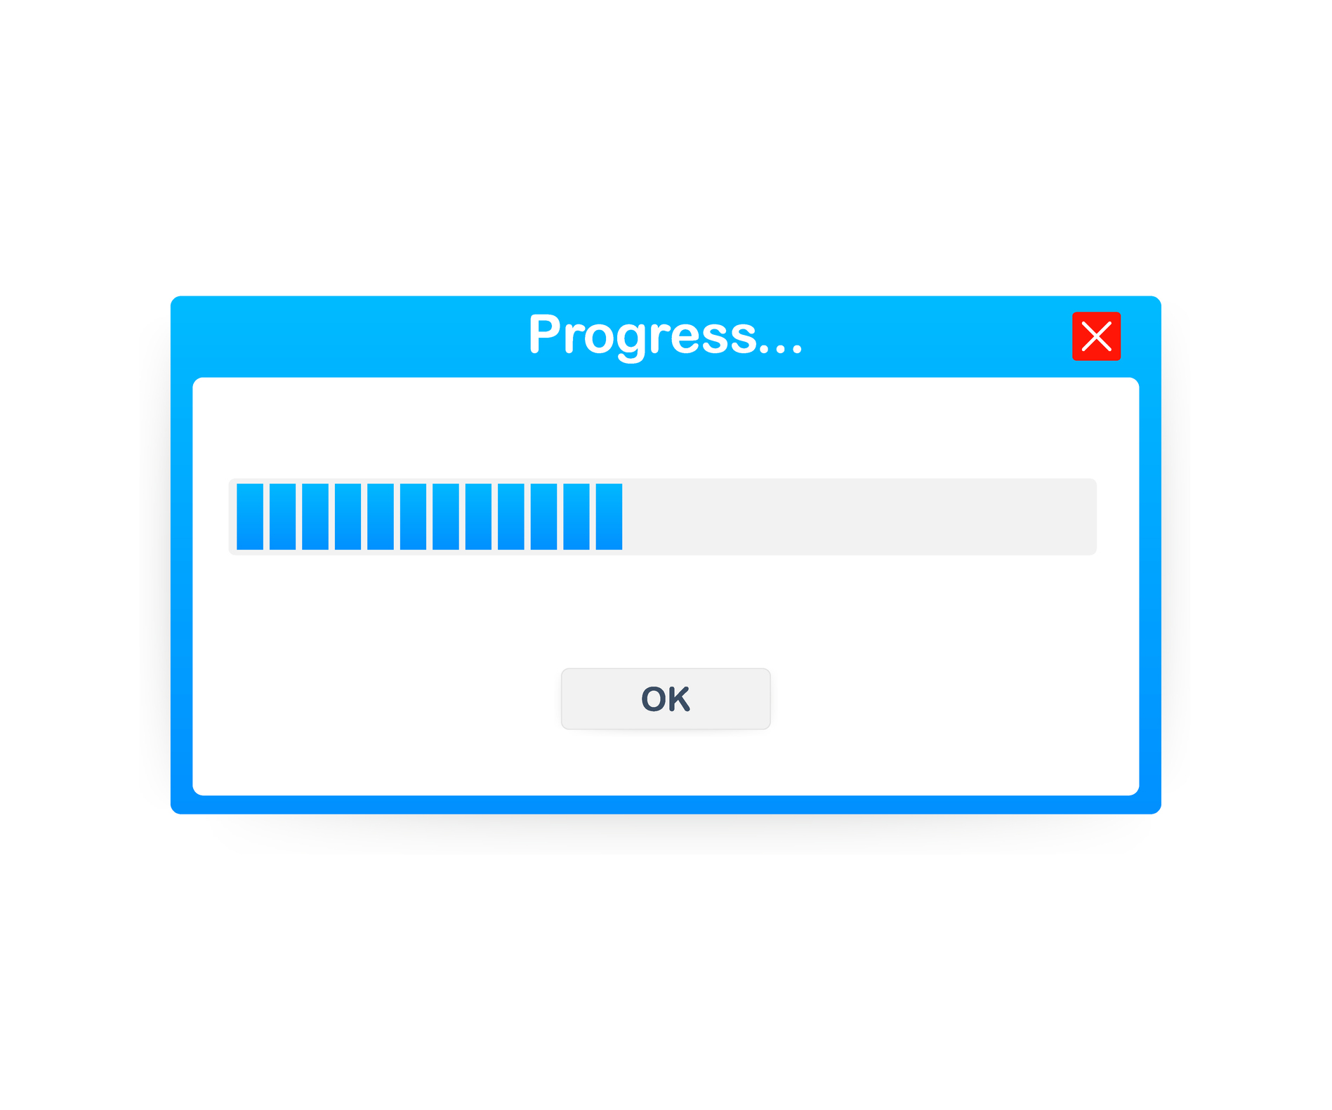
Who Has Broadband Access?
Bridging the Digital Divide
Microsoft: 50%
© 2020 Harrison Edwards, Inc. All Rights Reserved.

Slide 14
Those without access to high-speed connectivity face downward mobility
Vulnerable Populations:
Urban Poor
Rural Communities
Elderly Residents
© 2020 Harrison Edwards, Inc. All Rights Reserved.

Slide 15
Takeaway #2
The Digital Divide
The Digital Divide is now the economic divide.
© 2020 Harrison Edwards, Inc. All Rights Reserved.

Slide 16
2
Innovation
Precision Agriculture is Here
© 2019 Harrison Edwards, Inc. All Rights Reserved.

Slide 17
Community Demand
Farmers are demanding better connectivity to help remain economically viable
Connected equipment is on the market
Wireless networks are insufficient
© 2020 Harrison Edwards, Inc. All Rights Reserved.

Slide 18
What’s Here, What’s Coming
More Bandwidth is Needed
Connected Equipment
Data-Driven Decisions
Precision Irrigation
Instant Communication
What’s Ahead?
© 2020 Harrison Edwards, Inc. All Rights Reserved.

Slide 19
Innovation
More Bandwidth is Needed
Not a sustainable model..
© 2020 Harrison Edwards, Inc. All Rights Reserved.

Slide 20
3
The Problem
Rural Fiber is Difficult to Deploy
© 2019 Harrison Edwards, Inc. All Rights Reserved.

Slide 21
Fiber & 5G are Difficult to Deploy
Speed, Capacity
Cost
Organized misinformation campaigns
Politics
Zoning, Pole attachments and rights-of-way policies
Labor
Pushback from entrenched parties
© 2019 Harrison Edwards, Inc. All Rights Reserved.

Slide 22
5G Deployment Timeline
4G+
“5G”
Right now, it’s a land grab for pole attachments.
4G
5G
5G
Testing
2010
2018
2019-2020
2022?
4G/LTE brings faster connectivity
Carriers begin marketing 4G+ as “5G”
5G testing underway in IL, MN, and CA
5G is standardized and begins market rollout
© 2019 Harrison Edwards, Inc. All Rights Reserved.

Slide 23
Protect Against Misinformation
From Every Angle
Public Meetings
Media
Lobbying
Employees
Think Tanks
© 2020 Harrison Edwards, Inc. All Rights Reserved.

Slide 24
Takeaway #3a
Political Will
An uninformed vote is a “no” vote.
Tom Coverick, Key Banc Capital Markets
© 2020 Harrison Edwards, Inc. All Rights Reserved.

Slide 25
Takeaway #3b
Political Will
It’s easier to secure funding than it is to secure political will.
Chris Perlitz, Municipal Capital Markets
© 2020 Harrison Edwards, Inc. All Rights Reserved.

Slide 26
A Municipal Crisis Looms
Commercial Tax Ratibles Decline
The Data-Driven Economy is
Driving Change
to Municipal Budgets
33% of Workforce to Work Remotely by 2025
Rise of Online Retail
© 2019 Harrison Edwards, Inc. All Rights Reserved.

Slide 27
4
First Steps
Connectivity in Your Community
© 2019 Harrison Edwards, Inc. All Rights Reserved.

Slide 28
Community Support
Stakeholder Engagement
Community Needs Assessment
Targeted Messaging
Identify “Champions”
Build Political Will
© 2020 Harrison Edwards, Inc. All Rights Reserved.

Slide 29
Takeaway #4
Community Need
Ask yourself: What problems can connectivity solve? Does it address community need?
© 2020 Harrison Edwards, Inc. All Rights Reserved.

Slide 30
5
Successful Projects
What Works
© 2020 Harrison Edwards, Inc. All Rights Reserved.

Slide 31
Successful Projects
Common Threads
Begin with a strategy
Start small, then grow
Have a financial backstop
Market/Engage community
Protect
project
Price
Stability
Successful project teams are fully committed.
© 2020 Harrison Edwards, Inc. All Rights Reserved.

Slide 32
6
Project Killers
Identifying Blind Spots
© 2020 Harrison Edwards, Inc. All Rights Reserved.

Slide 33
Project Killers
The Blind Spots
Tactical approach
Wedded to a model
No financial backstop
Entrenched thinking
Too big, too fast
Move too slowly
Projects are killed by lack of grit and resources, and not being politically astute.
© 2020 Harrison Edwards, Inc. All Rights Reserved.

Slide 34
7
Case Studies(ish)
Washington, Ohio, California
© 2020 Harrison Edwards, Inc. All Rights Reserved.

Slide 35

Case Study
Grant County, Washington
© 2020 Harrison Edwards, Inc. All Rights Reserved.

Slide 36
Case Study(ish)
Grant County, WA
Grant PUD’s Fiber Network
Vocal Community
Have & Have Nots
Sustainability (Use Less Power/Water)
Technology & Profitability
Global Exports
Source: Grant County Public Utility District
© 2020 Harrison Edwards, Inc. All Rights Reserved.

Slide 37

Case Study(ish)
Coachella Valley, California
© 2020 Harrison Edwards, Inc. All Rights Reserved.

Slide 38
Case Study
Coachella Valley Unified School District
CVUSD Wanted Students to have 24/7 Access to the Internet
100% of Families on Free or Reduced Lunch
Home Internet Service is a Luxury
100 WiFi-Equipped Buses Park in Neighborhoods
District is 1,260 Square Miles
ISPs Won’t Build in the Area
Source: Cradlepoint
© 2020 Harrison Edwards, Inc. All Rights Reserved.

Slide 39
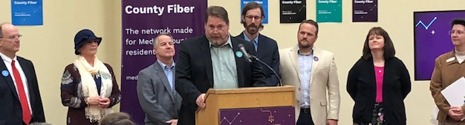
Case Study
Medina County, OH
© 2020 Harrison Edwards, Inc. All Rights Reserved.

Slide 40
Case Study
Medina County, Ohio
Medina County’s Existing Fiber Network (for Business) is Directly Responsible For:
1,000 New Jobs
Half: Total Payroll Created
Half: Capital Investment
Half: Square Footage
75% of Jobs Retained
Source: Medina County Economic Development Corporation (2019)
© 2020 Harrison Edwards, Inc. All Rights Reserved.

Slide 41
Thank You.
Bob Knight
EVP, Broadband & COO
Harrison Edwards, Inc.
914.242.0010 x110
bknight@harrison-edwardspr.com
© 2020 Harrison Edwards, Inc. All Rights Reserved.

