Slide 1
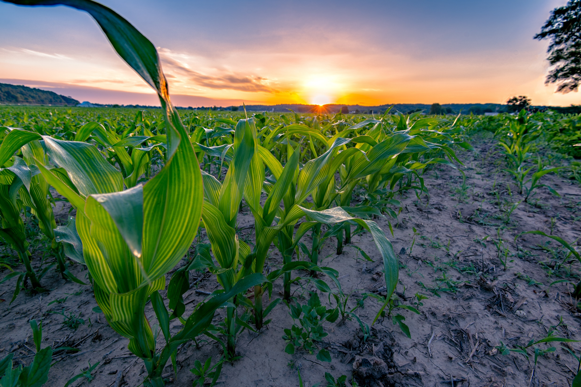
USDA Agriculture Outlook Forum
Feb. 20, 2020
The Innovation Imperative: Shaping the Future of Agriculture
Bruce Kettler
Director
Indiana State Department of Agriculture
@ISDAgov
Possibilities. Promise. Purpose.

Slide 2
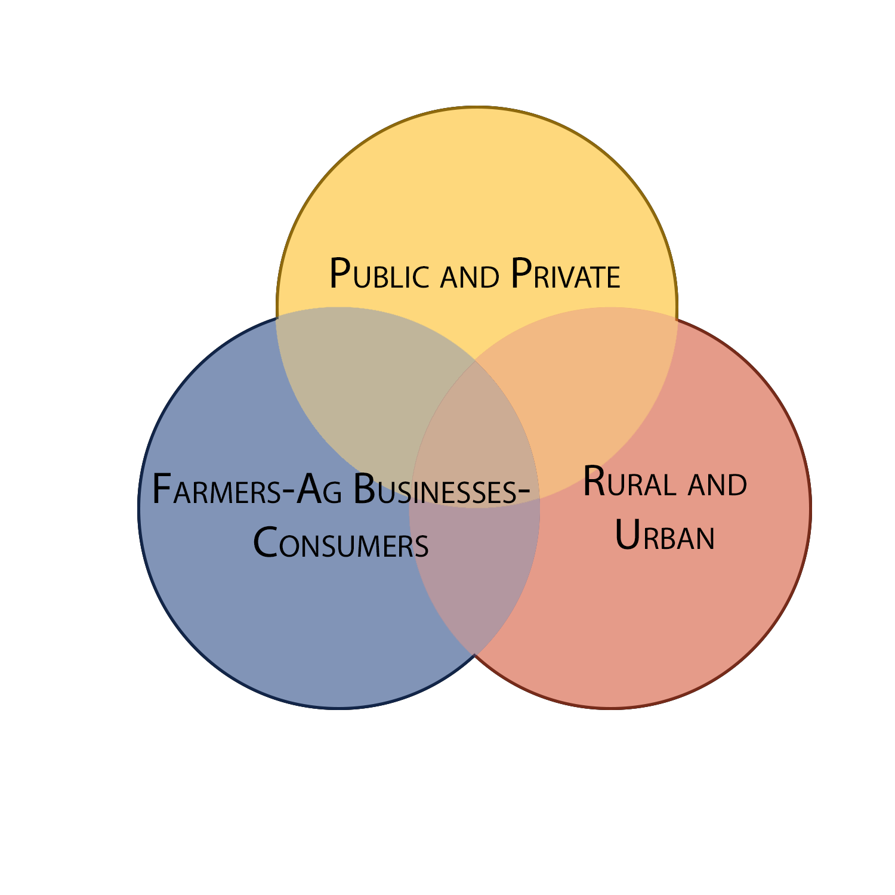
NO INDIVIDUAL SECTOR
OPPERATES IN A VACUUM
BRUCE KETTLER

Slide 3
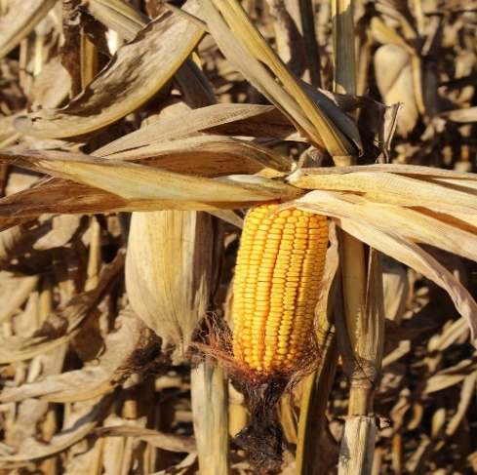
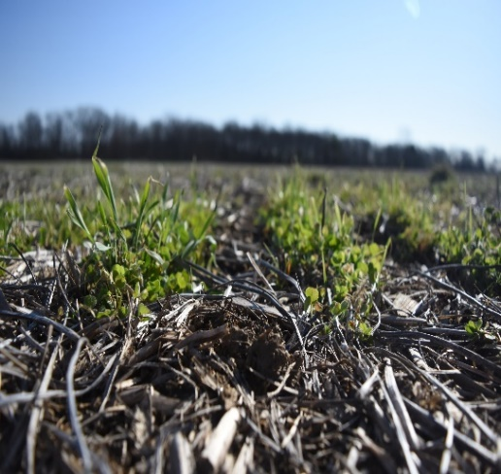
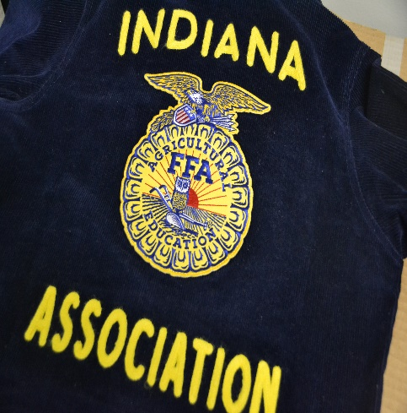
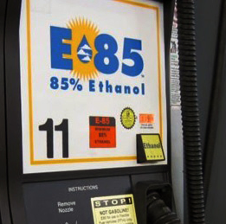
Indiana State Department of Agriculture
Director
Soil Conservation
Economic Development
Indiana Grain Buyers
Public Affairs
FFA

Slide 4
AGRICULTURAL ADVOCACY
LOCAL
STATE
FEDERAL
BRUCE KETTLER

Slide 5
YOUTH LEADERSHIP
& WORKFORCE DEVELOPMENT
Agriculture Education
AgriNovus Indiana
Ag+Bio+Science
BRUCE KETTLER

Slide 6
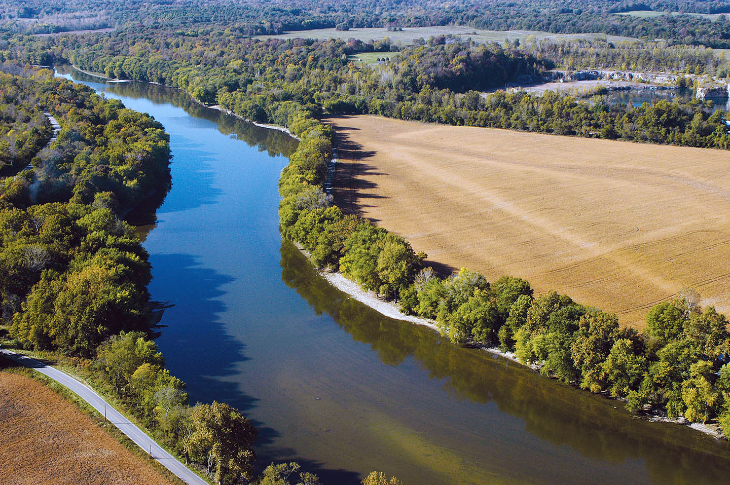
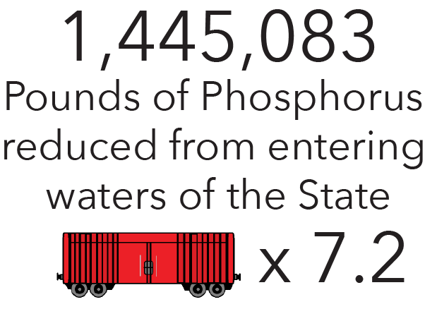
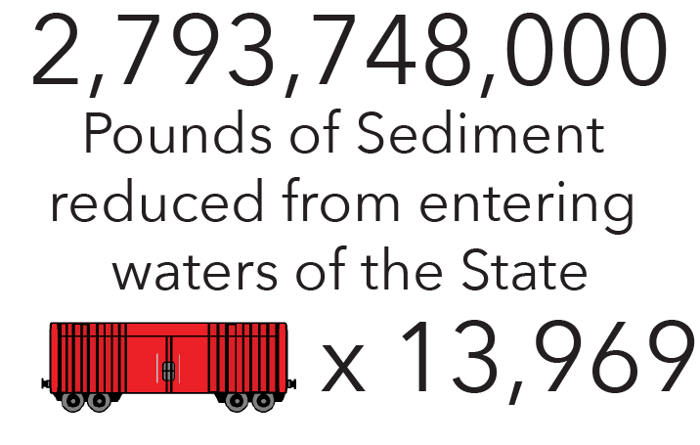
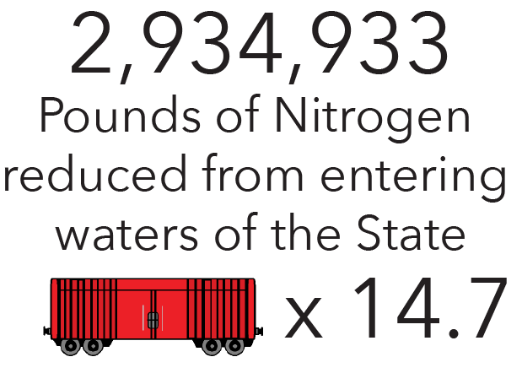
SOIL CONSERVATION & CLEAN WATER
Partnerships
Natural Resources Conservation Service
Farm Service Agency
SWCD’s
Indiana Conservation Partnership
22,338 installed practices
2018

Slide 7
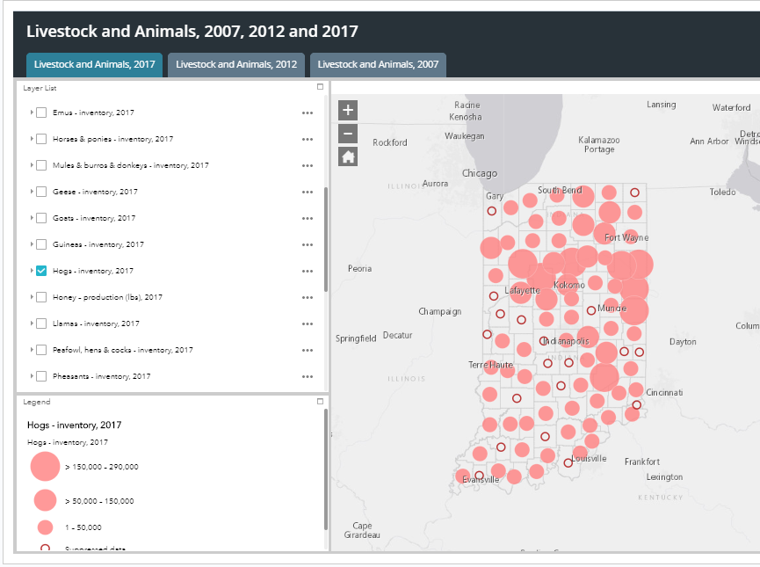
RURAL ECONOMIC VIABILITY
Vital to farms, ag businesses, rural communities
Indiana Economic Development Corporation
36 projects & 2,992 jobs
Over $1 billion spent on investment
Ag Asset Maps
BRUCE KETTLER

Slide 8
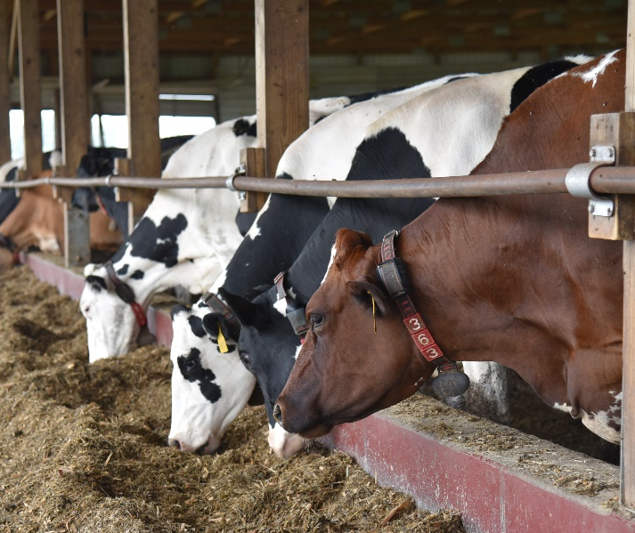
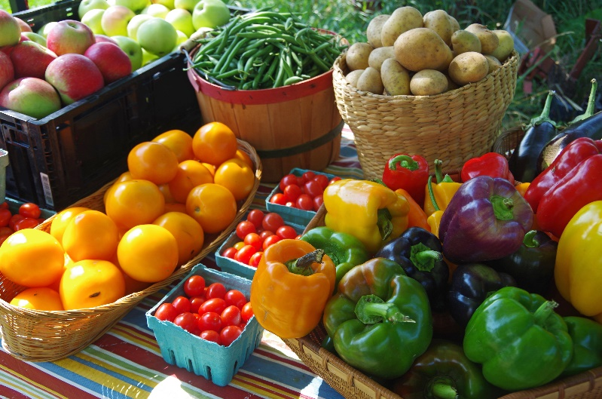
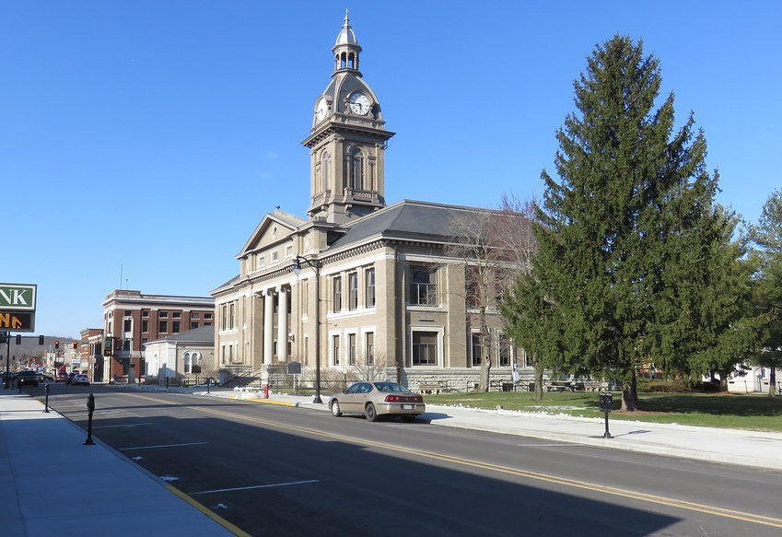
QUALITY OF LIFE
Rural connectivity
Next Level Funds
Indiana Grown
Diversification
Indiana Grown for Schools
Healthcare facilities
BRUCE KETTLER

Slide 9
“Great vision without great people is irrelevant.”
Jim Collins, Good to Great

Slide 10
CONTACT US
EMAIL
BKettler@isda.in.gov
PHONE NUMBER
317.232.8770
WEBSITE
www.isda.in.gov
SOCIAL MEDIA
@ISDAgov
FEB 2, 2018

