Slide 1
USDA’s 2020 Farm Income Forecast
.
Agricultural Outlook Forum
Carrie Litkowski
February 20, 2020
This work was supported by the U.S. Department of
Agriculture, Economic Research Service.

Slide 2
Farm Sector Overview
2
million farms
951+
thousand farm businesses
6+
million people living in farm households
Source: Farm Income and Wealth Statistics Data Product & Census of Agriculture
Notes:
8/27/2019: 2017 Census of Ag = 2.042 farms (900 million acres); 2018 ARMS = 951,422 farm businesses.
CL reviewed 11/23/2019.

Slide 3
Summary*
Net cash farm income for 2020 is forecast at $109.6 billion (down 9.0 percent relative to 2019, in nominal dollars). Net farm income is forecast at $96.7 billion (up 3.3 percent).
Cash receipts from commodity sales are expected to increase $10.1 billion (2.7 percent) in 2020.
Direct government payments are forecast to decrease $8.7 billion (36.7 percent) and federal commodity insurance indemnities to decrease $1.7 billion (16.6 percent).
Total production expenses are forecast to increase $10.4 billion (3.0 percent).
Farm sector assets and debt are both forecast to increase (1.3 and 2.3 percent respectively), with overall equity rising by 1.1 percent.
Average net cash farm income for farm businesses is forecast to decrease 8.1 percent to $85,200 in 2020.
Median farm household income is forecast to decrease 0.3 percent to $76,590 in 2020.
*All values here are in nominal dollars. Inflation is forecast at 1.8 percent in 2020.
Notes:
CL updated and checked 11/23/19

Slide 4
Farm sector profits expected to be near average in 2020
-10.7% from ’19F
1.4% from ’19F
Notes:
CL Updated and checked 11/24/2019

Slide 5
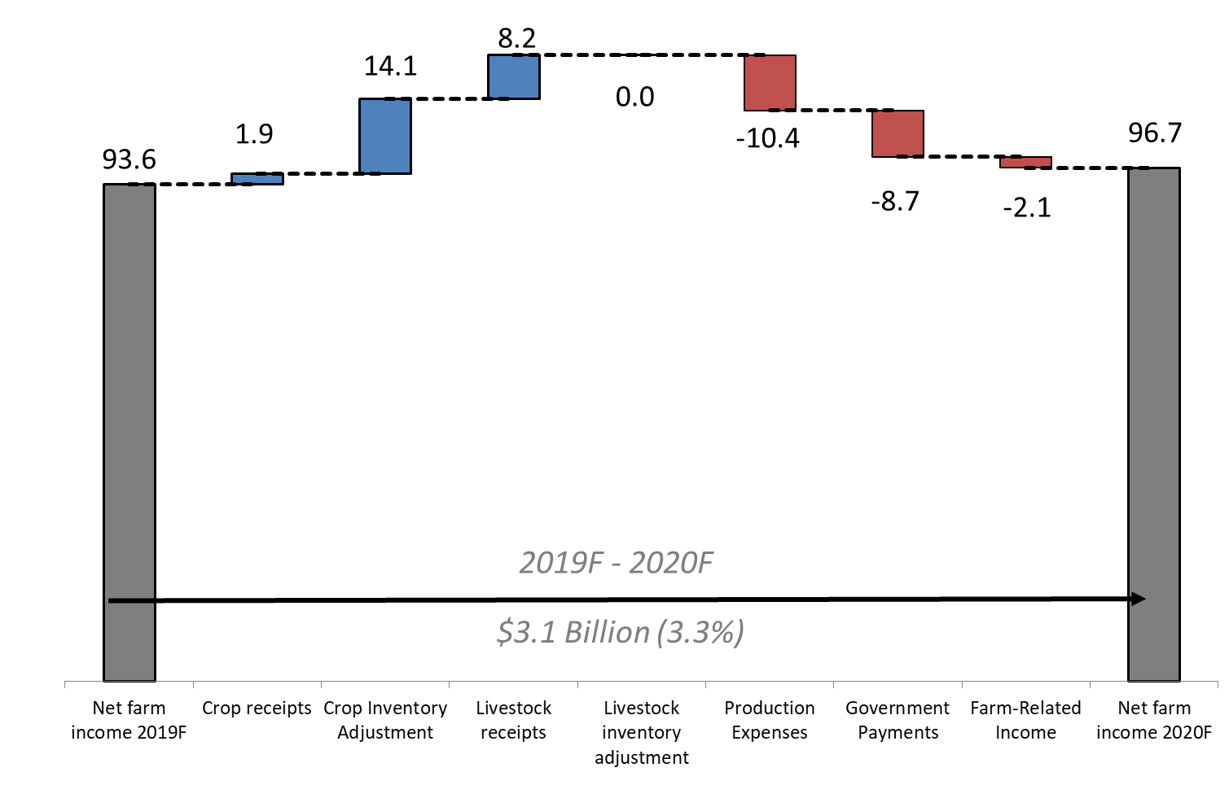
Forecast increase in net farm income driven by increases in value of production
$ Billions
Higher crop production values and livestock receipts are the largest contributors to rising income.
Increase in production expenses is tempering growth somewhat.
+
=
Crop value of production up $16.1 billion
F= Forecast.
Source: USDA, Economic Research Service, Farm Income and Wealth Statistics
Data as of February 5, 2020
Notes:
CL Updated and checked 2/3/20

Slide 6
Total crop cash receipts forecast to increase in 2020
Lower prices temper increases in Corn cash receipts.
Soybean cash receipts expected to fall due to lower quantities, should outweigh higher prices.
Change from 2019F
Corn +2.1%
Soybeans -2.5%
Cotton +2.1%
Fruits/Nuts +6.3%
Veg/Melons -1.8%
Wheat +0.9%
Notes:
CL Checked 2/3/20

Slide 7
Total animal/animal product cash receipts forecast to increase in 2020
Receipts for dairy and hogs expected to increase following higher prices and quantities sold.
Change from 2019F
Cow/calf +1.6%
Dairy +5.2%
Broilers +1.0%
Hogs +18.4%
Eggs +2.7%
Notes:
CL checked 2/3/20

Slide 8
Total direct payments to farmers expected to decrease
Program, 2020F $, % change (nominal)
Total, $15B (-36.7%)
Conservation, $4.2B, (+4.4%)
Function of crop price, $3.9B, (+39.3%)
All other, $3.2B, (+26.4%)
Market Facilitation Program, $3.7B, (-74.2%)
Notes:
CL checked 02/03/20

Slide 9
Total production expenses forecast to increase in 2020
Expenses up 3.0 percent (nominal) in 2020, and up 1.1
percent when inflation-adjusted.
Notes:
CL checked 2/3/20

Slide 10
2020 forecasts for most individual expense items to increase
2019F-20F % change
+5.8%
Feed and labor expenses forecast to continue to rise.
Fuel prices expected to increase after decreasing in 2019.
Interest expenses forecast to fall following lower interest rates.
+5.3%
+2.0%
+0.5%
+5.9%
+3.3%
+2.5%
+2.5%
+5.0%
-7.0%
Notes:
CL checked 2/3/20

Slide 11
Balance sheet forecast remains strong…
$ Billions (2020)
Farm equity forecast to decrease 0.7% (inflation adjusted) in 2020.
Value of farm sector assets is forecast to decrease 0.6% (inflation adjusted) in 2020.
Overall debt forecast to increase 0.5% (inflation adjusted), led by an increase in real estate debt.
2.7T, -0.7%
0.4T, +0.5%
F= Forecast. Values are inflation adjusted using the chain-type GDP deflator, 2020=100
Source: USDA, Economic Research Service, Farm Income and Wealth Statistics
Data as of February 5, 2020
Notes:
CL Checked 2/3/20

Slide 12
…but trends indicate growing financial stress
The sector’s risk of insolvency at highest level since 2003.
Likelihood of default across the sector remains historically low despite increases since 2013.
15.73
13.59
Notes:
CL checked 2/3/2020

Slide 13
Bankruptcies trending upwards in recent years
Since 2015, bankruptcy rate has trended upwards as the debt service ratio has leveled since 2017.
Debt service ratio describes the share of production used for debt payments.
2019 debt service ratio is forecasted.
Sources: Debt Service Ratio from the USDA, ERS Farm Income and Wealth Statistics; Bankruptcy data from U.S. Courts Statistical Tables
Data as of February 5, 2020
Notes:
Christine: Changed the bankruptcy rates to be Months December 30th. Added 2019 Q4 data so 2019 is no longer a forecast.
CL 11/24/19: appears to me that Guam etc not taken out of total.
CL checked 11/24/19 (use of Dec data, changed some points notably, like 2004)

Slide 14
“Farm businesses” include operations with most production, assets, and debt
Farm businesses include intermediate and commercial farms and are approximately 951,000 farm operations out of roughly 2 million farms in the U.S.
ERS uses ARMS to classify the sector into a typology of farms that are residence (retired or non-farm primary occupation, GCFI less than $350K), intermediate (primary occupation is farming, GCFI less than $350K), and commercial farms (GCFI of $350K or more, plus non-family farms)
GCFI = gross cash farm income (before expenses)
Source: USDA, Agricultural Resource Management Survey (ARMS), 2018
Notes:
Updated 11/19/19 with 2018 ARMS data

Slide 15
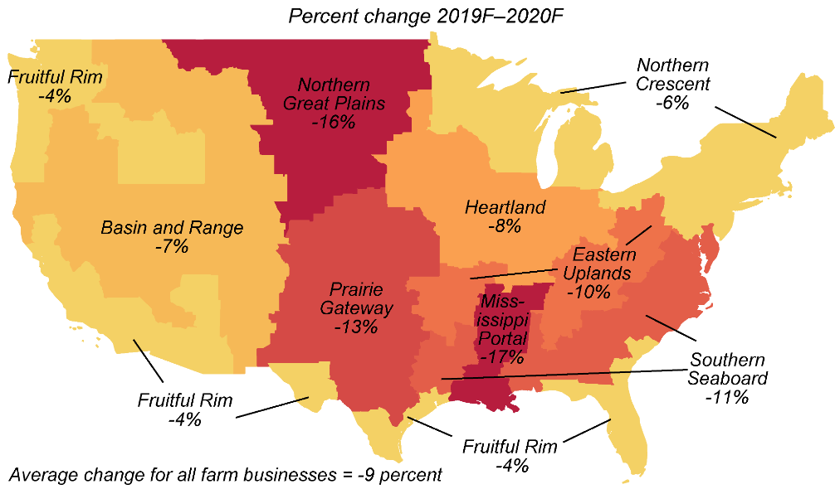
Average net cash income for farm businesses expected to be down across all regions in 2020
Farm businesses are defined as operations with gross cash farm income of over $350,000 or smaller operations where farming is reported as the operator's primary occupation. The partial budget forecast model is based on the 2018 Agricultural Resource Management Survey (ARMS) using parameters from the sector forecasts. The model is static and does not account for changes in crop rotation, weather, and other location-based production impacts that occurred after the base year. Data as of February 5, 2020. Source: USDA, Economic Research Service, Farm Income and Wealth Statistics.
Notes:
CL check 11/23/19

Slide 16
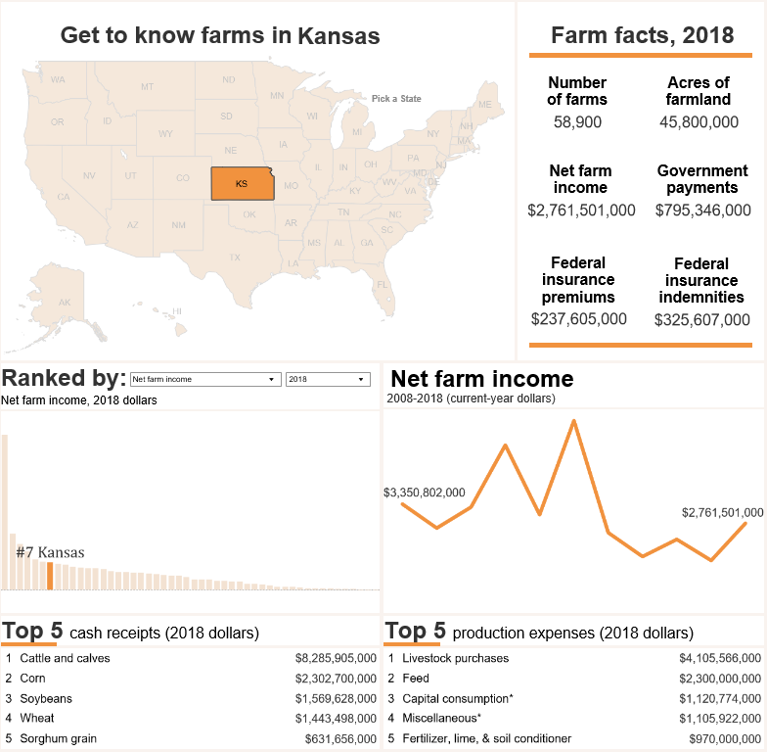
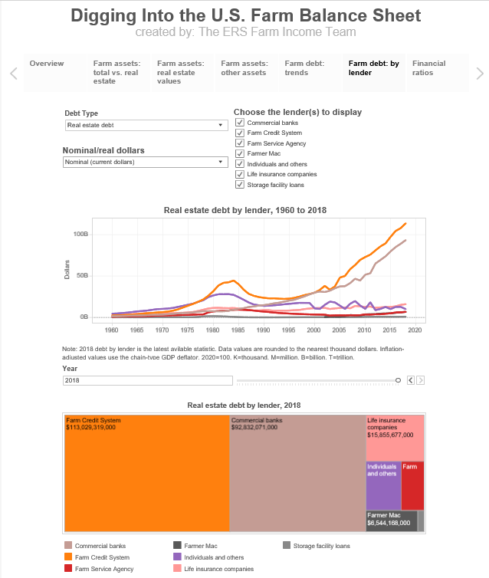
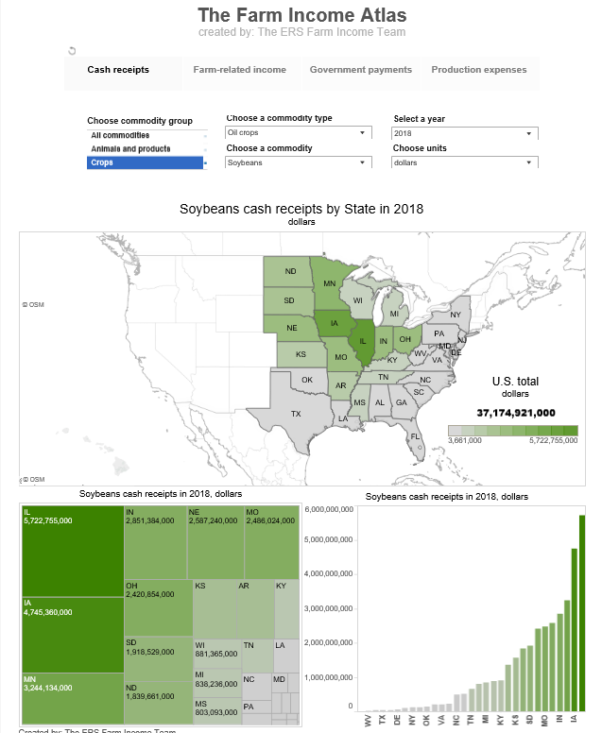
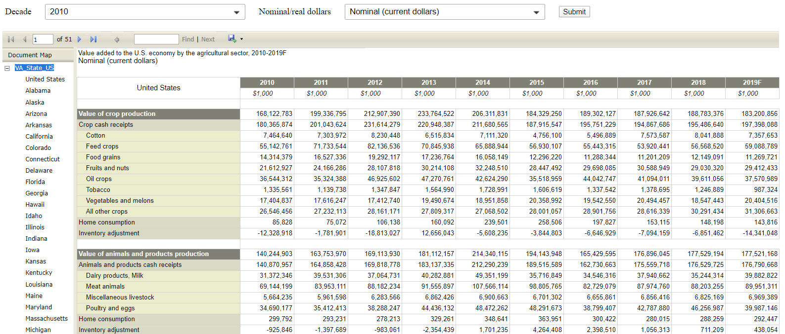
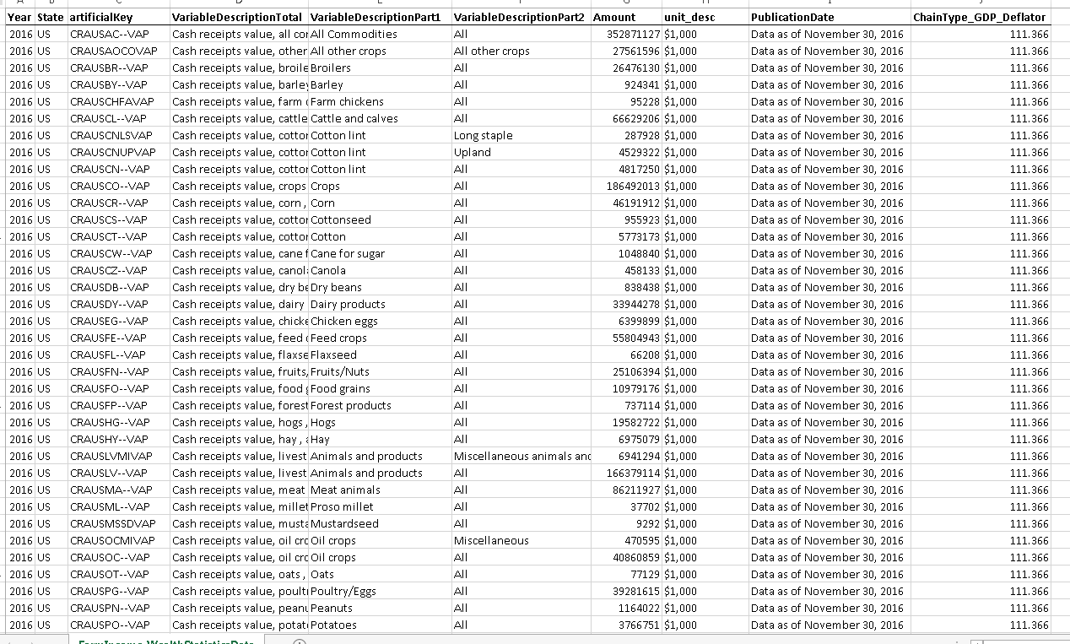
Many Ways to Explore the Data
https://www.ers.usda.gov/data-products/farm-income-and-wealth-statistics/
Visualizations let you dive into the financials of the farm sector
Current and archived comprehensive datasets
Tailored financial reports
Notes:
I’d also like to draw your attention to some new visualizations that our team produced that let user’s explore the data and we think would be useful.
The first is Get to know your state which enables the user to pic any state and year and see a detailed set of facts on the state INCLUDING comparisons to other states.
The middle one lets the user dig into the all of our detailed balance sheet data.
Finally, on the right we have the farm income atlas that encourages users to explore all of the state and national financial data that makes up the farm income statement.
This includes detailed state-level charts on cash receipts.

Slide 17
Questions?
Farm Sector Income and Finances:
https://www.ers.usda.gov/topics/farm-economy/farm-sector-income-finances/
Contact Information:
farmincometeam@ers.usda.gov

