Slide 1
U.S. Farm Sector’s Sensitivity to Labor Costs and Availability
Veronica Nigh
American Farm Bureau Federation
Ag Outlook Forum 2020

Slide 2
Agriculture
Labor is farmers’ third highest expense
Time-sensitive (or not)
Geographically concentrated labor demand
Growing pains with domestic workers
Increasing farm size
Notes:
First, labor is farmers’ third highest expense, accounting for 17% of production costs for the sector as a whole and up to 40-50% in labor-intensive subsectors such as fruit, vegetables, and horticulture. Hence, farm businesses focus heavily on labor availability and wages in an effort to control costs and maximize profits;
Second, The sector’s dependence on hired labor is also generally time-sensitive due to the role hired farm workers play in harvesting and marketing perishable fruit, vegetable, and horticulture products. Over the last decade, hired farm workers have also grown in importance in other subsectors, including dairy, hogs, and poultry, where larger farms have less operator and family labor to draw on and have to rely on hired labor to operate what are also time-sensitive, year-round enterprises
Third, farm labor needs are also concentrated geographically in states such as California, Texas, Michigan, Washington, and North Carolina, but more importantly within smaller areas within these states. Farmers’ hired labor needs in these smaller areas typically exceed the local legal work force even if legal workers were willing to do farm work. This pattern of “local” demand far exceeding the “local” supply of willing legal workers is spreading to more areas of the country and to more commodity subsectors. Hence, farm businessmen typically have to look outside their immediate areas and the local labor supply in an effort to find farm workers;
Fourth, given the limited skills required for farm work and the manual nature of the work, the majority of Americans apparently believe that they have “outgrown” farm work as reflected in their unwillingness to take farm jobs even temporarily despite being unemployed. A 2010 national survey conducted by the National Council of Agricultural Employers of H-2A employers showed that 68% of the 36,000 domestic workers state agencies referred to H-2A employers did not accept jobs offered to them. Only 5% of referred workers worked through the contract period.
While the generally low wages paid farmworkers are consistent with the low-skill nature of the work, far more Americans are willing to accept even lower minimum wage jobs rather than work in agriculture. In this setting, the local legal labor pool is not only small but unwilling to work in agriculture; and
Fifth, while mechanization has reduced the need for hired labor sharply over time, increased farm size has boosted the need for more hired farm workers even more. The trend toward a declining number of hired workers in effect for several decades is reversing, with the number of hired farm workers stabilizing and showing small increases over the last few years. Hence, operator demand for hired workers is not likely to continue to decline and ease farmers’ concerns.

Slide 3
Factors Outside of Agriculture
Elastic demand for food
Challenging immigration system with increased threat of enforcement
Wage potential in U.S.
H-2A Temporary Ag Worker Program
Notes:
The very limited potential for farmers to pass production cost increases—such as higher wages--along to consumers, particularly in labor-intensive subsectors such as fruits, vegetables, and horticulture where consumers are both price sensitive and lower-cost imported products are readily available. Despite multiple surveys showing U.S. consumers’ willingness to pay more for safer American product, cost appears to ultimately shape consumer purchases. Hence, the theoretical option of pushing farm wages up enough to rekindle American workers’ interest in working in agriculture is not viable since substantially higher labor costs without any offsetting increase in commodity prices and farm income would quickly put farmers out of business;
The broken immigration system that effectively allows a large number of undocumented workers to enter/reenter the U.S. with relative ease despite more and increasingly costly border protection measures and enforcement efforts to identify and deport “undocumented workers” found within the country;
The potential for low-skilled workers in Mexico and Central America to make double their local minimum low-skilled wages at home by working in the U.S. This insures that a large and reliable illegal workforce is available for farmers to draw on; and
The extent to which farmers’ primary alternative to hiring undocumented workers—the H-2A program—is broken. One summary measure of the problems with the H-2A program is the fact that H-2A visas have only increased from 31,538 in 2002 to 65,345 in 2012, despite generally accepted estimates putting the number of undocumented workers employed in agriculture at 525,000 or more and despite the notable increase in enforcement. Both farm employers’ and worker advocates have voiced their strong dissatisfaction with the existing H-2A program.
The H-2A program has become a costly administrative nightmare for many farmers. Farm employers cite the cumbersome nature of the program and the high wage and benefit costs that the program imposes on. Worker advocates cite inadequate protection for workers, poor housing conditions, and employer failure to live up to worker payment provisions by making prompt and full payment of wages due.

Slide 4
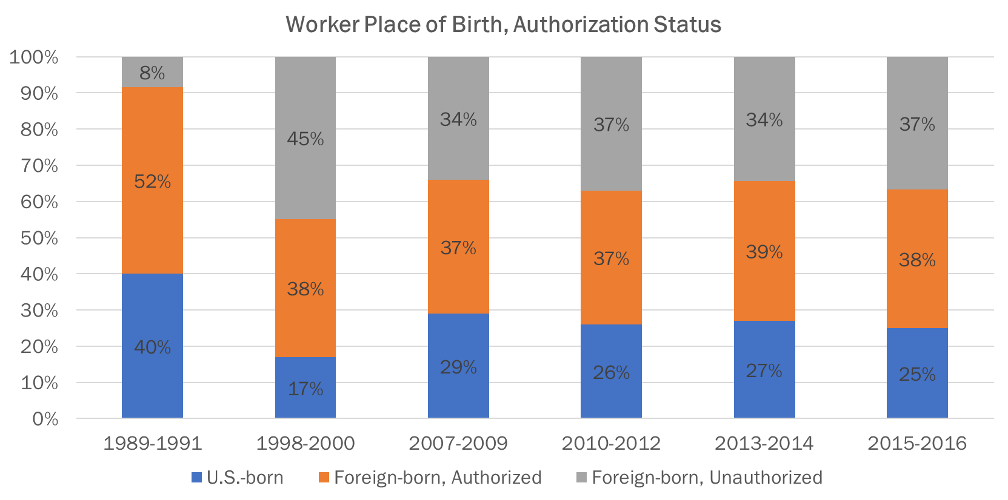
Hired Workers Increasingly Foreign-born, Unauthorized
Source: National Agricultural Worker Survey (NAWS)

Slide 5
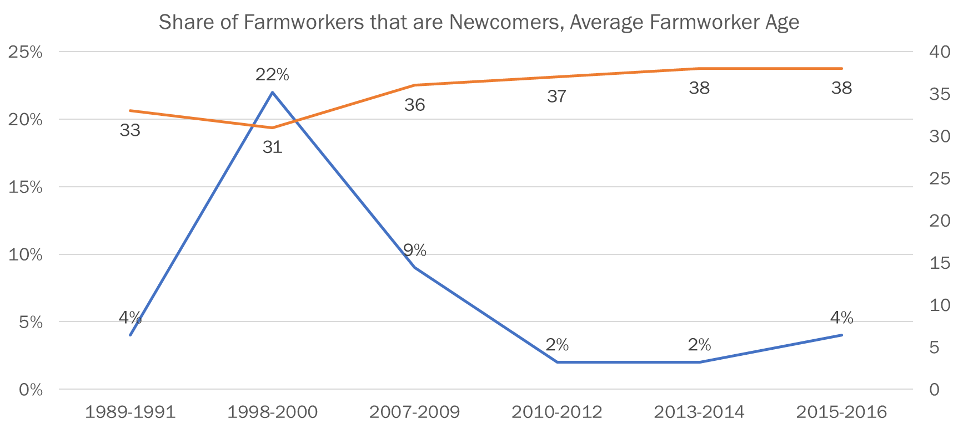
Like Farm Owners, the Average Farmworker Age Continues to Rise as Share of Newcomers Remains Low
Source: National Agricultural Worker Survey (NAWS)

Slide 6
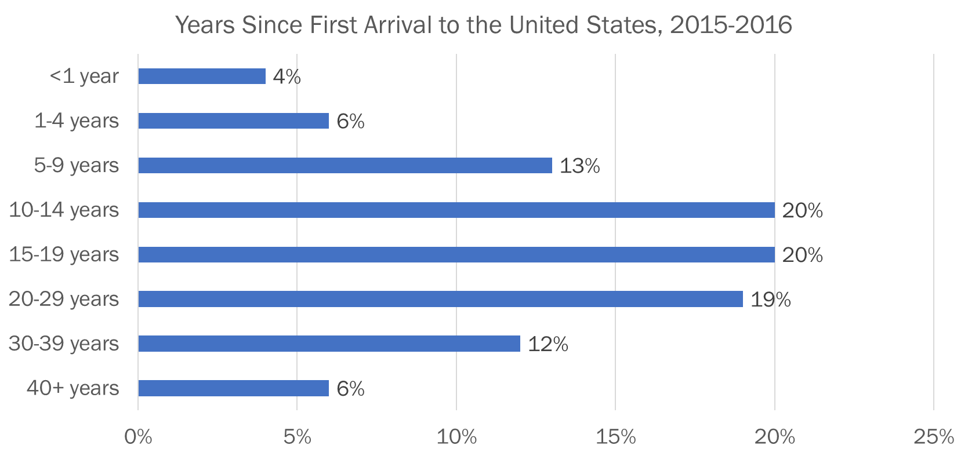
Three-quarters of farmworkers had been in the United States for at least 10 years
Source: National Agricultural Worker Survey (NAWS)

Slide 7
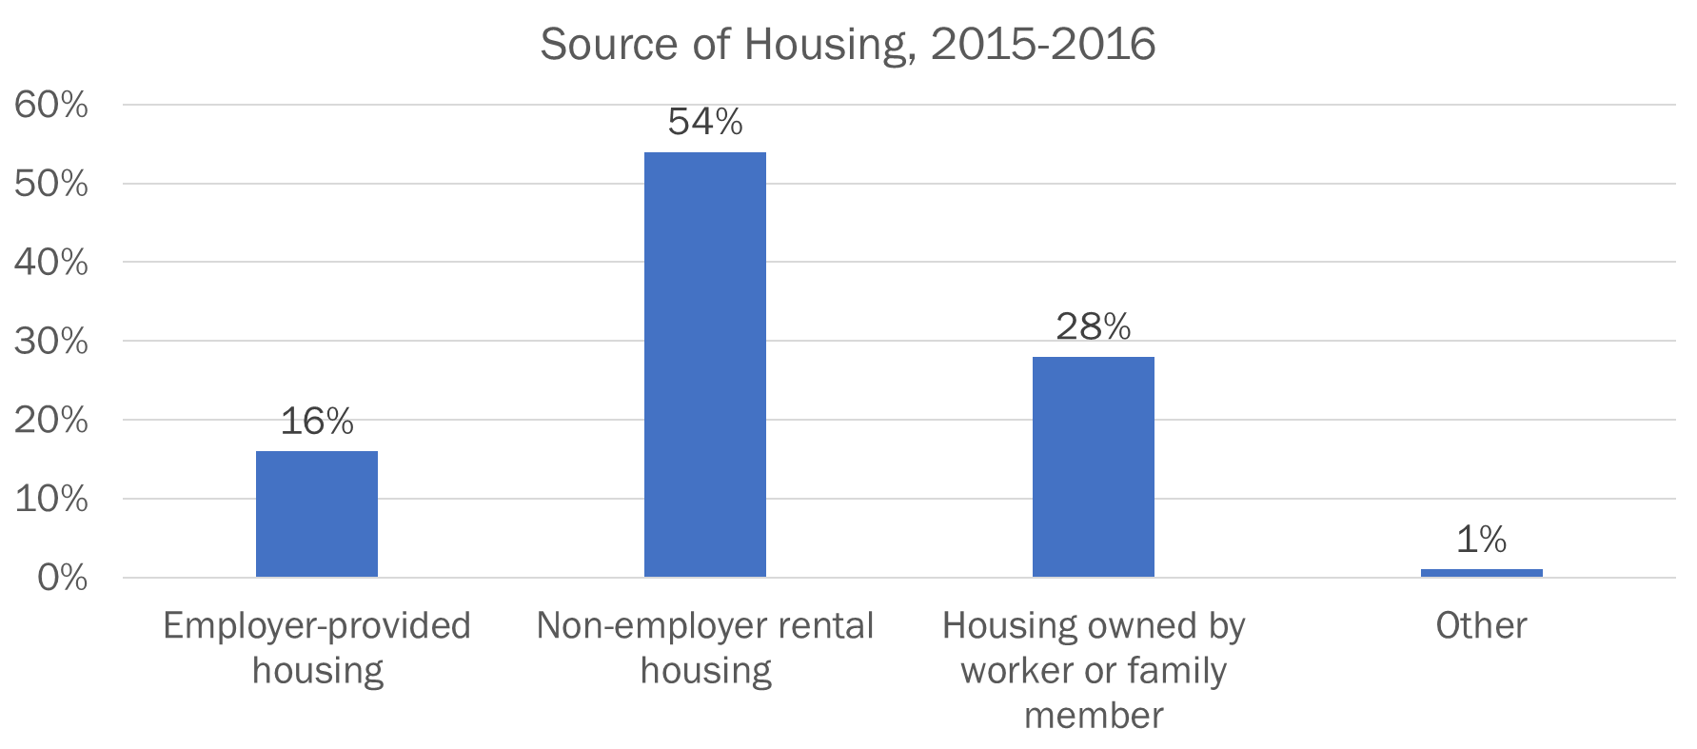
Most Non-H-2A Crop Worker Housing Is Not Employer Provided
Source: National Agricultural Worker Survey (NAWS)

Slide 8
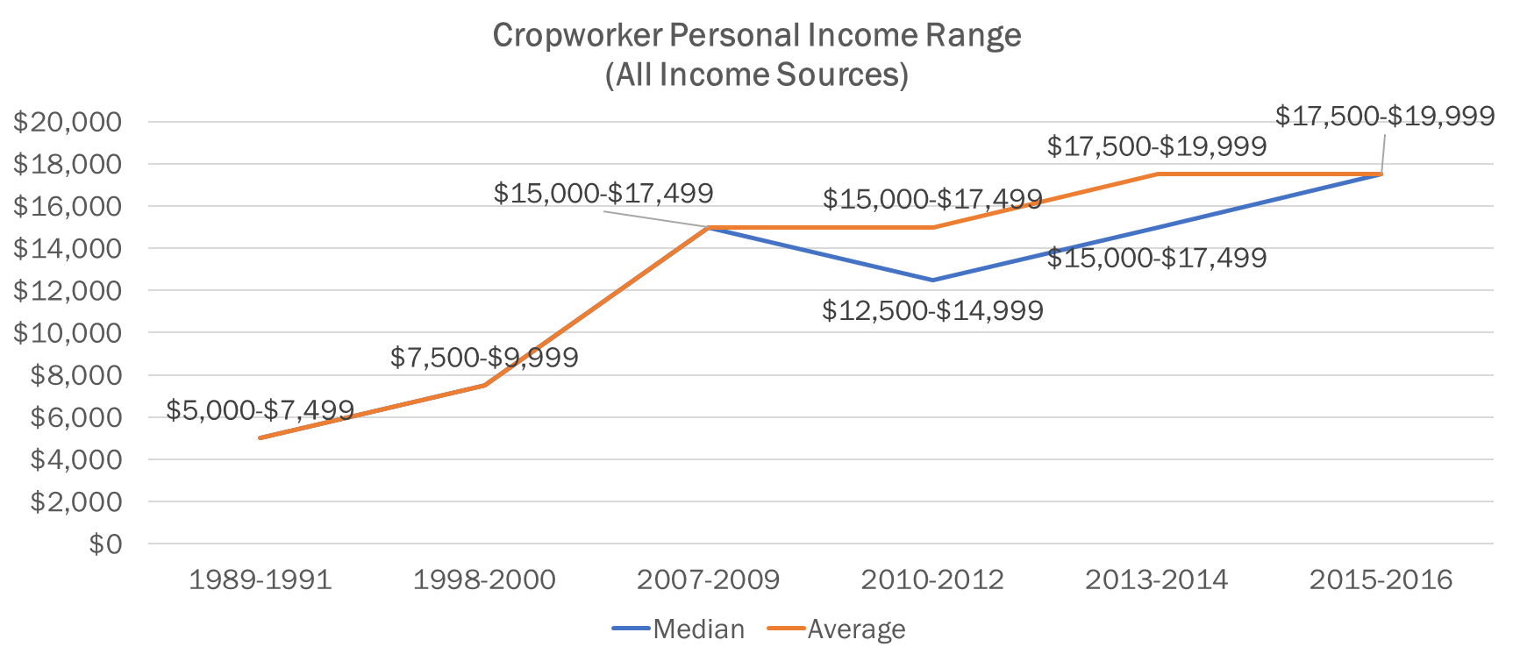
Income Has Been Rising, Nearly 17% Increase Between 2007-2009 and 2015-2016 Surveys
Source: National Agricultural Worker Survey (NAWS)

Slide 9
Enter H-2A, For Some
The H-2A temporary agricultural program allows agricultural employers who anticipate a shortage of domestic workers to bring nonimmigrant foreign workers to the U.S. to perform agricultural labor or services.
Employment is of a seasonal nature where it is tied to a certain time of year by an event or pattern and requires labor levels above what is necessary for ongoing operations.
Employment is of a temporary nature, to last no longer than one year.
The seasonal and temporary conditions of the program eliminate use of the program for much of the livestock sector.
A 2009 National Milk Producers Federation study found that 62% of the nation’s milk supply use immigrant labor.

Slide 10
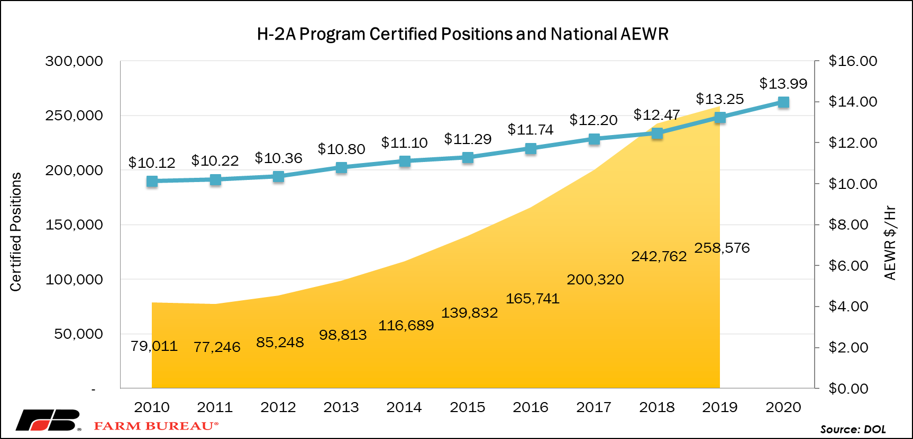
Usage of the H-2A Program Continues to Climb, As Does the AEWR

Slide 11
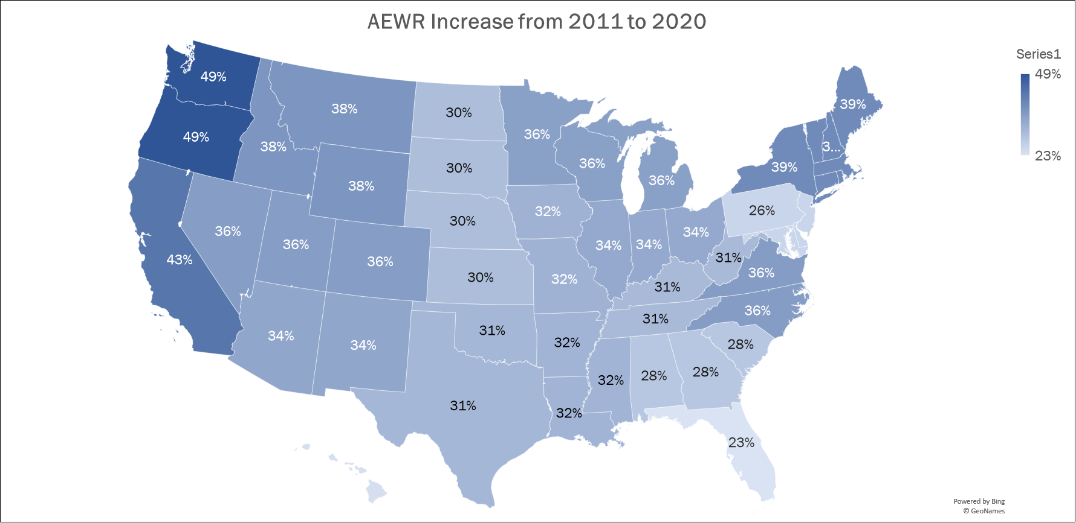
National Average AEWR has Climbed by 37% Over the Last Ten Years
Source: DOL

Slide 12
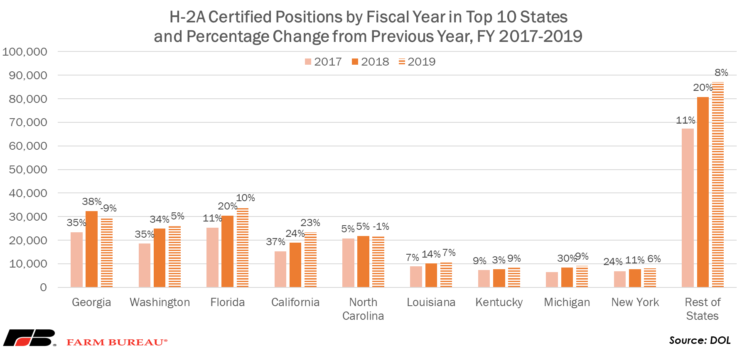
The Top States Utilizing the Program Has Remained Fairly Constant

Slide 13
Some Top H-2A Crops and Occupations May Be Surprising
Top 25 H-2A Crops and Occupations Certified, FY2016
Primary Crops/Occupations | Positions Certified | Primary Crops/Occupations | Positions Certified
Berries | 15,335 | Fruits and Vegetables | 4,538
Hay and Straw | 10,066 | Citrus | 4,530
Apples | 9,764 | Squash | 3,749
Tobacco | 9,269 | Livestock | 3,582
General Farm Worker | 8,717 | Peppers | 3,494
Melons | 8,513 | Sugarcane | 3,435
Sweet Potatoes | 7,426 | Trees | 3,340
Lettuce | 7,060 | Oranges | 3,030
Nursery and Greenhouse Workers | 6,008 | Construction of Livestock Buildings | 2,977
Corn | 5,893 | Cucumbers | 2,713
Onions | 5,282 | Cherries | 2,572
Tomatoes | 4,836 | Peaches | 2,539
Ag Equipment Operator | 4,786 | All Others | 22,287
Source: DOL

Slide 14
2014 AFBF Labor Study
Alternative 1: Enforcement Only
Alternative 2: Enforcement with a Path to Legalization Without a Guest Worker Program
Alternative 3: Comprehensive Reform Including an Expanded H-2A Guest Worker Program for Agriculture
Alternative 3a: Comprehensive Reform Including a Redesigned Guest Worker Program for Agriculture
Notes:
First, national farm data was used to determine the relative importance of immigrant labor
Second, economic analysis was used to estimate the likely increases in wages paid by farm employers under four different immigration reform alternatives.
Finally, input/output analysis was used to examine how varying levels of labor losses would reduce overall net farm income, farm asset values, and food prices. At the sector level, looked at production levels and producer returns for fruits, vegetables, grains and livestock production

Slide 15
2014: Gauging the Farm Sector’s Sensitivity to Immigration Reform via Changes in Labor Costs and Availability
Notes:
The results of this analysis suggest that the enforcement-only option would have a significant disruptive impact on agriculture, leading to large enough losses in farm income by the end of a 5-year implementation and adaptation period to trigger a large scale restructuring of the sector, higher food prices, and greater dependence on imported products.

Slide 16
More Specifically, Dairy
Study Results:
Dairy:
Reduce the U.S. dairy herd by 1.34 million head, milk production by 29.5 billion pounds and the number of farms by 4,532.
Retail milk prices would increase by an estimated 61%.
Dairy Industry and Beyond:
Eliminating immigrant labor in dairy farms would reduce U.S. economic output by $22 Billion and 133,000 workers, both immigrant and native-born, would lose their jobs.
Slightly more than 50% of losses would occur in input supply sectors and services provided to dairy farms.
Notes:
First, a national survey of dairy farmers was conducted to determine the relative importance of immigrant labor to individual dairy farms.
Second, economic analysis was used to estimate the likely losses in milk production and reductions in herd size and farms associated with reductions in immigrant workers on dairy farms.
Finally, input/output analysis was used to examine how varying levels of labor losses would reduce industry sales, value-added and jobs. These losses were estimated not
only for the dairy farm sector, but also for those sectors that supply inputs and services to dairy farms.
National survey of 5,000 dairy farms, with responses from 47 states
http://www.nmpf.org/sites/default/files/NMPF%20Immigration%20Survey%20Web.pdf

Slide 18
Thank you
Veronica Nigh
Economist
Email: veronican@fb.org
Office: 206-406-3622
www.fb.org/market-intel

