Slide 1
Specialty Crop Food Safety Update
Jennifer McEntire, Ph.D.
VP Food Safety jmcentire@unitedfresh.org

Slide 2
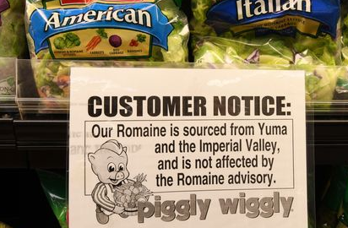
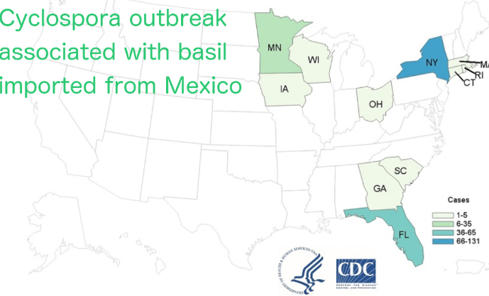
It’s been a tough year for fresh produce

Slide 3
What’s Changed
Detection
Clinical
Whole genome sequencing
Visibility
Social media
General right to know
FSMA related rules
Consumer confidence?
Public health
Markets?
Domestic
Export
Indoor ag?

Slide 4
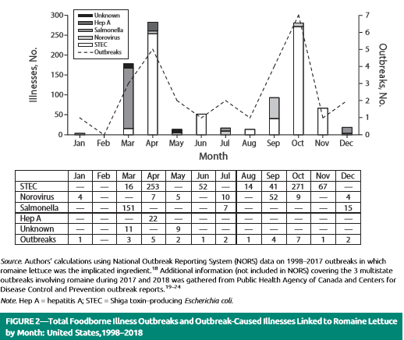

Slide 5
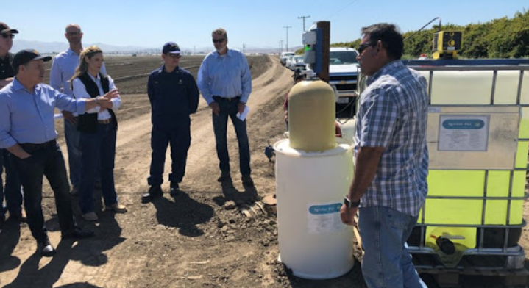
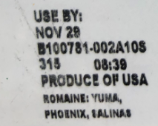
Industry Focus is on Prevention
But we need a backup plan…
LEAFY GREENS (CA and AZ)
Treating water used for overhead irrigation
Move to drip tape
Increase distance from large animal feeding operations

Slide 6
New Era of Smarter Food Safety
Announced 4/19

Slide 7
4 Main Areas
Tech-Enabled Traceability and Foodborne Outbreak Response
Smarter Tools and Approaches for Prevention: new data analysis tools and predictive analytics
Adapting to New Business Models and Retail Food Safety Modernization: e-commerce and home delivery of foods, and traditional business models, such as retail food establishments.
Food Safety Culture: Promoting and recognizing the role of food safety culture on farms and in facilities.

Slide 8
“New Era”
Public meeting late fall
1300 people (in DC and webinar)
Written comment period
“Blueprint” next month?
10 yr plan
What does this mean?

Slide 9
Thank you!
Questions?

