Slide 1
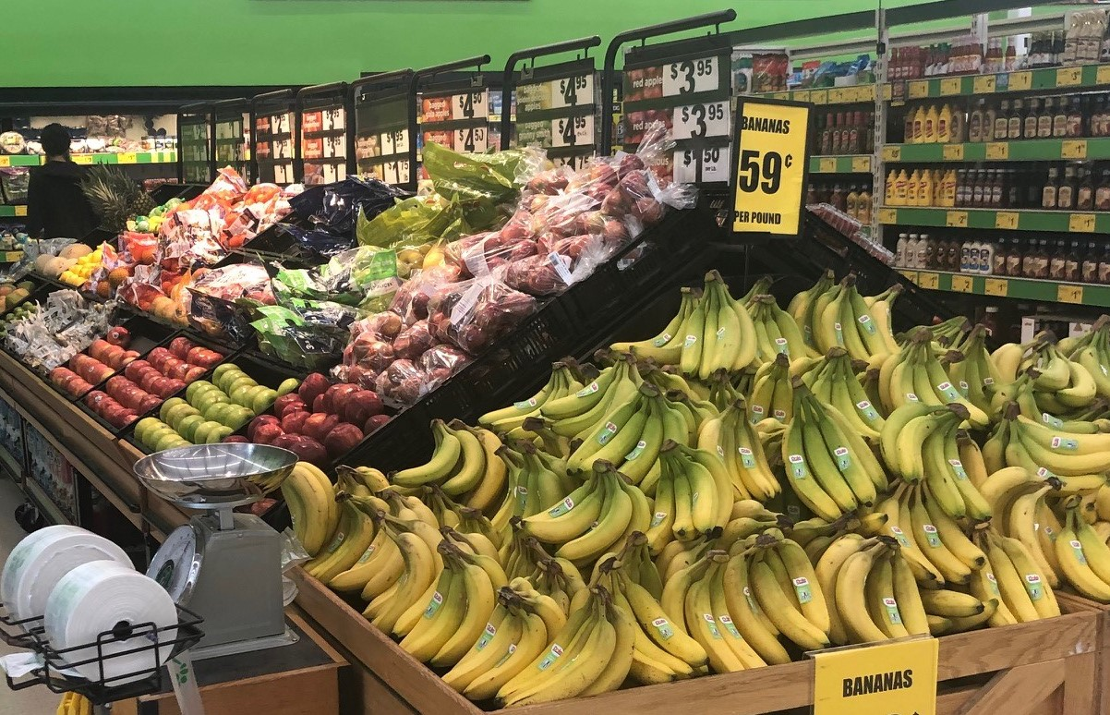
Food Price Outlook
2020 USDA Agricultural Outlook Forum
February 20, 2020
Gianna Short, PhD
Food Markets Branch, Food Economics Division, Economic Research Service, USDA
202-694-5543, gianna.short@usda.gov

Slide 2
Outline
  Overview of consumer spending on food
  Food price trends over time
  Factors that influence retail food prices
  What happened to food prices in 2019
  2020 food price forecasts in historical context
  Next Food Price Outlook release: Tuesday, Feb. 25th
  Additional useful ERS publications

Slide 3
On average, U.S. consumers spend
12.9 percent of expenditures on food
Share of U.S. Household consumer expenditures by major categories, 2018
Source: USDA, ERS using BLS Consumer Expenditure Survey data

Slide 4
Food price inflation is lower than all-items inflation for last five years
Percent change in subset
of CPI categories from 2015 to 2019
Source: USDA, ERS using BLS CPI-U data, not seasonally adjusted

Slide 5
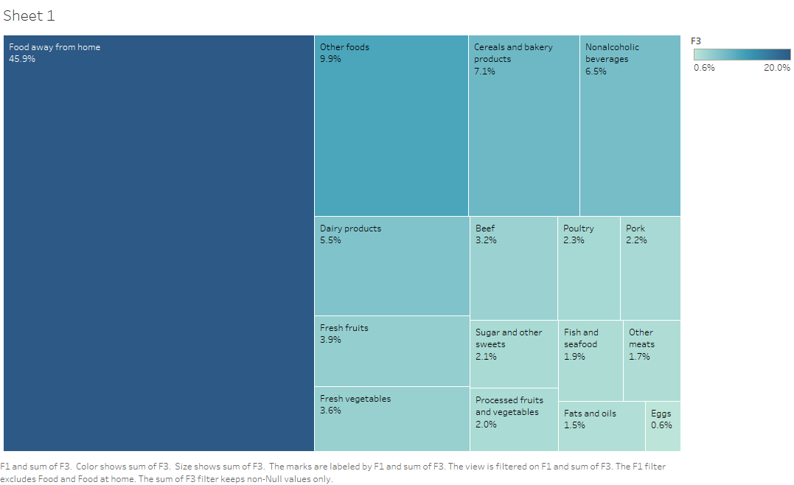
Food categories have different weights in overall CPI
Other foods
9.9%
Cereals and
bakery
products
7.1%
Nonalcoholic beverages
6.5%
Relative importance
of food types in consumer price index (CPI), Nov 2019
Source: USDA, ERS
using BLS CPI-U data
Dairy products
5.5%
Poultry
2.3%
Pork
2.2%
Beef
3.2%
Fresh fruits
3.9%
Sugar and other sweets
2.1%
Fish and seafood
1.9%
Other meats
1.7%
Food away from home
45.9%
Fresh vegetables
3.6%
Processed fruits and veg
2.0%
Fats and oils
1.5%
Food at home

Slide 6
Consumer Price Index (CPI) for Food at home and Food away from home, 1980-2019
Source: USDA, ERS using BLS CPI-U data, not seasonally adjusted
Food price growth is now different for at-home versus away-from-home
CPI-U (not seasonally adjusted), 1982-1984 = 100
Around 2009, the CPI for food at home starts growing at a slower rate than for food away from home

Slide 7
Food price volatility has changed over time
Annual percent change, Food away from home and Food at home CPI
Source: USDA, ERS using
BLS CPI-U data, not seasonally adjusted
Annual percent change

Slide 8
Food price volatility has changed over time
Annual percent change, Crude foods and feeds PPI and Food at home CPI
Source: USDA, ERS using
BLS CPI-U and PPI data, not seasonally adjusted
Percent change
Annual percent change
Notes:
Crude in 2019 0.2

Slide 9
Food price volatility has changed over time
Annual percent change, Crude foods and feeds PPI and Food at home CPI
Source: USDA, ERS using
BLS CPI-U and PPI data, not seasonally adjusted
Percent change
Annual percent change
Notes:
Crude in 2019 0.2

Slide 10
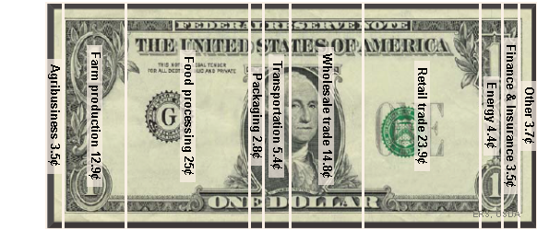
Many factors contribute to retail prices
Supply
Factors
(not exhaustive)
Energy prices
Commodity prices
Weather
Historical seasonality
Farm productivity
Imports/exports
Farm labor
Food processing labor
Transportation labor
Supply contracts
Retail rental rates
Retail labor
Perishability
Retail promotions
Consumer income
Consumer confidence
Consumer time availability
Tastes and preferences
Prices of other expenses
Prices of competing retailers
ERS Food at home dollar, 2017
Demand
Factors
(not exhaustive)

Slide 11
Annual Percent changes in
Retail Price, 2019
Source: USDA, ERS using BLS CPI-U data, not seasonally adjusted

Slide 12
Annual Percent changes in
Retail Price, 2019
Source: USDA, ERS using BLS CPI-U data, not seasonally adjusted
-10.0%
0.9%
1.9%
3.1%
3.8%

Slide 13
Annual Percent changes in
Retail Price, 2019
Source: USDA, ERS using BLS CPI-U data, not seasonally adjusted
20-year historic average

Slide 14
Food-away from-home inflation, 2000-2020
Source: USDA, ERS using BLS CPI-U data, not seasonally adjusted
2020 Food-away-from-home inflation forecast between 2-3%
Forecast range

Slide 15
2020 Food-at-home inflation forecast between 0.5-1.5%
Forecast range
Food-at-home inflation,
2000-2020
Source: USDA, ERS using BLS CPI-U data, not seasonally adjusted

Slide 16
Key takeaways
Currently in a period with
  low food-at-home price inflation (2019 CPI increased 0.9 percent)
  moderate food-away-from-home inflation (2019 CPI increased 3.1 percent)
2020 forecasts:
  Food-at-home CPI to increase between 0.5 and 1.5 percent
  Food-away-from-home CPI to increase between 2.0 and 3.0 percent

Slide 17
What’s next
Food Price Outlook update: Tuesday, Feb. 25th
Available at: http://www.ers.usda.gov/data-products/food-price-outlook
Calendar year 2020: New model development and testing
  Incorporation of more price factors
  machine learning prediction methods

Slide 18
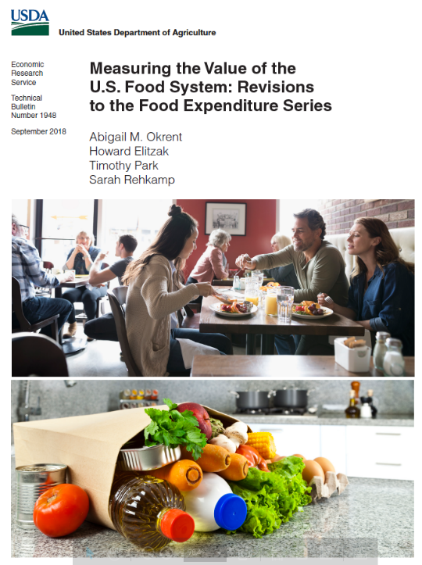
Other ERS Food Markets Branch work
Food Expenditure Series: Comprehensive data set that measures the U.S. food system, quantifying the value of food acquired in the United States by type of product, outlet, and purchaser.
https://www.ers.usda.gov/data-products/food-expenditure-series/
Fruit and Vegetable Prices: Average prices for over 150 commonly consumed fresh and processed fruits and vegetables. Reported estimates include each product's average retail price per pound and per edible cup equivalent.
https://www.ers.usda.gov/data-products/fruit-and-vegetable-prices

Slide 19
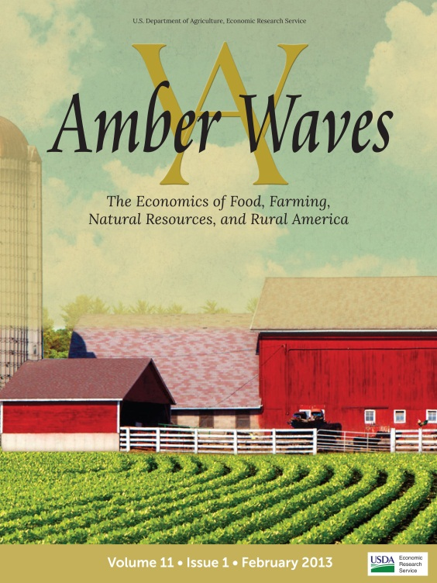
Additional ERS resources
Amber Waves: Current ERS economic and policy research on agriculture, food, rural America, and the environment for policymakers, academics and the public.
Charts of Note: Highlights from ERS current and past research.
A version of the 2020 food-at-home forecast slide is a chart of note today.
Charting the Essentials: 70 charts and maps covering key information about agricultural markets and trade, farm income, food prices and consumption, food security, rural economies, and the interaction of agriculture and natural resources.
-> Subscribe online for email notifications on updates to these and more

Slide 20
Food Price Outlook
2020 USDA Agricultural Outlook Forum
February 20, 2020
Gianna Short, PhD
Food Markets Branch, Food Economics Division, Economic Research Service, USDA
202-694-5543, gianna.short@usda.gov

