Slide 1
Outcomes from the 2014 Pilot Programs
Presented By: Tyler Mark
Associate Professor
UK Agricultural Economics

Slide 2
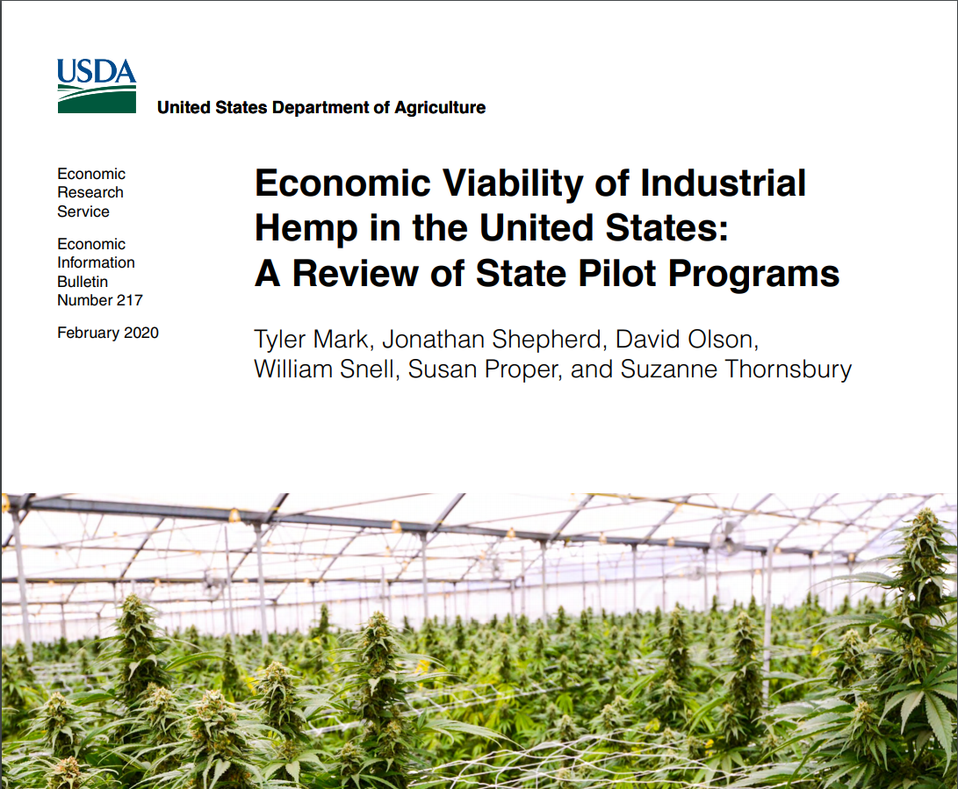
The 2014 Farm Bill allowed State departments of agriculture and institutions of higher education to legally grow and cultivate hemp for purposes of research or to license growers in their State for these activities

Slide 3
Acres increased rapidly
Field and controlled atmosphere plantings
lack of consistently reported data
Source: USDA Economic Research Service based on data reported by State pilot programs, USDA Farm Service Agency, and Vote Hemp.

Slide 4
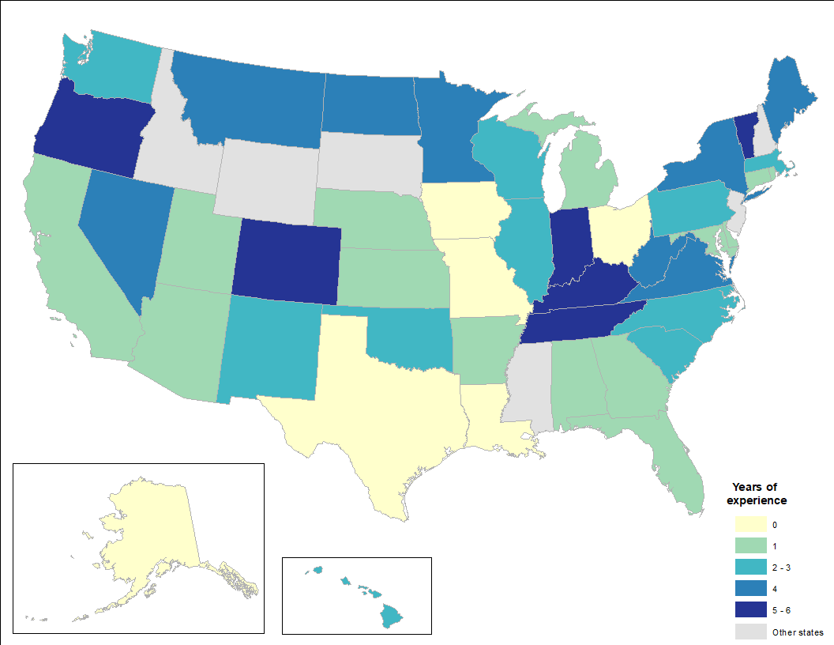
Years of Hemp Planting Reported by States, 2014-2019
States began production at different times
Establishing legislation was a challenge
State requirements were inconsistent
Source: USDA Economic Research Service based on data reported by State pilot programs

Slide 5
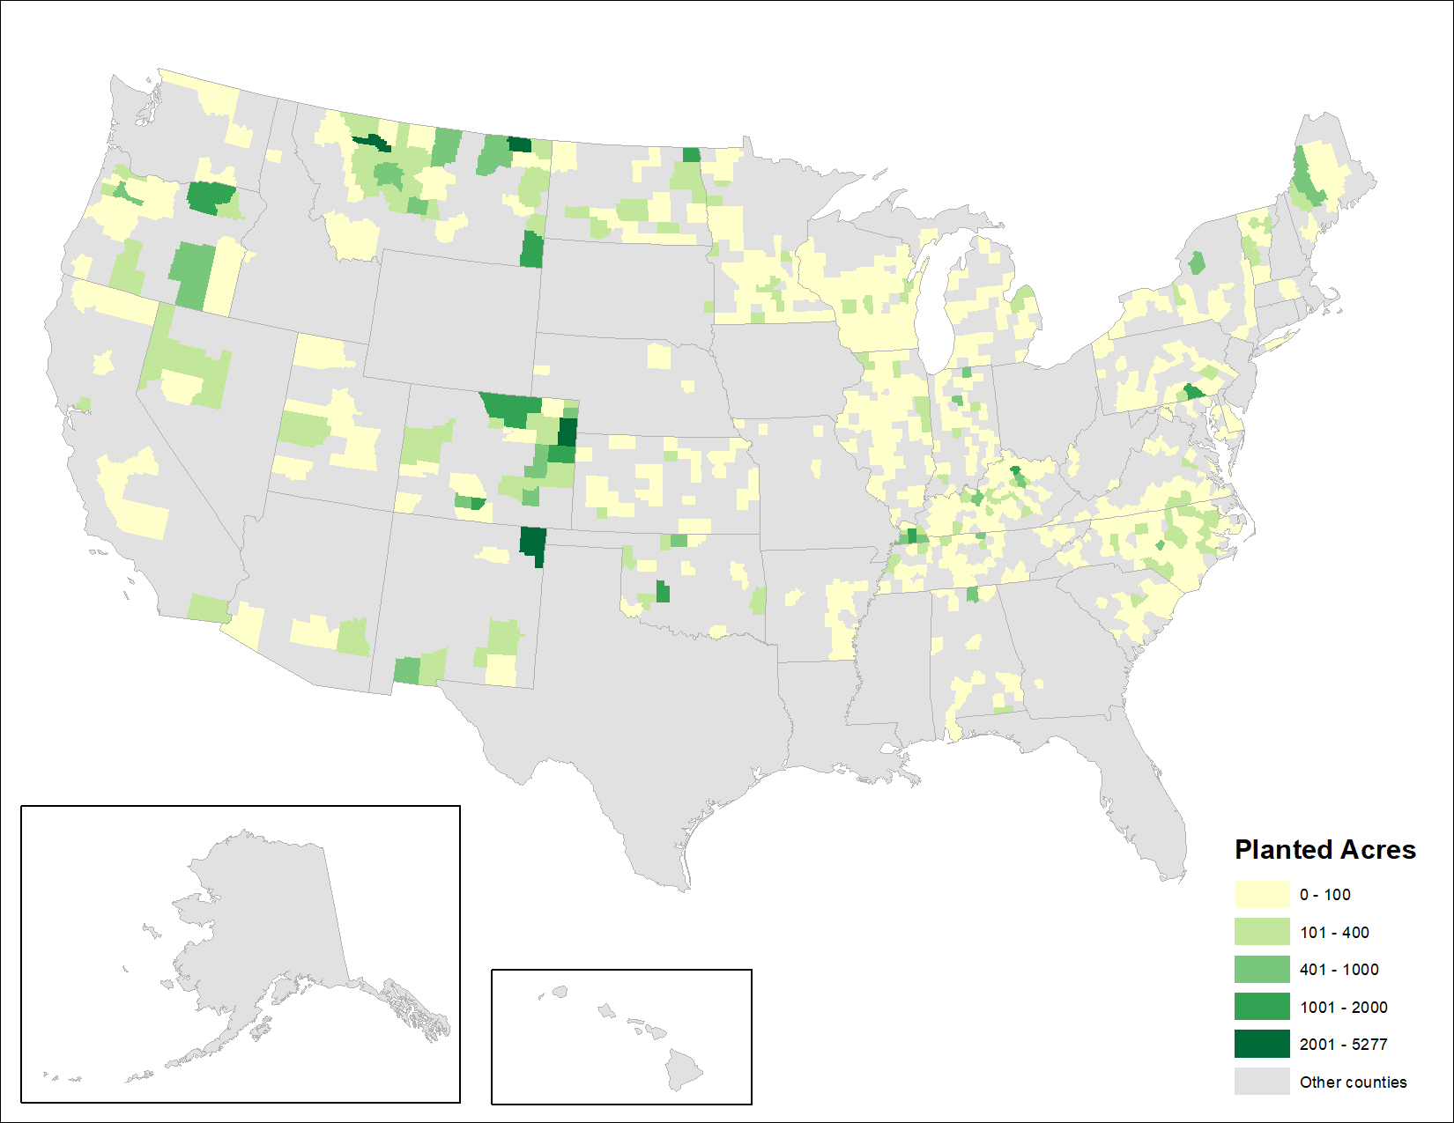
Production Density at the County Level, 2019
By 2019 production was widespread
Largest number of planted acres reported in Colorado, Kentucky, Montana, Oregon, North Carolina
Source: USDA Farm Service Agency, Data as of December 2019

Slide 6
Global production is increasing canada has potential to be a major competitor
Canadian Hemp Acreage, 1998-2018
Source: Health Canada

Slide 7
Hemp is a traded commodity
Source: USDA Economic Research Service based on data from U.S. Commerce Department, Bureau of the Census
* 2019 is a partial year

Slide 8
Challenges in transitioning from pilot to large scale production

Slide 9
Hemp outlook???
“The long-term prognosis is generally favorable across a range of product categories and downstream markets, but the road getting there is likely to be a rough-and-tumble ride, with as many losers and there will be winners.”
Source: Sterns, J.A. 2019. "Is the Emerging U.S. Hemp Industry Yet Another Boom–Bust Market for U.S. Farmers?" Choices. Quarter 3. Available online: www.choicesmagazine.org/choices-magazine/submitted-articles/is-the-emerging-us-hemp-industry-yet-another-boombust-market-for-us-farmers

Slide 10
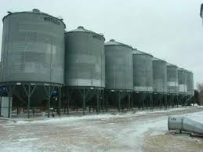
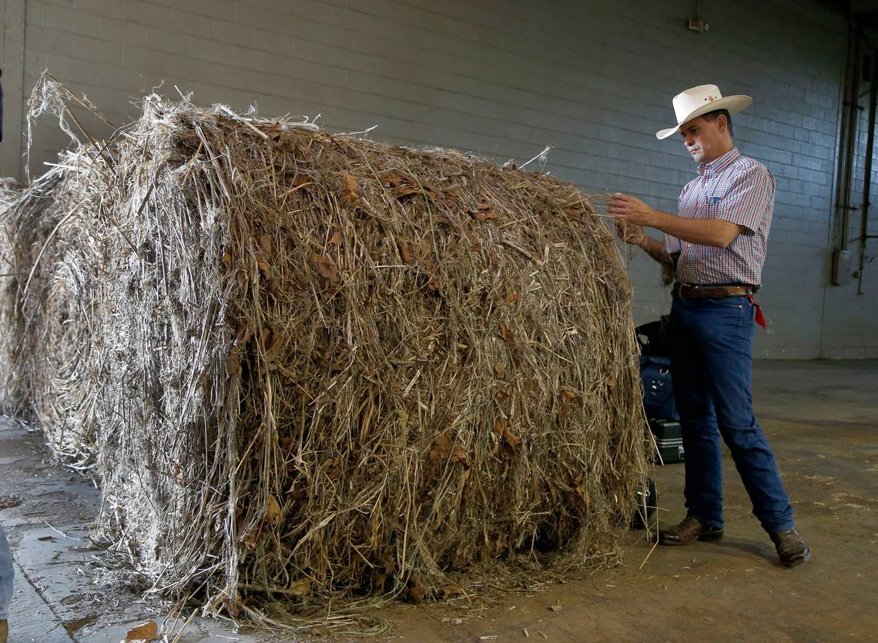
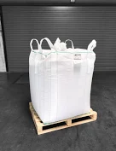
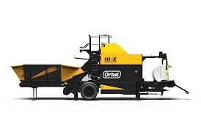
Contracts and storage
Contract Structure
  Contract terms
  Payment schedule
  Contract structures vary widely
  Speculation
Storage is often a distant thought to producers
  6-12 months of storage
  Impact on storage of other commodities
  Different than traditional grain storage
  Improper storage creates off flavors or mold

Slide 11
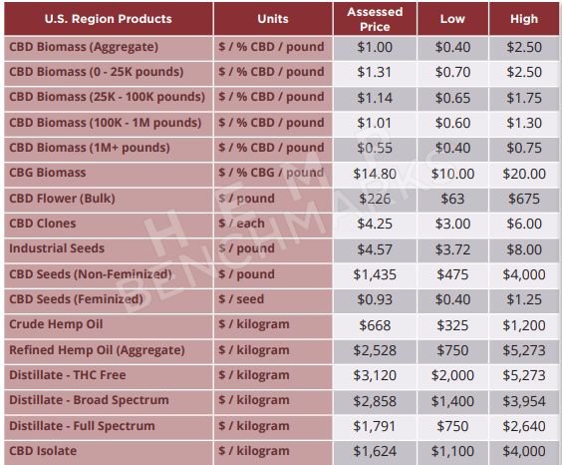
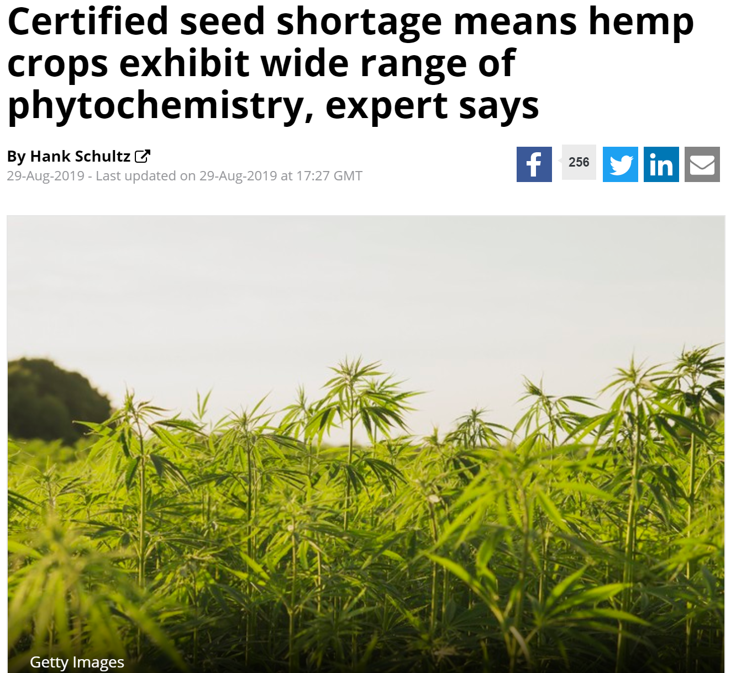
Input Costs & Availability
Conventional vs. Feminized vs. Clones
  Costs
  Will there be enough available in 2020?
Labelled Chemicals
  EPA is reviewing
Source: Hemp Benchmarks

Slide 12
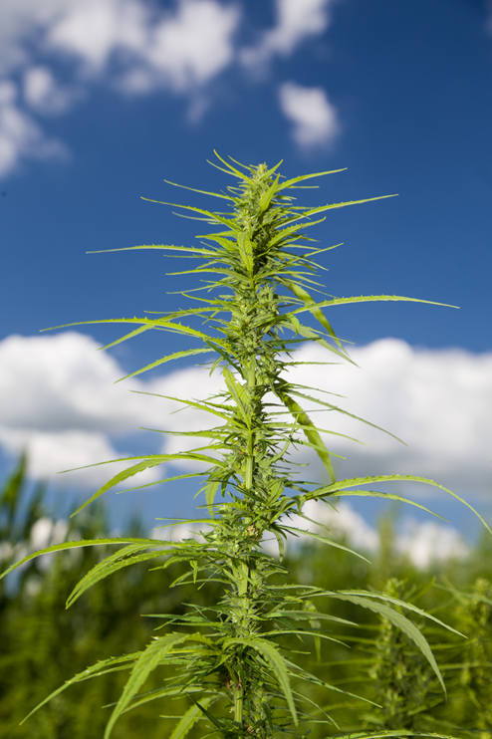
Access to Credit & Risk Management
Access to operating capital
  Will lenders even lend to hemp producers?
  Setting up bank accounts to put hemp money in can be problematic
  Utilization of operating loan to produce hemp
Lack of risk management tools
  Crop insurance
  Farm programs
  Futures markets...
  Security

Slide 13
2019-2020 Midpoint Biomass Price for 3 Key States

Slide 14
Summary
Pilot programs reintroduced industrial hemp production in the United States
Some challenges were identified including lack of data
U.S. production increased under the pilot programs
Global production is increasing as well
Transitioning to commercial production is underway: likely to be a rough a tumble ride

Slide 15




Will Snell
Extension Professor
Phone: 859.257.7288
Email: wsnell@uky.edu
Jonathan D Shepherd
Farm Management Specialist
Phone: 859.218.4395
Email: jdshepherd@uky.edu
Tyler Mark
Production Economist
Phone: 859.257.7283
Email: tyler.mark@uky.edu
@kytweeter55

