Slide 1
USDA Agricultural Outlook Forum 2020
February 21, 2020
Michael E. Lemmon, DVM
CEO Whiteshire Hamroc, LLC

Slide 2
Background
Whiteshire Hamroc (WH) has marketed Swine Genetics into China for over 20 years
WH has marketed AirWorks Pig Buildings since 2008.
WH has owned and managed genetic production systems in China
Lost 10,000+ pigs in 2018 and 2019 to ASF at one Genetic Farm
Office in Beijing with 4 Associates
Average 9-10 trips per year for marketing and management purposes
WH has worked closely with both large and small producers in China
  Educational seminars and exchanges
  Multiple technology transfer events

Slide 3
Current African Swine Fever Status
Well over 50% of the production has been affected by ASF.
Some farms have repopulated and restarted production.
  Some have become reinfected
Many farms with poor locations or poor buildings will never produce pigs again.
Fear of infection/reinfection is still high! ASF is still not completely controlled.
Very small farms have little risk to restart and are being encouraged to do so.
Some smaller farms have restocked with poultry instead of pigs.
Many larger farms are restarting with additional biosecurity.

Slide 4
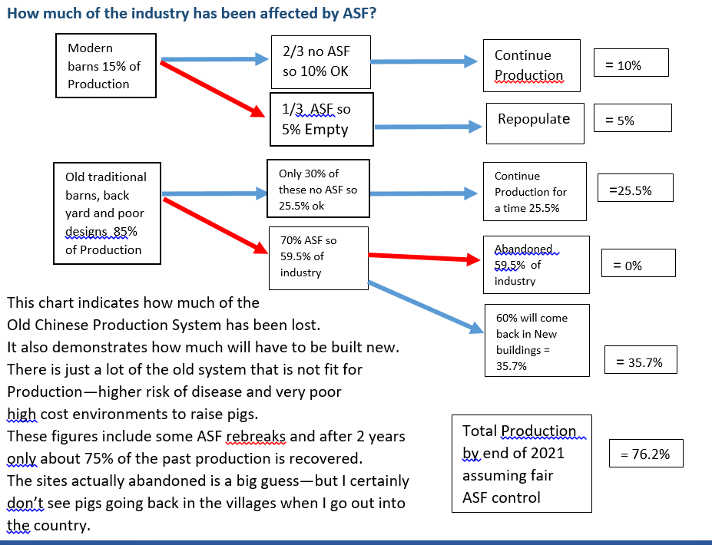

Slide 5
How is the consumer reacting to the shortage of pork?
Shortage not as apparent in the big cities—imports as well as local supply apparently is channeled to where the money is.
  City families have more disposable income.
Very evident in rural areas and smaller Cities/Towns
  Pork is just not available at restaurants/local butchers.
  Small towns have no production and little money to buy expensive pork.
All areas
  Substitution of other proteins for pork has already occurred,
  Decrease of animal protein in nearly all Chinese dishes—especially rural areas.
  Government suggestions that Pork (Protein) is a bad choice for a healthy diet.
  2-3X price has decreased demand everywhere.

Slide 6
Factors Affecting ASF Spread and Recovery
Cultural
Political/Governmental
Industry Structural and Management Problems

Slide 7
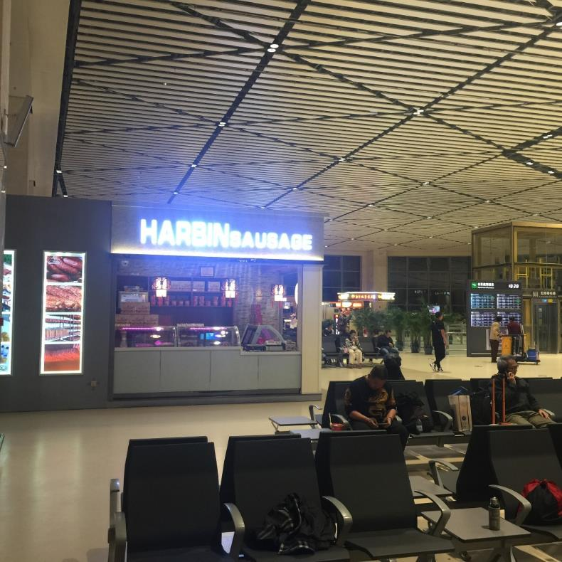
Asian Food Culture also Contributed to ASF Spread
Chinese families are often spread all over China.
Every Traditional Festival results in family members traveling back home. Spring Festival, National Day Holiday, Mid-Autumn Day, Dragon Boat Festival, New Year
Nearly every airport has processed meats for sale to travelers.
Part of the Chinese culture is to share local sausages, processed meats and other foods with relatives during these festivals!
Harbin Airport in Heilongjiang

Slide 8
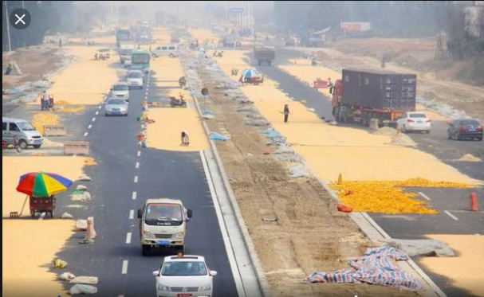
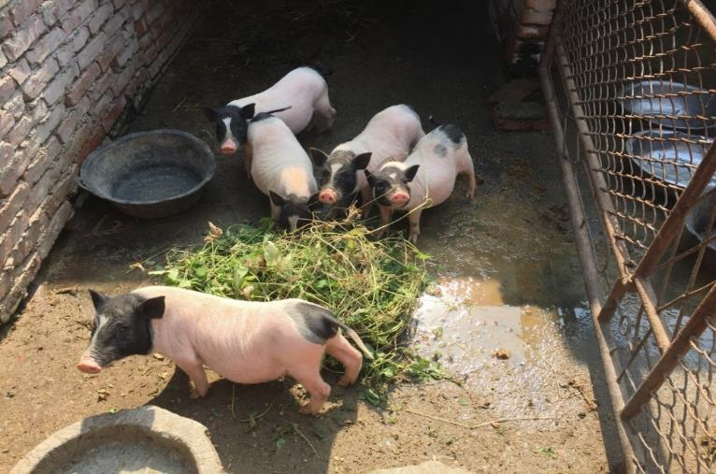
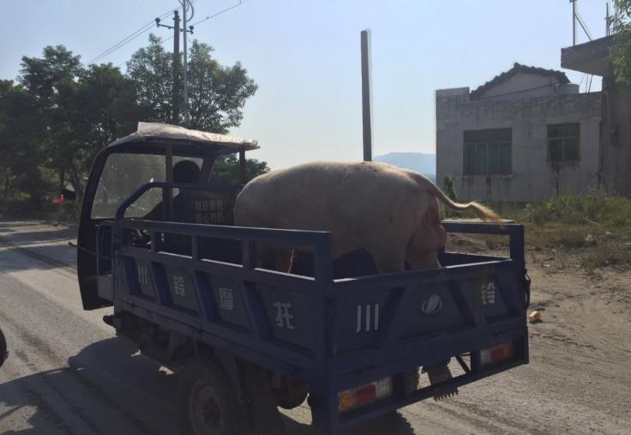
Cultural Factors
Festival travel and food exchanges
Proximity of people and pigs
Village pig as the family garbage disposal
Every man for himself!

Slide 9
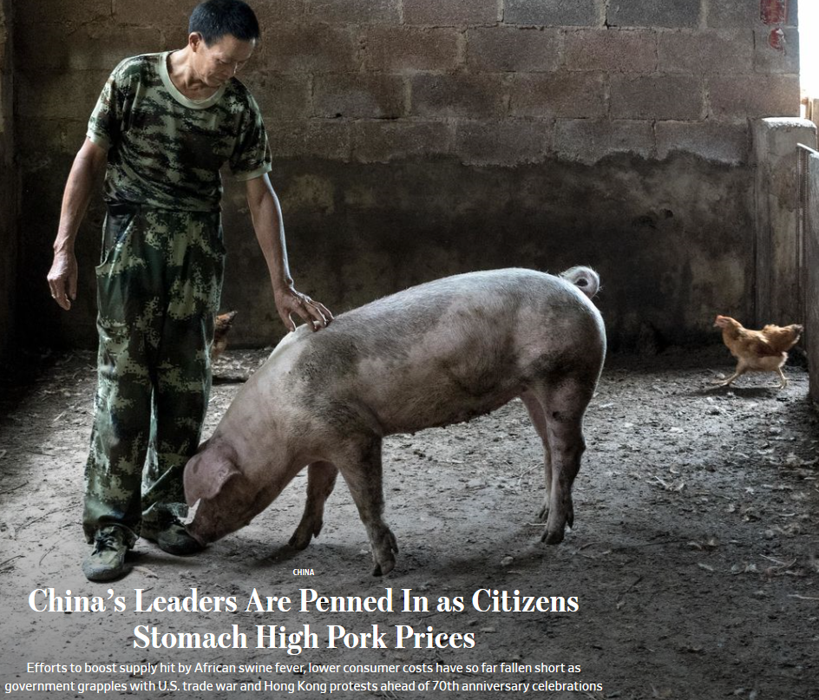
At some point along the way, ASF became more of a political problem than a disease problem for China’s leaders.
National and International transparency was absent very early in the ASF outbreak in China!

Slide 10
Political and Governmental Factors
Lack of preparedness for any epidemic or other natural disaster.
Lack of staff and funding to carry out prevention and control strategies relative to the size of the industry.
Political issues took precedence over practical and science based decisions relative to ASF management and control.
Lack of transparency at all levels from producer to government agencies.
Lack of sufficient indemnities to encourage producers to report and properly depopulate infected pigs. Local governments were responsible.
Non reporting by local governments because of the added financial burden on already strapped local governments.

Slide 11
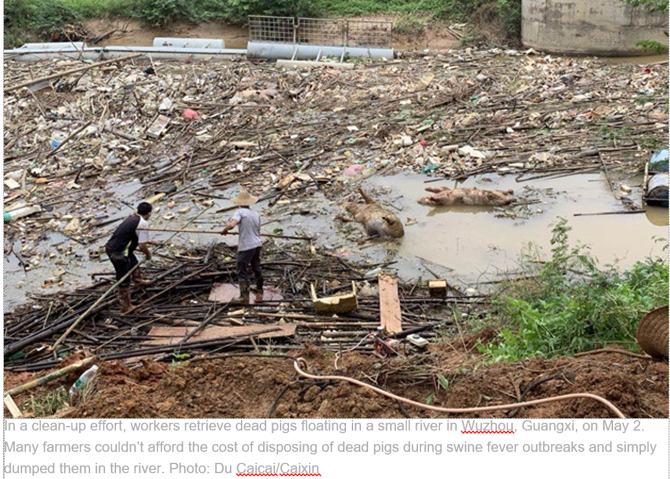
Dead Pig Disposal
For some small farmers the nearest stream or river was the disposal method of choice.
Small farmers have little land to bury pigs properly.
There is rarely a good rendering option available.
Some dead pigs were simply moved to a road at night and dropped into the side ditch.
Dead disposal will be a huge problem in the US!!!

Slide 12
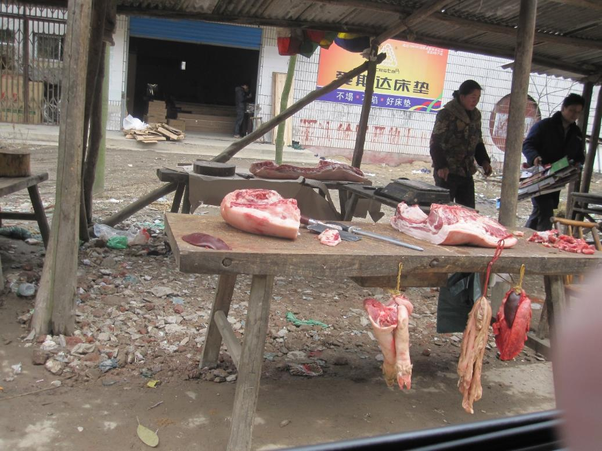
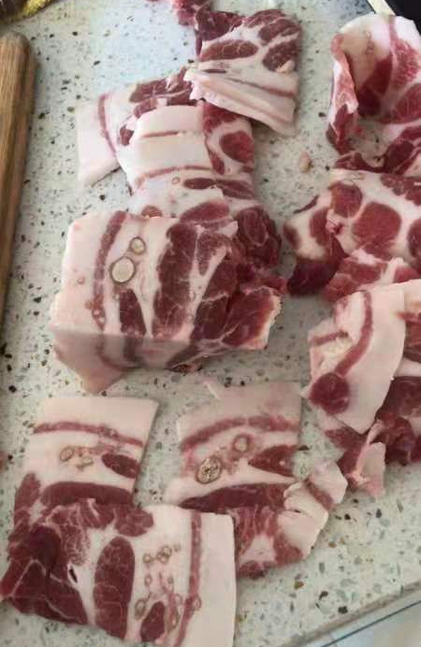
Each village had one or more of these butchers! They were often an outlet for sick pigs from local farms.
Look closely at the product.
These are no longer seen in rural areas post ASF.

Slide 13
Industry Factors
Lack of understanding of epidemiology and pathogenesis of the ASF virus at all levels of production and government.
China has areas of extreme pig density.
Uncontrolled and unmanaged pig movement (100+M pigs moved across Provinces annually).
Lack of credible and capable diagnostic laboratories.
Past acceptance of viral diseases, FMD, HC (SF), PED, others.
It would be hard to create a better environment for virus spread than what exists in China!
Recovery: many things are the same—don’t expect too much change!

Slide 14
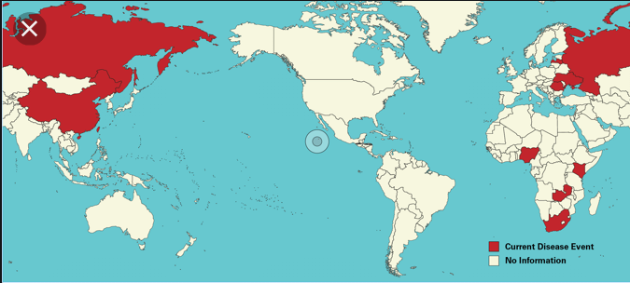
What does it mean to the USA now that the Americas are surrounded by the threat of ASF?

Slide 15
Globalization complicates disease control!
People, human food, animal feedstuffs and biologics transfer across borders daily!
Old production methods and cultural practices in one country can put people and animals in other countries at risk in the event of a pandemic.
2003 SARS epidemic in China highlighted the concerns of political interests interfering with human health. Coronavirus has raised concerns again.
The ASF pandemic in China has caused transparency concerns to resurface.
70% of new human diseases originate from animals!
Awareness and protectionist attitude—especially when transparency is in question!

Slide 16
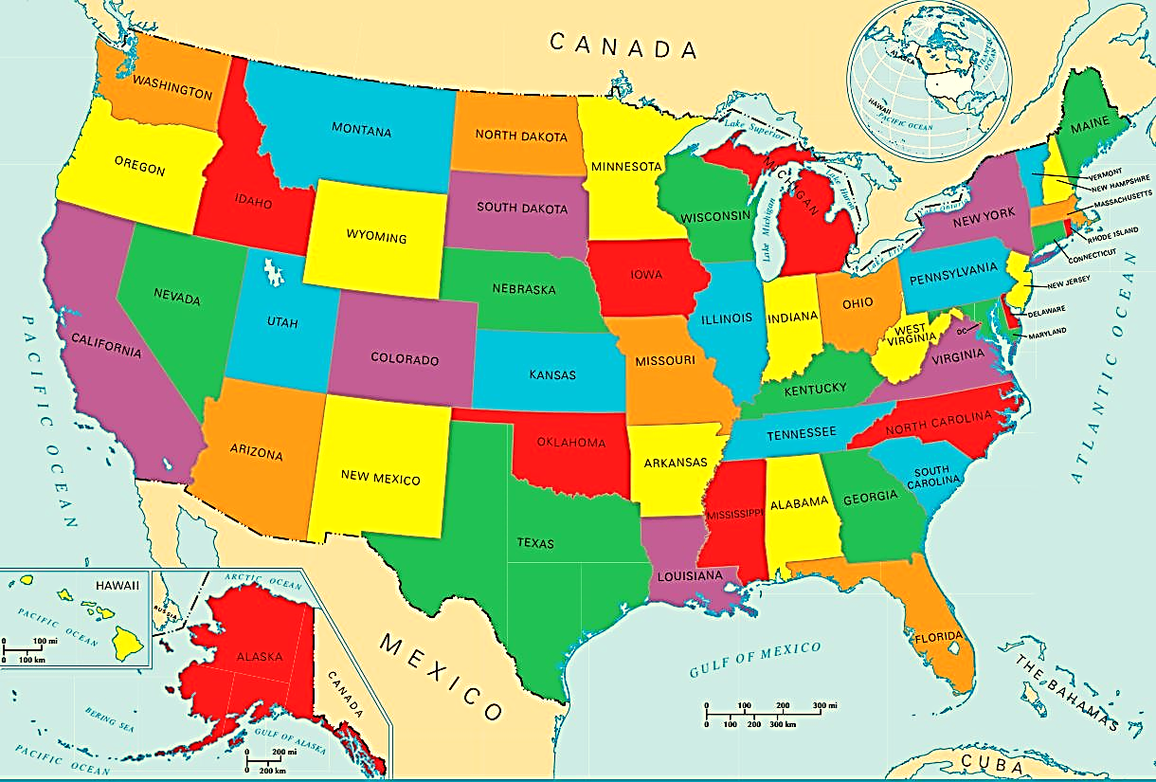
Indiana BOAH data in 2015
3,531,468 pigs imported into Indiana
92% feeders
Average of 913 pigs per permit
3,870 Trucks entering Indiana
Slaughter pigs do not require a permit
Illustrates how we have connected pig populations and diseases across large distances! Daily!!
There were at least 3870 potential disease risk events for Indiana!
Notes:
How is the 30,000 ft. view of this practice resulting from multi site practices viewed from a disease control standpoint. Awareness of the scope of pig movement! In the event of an FAD, regionalization efforts will be impossible to manage!

Slide 17
What is important to the US industry?
Education of the industry—through NPPC, NPB, State offices or other.
  Run disease simulation exercises to test industry response.
  Recognize the risks of emphasizing individual economics against industry health.
Evaluate ways to minimize current pig movement and its risks.
  Multi-site systems add risk and cost to pork production!
  Long incubation periods of some viral diseases frustrate early detection.
Improve communication and transparency.
  Between diagnostic labs and government agencies.
  Between production systems (pig, poultry, and other livestock).
Continue to support State and Federal Diagnostic Laboratories.
Develop and invest in an indemnity fund specifically for direct payments to producers diagnosed with an FAD such as ASF.

Slide 18
How do we protect the US food system?
Investigate potential production systems that Minimize Pig Movement—”Single Site” Production Systems.
Support and fully fund the “Secure Pork Supply” initiatives by the NPPC and USDA (securepork.org). Support and protect our Animal Diagnostic Labs!
Monitor incoming pigs at Slaughter plants—esp in high risk areas.
Make sure disease control efforts continue to be about disease control and food safety instead of politics.
Better identify risks to our food system.
Support border controls! Stop FADs at our borders!
Feral Pig Controls
Promote opportunities for cooperation and international intervention in local outbreaks of potential pandemic diseases—especially in countries that are poorly prepared to manage disease outbreaks.
Support our Border Partners in their monitoring and control efforts!

Slide 19
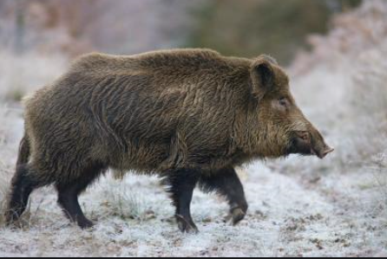
ASF is unlike previous Swine diseases!
Where does ASF go next?
What is the next Pandemic if not ASF?
Will we be prepared?

