Slide 1


February 21, 2020
Brett Stuart
China ASF Update & 2020 Outlook

Slide 2
Why ASF is
A Global Protein Game Changer?
The virus is very strong (hard to kill)
Mortality rates > 95%
There is no vaccine
75% of the world’s hogs are now threatened
  (EU and Asia)
Chinese pork supplies = 20% of total global meat/poultry
The losses in China and Vietnam are massive

Slide 3
How Bad Is it?
Chinese gov’t
  Oct inventory down -40%
  Oct slaughter down -46%
  Now claiming increases…
Private sources (feed, pharma, equip, genetics)
  Sales are down -70% to -80% from a year ago
Our estimate
  At least -65% of the herd is now gone
  Roughly one-third of the global swineherd

Slide 4
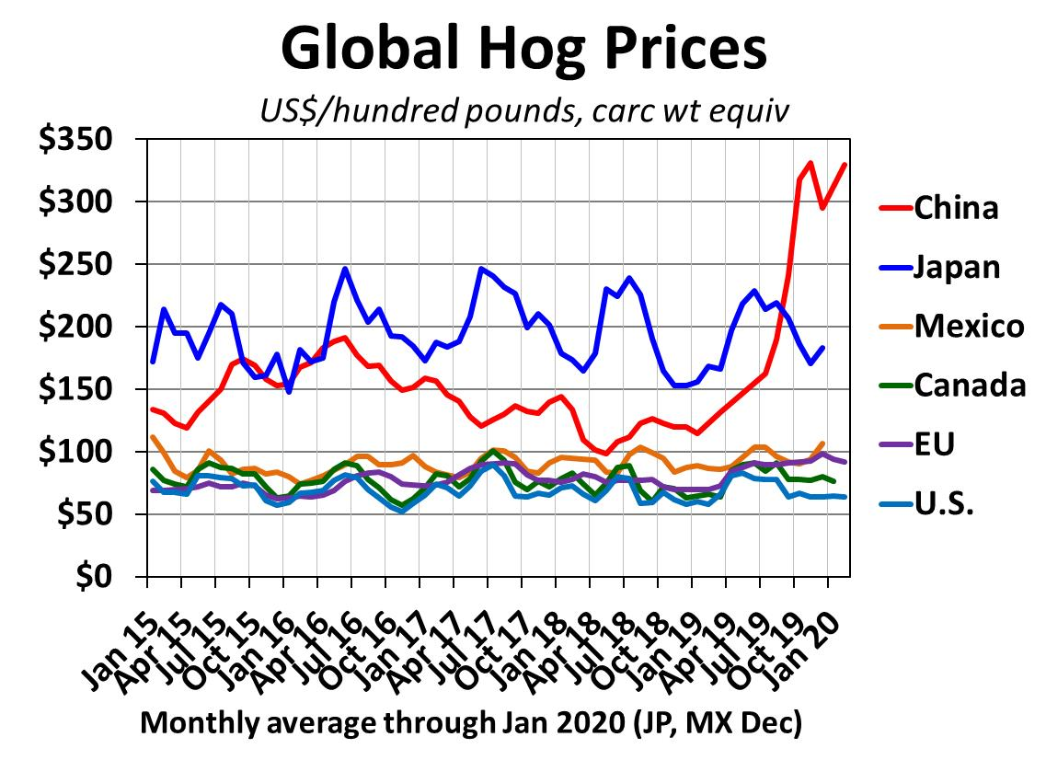
Various sources

Slide 5
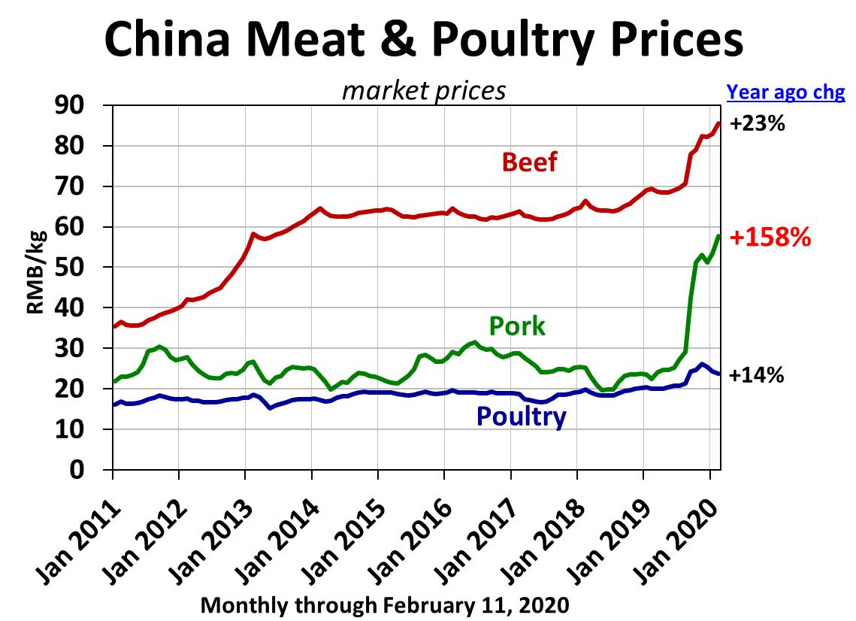
Source: China MARA

Slide 6
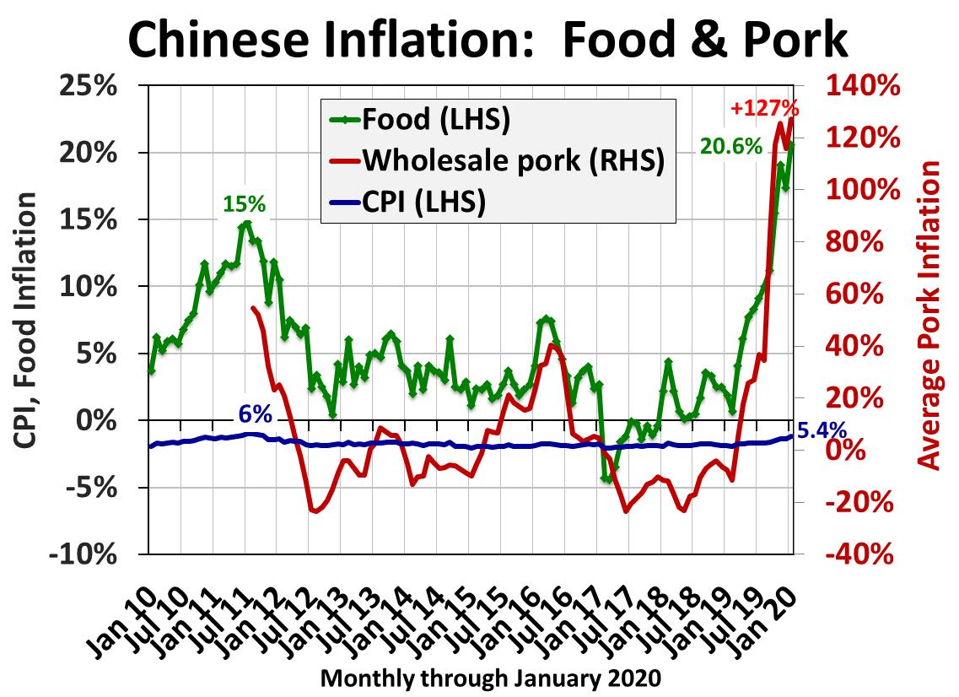
Source: China NBS, MARA, JCI

Slide 7

China’s Shortages Are Real
Social media reports of shortages
Contacts “on the ground”…
Gov’t actions:
  Direct provincial governments to
  increase pork output
  Released 200,000+ mt of frozen pork from
  storage (5 ounces/capita)
Food inflation is now soaring
But consumer pressure is different there…

Slide 8
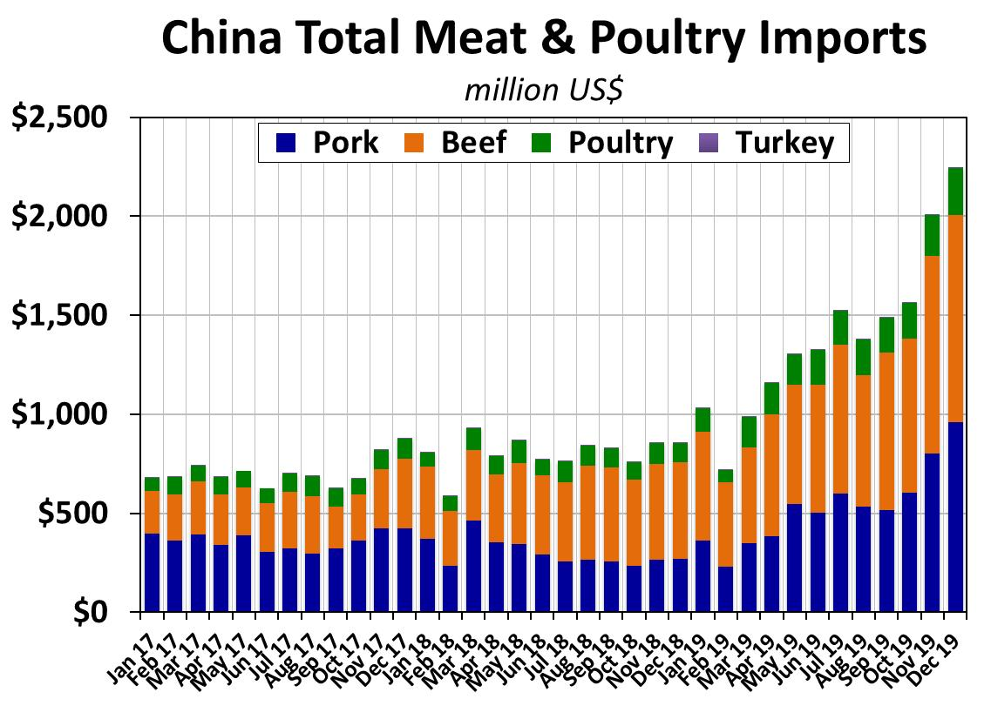
Source: China MARA

Slide 9
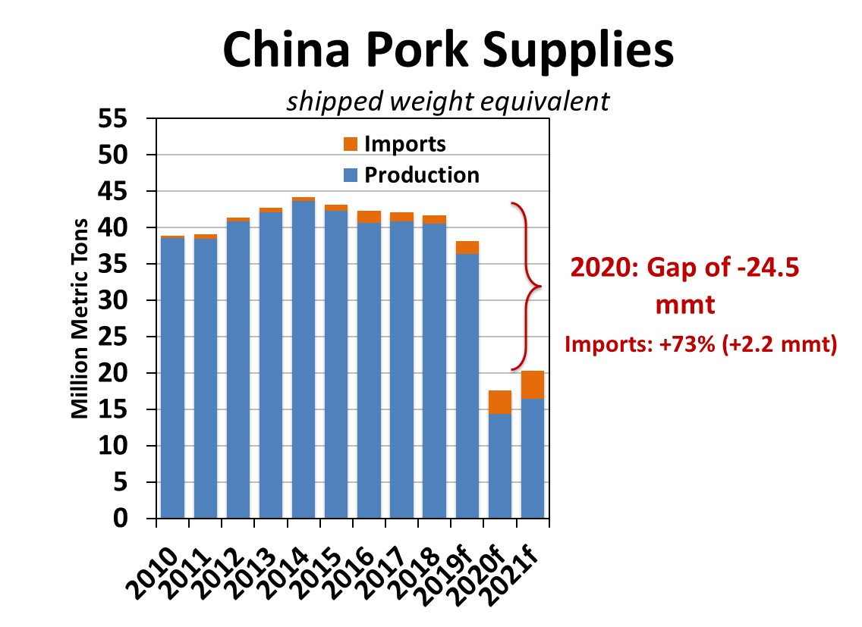
Source: USDA, AgriTrends forecasts
Notes:
We forecast China’s pork gap in 2020 at -32 million metric tons on a carcass-weight equivalent or 24 million metric tons on a shipped weight basis (trade data is typically reported on a shipped weight basis). Even an import increase of +2.7 million metric tons does little to fill this massive gap.

Slide 10
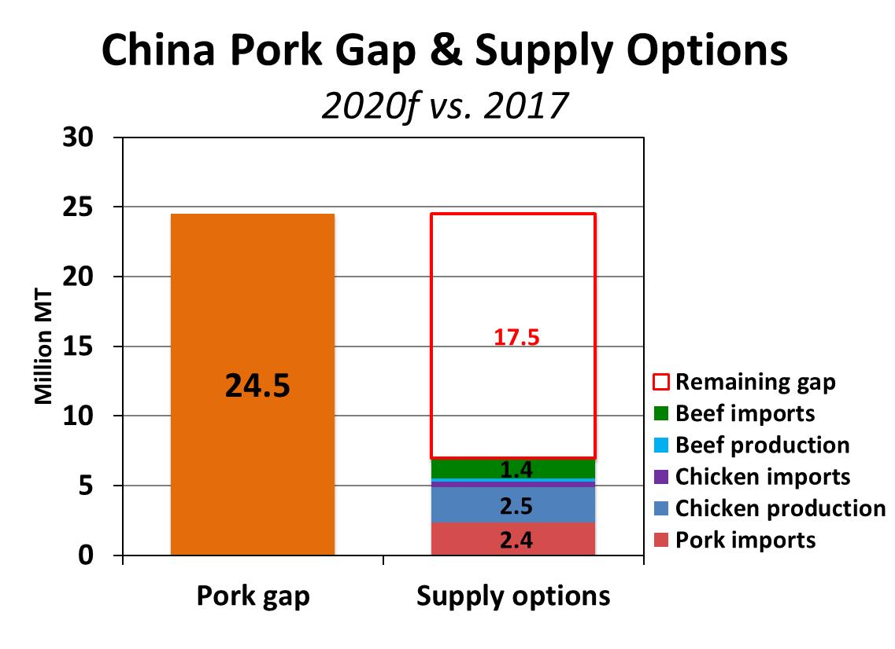
Source: AgriTrends, shipped-weight equivalent

Slide 11
China: Is Recovery Possible?
Government Optimism
Optimism is all they have
Edicts to local officials
  “Do everything possible to ensure adequate supplies”
  “Stop the declines as soon as possible”
News media ordered to write articles restoring confidence of pig farmers by reporting on effectiveness of government policies and giving examples of successful recovery
Restore “normal” supplies in 2021?
  70% recovery (30% imports)
    30% = 16 mmt (2x global pork trade today)

Slide 12
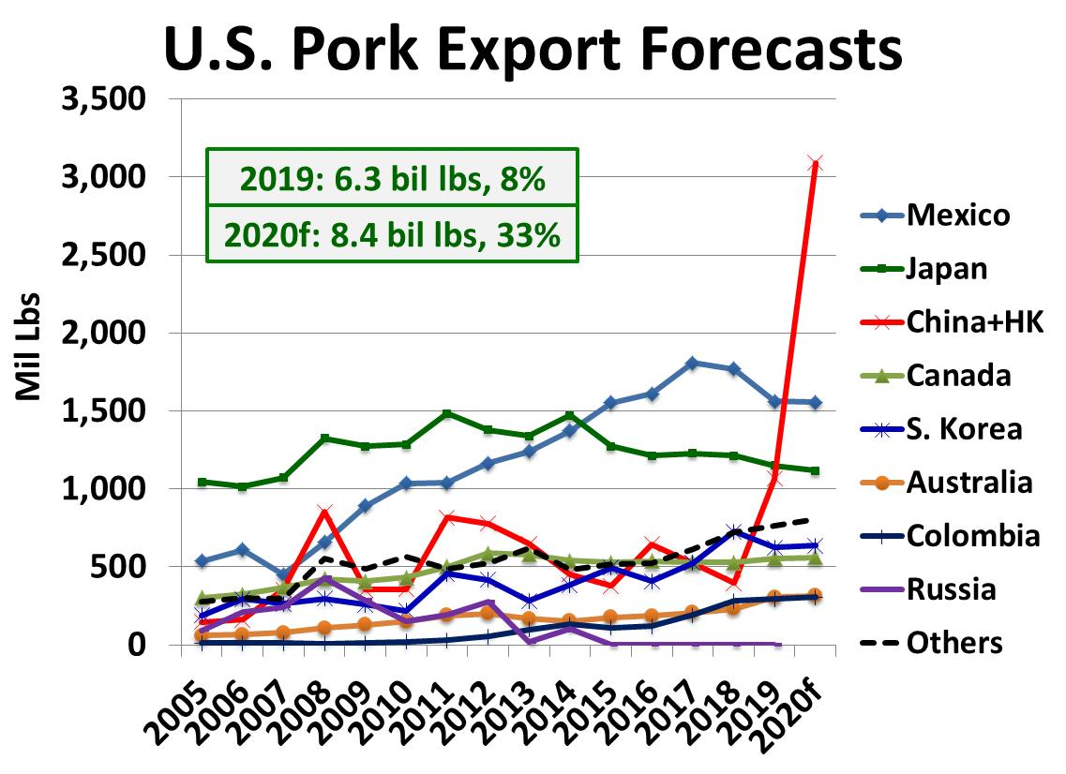
11% of US prod
Source: USDA/ERS, AgriTrends forecasts
Notes:
Key assumptions
Retaliation tariffs eliminated (via waivers)
Prices remain above 26 rmb/kg
No games (plant delistings, etc)
The Math
Total U.S. pork exports increase +2.0 bil lbs
U.S. production +1.248 bil lbs (Wasde)
Net supplies decline -0.752 bil lbs
(-2.3 lbs/capita carc wt, -1.7 pounds retail wt)
-3.2% per cap supply equates to 6.4% price increase
BUT – we may be wrong, exports could exceed those levels
Pork supplies were down -2% in 2014, prices rose +25%
Cuts could get volatile (bellies, hams)

Slide 13

Thank You
Brett Stuart
bstuart@globalagritrends.com
303-803-8716
Email info@globalagritrends.com For a free newsletter

