Slide 1
USDA TARGET Center
Accessible Communications Program
October 16, 2023
Nancy Frohman
Accessible Communications
Program Manager
USDA Office of Operations
TARGET Center
Heather Ihlenfeldt
Reasonable Accommodation
Coordinator
USDA Departmental Administration
Human Resources Management Staff
Notes:
Introduction
Hello my name is Nancy……program manger of acp…..at the USDA OO TC in Washington DC.
Introduce to Heather Ihlenfeldt, RA Coordinator at the USDA Departmental Administration (DA). Heather is joining me to explain the roles, requirements and responsibilities of providing reasonable accommodations at USDA.
Now, I will go through the slides on ACP and definitely I will pause for you for your questions because I want interactions and I know this is a lot of information to receive.

Slide 2

ADVANCING ACCESS & EQUITY
National Disability Employment Awareness Month of 2023
Celebrating 50 years of the Rehabilitation Act of 1973!
Notes:
Advancing Access & Equity
National Disability Employment Awareness Month of 2023
Celebrating 50 years of the Rehabilitation Act of 1973!
October’s special observance month!
Observed in every October! National Disability Employment Awareness Month (NDEAM) celebrates the contributions of America’s workers with disabilities past and present and showcases supportive, inclusive employment policies and practices that benefit employers and employees. Department of Labor’s Office of Disability Employment has chosen "Advancing Access and Equity" as the theme for this year NDEAM 2023. Kudos to ODEP!

Slide 3
Learning Objectives
Importance of accessible communication and identifying those who need it.
Learn the factors that lead to communication barriers.
Gain an understanding of USDA’s Departmental Regulations.
Notes:
You will learn to understand of the significance of accessible communications and empower the identification of those requiring communication access.
You will learn to the factors contributing to communication barriers, including examples of areas such as vision, hearing, speech, and cognitive disabilities.
RA Coordinator Heather Ihlenfeldt will go through the USDA’s Departmental Regulations pertaining to Reasonable Accommodations and Personal Assistance Services for Employees and Applicants with Disabilities, and the responsibilities.

Slide 4

Communication is the ability to
  Receive,
  Send,
  Process,
  Comprehend concepts, or verbal, nonverbal and graphic symbol systems.
Notes:
What is communication? Communication is the ability to receive, send, process, comprehend concepts, or verbal, nonverbal and graphic symbol systems.
Communication is an interactive, two-way process of sharing information back and forth between two parities that includes both understanding and being understood.

Slide 5
Communication access
  People with sensory disabilities can communicate (and be communicated with) on an equal footing with those who do not have such disabilities.
  To receive and share information is essential to learn, exchange ideas, express feelings and form relationships.
  No communication barriers.
Notes:
People with sensory disabilities can communicate (and be communicated with) on an equal footing with those who do not have such disabilities.
To receive and share information is essential to learn, exchange ideas, express feelings and form relationships.
No communication barriers.
Communication access is when everyone can get their message across with no communication barriers.

Slide 6
significance of providing
Accessible communications
  Executive Order on Diversity, Equity, Inclusion, and Accessiblity in the Federal Workforce (DEIA).
  USDA Office of DEIA.
  Benefits all audiences by making information clear, direct and easy to understand.
Notes:
Why it is significant to provide accessible communications because of
Executive Order on Diversity, Equity, Inclusion, and Accessiblity in the Federal Workforce (DEIA).
USDA Office of DEIA.
Benefits all audiences by making information clear, direct and easy to understand.
Continue to next slide…

Slide 7
significance of providing
Accessible communications (CONT.)
Receive opportunities for feedback and experiences on various barriers to accessing information.
Diverse and inclusion.
Increase your customers.
Hire new employees.
Do the right thing.
Notes:
Receive opportunities for feedback and experiences on various barriers to accessing information.
More diverse and inclusion.
Increase your customers.
Hire new employees.
Do the right thing!

Slide 8
Identification requiring communication access
USDA individuals with disabilities, including those with vision, hearing, communication, and cognitive disabilities.
USDA employees, customers, job applicants, visitors, farmers, firefighters, rangers, private landowners, land managers, and small business customers.
USDA Service Centers in the NCR and Nationwide.
Notes:
Who requires the communication access.
USDA individuals with disabilities including those with vision, hearing, speech, and cognitive disabilities.
USDA employees, job applicants, visitors, farmers, firefighters, ranchers, private landowners, land managers, and small business customers.
USDA Service Centers in the NCR and Nationwide.

Slide 9
Factors contributing to communication barriers
Vision
Hearing
Communication
Cognition
Notes:
There are four factors that contributing to the communication barriers: Vision, Hearing, Speech and Cognition.
On what you would need to accommodate the vision, hearing, speech and cognitive disabilities, you will learn what accommodations to provide to remove the communication barriers in in each areas.

Slide 10
Varieties of VISION disabilities
Blind.
DeafBlind.
Far-Sighted.
Legally Blind.
Low Vision.
Near-Sighted.
Partially Sighted.
People with Vision Loss.
Totally Blind.
Notes:
You might want to know the varieties level of vision disabilities in the blind community
blind, deafblind, far-sighted, legally blind, low vision, near-sighted, partially sighted, people with vision loss, totally blind and visually impaired.
They are all different individuals so you need to accommodate them in different methods.
Go on next slide.
-----------------------------------------
If a customer ask a question to explain what it means, go below and explain if needed.
Low vision is used to describe a loss of visual acuity while retaining some vision. It applies to individuals with sight who are unable to read a newspaper at a normal distance of viewing, even with the aid of glasses or contact lenses. People with low vision often need adaptations in lighting and/or enlarged print to read something.
There are two specific types of low vision:
“Near-sighted” - Unable to see distant objects clearly.
“Far-sighted” - Unable to see close objects clearly.
The partially sighted student meets the challenge of disability in much the same way as a totally blind student. Accommodations include the use of readers, audio taped texts, and raised-line drawings. The partially sighted student may be able to use large print books and a Closed-Circuit TV (CCTV) or other magnifying device. Some partially sighted students can take notes in class by printing very large with a felt tip pen or marker; others will tape record lectures for later use.
Legally Blind refers to people that have less than 20/200 vision in the better eye or a limited field of vision that is 20 degrees or less at its widest point. People who are legally blind may have some useful vision.
Totally Blind individuals need Braille, raised-line drawings, audio recordings, and/or other non-visual media as an accommodation for accessing the content of visually presented materials.

Slide 11
EFFECTIVE COMMUNICATIONS access for vision
Provide braille, large prints or audio.
Give a clear word picture when describing things to an individual with vision loss. Include details such as color, texture, shape and landmarks.
Use their name when addressing them, it lets them know you are speaking to them, not someone else in the room.
Identify the details of the room when in presence with audio.
Notes:
This is important to ensure to provide effective communication access plans for vision:
Provide Braille, Large Prints or Spoken Audio
Give a clear word picture when describing things to an individual with vision loss. Include details such as color, texture, shape and landmarks.
Use their name when addressing them, it lets them know you are speaking to them, not someone else in the room. It is important engagement because they don’t see you talking to them directly.
Identify the details of the room when in presence with audio. For instance, describe the meeting room, how many people in there, introduce ppl who is in room, table/chairs settings, where to go, etc.
(continue to next slide…)

Slide 12
EFFECTIVE COMMUNICATIONS access for vision (cont.)
Provide assistive technology such as screen magnification and/or speech reading for utilizing the computer and mobile devices.
Provide audio that contains the same information as documents you provided.
Audio/video description.
Availability of reasonable accommodation(s) on event and training announcements.
Notes:
Continue and read all with explanation.

Slide 13
Varieties of Hearing disabilities
Deaf.
Hard of Hearing.
Hearing Loss.
Late-Deafened.
Low Vision and Deaf.
Low Vision and Hard of Hearing.
DeafBlind.
Notes:
There are the varieties level of hearing disabilities in the deaf and hard of hearing community such Deaf with Big D or small d deaf, deaf and hard of hearing, deaf or hard of hearing, DeafBlind, hard of hearing, hearing loss, hearing people, late-deafened, low vision.
All of them require different needs base on individuals’ preference of communications.

Slide 14
EFFECTIVE COMMUNICATIONS access for hearing
Qualified Service Providers:
  American Sign Language Interpreters.
  CART Captioners.
  TypeWell/Notetakers.
Other types of service providers, such as Oral, Cued-Speech, Tactile Interpreters, etc.
Captions.
Notes:
Read each and explain.
Continue to next slide.

Slide 15
EFFECTIVE COMMUNICATIONS access for hearing (CONT.)
Networking speed for the high-quality videophone calls.
Video Relay Service (VRS).
Voice to text transcription applications.
Chat.
Internet captioned telephone service.
Written or printed content.
Notes:
Read and explain each.
Written/printed content: Designs for accessible to a wide range of individuals, including those with disabilities. Those may also mean old fashioned papers or utilizing technology apps.
Continue to next…

Slide 16
EFFECTIVE COMMUNICATIONS access for hearing (CONT.)
Face to face, eye contacts.
One on one, not group.
Lighting settings.
Do not cover your mouth.
Gesture.
Rephrase.
Notes:
Read and explain.

Slide 17
EFFECTIVE COMMUNICATIONS access for hearing (CONT.)
Digital accessibility.
Agenda for meetings in advance for customers and service providers.
Availability of reasonable accommodation(s) on event and training announcements.
Notes:
Read and explain each

Slide 18
Three major types of communication disabilities
Articulation.
Fluency.
Voice.
Notes:
Articulation: Express and thinking into words or statements.
Fluency: How words and sentences flow altogether.
Voice: Not everyone has a voice. Even when one has a voice, this can be scrambled.

Slide 19
EFFECTIVE COMMUNICATIONS access for Communication disabilities
Give the person more time.
Qualified Speech to Speech Transliterator.
Check that you have their attention before talking.
Reduce background noise and distractions.
Use short sentences and familiar words
Notes:
Learn how to make it simple effective communication access with the speech language disabilities.
Explain each and why.
Continue to next slide.

Slide 20
EFFECTIVE COMMUNICATIONS access for Communication disabilities (CONT.)
Emphasize the key word or small group of words.
Communicate clearly and slowly and use an appropriate.
Tone.
Be patient.
Notes:
Explain each and why.

Slide 21
Varieties of cognitive disabilities
Intellectual disability.
Autism spectrum disorders.
Mental health.
Brain injury.
Stroke.
Types of dementias.
Notes:
“Cognitive disabilities” is a broad range of conditions that include intellectual disability, autism spectrum disorders, severe, persistent mental illness, brain injury, stroke, and Alzheimer's disease and other dementias.

Slide 22
EFFECTIVE COMMUNICATIONS
FOR cognitive disabilities
Use clear and simplified language.
Avoid using technical language.
Avoid using long words with many syllables.
Rephrase your sentence.
Allow them to think and answer.
Be patient.
Notes:
Learn the simple and effective communications for Cognitive disabilities.
Read each and elaborate each.

Slide 23
Evaluation on communication access in the service areas
  Purpose.
  Form.
  Identify and recommendations.
  Solutions.
Notes:
Read and explain.
I will provide the demonstration how to improve the communication access at the service center on October 25th at 10:00 AM so make sure you to join the event and it will benefit you to learn how to adjust the communication access at your service center.

Slide 24
responsibilities for Providing accessible Communications
Mission Areas, Agencies, and Staff Offices.
National Capital Region (NCR).
Nationwide.
Notes:
Everyone at USDA must be very aware of the responsibilities of providing accessible communications to the employees and customers’ communication needs. All mission areas, agencies, and staff offices have responsibilities to provide and fund the RA.
Before the next slide, turn this over to Heather Ihlenfeldt, the RA Coordinator at DA.

Slide 25
requirements and responsibilities on reasonable accommodations (RA)
Rehabilitation Act of 1973.
Americans with Disabilities Act Amendments Act of 2008 (ADAAA).
Departmental Regulation (DR 4300-008): Reasonable Accommodations (RA) and Personal Assistance Services (PAS) for Employees and Applicants with Disabilities.
Mission Areas, Agencies, or Staff Offices have the responsibilities to provide and fund the RA.
Notes:
Heather Ihlenfeldt takes over…

Slide 26
RA procedures
RA Contacts on the TARGET Center Website: https://www.usda.gov/target-center/topics/ra-list
Contact your RA Coordinator in your Mission Area, Agency or Staff Office.
Reasonable Accommodations Coordinators and Supervisors: Importance of collaboration.
Approval and funding.
Notes:
Heather Ihlenfeldt proceeds on this slide.

Slide 27

Current and Upcoming Meetings
OCTOBER
MONDAY WEDNESDAY
THURSDAY
TUESDAY
10/16/2023
11:00 AM – 12:00 PM
USDA TARGET Center
Accessible Communications
Program
Nancy Frohman
Accessible
Communications
Program Manager
10/17/2023
11:00 AM – 12:00 PM
Unmasking Hidden Challenges: Chronic Conditions in the Workplace
Dr. Theresa Haskins Haskins Consulting
1:00 PM – 2:00 PM
Equity, Accessibility, and Inclusion in the Workplace (Part 1 of 2)
Dr. Theresa Haskins Haskins Consulting
10/18/2023
10:00 AM – 11:00 AM
Ergonomic Equity: Addressing Risk Factors Through Job Analysis and Prevention
Sandra Miller
Britroix
12:00 PM – 1:00 PM
Digital Accessibility Fundamentals for Websites, Documents, and Video
Mike Caprara
The Viscardi Center
10/17/2023
10/23/2023
11:00 AM – 12:00 PM
Emotional Intelligence (Part 1 of 2)
Carolyn Owens,
MCC, SPHR
1:00 PM – 2:00 PM
Proper Posture in the Workplace to Prevent Posture-Related Problems (Part 1 of 2)
Dr. Krista Burns
American Posture Institute
10/24/2023
11:00 AM – 12:00 PM
Thriving with ADHD at Work
Dr. Theresa Haskins Haskins Consulting
1:00 PM – 2:00 PM
Equity, Accessibility, and Inclusion in the Workplace (Part 2 of 2)
Dr. Theresa Haskins Haskins Consulting
10/25/2023
10/26/2023
10:00 AM – 11:00 AM
Assistive Technology at New Heights
Dr. Wayne Crolley
Novare Products, LLC
10/25/2023
10:00 AM - 12:00 PM
USDA TARGET Center
Accessible Communications Demonstrations
(Virtual/Onsite)
Nancy Frohman
Accessible Communications
Program Manager

Slide 28
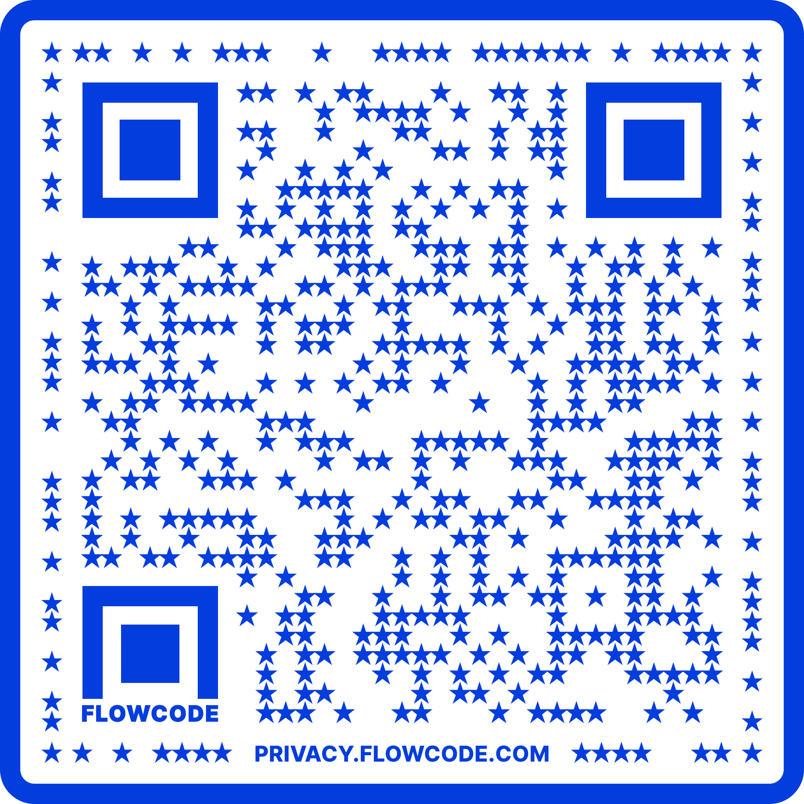
Contact Information
TARGET Center Website
https://www.usda.gov/target-center
TARGET Center Email
target-center@usda.gov
TARGET Center Phone Number
(202) 720-2600

