Slide 1
Computer/Electronic
Accommodations Program
Support. Equip. Empower.
Grace Hoffman
USDA TARGET NDEAM Presentation
10/05/2023
Notes:
General opening remarks. Content will be dependent on how the CAP representative(s) are introduced to the audience.

Slide 2

Advancing Access & Equity

Slide 3

Purpose and Agenda
Purpose
To provide an understanding of the Computer/Electronic Accommodations Program (CAP).
Agenda
  CAP Overview
  CAP Customers and Services
  CAP Resources
  Questions
Notes:
Our purpose in today’s briefing is to provide you with a working knowledge of CAP, our history, the services we provide and the individuals who are eligible for our CAP services. We will also provide information regarding CAP’s request and acquisitions process and some insight on the budget.

Slide 4

CAP Overview
Notes:
Before I get started, “how many of you (by the show of hands) know about CAP, have used CAP services or are working with CAP?

Slide 5
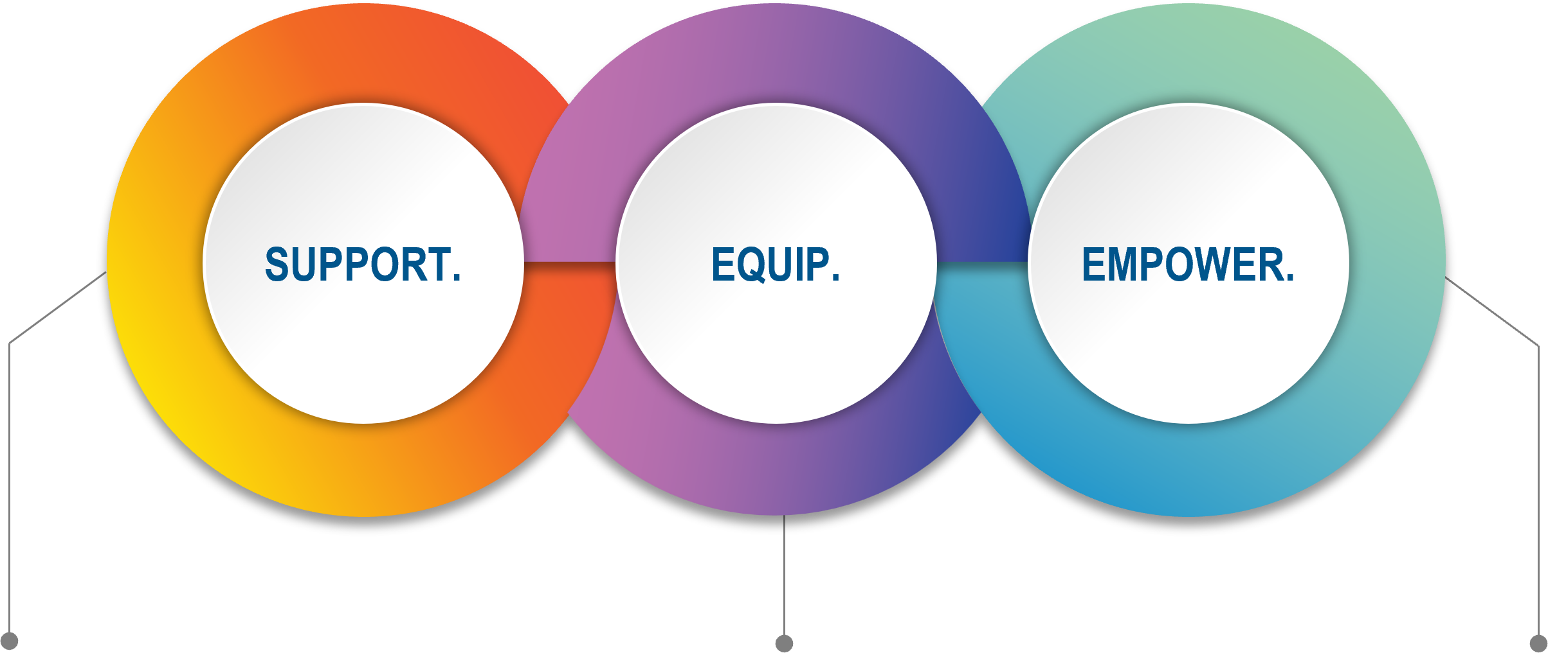
What is CAP?
Department of Defense (DoD) Centrally Funded Program
Support DoD employees with disabilities and wounded, ill and injured Service members
Equip employees and Service members with assistive technology (AT) and services, as reasonable accommodations
Empower employees with equity, inclusion and accessibility promoting their support of the DoD mission
Notes:
CAP provides assistive technology and services as accommodations, and associated training at no cost to DoD agencies. We provide accommodations to DoD civilians with disabilities and wounded, ill or injured Service members. CAP assists employees in identifying the most appropriate accommodations by providing needs assessments.
CAP supports civilian employees and active duty Service members with qualifying medical conditions
You may have employees with disabilities who have had their conditions and limitations for all or most of their lives. Chances are that they can identify their own appropriate accommodations. However, some individuals may have newly acquired limitations or may be performing different dutiesin a new location. They may realize they need better tools but may not know what assistive technology is available. The needs assessment process helps address that.
CAP also provides training, both online and virtually, on our services as they relate to disability program management. We want to support your efforts to ensure agency hosted and sponsored events and programs are accessible to individuals with disabilities, including members of the general public.
Through these actions, CAP supports the compliance with a variety of federal disability laws, rules, and regulations.

Slide 6
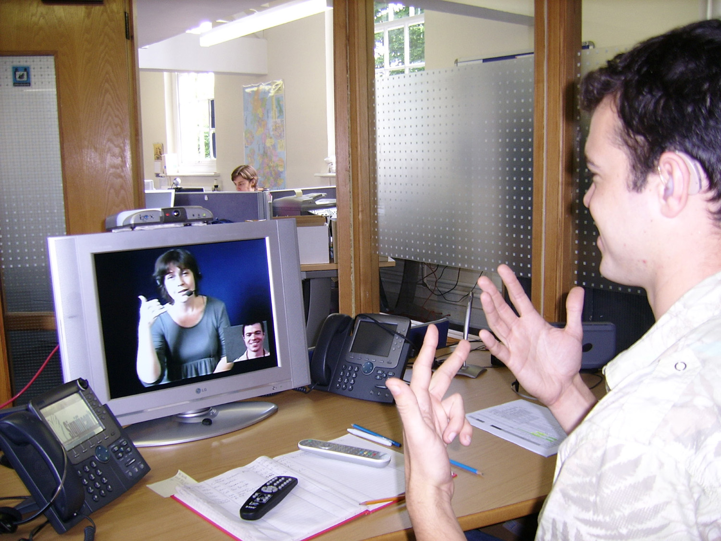
CAP Background
1990
Centrally funded program established to accommodate employees with disabilities of the DoD
2000
Expanded to cover select non-DoD Executive Branch Federal Agencies
2004
Expanded to cover wounded, ill, and injured (WII) Service members (SM) who remain on active duty to include National Guard and Reserve members under Title 10 and allow Service members to keep AT upon separation from military
2021
CAP conducts needs assessments and consultation to 70 non-DoD agencies of the executive branch. Agencies procure AT
2022
Conducts needs assessments and procures AT for DoD employees and WII SM. Continues providing needs assessments and consultation to non-DoD agencies.
Notes:
CAP was established in 1990 by the Department of Defense as a centrally-funded resource in the identification and procurement of assistive technology accommodations for DoD civilian employees with disabilities.
On October 30, 2000, Congress signed the National Defense Authorization Act giving CAP the authority to provide assistive technology, devices, and services to any department or agency in the Federal Government upon the request of the head of the agency. At the height of this partnership, CAP was providing services to 70 non-DoD agencies including Homeland Security, Justice, Veteran’s Affairs, NASA and the Nuclear Regulatory Commission.
In 2004, CAP began providing to those on active duty
Public Law 109-364 was passed on October 17, 2006, allowing Service members to retain AT provided by CAP upon separation from active duty
DoDI 6025.22, Assistive Technology (AT) for Wounded Service Members (DoDI 6025.22) was signed on September 9, 2008, establishing policy for AT programs in the Military Health System
In October 2020, the beginning of FY21, CAP resumed its original role as an acquisitions resource to only the DoD. CAP can still provide needs assessments and product information to employees of non-DoD agencies.
2022- CAP continues procuring AT for DoD agencies and continues to provide needs assessments and consultation to non-DoD agencies.
Photo reference: https://commons.wikimedia.org/wiki/File:Deaf_or_HoH_person_at_his_workplace_using_a_Video_Relay_Service_to_communicate_with_a_hearing_person_via_a_Video_Interpreter_and_sign_language_SVCC_2007_Brigitte_SLI_%2B_Mark.jpg

Slide 7

Rehabilitation Act of 1973
Requires federal agencies to reasonably accommodate job applicants and employees with disabilities
Section 501
Section 504
Section 508
  Prohibits federal employment discrimination against individuals with disabilities
  Mandates affirmative action
  Prohibits discrimination in any federally-funded program, service or agency
  Specifies federal information communication technology must be accessible and usable for both employees and the public
Notes:
CAP provides services as required by The Rehabilitation Act of 1973:
The rehabilitation act is a federal law that requires agencies to provide reasonable accommodation(s) to qualified applicants and employees with disabilities
Reasonable accommodation(s) must be made available to applicants participating in the hiring or application process and allow employees to perform the essential functions of the job and partake in the benefits and privileges of employment

Slide 8

Rehabilitation Act of 1973 Mandates
Requires employees with disabilities have equal access to ALL benefits and privileges of employment, including:
  Training
  Services such as employee assistance programs, credit unions, cafeterias, lounges, gyms, auditoriums, and transportation
  Social functions and parties
Applies to all federal agencies, as well as any activities or programs that receive federal funding.
Mandates agencies that interact with the public must provide accommodations for members of the public.
Notes:
The Rehabilitation Act of 1973 also states that the benefits and privileges of employment must be made accessible. Accessibility to benefits and privileges may include training, services, and social functions sponsored by the agency.
The Rehab Act is expansive and covers all functions and activities undertaken by federal agencies.

Slide 9

Department of Defense Instruction (DoDI)
DoDI 1000.31 (2018)
“Computer/Electronic Accommodations Program”
DoDI 6025.22 (2015)
“Assistive Technology for Wounded, Ill, and Injured Service Members”
  Lays out CAP’s basic responsibilities, procedures, and policies.
  Specifies which agencies, individuals, and DoD components can receive services from CAP.
  Establishes cooperation and contact between CAP, Military Treatment Facilities (MTF), and Wounded Warrior Program.
  CAP must provide active-duty service members with assistive technology.
2022/2023: Reissue DoDI 1000.31 in progress
New CAP DoDI will combine 1000.31 and 6025.22
Notes:
There are currently two Department of Defense Instructions, or DoDIs, relative to CAP:
DoDI 1000.31 “Computer/Electronic Accommodation Program” was published on October 28, 2018.
establishes policy and assigns responsibilities for the implementation of CAP.
Defines individuals, DoD components, and other Executive departments or federal agencies that are eligible to receive assistive technology (AT), AT devices, and AT services provided by CAP
DoDI 6025.22 “Assistive Technology (AT) for Wounded, Ill, and Injured Service Members was re-issued in January 2015.
establishes policy and assigns responsibilities between CAP, Military Treatment Facilities (MTFs) and Warrior Transition Units (WTUs)
Requirements expanded to include wounded warrior programs
Requires identification of points of contact (POC) at MTF and wounded warrior programs
A Reissue of DoDI 1000.31 is in progress in 2022. This will combine these two existing CAP DoDIs

Slide 10
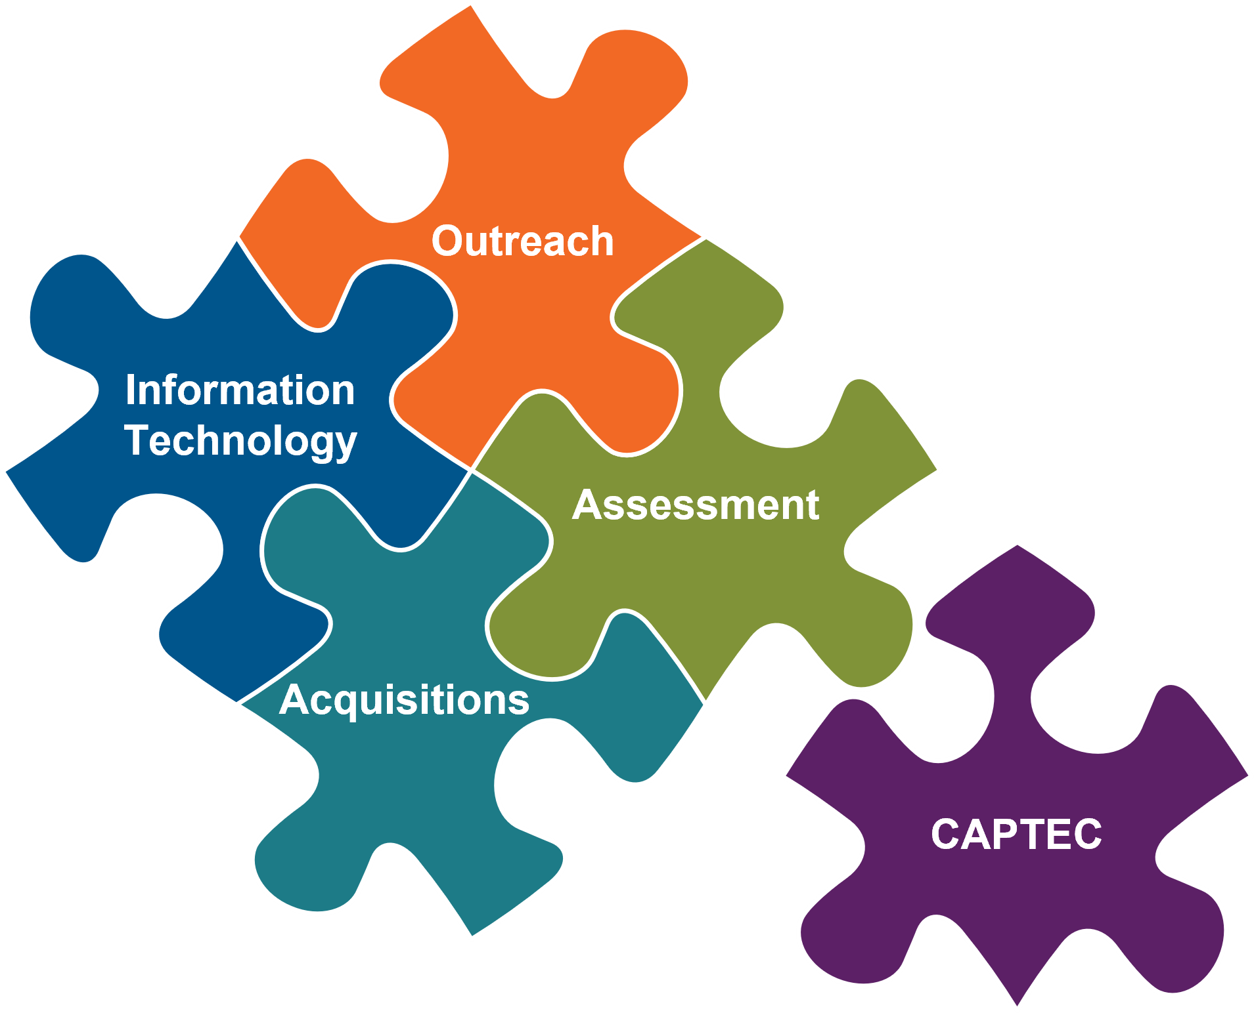
CAP Teams
Notes:
CAP consists of 5 teams working in coordination to meet its mission. This is best explained by looking at the CAP request process.
When an employee or Service member visits the CAP website, they can submit a request for AT, AT Devices, and/or Services. The Information Technology team ensures that the CAP website and database are working properly and are constantly making updates to streamline the process for customers, employees, and stakeholders.
Submitted requestsare managed by CAP’s Assessment Team. The Assessment Team will review the request to validate the need and to ensure that all required documentation is submitted A needs assessment may be required to assist individuals identify their needs and the AT most appropriate for the submitted request. The Assessment Team conducts assessments remotely by working one-on-one with an individual to understand their diagnosis and limitations, what their job functions are, and how their disability impacts their ability to meet those job functions. The Assessment Team will use the information acquiredto make AT recommendations.
A subset of the Assessment Team is CAP’s Technology & Evaluation center, CAPTEC, located in the Pentagon. If an employee or Service member is in the DC area, they may visit CAPTEC for an in-person assessment. CAPTEC offers the opportunity to try some of the AT available. In addition to in-person assessments, CAPTEC can provide AT demonstrations, briefings, and tours for individuals, POCs, and stakeholders interested in learning more about CAP and available tools.
Once a request is reviewed and approved, the request transitions to CAP’s Acquisitions Team for procurement. The Acquisitions team follows Federal Acquisitions Regulations to procure all AT, AT Devices, and Services using the best available method, comprised of Blanket Purchase Agreement, Purchase Order, or Government Purchase Card depending on the item, quantity, and the price. The Acquisitions Team keeps employees and Service members informed once the item is ordered and provides regular status updates (i.e.: regarding any items on backorder, provides tracking information). The Acquisitions Team also oversees CAP’s inventory of commonly requested items and will ship those items directly from CAP to the end user.
Last but not least we have the CAP Outreach Team to raise aware and foster our relationships with DoD employees and Service member, conducts customer interface with DoD agencies and provides briefings and information to ensure widespread awareness of CAP services.

Slide 11

CAP Customers and services
Notes:
What exactly does CAP do, and who is eligible for our services?

Slide 12

Customers: Service Members
Active duty Service members, including:
  Wounded, ill, and injured active duty Service members.
  Service members continuing on active duty (COAD).
National Guard and Reserve Service members serving on full-time active duty under Title 10, U.S.C.
Notes:
CAP supports two primary groups of DoD employees: Service members with limitations and DoD employees with disabilities.
Service members with limitations may include wounded, ill and injured Service members. Service members who may be in the process of separating from active duty through the medical board process, may retain the AT provided by CAP as their personal property to use in future endeavors such as returning to school or starting a new job.
Service members may have a condition that impacts their ability to do their job but plan to remain on Active Duty, referred to as COAD.
CAP also support NG and Reserve serving on full-time AD under Title 10.

Slide 13

Customers: Civilians
DoD employees with disabling conditions including:
  Workers’ Compensation beneficiaries
  Term and Temporary Employees,
  Workforce Recruitment Program (WRP) Interns
  Detail appointments
DoD managers who are ready to hire and accommodate (Schedule A).
DoD agencies that want to ensure their programs and services are accessible.
Federal partner agencies with employees that require needs assessments.
Notes:
The other category of CAP customers is DoD employees with disabilities
These may include Worker’s compensation beneficiaries and term/temporary employees, such as interns participating in the Workforce Recruitment Program.
CAP also supports DoD managers and agencies who understand their obligations to accommodate their employees and in making their information and services accessible to employees or the general public.
AT provided to civilian employees becomes the property of the organization once the employee departs the organization.

Slide 14
CAP Quiz
Which of the following qualify as computer/electronic assistive technology?
*Select all that apply
  Work place furniture to support employee for medical issues.
  Lighting and soundproofing modifications to improve the work space.
  A service or device to increase functional capabilities of disabled individuals.
  Scooters, wheelchairs and/or building modifications to improve work place access.
Notes:
Before we review the types of accommodations CAP can provide, please take a minute to answer the following question: Which of the following qualify as computer/electronic assistive technology? Please select all that apply.
Give 20-30 seconds for responses. Presenter will then review the responses provided and read off the percentages of responses for each.
The correct answer is C, a service or device to increase functional capabilities of disabled individuals. The next slides will provide additional information on assistive technology and CAP services.

Slide 15
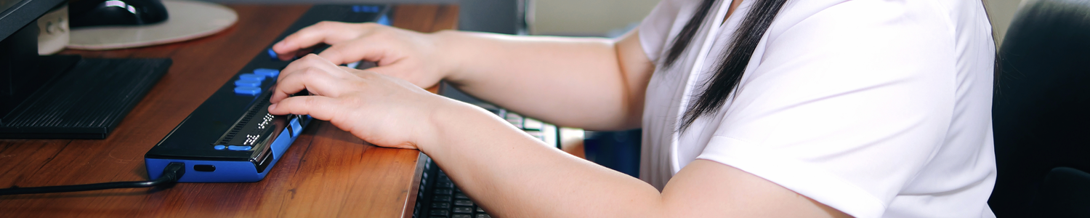
Assistive Technology Act (AT) Definitions
As defined by the Assistive Technology Act of 1998
  AT services assist an individual with a disability in the selection, acquisition, or use of an assistive technology device.
  AT devices are used to increase, maintain, or improve the functional capabilities of individuals with disabilities.
Notes:
AT is technology that enables individuals with disabilities to enjoy equal employment opportunities and provides equal access to computer and telecommunication work environments. AT consists of both devices and services. AT does not include durable medical equipment.
AT Devices are any item, piece of equipment, or product system, whether acquired commercially, modified, or customized, that is used to increase, maintain, or improve the functional capabilities of individuals with disabilities. The device may assist individuals in accessing computer and telecommunication systems and gaining improved access to care and decision making. The device may also assist individuals by removing one or more barriers in the workplace caused by a disabling medical condition. For example, if someone has a condition that limits their ability to type on the computer, voice recognition software used to control the computer with the voice would be an example of an AT device.
AT services include assistance in the selection, acquisition, or use of an AT device. Services may also include needs assessments, acquisition, integration, coordination of services with rehabilitation plans, training on the use and implementation of an AT device, and technical assistance.

Slide 16






CAP Services
Interpreting Services
Training/Technical Services
CART Services
Technology Demonstration
Video/Media Captioning Services
Needs Assessments
Notes:
This slide shows a variety of services offered by CAP.
CAP provides training, both online and virtually, on our services as they relate to disability program management. We want to support your efforts to ensure agency hosted and sponsored events, programs, and materials are accessible to individuals with disabilities. CAP can assist by providing interpreting, Communication Access Real-time Translation (CART), or captioning services when needed.
Through these actions, CAP supports the compliance of a variety of federal disability laws, rules and regulations.
CAP also assists in identifying the most appropriate accommodations via needs assessments and technology demonstrations. You may have employees who have had their disabling condition for all or most of their lives. Chances are that they can identify their own appropriate accommodations. However, some individuals may have newly acquired limitations, or may be performing different duties in a new location. They may realize they need better tools, but may not know what is available. The needs assessment process helps address that need.
All of the stated CAP services are provided at no cost to the requesting DoD organization.

Slide 17





CAP Disability Categories
Dexterity
Cognition
Deaf/Hard of Hearing
Communication
Blind/Low Vision
Notes:
CAP provides assistive technology which targets 5 primary disability categories: Dexterity, Deaf/Hard of Hearing, Blind/Low Vision, Cognition and Communication. The following slides will focus on each specific disability category in more detail.

Slide 18

Dexterity
What are Dexterity Conditions?
Dexterity conditions refer to
any physical disability that limits the physical function of one or more limbs.
conditions may include quadriplegia, paraplegia, multiple sclerosis, cerebral palsy, carpal tunnel syndrome, tendonitis, arthritis, sciatica, amputations or degenerative disc disease.
limitations affecting mobility could include decreased range of motion in the arms, fingers, wrists, back or neck, and decreased muscle control, spasms, paralysis, tingling or numbness.
Notes:
Dexterity limitations are those which prevent a person from physically controlling their computer through standard input methods. This can include disabling conditions such as carpal tunnel syndrome, tendonitis, arthritis, spinal fusions, ALS, or quadriplegia. Some of the most commonly requested and frequently provided tools include alternative keyboards and pointing devices, voice recognition software, keyboard trays, monitor arms, document holders and telephone headsets.

Slide 19

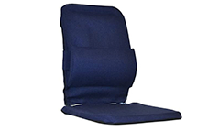
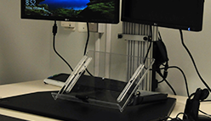

Dexterity Solutions
Dexterity accommodations may include:
Alternative keyboards, input devices, and voice recognition software
Back / seat support
Positioning tools such as document holders, monitor arms, and keyboard trays
Telephone headsets
Notes:
Some of the most commonly requested and frequently provided tools include input devices such as alternative keyboards and pointing devices. These will allow individuals with conditions that impact the fingers, hands, wrists, arms, or shoulders to use input devices that can be adjusted to meet their needs. For individuals whose conditions makes it difficult to use a keyboard and mouse, voice recognition software will allow individuals to use their voice to control the computer.
For individuals who have a condition that requires additional support while seated in their office chair, CAP can provide chair inserts such as lumbar supports and seat cushions.
Positioning tools such as document holders, monitor arms, and keyboard trays can assist in creating an adjustable workstation tailored to an individual’s specific needs. For example, if an employee is 5 feet tall with a shoulder condition is working at tall desk, they would need to reach up and forward to access the keyboard and mouse. A keyboard tray would attach to the employee’s existing desk enabling input devices to adjust to a comfortable height and distance, reducing the strain on their shoulder throughout the day.
Telephone headsets can also be beneficial for individuals with dexterity conditions that are required to use the phone throughout the day. A telephone headset would allow the individual to speak on the phone hands-free and eliminate the need to cradle the headset between the ear and shoulder. For individuals who need a headset for the phone and the computer, CAP can also provide switchboxes to allow for the usability of the same headset for both devices.

Slide 20

Blind/Low Vision
What are Vision Conditions?
Vision conditions:
Impact the ability to see, either partially or completely.
Conditions may include glaucoma, cataracts, macular degeneration, retinopathy or total blindness.
Limitations could include blurriness, blind spots, floaters, tunnel vision or any other visual disturbances.
Notes:
Vision conditions impact the ability to see, either partially or completely. Vision limitations can include diagnosed conditions such as glaucoma, diabetic retinopathy, macular degeneration, cataracts and legal or complete blindness. These conditions may impact an individual’s ability to complete the essential functions of their job.

Slide 21



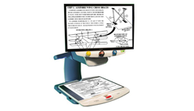
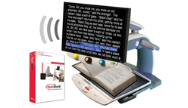
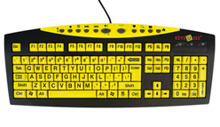
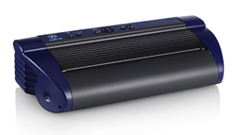
Blind/Low Vision Solutions
Vision accommodations may include:
Screen readers
Magnification software
Closed circuit televisions (CCTVs)
Notetakers
Scanner / readers
Large print keyboards
Braille displays / braille embossers
Notes:
Commonly requested and provided tools to support individuals who are blind or have low vision. For individuals who are blind or do not rely on their vision may use tools such as screen readers, which take all information coming from the computer in a visual format and converts it to speech output. Braille displays, which provide the computer’s output in three dimensional Braille. Scanner/Readers, which, as the name suggests, will scan a hardcopy document and read the information aloud.
For individuals who have low-vision, screen magnification allows for custom adjustment of information on the screen is displayed adjustments include magnification, color contrast, pointer and cursor finders, multiple viewing options, and option to have the information read aloud. For hardcopy documents, portable and desktop CCTVs may assist by displaying the information from a hardcopy on a screen which can then be adjusted through magnification and color contrast. Large print keyboards with varying color contrast options may assist individuals who are not touch-typists with finding the correct keys on their keyboard.

Slide 22

Deaf/ Hard of Hearing
What are Hearing Conditions?
Hearing conditions:
Impact the ability to hear, either partially or completely.
Conditions may include otosclerosis, tinnitus, and deafness.
May cause limitations resulting in difficulty hearing certain volumes, tones or frequencies, ringing in the ears, or the inability to hear anything at all.
Notes:
Hearing conditions impact the ability to hear, either partially or completely. Limitations can include difficulty in hearing certain volumes, tones or frequencies, ringing in the ears, or the inability to hear anything at all.

Slide 23
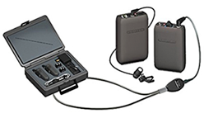
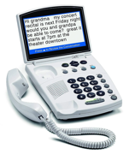

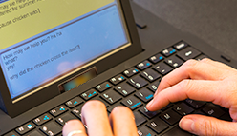
Hearing Solutions
Hearing accommodations may include:
Assistive listening devices such as Frequency Modulation (FM) systems
Telephone access through videophones, captioned telephones, or amplified telephones
Clear masks
Deaf-to-Hearing communication devices
Notes:
Accommodations for people with differing levels of hearing loss may include assistive listening devices for use in one-on-one conversations or in conference rooms. These might be used in place of prescribed hearing aids or may be used along with the hearing aids. Can also provide video telephones so that users of American sign language can communicate easily and naturally in their native language. CAP is also able to provide clear masks and deaf-to-hearing communication devices.

Slide 24

Cognition
What are Cognitive Conditions?
Cognitive conditions:
Include any disorder that significantly impairs the cognitive function of an individual.
May include dyslexia, attention deficit hyperactivity disorder (ADHD), multiple sclerosis, stroke, Alzheimer's disease, and traumatic brain injury (TBI).
Limitations could include memory loss, decreased organization, decreased concentration, word finding difficulty, or orientation difficulty.
Notes:
Cognition and learning disabilities may be related to diagnoses such as ADHD, dyslexia, PTSD, or TBI. Individuals with limitations relative to cognition may experience issues with short-term memory, organization, executive functioning skills, and limitations in the ability to communicate both expressively and receptively in written language.

Slide 25
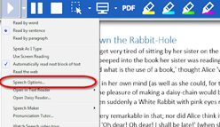

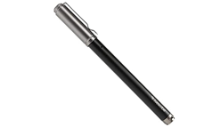
Cognition Solutions
Cognitive accommodations may include:
Cueing and memory aids
Literacy software
Noise cancelling headsets
Recording devices such as pens and digital voice recorders
Notes:
Accommodations for individuals experiencing cognition difficulties may include digital pens and recorders to help with memory recall, literacy software, which can provide varying levels of assistance in both expressive and written language, or noise canceling headsets to aid in concentration when working in noisy environments.

Slide 26
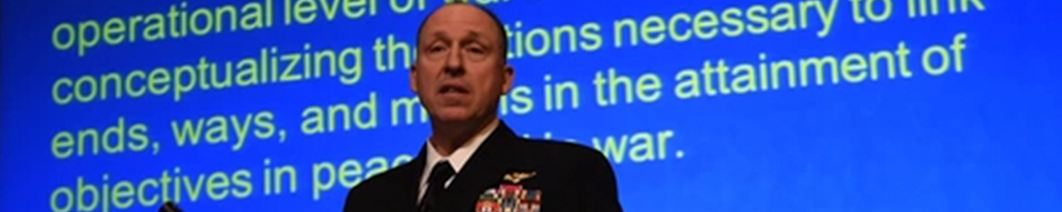
Communication
What are Communication Conditions?
Communication conditions:
Impact an individual's ability to communicate
May include apraxia or voice disorders
Limitations may include the inability to amplify the volume of speech or being non-verbal
Notes:
Communication limitations may impact the way in which a speaker’s voice is perceived and understood. Individuals with limitations relative to communication may experience difficulty amplifying their voice to a volume that can be heard by others or the inability to speak at all.

Slide 27
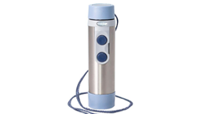
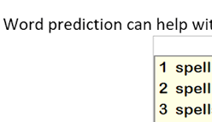
Communication Solutions
Communication accommodations may include:
Voice amplification devices
Word prediction software
Augmentative communication devices
Notes:
Some of the most commonly requested accommodations include voice amplifiers and augmentative communication devices for people who have difficulties in generating speech, as well as word prediction software for individuals who have difficulty with word finding.

Slide 28

Budget
Budget
CAP complies with organization cutoff dates and acquisition timelines in accordance with Federal Acquisitions Regulations (FAR).
CAP Annual Budget Highlights
01 OCT - 30 SEP: Annual Fiscal Year (FY) budget
NOV: Generally new FY funding becomes available
JUN/JUL: Acquisition cut off dates occur to ensure proper budget closeout
Notes:
We included a slide to help customers understand how CAP’s budget works. CAP complies with Federal Acquisition Regulations and this puts some constraint on our program as we work to meet budget timelines.
• CAP’s budget adheres to the federal FY budget (01 OCT- 30 SEP)
• Funding generally becomes available in November (or when the next FY budget is approved)
• ACQ cut-off dates occur JUN/JUL timeframe

Slide 29

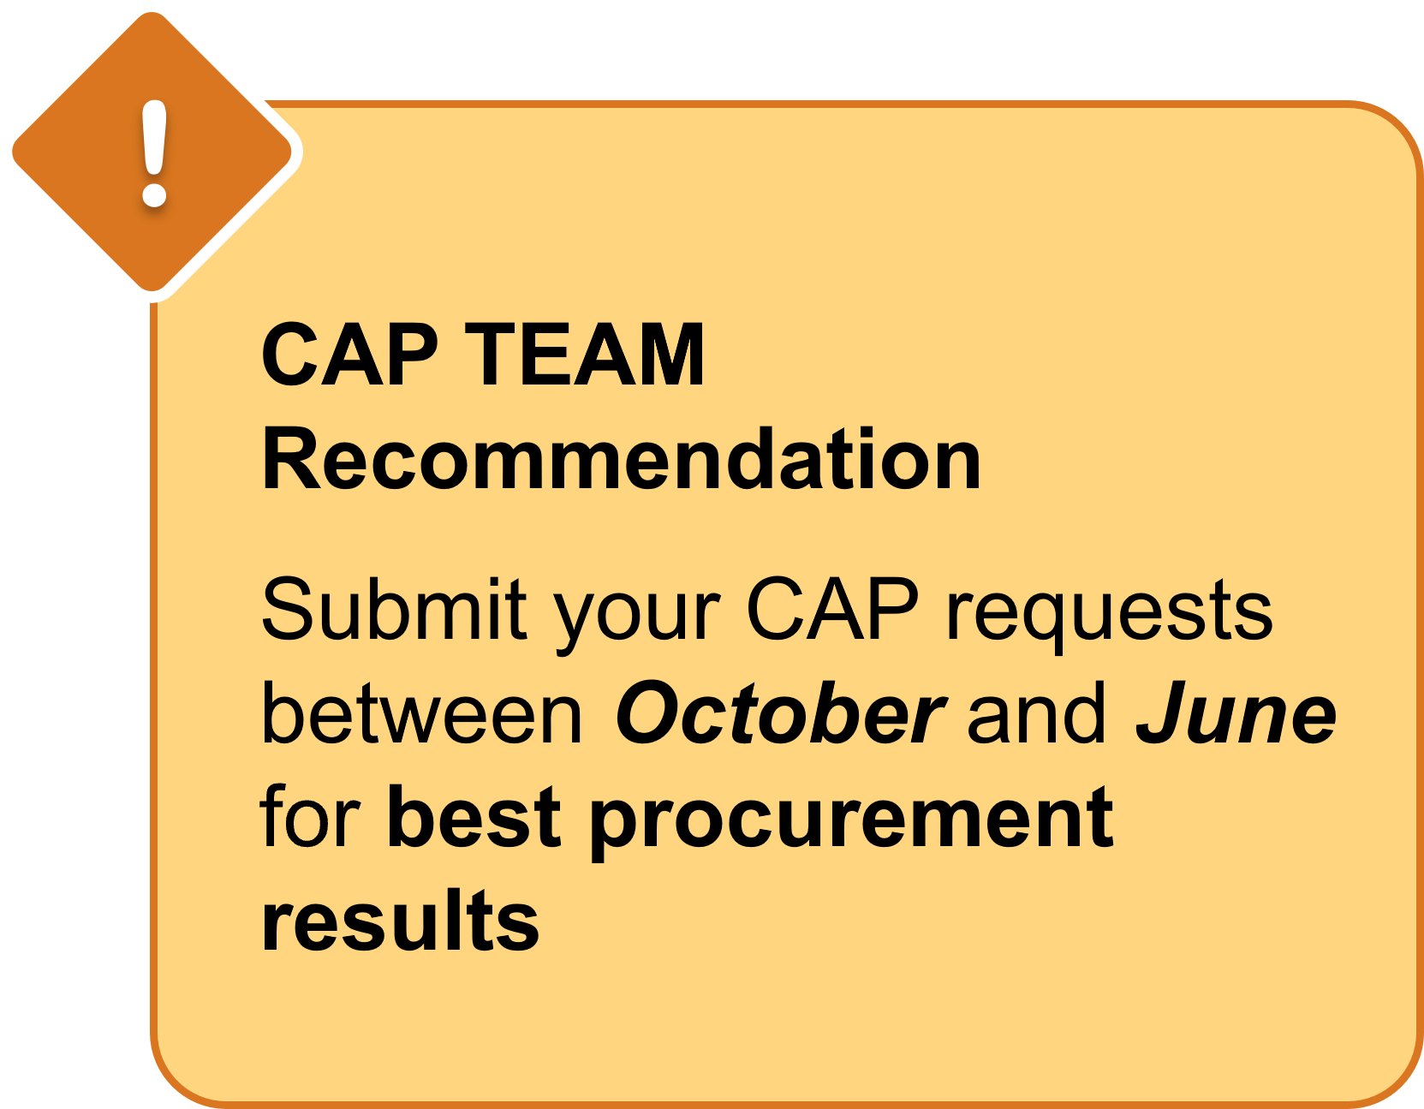
Best Practice
CAP accepts requests at all times.
Timing of the request may impact approval and delivery.
Notes:
Even though CAP has some fiscal timeline constraints, CAP accepts AT requests throughout the year
The timing of the request and sometime supply chain issues may contribute to delivery delays
The best time to submit a CAP request is from October through June

Slide 30

CAP resources
Notes:
CAP has developed some resources to help our partners and customers to better access our services and increase their knowledge regarding reasonable accommodations.

Slide 31
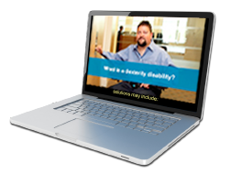
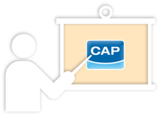


CAP Resources www.cap.mil
CAP’s Online Training Modules
We have developed a series of online training modules. Learn about disability etiquette, reasonable accommodations, how to work with CAP and challenges in employment.
CAP’s Quick Tips
CAP has created a series of short videos to help answer some of our customer’s most frequently asked questions.
CAP has recorded a series of webinars to share the CAP training experience with our customers and stakeholders around the world. To see newly recorded webinars and a list of upcoming topics, please visit our website.
CAP’s Webinars
Request CAP at Your Event
CAP may be able to come to your location to provide briefings, trainings, and needs assessments. Please visit the Training & Outreach section of our website to request CAP's attendance.
Notes:
CAPs online training modules include information for managers/supervisors, employees, and agency points of contact. CAP’s Quick Tips are designed to help help our customers have an easier and more seamless experience in submitting their CAP requests.
Quick Tip topics include eligibility for CAP services, how to find your serial number when requesting a software upgrade, needs assessments, choosing the correct delivery address, and accommodations that are outside CAP’s scope.
CAP has also developed webinars and training on topics such as accommodating people with ADHD and anxiety, medical documentation, accommodating the aging workforce, and disability etiquette.
Please keep in mind that we recently updated our website to allow for a better customer experience. As we work to implement all of the updates, the resources listed may be found on CAP’s youTube channel. The link will be provided on the following slide.

Slide 32




Connect with CAP
Facebook
www.facebook.com/DoDCAP
Twitter
www.twitter.com/DoDCAP
YouTube
www.youtube.com/TheDoDCAP
Instagram
www.instagram.com/dod_cap
Notes:
CAP is on social media.
Follow us on Facebook, Twitter, and Instagram for information on special events and observances, and news regarding CAP and reasonable accommodations.
Visit CAP’s YouTube page to see demonstration videos of assistive technologies

Slide 33

CAP Contact Information
Phone: 703-614-8416
833-227-3272
Videophone: 571-384-5629
Email: cap@mail.mil
Website: www.cap.mil
CAPTEC
Phone: 703-693-5160
Email: cap.captec@mail.mil
cap.outreach@mail.mil
Notes:
CAP is accessible. Even though CAP employees are still primarily on telework, our telephone, toll-free number, and videophone are answered. Monday through Friday from 8 AM to 4:30 PM Eastern time.
You can email CAP or visit our website at any time. CAP’s Technology & Evaluation Center (CAPTEC) in the Pentagon is currently open by appointment on Mondays and Wednesdays. However, you can email CAPTEC at any time and voice messages left at the CAPTEC number are checked and returned at least daily.

Slide 34
Additional CAP Briefs
Go to www.cap.mil to request a brief for your organization!
CAP Briefs and Lunch and Learn Topics
  Introducing CAP’s New Website!
  Assistive Technology Overview
  CAP Needs Assessments Overview
  CAP Video Tutorial Series: Account Registration and Request Submission, Requesting CAP at your Event, and live Q&A session!
Send us an email to cap.outreach@mail.mil add your name to CAP’s Lunch and Learn series
Notes:
In support of National Disability Employment Awareness Month, CAP is offering lunch and learn series throughout the month of October. After October, CAP will continue to offer Lunch and Learn events.
.
If you would like to request a briefing for your organization, visit cap.mil and submit an event request.
*Note, this slide can be updated each month with upcoming CAP events

Slide 35
QUESTIONS?
Notes:
Does anyone have any questions?

Slide 36

Current and Upcoming Meetings
OCTOBER
MONDAY
TUESDAY
WEDNESDAY
THURSDAY
10/2/2023
10/3/223
11:00 AM – 12:00 PM
Rethinking Disability and What It Means to Be Disabled
Dr. Theresa Haskins Haskins Consulting
1:00 PM – 2:00 PM
(Neuro) Diversity Includes You
Dr. Theresa Haskins Haskins Consulting
10/3/2023
10/4/2023
10/5/2023
10:00 AM – 11:00 AM
USDA TARGET Center Assistive Technology Program
Rashida Owens
Assistive Technology Program Manager
12:00 PM – 1:00 PM
USDA TARGET Center
Ergonomics Program
Stephanie Bradley
CEAS, CAE
Ergonomics Program Manager
11:00 AM – 12:00 PM
Nurturing Workplace Well-Being and Supporting Mental Health (Part 1 of 2)
Dr. Theresa Haskins
Haskins Consulting
1:00 PM – 2:00 PM
PTSD Is More Common Than You Think
Alla Weinberg
Spoke & Wheel
10:00 AM – 11:00 AM
Empowering Lives Through Assistive Technology Solutions
Donny Osborn
Boundless AT
12:00 PM – 1:00 PM
Department of Defense Computer/Electronic Accommodations Program (CAP)
Erin Sanderson
CAP
HOLIDAY
10/10/2023
10/11/2023
10/12/2023
11:00 AM – 12:00 PM
Autism Inclusion and the Pathway to Neurodiversity
Dr. Theresa Haskins Haskins Consulting
1:00 PM – 2:00 PM
Lessons from Unpredictable Journeys: Insights from Temporary and Situational Disabilities (Part 1 of 2)
Dr. Theresa Haskins Haskins Consulting
11:00 AM – 12:00 PM
Creating a
Trauma-Informed Workplace
Alla Weinberg
Spoke & Wheel
1:00 PM – 2:00 PM
Nurturing Workplace Well-Being and Supporting Mental Health (Part 2 of 2)
Dr. Theresa Haskins Haskins Consulting
10:00 AM - 12:00 PM
USDA TARGET Center
Ergonomics Demonstrations
(Virtual/Onsite)
Stephanie Bradley
CEAS, CAE
Ergonomics Program Manager
Stephen DiCarlo
Humanscale
Howard Flowers
BodyBilt
1:00 PM - 3:00 PM
USDA TARGET Center Assistive Technology Demonstrations
(Virtual/Onsite)
Rashida Owens
Assistive Technology Program Manager

Slide 37
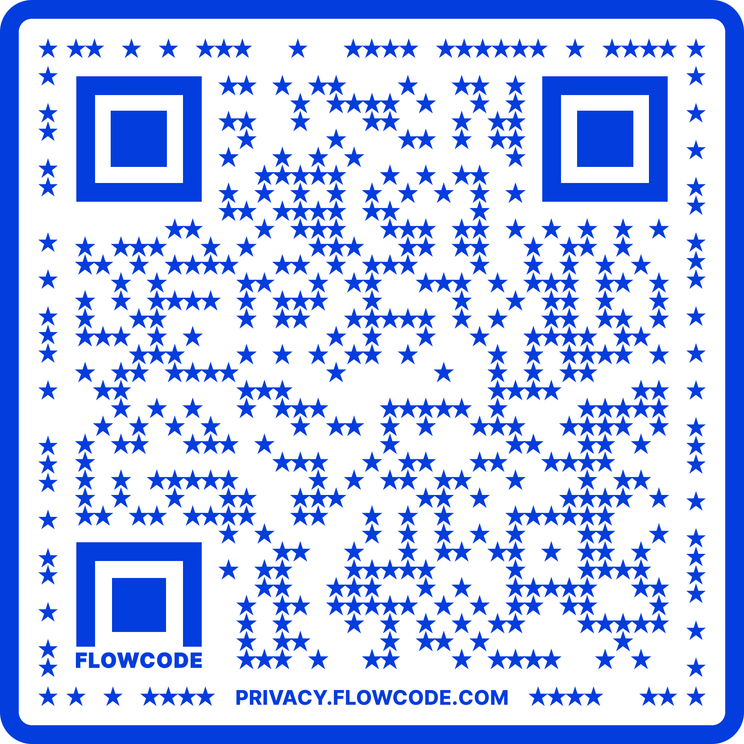
Contact Information
TARGET Center Website
https://www.usda.gov/target-center
TARGET Center Email
target-center@usda.gov
TARGET Center Phone Number
(202) 720-2600

