Slide 1

Proper Posture in the Workplace
To Prevent Work-Related Problems
DC, DHA
Founder of the American Posture Institute
National Disability Employment Awareness Month Symposium | 2023 USDA TARGET Center

Slide 2

Advancing Access & Equity

Slide 3
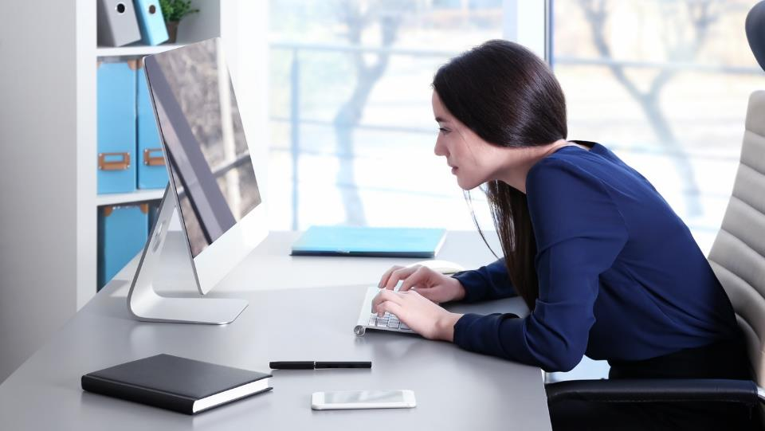
Check Your Posture Right Now
Posture Check
  Are your ears in front of your shoulders?
  Are your shoulders slouched forward?
  Are you looking down at your computer screen or device?
  Are you crossing your legs?
  Are you fidgeting to stay comfortable?

Slide 4
Posture Challenge
Proper Posture
  Sit up as if a string is pulling the top of your head toward the ceiling
  Pull head back with the ears aligned over the shoulders
  Shoulders back
  Shoulders stacked over the hips
  Neutral position of the hips and low back
  Both feet on the ground with the feet pointed forward

Slide 5

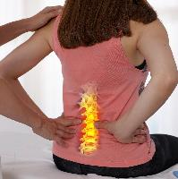
DID YOU KNOW?
73% of university students present with forward head posture
  (Singh, Kaushal, & Jasrotia, 2020)
>70% of school aged children present with moderate to severe forward head posture
  (Chandoliya, Chorsiya, & Kaushik, 2021)
80% of people will experience back pain at some point in their life
  (Wolrd Health Organization, 2010)
*Disclaimer: This is not medical advice. Please consult your physician for emergencies, instability, or if you are not feeling well. Perform these Posture Tips with caution and stop immediately if you are in pain.

Slide 6

The Impact of Abnormal Working Postures
49%
of employees working from home reported neck and head pain
45%
of employees working from home reported low back pain
62%
of employees working from home reported upper back and shoulder pain
(KOTOWSKI ET AL., 2022)

Slide 7
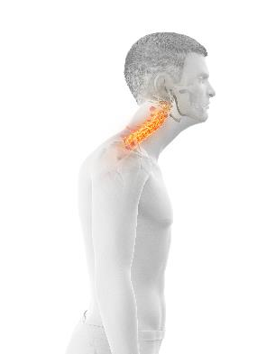
If You…
Have had neck pain or back pain
Felt stiff when you wake up in the morning
Fidgeted to stay comfortable while working
Slouched while working from your devices
Have a sedentary occupation
Wondered if your posture is in
proper alignment

Slide 8
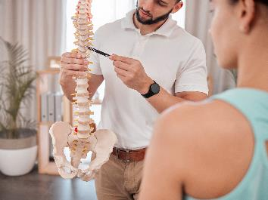
…then this Workshop is for You!
What is posture?
The Posture Health Connection
How can postural distortion patterns cause pain and dysfunction?
Proper posture in the workplace
5 posture exercises to prevent neck and back pain and disability at work

Slide 9
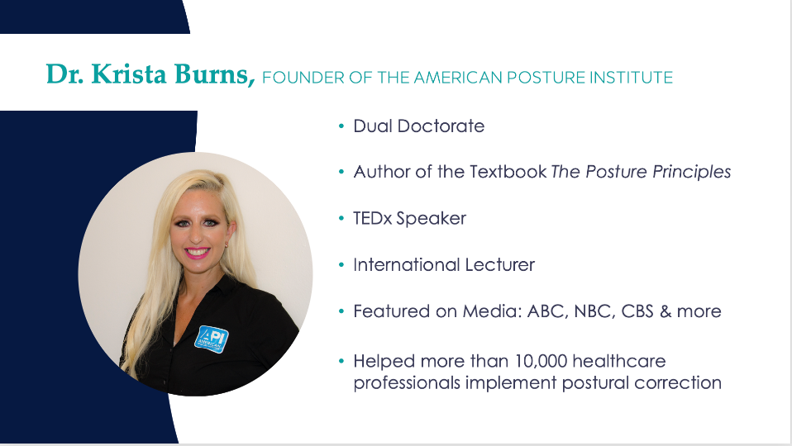
No Slide Title

Slide 10

We are on a Mission to Reverse Postural Decline in the Digital Age

Slide 11

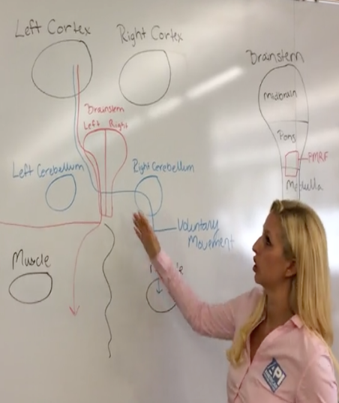
From Injured to Inspired

Slide 12
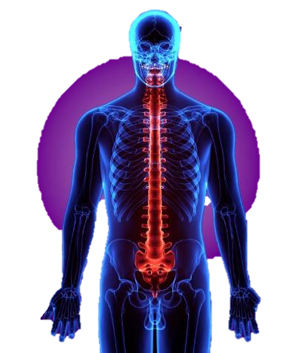
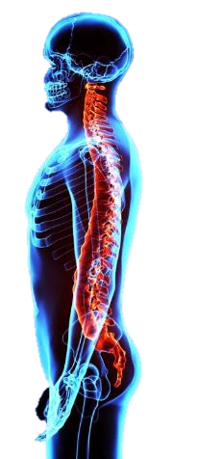
What is “Posture?”
Posture is the structural framework of your body to protect the integrity of your inner organs and nervous system and to resist gravity in an upright position while static or moving
2 Components of Posture
  Orientation
  Stabilization

Slide 13
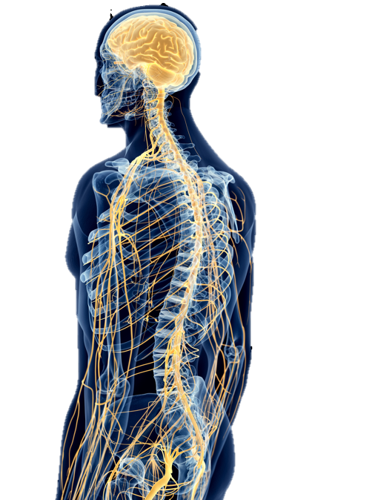
Communication Between Brain and Body
The brain is the master control center of the body
Proper posture allows better communication between the brain and the body so your body can balance, move, and function better

Slide 14
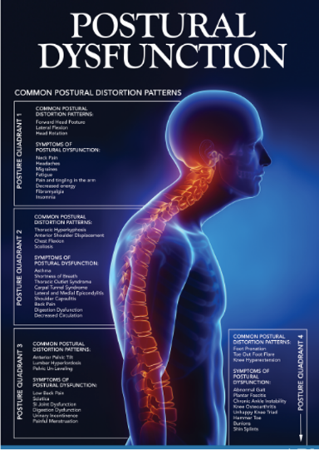
The Posture Health Connection
4 Posture Quadrants of the Body
  Proper posture supports optimal function of the posture quadrants
  Postural distortion patterns disturb the function of the posture quadrants
Neurologic Integration
  Proper posture sends appropriate neurologic input to the brain for better neural integration and optimal motor output
  Postural distortion patterns disrupt neurologic input to the brain resulting in altered neural integration and poor motor output

Slide 15

Feel the Posture
Health Connection
Try this with me
Take a breath in slumped posture
Take a breath in proper posture
Do you feel a difference with
your breathing?
Proper posture helps your body instantly function better

Slide 16
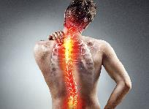
Posture & Neck Pain
The Relationship Between Forward Head Posture and Neck Pain: A Systematic Review and Meta-Analysis
Adults with neck pain show increased forward head posture when compared to asymptomatic adults and that forward head posture is significantly correlated with neck pain measures in adults and older adults.
Mahmoud, N. F., Hassan, K. A., Abdelmajeed, S. F., Moustafa, I. M., & Silva, A. G. (2019). The relationship between forward head posture and neck pain: a systematic review and meta-analysis. Current reviews in musculoskeletal medicine, 12(4), 562-577.

Slide 17

Posture & Low Back Pain
Non-specific Low Back Pain and Postural Control During Quiet Standing—A Systematic Review
The results show that persons with and without non-specific LBP differed in several parameters of postural control such as the center of pressure displacement, postural control strategy, and muscle activation patterns.
The combination of neuromuscular and biomechanical parameters was associated with the disability of postural control in individuals with LBP during standing.
Koch, C., & Hänsel, F. (2019). Non-specific low back pain and postural control during quiet standing—A systematic review. Frontiers in psychology, 10, 586.

Slide 18

Posture & Human Function
The Impact of the Position of the Head on the Functioning of the Human Body: A Systematic Review
The position of the head has a significant effect on the human body. Research findings show that abnormal head position changes affect muscle activity, proprioception, the pattern of breathing, and neck pain.
Szczygieł, E., Fudacz, N., Golec, J., & Golec, E. (2020). The impact of the position of the head on the functioning of the human body: a systematic review. Int J Occup Med Environ Health, 33(5), 559-568.

Slide 19
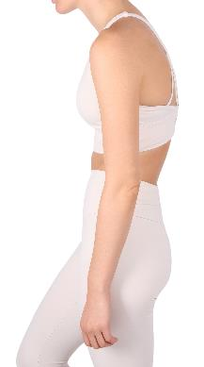
Posture & Respiration
Effect of Forward Head Posture on Thoracic Shape and Respiratory Function
Forward head posture causes expansion of the upper thorax and contraction of the lower thorax, and these morphological changes cause decreased respiratory function.
Koseki, T., Kakizaki, F., Hayashi, S., Nishida, N., & Itoh, M. (2019). Effect of forward head posture on thoracic shape and respiratory function. Journal of physical therapy science, 31(1), 63-68.

Slide 20
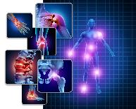
Posture & Fibromyalgia
Trunk position sense, postural stability, and spine posture in fibromyalgia
Women with FMS had poor trunk position sense and postural instability, and alterations in spine posture. Therefore, the training of trunk position sense, postural stability, and posture might be beneficial and, thus, should be considered while planning an optimal treatment.
Toprak Celenay, S., Mete, O., Coban, O., Oskay, D., & Erten, S. (2019). Trunk position sense, postural stability, and spine posture in fibromyalgia. Rheumatology international, 39(12), 2087-2094.

Slide 21
Postural Distortion Patterns
Postural Distortion Patterns can impact your health
  Neck pain
  Headaches
  Jaw pain
  Back pain
  Hip pain
  Carpal Tunnel Syndrome
  Balance deficits
  Respiration dysfunction
  Muscle tension
  Mood
  Depression

Slide 22
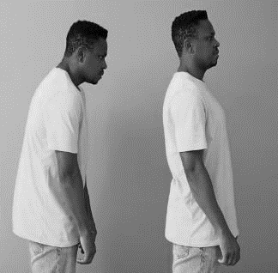
Have You Experienced Any of These Symptoms?
Posture Quadrant 1
Posture Quadrant 2
Lateral or Medial Epicondylitis
Respiration Dysfunction
Thoracic Outlet Syndrome
Carpal Tunnel Syndrome
Asthma
Upper Back Pain
Decreased Circulation
Shoulder Pain
Neck Pain
Headaches
Migraines
Fatigue
Jaw Pain
Pain and Tingling in the Arms
Fibromyalgia
Poor Balance
Posture Quadrant 3
Posture Quadrant 4
Low Back Pain
Sciatica
Sacroiliac Joint Dysfunction
Hip Pain
Digestion Dysfunction
Urinary Incontinence
Pelvic Floor Weakness
Gait Abnormalities
Plantar Fasciitis
Chronic Ankle Instability
Knee Osteoarthritis
Shin Splints

Slide 23

Posture Challenge - Check Your Posture
Posture Check
  Were you able to maintain proper posture?
  Did you go back into a slouched position?
  Are you fidgeting to stay comfortable?
If you cannot maintain proper posture, you likely have
postural distortion patterns

Slide 24
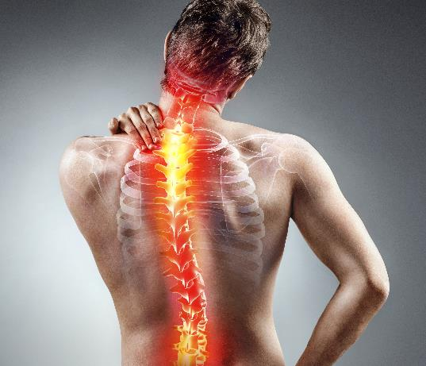
Long-Term Consequences if Postural Distortion Patterns are
Not Corrected
Spinal degeneration
Chronic pain
Increased stress
Neurologic deficits
Disability function

Slide 25
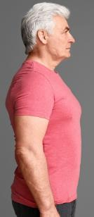

The Posture Health Connection.
Proper Posture
More resilient to stress
Less pain
Proper breathing
Better balance
Better mood
Postural Dysfunction
More stress
Increased pain intensity
Respiration dysfunction
Postural instability
Depressed mood

Slide 26
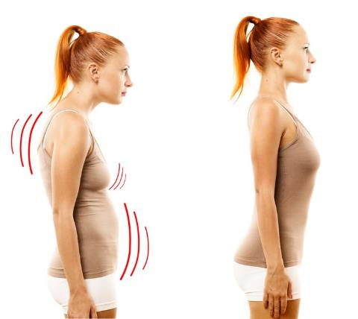
Proper Posture is Good for Your Health
Proper posture helps you instantly:
  Look better
  Move better
  Feel better
So you can LIVE BETTER

Slide 27
Posture Embodies How You Feel
What posture do you have when you are happy vs. sad?
Upright Posture
  “Upright” posture = “Uplifted” mood
  Power Posture
Slumped Posture
  “Depressed” posture = Feeling “Down”
  Closed posture is associated with less stress resilience

Slide 28

Lift Up to Feel Uplifted

Slide 29

Power Posture

Slide 30
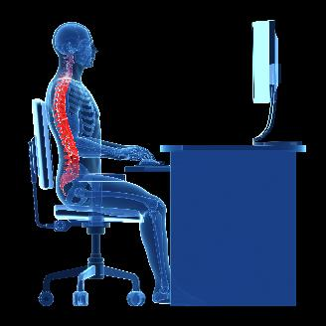
Proper Posture in the Workplace.
Proper Posture
  Helps prevent musculoskeletal pain
  Helps prevent workplace injuries
  Improved workplace confidence
  Helps you stay focused
  Makes you more stress resilient
  Helps you breathe and balance better

Slide 31
What Causes
Postural Distortion Patterns?

Slide 32

Modern Risk Factors for Postural Distortion Patterns
Sedentary lifestyle
Too much time slumped while using devices
Inadequate amount of physical activity
Poor ergonomic design

Slide 33

Who is Susceptible to Postural Distortion Patterns?
People who have suffered physical trauma
Sedentary workers
Children and adults who spend a lot of time using tech devices
Athletes who perform repetitive motions
Elderly adults

Slide 34
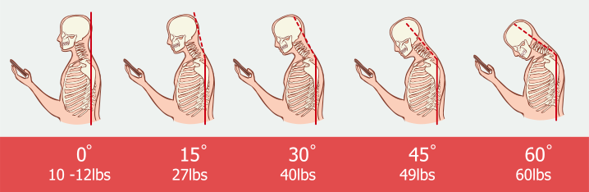
What is “Tech Neck?”
Forward head posture from looking down at devices for prolonged periods of time
  Can be a painful condition of the spine
  As the head goes forward, the amount of pressure on the neck increases

Slide 35

Have a Yearly Posture Assessment Performed with Posture Imaging

Slide 36

Exercises for Proper Posture at Work
Reverse posture exercises to prevent postural distortion patterns
36

Slide 37


Have an Active Workspace
POSTURE EXERCISE #1:
Keep moving throughout
your workday
Sit on an exercise ball or
posture cushion

Slide 38
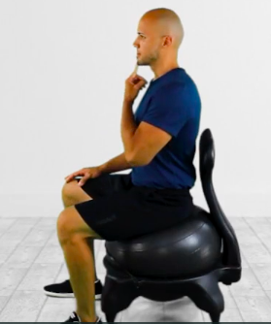
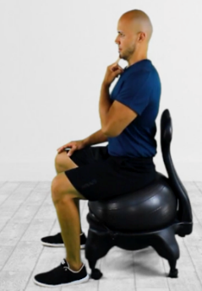
Perform Neck Retractions
POSTURE EXERCISE #2:
Keep your eyes forward and parallel to the ground
Place one finger on your chin
Retract your head back so your ears are aligned over your shoulders
Perform 5 repetitions and hold for 10 seconds each

Slide 39
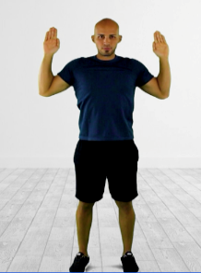
Perform Posture Angel Exercises
POSTURE EXERCISE #3:
Keep your eyes forward and parallel to the ground
Flatten your spine
Lower your arms feeling a pull of the muscles between your scapulae
Hold for 10 seconds, perform 5 repetitions

Slide 40
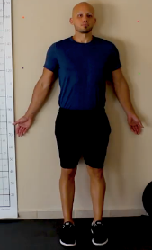
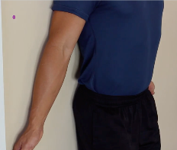
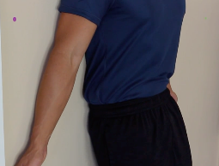
Perform
Pelvic Tilts
POSTURE EXERCISE #4:
Stand with your back flat against the wall or sit with your back flat against the chair
Tilt your hips forward with an arch in your spine
Flatten your spine against the wall or chair
Localize the movement to your hips, not your legs
Perform 5 controlled repetitions

Slide 41
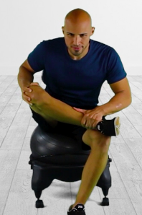
Perform the
Figure 4 Stretch
POSTURE EXERCISE #5:
Sit with your back straight, eyes looking straight forward, and place your ankle over the opposite knee
Inhale, as you exhale slowly lower your chest towards your lap keeping your back straight
Repeat for 5 respirations

Slide 42

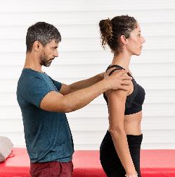
Perform these Exercises to Have Better Posture
These 5 exercises will help you have better posture instantly

Slide 43

Make your posture a priority
To look better, feel better, move better, and work safer

Slide 44
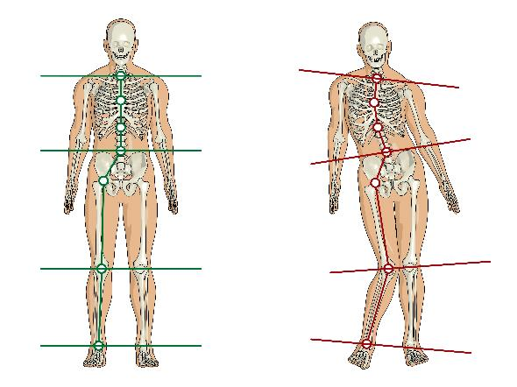
Your Posture is the Foundation of Your Health

Slide 45
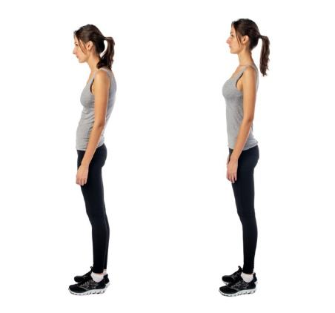
Your Posture is Your First Impression
A
B
Which posture do you prefer?
(A or B)
Do you prefer to look healthy, pain free, and more positive?

Slide 46

Postural
Correction is Our Specialty
www.AmericanPostureInstitute.com
Facebook.com/AmericanPostureInstitute
@AmericanPostureInstitute

Slide 47
Posture by Design,
Not by Circumstance

Slide 48

Contact Information
TARGET Center Website
https://www.usda.gov/target-center
TARGET Center Email
target-center@usda.gov
TARGET Center Phone Number
(202) 720-2600

Slide 49

Current and Upcoming Meetings, cont.
OCTOBER
MONDAY WEDNESDAY
THURSDAY
TUESDAY
10/16/2023
11:00 AM – 12:00 PM
USDA TARGET Center
Accessible Communications
Program
Nancy Frohman
Accessible
Communications
Program Manager
1:00 PM – 2:00 PM
USDA TARGET Center
Education Program
Michelle Sherbondy
Education Program Manager
10/17/2023
11:00 AM – 12:00 PM
Unmasking Hidden Challenges: Chronic Conditions in the Workplace
Dr. Theresa Haskins Haskins Consulting
1:00 PM – 2:00 PM
Equity, Accessibility, and Inclusion in the Workplace (Part 1 of 2)
Dr. Theresa Haskins Haskins Consulting
10/18/2023
10:00 AM – 11:00 AM
Ergonomic Equity: Addressing Risk Factors Through Job Analysis and Prevention
Sandra Miller
Britroix
12:00 PM – 1:00 PM
Digital Accessibility Fundamentals for Websites, Documents, and Video
Mike Caprara
The Viscardi Center
10/23/2023
11:00 AM – 12:00 PM
Emotional Intelligence (Part 1 of 2)
Carolyn Owens,
MCC, SPHR
1:00 PM – 2:00 PM
Proper Posture in the Workplace to Prevent Posture-Related Problems (Part 1 of 2)
Dr. Krista Burns
American Posture Institute
10/24/2023
11:00 AM – 12:00 PM
Thriving with ADHD at Work
Dr. Theresa Haskins Haskins Consulting
1:00 PM – 2:00 PM
Equity, Accessibility, and Inclusion in the Workplace (Part 2 of 2)
Dr. Theresa Haskins Haskins Consulting
10/25/2023
10/26/2023
10:00 AM – 11:00 AM
Assistive Technology at New Heights
Dr. Wayne Crolley
Novare Products, LLC
10/25/2023
10:00 AM - 12:00 PM
USDA TARGET Center
Accessible Communications Demonstrations
(Virtual/Onsite)
Nancy Frohman
Accessible Communications
Program Manager
1:00 PM - 3:00 PM
USDA TARGET Center
Education Demonstrations
(Virtual/Onsite)
Michelle Sherbondy
Education Program Manager

