Slide 1
Submitting Claims and Reports
GM 301
Transforming Financials at the People’s Department
Version 1.0

Slide 2

Agenda
Transforming Financials at the People’s Department
Course Introduction
Module 1 – Creating and Submitting Claims
Module 2 – Submitting Reports
Course Summary

Slide 3

Introduction
Transforming Financials at the People’s Department
Name
Role
Training Purpose

Slide 4

Course Objectives
Transforming Financials at the People’s Department
After completing this course, you will be able to:
Summarize the ezFedGrants claims creation and submission process
Describe the process for submitting and approving reports in ezFedGrants
Navigate to and within ezFedGrants system

Slide 5
Agenda
Transforming Financials at the People’s Department
Course Introduction
Module 1 – Creating and Submitting Claims
Module 2 – Submitting Reports
Course Summary

Slide 6
Objectives
Transforming Financials at the People’s Department
After completing this module, you will be able to:
Describe the ezFedGrants claims creation process
Describe the ezFedGrants claims submission process
Explain the functionality, goals and benefits of ezFedGrants

Slide 7
Creating and Submitting Claims
Transforming Financials at the People’s Department
What’s Needed?
You must have access to ezFedGrants with a user role and permissions to create and/or certify (digitally
sign) claims.
The agreement you are making a claim against must be in Active status.
In order to submit a new claim to your USDA agency, any previously created claims from your organization must have been fully submitted [digitally signed and submitted by the certifying official(s)] to your USDA agency or cancelled.
Any overdue performance and/or financial progress reports must be submitted to your USDA agency before a claim can be submitted.

Slide 8
Creating and Submitting Claims
Transforming Financials at the People’s Department
Helpful Hints
Certain screenshots may display only a portion of the screen. Note that when working within a system, only the center body of the screen will change. The navigation options along the left side of the screen and the header bar across the top of the screen will remain the same.
When submitting a claim, it is recommended to fully review the claim forms, including fields not covered in this presentation, and contact your agency representative if you have any questions.
Note: Data used in this procedure is a representative sample for the purpose of training. Actual data in the system may vary based on agency and scenario.

Slide 9
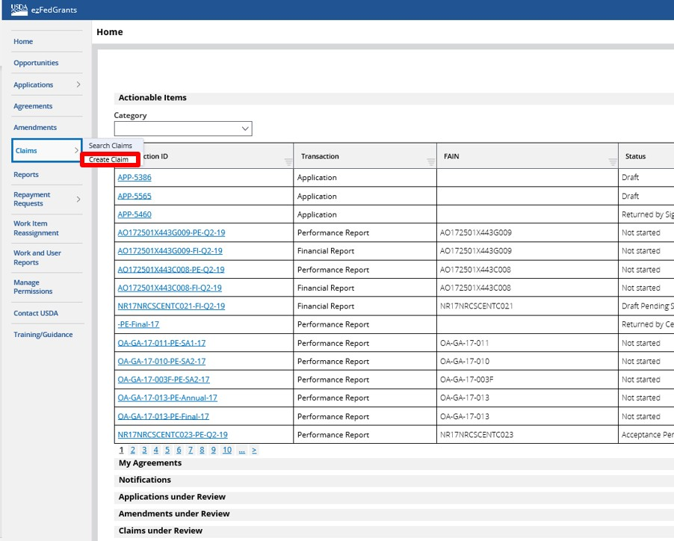
Creating and Submitting Claims
Transforming Financials at the People’s Department
Start by accessing the ezFedGrants Home screen, and select Create Cl
aim.

Slide 10
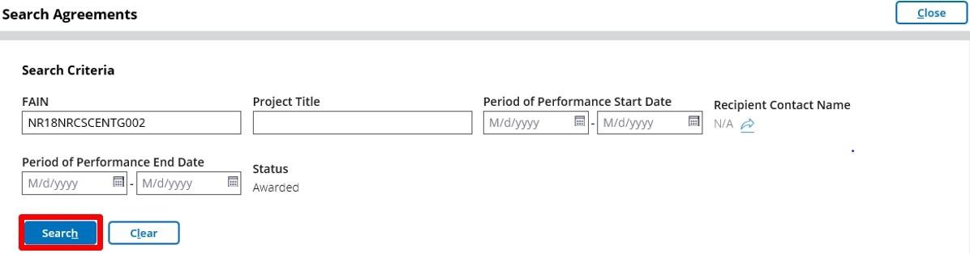
Creating and Submitting Claims
Transforming Financials at the People’s Department
The Search Agreements screen will open. From here you may search for the agreement you would like to make a claim against. To begin, enter information about the relevant agreement in the available Search Criteria fields. Once you have completed all applicable search criteria fields, click the Search button.

Slide 11
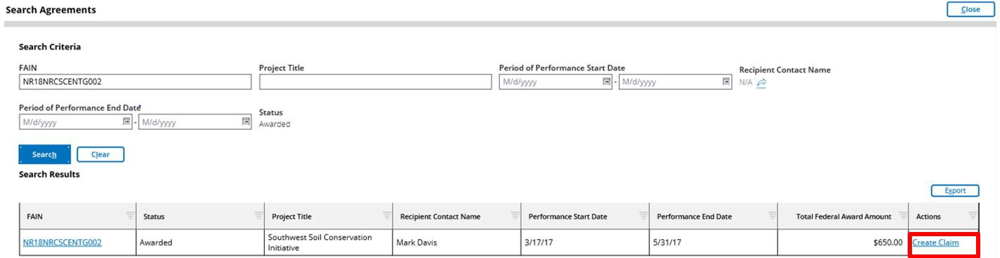
Creating and Submitting Claims
Transforming Financials at the People’s Department
Locate the relevant agreement in the Search Results table and click the Create Claim link to initiate the claim creation process.

Slide 12
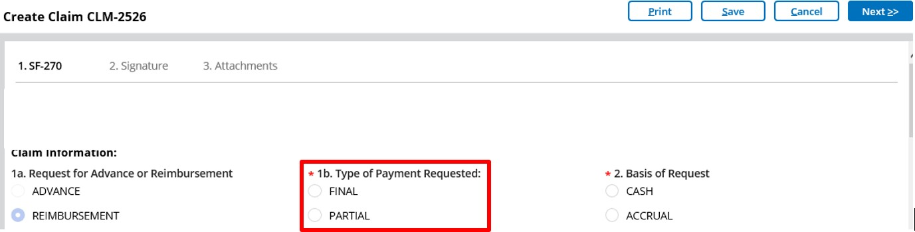
Creating and Submitting Claims
Transforming Financials at the People’s Department
Once the Create Claim screen opens, the SF-270 will appear, prepopulated with information from the initial agreement. Complete the SF-270.
In Box 1 Type of Payment Requested, select either Final or Partial.

Slide 13
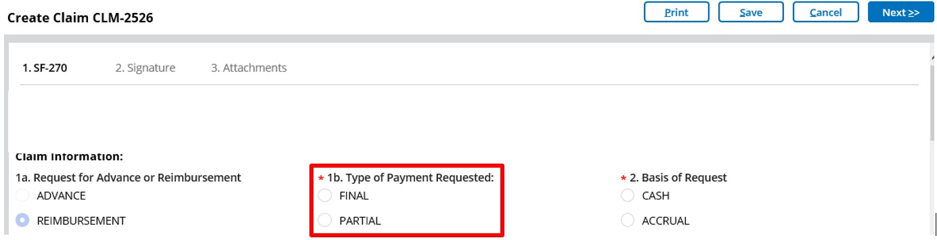
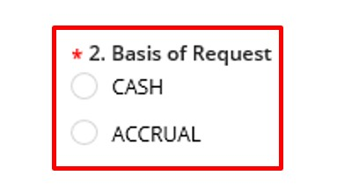
Creating and Submitting Claims
Transforming Financials at the People’s Department
Some fields are pre-populated from the associated agreement and cannot be edited. Grey fields will have auto-populated information or information that is yet to be determined. White fields or option buttons require input.
In Box 2 Basis of Request, select either Cash or
Accrual.

Slide 14
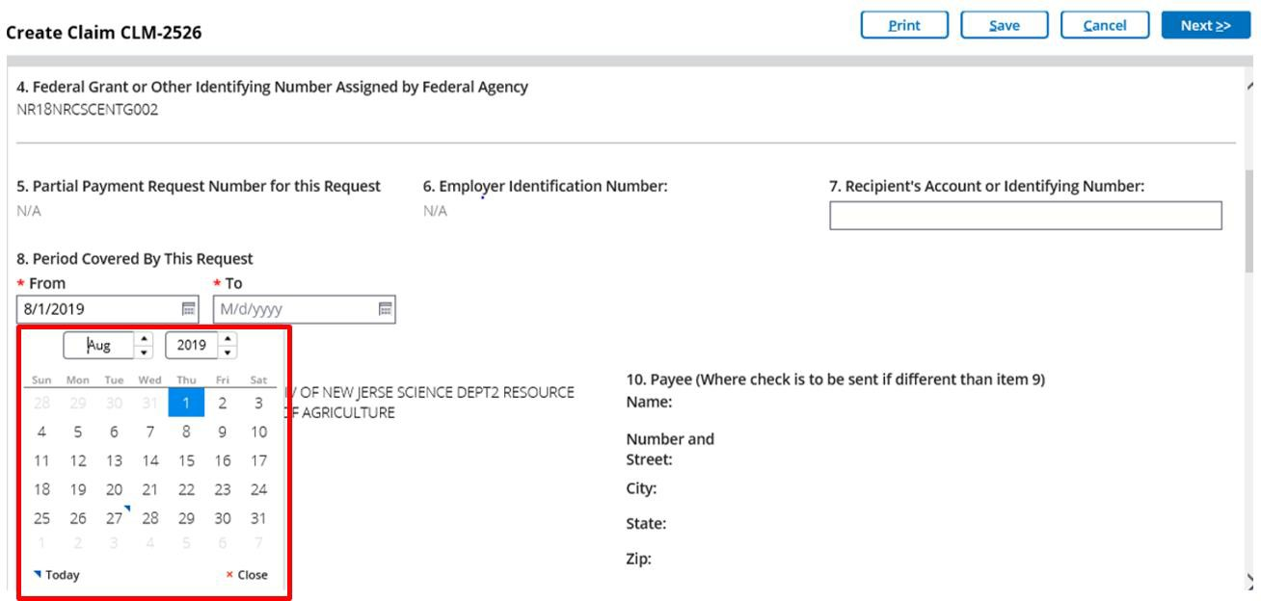
Creating and Submitting Claims
Transforming Financials at the People’s Department
In Box 8 Period Covered by This Request, enter the From and To fields. These dates must fall within the Period of Performance dates for the associated agreement.
Select a date from the calendar (click the Calendar icon in each field) or type the date in MM/DD/YYYY format.

Slide 15
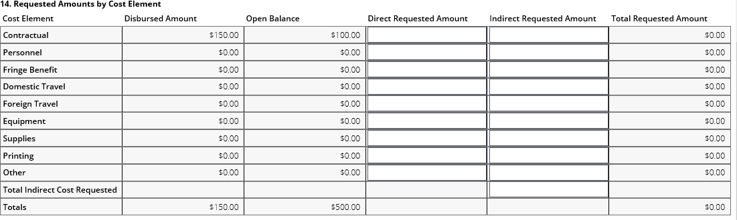
Creating and Submitting Claims
Transforming Financials at the People’s Department
In the Direct Requested Amount column, input relevant values for each Cost Element applicable to this claim.
The amount requested for an individual cost element can exceed the budgeted amount allocated to that line; however, the total amount requested for the entire claim cannot exceed the total amount of funds for the entire agreement.

Slide 16
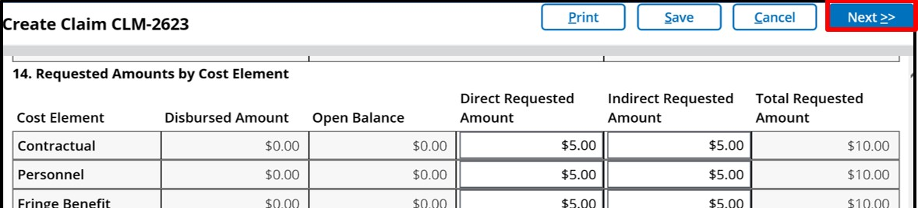
Creating and Submitting Claims
Transforming Financials at the People’s Department
Once you have entered all of the relevant dollar amounts, click the Next button at the top of the screen.

Slide 17
Creating and Submitting Claims
Transforming Financials at the People’s Department
Adding a Signature
The second stage of claim creation is the signature stage. You must select a primary certifying official for this claim. Depending on your agency or organization, a secondary certifying official may or may not be required. Click in the Primary Certifying Official field.
The Certifying Official assignment is not the same as the Signatory Official user role for your organization. Certifying Official is a temporarily assigned role linked to one specific business object (such as a claim), whereas the Signatory Official role is a permanent user role. Any user can be a Certifying Official, regardless of her/his permanent role.

Slide 18
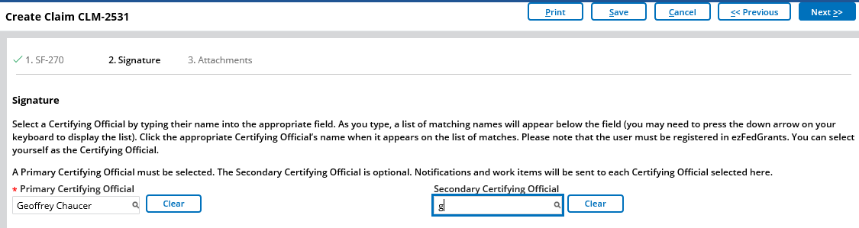
Creating and Submitting Claims
Transforming Financials at the People’s Department
You must designate at least one Certifying Official in the Primary Certifying Official field. This can be yourself or any other user with ezFedGrants access for your organization.
Begin typing the username of the individual you would like to assign and the system will generate a dropdown menu of suggested usernames as you type. When you see the relevant username, click the username in the dropdown menu.

Slide 19
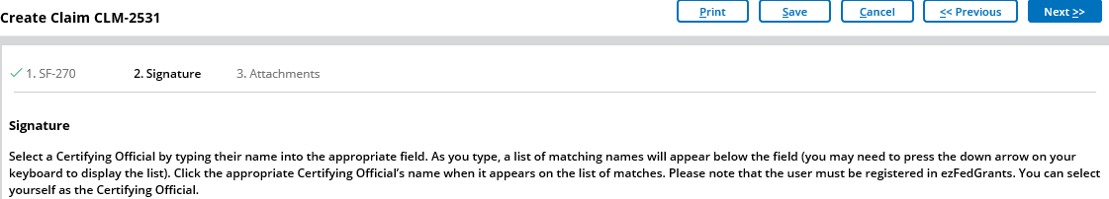
Creating and Submitting Claims
Transforming Financials at the People’s Department
You can advance to the next stage of claim creation by clicking the “Next >>” button
in the top right corner of the screen.

Slide 20
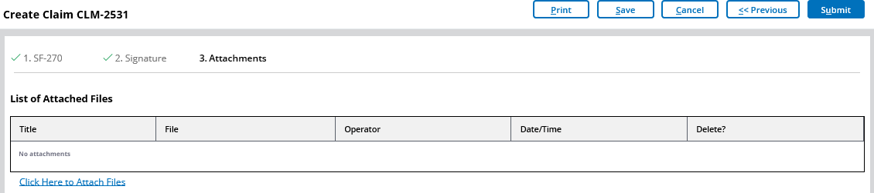
Creating and Submitting Claims
Transforming Financials at the People’s Department
Adding Attachments
Stage three, the final stage of claim creation, is the attachments stage. Attachments are not required in order to submit a claim, but your organization or awarding agency may require attachments with your claims.

Slide 21
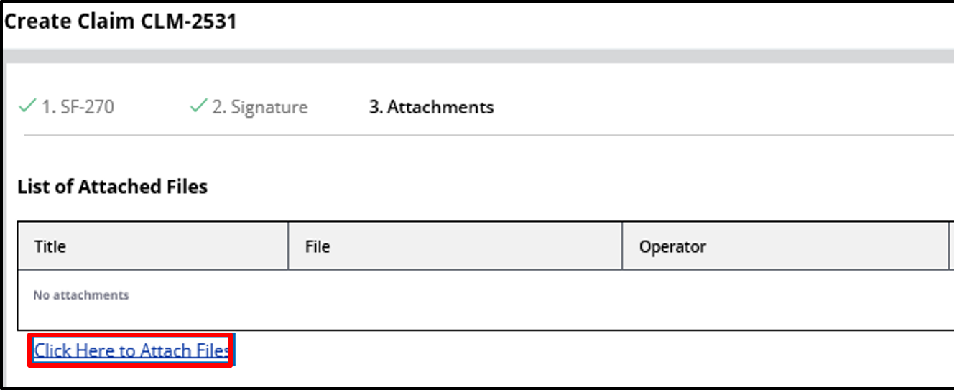
Creating and Submitting Claims
Transforming Financials at the People’s Department
To add an attachment, select the Click Here to Attach Files link under the List of Attached Files table. This will open the Add Attachment popup window.

Slide 22
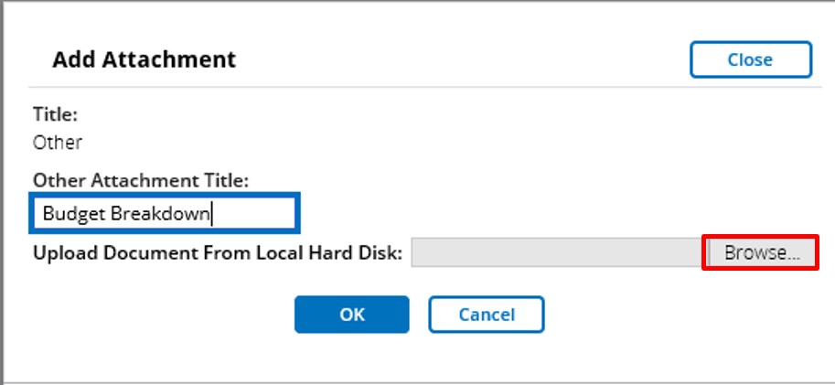
Creating and Submitting Claims
Transforming Financials at the People’s Department
In the Add Attachment popup window, click the Browse button to locate and select the desired attachment file on your computer. Then, click in the Other Attachment Title field and type a title for your attachment. Click the OK button to attach your file and close the Add Attachment popup window.

Slide 23
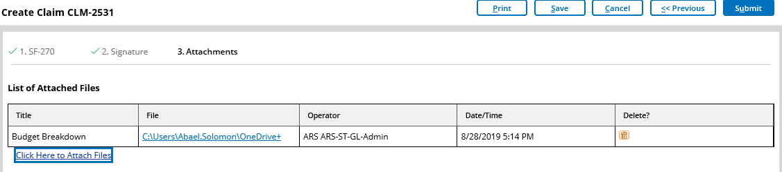
Creating and Submitting Claims
Transforming Financials at the People’s Department
Once you have attached all necessary files and you are ready to submit the claim for review by the Certifying Official, click the Submit button.

Slide 24
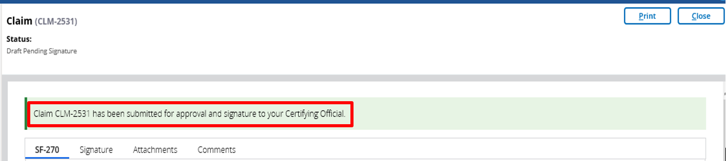
Creating and Submitting Claims
Transforming Financials at the People’s Department
If your claim has submitted successfully, the system will display a submission confirmation message. The individuals you assigned as certifying officials will then receive work items and notifications alerting them to the new claim.

Slide 25
Creating and Submitting Claims
Transforming Financials at the People’s Department
Certifying Claims
Once the claim is submitted it must be certified by the designated certifying official.
A certifying official introduces an additional level of review prior to final submittal to the USDA partner agency.
The following steps detail the process that certifying officials use to review and submit claims.

Slide 26
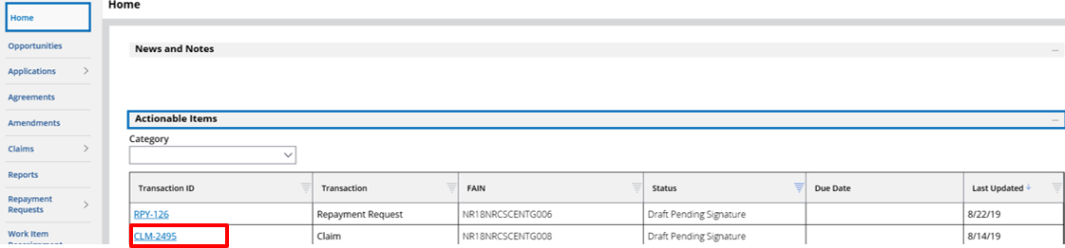
Creating and Submitting Claims
Transforming Financials at the People’s Department
Begin by accessing the ezFedGrants External Portal Home screen.
Then, locate the claim you want to review in the Actionable Items
section and click the Transaction ID link to open the claim work item.

Slide 27

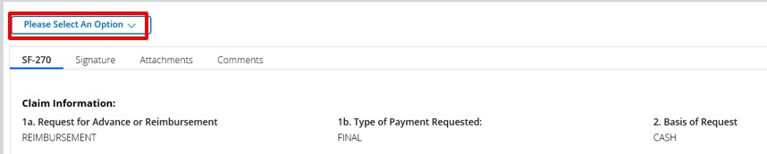
Creating and Submitting Claims
Transforming Financials at the People’s Department
On the Claim screen, review the SF-270 form and attachments by clicking the tabs.

Slide 28
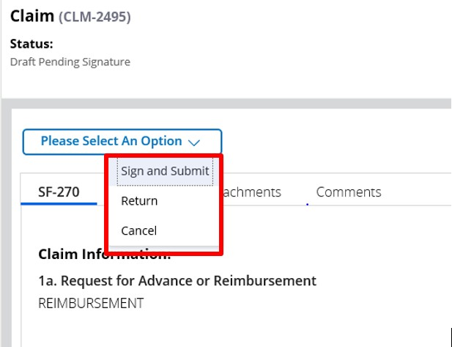
Creating and Submitting Claims
Transforming Financials at the People’s Department
After reviewing the claim, select Sign and Submit, Return, or Cancel from the Decision dropdown menu.
Sign and Submit: The claim is ready to be submitted to the agency.
Return: The claim needs to be corrected before submission to the agency.
Cancel: The claim should be discarded.
If the claim appears complete, correct, and ready to submit, click the Sign and Submit option on the Please select an option dropdown menu to proceed with digitally signing the claim and submitting it to the awarding agency. The Return option will return the claim to the claim creator for editing. The Cancel option will cancel and void the claim.

Slide 29
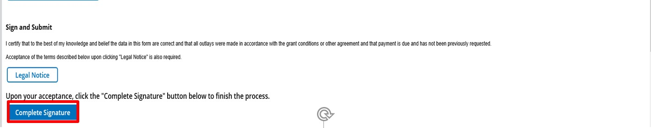
Creating and Submitting Claims
Transforming Financials at the People’s Department
Once you select the Sign and Submit option, you must review and agree to the legal notice/terms and conditions before submitting the claim to your agency. To review and accept the terms and conditions, click the Legal Notice button. This will open the Legal Notice popup window.

Slide 30
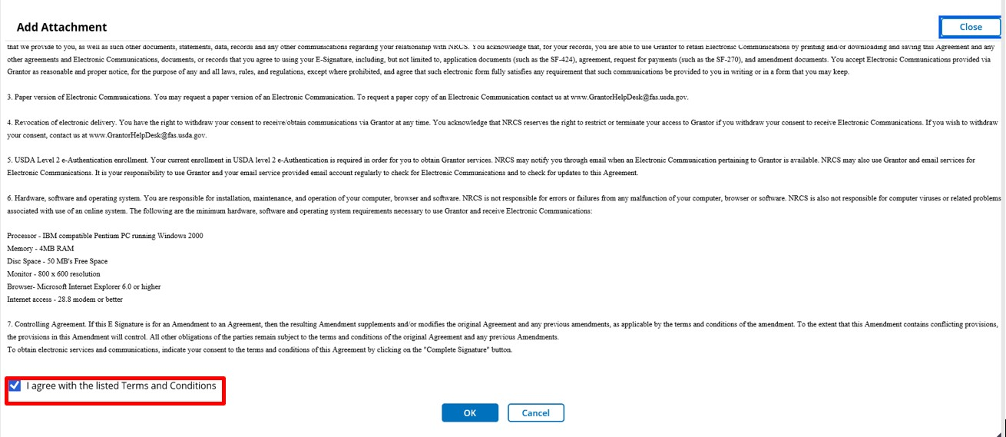

Creating and Submitting Claims
Transforming Financials at the People’s Department
Acceptance of the legal notice is required to submit your claim to the agency. If you disagree with the legal notice, please contact an agency representative.
Once you have reviewed the legal notice, scroll to the bottom of the Legal Notice popup window and click the checkbox to the left of the I agree with the listed Terms and Conditions statement.
Click the OK button to submit your acceptance of the legal notice and proceed with claim submission. This will close the Legal Notice popup window.

Slide 31
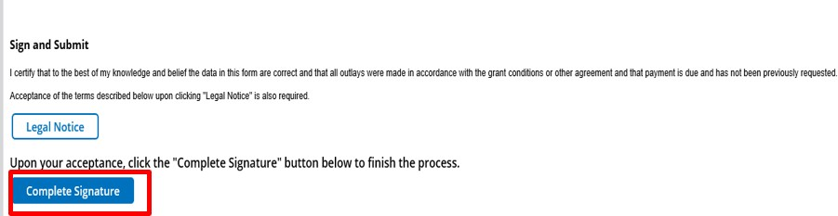
Creating and Submitting Claims
Transforming Financials at the People’s Department
Once you click the OK button, you will be returned to the Claim screen. Click the Complete Signature button to finalize your digital signature and submit the claim to your agency. If submission is successful, the system should display a confirmation message. Otherwise, you can confirm the successful submission by checking that the claim no longer appears on your worklist/actionable items list.

Slide 32

Module Summary
Transforming Financials at the People’s Department
In this module, you have learned to:
Describe the ezFedGrants claims creation process
Describe the ezFedGrants claims submission process

Slide 33
Agenda
Transforming Financials at the People’s Department
Course Introduction
Module 1 – Creating and Submitting Claims
Module 2 – Submitting Reports
Course Summary

Slide 34
Objectives
Transforming Financials at the People’s Department
After completing this module, you will be able to:
– Describe the process for submitting reports in ezFedGrants

Slide 35
Submitting Reports
Transforming Financials at the People’s Department
What’s Needed?
The agreement must be in active status.
No previous reports can be in the workflow. All previously created reports must be submitted or cancelled in order to fill out and submit a new report.
The user must be provisioned with the correct roles (either Grants Processor or Grants Administrative Officer)
Grants Processors must be included as a partner on any agreement they will be submitting reports for.

Slide 36
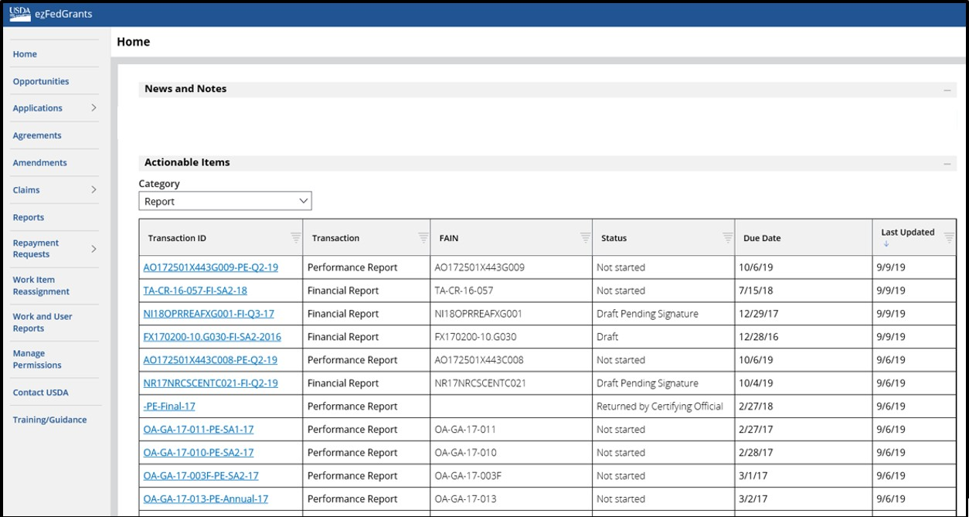
Submitting Reports
Transforming Financials at the People’s Department
Start by accessing the ezFedGrants homepage and navigating to the Actionable Items section then selecting Report from the Category filter.

Slide 37
Submitting Reports
Transforming Financials at the People’s Department
Identify the report you wish to submit and click on the link under the Transaction ID column.
The report type for each report is specified under the Transaction column.

Slide 38
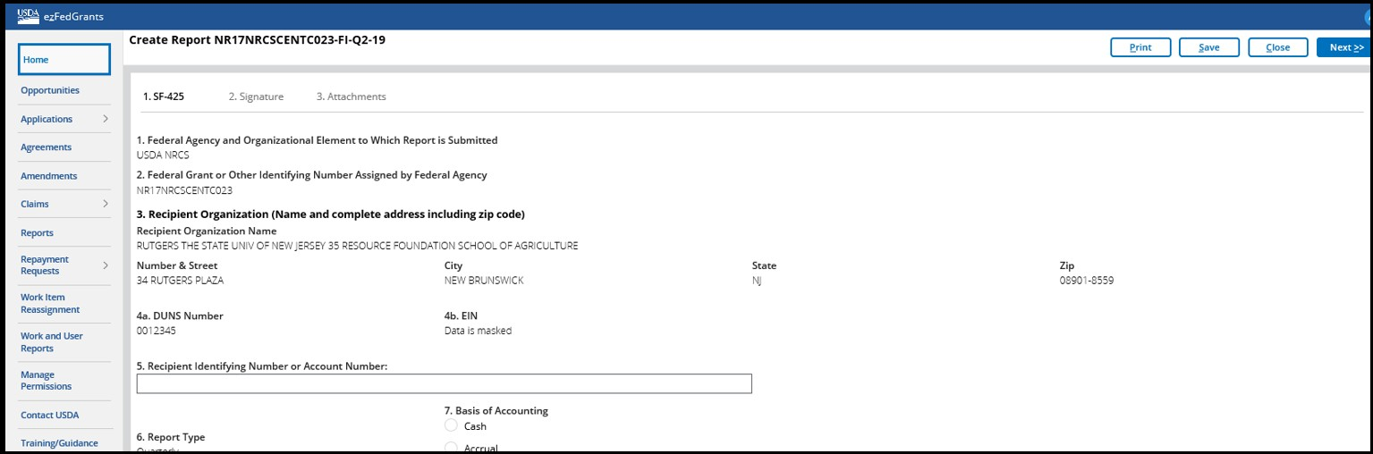
Submitting Reports
Transforming Financials at the People’s Department
Start on the first tab of the report creation process. The first tab is the standard form. This is a financial report so it is the SF-425 form. In order to navigate to other portions of the report creation process, click on the other tabs (e.g. 2, 3)

Slide 39
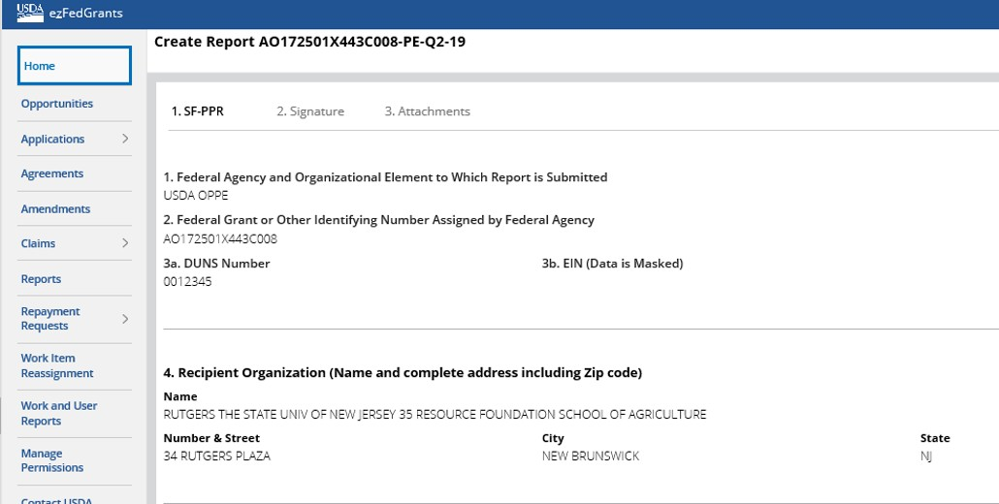
Submitting Reports
Transforming Financials at the People’s Department
If you are completing a performance report, you will see the SF-PPR on the Create Report screen. The process for completing and submitting a performance report is almost identical. In this case, the form you will be required to complete is the SF-PPR.

Slide 40

Submitting Reports
Transforming Financials at the People’s Department
Enter performance reporting information in Box 10 Performance Narrative. If not already provided by the agency, please contact an agency representative for performance narrative instructions. You may also attach a performance narrative as instructed by the awarding Federal Agency, then fill out other areas as necessary.

Slide 41
Submitting Reports
Transforming Financials at the People’s Department
Click the Next button to proceed to the Signature stage.
As you type, options of organization users will display for selection.

Slide 42
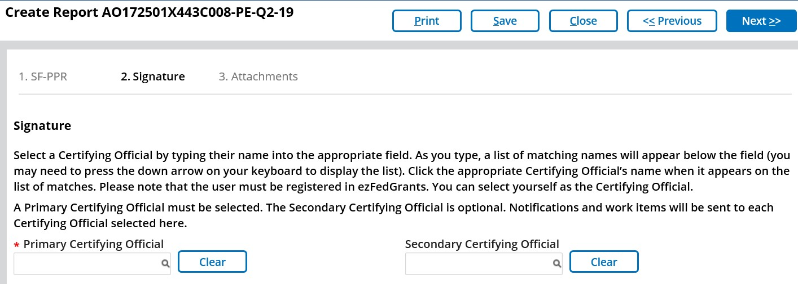
Submitting Reports
Transforming Financials at the People’s Department
Click the Next button to proceed to the Signature stage. You will designate one or more Certifying Officials for your report. The Certifying Official is responsible for digitally signing the report. As you type, options of organization users will display for selection.
To move to the final step, select
3. Attachments or click Next.

Slide 43
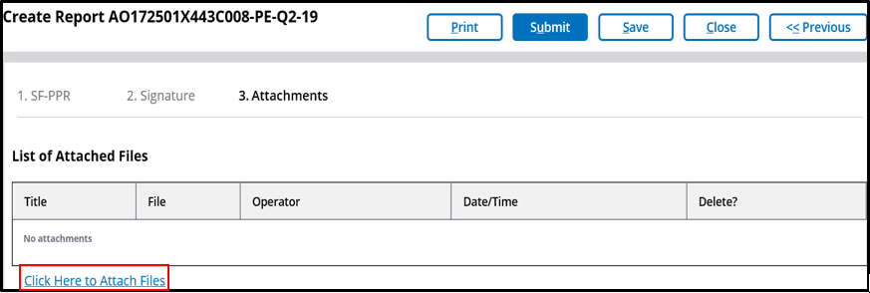
Submitting Reports
Transforming Financials at the People’s Department
To attach a file, Select the "Click Here to Attach Files" link.

Slide 44
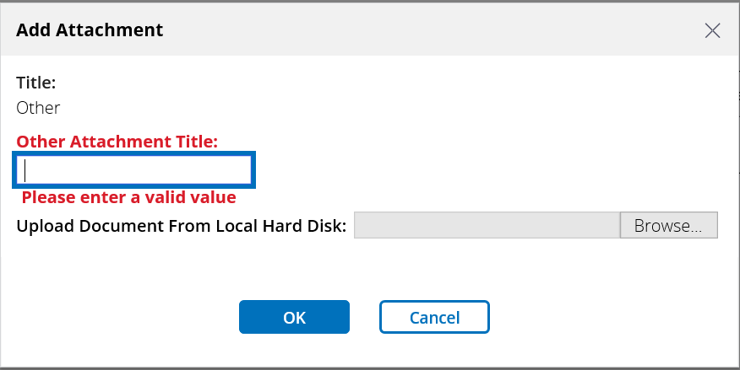
Submitting Reports
Transforming Financials at the People’s Department
Click in the "Other Attachment Title" field and enter an attachment title into the field. This will assist in identifying the attachment later.

Slide 45
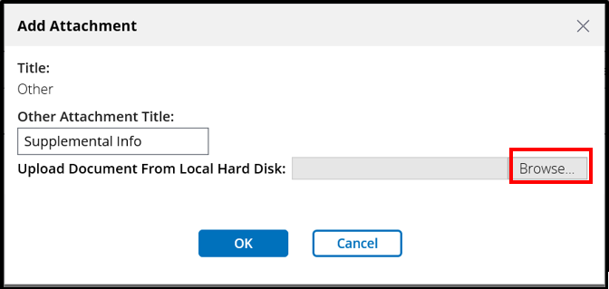
Submitting Reports
Transforming Financials at the People’s Department
Click the Browse button and select the file you want to attach from your computer. Attachment size is limited to 10 MB per attachment.

Slide 46
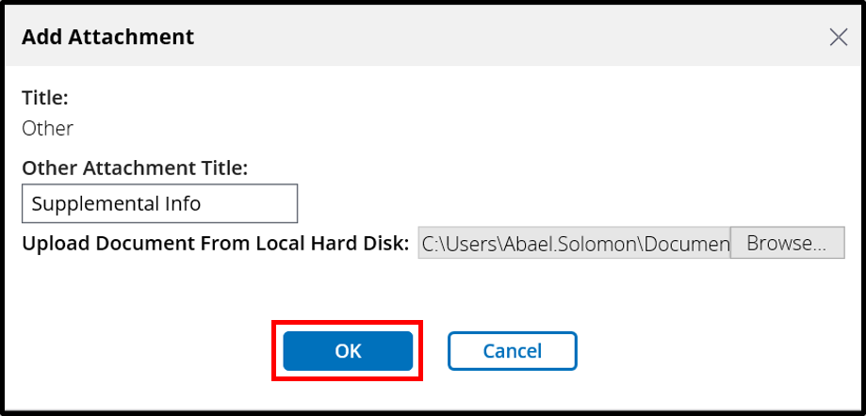
Submitting Reports
Transforming Financials at the People’s Department
Once the file attaches, click the OK button. Repeat these steps for any additional attachments.

Slide 47
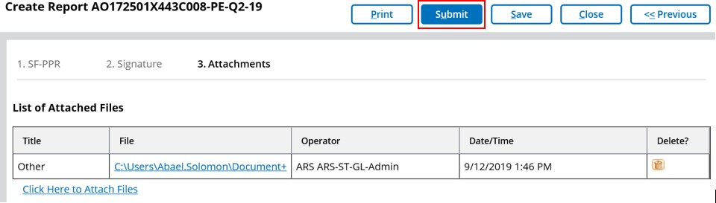

Submitting Reports
Transforming Financials at the People’s Department
Once you have completed filling out all the necessary information for the report, click the Submit button.

Slide 48
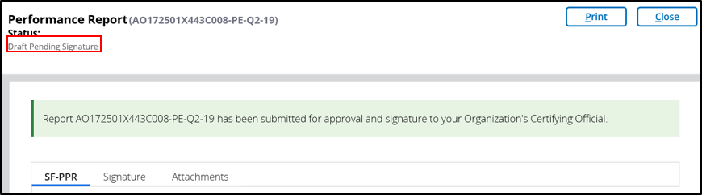
Submitting Reports
Transforming Financials at the People’s Department
After the report is submitted, a work item will be sent to the Certifying
Official(s) and the status of the report will change to "Draft Pending Signature."

Slide 49
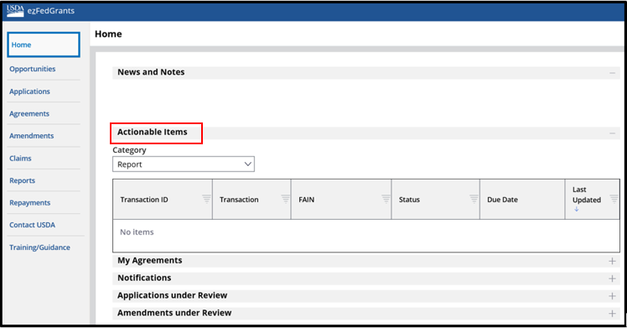
Certifying Reports
Transforming Financials at the People’s Department
On the ezFedGrants External Portal Home screen, the Certifying Official will need to locate the report to review in the Actionable Items section. Click the Transaction ID link to open the report work item. If you have a lot of work items, use the Category field to filter your work items.

Slide 50
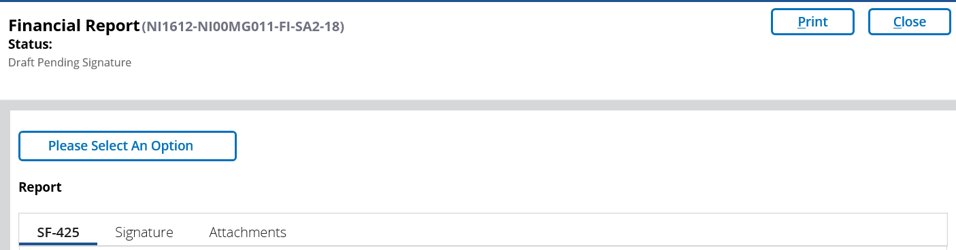
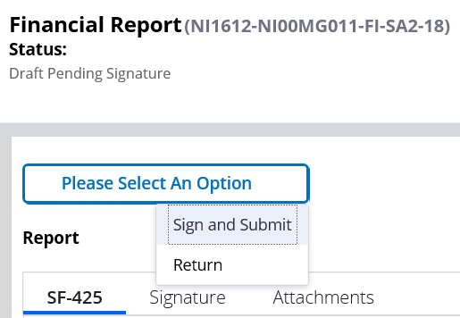
Certifying Reports
Transforming Financials at the People’s Department
Review each section of the report and select a decision from the from the Please select an option dropdown . In order to submit the report to the agency or department, Click the Sign and Submit option to approve the report. To return the report to its creator for edits, select the Return option and enter relevant comments.

Slide 51
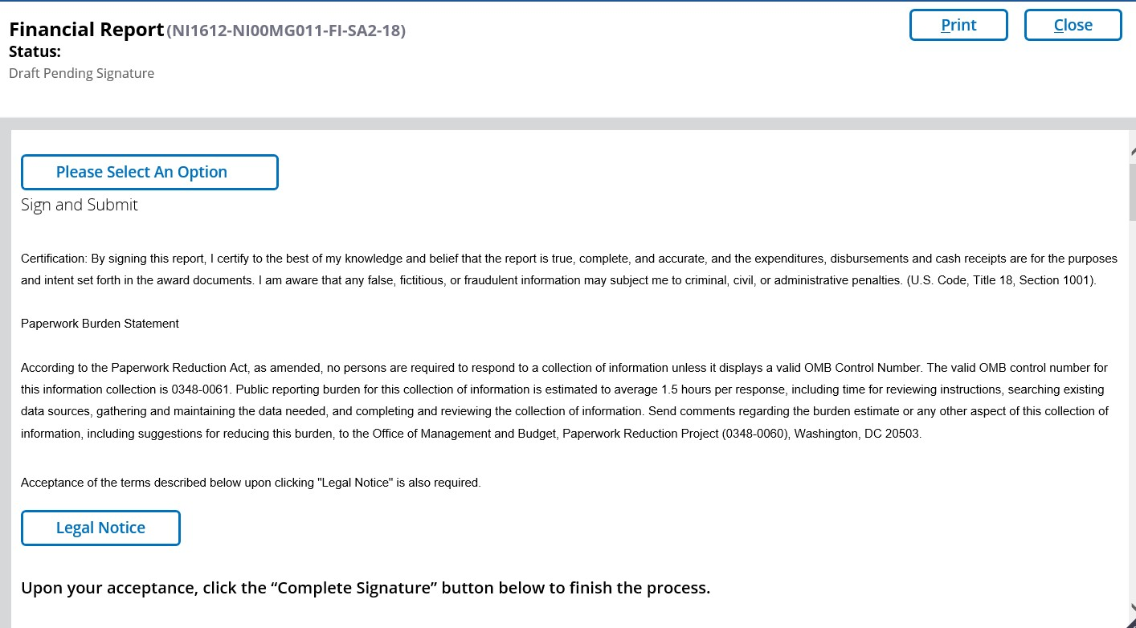
Certifying Reports
Transforming Financials at the People’s Department
After selecting to sign and submit the report, you will have to review the legal notice section. In order to do this, click the Legal Notice button

Slide 52
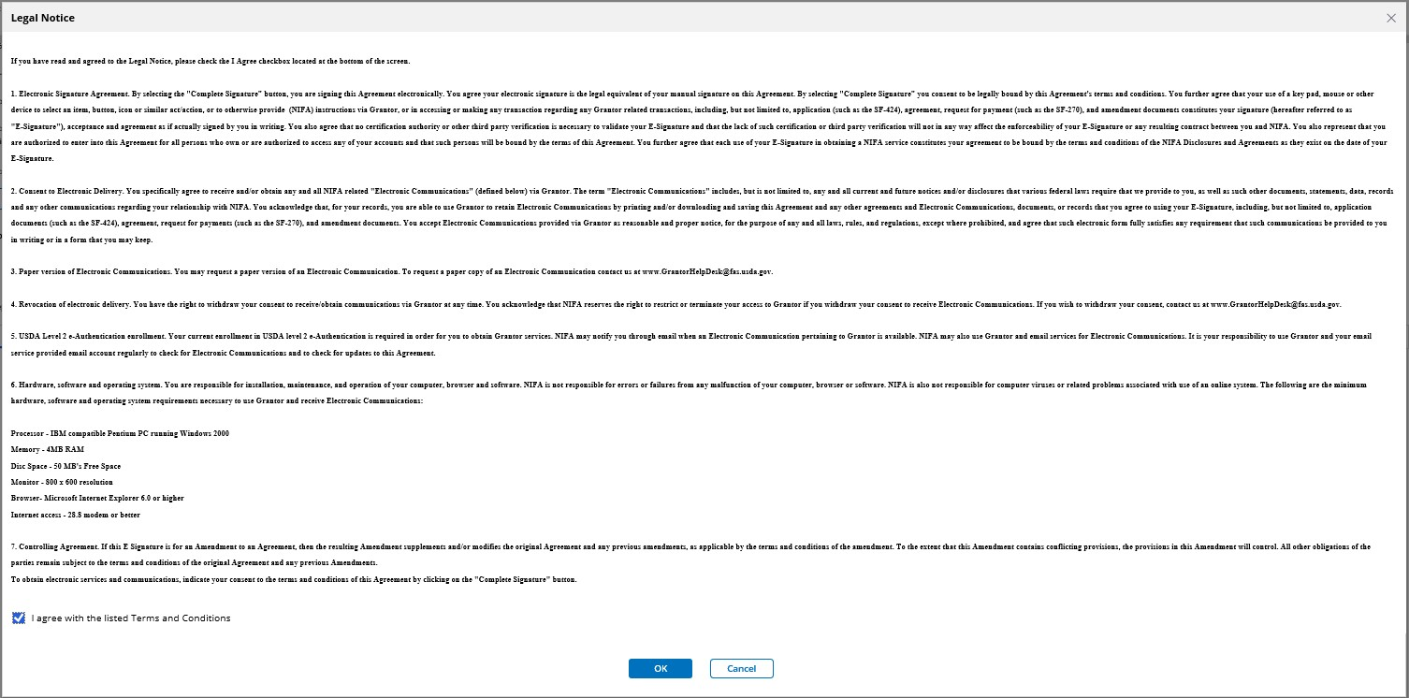
Certifying Reports
Transforming Financials at the People’s Department
After reviewing the legal notice and if you agree with the listed terms and conditions, click in the I agree with the listed Terms and Conditions checkbox, then click the OK button.

Slide 53
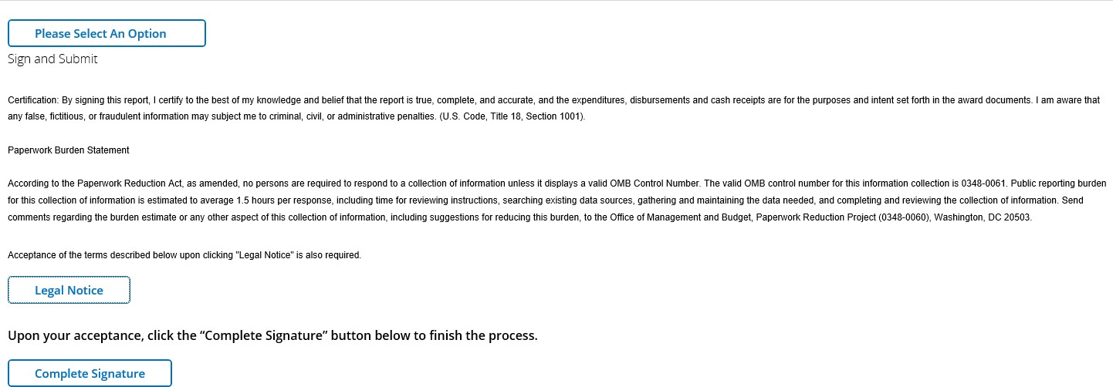
Certifying Reports
Transforming Financials at the People’s Department
Click the Complete Signature button.

Slide 54
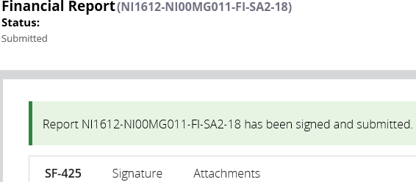
Certifying Reports
Transforming Financials at the People’s Department
After successfully signing and submitting the report, you will be taken to a confirmation page and the status of the report will change to "Submitted."

Slide 55
Module Summary
Transforming Financials at the People’s Department
In this module, you have learned to:
– Describe the process for submitting reports in ezFedGrants

Slide 56
Agenda
Transforming Financials at the People’s Department
Course Introduction
Module 1 – Creating and Submitting Claims
Module 2 – Submitting Reports
Course Summary

Slide 57

Additional Training and Resources
Transforming Financials at the People’s Department
Your Agency Representative
Monthly FAQ Session
ezFedGrants Help Desk: ezFedGrants@cfo.usda.gov
For eAuthentication issues including password resets, contact the eAuthentication helpdesk at eAuthHelpDesk@usda.gov

Slide 58

Questions?
Transforming Financials at the People’s Department

