Slide 1
Repayment Requests
GM 304
Version 1.0

Slide 2
Agenda
Course Introduction
Module 1 – Creating a Repayment Request
Module 2 – Certifying a Repayment Request
Course Summary

Slide 3
Introduction
Name
Role
Training Purpose

Slide 4
Course Objectives
After completing this course, you will be able to:
Summarize the ezFedGrants repayment request creation and submission process
Navigate to and within ezFedGrants system

Slide 5
Agenda
Course Introduction
Module 1 – Creating a Repayment Request
Module 2 – Certifying a Repayment Request
Course Summary

Slide 6
Objectives
After completing this module, you will be able to:
Summarize the ezFedGrants Repayment Request creation process
Understand when a Repayment Request is needed

Slide 7
Creating a Repayment Request
What is it?
An improper payment or excess funds that need to be returned.
Examples of when a Repayment Request would be appropriate:
Overpayment (e.g., ineligible expense(s), changes in Negotiated Indirect Cost Rates)
Duplicate payment (e.g. payment for same request)
Paid to incorrect recipient
Paid against incorrect recipient
Repayment of unused advance

Slide 8
Creating a Repayment Request
What’s Needed?
Access to the ezFedGrants External Portal.
To create repayment requests and submit them for approval as an external user, you must have either the Grants Processor (GP) or Grants Administrative Officer (GAO) role.
To create repayment requests and submit them for approval as an external user, you must have agreements with an agency that utilizes the ezFedGrants repayments functionality.
In order to create a repayment for reimbursements, reimbursement claims must exist against the agreement.
In order to create a repayment for advances, an unjustified advance amount must exist against the agreement.

Slide 9
Creating a Repayment Request
Helpful Hints
Have a copy of the SF-270 submission available to assist in completing the Valid From, Valid To, Direct Expenses, and Indirect Expenses fields.
Certain screenshots may display only a portion of the screen. Note that when working within the system, only the center body of the screen will change. The navigation options along the left side of the screen and the header bar across the top of the screen will remain the same.
Note: Data used in this procedure is a representative sample for the purpose of training. Actual data in the system may vary based on agency and scenario.

Slide 10
Creating a Repayment Request
Start by accessing the ezFedGrants External Portal Home screen.
Click the My Repayment Request item on the left side navigation bar to open the submenu and select the Create Repayment Request menu item to open the Search Agreements screen.

Slide 11
Creating a Repayment Request
On the Search Agreements screen, enter relevant search criteria in the Search Criteria fields to identify the agreement for which the repayment will be requested. This search will, by default, only include agreements for the organization that have been awarded and have a disbursed amount.

Slide 12
Creating a Repayment Request
Once you have entered your search criteria, click the Search button.
Locate the relevant agreement in the Result List table and click the Create Repayment Request link for the proper row. Once you click this link, the Create Repayment Request screen will appear. Agreements that belong to agencies that do not have repayment functionality will not have this link available for their agreements.

Slide 13
Creating a Repayment Request
Filling out a Repayment Request
On the Create Repayment Request screen there are several fields that are prepopulated and uneditable. The data in these fields are pulled from the agreement that the repayment request is for and include Federal Agency Name, Federal Award Identifying Number (FAIN), Project Title, Total Federal Award Amount, Total Disbursed Amount, and the Recipient Organization fields.
Several fields are required to be filled before the repayment request can be submitted. These fields are indicated with an asterisk.

Slide 14
Creating a Repayment Request
Click into the Total Repayment Request Amount field and enter the total amount that is being requested for repayment. The amount in this field must be less than the total disbursed amount. Hovering over this field will provide you with a short explanation of the amount limitation on the field.

Slide 15
Creating a Repayment Request
Click into the Associated Claim ID(s) field and enter the Grantor Claim IDs of all of the claims associated with this request. You must enter at least one Claim ID to identify the source of the funds to be repaid. To locate the Grantor Claim IDs, the user can check the Claim Overview section of the Agreement Details Screen for this particular agreement.

Slide 16
Creating a Repayment Request
Click the Calendar icon by the FROM and TO field in the Period Covered by This Request section and, from the pop out calendar, select the date that corresponds with the beginning of the claim period that is being repaid. The date can also be typed manually into this field using the format MM/DD/YYYY.

Slide 17
Creating a Repayment Request
On the Create Repayment Request screen, click the Reason for Repayment Request field and select an option from the dropdown to indicate the reason that the claim is being repaid. If your explanation is included in an attachment (which you will upload later in this process), please enter “See attachment” or a similar comment.
Notes:
The available options from the dropdown are as follows:
Overpayment (e.g., ineligible expense(s), changes in Negotiated Indirect Cost Rates)
Duplicate payment (e.g. payment for same request)
Paid to incorrect recipient
Paid against incorrect recipient
Repayment of unused advance
Other (Note: If Other was selected as the Reason for Repayment Request, a conditionally mandatory text field will appear. The user will be required to enter an explanation of the purpose of the repayment.)

Slide 18
Creating a Repayment Request
On the Create Repayment Request screen, enter an explanation of the repayment into the appropriate free text box. This explanation should be as detailed as possible, including any clarifications of the Reason for Repayment Request. Comments are required for all reasons but are especially important if you selected Other in the previous step.

Slide 19
Creating a Repayment Request
Once all required fields have been filled out, click Next in the top right corner of the screen.
The fields in the Certification section on the first breadcrumb are populated when the Certifying Official signs the Actionable Item for the repayment request during workflow. Before this stage, they remain blank.

Slide 20
Creating a Repayment Request
Click the Primary Certifying Official field and begin typing the name of the individual you would like to assign as the primary certifying official for this request. Any individual in your organization with ezFedGrants access may be assigned as a Certifying Official, including yourself. Repeat this step if you would like to assign an alternate Certifying Official in the Secondary Certifying Official field.

Slide 21
Creating a Repayment Request
Once a Primary Certifying Official, and any secondary certifying officials have been selected, navigate to the next step in the process by clicking Next in the top right corner of the screen.

Slide 22
Creating a Repayment Request
On the Attachments breadcrumb, the attachments required for upload are listed. To upload this attachment, select the Click Here to Attach Files. This will trigger the Add Attachment popup to display. For repayment requests, the creator will be required to upload a Justification attachment before submission.

Slide 23
Creating a Repayment Request
On the Add Attachment popup, click the Browse button to load a file from the local hard drive. Once this is completed, the OK button can be clicked to attach the file to the repayment request.

Slide 24
Creating a Repayment Request
Once all fields are filled and attachments are uploaded, the repayment request will be able to be submitted. Click the Submit button in the top right corner of the Create Repayment Request screen.

Slide 25
Creating a Repayment Request
ezFedGrants will check that your repayment request meets all minimum requirements. Once the repayment request is successfully submitted, a confirmation message will be displayed, and the status will change. The Certifying Official indicated on the Signatures portion of the repayment request will receive an Actionable Item, which starts the Repayment Request Workflow.

Slide 26
Agenda
Course Introduction
Module 1 – Creating a Repayment Request
Module 2 – Certifying a Repayment Request
Course Summary

Slide 27
Objectives
After completing this module, you will be able to:
Summarize ezFedGrants Repayment Request Certification process

Slide 28
Certifying a Repayment Request
What is it?
Once a Repayment Request has been created and submitted, it must be reviewed by the Certifying Official(s) that were designated.
Once the Certifying Official reviews the Repayment Request, it can then be submitted to the Awarding Agency for review and processing.

Slide 29
Certifying a Repayment Request
Start the procedure by accessing the ezFedGrants External Portal Homepage screen to locate the repayment request you want to review in the Actionable Items section.

Slide 30
Certifying a Repayment Request
Under the Actionable Items section, click the relevant Transaction ID link to open the repayment request work item.
Note: If you have a lot of work items, use the Category dropdown menu to filter the Actionable Items list.

Slide 31
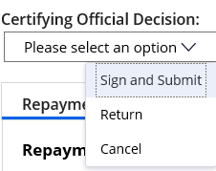
Certifying a Repayment Request
If the Repayment Request is complete, correct, and ready to submit to the awarding agency, click the Sign and Submit option on the Please select an option dropdown menu to proceed with digitally signing the Repayment Request and submitting it to the awarding agency.
Select Return to return the Repayment Request to the Repayment Request creator for editing. The Cancel option will remove the Repayment Request from the workflow.

Slide 32
Certifying a Repayment Request
Once you select the Sign and Submit option, you must review and agree to the legal notice/terms and conditions before submitting the Repayment Request to the awarding agency. To review and accept the terms and conditions, click the Legal Notice button. This will open the Legal Notice popup window.

Slide 33
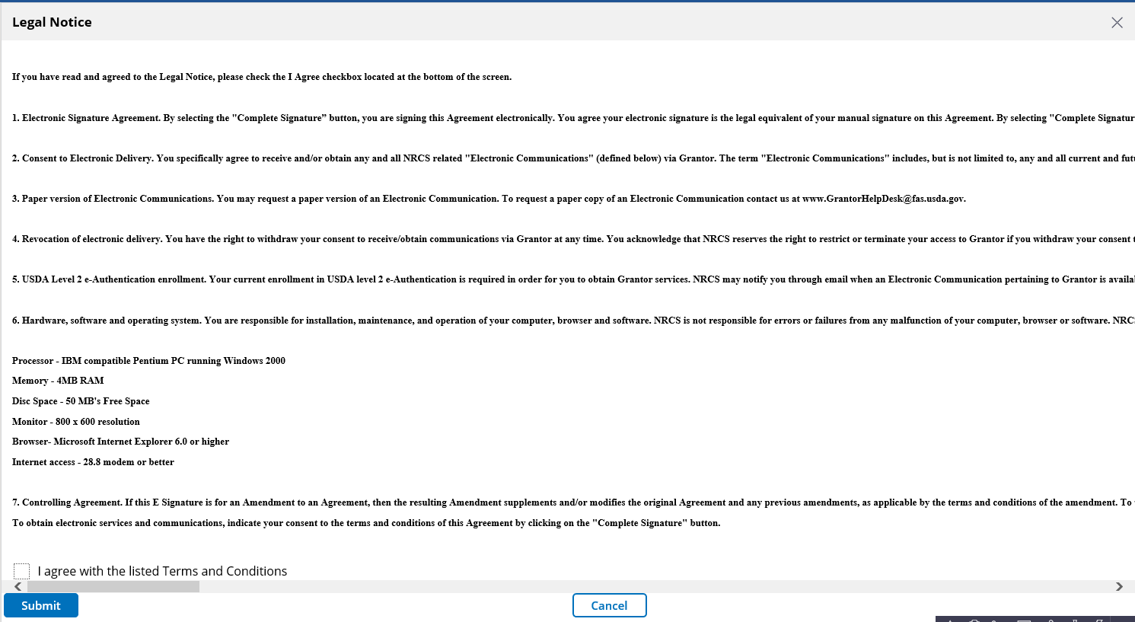
Certifying a Repayment Request
Review the Legal Notice terms and conditions. Once you have reviewed the legal notice, scroll to the bottom of the Legal Notice popup window and click the checkbox to the left of the I agree with the listed Terms and Conditions statement. Click the Submit button to confirm your acceptance of the legal notice and proceed with Repayment Request submission. This will close the Legal Notice popup window.

Slide 34
Certifying a Repayment Request
Once you click the OK button, you will be returned to the Repayment Request screen. Click the Complete Signature button to finalize your digital signature and submit the Repayment Request to the awarding agency for review. If submission is successful, the system should display a confirmation message. Otherwise, you can confirm the successful submission by checking that the Repayment Request no longer appears on your worklist/actionable items list.

Slide 35
Agenda
Course Introduction
Module 1 – Creating a Repayment Request
Module 2 – Certifying a Repayment Request
Course Summary

Slide 36
Course Summary
Today we learned about:
How to Create a Repayment Request in ezFedGrants
How to Certify and Submit a Repayment Request

Slide 37
Additional Training and Resources
Monthly FAQ Session
Your Agency Representative
ezFedGrants Help Desk: ezFedGrants-cfo@usda.gov

Slide 38
Questions?

