Slide 1
Improving NASS Estimates of Planted Acres
Linda J Young
USDA National Agricultural Statistics Service
February 20, 2020

Slide 2
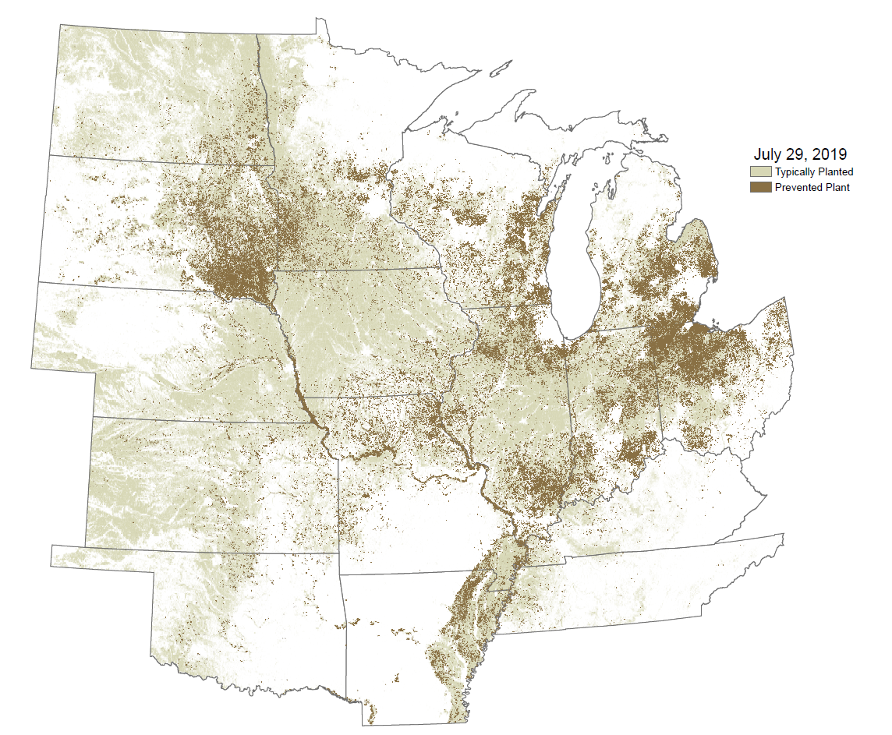
2019 Planted Acres and Those That
Could Not be Planted as Planned

Slide 3
Illinois Pilot Study: Paradigm Shift
Historical Approach to Estimating Planted Acreage
  Primary Source: Surveys
  Secondary Sources: Non-survey data, e.g., remote sensing, administrative, and weather data
Possible New Approach to Estimating Planted Acreage
  Primary Sources: Non-survey data
  Secondary Source: Survey data

Slide 4
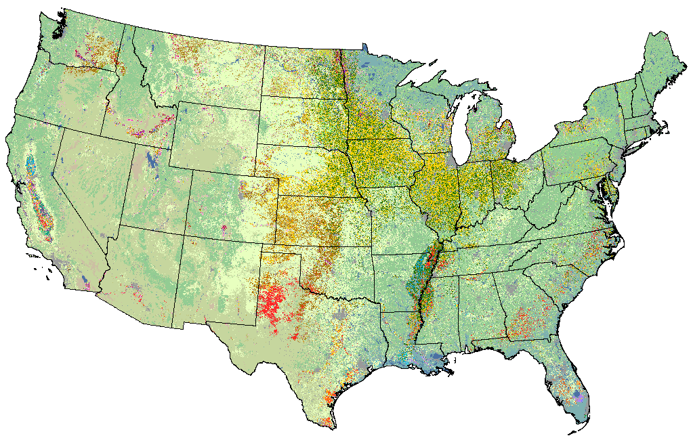
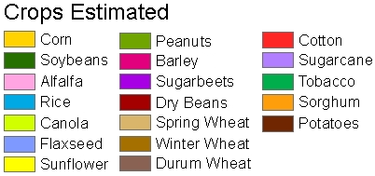
Cropland Data Layer
Annual national coverage since 2008
A raster, crop-specific, land cover data set produced using satellite data for acreage estimation
Historically,
85% - 95%
accurate
for major
crops
* 9 billion pixel 30m product

Slide 5
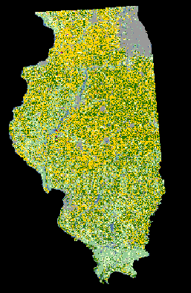
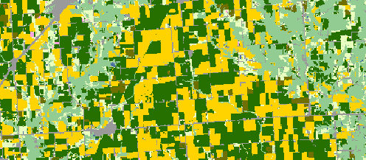
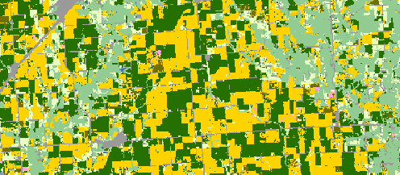
Preseason Prediction of Land Planted to Corn and Soybeans
Predicted 2018 June CDL - GEE
Predicted 2018 June CDL - GEE
2018 Final CDL

Slide 6
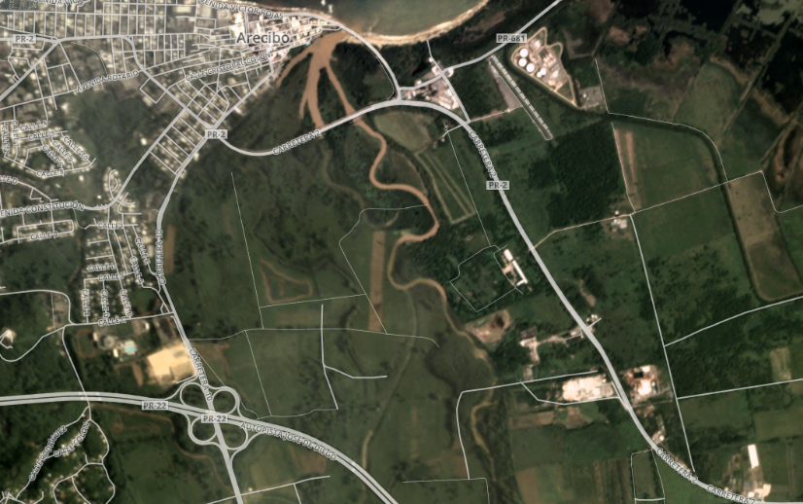
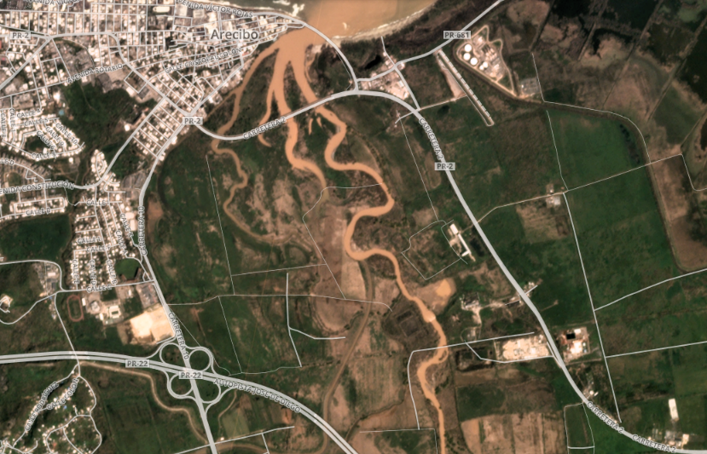
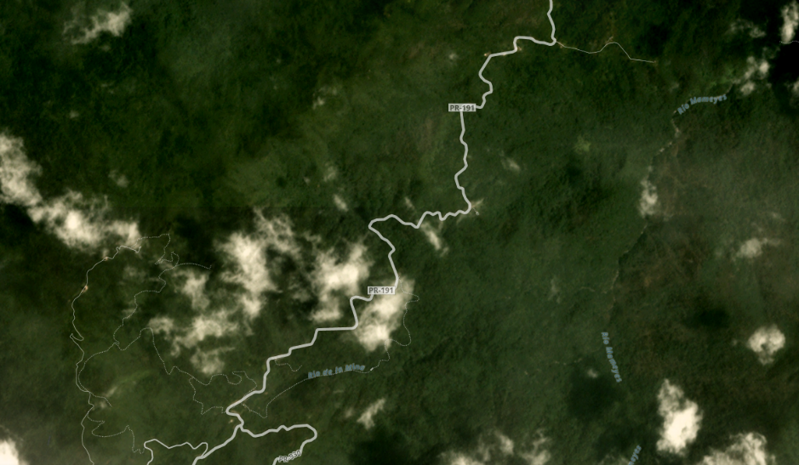
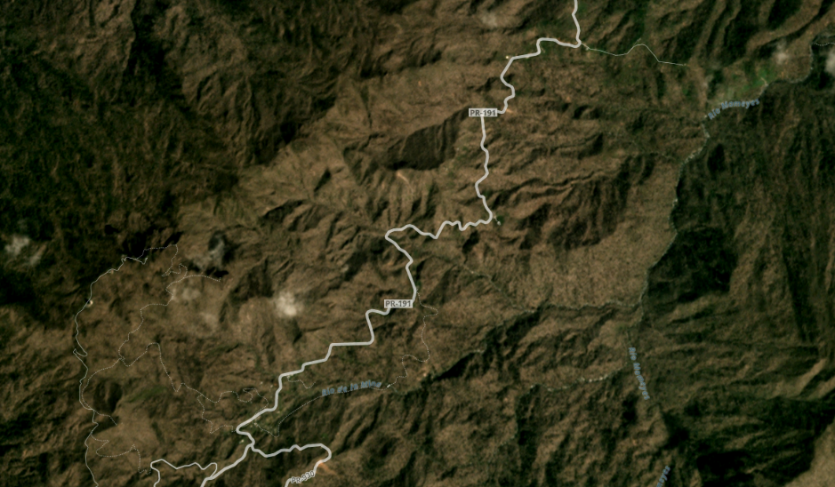
Remote Sensing: Finer Resolution
Puerto Rico, Hurricane Maria 2017
Before After
Daily 3m imagery
Provides data on inundated areas
Information?
  Time of planting
  Crop planted
Washed-out Fields
Defoliated Forests

Slide 7
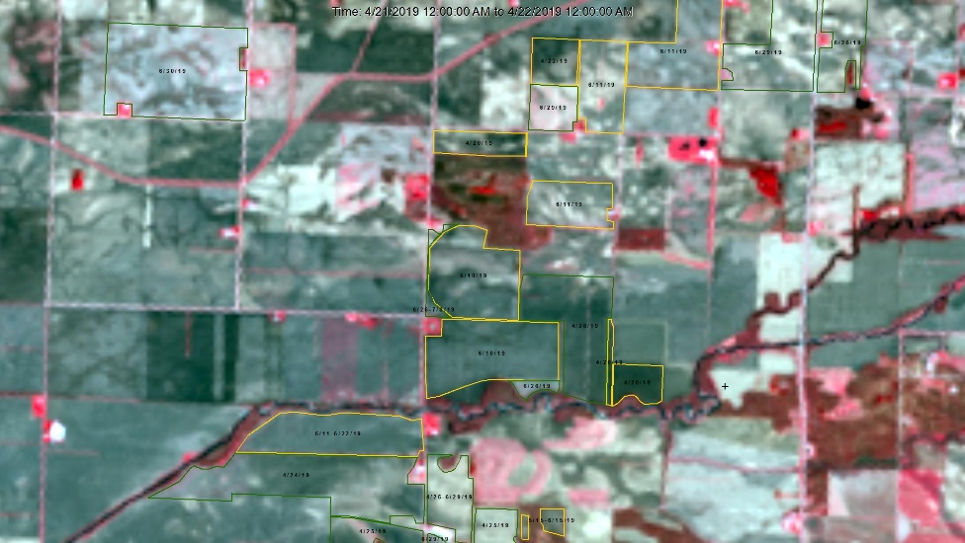
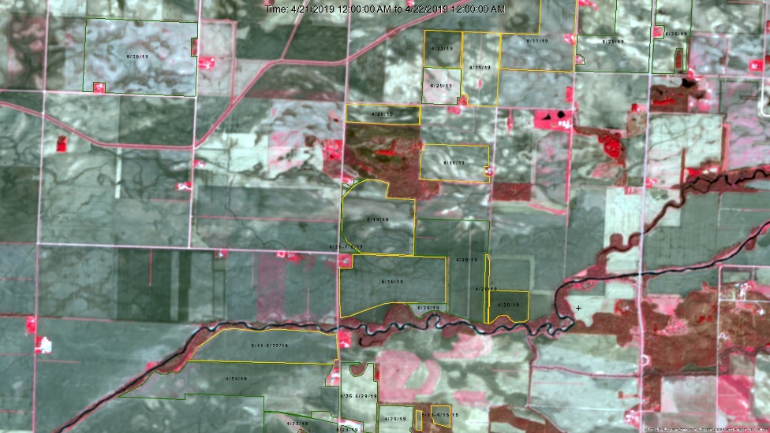
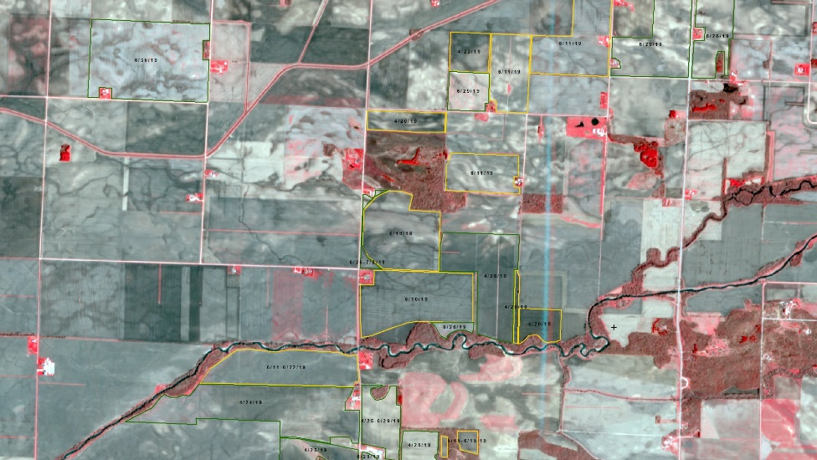
What is the Value of High Resolution Imagery?
30-meter
10-meter
3-meter
3-meter

Slide 8
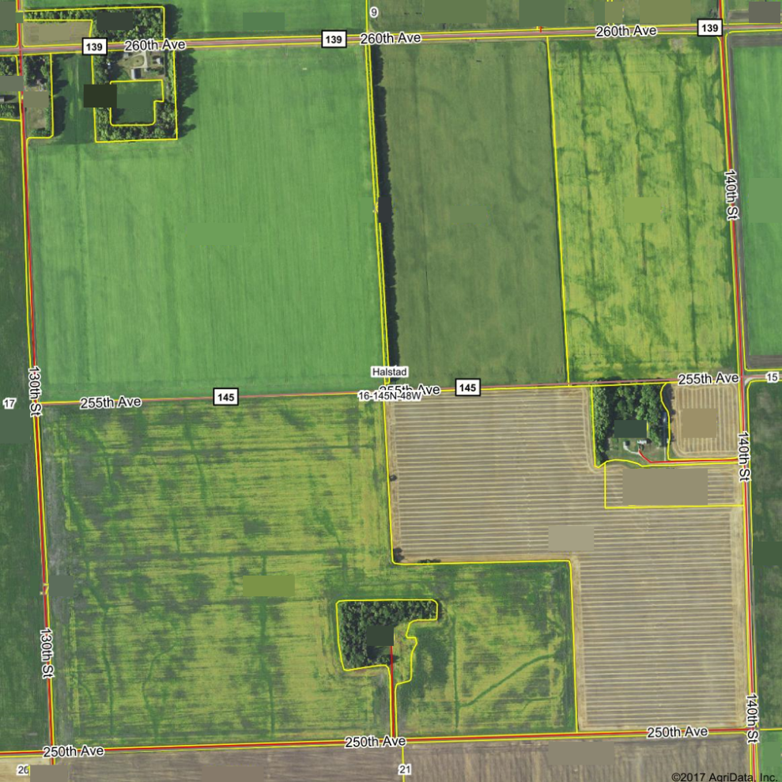
Farm Services Agency (FSA) Data
FSA Common Land Units
FSA-578 Form
  Available for all land associated with a USDA program in a calendar year
  Provides crop information
Need: Link survey data to the land
  FSA and NASS farm definitions differ
  Have linked farms with simple farm structures—working on the rest
https://www.agridatainc.com/Home/Products/Mapping%20Features/Land%20Resource%20Intelligence/FSA%20Field%20Boundaries%20(CLU)

Slide 9
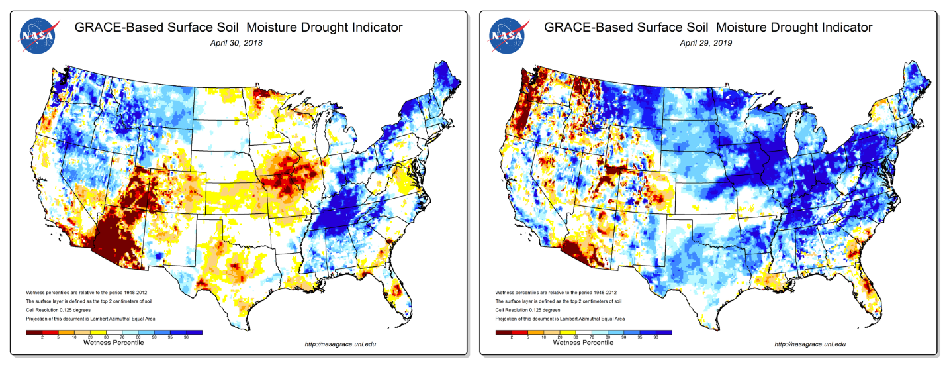
Quantifying Soil Moisture: GRACE

Slide 10
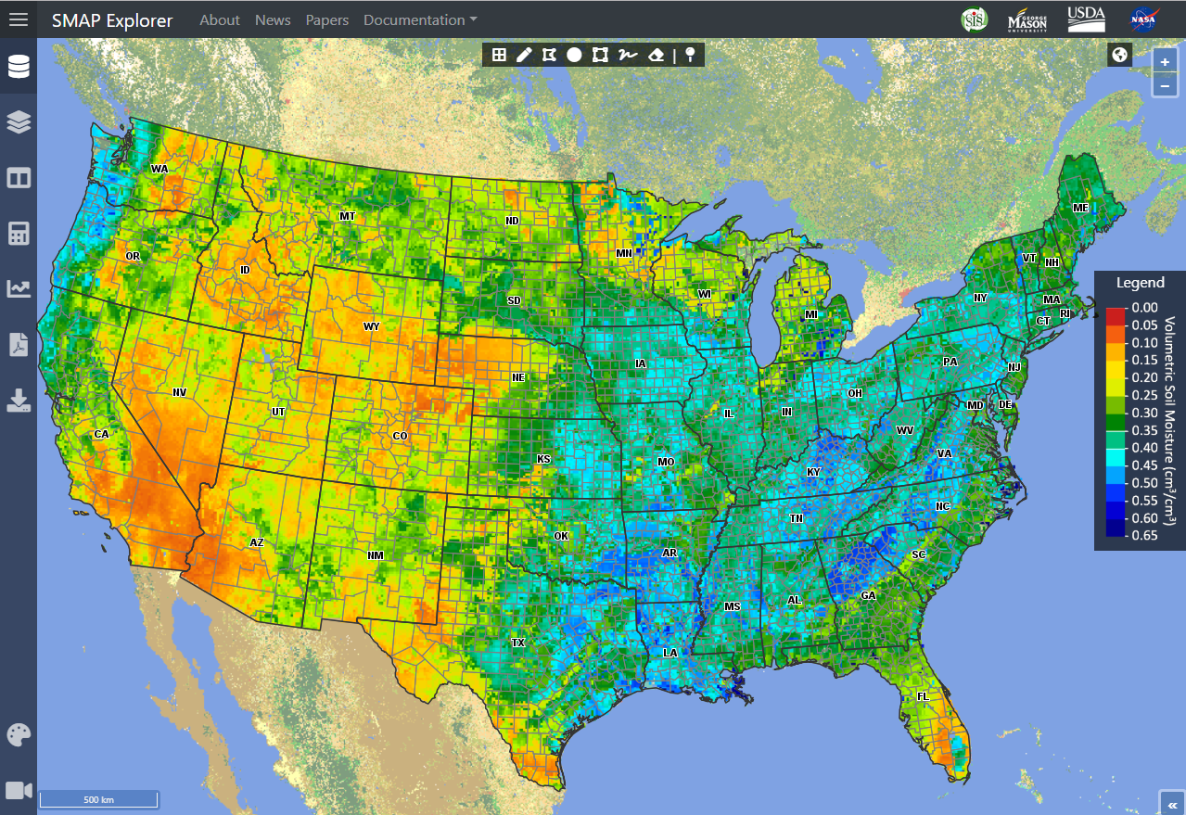
Soil Moisture Monitoring Prototype
Provide qualitative and quantitative top and sub soil moisture measurements

Slide 11

Pre-Planting and Planting Weeks
Prospective Plantings
Acreage
3/29/2019
6/28/2019
Pre-Planting Weeks
Planting Weeks
Usual planting dates: April 14 to June 5
Most active planting dates: April 14 to June 5
Source: https://downloads.usda.library.cornell.edu/usda-esmis/files/vm40xr56k/dv13zw65p/w9505297d/planting-10-29-2010.pdf

Slide 12
Time of Planting and Precipitation
Most Active Period
Week
Week
Source: https://quickstats.nass.usda.gov/
Statewide Average Precipitation

Slide 13
Pre-Planting: GRACE-Based Root Zone Soil Moisture Drought Indicator
Week 9
Week 10
Week 11
Week 12
Week 13
2011
2019

Slide 14
Planting: GRACE-Based Root Zone Soil Moisture Drought Indicator
Week 14
Week 15
Week 16
Week 17
Week 18
2011
2019

Slide 15
Final Thoughts
Focus: Providing estimates that make sense agronomically
Opportunity to add data as it becomes available
  Want to compare 30-m vs 10-m vs 3-m remote sensing data
Potential outcomes:
  Reduction in respondent burden
  Releasing estimates on a finer temporal and spatial scale
Illinois Pilot Study is a proof-of-concept test
  All methods are scalable
  A phased approach

Slide 16
Thank you!
Linda.J.Young@usda.gov

