Slide 1
Food Safety Assessment and New Food Technologies at the Food and Drug Administration
Jeremiah Fasano
Office of Food Additive Safety
Center for Food Safety and Applied Nutrition
February 21, 2020

Slide 2
FDA’s Oversight of Food Safety
FDA’s primary source of authority is the Federal Food, Drug, and Cosmetic Act, which includes the responsibility to ensure that foods are safe, wholesome, sanitary, and properly labeled
Adulteration of food is a key concept in ensuring food safety
Under FD&C Act Sec. 402 a food is adulterated
  if it bears or contains any food additive that is unsafe within the meaning of section 409 (the food additive provision)
  if it has been prepared, packed, or held under insanitary conditions whereby it may have become contaminated with filth, or whereby it may have been rendered injurious to health

Slide 3
Systems-Based Oversight
For Food Production
Hazard analysis
  Known or reasonably foreseeable
  Biological, chemical, physical hazards
Preventive controls
  Process, allergen, sanitation, other as needed
Oversight and management of controls
  Monitoring, correction, corrective action, verification
Supply chain program
  If needed based on hazard analysis
Recall plan

Slide 4
What Is A Food Ingredient?
Any substance the intended use of which
results or may reasonably be expected to result
in its becoming a component
or otherwise affecting the characteristic of any food
including any substance intended for use in producing, manufacturing, packing, processing, preparing, treating, packaging, transporting or holding food

Slide 5
Practical Implementation
Same quantity and quality of scientific data
Food & Color Additives
FDA approval via rulemaking
Food Contact Substances
FDA authorization via notification
GRAS Ingredient Uses
Expert consensus on safety
All ingredients must be lawful for their intended use

Slide 6
Reasonable Certainty of No Harm
Identity and Exposure
Relevant Properties
Appropriate Data

Slide 7
Assessing the Effects of Significant Manufacturing Process Changes
FDA recognizes the potential significance of manufacturing process changes for safety
Guidance issued in 2014: 79 FR 36533
Recommend assessment and consultation

Slide 8
Changes in Production Processes
Process considered only insofar as it affects properties or safety of food
Important to understand potential impacts on properties relevant for safety
Information needed to establish safety may change if process changes

Slide 9
Examples from Past Experience
Substances produced by cultured cells
Cultured cells for direct consumption
New plant varieties produced by modern biotechnology

Slide 10
Substances Produced by Cultured Cells
Enzymes
Oils
Transgenic proteins
CSIRO

Slide 11
Cultured Cells Evaluated as
Direct Food Ingredients
Cells
Bacterial
Algal
Fungal
CSIRO

Slide 12
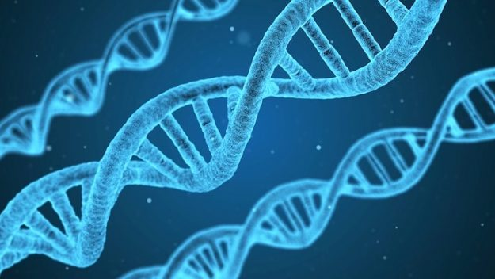

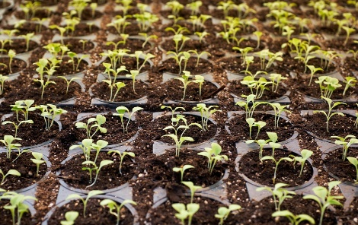
New Plant Varieties Produced
Using Modern Biotechnology

Slide 13
Observations from Past Experience
Biological production systems are complex
Questions about consistency and control of outcomes often arise during the safety evaluation
These questions can be successfully addressed during the safety evaluation process prior to market entry

