Slide 1
Variability and Trends in Expected Weather Patterns
Dr. Jim Angel
Prairie Research Institute
University of Illinois

Slide 2
Introduction
What happened in 2019
Current conditions
Trends and Concerns
Adaptation

Slide 3
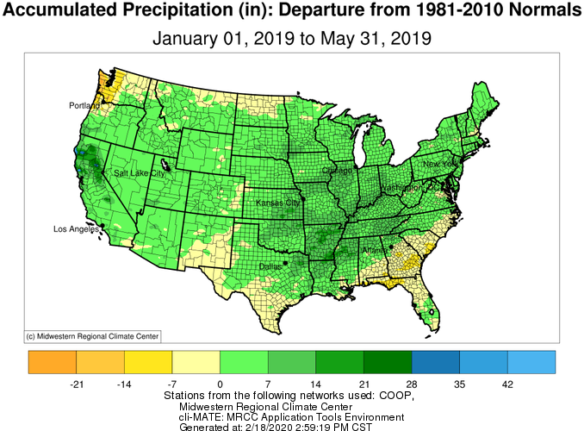
Last winter and spring

Slide 4
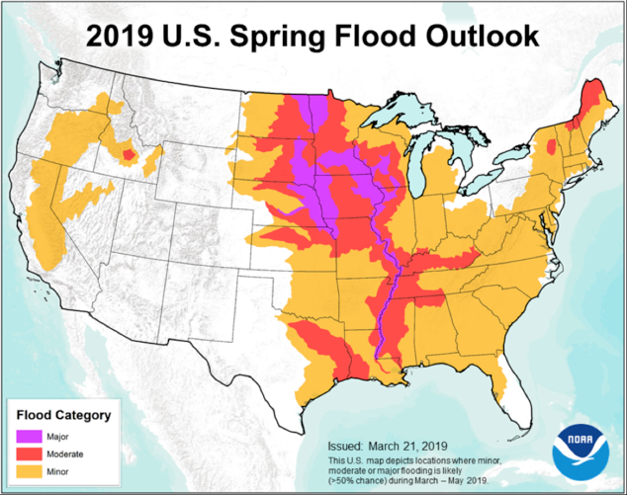
Weather.gov

Slide 5
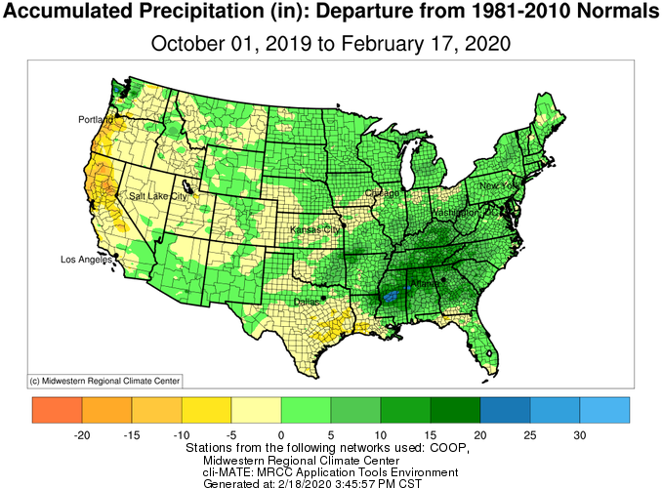
Last fall and this winter

Slide 6
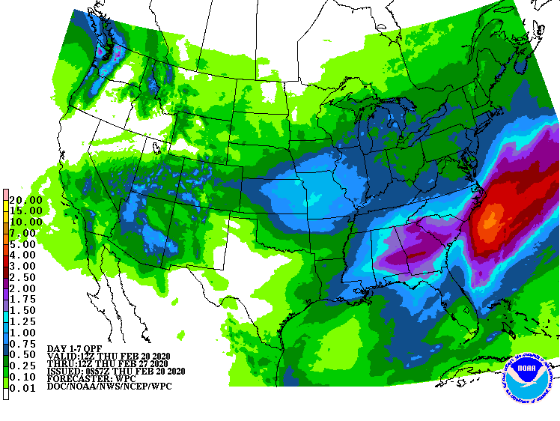
7-Day Precipitation Amounts (QPF)
“NWS QPF”

Slide 7
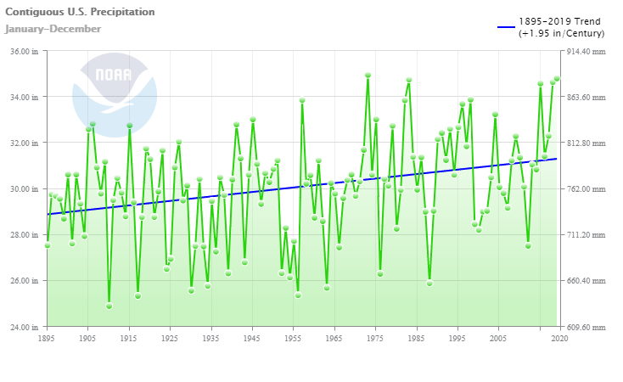

Slide 8
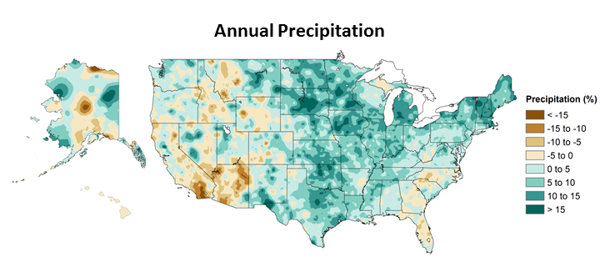
1986-2015 minus 1901-1960

Slide 9
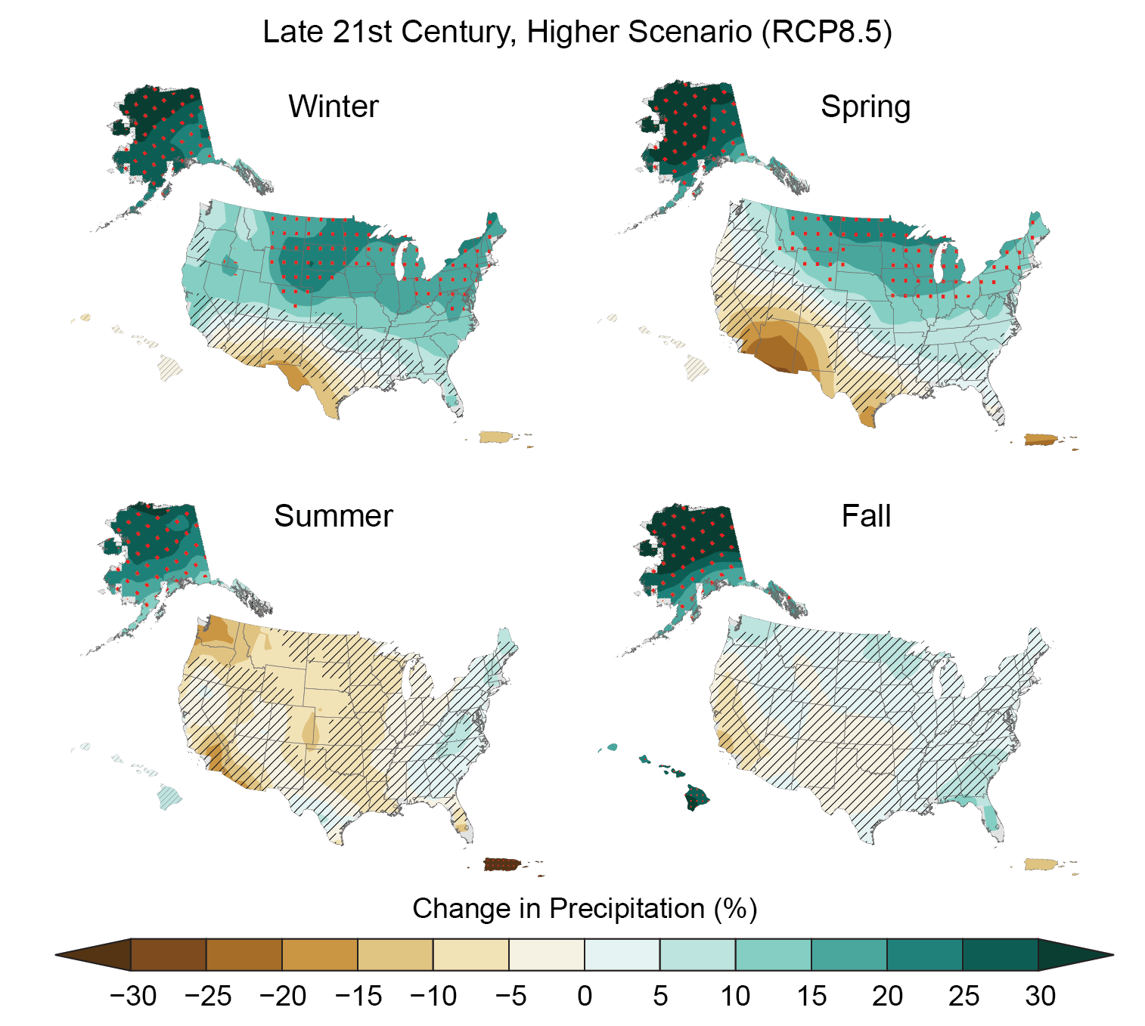
2070-2099

Slide 10
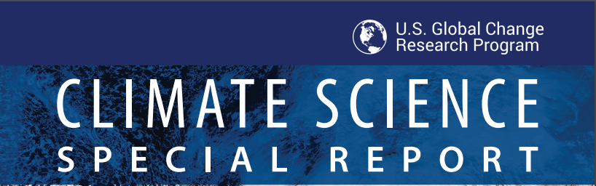
Volume I of the NCA4
Precipitation will continue to increase (medium confidence)
Heavy precipitation events will increase in frequency and amounts (high confidence)
https://science2017.globalchange.gov/

Slide 11
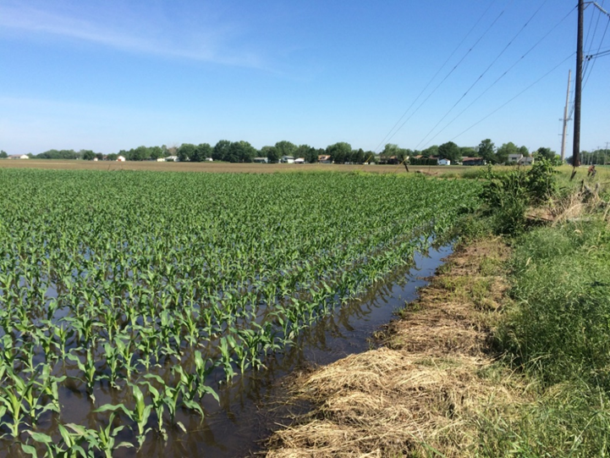
Impacts of Wetter Growing Season
Reduced workable field days
Planting delays
Replanting
Prevent planting
Soil compaction
Drainage
Nutrient loss
More plant disease

Slide 12
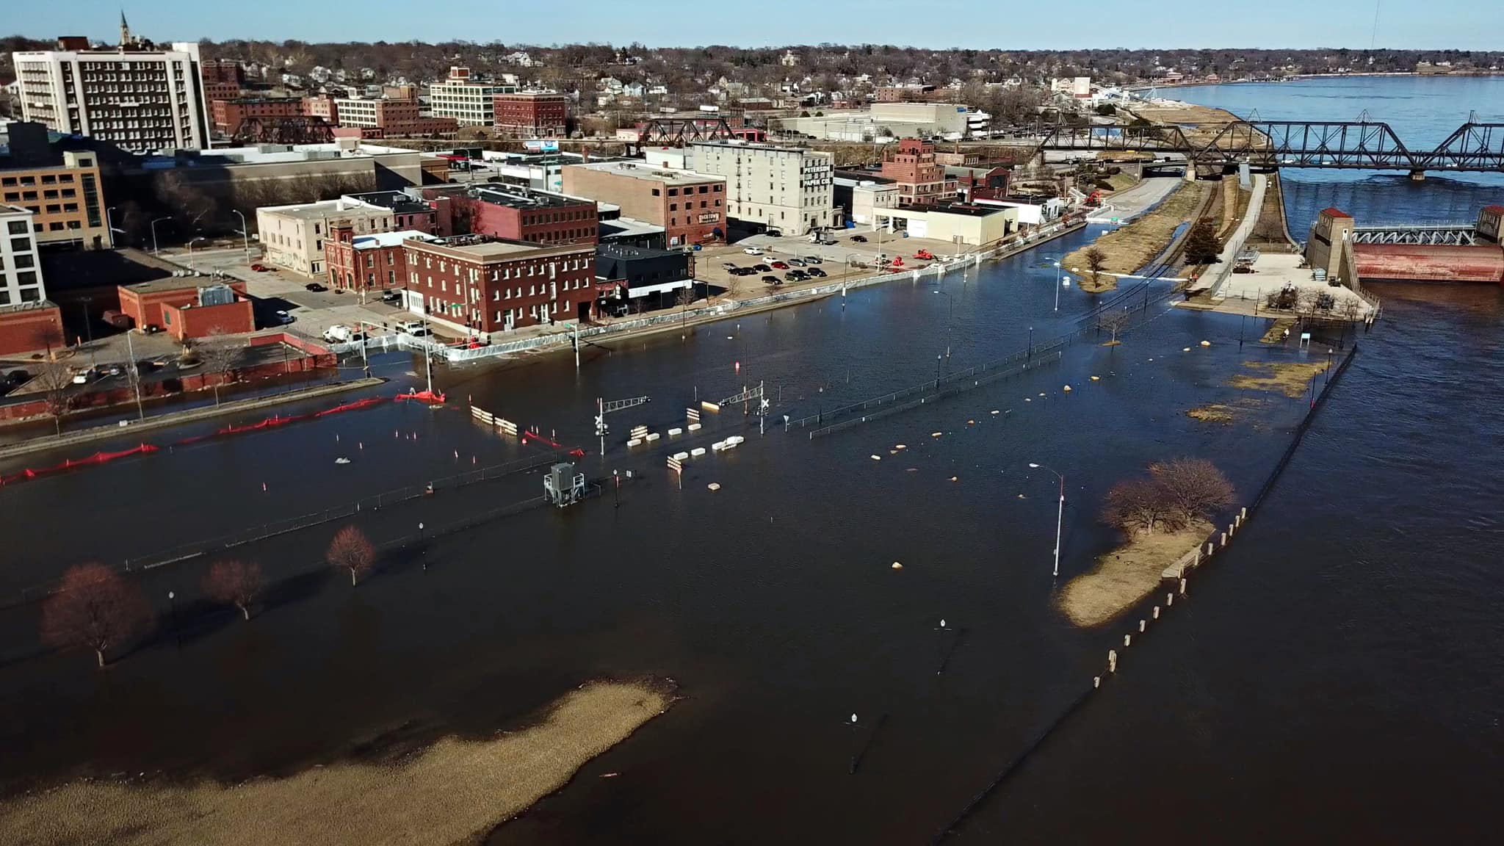
Disrupt transportation
Mississippi River on 3/25/19 - Davenport, IA Photo: Steve Toft (QC Drone)

Slide 13
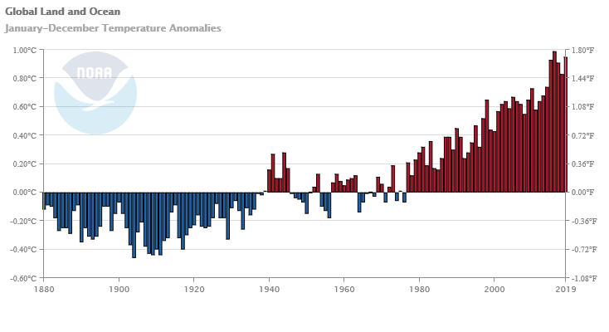

Slide 14
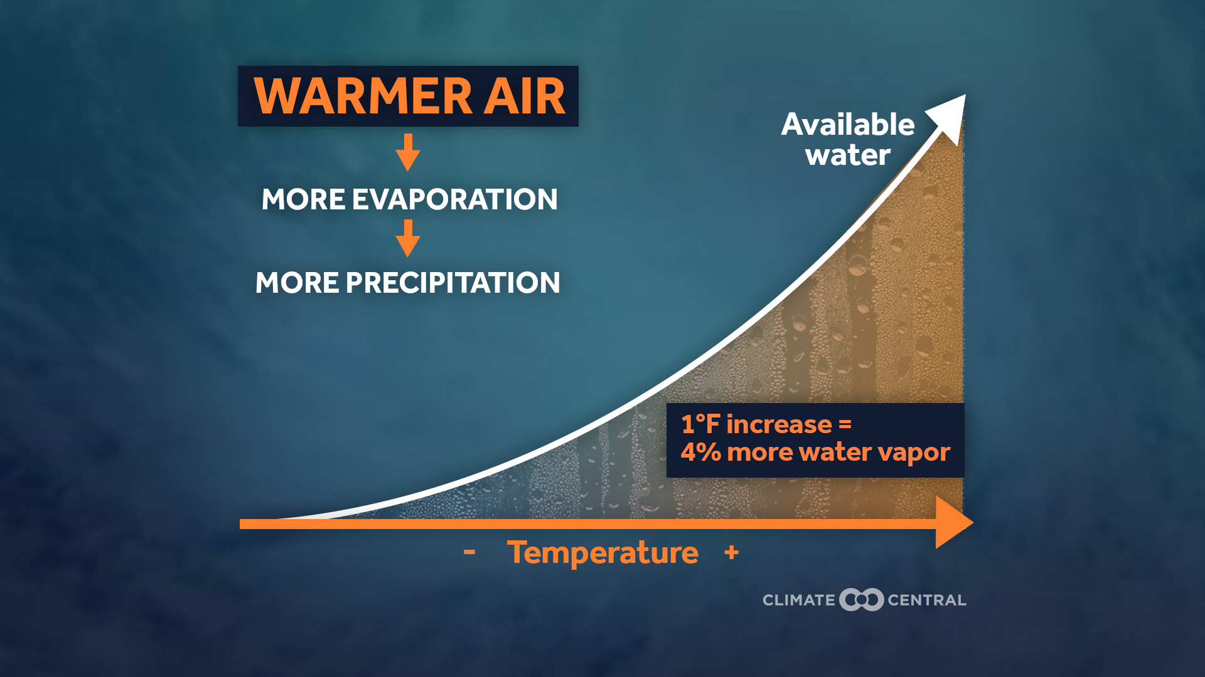
Increased Humidity

Slide 15
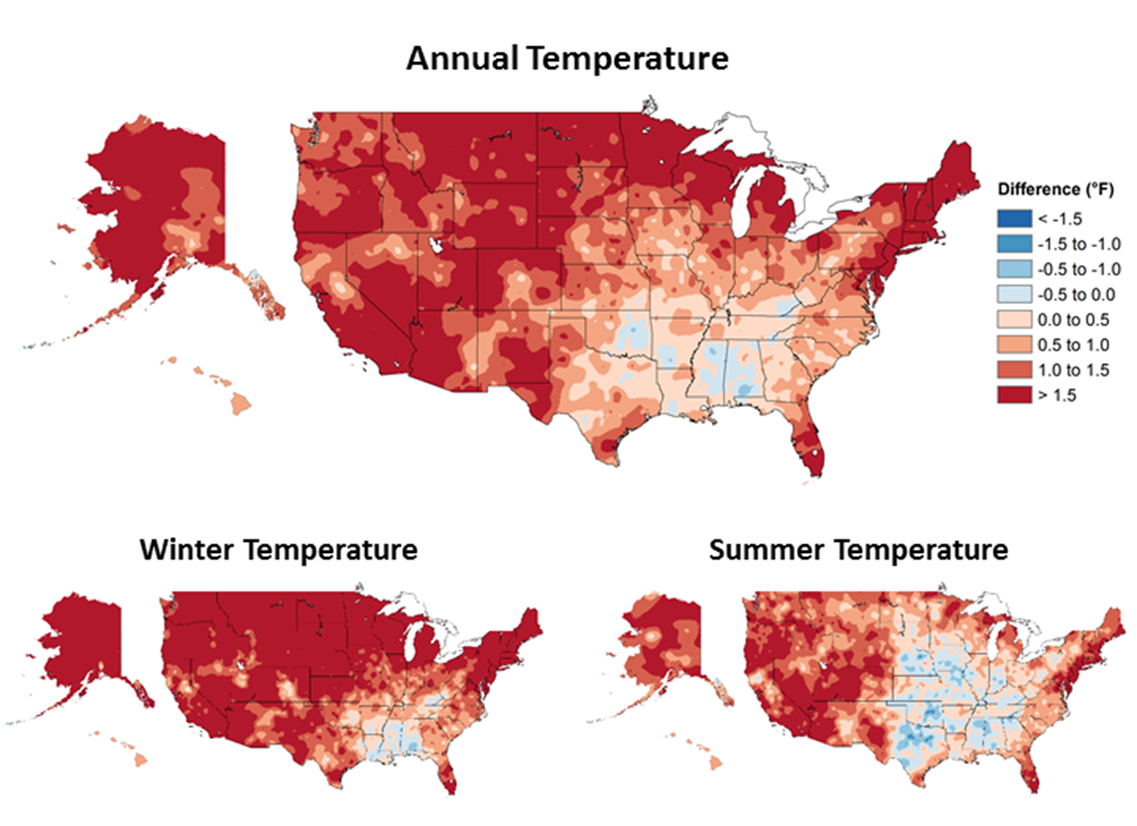
Observed changes in mean temperatures, 1901-1960 vs 1986-2016

Slide 16
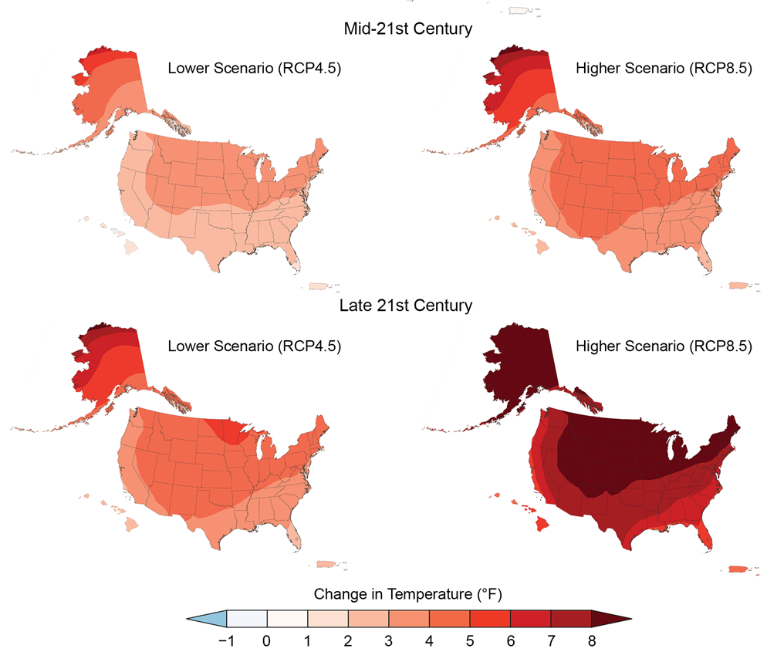
2 to 4°F increase
3 to 9°F increase
https://nca2018.globalchange.gov/chapter/2/

Slide 17
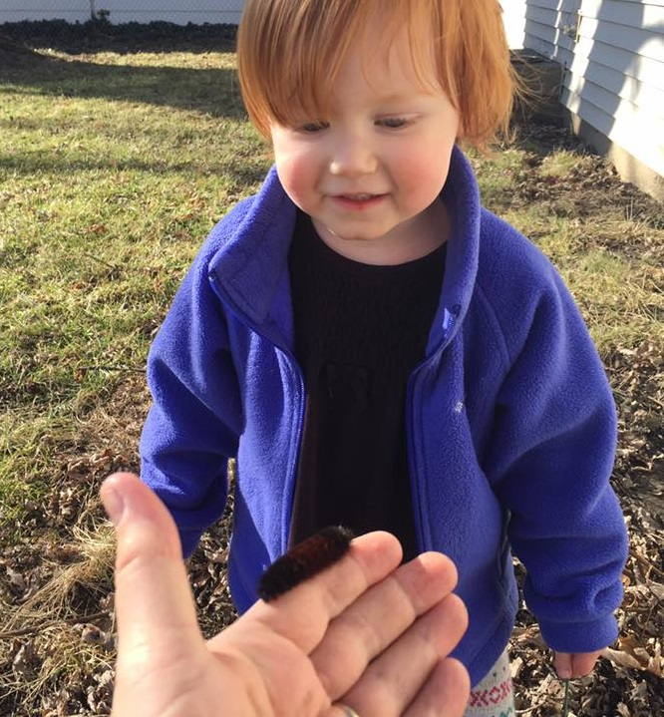

Slide 18
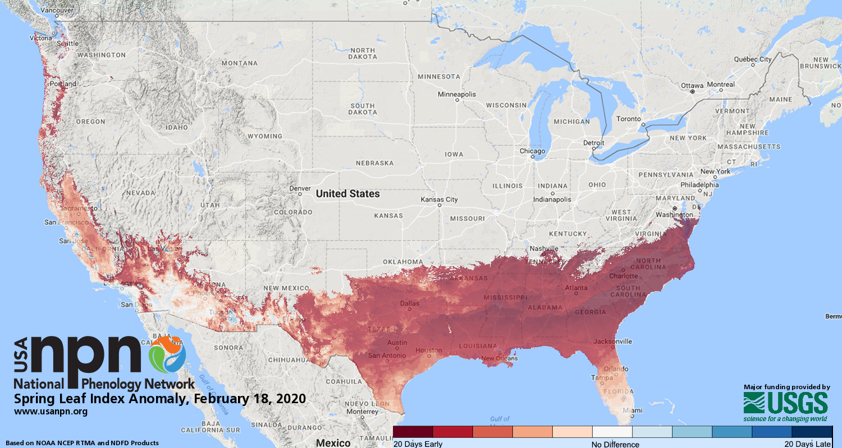
False Spring

Slide 19
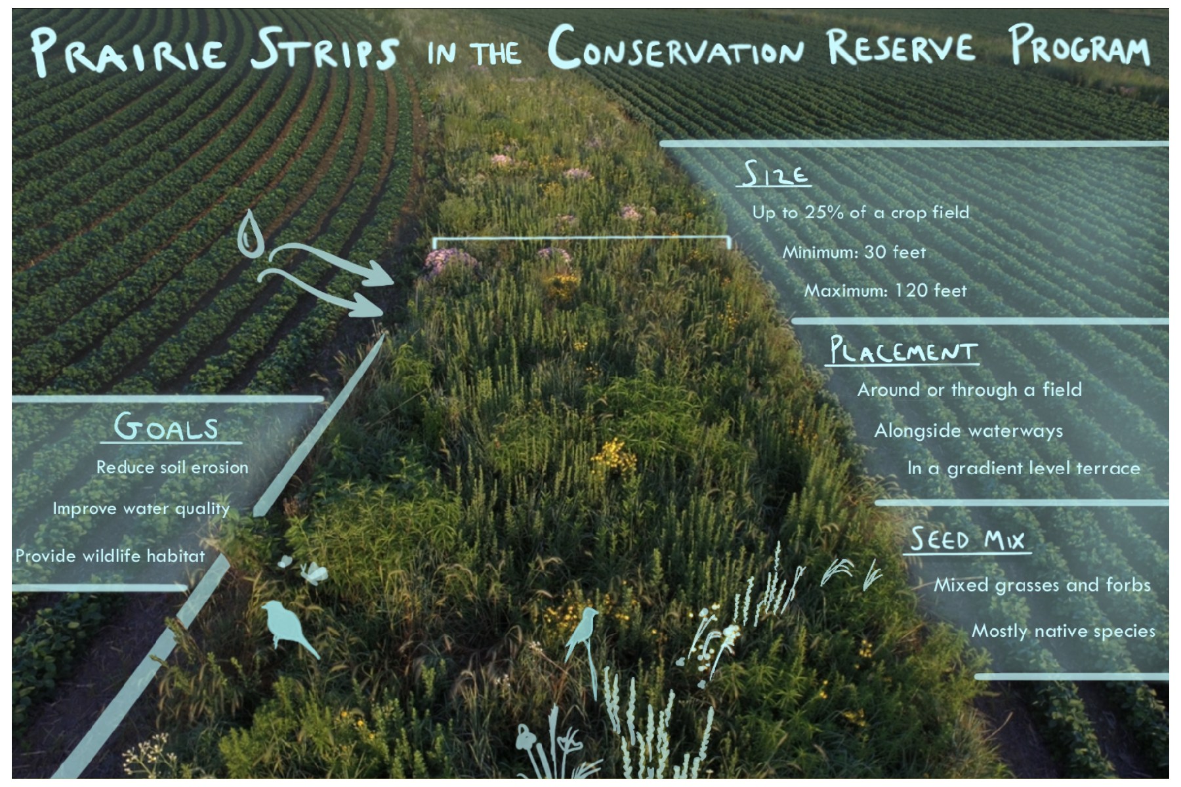
Prairie Strips in CRP de Kok-Mercado and Katrina Ruff

Slide 20
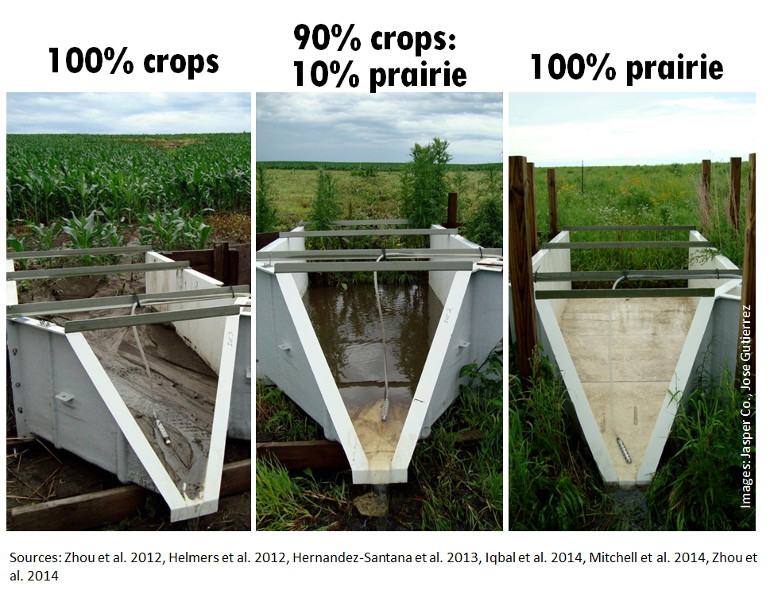
Flumes at Neal Smith credit Jose Gutierrez

Slide 21
Quick Stats
In a corn-soybean rotation with 10% coverage
  37% reduction in runoff
  95% reduction in sediment loss
  70% reduction in nitrogen loss
Practices just accepted for USDA Conservation Reserve Program

Slide 22
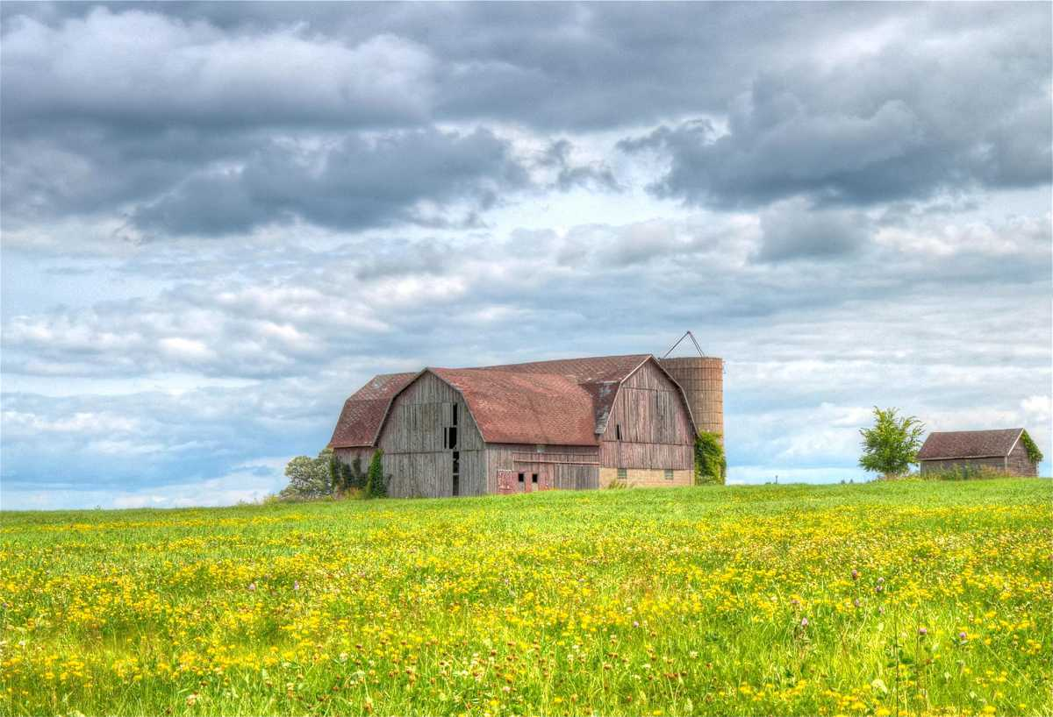
Summary for Much of US
Warmer throughout the year
Wetter, and more frequent and heavier rain events
Concern moving forward with higher summer heat

Slide 23
Thank you!
Dr. Jim Angel
Email: jimangel@Illinois.edu
Twitter: @jimangel22

