Slide 1

5G: Its Opportunities and Challenges in Precision Agriculture
SAURBH CHHABRA, Sr. Electronics Engineer
Wireless Telecommunications Bureau
Federal Communications Commission
February 20, 2020

Slide 2
Agenda
What is 5G?
5G: Opportunities in Precision Ag
5G: Challenges in Precision Ag
FCC Efforts to Realize the Opportunities of 5G

Slide 3
What is 5G?

Slide 4
ITU defines IMT-2020 (5G) as:
Parameters | Target
User experienced data rates | 100 Mbps
Peak data rates | 20 Gbps
Mobility | up to 500 km/h with acceptable QoS
Latency (air interface) | 1 ms
Connection density | 10⁶/km²
Network energy efficiency | 100 times better than IMT-Advanced
Spectrum efficiency | 3 times better IMT-Advanced
Area traffic capacity | 10 Mbit/s/m²
Source:
ITU, Study Group 13, Telecommunication Standardization Sector, Report: TD 208 (PLEN/13)
Notes:
ITU writes broad goals; 3GPP writes specifications and submits to ITU candidate technologies for 5G

Slide 5
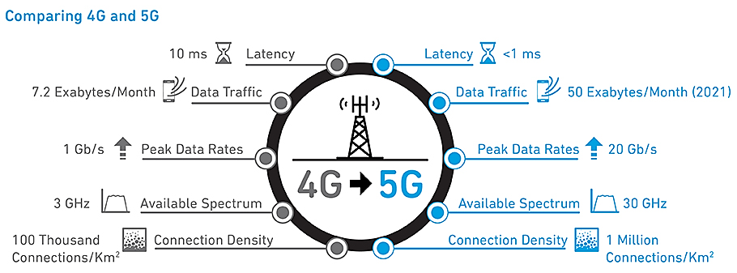
Capabilities of 5G
Source: https://www.qorvo.com/design-hub/blog/getting-to-5g-comparing-4g-and-5g-system-requirements
Notes:
This compares 4G LTE-Advanced to 5G NR; the latency is air-interface latency.

Slide 6
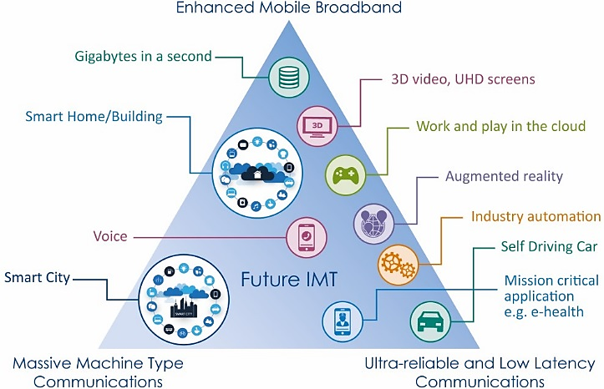
5G Use Cases
Source: https://www.testandverification.com/5g-usage-scenarios-nsa-sa
Notes:
Precision Ag can benefit from all these features and use cases of 5G. IoT sensors from mMTC; robotics, automation and near real-time data processing from URLLC & eMBB.

Slide 7
Spectrum Capabilities in General
CAPACITY
High Band
Mid-Band
Low-Band
COVERAGE
Notes:
Generally, high band spectrum provides better capacity than coverage, and low band spectrum provides better coverage than capacity. Deployments using low and mid-bands can provide a good compromise in both coverage and capacity.

Slide 8
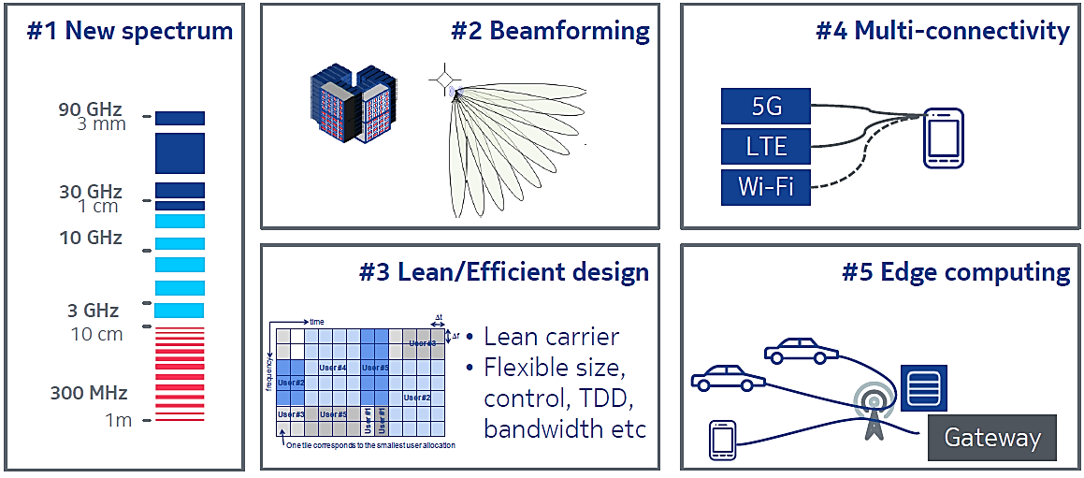
Some Key 5G Enabling Technologies
Source: Nokia, Enabling Technologies for 5G, The next generation network, June 1, 2018, Dr. Brian Cho
Notes:
New and more spectrum is being made available; Massive MIMO & Beamforming will provide more focused coverage and better user experience; Lean Carrier design will allow base station power savings and better spectrum utilization than 4G; Multi-connectivity will ensure better access based on what’s available; Edge computing brings cloud resources—compute, storage and networking—closer to applications, devices and users. It does by using small power cell stations to enable data to travel at high speeds—without having to travel long distances to a cloud or data center.
“Network Slicing” is the idea that each of these customers can get exactly what they want from a carrier off of a single platform, and each can customize and control their environment to a high level in a virtual way. Customizable network attributes could include data speed, quality, latency, reliability, security, and services. For Precision Agriculture, a network slice could offer services catered for farm use.

Slide 9
5G: Opportunities in Precision Ag

Slide 10
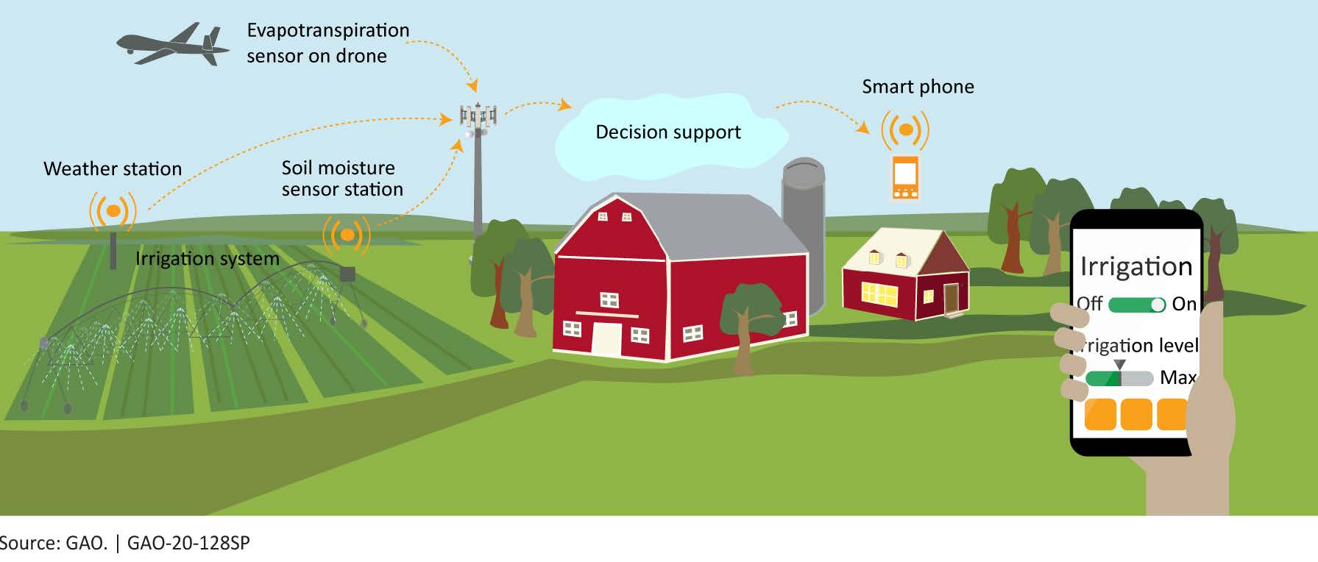
Opportunities in Precision Ag
Notes:
Precision Ag is everything that makes the practice of farming more accurate and controlled when it comes to growing crops and raising livestock.
Precision Ag technologies include GPS/GNSS, Mobile devices, Robotics, Variable Rate Irrigation/seeding/fertilization, IoT sensors for real-time weather/nitrogen/soil-moisture monitoring. Some or all of these technologies are expected to benefit from the deployment of 5G networks, where all devices to be used for Precision Ag are connected to give the farmer real-time access to information from the farm.

Slide 11
5G Opportunities in Precision Ag
Robotics
IoT sensors can be readily deployed to improve efficiency (improving production/yields and reducing waste)
IoT
IoT coverage can exist even w/o 5G high-speed coverage
5G Mobile/Fixed can provide coverage in rural areas
Coverage
Lower latency & edge computing capabilities of 5G can allow Artificial Intelligence, Robotics, and Automation to further improve efficiencies
Notes:
Edge Computing and low latency will enable real-time processing of data collected from IoT sensors; while both low latency and high-speed connections will enable automation by way of Artificial Intelligence and robotics. In essence, these 5G features will allow a farm to be run much more efficiently.

Slide 12
5G: Challenges in Precision Ag

Slide 13
5G: Challenges in Precision Ag
5G Coverage
Broad 5G coverage is lacking in rural areas
5G RAN, Core & Devices
Benefits of 5G will be fully realized with development of 5G Radio Access Network, 5G Core, and 5G Device ecosystem
Precision Ag Applications
Many IoT sensors only need low-speed internet access (though some may need higher speeds)
Some automation/robotics applications may need high-speed internet access and edge computing
Shift spectrum resources from 4G to 5G (DSS)
Notes:
Dynamic Spectrum Sharing (DSS) enables mobile operators to dynamically share spectrum resources across different technologies. Source: https://www.nokia.com/blog/nokia-launch-dynamic-spectrum-sharing-solution-2020/
The ability to share spectrum resources between 4G and 5G (DSS) may ease coverage challenges.

Slide 14
FCC Efforts to Realize the Opportunities of 5G

Slide 15
FCC Efforts to Realize the Opportunities of 5G
Making spectrum available for 5G:
  Recent 28/24/37/39/47 GHz auctions provide ~5 GHz of high-band spectrum for 5G
  Our work on the 2.5 GHz, 3.5 GHz, and 3.7-4.2 GHz bands could make more than 600 megahertz of mid-band spectrum available for 5G deployments
  Improvements to low-band spectrum (useful for wider coverage) with targeted changes to the 600 MHz, 800 MHz, and 900 MHz bands
  Creating new opportunities for the next generation of Wi-Fi in the 6 GHz and above 95 GHz bands
Updating infrastructure policy and encouraging private sector to invest in 5G networks
Modernizing outdated regulations to promote the wired backbone of 5G networks
Source: https://www.fcc.gov/5G
Notes:
The FCC is expediting federal, state & local review of small cell infrastructure.

Slide 16
FCC Efforts to Realize the Opportunities of 5G
The Broadband Deployment Advisory Committee (BDAC) at FCC provides advice and recommendations for the FCC on how to accelerate broadband deployment
Recently established Precision Ag Connectivity Task Force at FCC will provide recommendations to the FCC on how to advance broadband deployment to unserved agricultural lands for use of precision ag technologies
Chairman Pai intends to establish the 5G Fund, which would make up to $9 billion available to deploy advanced 5G mobile wireless services in rural America; at least $1 billion specifically for deployments facilitating Precision Ag
FCC established the Rural Digital Opportunity Fund, which, through a two-phase reverse auction mechanism, will provide up to $20.4 billion over ten years to finance up to gigabit-speed broadband networks in unserved rural areas
Source: https://www.fcc.gov/5G,
https://www.fcc.gov/task-force-reviewing-connectivity-and-technology-needs-precision-agriculture-united-states,
https://www.fcc.gov/document/fcc-launches-20-billion-rural-digital-opportunity-fund
Notes:
FCC Chairman Pai announced he intends to establish the 5G Fund, which would make up to $9 billion in Universal Service Fund support available to carriers to deploy advanced 5G mobile wireless services in rural America. The $9 billion Fund also would set aside at least $1 billion specifically for deployments facilitating precision agriculture needs.
On January 30, 2020, the FCC established the new Rural Digital Opportunity Fund to efficiently fund the deployment of high-speed broadband networks in rural America. Through a two-phase reverse auction mechanism, the FCC will direct up to $20.4 billion over ten years to finance up to gigabit speed broadband networks in unserved rural areas, connecting millions more American homes and businesses to digital opportunity.

Slide 17
Concluding Remarks
5G presents many opportunities in Precision Ag
  Broadband Coverage to Rural Areas
  AI/Automation/Robotics with high-speed and low-latency connectivity
  IoT use even in areas with low-speed connectivity
5G presents challenges as well
  5G lacks broad coverage and spectrum use will need to shift from 4G to 5G
  Deployment of 5G RAN, 5G Core, and Edge Computing may be needed for use of AI/Automation/Robotics in Precision Ag
There may be other opportunities and challenges that will come with implementation of 5G and its use in Precision Ag; but, by working together, government and industry can help realize the potential of 5G and find solutions to overcome the challenges.
Notes:
5G presents many opportunities for Precision Agriculture, including the potential to extend high speed and reliable broadband to rural areas, and the use of IoT sensors to provide data for efficient use of agricultural resources.

