Slide 1
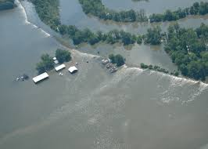
The Impact of Natural Disasters on Agricultural Economics
Keith Coble
@DrKeithHCoble
coble@agecon.msstate.edu

Slide 2
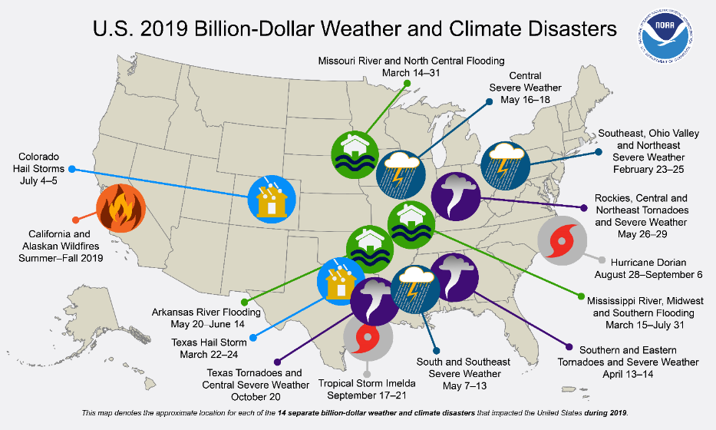

Slide 3
NOAA National Centers for Environmental Information (NCEI) U.S. Billion-Dollar Weather and Climate Disasters (2020). https://www.ncdc.noaa.gov/billions/

Slide 4
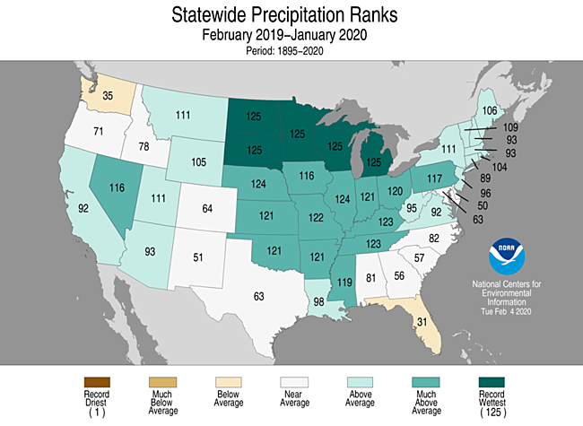

Slide 5
Private and Public Risk Management Provisions
The revolutionary idea that defines the boundary between modern times and the past is the mastery of risk….Risk management guides us over the vast range of decision making from allocating wealth to safeguarding public health, from waging a war to planning a family, from paying insurance premiums to wearing a seatbelt; from planting corn to marketing cornflakes.
Peter Bernstein in “Against the Gods: The Remarkable Story of Risk

Slide 6
Approaches to Risk Management?
Risk avoidance – don’t drive Loss prevention – Wear your seat belt Risk retention – Don’t pay for insurance on an old car Risk transfer – insurance or futures markets

Slide 7
Approaches to Farm Risk Management?
Risk avoidance – Don’t farm Loss prevention – Develop on-farm water storage Risk retention – Personal saving Risk transfer – insurance or futures markets

Slide 8
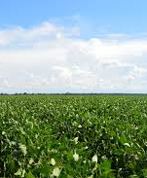
Agricultural Risk is Difficult to Assess Relative to Other Risks
Risk is a function of:
  Weather over entire season
  Management decisions
  Variety
  Soils
  Production system
  Markets

Slide 9
Agricultural Crop Risk
Spectrum of Risk Independence
Independent risk
Positively Correlated risk
Insurance
Futures Markets
Hail
Yield
Revenue
Price

Slide 10
Public versus Private
Private
  Innovation
  Can tap into world reinsurance market
  Avoids moral hazards and adverse selection
Public
  Subsidized
  Can tap into U.S. treasury
  Rarely can solve the moral hazard and adverse selection problems

Slide 11
Deceiving ourselves about ag risk
“It's easier to fool people than to convince them that they have been fooled.” ― Mark Twain
Why, sometimes I've believed as many as six impossible things before breakfast. - Alice in Wonderland.
The creature we study in economics is similar to Mr. Spock from Star Trek … The world I study is full of people more like Homer Simpson — Robert Thaler

Slide 12
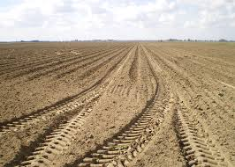
Cost and Benefit of Conservation and Disaster Prevention
Short Run versus Long Run
  Discount rates and risk aversion
  Uncertainty
Personal versus social benefits
Reversibility

Slide 13
Soil Health as an Example
Long term vs Short-term Planning
Current soil health policy may crowd-out privately optimal behavior. Optimal policy depends on whether society and landowners value the future differently.
Farmers probably don’t know enough their own soil health.
We still do not know much about how soil health evolves over time in response to production practices.

Slide 15
Why good loss experience? Good weather, risk pool, production systems, or better crop insurance program

Slide 16
Ex Ante Indemnification
Ex ante insurance institutionalizes premiums and indemnity structures for insurable risks. More time is available to define and implement the program than an ex post program.
A standing program is costly and, if premiums are charged, government costs are reduced.
However, if producers are unwilling to pay for insurance, then government objectives are thwarted
- generally, the low willingness to pay for insurance is a function of either low probabilities of occurrence or low economic costs of an occurrence, or both.

Slide 17
Ex Post Indemnification
do not require significant a priori institutional infrastructure or producer enrollment.
Avoids the creation of institutions and program costs for a low probability event.
the hurried nature of ex post indemnification and the tendency for each event to differ makes it difficult to either efficiently or equably indemnify rare, but often costly, events.
a completely ad hoc program also precludes incentive structures to induce preventive measures.
A related issue is the demand for protection for extremely low probability risks.
  - decision makers often make large errors in subjective assessments
  - insurance demand?
  - penalties and incentive structures (Bonus/Malus systems)?

Slide 18
Ex Ante Indemnification
Manageable risks with high probability of occurrence and available effective management strategies are seldom deemed insurable.
  Insuring a risk that has effective management remedies would likely be fraught with moral hazard issues as insurance would provide a strong incentive to shirk good management
  In some instances producers may require education, training or decision aids which the government may support or develop.
  Group management or spatial eradication programs tend to have high initial costs but strong long-run benefits/cost ratios. They also have potential for free-rider problems.

Slide 19
The Future
Likely to face more severe events
Can government incentivize mitigation rather than disincentivize it?
Can public and private complement?
Technology
  Rainfall maps and basis risk
  Ground truth, soil mapping, etc.

Slide 20
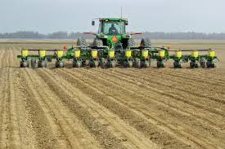
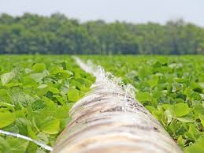
Thank You

