Slide 1


Sugar Consumption
  U.S. sugar production, consumption, net imports
  Sugar deliveries by usage category and region
  Key drivers of U.S. sugar deliveries and consumption

Slide 2






“Scare” headlines for sugar
Time Health
The Guardian
Boston Globe
Bloomberg
New York Times
Food Processing
Sugar is definitely toxic, a new study says
Sugar is poison. My heart attack has finally opened my eyes to the truth
The war on sugar
Is sugar the new tobacco?
Big sugar versus your body
Are sugars the new public enemy No. 1?

Slide 3

Sugar or beverage taxes around the world
 | Sugar or beverage taxes in place or announced
 | Regional or local sugar or beverage taxes in place or announced
 | Sugar or beverage taxes under recent consideration
Denmark repealed 80-year old fat and sugar taxes in 2013 and 2014.
Malaysia raised sugar pricing instead of setting a beverage tax in 2017.
Canada’s Northwest Territories have announced plans for a soda tax.
In Spain, Catalonia has announced a sugar tax.

Slide 4
Sweetener & soda taxes in the U.S.: Highly dilute potential influence
U.S. locations with beverage taxes
  Berkeley, San Francisco, Albany, Oakland
  Boulder
  Philadelphia: Facing serious challenges
  Cook County (Chicago) - Repealed by County Board
  Seattle
  Santa Fe? - Voters rejected this tax
  Portland
  State legislatures (Connecticut, California, Massachusetts, New York, Vermont…) are looking more seriously at beverage taxes, as well.
Research suggests that these taxes can shift demand to healthier choices. Most of the taxes as implemented are lower than experts would like, and there are often exceptions (juices, teas, dairy-based drinks, coffee drinks).
Results so far are mixed, and even when consumption is lowered, there is little indication of lower obesity rates or improved health results.
  How many Americans are
  currently subject to these taxes?
Arkansas adopted a tax on all soft drinks in 1993.

Slide 5
Sugar consumption
*Estimate. Source: USDA, McKeany-Flavell

Slide 6
Nutritive sweetener deliveries per capita

Slide 7
U.S. population growth slowing

Slide 8
Refined sugar & HFCS domestic deliveries
*Estimate
Source: ERS, McKeany-Flavell

Slide 9
Futures vs. delivered sweetener pricing
Source: DTN M&B, McKeany-Flavell

Slide 10
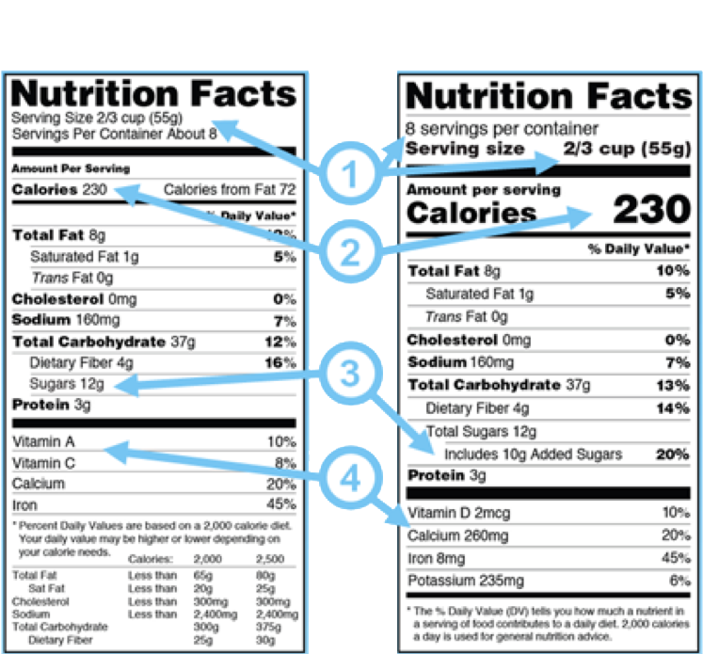

Sweetener & soda taxes in the U.S.: Highly dilute potential influence
  FDA has changed the guidelines for nutrition labels on packaged goods to more clearly present the information that is more accurate and nutritionally valuable to consumers—at least theoretically.
  The new labels will make the number of servings per package and the serving size more visible (1). The most notable change, however, may be increasing the prominence of the calories per serving (2). Also significant: Labels will now identify more clearly the nutritional contribution of added sugars (3).
  According to FDA, the basis for calculating serving sizes may be modified to more realistically represent actual consumption patterns.
  Labels will no longer be required to present vitamin A and C, replaced by information on vitamin D and potassium, which FDA considers of greater importance for the average consumer (4).
Original Label
New Label

Slide 11
Sugar deliveries by category
  According to Information Resources, Inc., 43% of U.S. consumers place taste above health benefits
  in their food purchasing decisions.

Slide 12
Sugar deliveries to the beverage industry
Source: FSA

Slide 13
Sugar deliveries to the confectionery industry
Source: FSA

Slide 14
Confectionery industry, sales by volume

Slide 15
Sugar deliveries to the ice cream & dairy industry
Source: FSA

Slide 16
Dairy manufacturing volumes, select products

Slide 17
Domestic vs. world raw sugar futures prices
Source: DTN, McKeany-Flavell

Slide 18
Sugar-containing product imports
Est. equivalent sugar content
Source: USDA

Slide 19

Summary
Bearish sugar consumption trends
Sugar being demonized as unhealthy
Population growth slowing on lower birth rate and immigration
Food marketers reduce product size offerings instead of increase prices
Taxes and other legislation designed to reduce consumption of high calorie beverages and food products
Bullish sugar consumption trends
Population is still growing 0.5% per year
Many consumers prefer sugar over HFCS as a healthier, more natural ingredient
The functionality, taste, and value proposition is hard to beat

