Slide 1
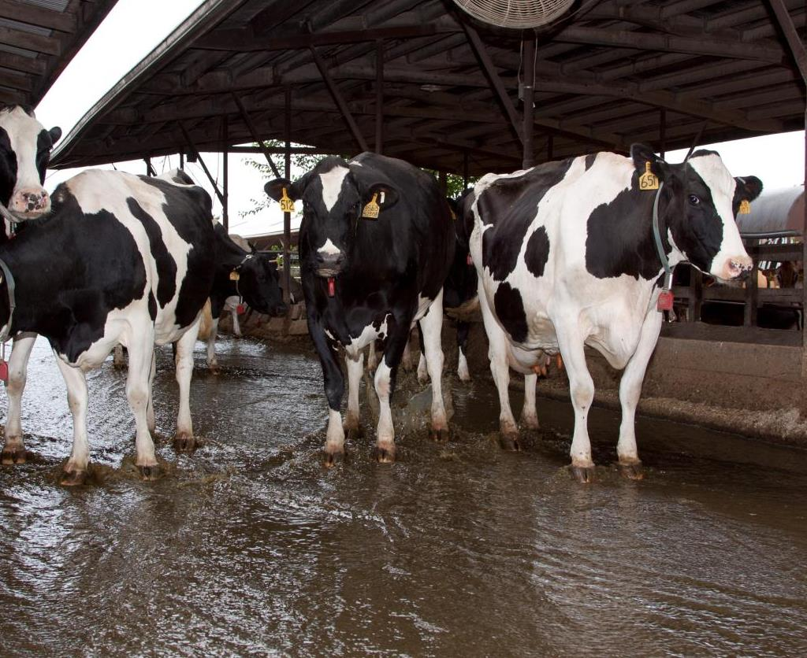
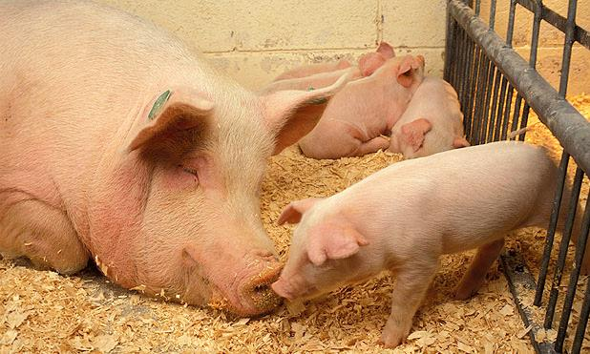
Livestock Greenhouse Gas Intensity Metrics
Cortney Itle, Eastern Research Group
Notes:
NRCSMD12029.tif USDA photogallery
Image Number K7975-10 (ARS Image Gallery : USDA ARS)

Slide 2
Greenhouse Gas Emissions from Livestock
Livestock sources of GHG:
  Manure management: Methane and nitrous oxide emissions are produced from the treatment and storage of manure
  Enteric fermentation: Methane emissions result from digestive process of animals, especially ruminants like cattle

Slide 3
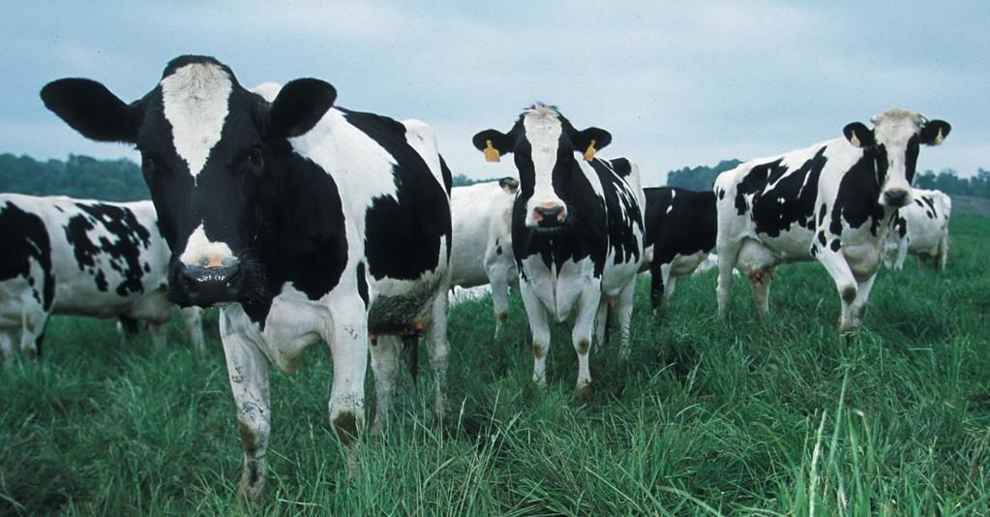
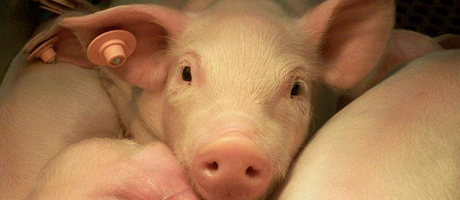
Why estimate GHG intensity metrics?
Provides insight on per-unit emissions trends by commodity
Shows the evolution of the sector over time
Inform future efforts to reduce intensities

Slide 4
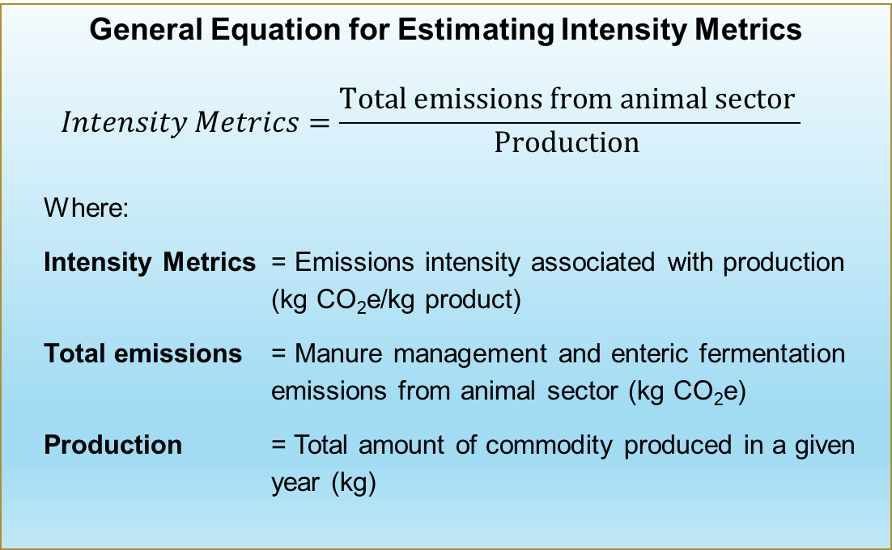
Estimating Intensity Metrics
General Equation for Estimating Intensity Metrics
$$Intensity Metrics=\frac{Total emissions from animal sector }{Production }$$
Where:
Intensity Metrics = Emissions intensity associated with production (kg CO₂e/kg product)
Total emissions = Manure management and enteric fermentation emissions from animal sector (kg CO₂e)
Production = Total amount of commodity produced in a given year (kg)
Analysis includes:
  Methane and nitrous oxide emissions
  Emissions from enteric fermentation and manure management
  All animals in the production cycle
Emissions data from 1990-2018 Inventory of U.S. Greenhouse Gas Emissions and Sinks
Production data from USDA National Agricultural Statistics Service (NASS)QuickStats Database)

Slide 5
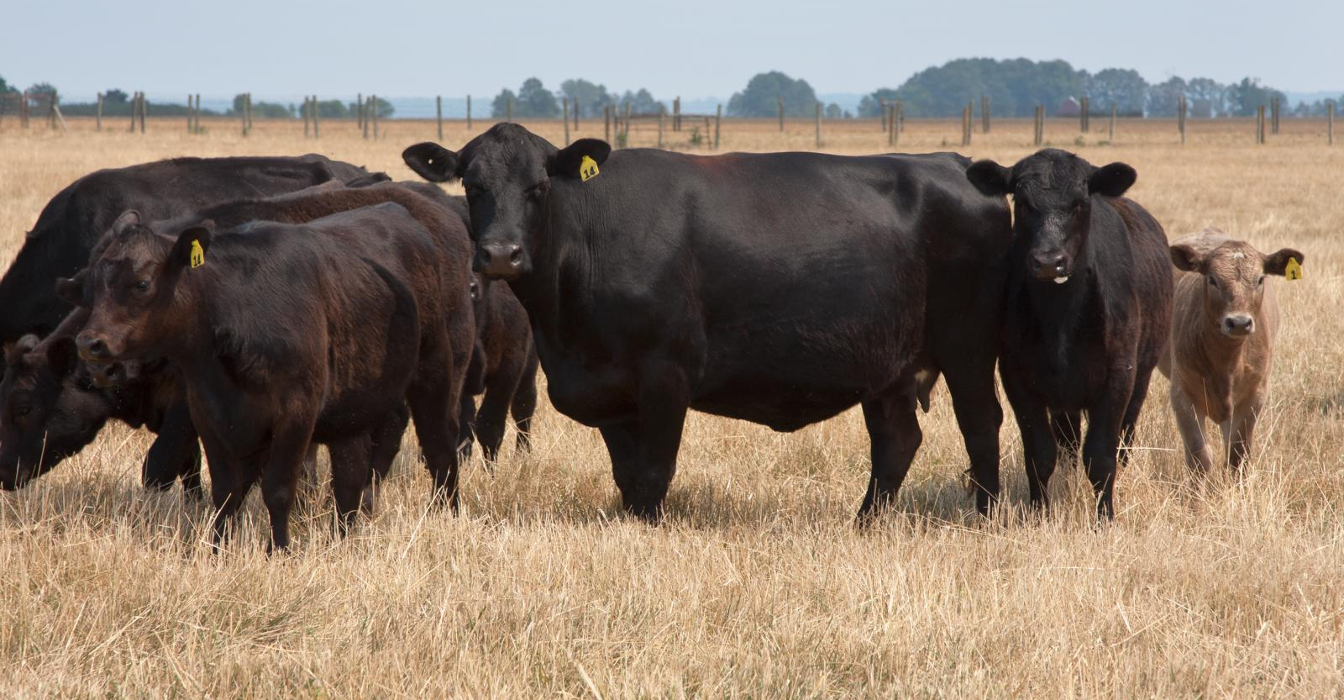
Beef Production
Notes:
Includes:
Bulls
Beef calves
Beef cows
Beef replacements
Steer stockers
Heifer stockers
Feedlot cattle
NRCSVA12079.tif
NRCSMS12056.tif

Slide 6
Intensity Metrics – Beef Production
U.S. Total Beef Cattle Population and Associated Emissions
Most (>90%) of the GHG emissions from beef emissions are from enteric fermentation
Emissions from manure management systems have increased (~40%) since 1990, due to increased beef feedlots (vs pasture-based systems)

Slide 7
Intensity Metrics – Beef Production
Index Graph
Beef and Veal Production GHG Intensity Metric Trends
Beef production per head has increased ~20% and emissions per head has increased ~8% since 1990
  Associated with overall increase in animal weight
Notes:
Explain index graph

Slide 8
Intensity Metrics – Beef Production
Kilograms CO₂e Emitted
per Kilogram of Beef and Veal Produced
Emission per unit of meat have decreased by about 6 percent since 1990

Slide 9
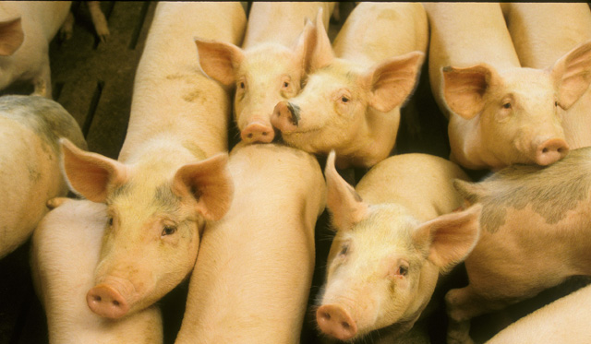
Swine Production
Notes:
Image Number K5657-3
Image Number K7975-10 (ARS Image Gallery : USDA ARS)

Slide 10
Swine Production
U.S. Total Swine Population and Associated GHG Emissions
GHG emissions primarily (~90%) from manure management
Since 1990, there has been ~37% net increase in the total annual U.S. swine population
Notes:
Greenhouse gas emissions from the swine industry result primarily from livestock manure management; enteric fermentation contributes only about 10 percent of the total emissions from swine. Driven by population and wms
Since 1990, there has been about a 37 percent net increase in the total annual U.S. swine population
Between 1990 and 2018, emissions loosely correlate with both production and population trends

Slide 11
Swine Production
Index Graph
Pork Production GHG Intensity Trends
Notes:
Downward trend in intensity is consistent with trends in emissions and pork production on a per-head basis;
Pork production per head has increased by about 25 percent since 1990, but emissions per head have only increased by about 3 percent over the same timeframe.

Slide 12
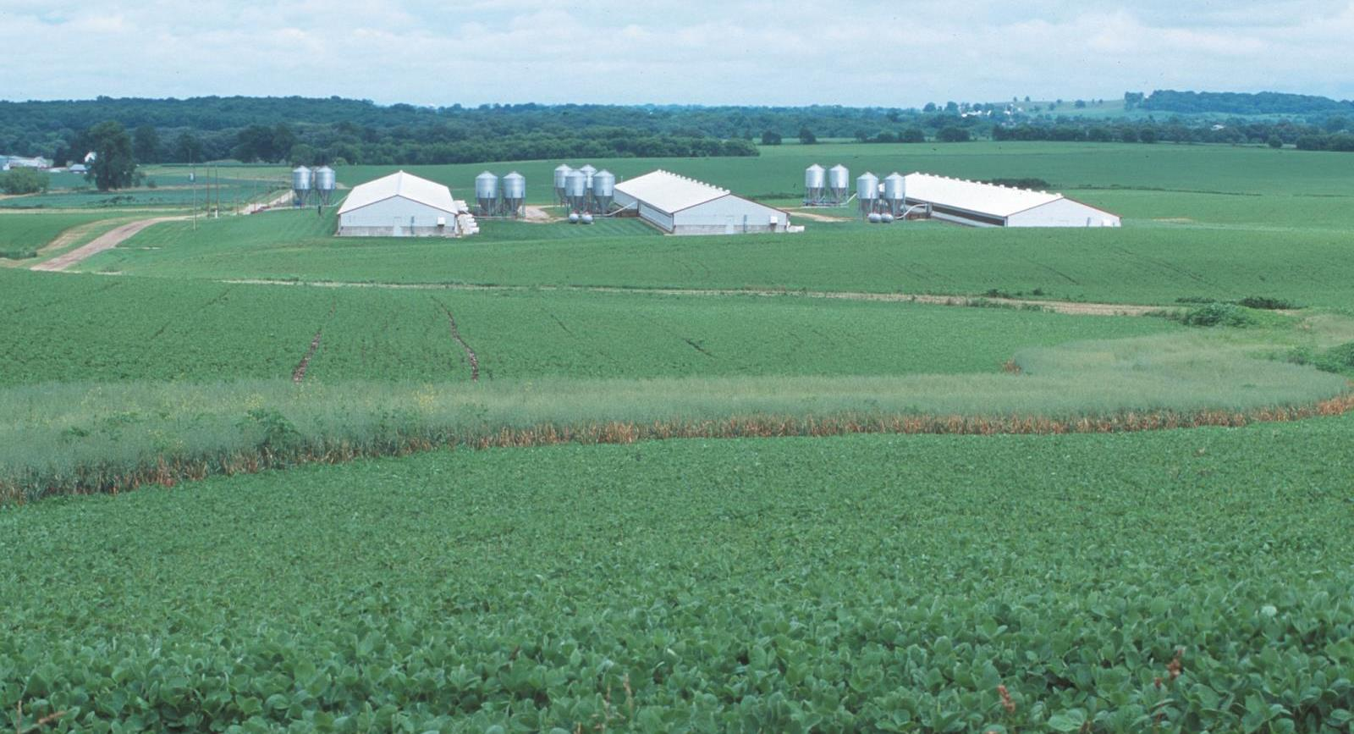
Swine Production
Kilograms CO₂e Emitted per Kilogram of Pork Produced
Notes:
NRCSWI00019.tif USDA photo gallery

Slide 13
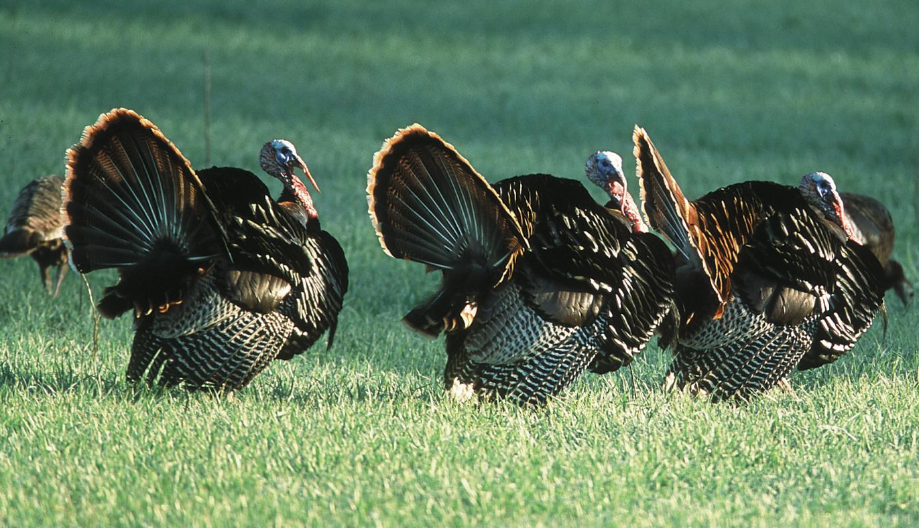
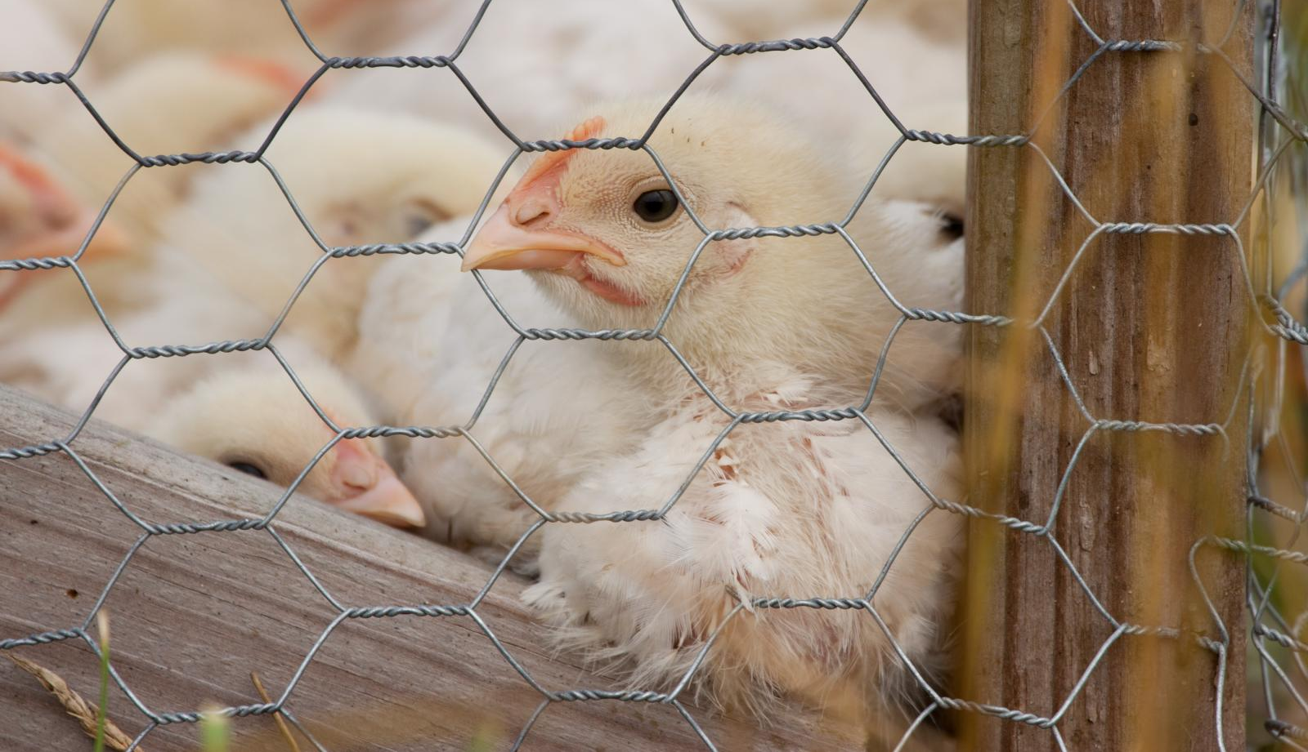
Poultry Production
Notes:
NRCSMD12172.tif
NRCSKS02046.tif

Slide 14
Poultry Production
U.S. Total Turkey, Broiler, and Chicken Populations and Associated Emissions
Total annual U.S. poultry meat animal population, total chicken and broiler populations, and total emissions from broiler meat production have increased by ~50% since 1990
Total emissions from chicken meat production have decreased almost 30%
Total turkey population and total emissions from turkey meat production have decreased since 1990
Notes:
Since 1990, there has been a 46.5 percent net increase in the total annual U.S. poultry meat animal population. total chicken population, total broiler population, and total emissions from broiler meat production have also increased over time by approximately 50 percent. However, total emissions from chicken meat production have decreased by 26.5 percent over the time series
total turkey population and total emissions from turkey meat production have decreased since 1990; turkey population has decreased by 30.7 percent and emissions have decreased by 40.7 percent. Turkey and chicken meat production has been consistently around 10 times less than broiler meat production during this time period, so these decreases in chicken and turkey emissions were not significant enough to reduce the poultry meat industry’s total emissions.

Slide 15
Poultry - Broilers and Chicken Production
Index Graph
Broilers and Chicken Production GHG Intensity Trends
Notes:
Downward trend in emissions and poultry production on a per-head basis
126.1% increase in chicken and broiler meat production
Emissions have increased at a slower rate than meat production
Industry improvements have increased efficiency and reduced emission intensity metrics
Overall, this downward trend is consistent with trends in emissions and poultry production on a per-head basis. The fact that emissions have increased at a slower rate than meat production suggests that industry improvements have increased efficiency and reduced emission intensity metrics, including, for example, the increase in slaughter weight over the time series
U.S. production of poultry meat has increased 107 percent since 1990, consistent with the U.S. poultry population. There has been a 126.1 percent increase in chicken and broiler meat production and a 28.9 percent increase in turkey meat production
Between 1990 and 2008 for both industries, emissions correlate with production trends. After 2008, emissions significantly decreased with respect to poultry meat production, and remain lower than 2008 values as of 2018. This is mainly due to the increase in poultry weight per head over this time period Because individual bird weight increased, less population was necessary to fulfill demand, resulting in less manure emissions over the time series

Slide 16
Poultry – Turkey Production
Index Graph
Turkey Production GHG Intensity Trends
Notes:
28.9% increase in turkey meat production
As individual bird weight increased, less population was necessary to fulfill demand, resulting in less manure emissions over the time series

Slide 17
Poultry Production
Kilograms CO₂e Emitted per Kilogram of Poultry Meat Produced
Notes:
NRCSWI00019.tif USDA photo gallery
. On a production basis, total poultry industry emissions have decreased by about 44 percent since 1990. Individually, chicken and broiler emissions have decreased by 36.1 percent and turkey emissions have decreased by 54.0 percent.

Slide 18
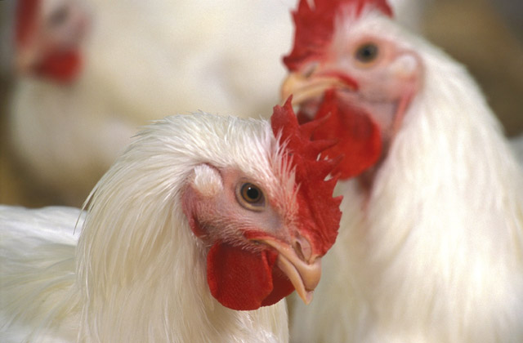
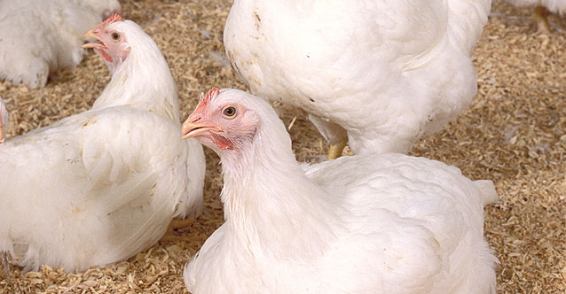
Egg Production
Notes:
NRCSMD12029.tif USDA photogallery
Image Number K7975-10 (ARS Image Gallery : USDA ARS)

Slide 19
Egg Production
Index Graph
Egg Production GHG Intensity Trends
The U.S. layer population has increased between 1990 and 2018
Egg production has increased and the number of eggs per layer has increased since 1990
Notes:
The relative stability of layer emissions—despite layer populations increasing by 45 percent—is due in part to layer populations increasing in states that manage manure mainly in poultry without bedding systems (e.g., Iowa); this type of manure management produces fewer emissions than other systems.

Slide 20
Egg Production
Grams CO₂e Emissions per Egg Produced
Emissions per egg produced decreased 35% since 1990
Egg production increased while layer emissions have remained relatively stable
  The number of eggs per layer increased about 11%
Notes:
emissions per egg produced, which have decreased by about 35 percent between 1990 through 2018. This trend corresponds to the increase in egg production outpacing the relatively stable layers emissions.

Slide 21
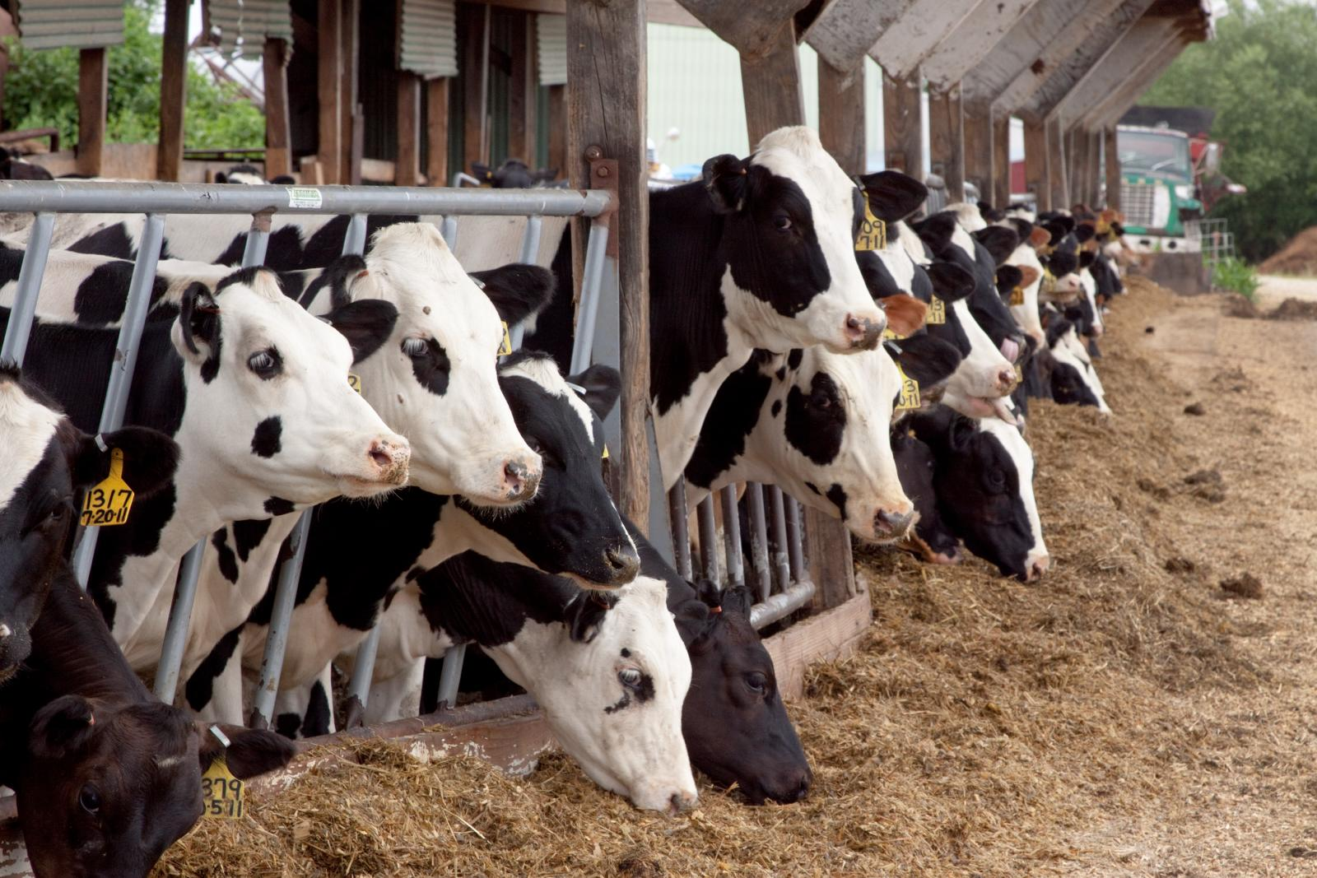
Milk Production
Notes:
NRCSMD12029.tif USDA photogallery
Image Number K7975-10 (ARS Image Gallery : USDA ARS)
Includes emissions from:
Dairy cows (milking & dry)
Dairy heifers
Dairy calves

Slide 22
Milk
U.S. Total Dairy Population and Associated Emissions
Notes:
Manure management and enteric fermentation emissions from dairy cattle have both increased since 1990
Impacted by population, manure management practice, animal diet, and geographic location
NRCSWI00019.tif USDA photo gallery

Slide 23
Milk Production
Index Graph
Milk Production GHG Intensity Trends
Milk production has increased by 47% and milk yield increased by 57% since 1990
Compared to 1990, more milk is produced today on large farms (more than 1,000 head) than small farms.
  Large farms are more likely to use liquid manure management systems which increases manure methane emissions and are more likely to have better herd management which increases milk yields

Slide 24
Intensity Metrics - Milk
Kilograms CO₂e Intensity of Milk
(kg CO₂e produced per kg of Milk)
Enteric fermentation intensity decreased because of the improvements in herd management resulting a decrease in the total number of dairy cows, relative to yield.
Manure management intensity increased due to increased usage of liquid manure management systems, such as anaerobic lagoons.

Slide 25
Thank you!
Cortney.Itle@erg.com

