Slide 1
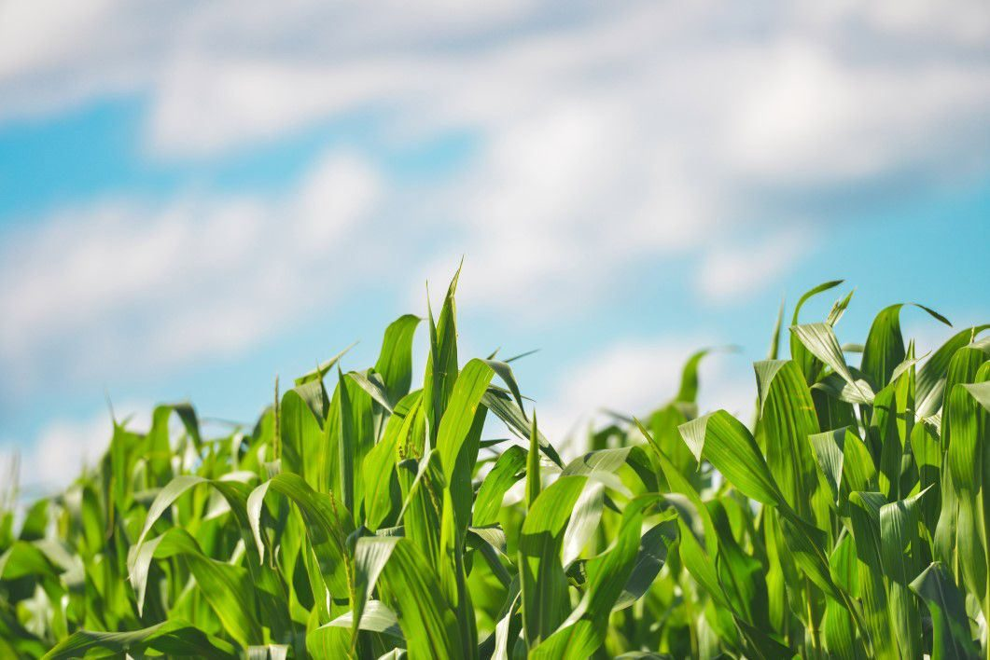
Sustainable Agriculture Means Sustaining Farmers:
Surveying the Field of Farm Stress Research and Outreach
Dr. Courtney Cuthbertson (they/them)
University of Illinois
USDA Agricultural Outlook Forum
February 25, 2022

Slide 2
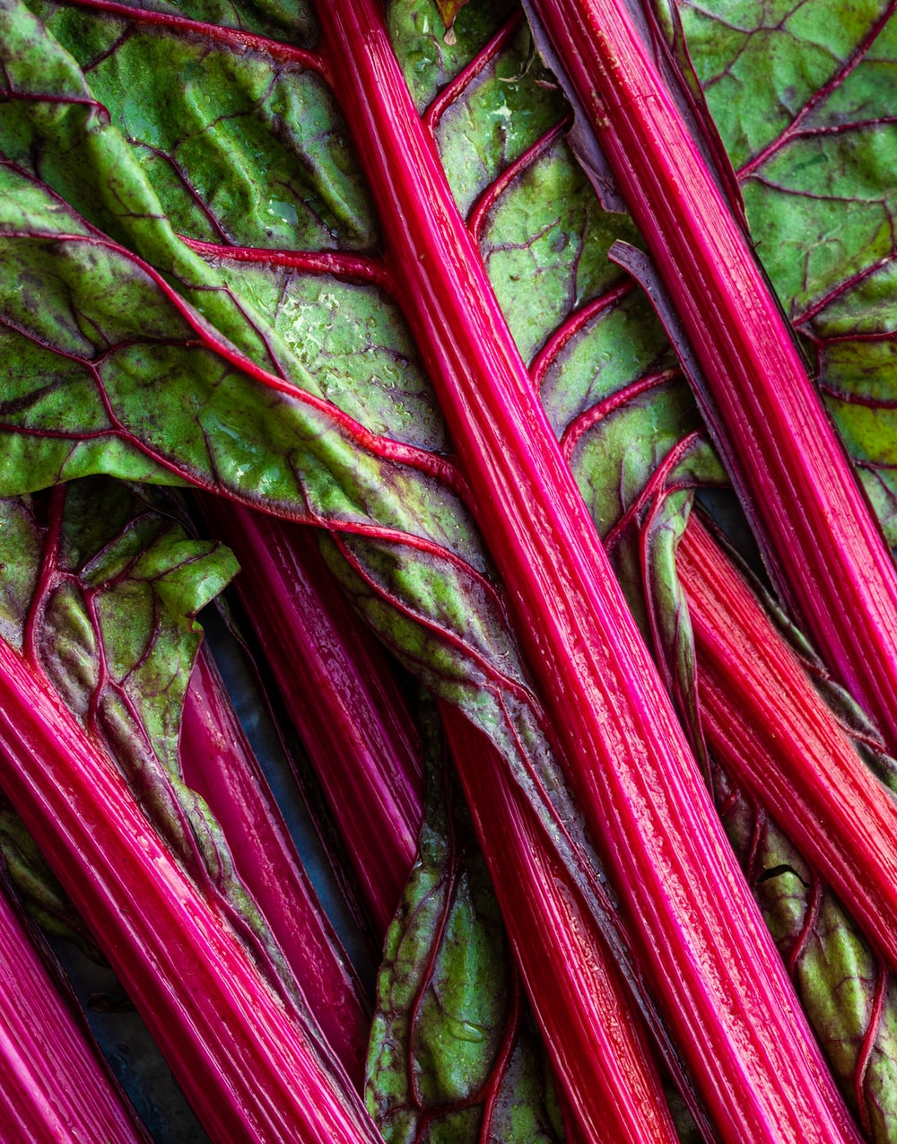
No farming without farmers.
No health without mental health.

Slide 3


Slide 4
Mental health is worse among producers.
General population
Agricultural community
7.3%
15.6%
27.4 (all occupations)
8.7-58%
27-71%
36.1
depression
7-8x higher
anxiety
4.5x higher
suicide rate – men (per 100k)
1.3x higher
(Reed & Claunch, 2020; Rudolphi et al., 2020; Bjornestad et al., 2021; Terlizzi & Villarroel, 2020; Weinberger et al., 2017; Peterson et al., 2020.)

Slide 5
What about substance use?
(SAMHSA 2015; Bush and Lipari 2015.)

Slide 6

What explains this?
Increased stress
Poor physical health and experiencing injury
Poor sleep quality
Recent negative life events
Financial concerns
Note: Higher suicide risk and rates have not
been explained by higher rates of mental health problems.
(Hawes et al. 2019; Yazd et al. 2019; Onuameze et al. 2013; Roy et al. 2013; Scarth et al. 2000; Witt, Reed, and Rayens 2020; Greig et al. 2020; Judd et al. 2006; Bjornestad et al. 2021; Kennedy et al. 2021; Stain et al. 2008; Zhao et al. 2019; Scheyett et al. 2019; Ringgenberg et al. 2018.)

Slide 7
What stressors impact mental health for farmers?
Financial concerns
Work environment
Navigating potential problems
Managing farm wellbeing/survival
For migrant farmworkers: distance from family, working conditions, language barriers, fear of deportation, acculturation
(Griffin et al. 2019; O’Connor et al. 2015)

Slide 8
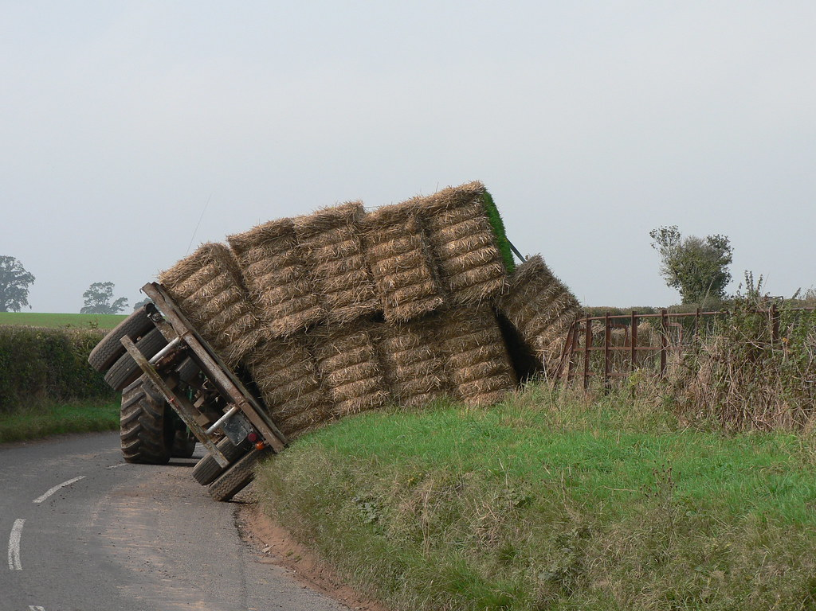
Impacts on agriculture
Higher risk of injury
Impacts on farm efficiency
Ripple effects on family
(Stoneman and Jinnah 2015; Xiao et al. 2013; Hounsome 2006.)

Slide 9
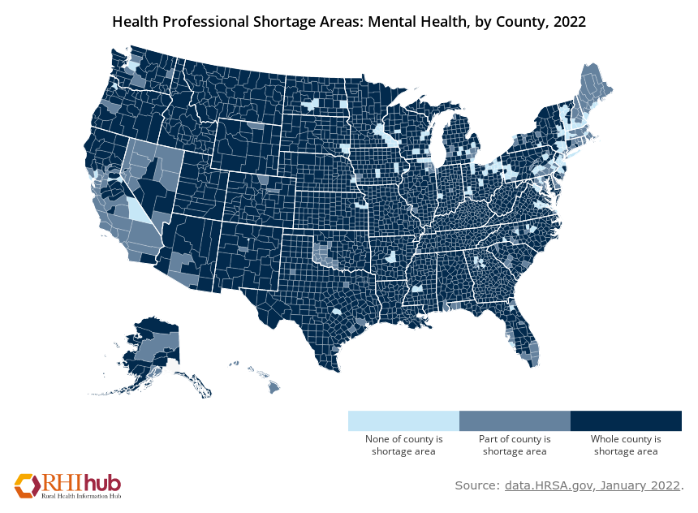
So producers should seek help, right?

Slide 10

Stigma is another barrier to care.
Negative beliefs about mental health, illness, people
Lead to isolation, negative self-perceptions
Contributes to less help-seeking
Values of stoicism, independence, aspects of
masculinity decrease help-seeking in producers
(Alston 2012; Weigel 2003; Creighton et al. 2017; Barlett and Conger 2004; Vayro et al. 2020; Roy, Tremblay, and Robertson 2014; Alston and Kent 2008.)

Slide 11




Outreach programs help producers.
Professional behavioral health services
Training programs
Farm and Ranch Stress Assistance Network
(FRSAN)
Telephone helplines
Support groups
Clearinghouse website and webinars
USDA-NIFA 2020-70028-32728​

Slide 12

Example: Mental health literacy training
Mental Health First Aid (MHFA)
Question. Persuade. Refer. (QPR)
Communicating with Farmers under Stress
Weathering the Storm

Slide 13

Remaining questions
What are effective ways to
deal with stigma?
How can we go upstream?
How can we create resources
inclusive of diversity in
agriculture?

Slide 14

What else should I know?
Everyone always has mental health.
Asking for help is a sign of strength.
You don’t have to be in crisis
to ask for help.
There are people who care and
want to help.
Finding the right mental health
provider can take time.

Slide 15
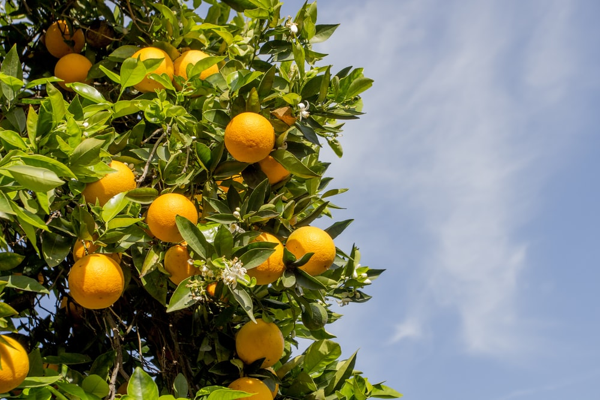
What can I do?
Connect with and listen to producers.
Start conversations about mental health in your community.
Visit www.farmstress.org for a listing of useful resources.
  Iowa Concern Hotline: 1-800-447-1985
Contact Cooperative Extension in your state
  and ask about farm stress programs and resources.
Learn more about mental health.
Help host a training.
Share resources with others.
Advocate for more resources, programs, and
funding to support producer mental health.

Slide 16

Thank you.
Dr. Courtney Cuthbertson (they/them)
Assistant Professor and Extension Specialist
Human Development and Family Studies
University of Illinois
cuthbert@illinois.edu

