Slide 1
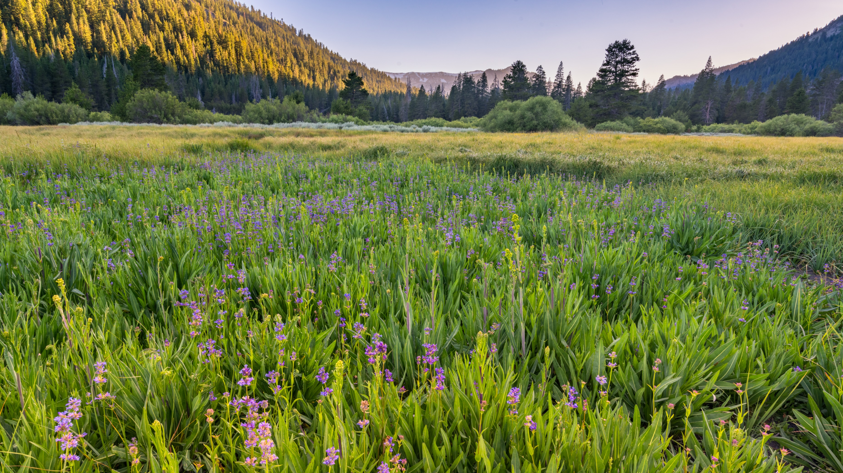

USDA USFS Presentation
Dan Porter | Forest Strategy Lead

Slide 2

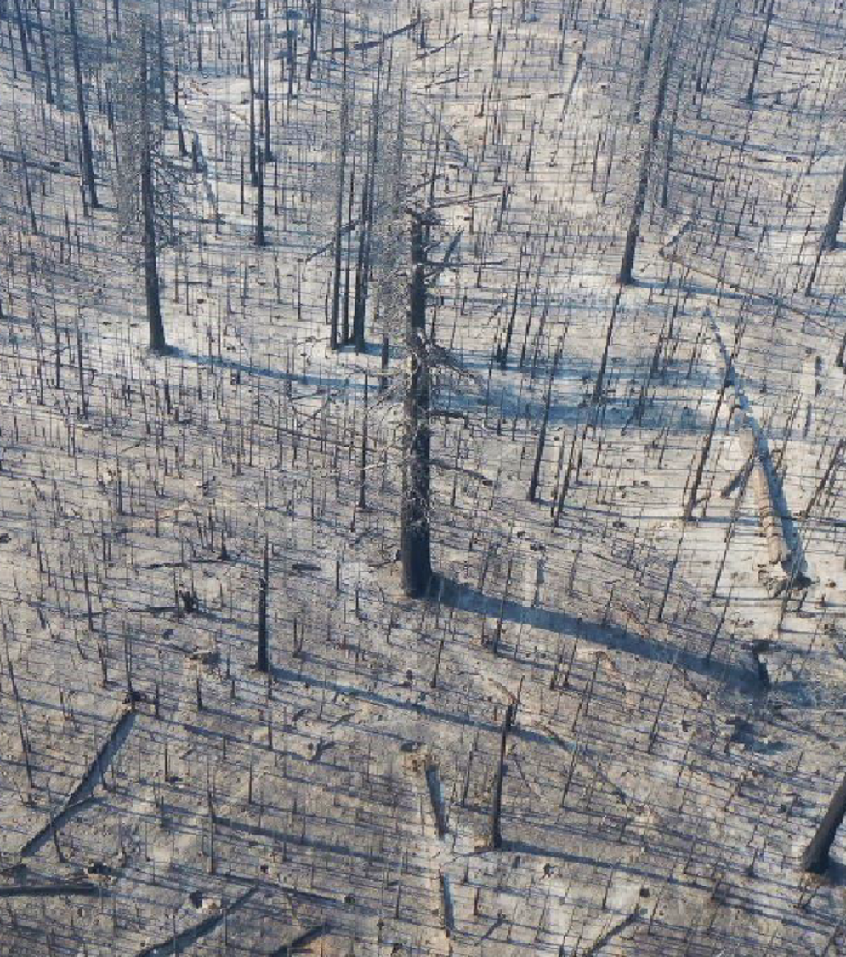
California (USFS Region 5)
1.
TREATMENTS
(bigger, more precise, faster)
2.
MARKET INNOVATIONS
(targeted public investments)
3.
SKILLED WORKFORCE
(new public policy, project intermediaries)

Slide 3
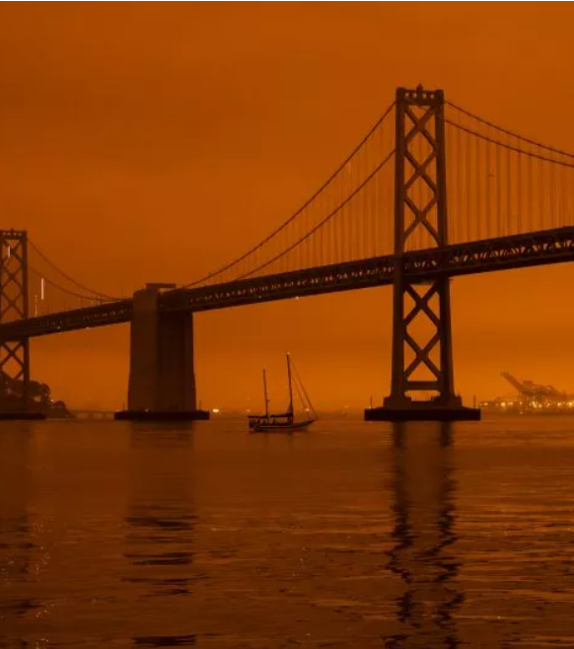
Future of the West?
CA, 40 MILLION PEOPLE, AND GROWING
CA WILDFIRE SUPPRESSION ($/YR.)
~$1B₍₂₀₀₆₎ → $4B₍₂₀₂₂₎
RESILIENCE FUNDING: STRONG START, BUT STILL NOT SIZED FOR THE CRISIS AT HAND.
USFS 10-yr plan: $5B/yr. need
Federal BIB: $655 M/yr.
CA 21/22 budget: $1B/yr.
San Francisco – September 20, 2020, midday

Slide 4
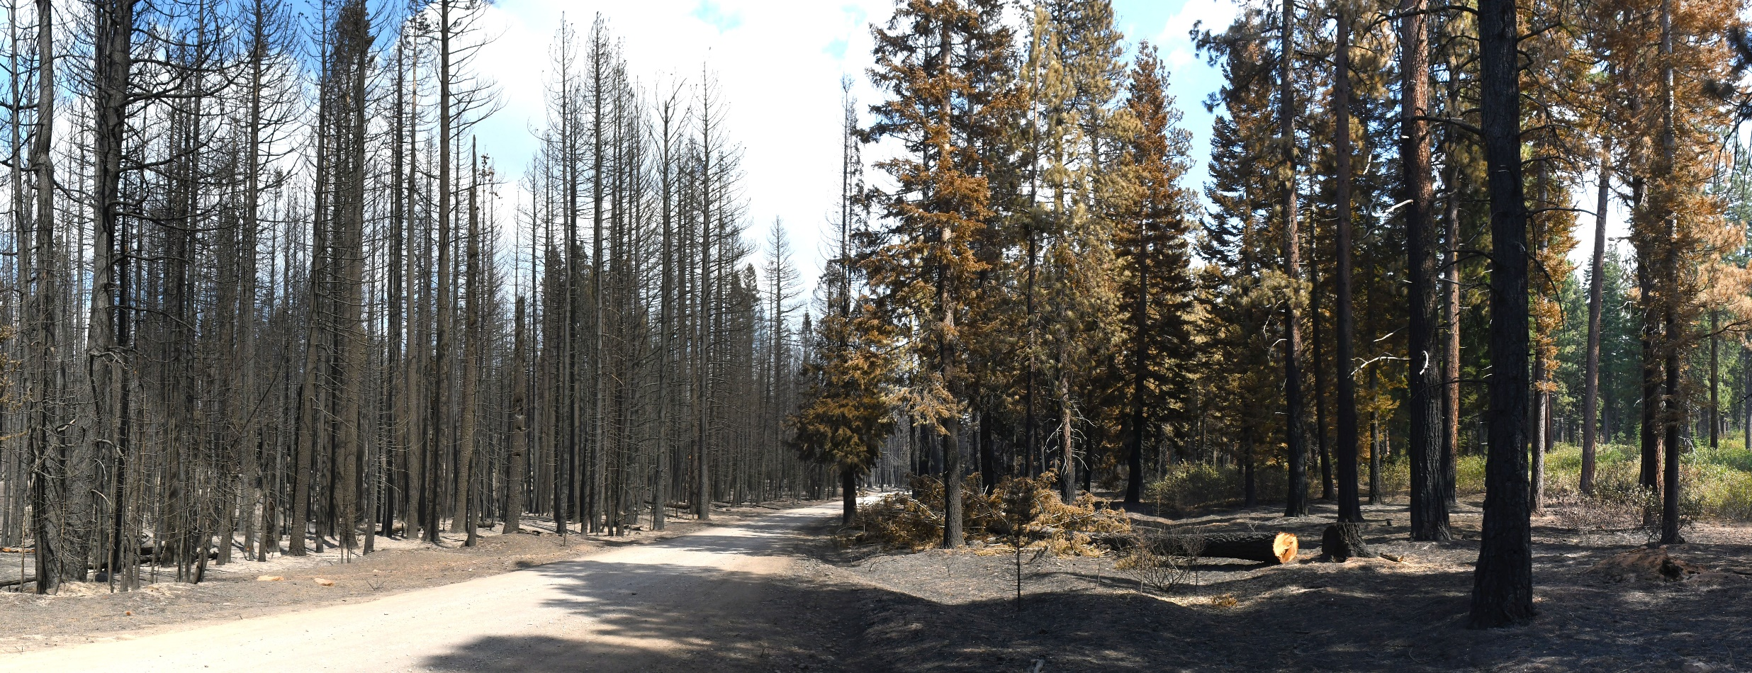
1.
TREATMENTS
Thinning + Prescribed Fire is Effective…
But treatments must be strategic, and work with novel fire regimes
USFS Experimental Forest / Antelope Fire

Slide 5
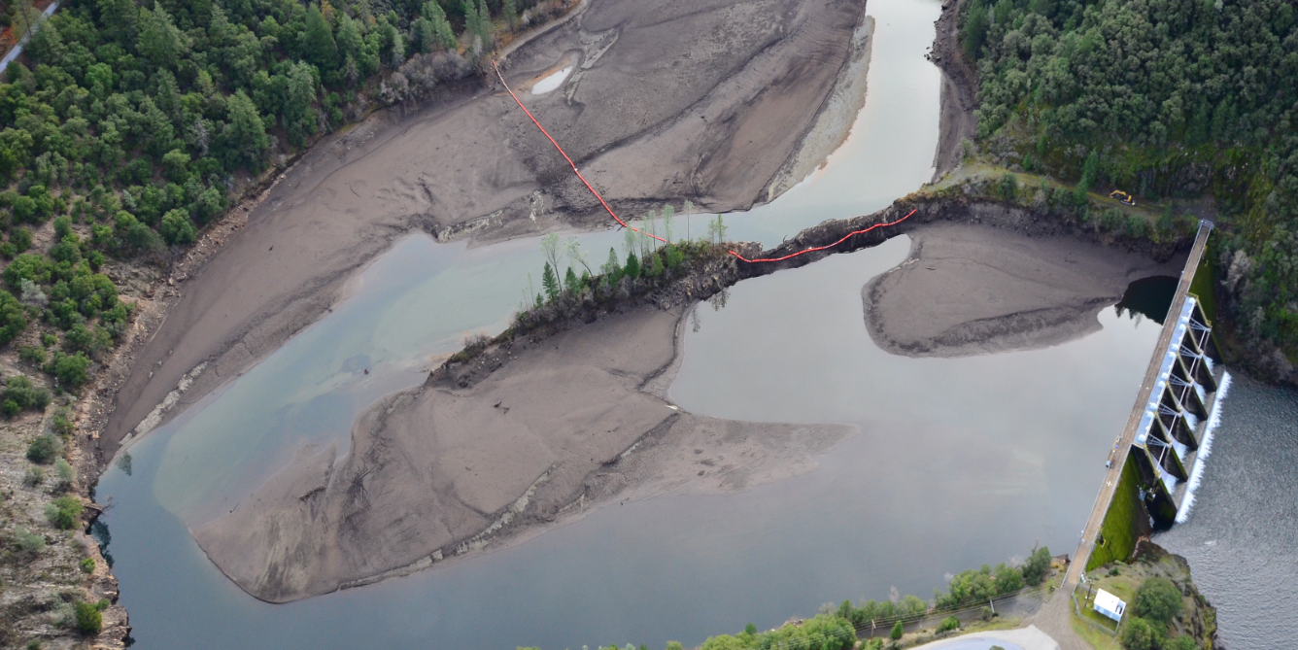
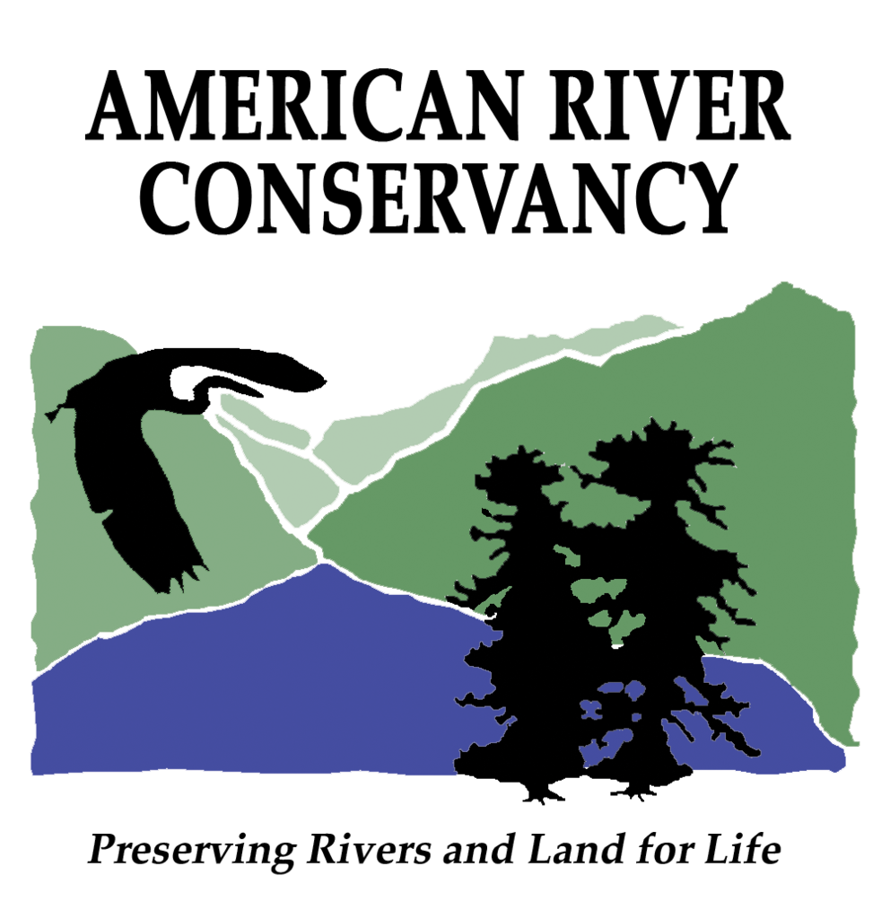




1.
TREATMENTS
French Meadows Project – 28,000 acres
Safeguarding rural water supplies

Slide 6
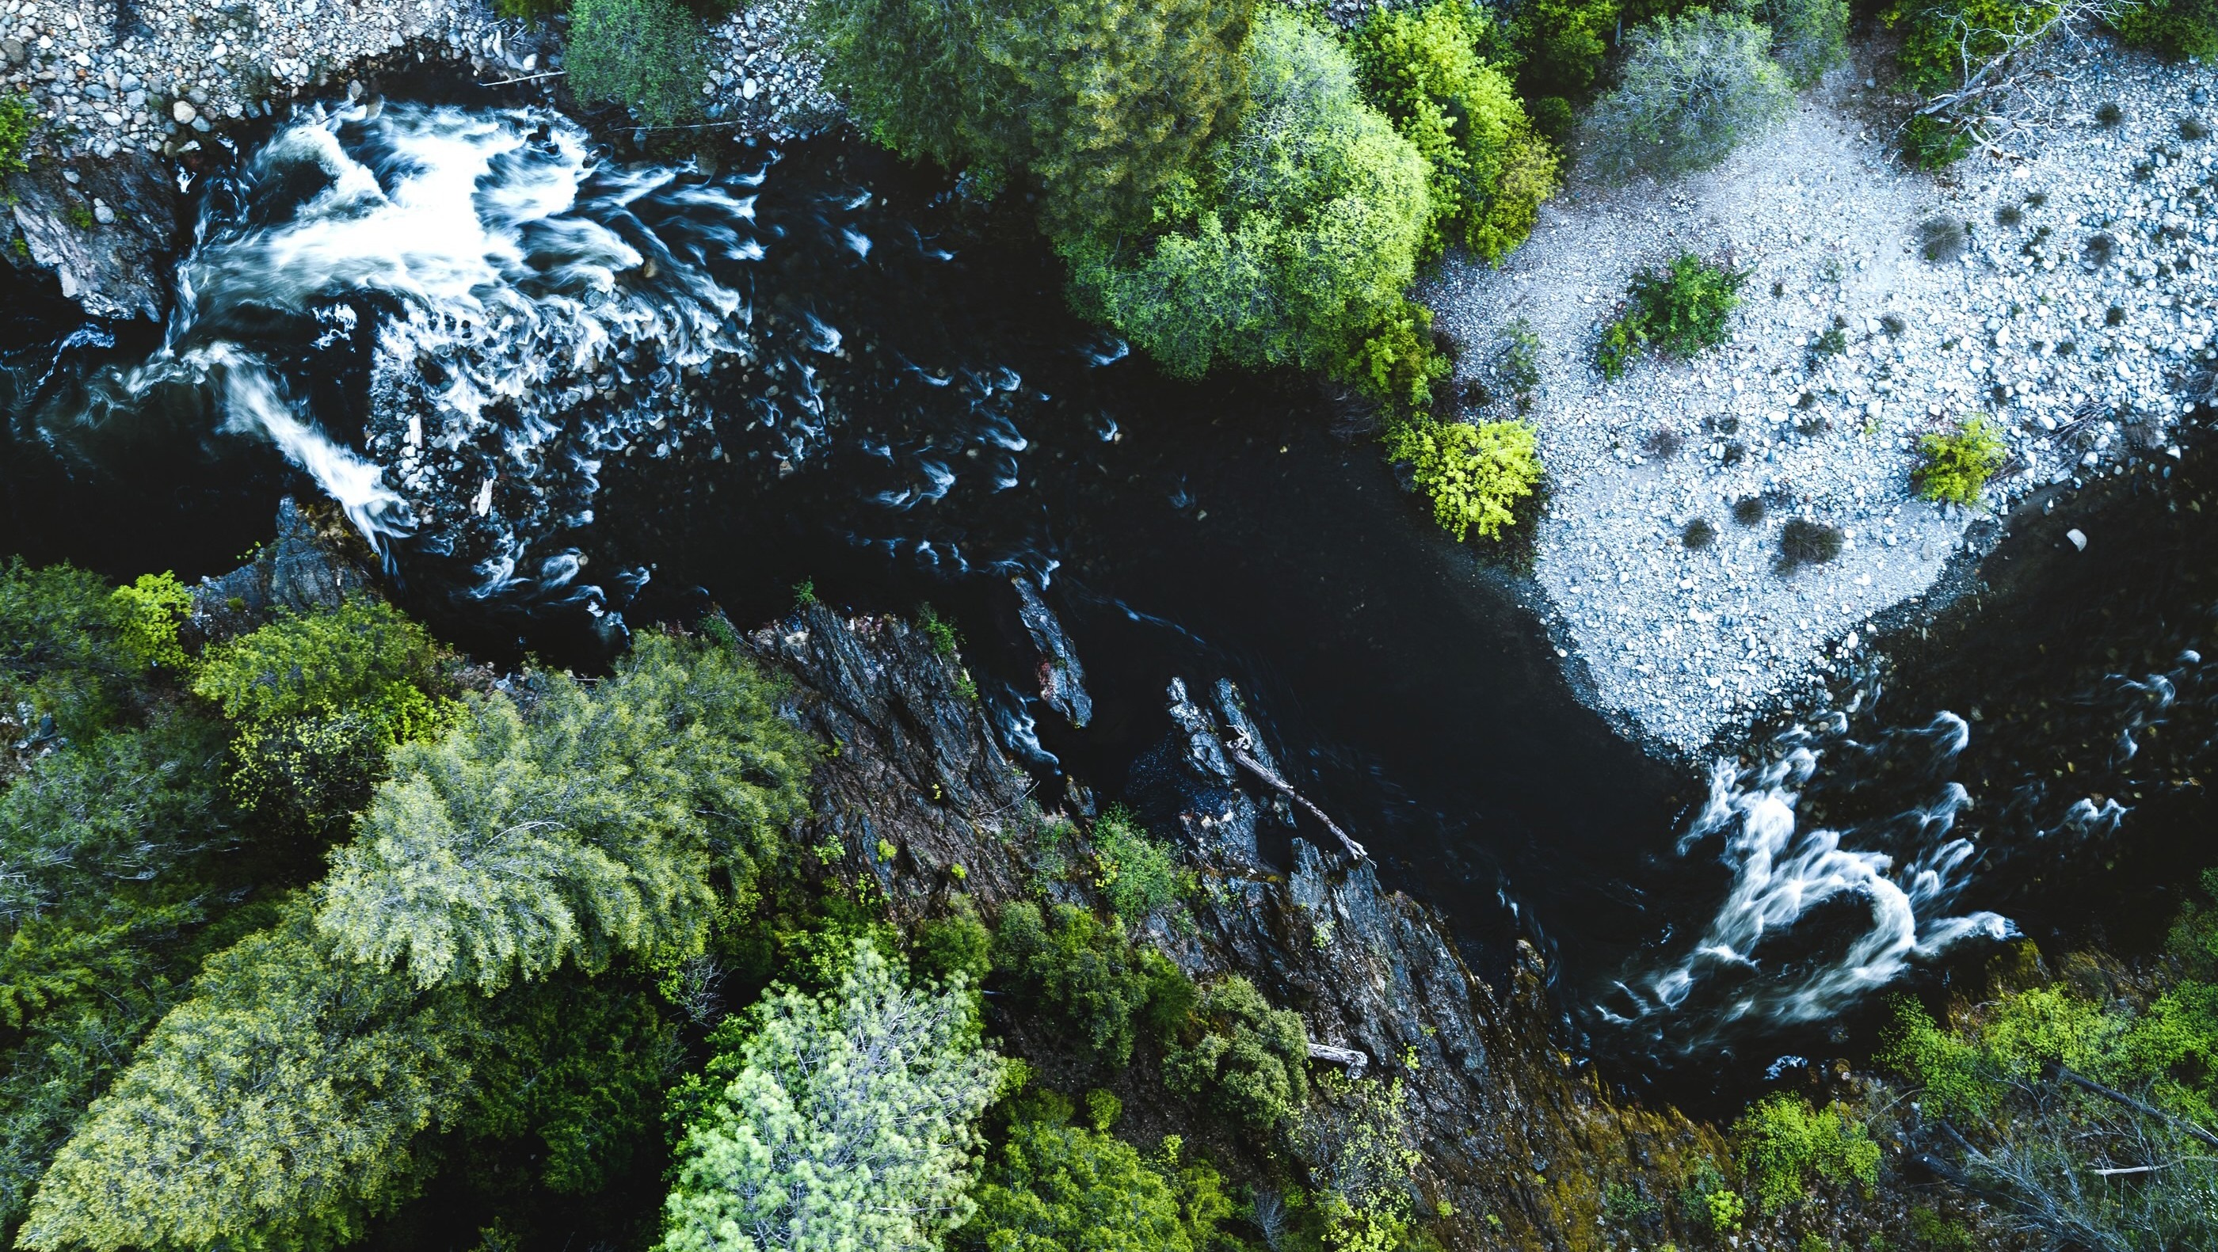
1.
TREATMENTS
North Yuba Forest Partnership – 275,000 acres
Precision management, for multiple beneficiaries, at scale

Slide 7
1.
TREATMENTS
North Yuba Forest Partnership – 275,000 acres
Precision management, for multiple beneficiaries, at scale
High resolution baseline data on current forest conditions
Dynamic scenario planning¹ using PSW/TNC resilience pillars
Staged NEPA, with public input along the way
If / then approach for fuel reduction treatment prescriptions
1. www.vibrantplanet.net/landtender

Slide 8
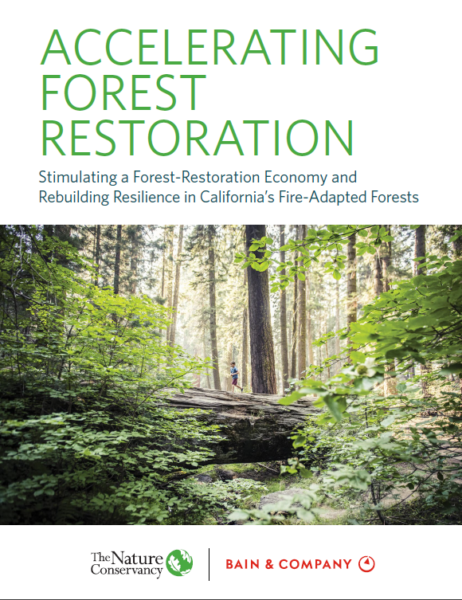
2.
MARKET INNOVATIONS
End markets analysis for the utilization of small diameter trees
_{Takeaways:}
Co-locating proven, and scalable wood conversion technologies is necessary to achieve CA’s wildfire and forest resilience goals.
Targeted public investments and policies are needed spur investment in low-margin and/or higher risk business models.

Slide 9
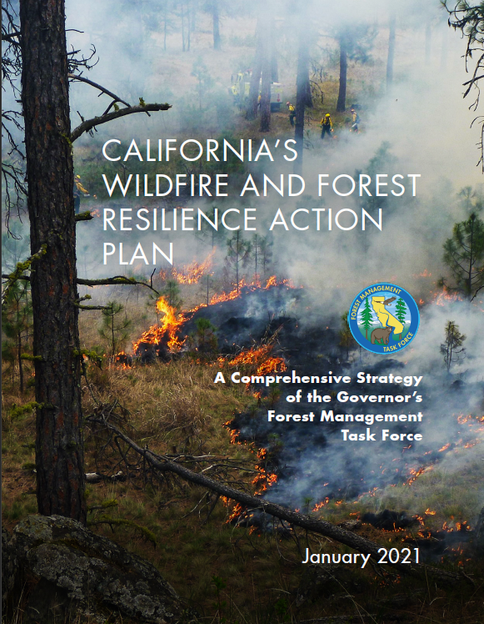

2.
MARKET INNOVATIONS
Feedstock Aggregation /
California Climate Catalyst Fund
All of government approach(Jan 2021 report)
Feedstock aggregation pilots (OPR)
$47 m Climate Catalyst Fund (GoBiz)
  Revolving loans
  Do more for industries aligned w-state goals
  4:1 private/public investment ratio

Slide 10
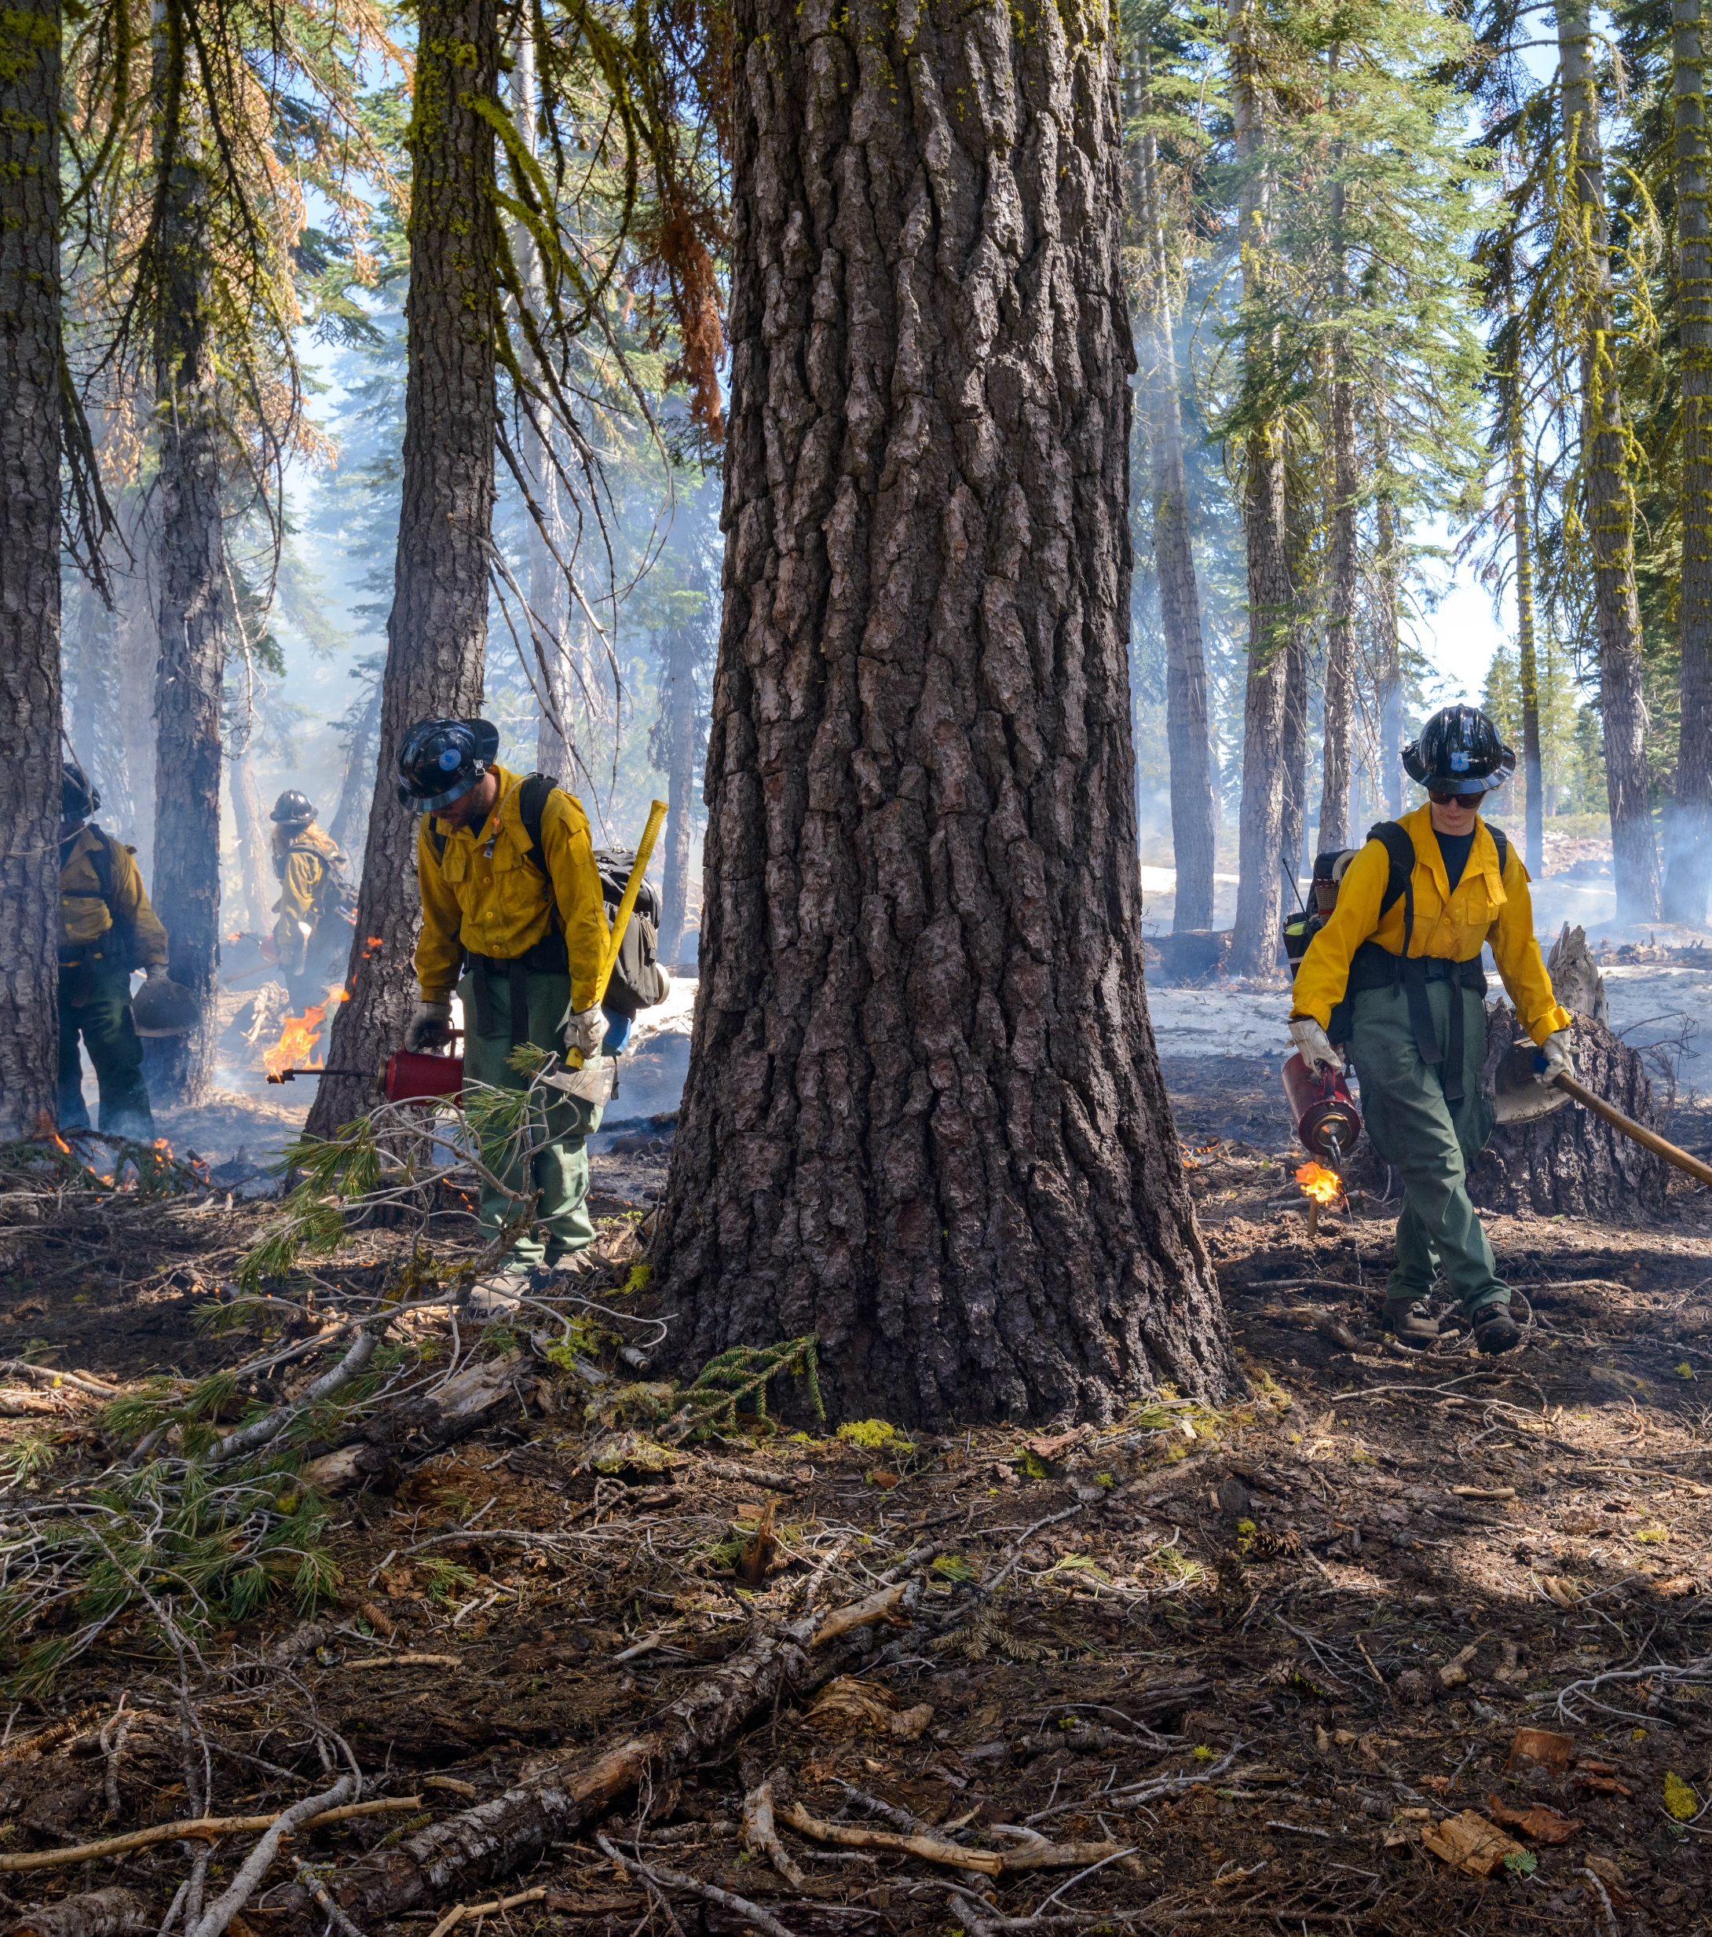
3.
SKILLED WORKFORCE
Building a world class workforce of restoration professionals
Dedicated, state-sponsored prescribed fire crew
State prescribed fire burn boss certification
Prescribed fire liability claims fund pilot
Great partnership with CA air quality regulators

Slide 11
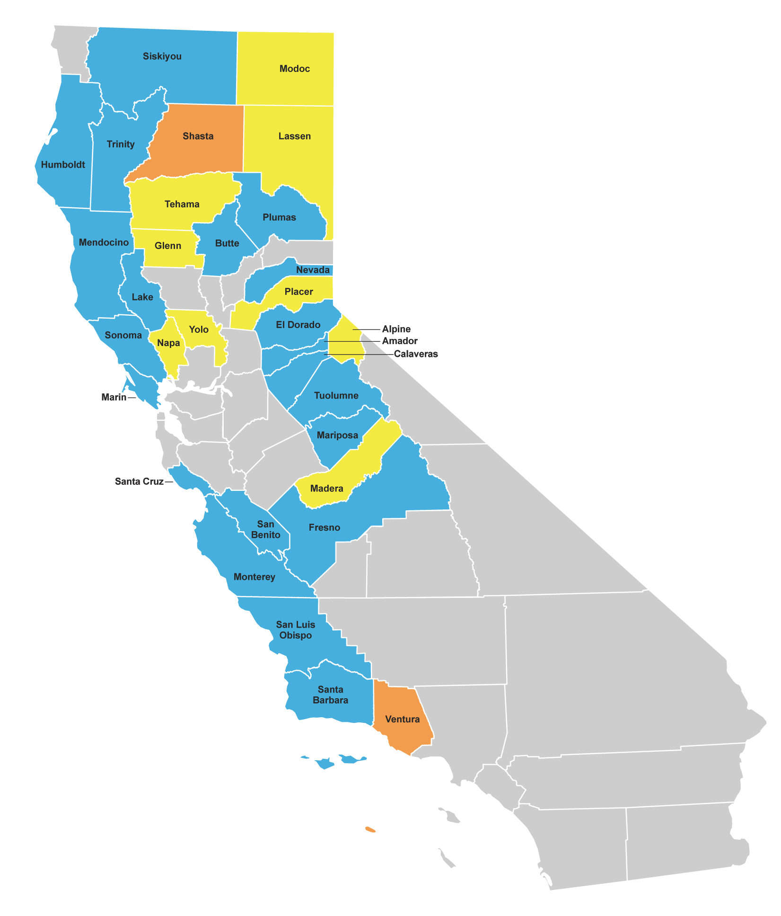
3.
SKILLED WORKFORCE
California PBA/Community-Based Burning Efforts
BLUE:
group formed and burning
ORANGE:
group in formation
YELLOW:
having conversations about forming
Map created by Jeff Stackhouse, University of California
Cooperative Extension; Katie Roberti, California
Cattlemen’s Association; February 2022

Slide 12
Acknowledgements
STATE FUNDING & POLICY LEADERSHIP
LARGE-SCALE RESTORATION PROJECTS
Jessica Morse (CNRA)
Patrick Wright (CNRA)
Dan Adler (GoBiz)
Liz Forsburg (TNC)
U.S. Forest Service and regional partners
Placer County
Placer County Water Agency
Yuba Water Agency
Cal Fire, Sierra Nevada Conservancy, UC
MARKET INNOVATIONS
Bain and Company
Governor’s Office of Planning & Research
USDA (Larry Swan, Steve Ostoja)
Market Lab (TNC)
WORKFORCE DEVELOPMENT
The Fire Restoration Group (Craig Thomas)
UC Cooperative Extension (L. Quinn-Davidson)
Dave Jones (former CA Insurance Commissioner)

Slide 13
Thank you!
Dan Porter | Forest Strategy Lead dporter@tnc.org

