Slide 1

Jon Driver
AOF2020

Slide 2
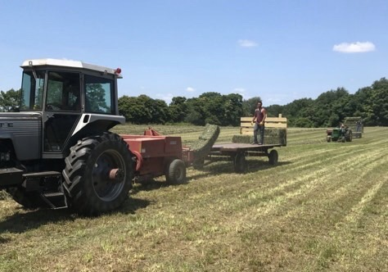
Old

Slide 3
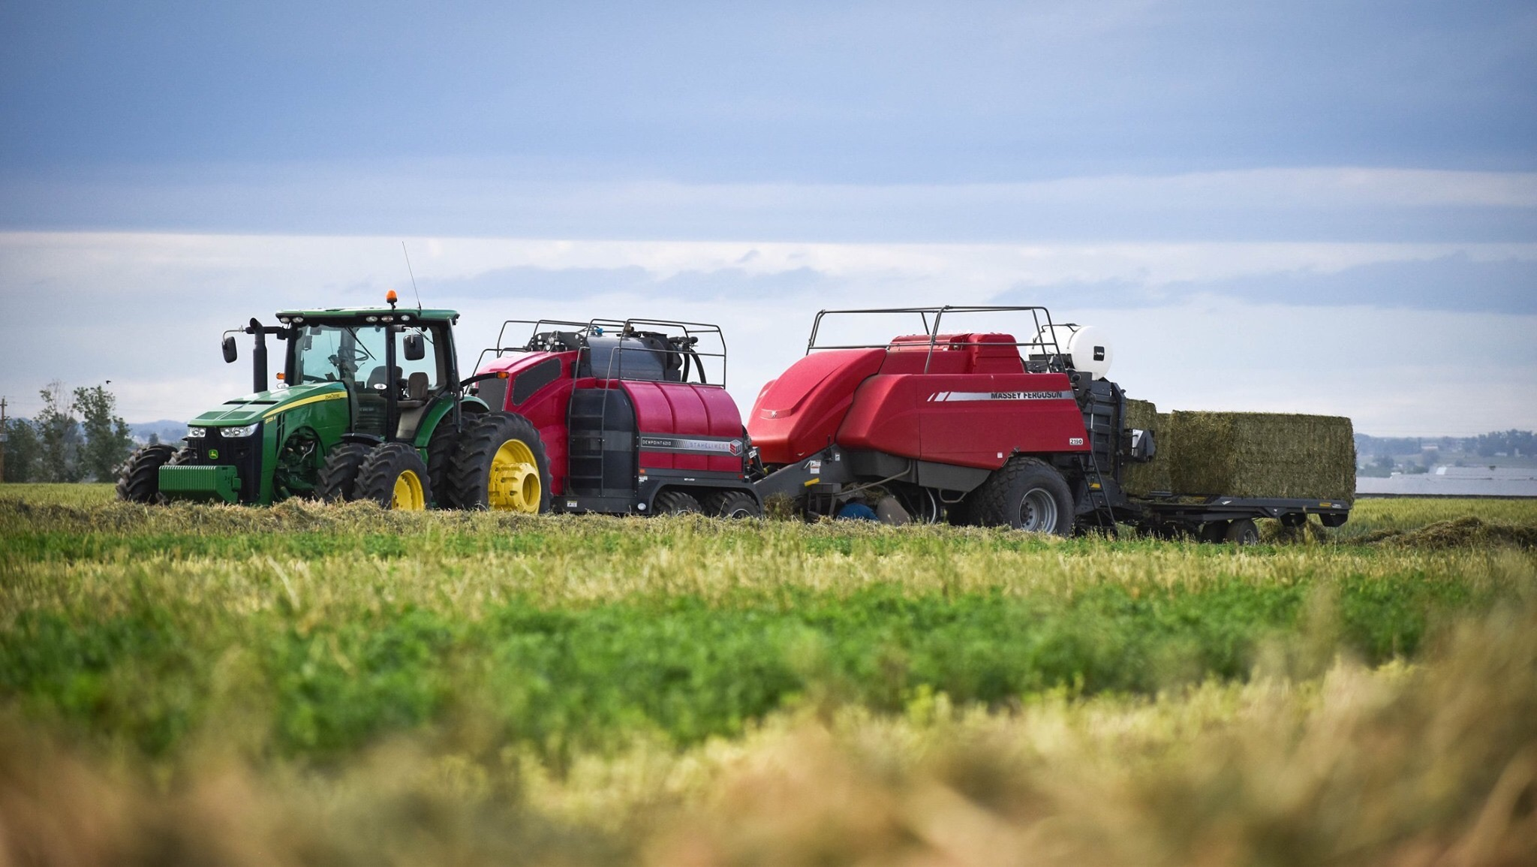
New

Slide 4
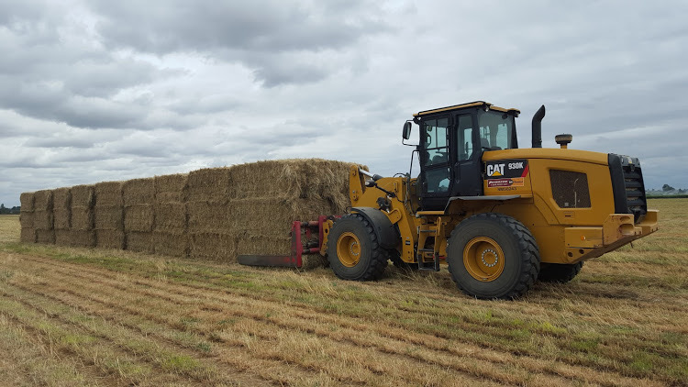
Big

Slide 5
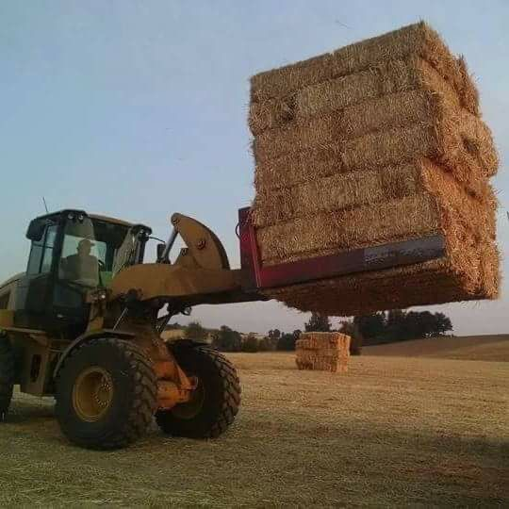
Big

Slide 6
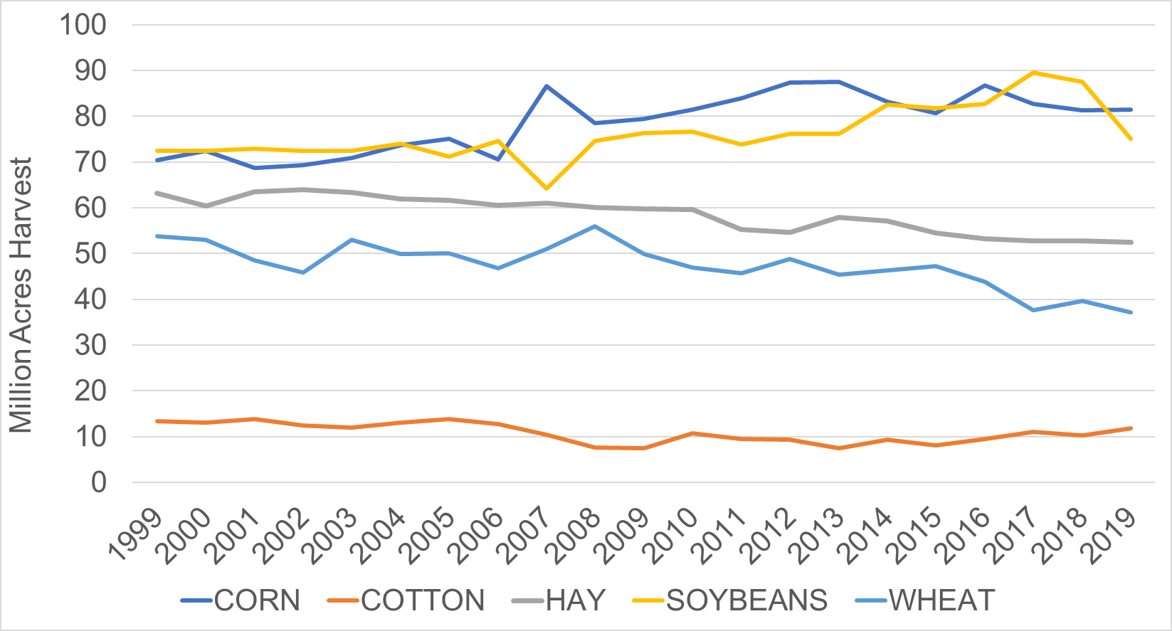
Acres

Slide 7
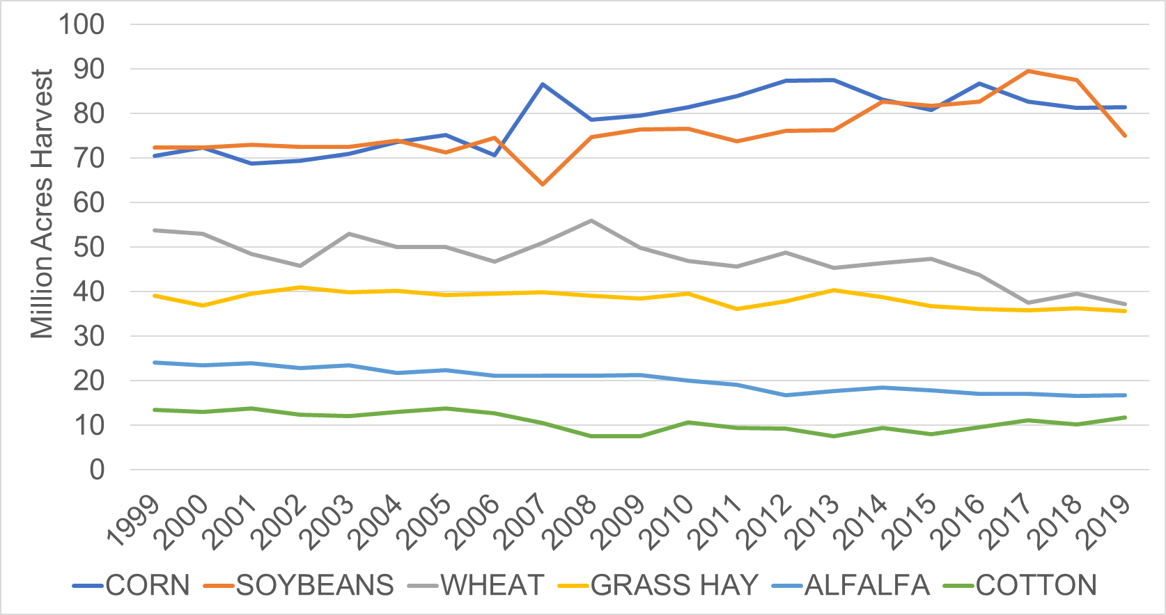
More Grass Hay than Wheat?

Slide 8
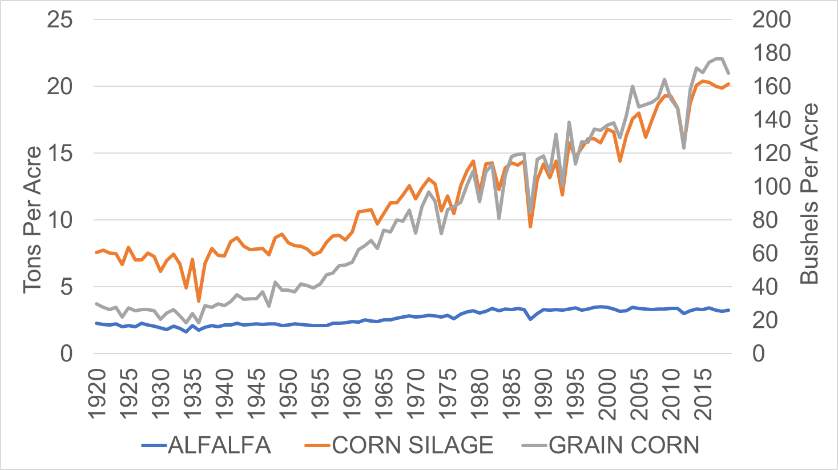
Productivity

Slide 9
Quality
High Quality
Low Quality
Slightly Profitable
Profitable

Slide 10
Export Hay Perspective

Slide 11
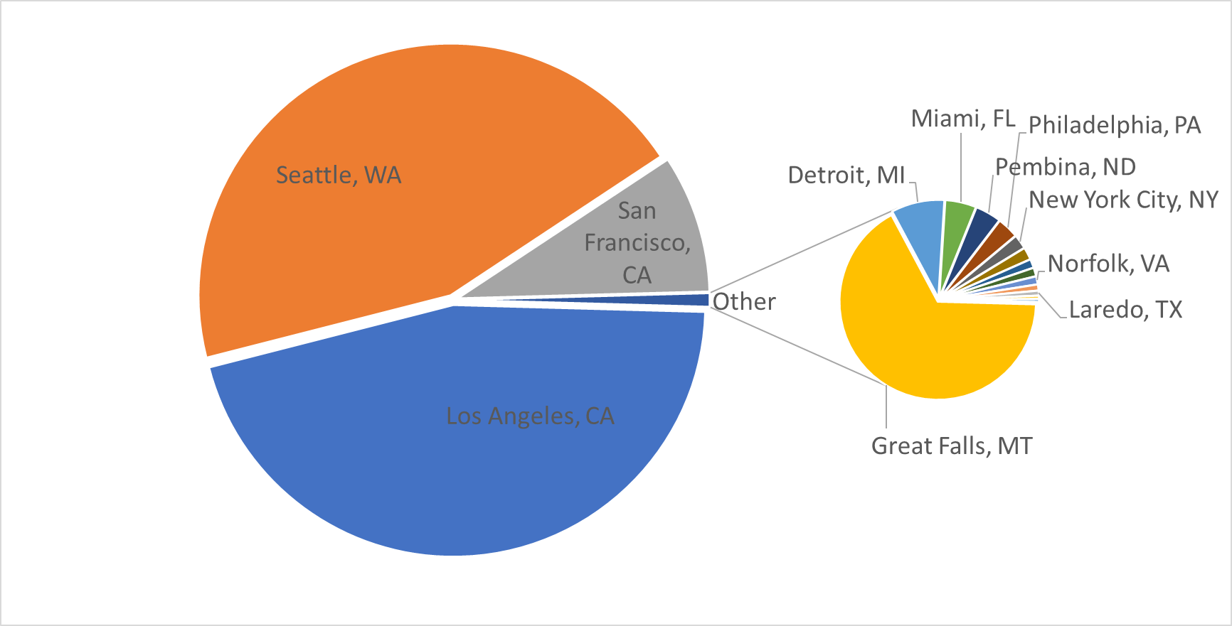
Total Exports
Source: Census Bureau
Notes:
Ideal oaten hay crop is high in sugar and low in fiber

Slide 12
Total Exports
Source: Census Bureau
Notes:
Ideal oaten hay crop is high in sugar and low in fiber

Slide 13
Grass Exports
Grass Hay Trade
Country | 2017 | 2018 | 2019 | 18-19 Change (Metric Tons) | 18-19 (% Change)
Japan | 758,843 | 720,773 | 770,753 | 49,980 | 7%
South Korea | 539,551 | 398,564 | 351,771 | (46,793) | -12%
Taiwan | 101,595 | 110,933 | 129,233 | 18,300 | 16%
United Arab Emirates | 57,739 | 50,570 | 51,541 | 971 | 2%
China | 24,247 | 16,648 | 19,549 | 2,901 | 17%
ROW | 40,476 | 43,950 | 45,719 | 1,769 | 4%
Total | 1,522,451 | 1,341,438 | 1,368,566 | 27,128 | 2%
Source: Census Bureau
Notes:
Ideal oaten hay crop is high in sugar and low in fiber

Slide 14
Alfalfa Exports
Alfalfa Trade
Country | 2017 | 2018 | 2019 | 18-19 Change (Metric Tons) | 18-19 (% Change)
China | 1,170,881 | 871,065 | 865,768 | (5,297) | -1%
Japan | 560,343 | 581,406 | 664,143 | 82,737 | 14%
Saudi Arabia | 360,237 | 480,888 | 417,518 | (63,370) | -13%
United Arab Emirates | 247,766 | 240,519 | 302,955 | 62,436 | 26%
South Korea | 200,071 | 221,257 | 241,998 | 20,741 | 9%
Taiwan | 56,295 | 65,868 | 79,328 | 13,460 | 20%
Canada | 40,999 | 44,728 | 46,134 | 1,406 | 3%
Qatar | 1,045 | 4,201 | 13,489 | 9,288 | 221%
ROW | 21,234 | 16,391 | 27,769 | 11,378 | 69%
Total | 2,658,871 | 2,526,323 | 2,659,102 | 132,779 | 5%
Source: Census Bureau
Notes:
Ideal oaten hay crop is high in sugar and low in fiber

Slide 15
China
May 14 deadline for export protocols
  Almond Meal Pellets and Cubes
  Alfalfa Hay and Pellets
  Timothy

Slide 16
Grass/Oat Hay Trade

Slide 17
Canadian Timothy

Slide 18
California
  Lowest alfalfa acres since 1938

Slide 19
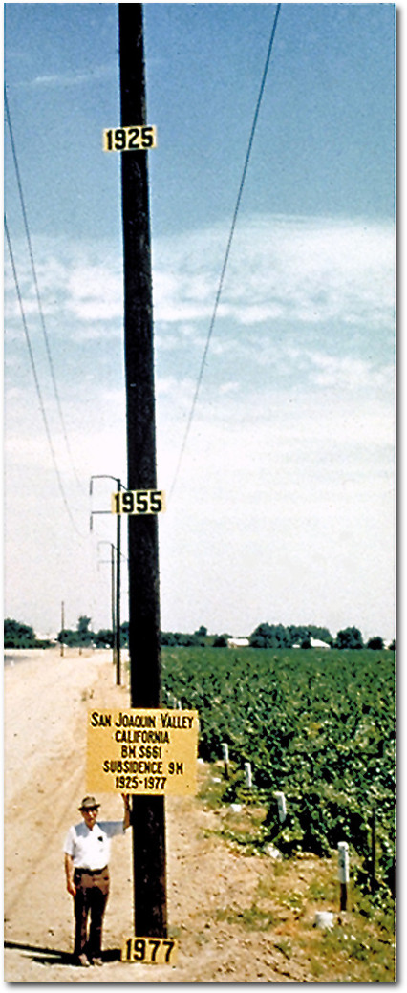
California – On the Wagon
Credit: Dr. Joseph F. Poland, USGS

Slide 20
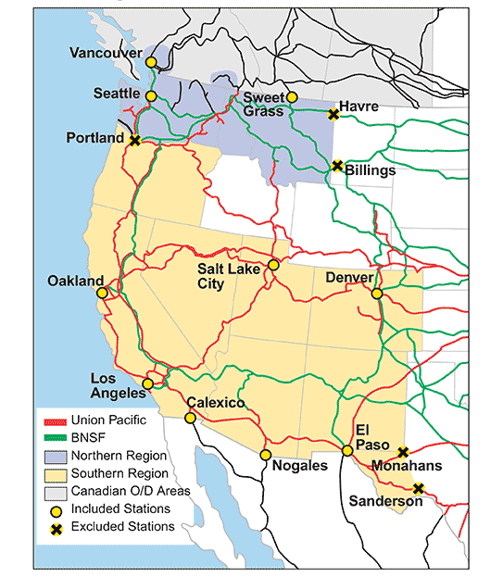
Infrastructure Matters

Slide 21
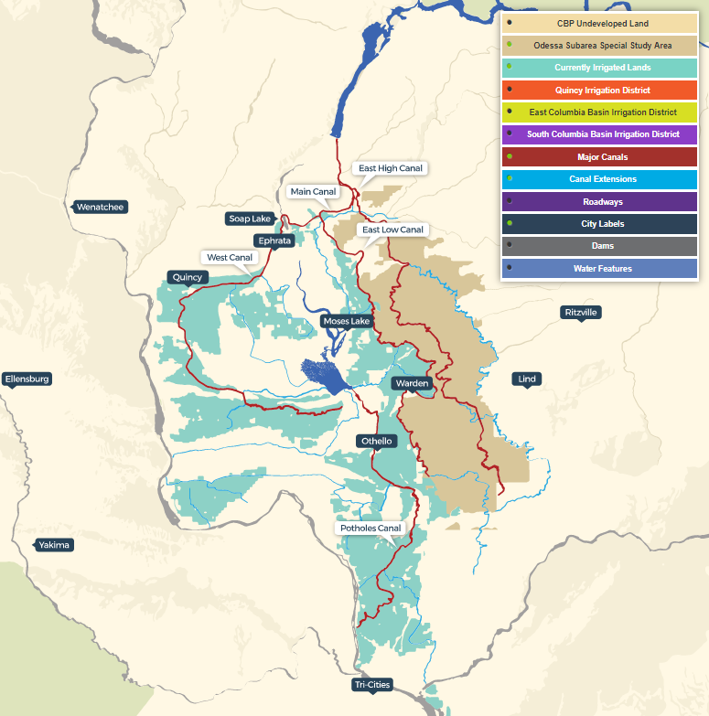
Odessa
  90,000 acres
  $465 million to build
  13% more irrigated land!
  $520 million in economic activity

Slide 22
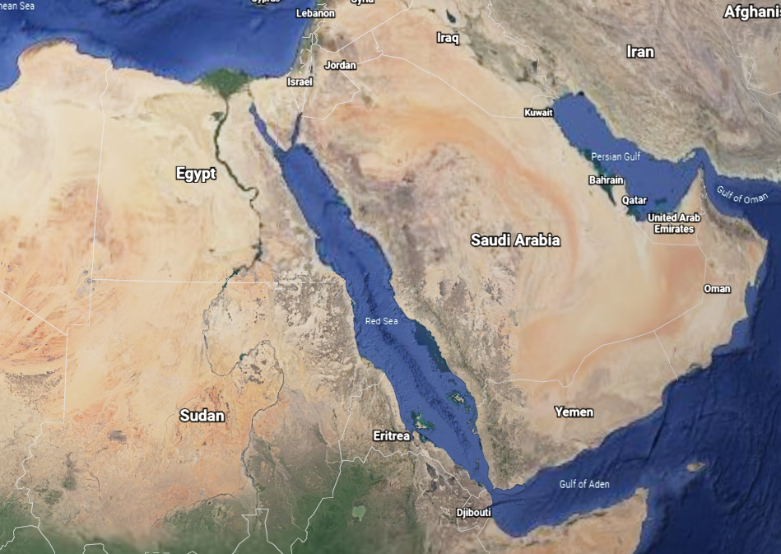
Sudan

Slide 23
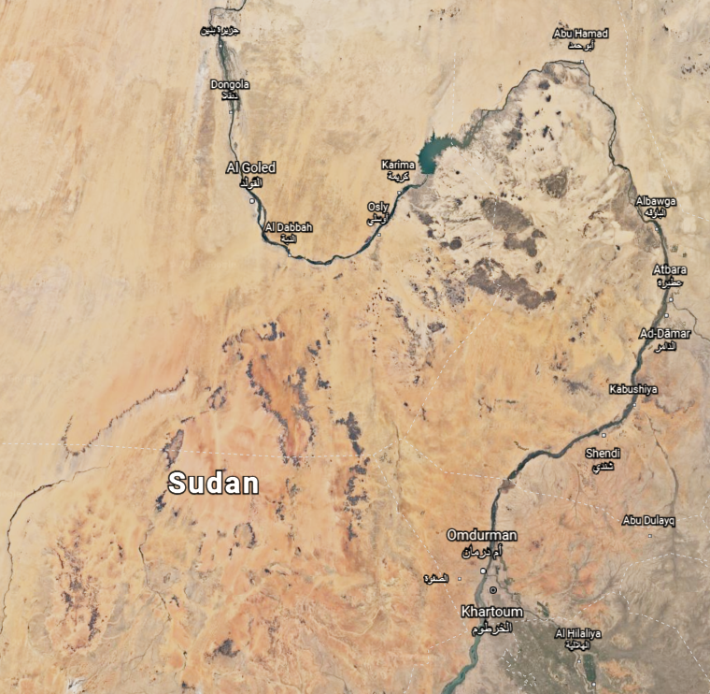
Sudan

Slide 24
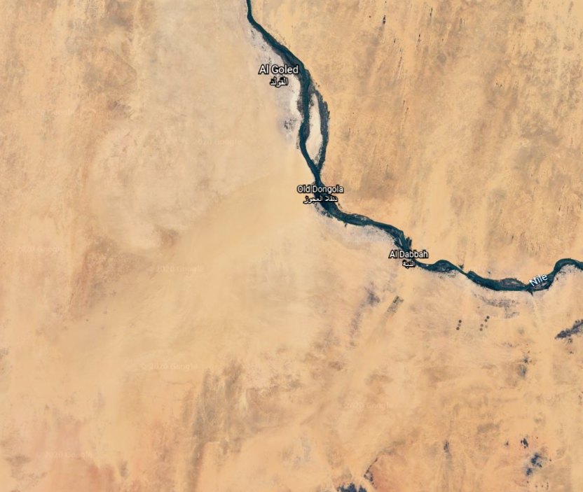
Sudan

Slide 25
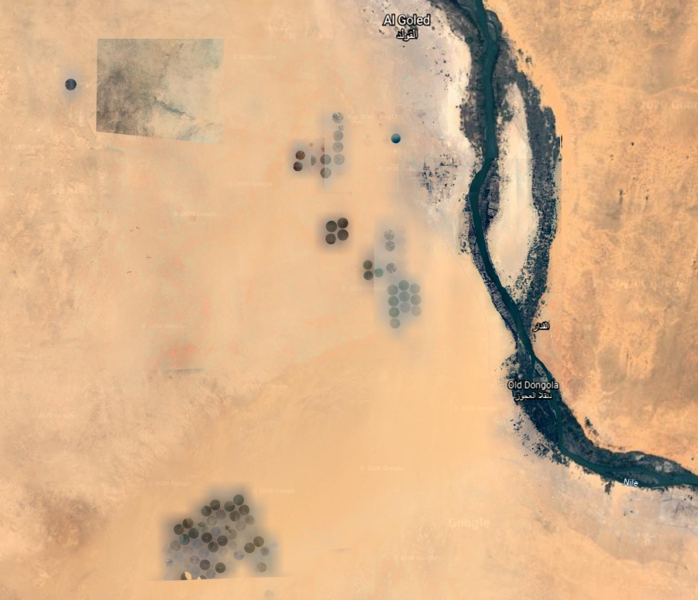
Sudan

Slide 26
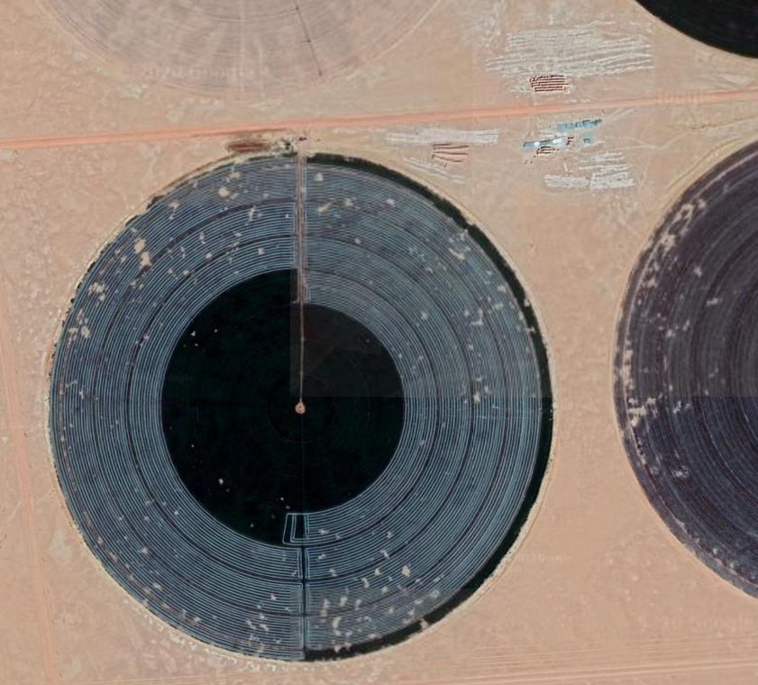
Sudan

Slide 27

Market Snapshots

Slide 28
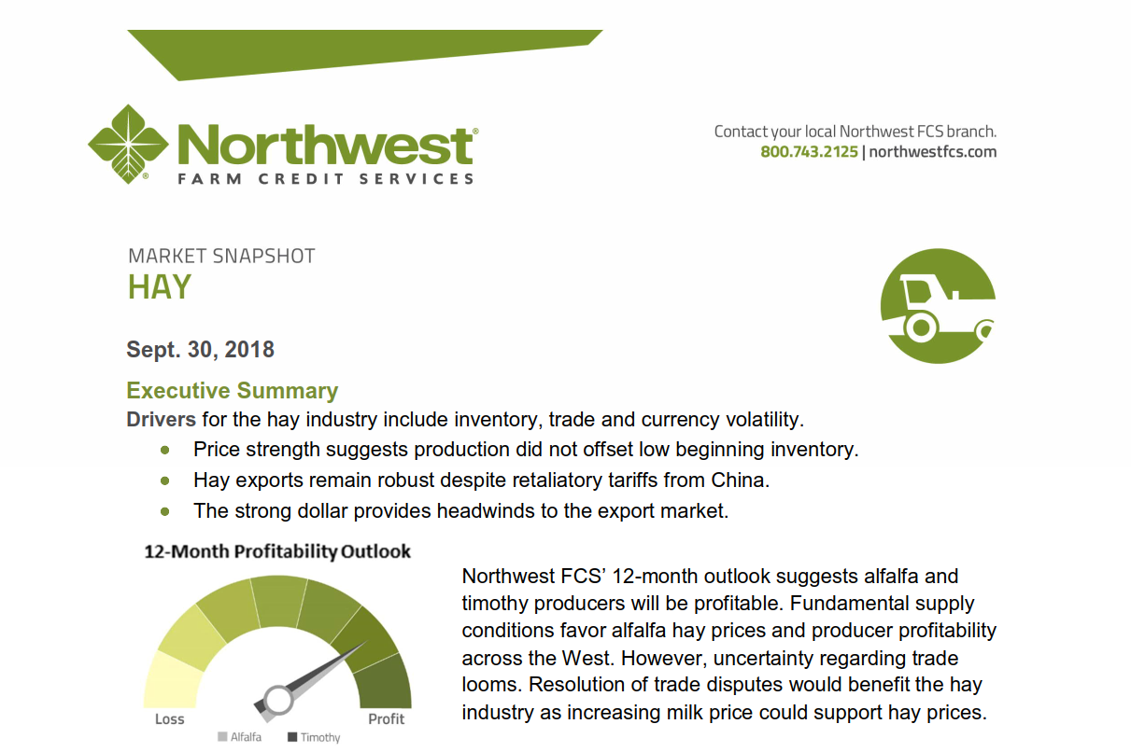
Market Snapshots

