Slide 1

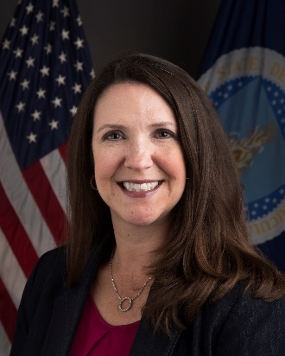
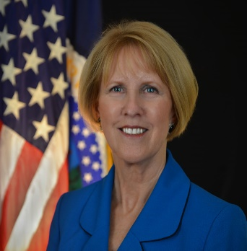
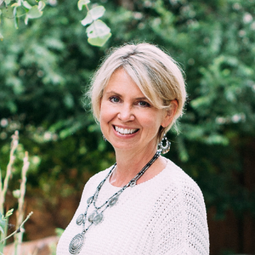
Food and Nutrition Service
Pam Miller, Administrator, Food and Nutrition Service
Pat Dombroski, Regional Administrator, Food and Nutrition Service, Mid-Atlantic Region
Jo Anne Mattson, Executive Director,
The Light House - A Homeless Prevention Support Center

