Slide 1
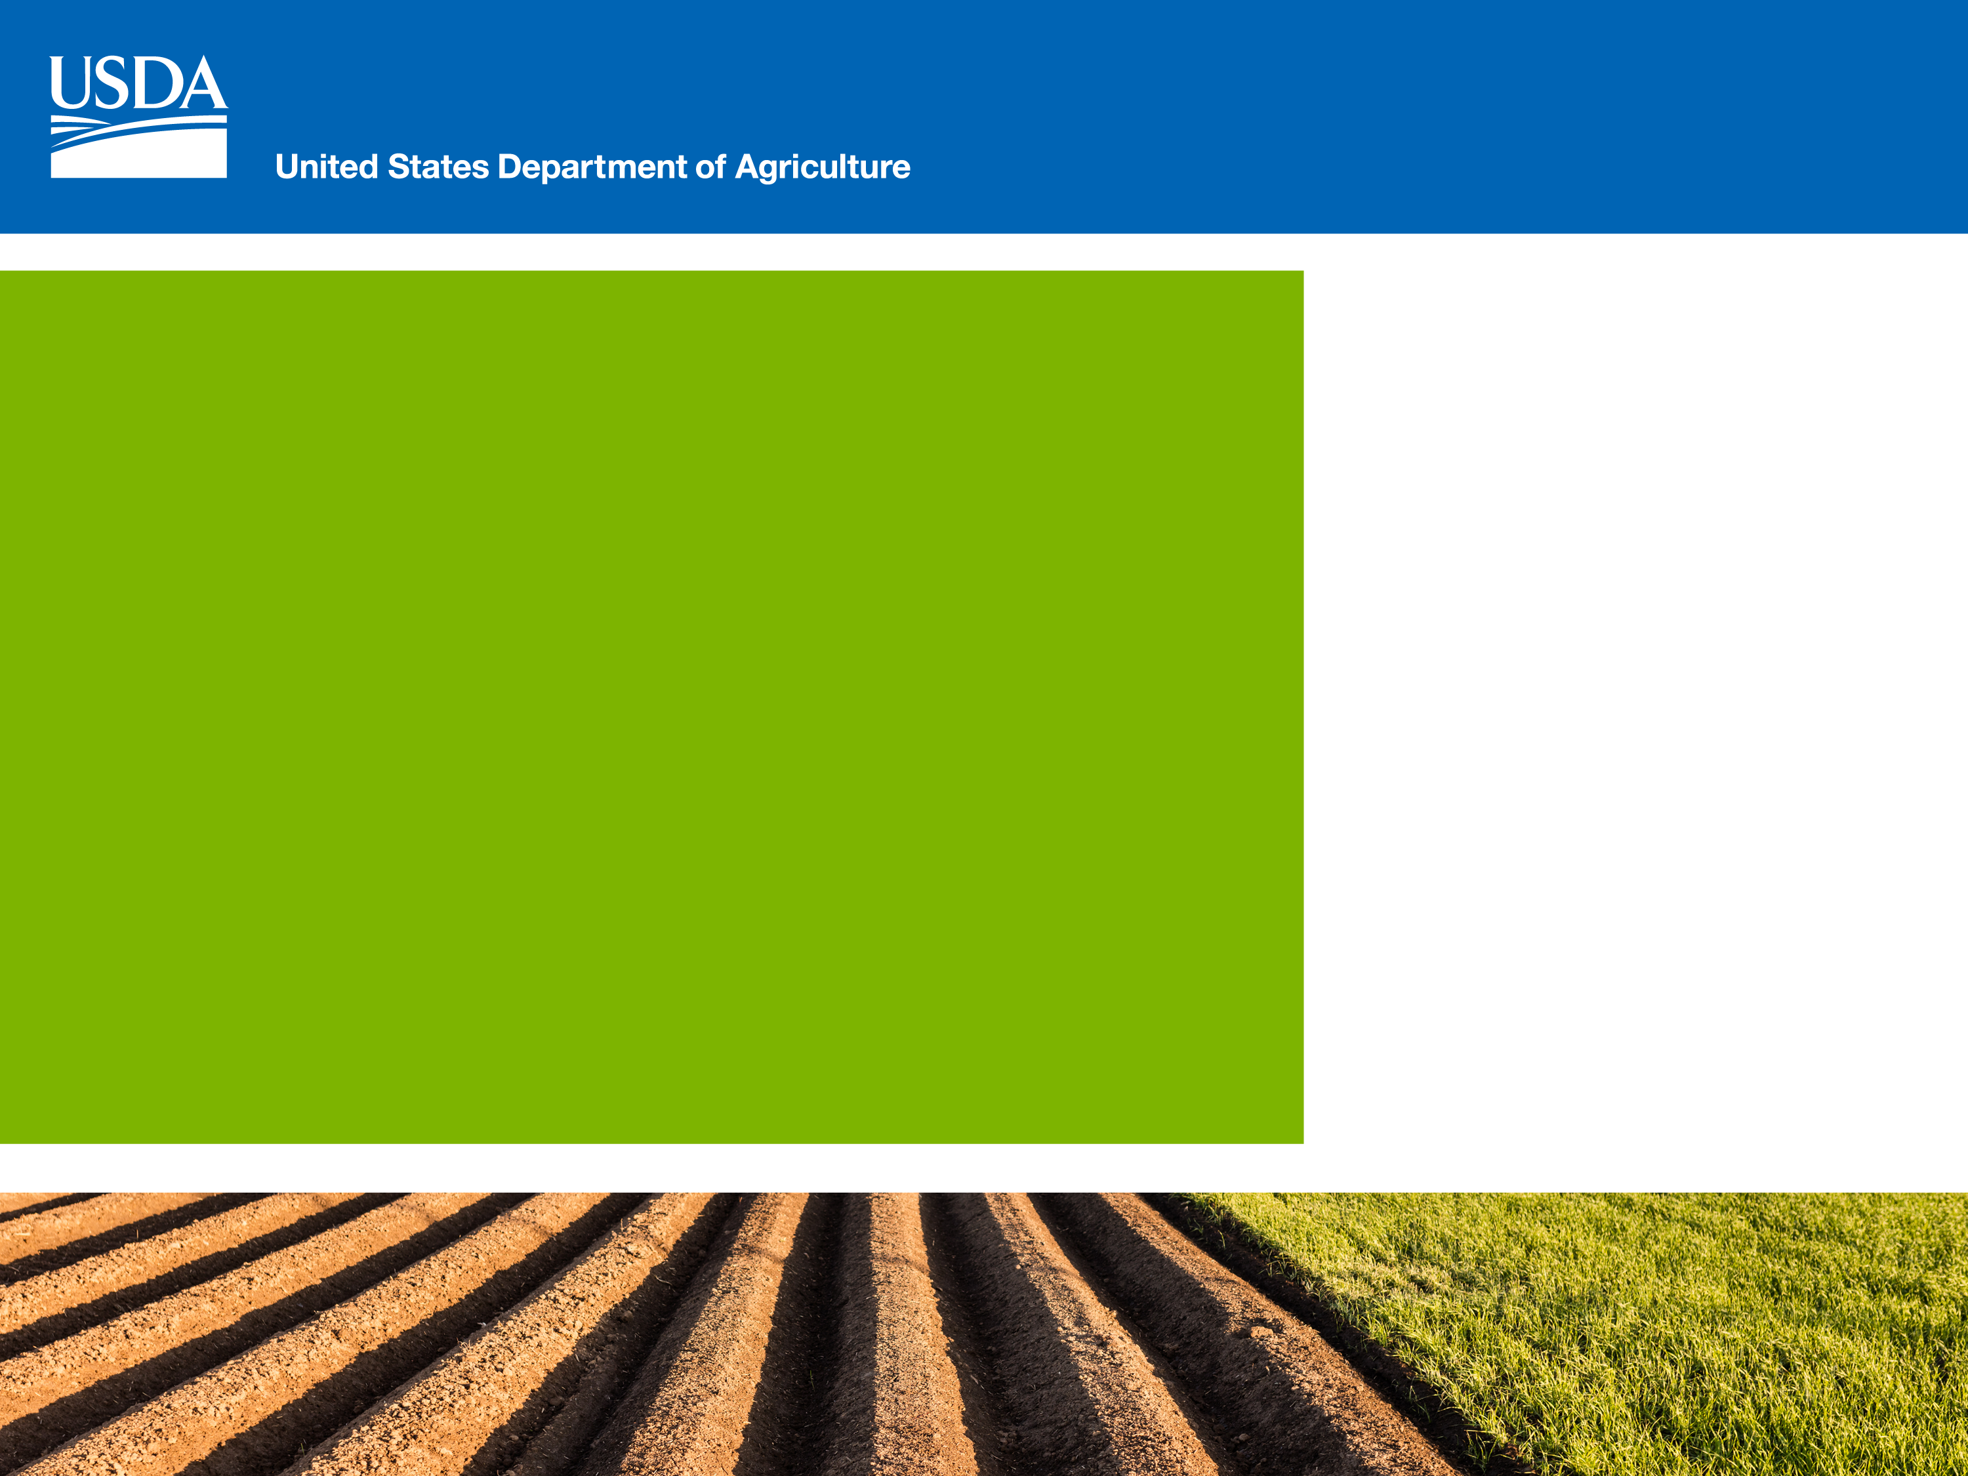
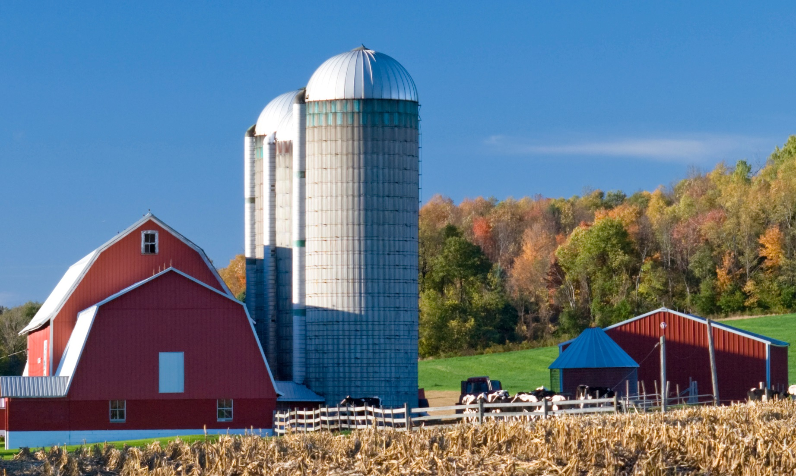
Farm Service Agency
Serving America’s
Agricultural Community
for More Than 80 Years
Michael Moore
Assistant to Director Loan Making Division
Washington, DC

Slide 2
Direct Loans
  FSA makes and services direct loans and provides supervised credit
  Funds come from the U.S. Treasury
Guaranteed Loans
  The lender makes and services the loan
  FSA guarantees loans made by conventional lenders for up to 95 percent of any loss
  DIRECT FARM OWNERSHIP AND OPERATING LOANS
  GUARANTEED FARM OWNEHIP AND OPERATING
  LOANS
  DIRECT AND GUARANTEED MICROLOANS
  DIRECT EMERGENCY LOANS
  DIRECT YOUTH LOANS
  GUARANTEED CONSERVATION LOANS

Slide 3
FY 2019 Funding Highlights:
- Total Obligations were the third highest in Agency history
- Direct FO obligations totaled $1.47 billion - the highest in the Agency’s history
Total Guaranteed Obligations
$3.106 Billion
7,611 loans

Slide 4
FY 2020 Funding Highlights:
- Operating under a Continuing Resolution (CR).
Unobligated direct and guaranteed OL funds from FY 2019 were carried over into FY 2020
FSA has received guaranteed loan funding under the CR
  $390,775,000 for Guaranteed FO
  $2,059,689,561 for Guaranteed OL
    Guaranteed OL is much higher because it includes carryover from FY 2019

Slide 5
Loan Program Delivery
Normally apply in the county where your base of operation is located
Upon request, FSA staff will assist applicants in completing paperwork
Guaranteed Loans are applied for with your local ag lender.
Notes:
To find the office that services your county visit www.offices.usda.gov.

Slide 6
Primary Loan Programs
Direct Farm Ownership (FO) Loans
Farm Operating (OL) Loans
EM Loans
Guaranteed Loans
Notes:
Your local office can provide you with a listing of local eligible lenders that participate in FSA’s guaranteed program.

Slide 7
Maximum Loan Limits
Direct Farm Ownership (FO) Loans
Regular - $600,000
Microloan - $50,000
Direct Farm Operating (OL) Loans
Regular - $400,000
Microloan - $50,000
Youth Loan - $5,000
Emergency (EM) Loans
$500,000
Guaranteed Loans
$1,750,000 (adjusted annually based on inflation)

Slide 8
General Eligibility Requirements
Direct and Guaranteed applicants must:
  Be unable to obtain sufficient credit elsewhere
  Be a citizen or a legal resident alien
  Possess legal capacity to incur the loan obligation
  Have acceptable credit history
  Be the owner-operator or tenant-operator of a family farm

Slide 9
General Eligibility Requirements
Not be delinquent on federal debt
Not have caused the agency a loss by receiving debt forgiveness (some exceptions)
Not have been convicted of planting, cultivating, growing, producing, harvesting, or storing a controlled substance within the last five years
Direct and Guaranteed Applicants must:

Slide 10
Direct Loans
A Direct Loan Applicant Must:
  Meet general management eligibility criteria
  Have applicable education, training, or farm experience that provides reasonable prospects of success (For an FO loan, must have participated in the operations of a farm or ranch for at least 3 years)

Slide 11
Direct Loans
A Direct Loan Applicant Must:
  Develop a realistic Farm Business Plan that projects repayment ability for the loan
  Provide adequate collateral for the loan
  Agree to take borrower training courses if needed and “graduate” to private sector credit when able to do so
  Not exceed restriction on years of eligibility

Slide 12
Direct Operating Loans
Purposes:
Purchase Equipment
Purchase Livestock
Production Expenses
Refinance operating expenses (other than FSA)
Operating Loans are repaid in 1 to 7 years

Slide 13
Youth Operating Loans
Under the direct Operating Loan Program
Program Requirements
- Must meet eligibility requirements,
be over 10 yrs. old and under 21
- Must have recommendation from advisor (4-H, Vo-Ag Teacher, Scout Leader, FFA Advisor, etc.)

Slide 14
Direct Farm Ownership Loans
Farm Ownership (FO) loans can be repaid in up to 40 years (Microloans are limited to 25 years)
Loan Purposes:
Purchase Land
Make Capital Improvements
Promote Soil and Water Conservation
Loan closing and related expenses

Slide 15
Direct Farm Ownership Joint Financing Arrangements
FSA can loan can not exceed 50% of the total amount financed:
- Interest rate is Farm Ownership rate minus 2% or a maximum of 2.5%
- Encouraged as a way to extend FSA loan funds and assist in the purchase of real estate.

Slide 16
Applicants must:
- be Beginning Farmers or Socially Disadvantaged Applicants
- provide a 5 % cash down payment
FSA can loan up to 45% of the least of:
- purchase price, appraised value, or $667,000
- Microloan Down Payment can not exceed $50,000
Direct Farm Ownership Down Payment Loans

Slide 17
Direct Farm Ownership Down Payment Loans
Maximum FSA loan is 20 years
Interest rate is 4% below regular direct Farm Ownership rate but no less than 1.5%
FSA can guarantee the balance with a term of no less than 30 years and no balloon payment due for the first 20 years
No guarantee fee charged
There is no limit on the purchase price of the property

Slide 18
Emergency Loans
  Used for real estate and operating purposes where a disaster or quarantine has been declared
Purposes:
  Refinance Farm debts
  Repair/replace farm property
    Buildings
    Machinery/Livestock
    Feed
    Other items

Slide 19
Guaranteed Loans
Guaranteed loans are:
    Made and serviced by local agricultural lenders
    Funded by the lender
    Often used to help lenders continue with customers who have experienced setbacks

Slide 20
Guaranteed Loan Making
The interest rate a lender charges:
  Set by lender using defined rate index
  can be fixed or variable

Slide 21
Program
Funding
Loan programs are funded by annual Congressional Appropriations
Loan funds are allocated to states
There are separate allocations of Socially Disadvantaged Applicants and Beginning Farmer targeted funds

Slide 22

Socially Disadvantaged Applicant
(SDA)
As defined by law, an Socially Disadvantaged Applicant (SDA) is one who is a member of a socially disadvantaged group whose members have been subjected to racial, ethnic, or gender prejudice because of their identity as a member of a group, without regard to their individual qualities.
SDA groups are African Americans, American Indians, Alaskan Natives, Hispanics, Asians, Pacific Islanders, and Women.

Slide 23
Socially Disadvantaged Applicant
FSA does not have a specific SDA loan program, but rather targets funds in existing programs to applicants that meet the definition
The targets are set by law
SDA loan applicants must meet loan program requirements

Slide 24
Beginning Farmer Loans
A beginning farmer or rancher is an individual or entity who:
(1) has not operated a farm or ranch for
more than 10 years
(2) meets the loan eligibility requirements of the program to which he/she is applying
(3) for an Farm Ownership loan, does not own a farm greater than 30 percent of the average sized farm in the county

Slide 25
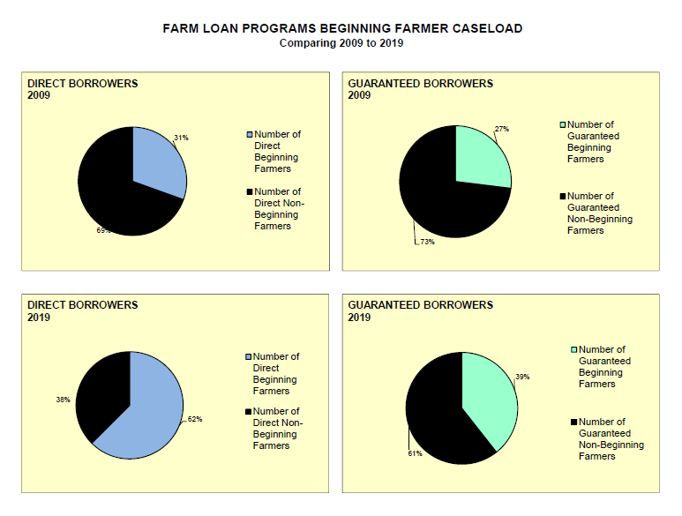
FSA Beginning Farmer Activity

Slide 26
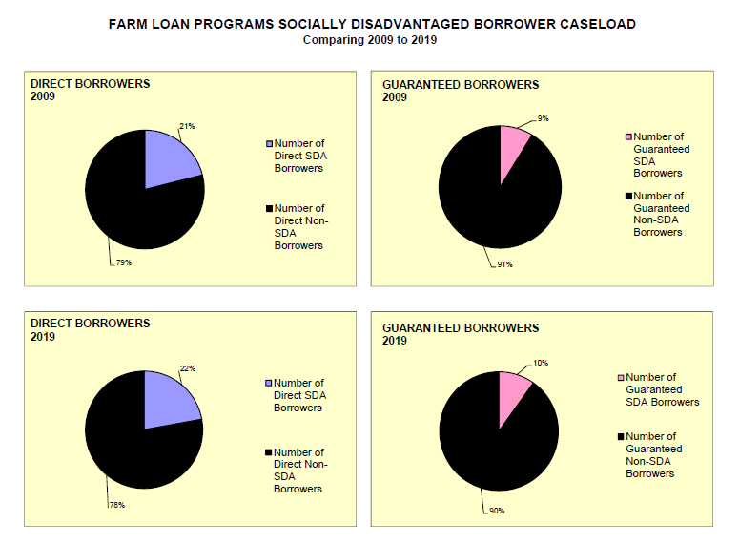
FSA Socially Disadvantaged Farmer Activity

Slide 27
2018 Farm Bill Changes
Industrial Hemp
Additional ways to meet Farm Ownership eligibility
Increased Loan Limits

Slide 28
2018 Farm Bill Changes
Increased Guaranteed Percentage for Socially Disadvantaged applicants from 90% to 95%
Veteran Farmer definition updated
Microloans can now be $50,000 for Operating Loan (OL) and Farm Ownership Loan(FO).

Slide 29
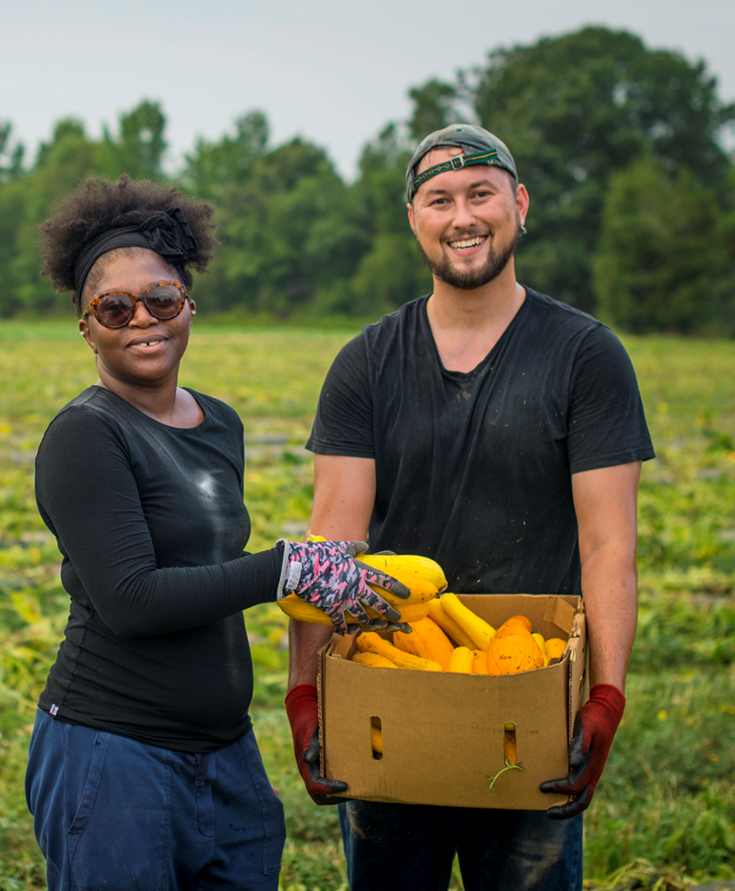
In communities nationwide, USDA and its partners help farmers, ranchers and other producers manage risk and grow their businesses.
We’re here to support your needs.
www.newfarmers.usda.gov/mentorship.
Notes:
FSA has taken steps to encourage a new generation of Americans to farm.
USDA Secretary Perdue signed a Memorandum of Understanding with SCORE, the nation’s largest volunteer network of expert business mentors, to support new and beginning farmers.
The agreement provides new help and resources for beginning ranchers, veterans, women, socially disadvantaged Americans and others, providing tools to help them both grow and thrive in agri-business.
SCORE matches business professionals and entrepreneurs with beginning farmers and ranchers to mentor them through the process of starting up and maintaining a new business, and to establish farm operators who may want to grow their operation or transition in a different direction;
USDA and its partners across rural America are working with SCORE to support farming and ranching operations, and identify and recruit mentors with a wealth of agriculture experience.
For more information or to sign up to become a mentor or mentee, visit: https://newfarmers.usda.gov/mentorship.

Slide 30
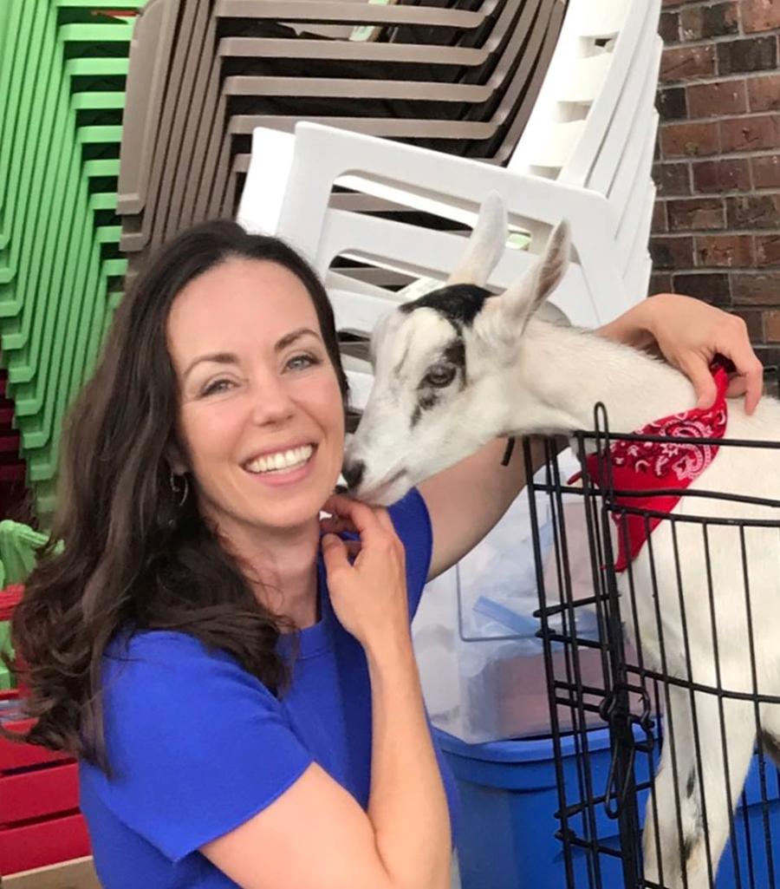
USDA – SCORE SUCCESS STORY
“It’s tremendous what USDA has to offer for people like me – a woman farmer and organic producer;”
“A lot of new farms need help. They need to make sure they are growing their product and getting to market, the last thing they want to think about is the financial growth strategy. SCORE can provide tremendous support in that aspect.”
-- Kerry Planck, Alpine Made
Notes:
Kerry Planck of Wales, New York, has turned raising goats into a successful business, Alpine Made, where she makes skincare products from certified raw organic goat’s milk.
While farming came easy for Planck, marketing a new business and getting product into the hands of customers proved to be more difficult until she found a mentor and assistance.
To build her business, Planck sought out resources in her community.
FSA provided Planck with initial financing (she continues to work with us to support her working capital needs); and
The Natural Resources Conservation Service (NRCS) helped with fencing and other farm infrastructure through the Environment Quality Incentives Program and the Conservation Stewardship Program.
Planck also attended an event coordinated between the Small Business Administration (SBA) and SCORE, a network of volunteer mentors, and resource partner to the SBA and USDA.
She sought out and was connected with a mentor – a businessman with expertise in sales, marketing and finance – who helped her market her product to the public.
Planck also worked with the New York Small Business Development Center to help structure her business plan. She and her mentor worked through the financial aspects. For example, how to do projections, revenue versus expenses and the role of profit in business growth. Planck’s mentor advises her on when to be conservative, or when to seize worthwhile opportunities.
Alpine Made now boasts a line of over 50 products which can be found in over 40 stores in western New York with plans to expand to stores in the eastern part of the state.
Farmers can sign up for a mentor or to become a mentee, and to learn more about the collaboration between SCORE and USDA at www.newfarmers.usda.gov/mentorship, or by visiting an FSA county office.

Slide 31
Online Resources
FSA Guide to Farm Loan Programs
FSA Loan Compass
Loan Application Forms
Farm Loan Account Information
SCORE – Free Ag Mentoring Service
Guide/Application Forms/ Compass: www.Fsa.usda.gov/farmloans
Loan Account Information: www.farmers.gov
SCORE: www.newfarmers.usda.gov/mentoring

Slide 32


