Slide 1
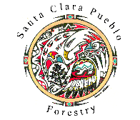
Developing Forest Resilience and Water Security in a Fire and Flood Affected Watershed
Garrett Altmann, M.sc.
Gis Coordinator/Project Manager, Department of Forestry
Santa Clara Pueblo, NM

Slide 2
Overview
Overview Santa Clara Pueblo and Watershed
Fire & Flood History
Disaster Declarations
Naturalistic Approach
Recovery Strategies: Engineering With Nature
Goals
Challenges
Conclusion

Slide 3
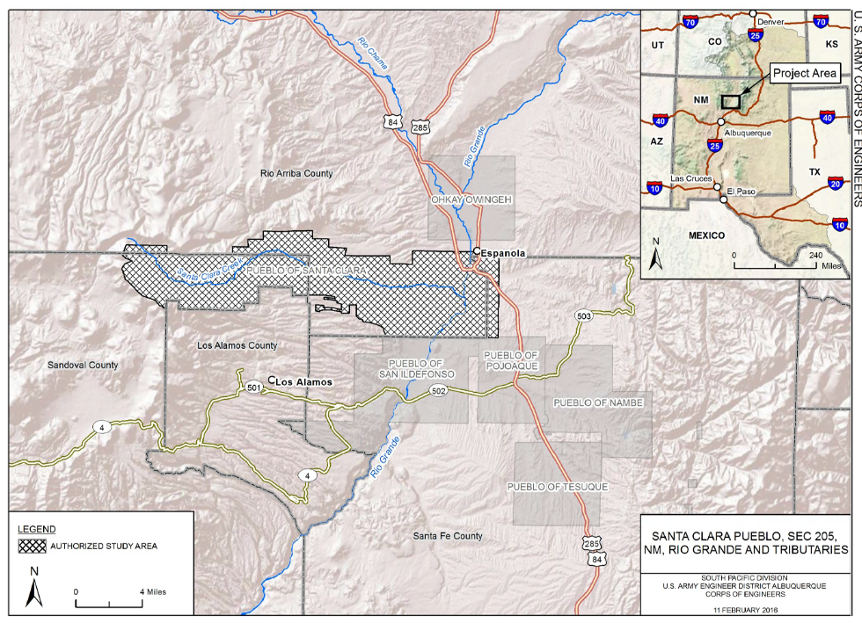
Overview: Santa Clara Pueblo
Kha’p’o Owingeh
-valley where the wild roses grow
Federally recognized Native American Tribe
Self Governance Tribe
Located on the Rio Grande in Northern New Mexico
Population: ~3,500
Area: 90 square miles
(58,000 acres)

Slide 4
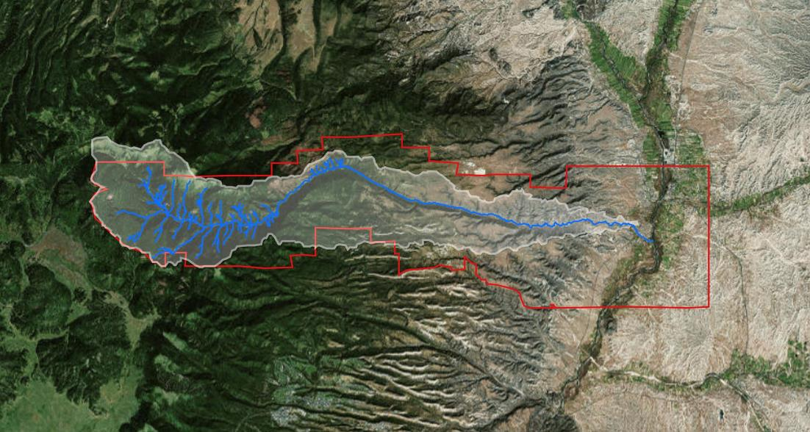
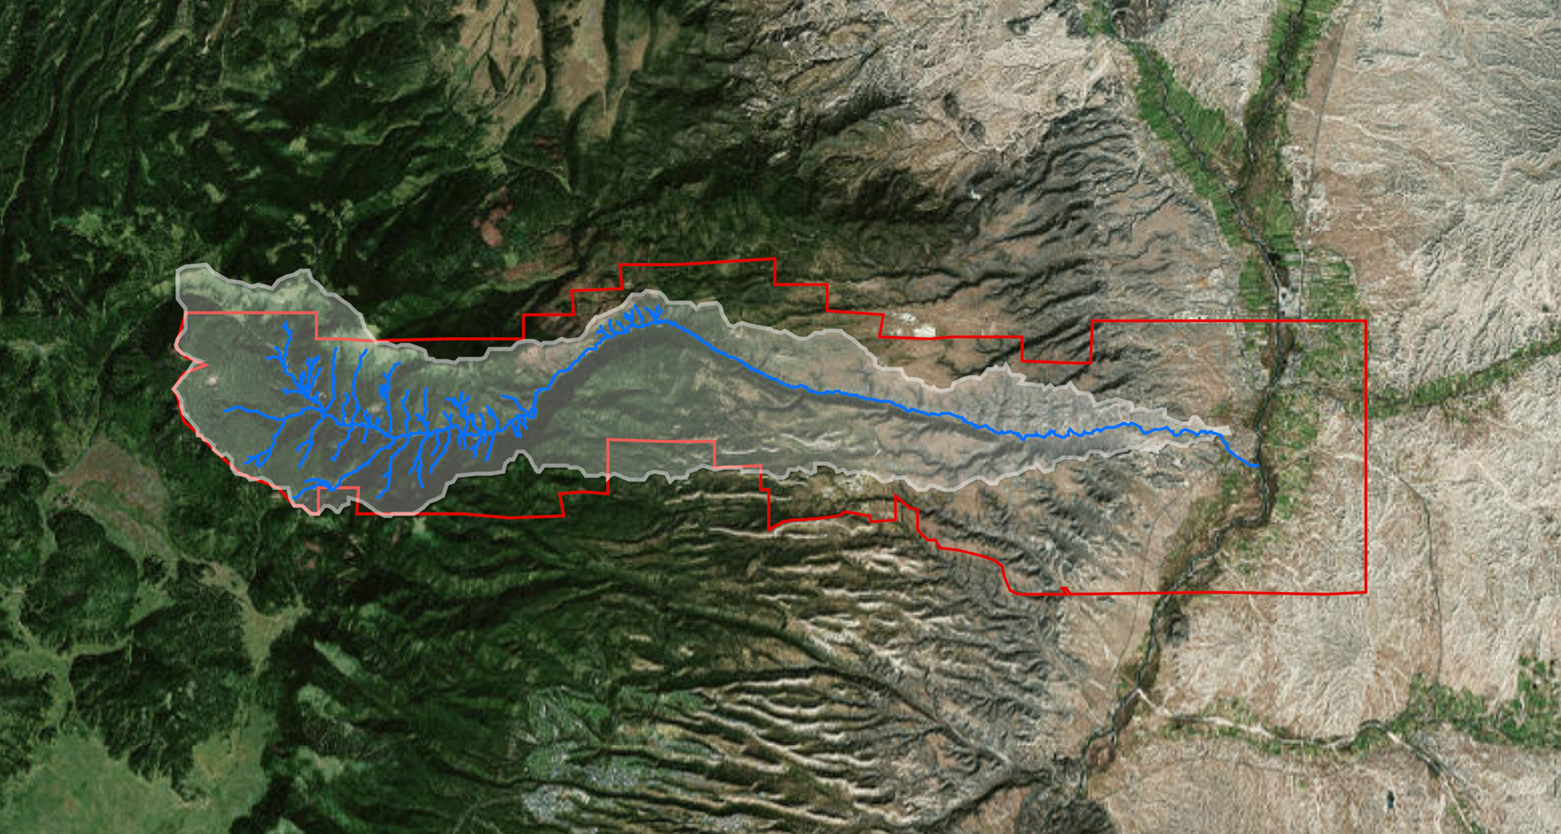
Santa Clara Creek Watershed
”Water is life”
32,000 acre watershed
~24-mile stream
Flows perennially from west to east
Elevation gradient from 9,000 to 5,000’
Transcends several bioclimatic zones
Central to the Pueblo lands, culture, and natural resources
North
1 mile

Slide 5
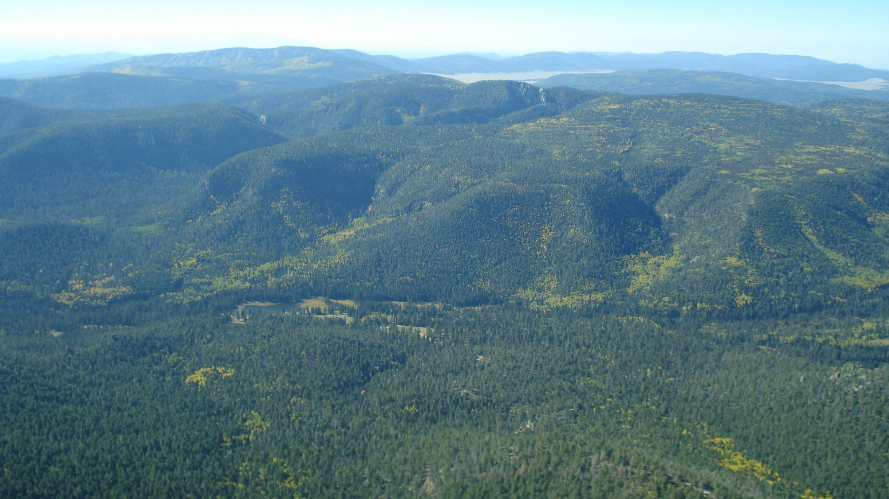
Upper Santa Clara Watershed in 2010 (view south)
Former 4th Pond

Slide 6
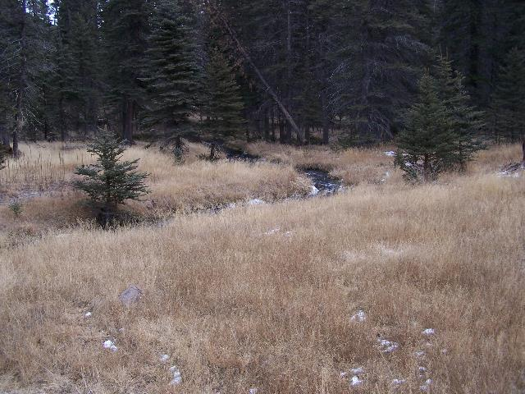
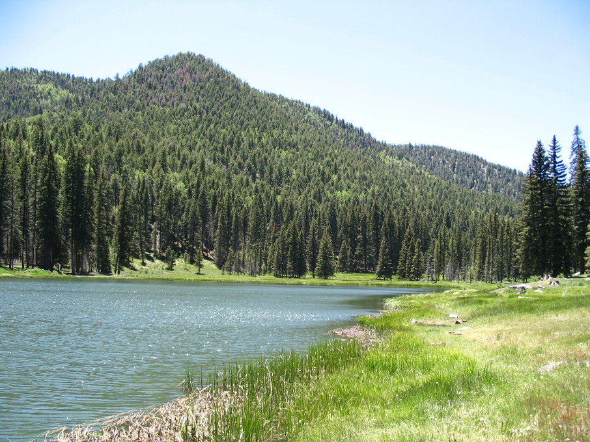
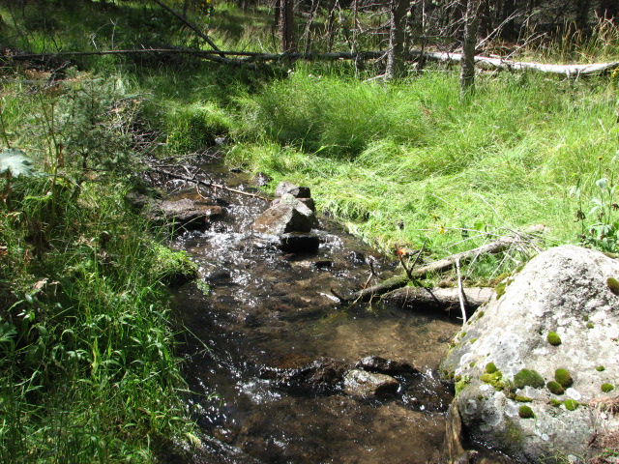
Santa Clara Creek & 4th Pond (2005)
4th Pond

Slide 7
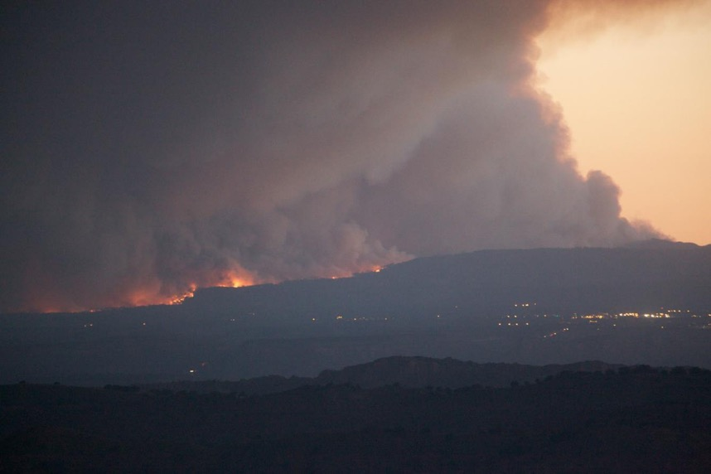
Natural Disasters
Unfortunately, natural disasters can strike unexpectedly….
Since 1998, three major wildfires have impacted Santa Clara Pueblo
All fires started off reservation
90% of tribal forests and 60% of watershed burned by moderate-to-high severity fire
Resulted in hydrophobic (water repellent) soils
Followed by devastating erosion and flood events
2011 Las Conchas Fire encroaching on nearby Los Alamos before advancing north through Santa Clara Pueblo tribal lands.

Slide 8
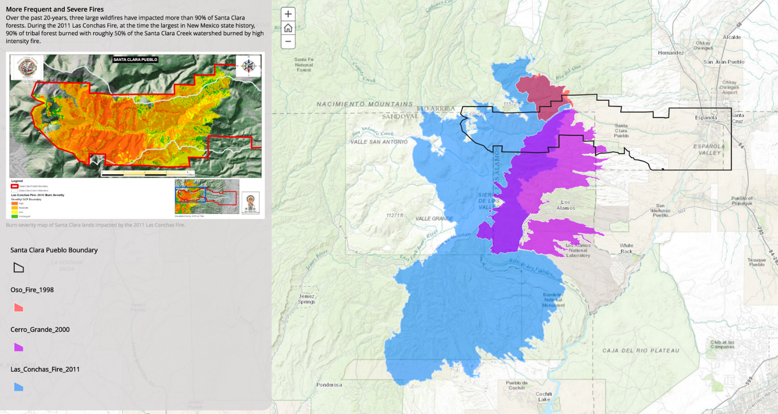
Fire History

Slide 9

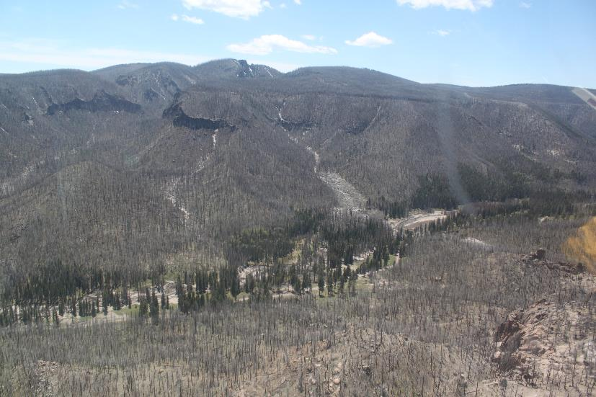
Stand Replacing Crown Fire
Before Fire (2010)
After Fire (2013)
4th Pond
4th Pond

Slide 10
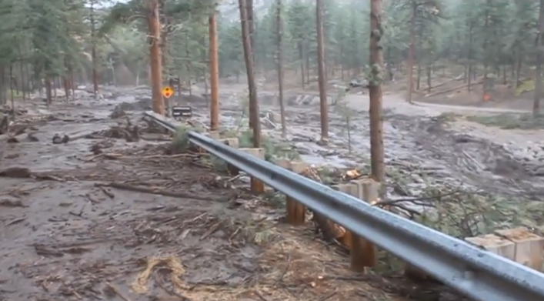
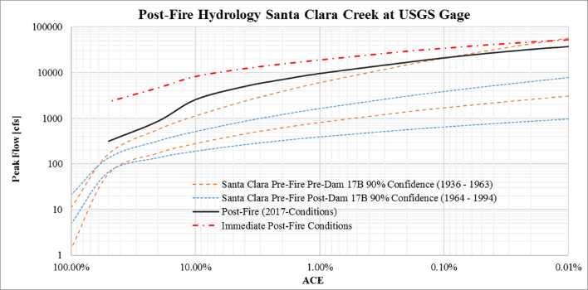
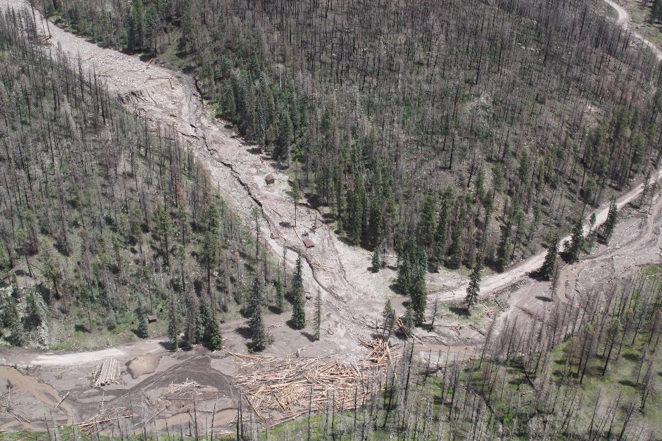
Simulated 2 year (50%) to 10,000 year (.01% ACE) events
After the fires came the flooding….
2011-2014 debris flows resulted in > $200M in estimated damages.
100% fish kill in watershed

Slide 11
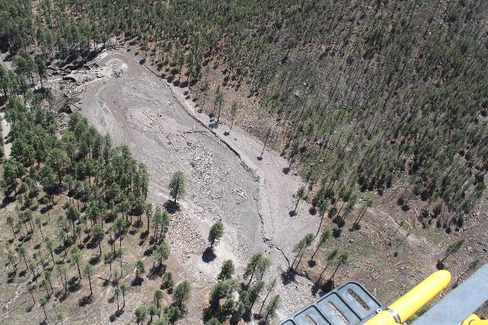
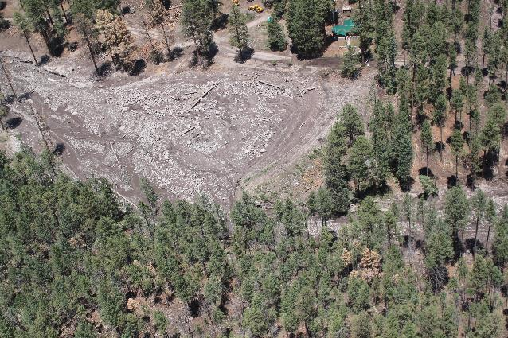
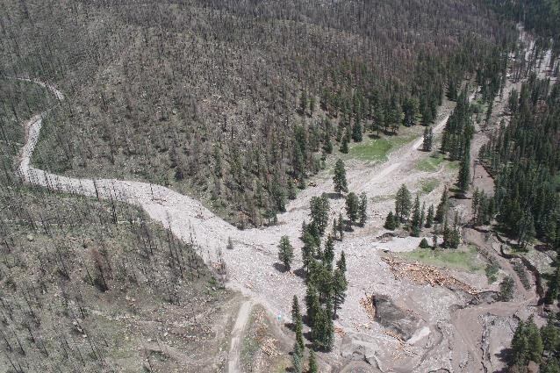
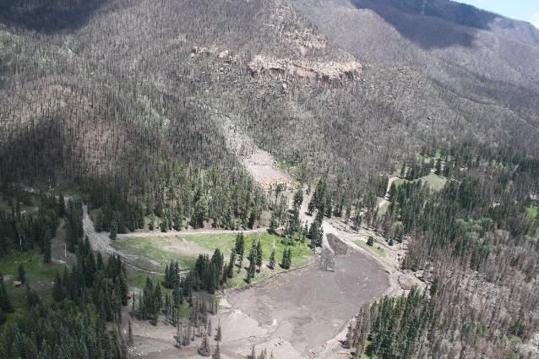
Debris inundation in ponds
All four dams eventually failed and breached
1st Pond
2nd Pond
3rd Pond
4th Pond

Slide 12
Disaster Declarations
Santa Clara Pueblo received five (5) Presidential Disaster Declarations from flooding:
DR-4047-NM, August 19-24, 2011
DR-4079-NM, June 22-July 12, 2012
DR-4147-SCP, July 19-21, 2013 (tribal declaration)
DR-4151-SCP, September 13-16, 2013 (tribal declaration)
DR-4197-NM, July 27- August 5, 2014

Slide 13
Recovery strategies:
Implemented the National Disaster Recovery Framework (NDRF)
  The FEMA NDRF identified partners, resources, roles and responsibilities.
Collaboration - federal, state, tribal, and non-governmental agencies.
  Flood mitigation to protect community
  Temporary road for emergency access
Developed a ‘top-down’ approach to treating the watershed:
  Mitigated remaining wildfire potential with Rx fuel breaks, thinning, logging
  Sediment source stabilization, primarily in ephemeral tributaries (2012-2018)
  Creek & riparian restoration (2018 – current)

Slide 14


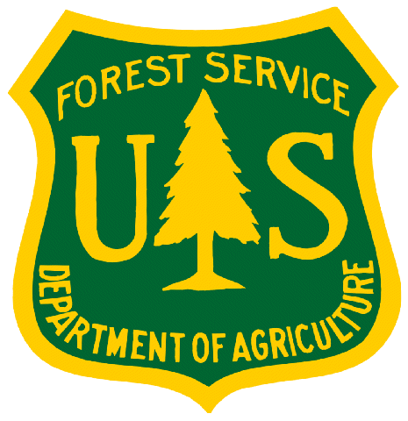





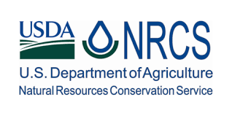











Collaborative Partnerships

Slide 15
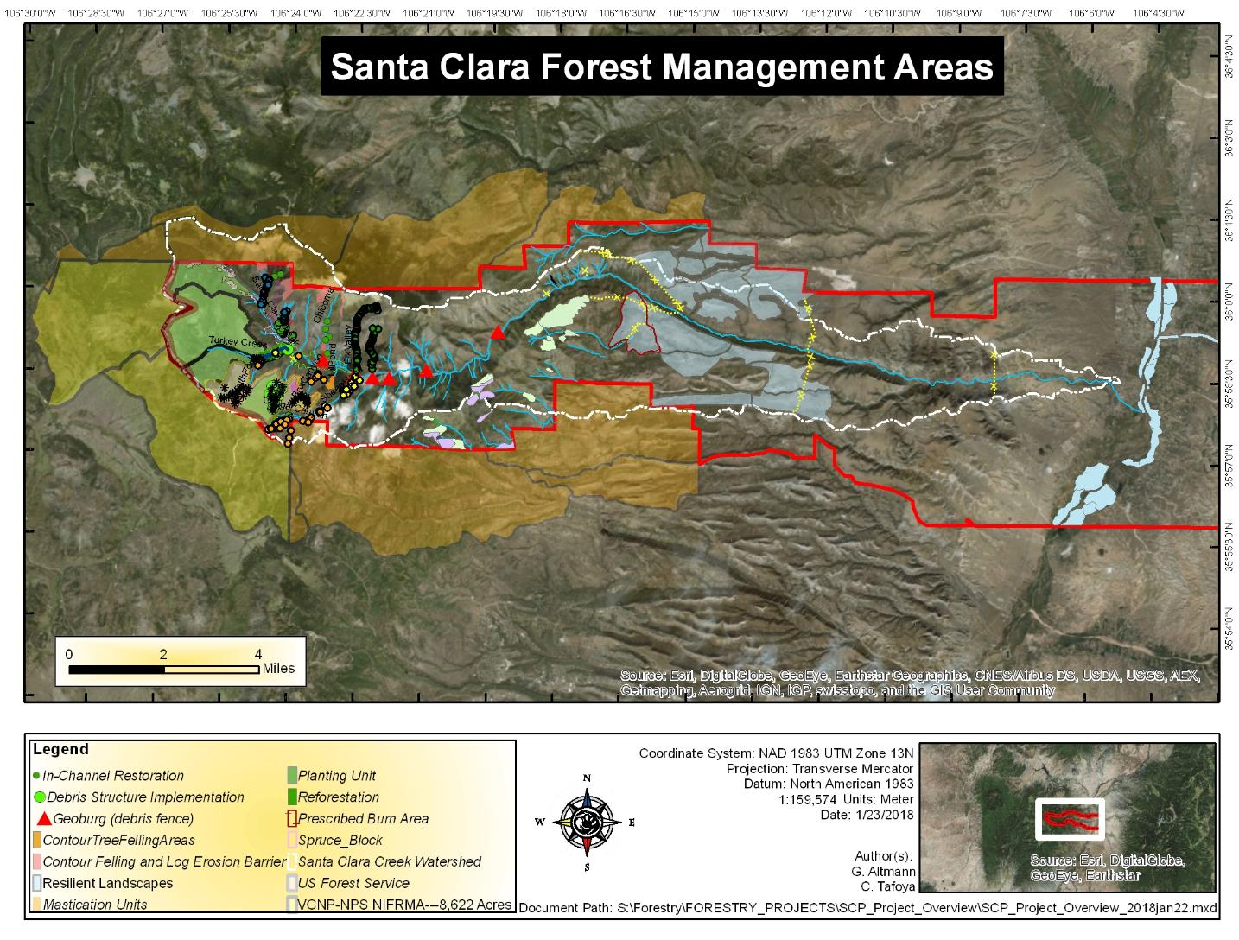
USFS Lands
Nat’l
Park
Service
Lands
USFS Lands

Slide 16
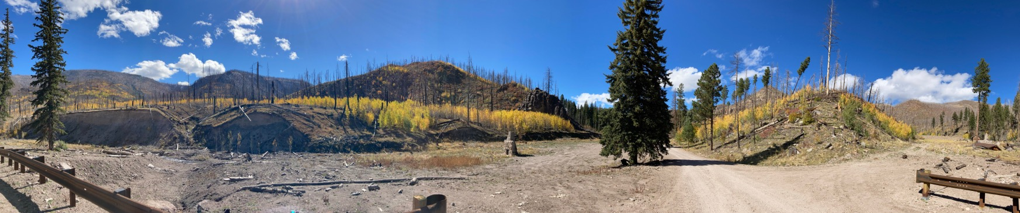
A Naturalistic Approach…
Develop nature based solutions (NBS) to increase resilience to variable climate events
  Fires, floods, prolonged drought
  Prioritize ecosystem services to mitigate flooding, increase water security, and access.
  Sustainably increase ecological, cultural, recreational, and economic value.
    Support reintroduction of native Rio Grande Cutthroat Trout

Slide 17
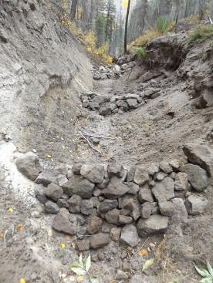
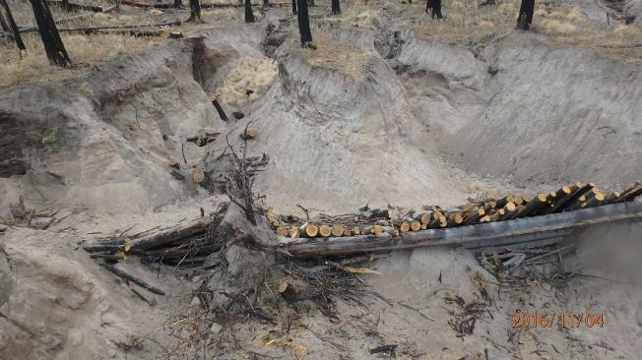
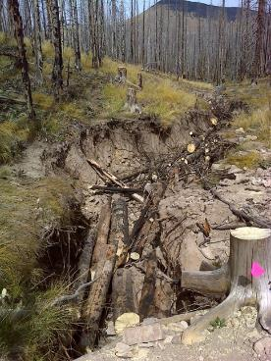
Strategies: Erosion Control
Low-tech structures are constructed in tributaries to reduce sediment transport, minimize head cutting, and aggrade incised channels.
The structures are cost-effective, being built by hand and using on-site materials. Over 5,300 structures have been built in 28 tributaries since 2014.

Slide 18
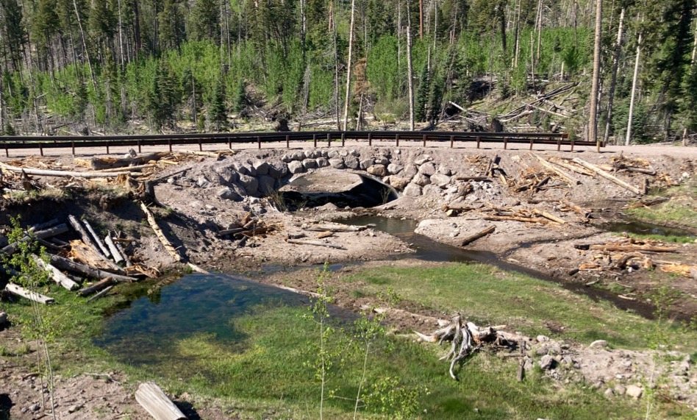
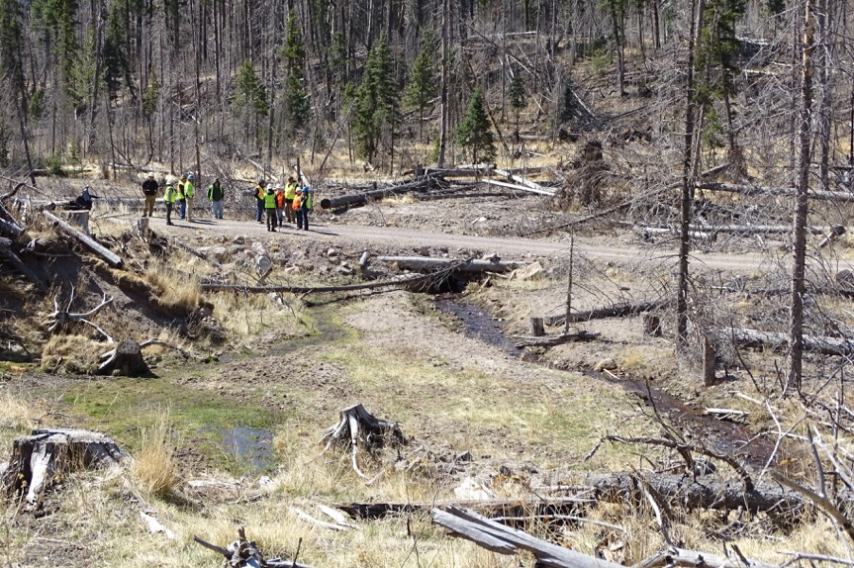
Flood Mitigation: Road Crossings
Cylindrical CMP culverts upgraded to bottomless culverts to convey 100-year flood events, facilitate meandering, floodplain connectivity, and fish passage.
Before
After
Pre-existing 48” CMP Culvert
24’x 7’ bottomless arch culvert

Slide 19
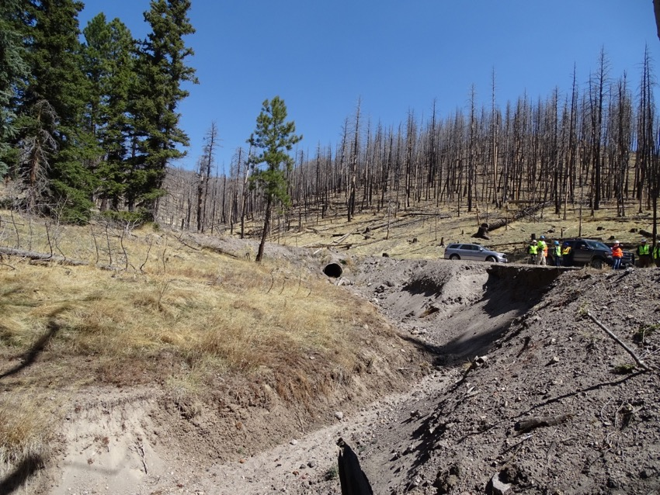
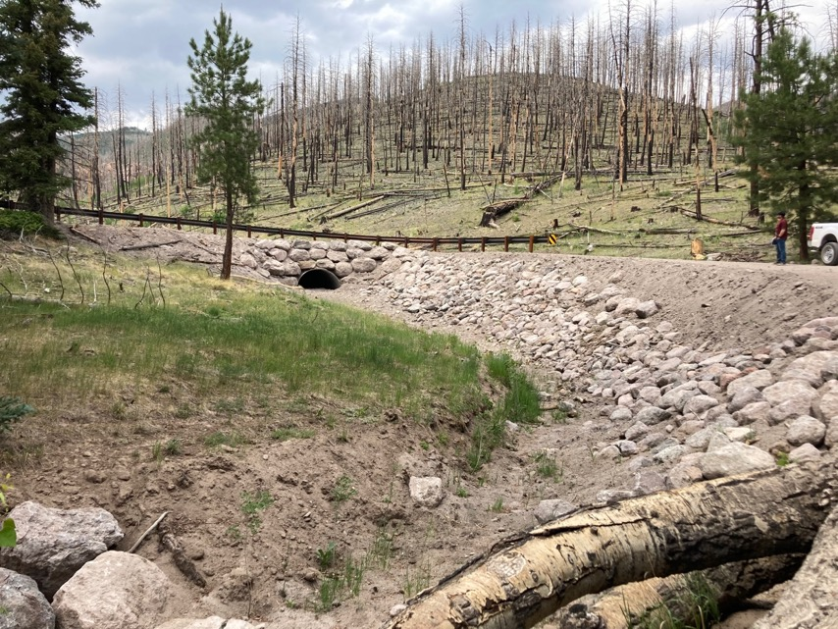
Flood Mitigation: Road Crossings
Ephemeral tributary crossing upgrade with bottomless culvert
Cylindrical culverts may be a more cost-effective substitution when set below grade to maintain natural bottom.
Before
After
Pre-existing 36”x40’ CMP Culvert
6’x 3’x 58’ Bottomless Culvert

Slide 20
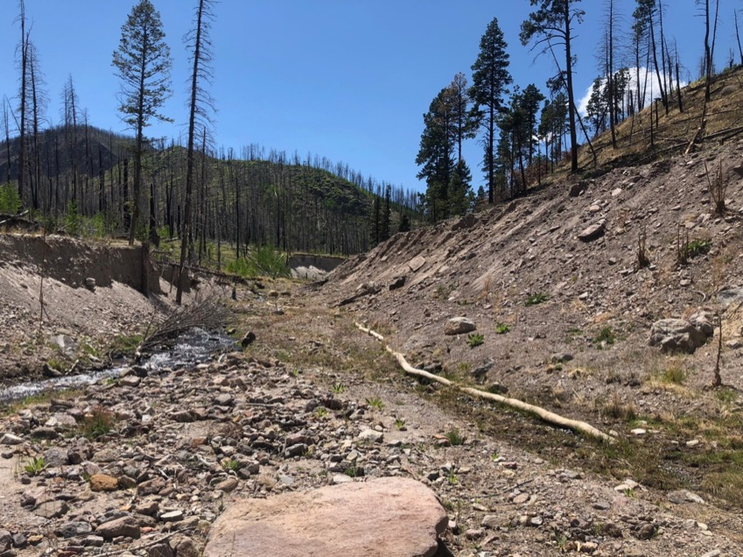
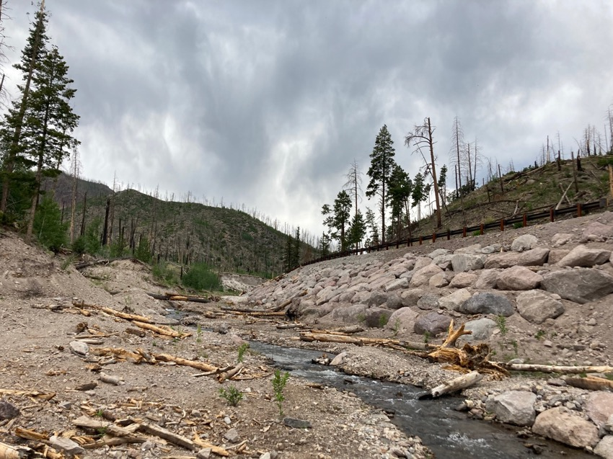
Flood Mitigation: embankment armor
Maximizes integration of bankfull channel with on-site rocks and woody debris
Before
After

Slide 21
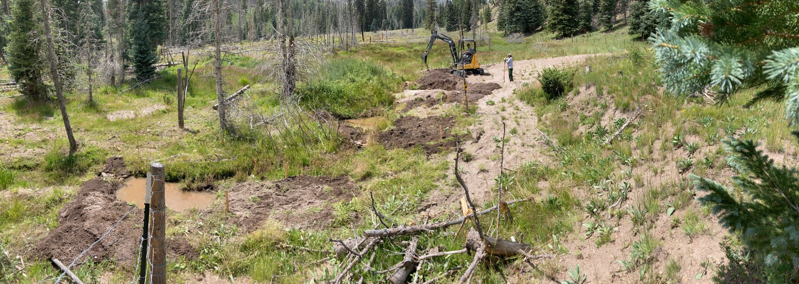
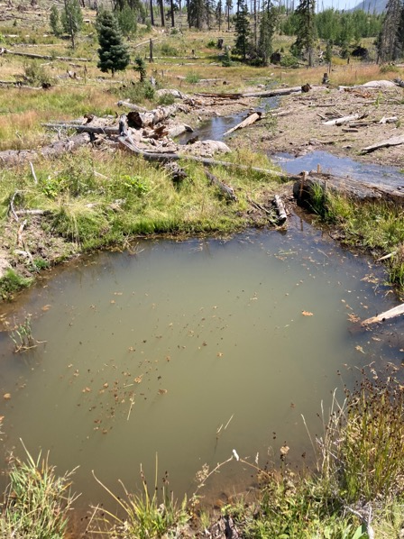
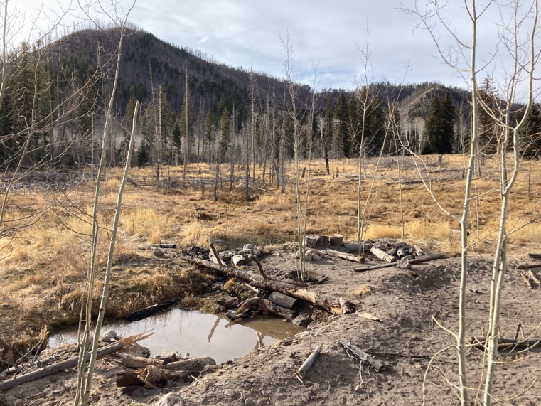
Water Storage: Beaver Dam Analogs

Slide 22
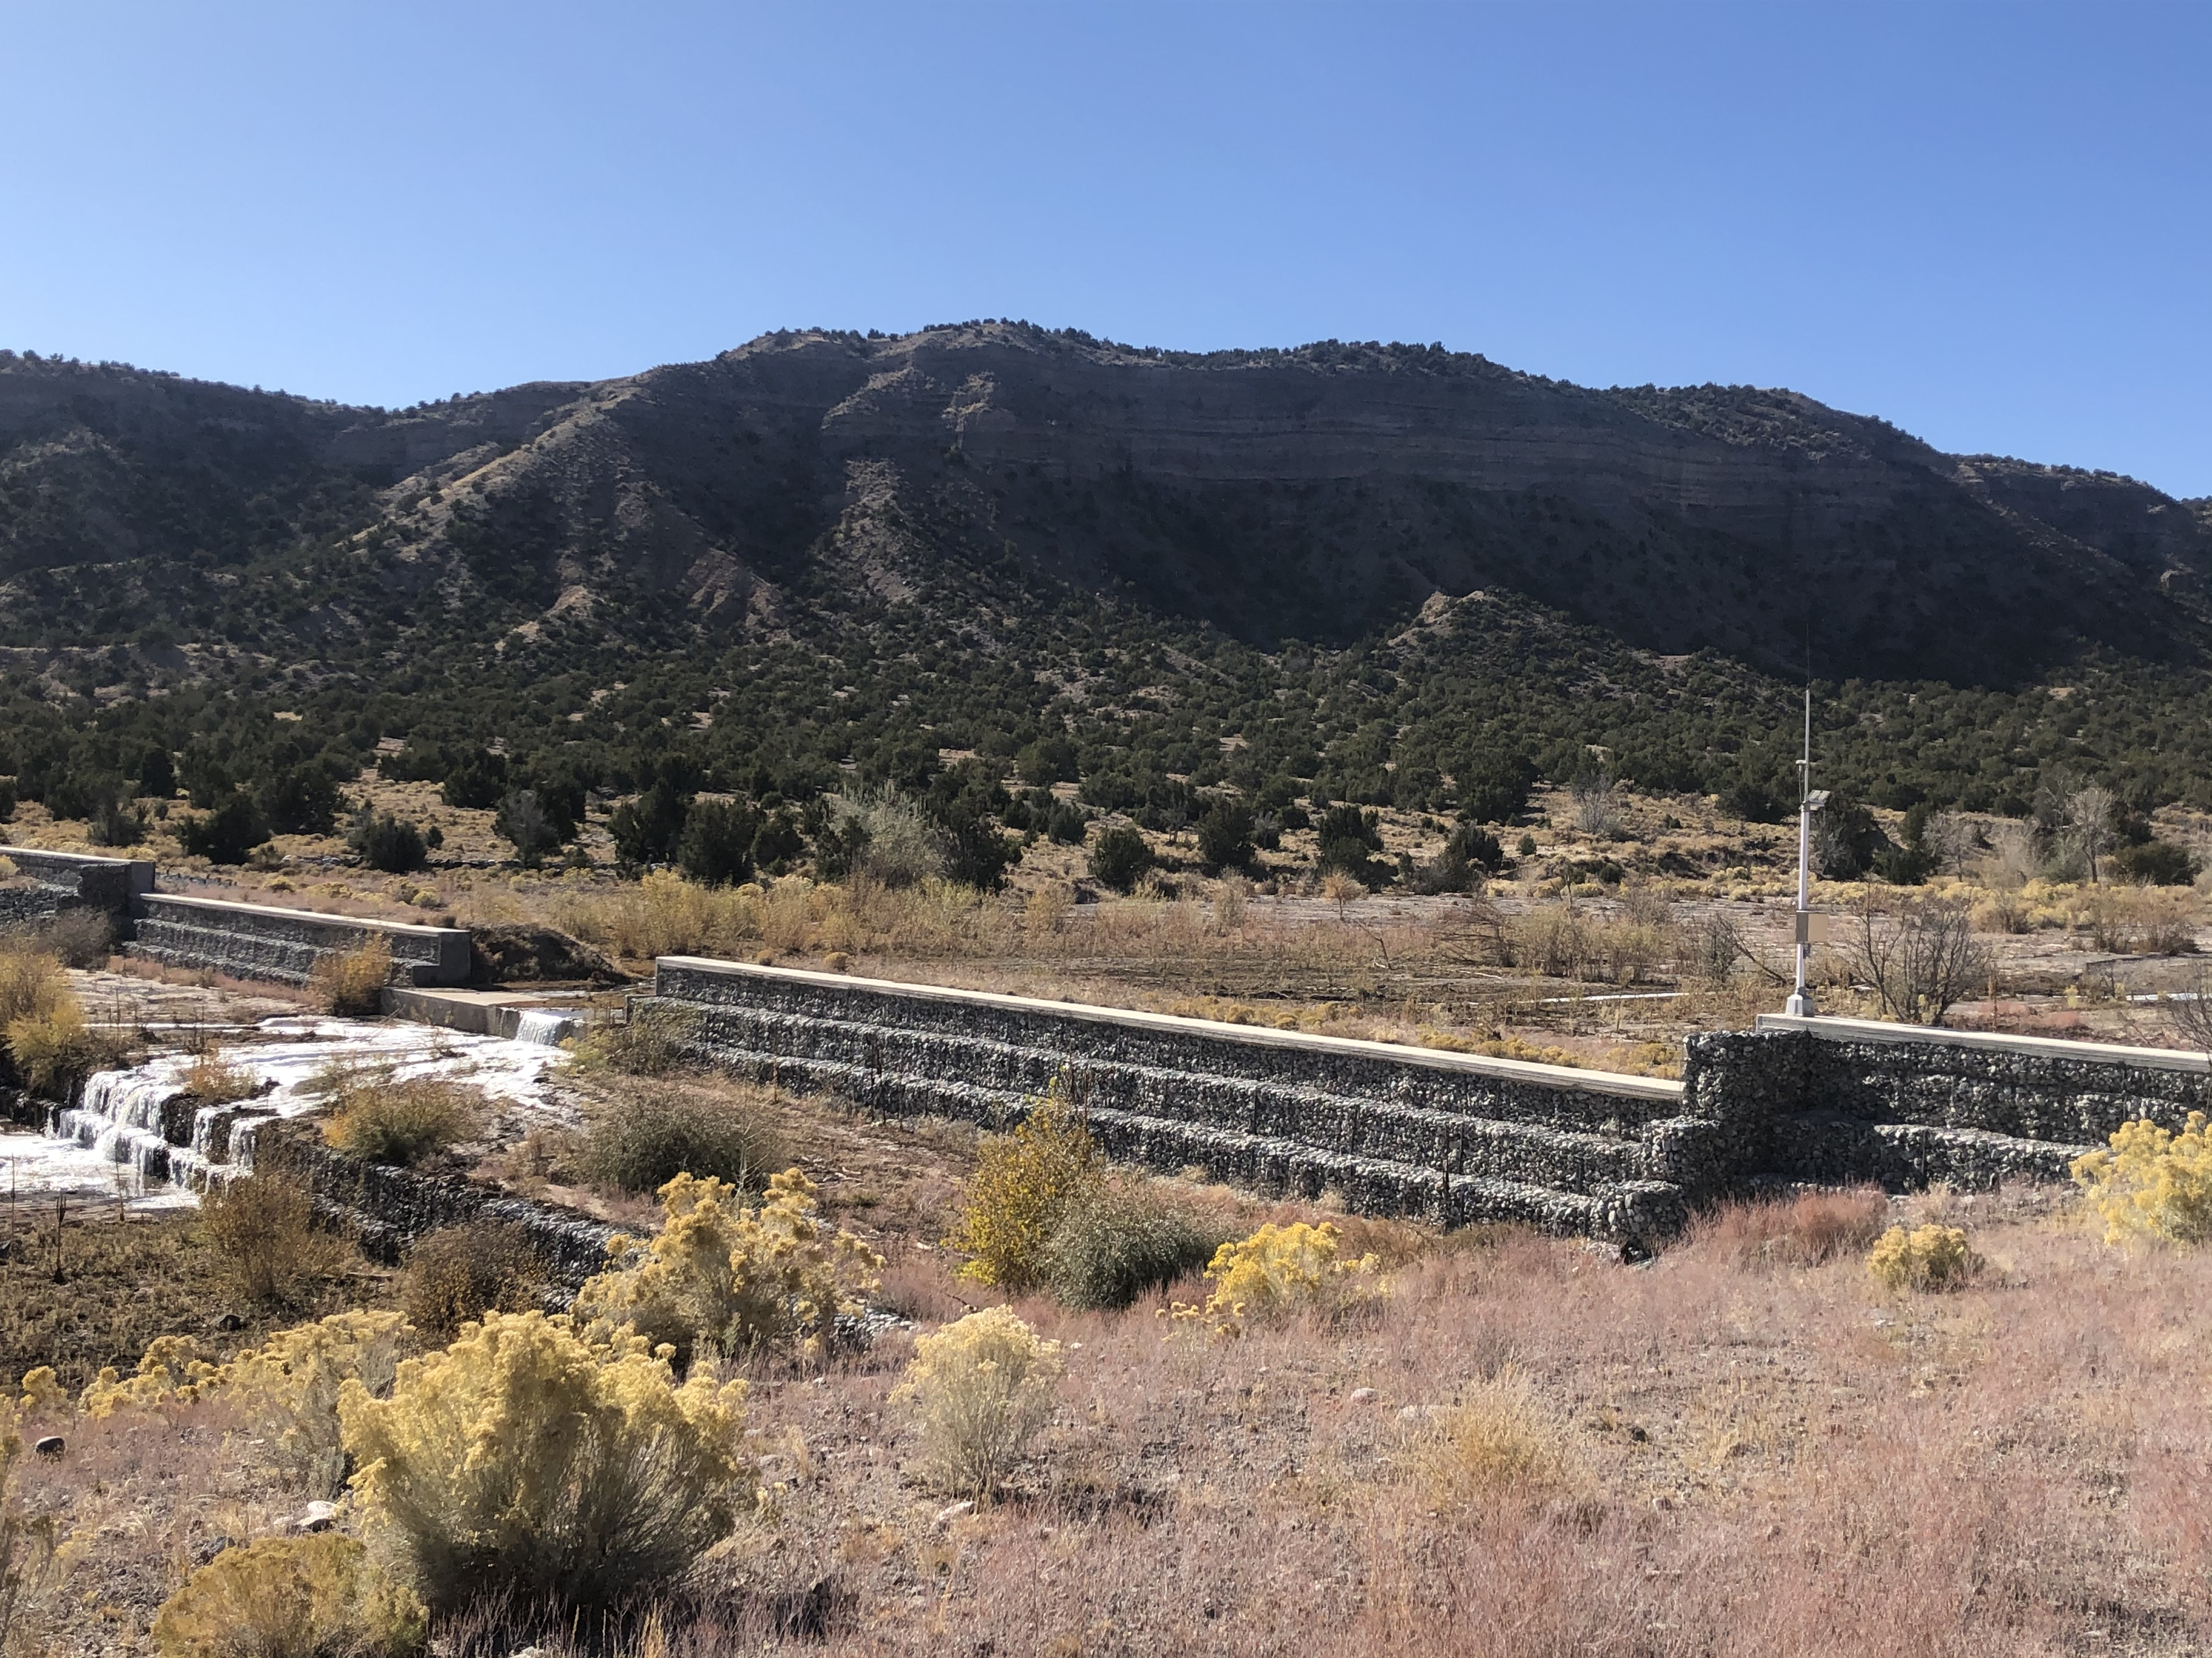
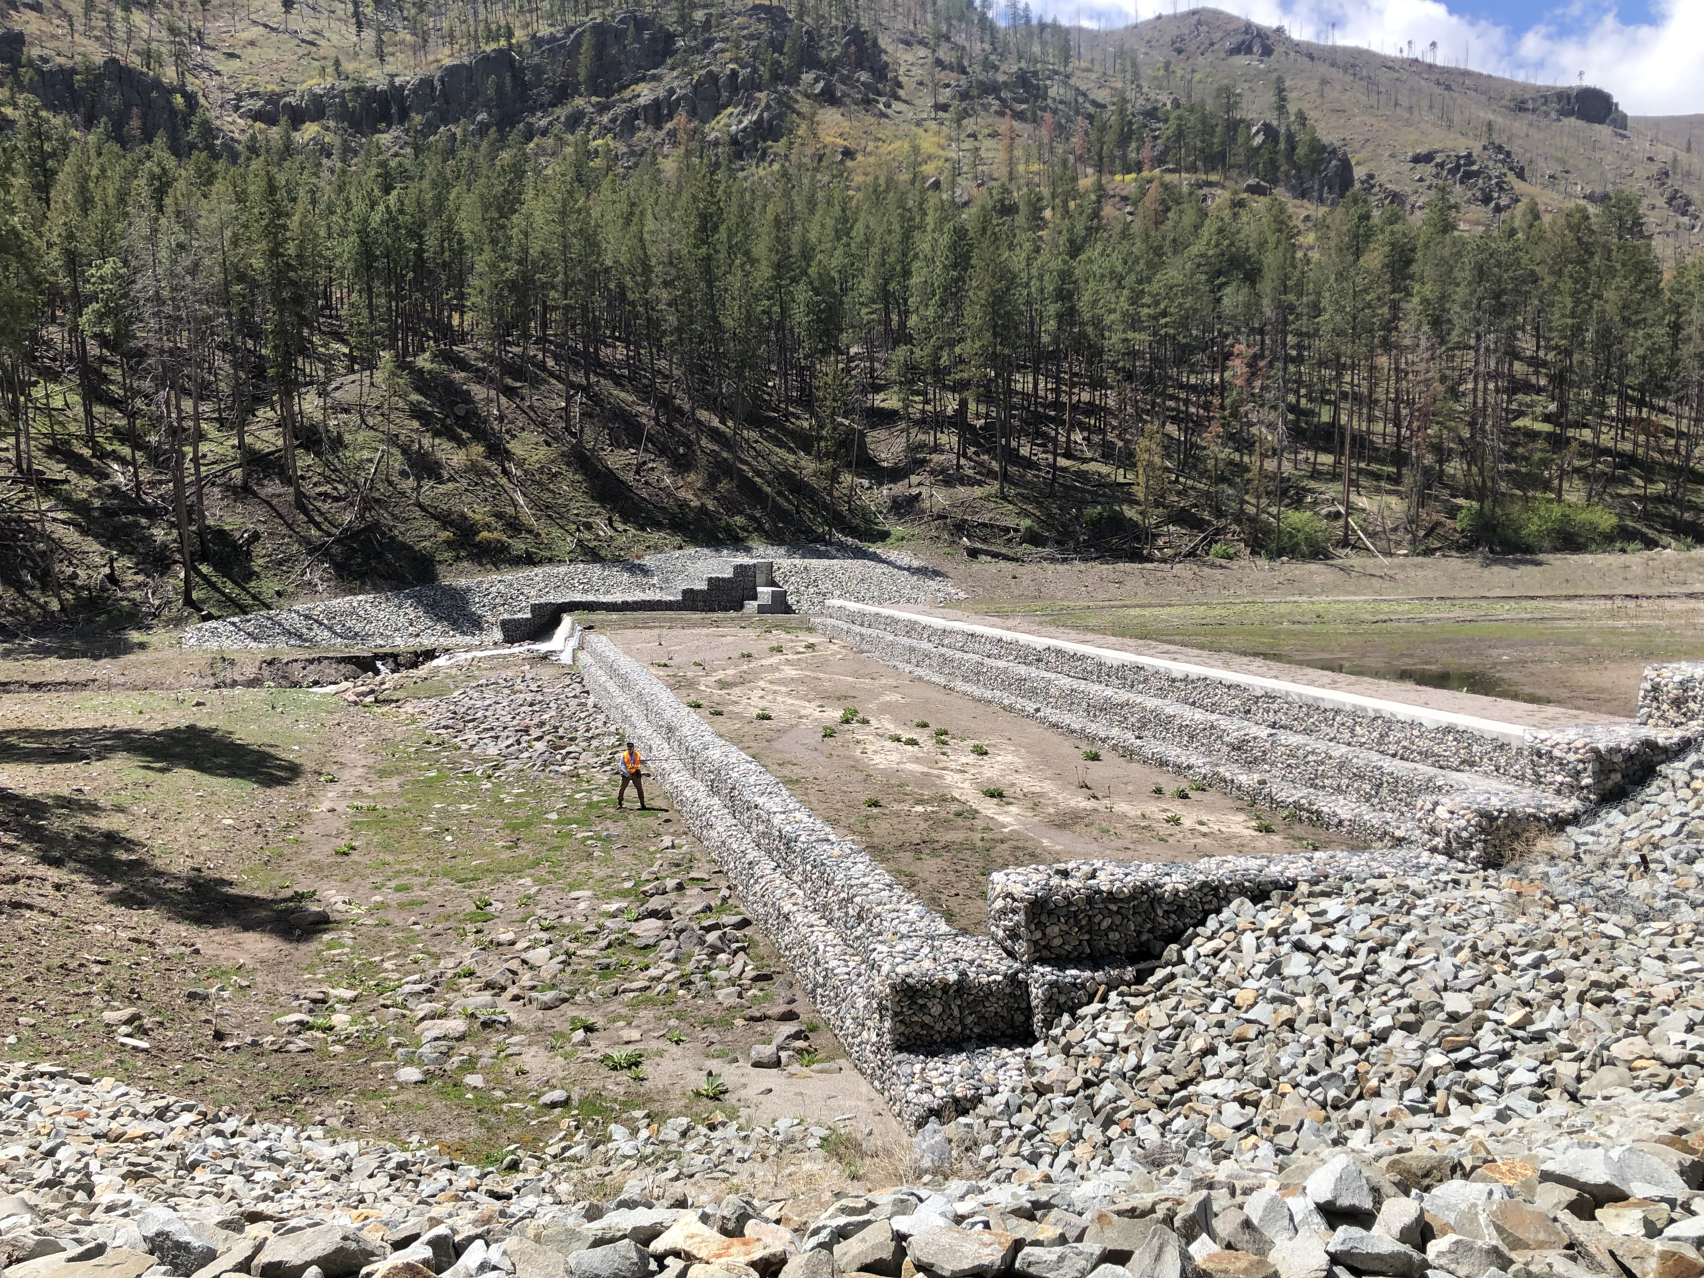
Flood mitigation: gabion dams
USACE constructed post-fire to attenuate flood energy and increase village evacuation time.
5-to-30 year lifespan
Ecologically disconnected
Being evaluated for earthern dam conversion through USACE EWN

Slide 23
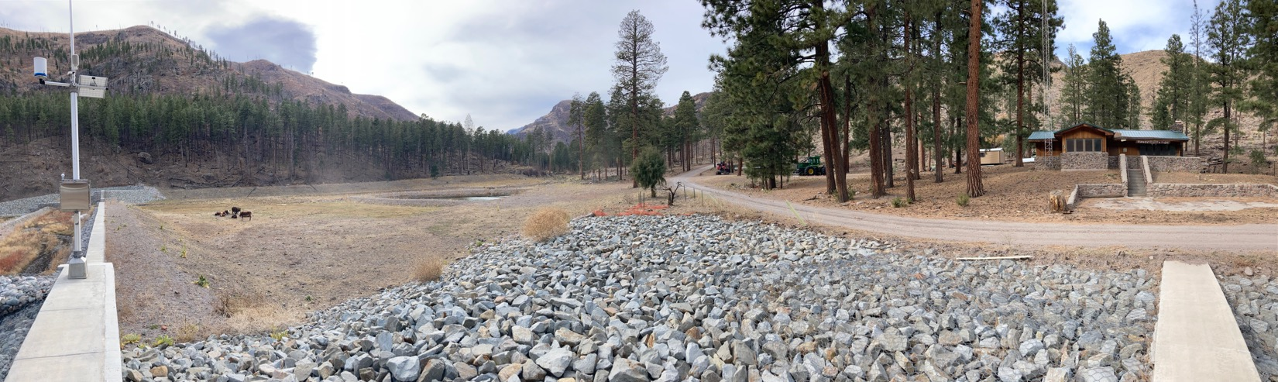
Water Storage: Off-channel ponds
2nd Pond Conceptual design for NRCS VPA-HIP Project “conservation trials”
Similar to an oxbow lake, off-channel ponds are located in floodplains.
Attenuate flood energy and scalable.
Can be placed as maintainable sediment retention basins.
Increase water storage, create habitat, and provide recreation.

Slide 24
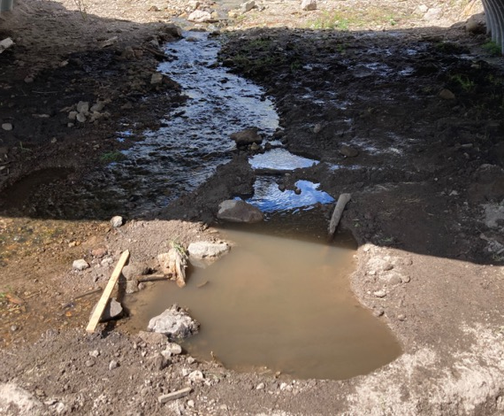
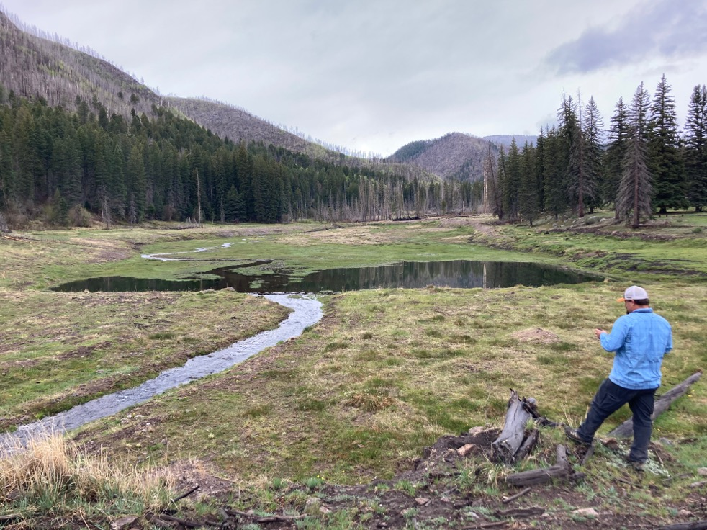
Water Storage: off-channel ponds
4nd Pond basin (post-sediment removal)
Conceptual scale model
Diversion
structure
Secondary
pond
Primary
channel
Beaver ponds
& wetlands
Primary
Pond
Pond(s) excavated below grade
No dam
Attenuates flood energy
Can integrate recreation access
Scalable

Slide 25
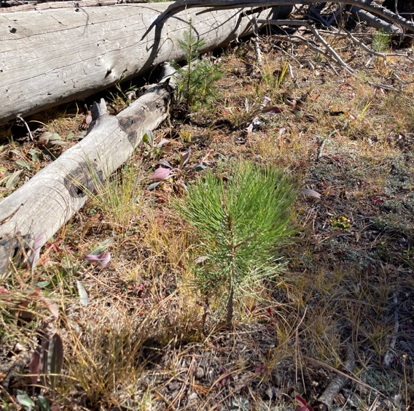
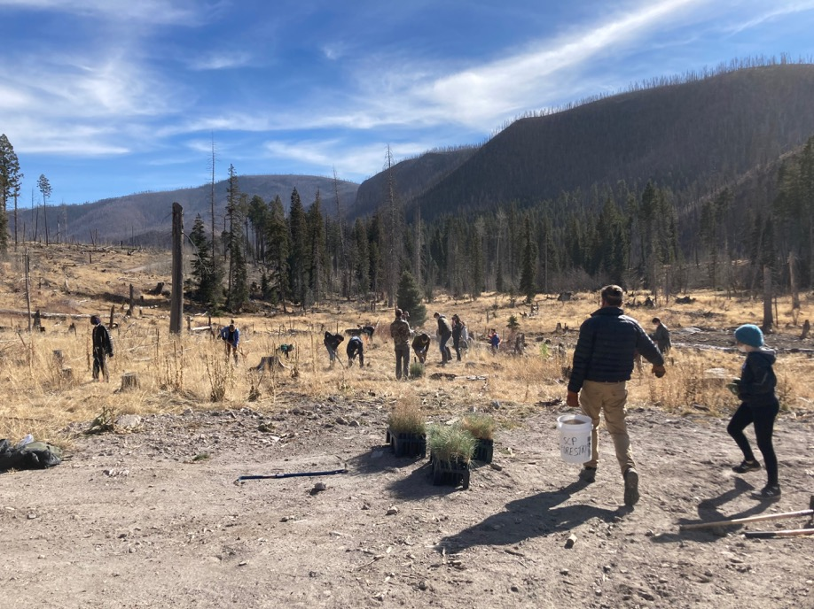
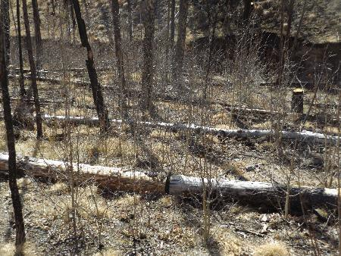
Reforestation: public participation
Community involvement and youth integration can create valuable learning opportunities, while developing a connection or sense of ownership for natural resources.

Slide 26
Goals
Expand naturalistic approach to Rio Grande and neighboring watersheds
Participate in co-stewardship on federal lands utilizing the Tribal Forest Protection Act, 638, and our established MOU’s with USFS and NPS
Develop proof of concepts and continue to innovate with new strategies:
  NRCS Volunteer Public Access – Habitat Incentive Program (VPA-HIP) is funding the design and construction off-channel pond “conservation trials”
  USACE Engineering with Nature (EWN) program
  Share concepts to support national & regional efforts, such as the NM 50-year water plan
  Share our story through outreach, tours, and via Story Map: https://arcg.is/0HGPHf
Restore the Santa Clara Canyon for future generations to enjoy.

Slide 27
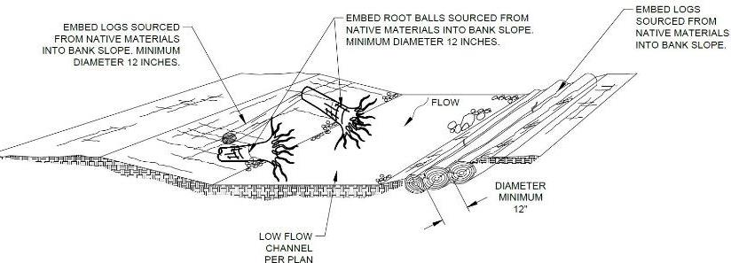
Challenges
Funding and non-federal cost share
Limited bioengineering design examples
Design vs. Construction Costs may exceed typical ratio
Finding contractors proficient in natural based restoration
Quantifying ecosystem services (Earth Economics)
Cultural limitations for quantifying surface discharge and subsurface water
NEPA and Sec. 404 Waters of the U.S. permitting

Slide 28
Conclusion
Nature based solutions offer an effective way to increase water security and resilience to climate change.
Maximizing ecosystem services facilitates resource sustainability, habitat diversity, wildlife prevalence, recreation opportunity, and economic value.
NBS can be scaled to accommodate different environments
NBS can integrate both scientific and traditional ecological knowledge.
Lastly, remember to keep it simple….
“If it’s good for the planet, it’s good for us.”
  - Santiago Naranjo, Santa Clara Pueblo Tribal Member and Forestry Tech

Slide 29
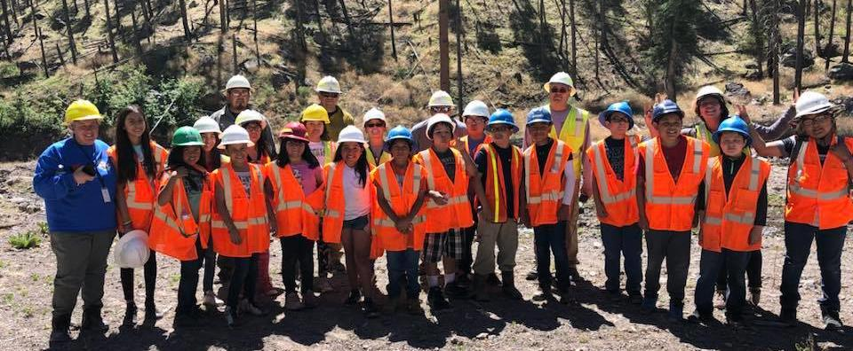
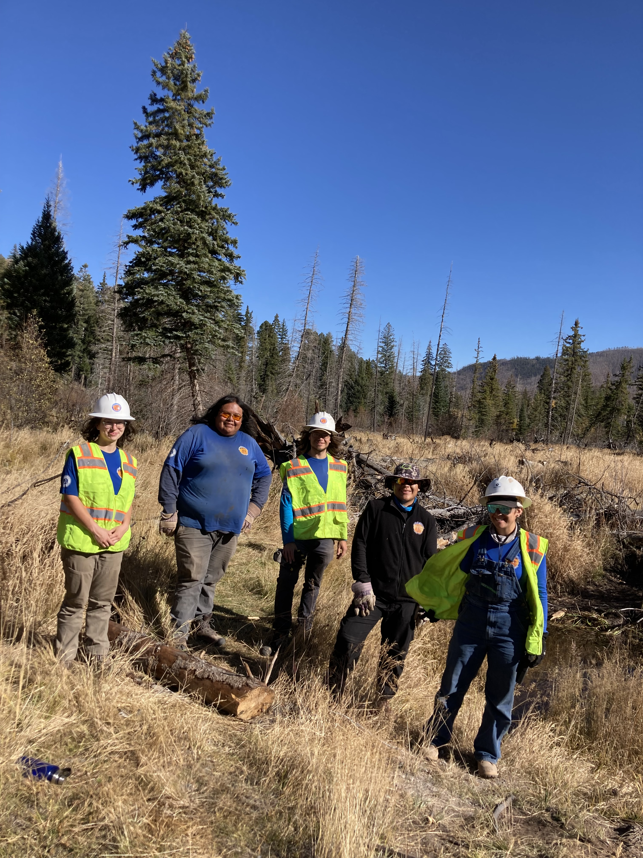
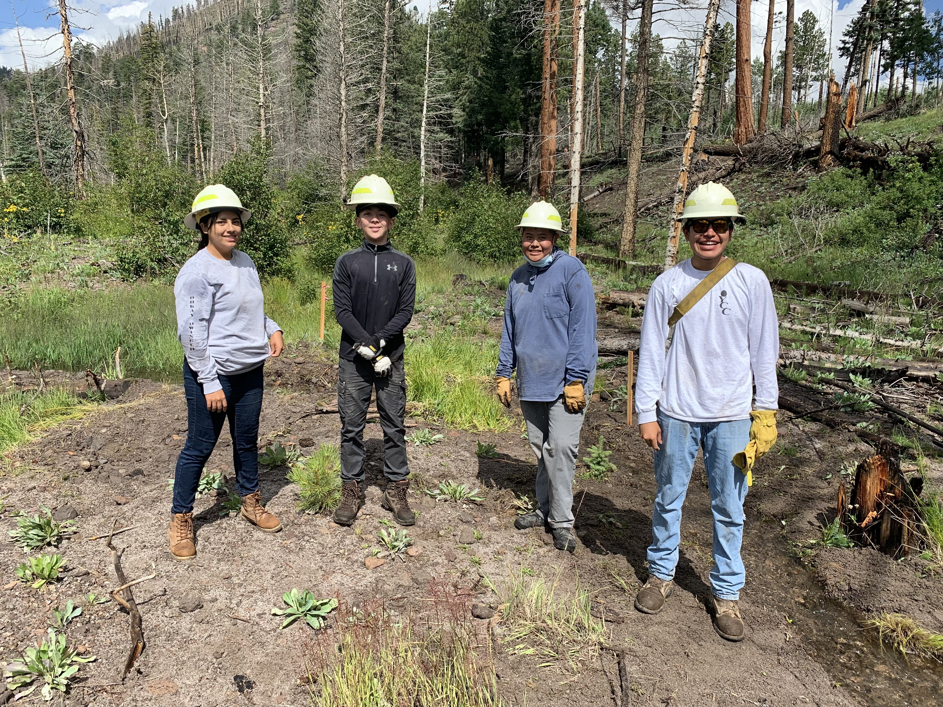
Thank you!!
Questions?

Slide 30
Resources
Haring, C. P., Altmann, G. L., Suedel, B. C., & Brown, S. W. (2021). Using Engineering with Nature® (EWN®) Principles to Manage Erosion of Watersheds Damaged by Large-scale Wildfires. Integrated Environmental Assessment and Management (IEAM), DOI: 10.1002/ieam.4453
Promoting Nature-Based Mitigation Through FEMA Mitigation Grants (2021), The Nature Conservancy (Santa Clara Pueblo featured in Case Studies) https://www.nature.org/en-us/what-we-do/our-priorities/tackle-climate-change/climate-change-stories/nature-based-fema-hazard-mitigation-guidebook/
FEMA IRC case studies (2) and (1) Teaching Note - available online at FEMA Case Study Library | FEMA.gov, used in disaster recovery trainings offered to disaster recovery personnel at the federal, state, tribal, and local levels to promote learning through story telling.
FEMA: Job Aids for Bioengineering Stabilization Methods
    Shoreline stabilization, Streambank Stabilization, Wildfire Mitigation (2018) https://www.fema.gov/media-library/assets/documents/156338
USACE
  Manual: Engineering with Nature Using Native Plant Communities (2014)
  Report: Incorporating Ecosystem Goods and Services in Environmental Planning – Definitions, Classification and Operational Approaches (2013)
State of Colorado, Water Conservation Board
  Living Streambanks- A Manual of Bioengineering Treatments for Colorado Streams (2016)

