Slide 1

China at Crossroads:
China-U.S. Agricultural Trade in the Shadow of a Dispute
Jason Grant and Everett Peterson
Associate Professor and director, Center for agricultural trade
DEPARTMENT OF AGRICULTURAL AND APPLIED ECONOMICS
Emeritus Professor, Center for agricultural trade DEPARTMENT OF AGRICULTURAL AND APPLIED ECONOMICS
USDA Agricultural Outlook Forum, Washington, D.C., February 20-21
Notes:
Thank you Danny and thank you for the invitation to speak at the 2020 Agricultural Outlook Forum.

Slide 2
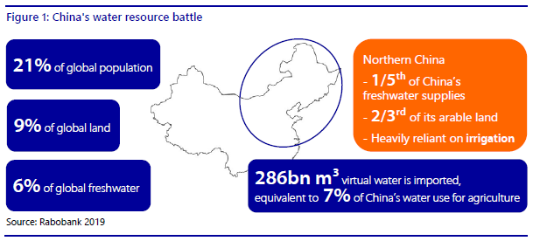
China
The well-known Chinese idiom “bread comes first” highlights the value Chinese citizens place on food security.
China’s continuing urbanization, increasing household income, and growing economy creates imbalance between agricultural resource availability and growing demand for agricultural products (Gale et al. 2015).
Chinese per capita water availability is only one-fourth of the global average, and its effective arable land accounts for less than 9% of the world total
Notes:
The well-known Chinese idiom “bread comes first” highlights the value Chinese citizens place on food security.
However, urbanization, China’s growing economy and increasing household income, and the fact that it is home to 21% of the world’s population creates an imbalance between agricultural resource availability and growing demand for agricultural products.
Chinese per capita water availability is only one-fourth of the global average, its effective arable land accounts for less than 9% of the world total and it imports 286 billion cubic meters of virtual water used to produce food and fiber in other countries.

Slide 3
China’s Total Merchandise and Agricultural Imports, 1995-2017
Author’s calculations based on UN Comtrade Data available at: https://comtrade.un.org/
Since joining the World Trade Organization (WTO) in 2001, China has become an important player in global agri-food trade.
The value of China’s agricultural imports has risen from $10.3 billion in 2002 to $115.3 billion in 2017, representing an average annual growth rate of 19.0%.
China’s share of global agriculture imports increased nearly four-fold from 2.1% to 8.6% over the same period.
China’s agricultural exports are 65% of imports resulting in China being a large net importer of agri-food products.
Notes:
For these reasons, China has become one of the most important trading partners in the world economy. China has been the U.S.’s number one destination for agricultural products in 2013, 2014, 2015 – exceeding Canada and Mexico, and the U.S.’s number 1 or 2 market for almost a decade prior to 2018 and 2019. Pictured here is China’s total merchandise imports and exports, and China’s agricultural import and exports. Notice how China’s overall trade balance has been in surplus since 2005 with total merchandise exports exceeding imports. However, for reasons mentioned in the previous slide, China’s agricultural trade balance has been in deficit since 2007. China has become one of the largest net importers of agricultural and food products.

Slide 4
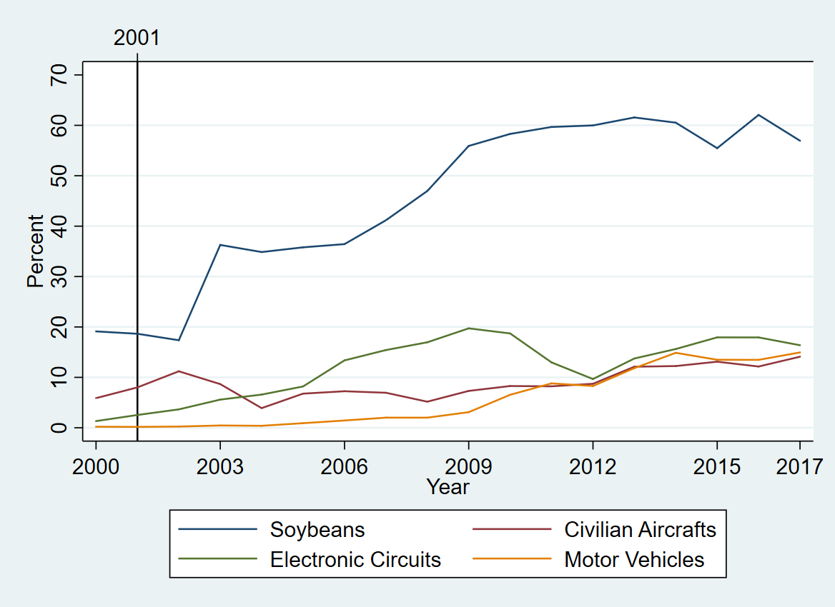
Top U.S. Exports to China as a Share of Total U.S. Exports in Each Product Category
Top Exports: civilian aircrafts, motor vehicles, electronic circuits, soybeans
Share of total U.S. exports in each product category:
Importance of China for U.S. soybean exports exceeds ALL product categories
2016 Share ~ 60% > 3 times the share of electronic circuits
China plants a combined 220 million acres in wheat, corn, and rice,
Just 17 million acres of soybeans
(Gale, 2018)
Notes:
China is also an important for soybeans even when compared to the top categories of non-agricultural goods. In 2017, the top export category to China was civilian aircrafts, with over $16 billion exports, followed by soybeans, at $12.2 billion, motor vehicles, at $10.3 billion, and electronic circuits, at around $5.3 billion. This figure shows U.S. exports to China as a share of U.S. total exports to the world for each product category. The importance of China for U.S. soybean exports is clear – with 60% of total U.S. soybean exports are sent to China. Brazil is a major competitor in the Chinese import market for soybeans. Together, the U.S. and Brazil have historically supply over 90% of China’s soybean imports.

Slide 5
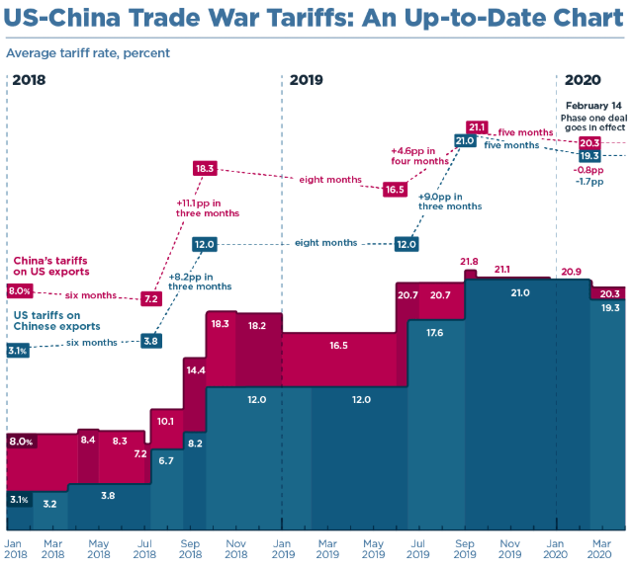
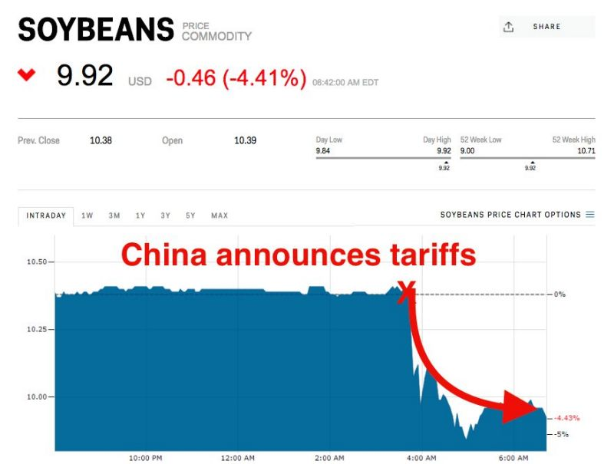
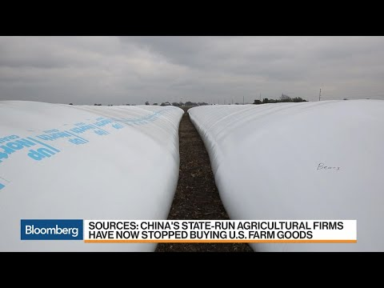
In 2018/19, the U.S.-China Trade Relationship
Came Under Strain
Source: Bown (2020). “Tariff Worries Remain After Two Years of Trade War and Despite a Phase One Deal”
Notes:
The U.S-China agricultural trade relationship came under strain in 2018 and 2019. Commodity markets such as soybean prices turned bearish, average applied tariffs escalated from 3.1% on Chinese imports and 8% on US products to 21% at the height of the trade dispute including many tariff peaks on pork and tree nuts that were affected by multiple waves of retaliatory tariffs. Trade tensions escalated further on Tuesday August 6, 2019, when China’s Commerce Ministry announced that China will no longer be buying U.S. agricultural goods (as reported by Bloomberg).

Slide 6
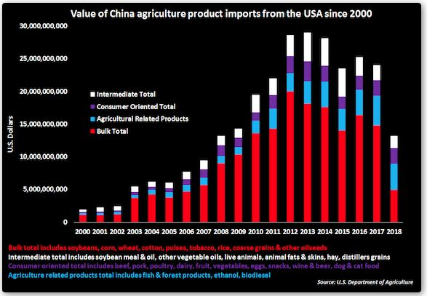
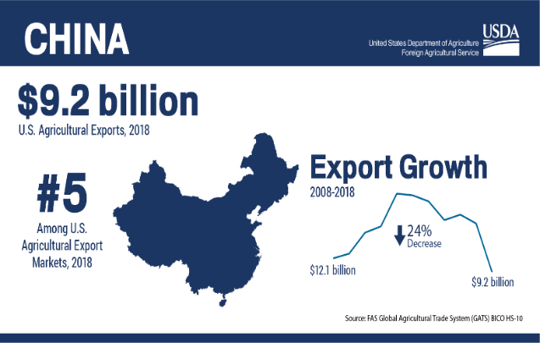
Agricultural Trade with China Deteriorated
Notes:
With rising tariffs, U.S. agricultural trade with China deteriorated. What was a 25 billion dollar export market for U.S. agricultural and related products fell sharpl in 2018 with exports totaling just 9.2 billion and China falling the number five export market for U.S. agriculture. As we will see, 2019 saw a slight uptick in U.S. agricultural exports to China at 13.8 billion compared to 2018 but remains onl 50% of 2016 and 2017 values

Slide 7
Agricultural Trade Balance Narrowed
($ Billion)
Source: Authors Calculation, FAS/GATS: https://apps.fas.usda.gov/gats/default.aspx
Notes:
Similarly the us agricultural trade balance - which is he difference between ag exports and imports and has been in surplus for decades – narrowed to 10 billion down from 38 billion in 2014 and 2016. the picture on right shows that the record surpluses experienced from 2012 to 2014 coincide with record bilateral trade surpluses with China underscoring he importance of the Chinese market for US agricultural products. the narrowing of the overall ag trade balance was in part due to the trade dispute with china and other countries in 2018.

Slide 8
U.S. Marketing Year Soybean Exports to China, 2016/17-2019/20
MY | Sep.-Dec. Total ($ Bil.)
2016/17 | $10.0
2017/18 | $7.74
2018/19 | $0.12
2019/20 | $3.44
Notes:
The effects of the trade dispute were felt in commodity markets, perhaps no more prominent than in soybeans. Plotted are u.s. soybean exports to china by marketing year. Our peak export season is the October-dec/jan period following harvest where soybean export sales run 2-3 billion per month. In the 2018/19 marketing year, however, soybean exports to china collapsed. The 2019/20 marketing year is under way and has experienced some recovery of soybean exports on signs of a Phase 1 deal and some good will buying gestures and tariff waivers but at a rate that is half of the u.s.’s “normal” peak marketing period.

Slide 9
Export Gains by Competing Suppliers
China’s Marketing Year Ag. Imports from EU28/BRAR/AUNZ & U.S., 2016/17 vs. 2018/19
$ Billion
EU28 = European Union 28 countries; BRAR = Brazil/Argentina; AUNZ = Australia/New Zealand
Source: Authors calculations from Trade Data Monitor
Notes:
While the US and china were sorting out their trade differences, competing export suppliers experienced significant trade flow gains. Plotted here are the combined value china’s total ag imports from eu28/brazil/argentina/australia/new Zealand during he 2018/19 marketing year. In a normal year u.s. exports to china will exceed the combined total of these five competing suppliers and shown by the dotted u.s. MY 2016/17 ag exports to china. In the 2018/19 MY we can see clearly that China relied on these five competing suppliers during our normal marketing year. It is not quite dollar-for-dollar displacement but the figure does highlight the classic trade substitution among competing export suppliers due to tariffs.

Slide 10
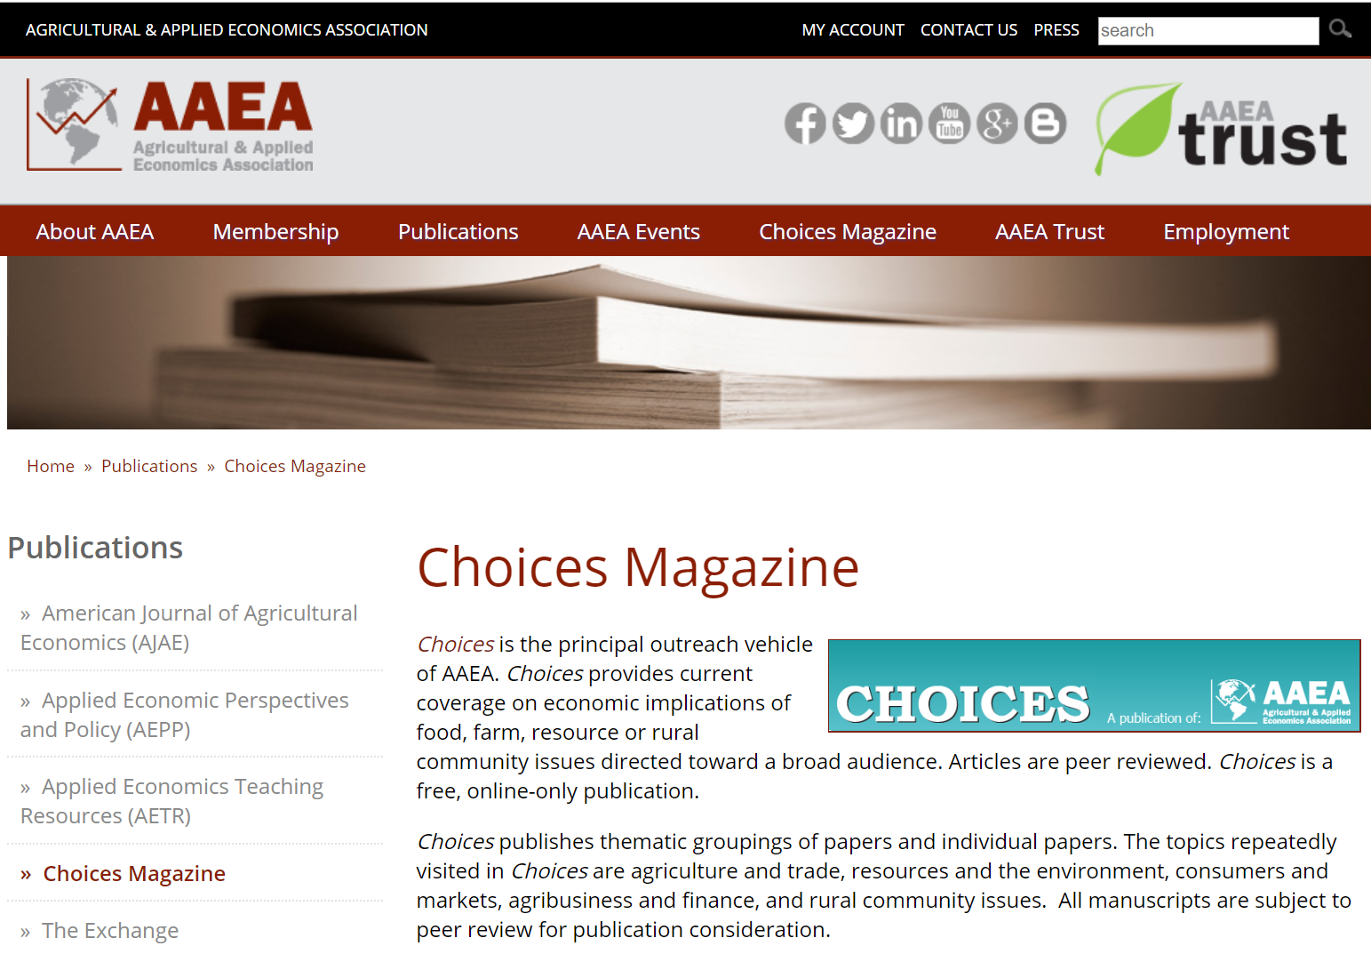

Choices Special Issue on Trade Retaliation
Thematic Overview: Jason Grant and Sharon Sydow
The 2018/19 Trade Conflict: A One-Year Assessment and Impacts on U.S. Agricultural Exports
Jason Grant, Shawn Arita, Charlotte Emlinger, Sharon Sydow and Mary A. Marchant
Tariff Impacts on Global Soybean Trade Patterns and U.S. Planting Decisions
Joanna Hitchner, Keith Menzie, and Seth Meyer
Tariff Retaliation Weakened the U.S. Soybean Basis
Michael K. Adjemian, Shawn Arita, Vince Breneman, Rob Johansson, and Ryan Williams
Impacts of Retaliatory Tariffs on Farm Income and Government Programs
Patrick Westhoff, Tracy Davids, and Byung Min Soon
How has the Trade War Affected the U.S. Cotton Sector?
Andrew Muhammad, S. Aaron Smith, and Stephen MacDonald
Implication of Trade Policy Turmoil for Perennial Crops
Daniel A. Sumner, Tristan Hanon and William A. Matthews
Impact of Retaliatory Tariffs on the U.S. Pork Sector
Frank Kyekyeku Nti, Lindsay Kuberka and Keithly Jones
Notes:
If you are interested in learning more about the trade dispute impacts on u.s. agriculture including farm prices, basis movements and program payments, i would like acknowledge my co-authors Sharon Sydow and Shawn Arita at the office of the chief economist and put a small plug in for our recent release of a special choices theme issue titled “the economic impacts of trade retaliation on u.s. ag.: a one year review”. Choices is the main outreach publication of the American agricultural and applied economics association.

Slide 11
Notes:
This figure summarizes our model-based U.S. agricultural export impacts for specific product groups impacted by 2018/19 trade disputes. Here, we graph the percentage trade effect estimated by the model on the vertical axis, and the average 2016-2017 value of U.S. exports preceding the trade conflict to a partner market. The third dimension is the size of the bubble which denotes the share of U.S. exports to China, EU, Canada, Mexico and Turkey. 27 country-by-product groupings are included.
-- 23 country-by-product sectors showcased negative and statistically significant trade effects. 9/23 occurred in China, 5/23 in Mexico, 4/23 to EU, 3/23 for TR and 2/23 for CAN.
-- Second, 6 out of 12 of sectors with > 50% trade reductions are exports to China; 3 to Mexico, 2 to EU and 1 to TR.
--China’s tariff actions had a noticeable impact on U.S. cereal grains compared to what the model suggests trade should have been. Note, however, that the share of U.S. exports of cereals to China, as represented by the diameter of the bubbles.
--Similarly, the impact of EU retaliatory tariffs had a strong impact on U.S. corn exports. However, compare this to EU retaliation on U.S. alcoh beverages exports. While the % trade flow reduction is smaller (-25% trade effect) the relatively larger size of alch bev bubble indicates the EU is a more important destination market for the U.S. exports in this product category (i.e., think….bourbon and other whiskey). The EU market accounts for 26% of U.S. exports of alcoh. bev.
--Within North America, Mexico’s retaliatory tariffs impacted U.S. agricultural exports to a greater extent than was found in Canada; in particular for U.S. pork, cheese, FV preparations and processed meats
--Finally, the Figure highlights the importance of U.S. oilseed exports to China. This product category is the only sector located in the lower right-hand quadrant, indicating:
A very high level of exports to China before tariff retaliation (2016-2017),
A significant negative trade impact due to retaliatory tariffs, and
A sizeable share of U.S. oilseed exports sent to China’s (60%), reflected by the 2nd largest bubble diameter.

Slide 12
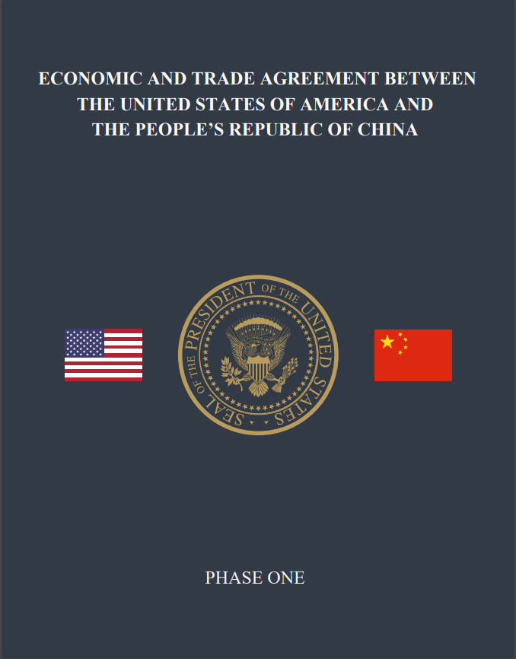
A New Beginning: U.S. China Phase 1 Agreement
China – will import on average of at least $40 billion annually of U.S. food, agricultural, and seafood products, for a total of at least $80 billion over the next two years.
Products will cover the full range of U.S. food, agricultural, and seafood products.
China will strive to import an additional $5 billion per year over the next two years.
Purchases are to be made at market prices based on commercial considerations and that market conditions may dictate the time of year that agricultural purchases are made within any given year.
Source:
https://ustr.gov/sites/default/files/files/agreements/phase%20one%20agreement/Phase_One_Agreement-Ag_Summary_Long_Fact_Sheet.pdf
Notes:
New beginnings. On January 15, 2020, President Trump and vice premier liu he signed the phase one trade deal. For agriculture the agreement addresses a broad range of market access commitments including purchase agreements and liberalization and harmonization of non-tariff measures.

Slide 13
Making Sense of the New Trade Environment:
CAT-Global Livestock-Crop Simulation Model
Description & Setup
13
Notes:
How do we make sense of this new agricultural trade environment? At the Center for Ag Trade – or CAT- we are nearing completion of a linked global livestock and crop model which allows us to look at bilateral trade linkages for example between the US and China and/or the US-JPN agreement.

Slide 14
Product & Country Aggregation
Count | Region | Acronym
1 | Argentina | arg
2 | Australia | aus
3 | Brazil | bra
4 | Canada | can
5 | China | chn
6 | Egypt | egy
7 | EU28 | eu
8 | India | ind
9 | Indonesia | idn
10 | Japan | jpn
11 | Korea, South | kor
12 | Malaysia | mys
13 | Mexico | mex
14 | New Zealand | nzl
15 | Russia | rus
16 | Philippines | phl
17 | Thailand | tha
18 | Ukraine | ukr
19 | United states | usa
20 | Vietnam | vnm
21 | Rest of central America | xcb
22 | Rest of Asia | xas
23 | Rest of South America | xsm
24 | Rest of Oceania | xoc
25 | Rest of middle east | xme
26 | Rest of Africa | xaf
27 | Rest of Europe | xeu
14 products:
  Beef
  Pork
  Poultry
  Wheat
  Corn
  Soybeans
  Sorghum
  Barley
  Rice
  Cotton
  Ethanol/DDGs
  Soybean Meal
  Soybean Oil
  Outside good
Notes:
The model is a new source differentiated simulation model forecasted from 2016 through to 2030. It includes 27 countries and regions; 20 individual countries and 7 aggregate regions. The model includes 14 livestock and cropping activities as well as a few byproduct industries. Today I will highlight a few livestock projections while we continue to iron out a few more linkages with cropping and feed grain activities.

Slide 15
Livestock Policy Scenarios
U.S.-Japan Trade Agreement
U.S.-China Phase One Agreement (Estimates)
-------------------U.S.-China Phase One Projections----------------
 | 2020 | 2021 | 2020 | 2021
 | (1000 mt) |  | ($ Million)
BEEF | 50 | 100 | 296 | 592
PORK | 640 | 1,000 | 1,578 | 2,465
POULTRY | 200 | 350 | 305 | 534
WHEAT | 2,500 | 4,000 | 559 | 895
CORN | 2,500 | 4,000 | 451 | 722
SOYBEANS | 40,000 | 45,000 | 15,550 | 17,494
TOTAL |  |  | $18,739 | $22,710
2017 TOTAL |  |  | $13,250
Increase |  |  | $5,489 | $9,451
* The above projections are those of Virginia Tech’s Center for Agricultural Trade and do not represent any official U.S. government determination
** Projections do not take into account possible delays in implementation due to COVID-19
Notes:
We conducted preliminary evaluations of two policy scenarios: Implementation and phasing in of Japan tariff reductions on beef, pork and poultry and the simultaneous implementation of US-JPN and the U.S.-China Phase One Agreement. On the left is the tariff reduction schedule agreed to between the U.S. and Japan compared to tariff reductions Japan agreed to in the EU-JPN and CPTPP agreements. Notice how US beef exports catch up immediately to EU and CPTPP members – leveling the playing field. For pork, our reading of the agreement suggests there is a one year lag in terms of liberalizing Japan’s gate price system for the U.S. compared to EU and CPTPP members. Japan is traditionally not a large destination market for poultry. The China phase one agreement is more of a challenge to model for individual commodity sectors. The above projections are those of Virginia Tech’s Center for Agricultural Trade and do not represent any official U.S. government determination.

Slide 16
Model Results (animal products only)
1. Forecast Simulation to 2030
2. Policy Simulation to 2030
Results = Difference between Policy
and Forecast Simulation
Projections
US beef and pork exports to Japan are 37% and 38.5% higher by 2030 due to new US-JPN Agreement (~ $1.1 billion total: $600 mil. (beef) and $495 mil. (pork))
Full implementation of US-JPN & US-China Phase One results in strong export gains for U.S. meat exports
  Significant export increases to China
  Smaller but still significant gains in Japan (30% (beef); 25% (pork))
  Substitution away from some CPTPP markets (Vietnam, Rest of Asia, Mexico)
On net, U.S. global meat exports higher (after all price adjustments): Pork: 5% net increase; Beef: 2.6%; Poultry: 2.8%. Returns to producers (producer surplus) exceed $1 billion by 2030 under full implementation
U.S. (fob) Export Prices Increases: Pork: 8.28%; Beef: 5.2% Poultry: 4.9%

Slide 17
Wrap-up:
Challenges to Global Marketplace for Agricultural Products

Slide 18
Macroeconomic Picture

Slide 19
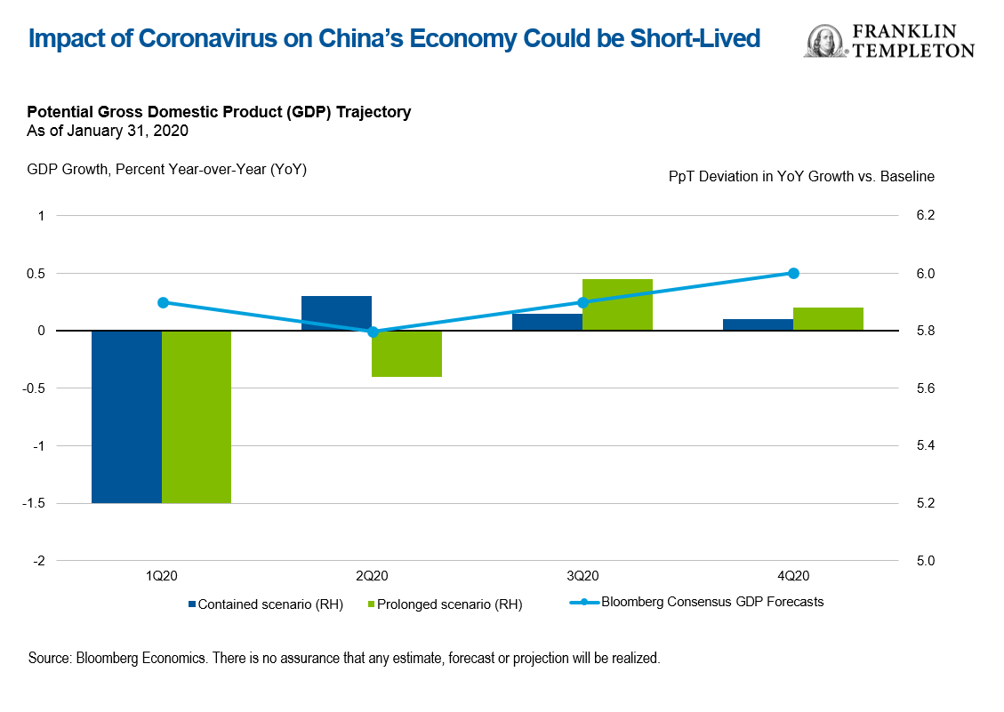
Headwinds Impacting U.S. Agricultural Trade & Phase One Agreement
COVID-19
  ~73,000 infected worldwide
  Consumer confidence/business activity/supply chain delays?
Additional drag on income & GDP growth
  How long will this linger?
Macro indicators out of India show weakening job market
Stronger dollar
Tariffs remain….for now

Slide 20

Thank you!
Contact Info:
  Jason Grant, Email: jhgrant@vt.edu | Ph: +1-540-231-7559
  https://aaec.vt.edu/people/faculty/grant-jason.html
  Center for Agricultural Trade (CAT)
  https://aaec.vt.edu/extension/Agricultural-Trade-Center.html

