Slide 1
The Outlook for Organic Agriculture
Catherine Greene, Andrea Carlson, and Kim Ha
Economic Research Service, USDA catherine.greene@usda.gov
96th Annual USDA Agricultural Outlook Forum
Arlington, VA February 21, 2020
The findings and conclusions in this presentation are those of the authors and should not be construed to represent any official USDA or U.S. government determination or policy. This research was supported by the intramural research program of the U.S. Department of Agriculture, Economic Research Service.

Slide 2
U.S. Organic Trends – Growth and Innovation
Going into the new decade:
Market penetration of organic food is increasing
Organic sales are increasing in every farm sector
Produce, dairy and poultry still top organic farm sectors
Certified research farms, food innovation labs are spreading

Slide 3
Retail market share grew for organic produce, milk, eggs, and poultry over the last decade—matching commodity increases
Source: USDA, Economic Research Service and data from market research company IRI for the 2008-18 period.

Slide 4
U.S. organic sales increased in every farm sector, 2012-2017—
Produce, dairy and poultry sectors lead
Source: USDA Economic Research Service using data from USDA National Agricultural Statistics Service,
2017 Census of Agriculture.

Slide 5
U.S. organic commodity sales doubled between 2012 and 2017—
Top States included California, Washington and Pennsylvania
Source: USDA Economic Research Service using data from USDA National Agricultural Statistics Service,
2017 Census of Agriculture.

Slide 6
U.S. organic research farms & food innovation labs—
Steady increase in certified facilities, 2000-2019
Source: USDA Economic Research Service based on data from USDA National Organic Program Integrity Database.

Slide 7
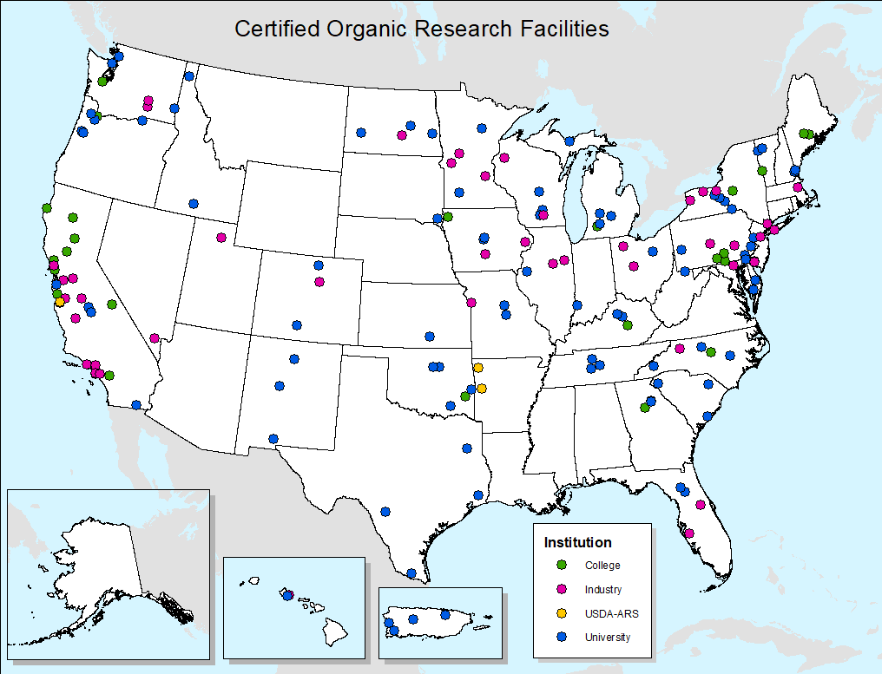
Certified organic research facilities in nearly 40 States in 2019—
California led with 26 certified facilities
Source: USDA Economic Research Service based on data from USDA National Organic Program
Integrity Database.

Slide 8
For More Information
For more information
USDA-ERS Organic Agriculture Topic Page: http://www.ers.usda.gov/topics/natural-resources-environment/organic-agriculture.aspx
USDA Organic Topic Page:
https://www.usda.gov/topics/organic

