Slide 1
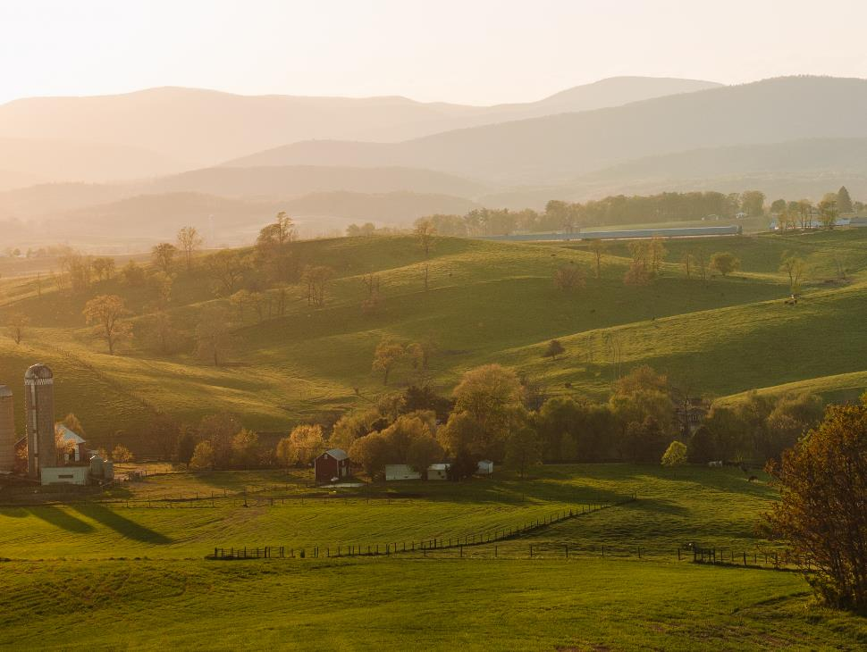

USDA 2020 Agricultural Outlook Forum
February 21, 2020

Slide 2
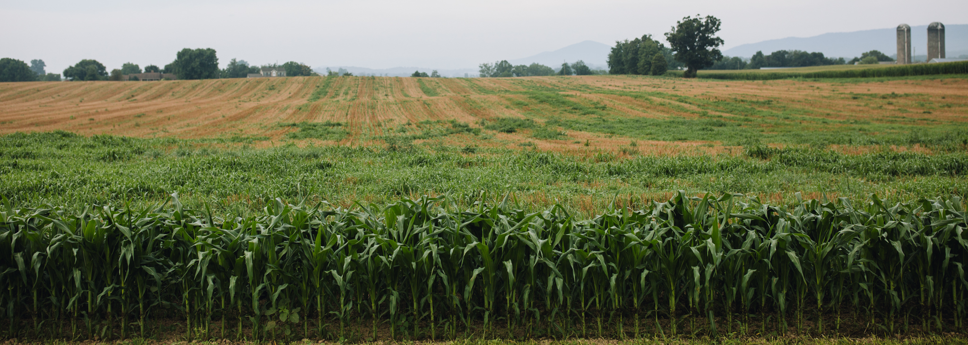
Small Family Farms Feeling the Pressure
Farmers have felt the pressure, being forced to produce higher quantities at cheaper prices.
Farmers have battled inflation as land and infrastructure costs have increased significantly, while profitability has remained relatively flat.
According to the 2017 Census of Agriculture:
Average age of farmers in 2017 was 57.5 years, which is 1.2 years older than 2012’s average. This reflects a long-term trend of aging in U.S. farmers.
Number of U.S. farms declined by over 67,000 between 2012 and 2017.

Slide 3
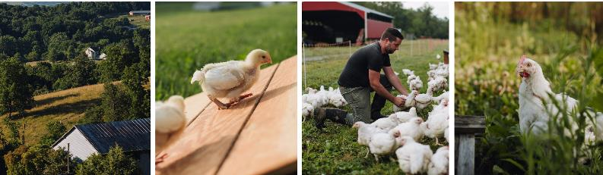
Changes in the Poultry Industry
Back in the day farmers owned their own birds, raised them on pasture with mother nature, and marketed them locally.
Then came vertical integration followed by consolidation. It became all about growing the most amount of chicken in the least amount of space in the shortest amount of time at the least cost.
In the process farmers lost the freedom to make farm specific decisions, even often forced to make facility upgrades.
Antibiotics become a necessity. Air and floor quality suffered. The natural environment went away and so did your delicious tasting chicken.

Slide 4
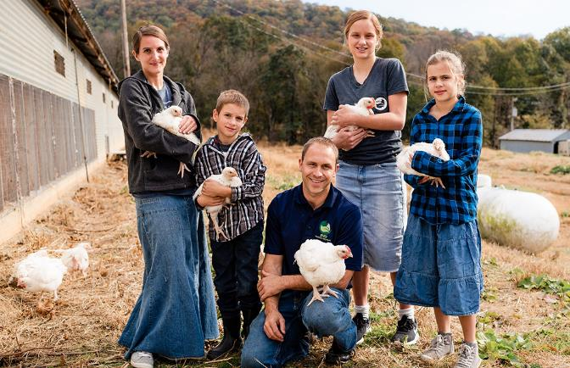
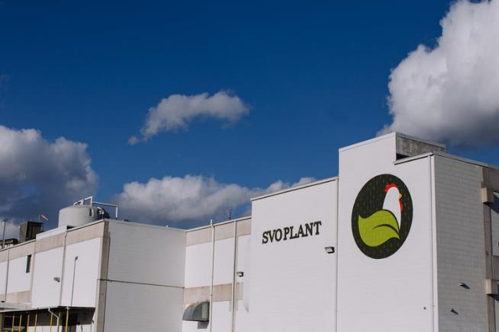
Shenandoah Valley Organic Is Born (2014)
Shenandaoh Valley Organic (SVO) was established to revolutionize the poultry industry with a mission of promoting and protecting generational family farms.
Our unique Farmer Focus Business Model transfers the ownership of animals back to the farmers who are treated as true partners: they receive fair compensation for their hard work and have the freedom to make decisions for their own businesses.
Most importantly, our model allows farms to be profitable and sustainable for the next generation.

Slide 5
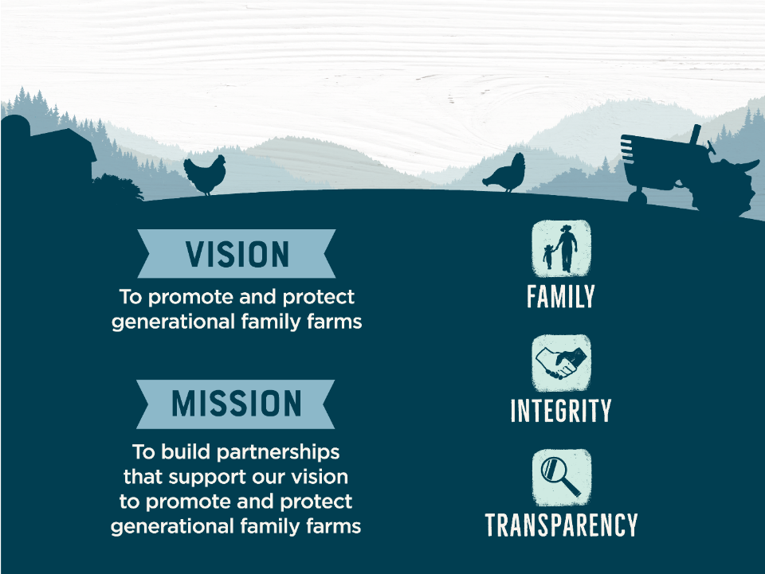


Vision, Mission, Values

Slide 6
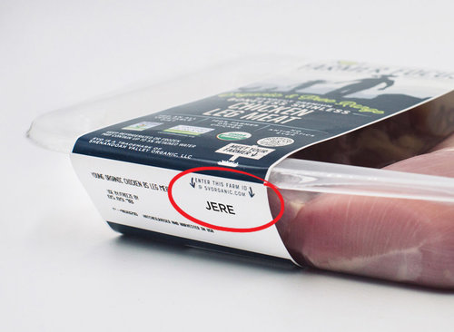
Transparency & Traceability
Traceability is very important to us. Every product has a 4-letter Farm ID which traces the product back to the farm on which the animal was raised.
Animal Welfare standards are a top priority and birds are raised humanely.
Environment and sustainability are critical to us. We are committed to using sustainable approaches to farming, production, and packaging.

Slide 7








Four Pillars of the Brand
1. Farmers 2. Animals
3. Environment/Sustainability 4. Products

Slide 8
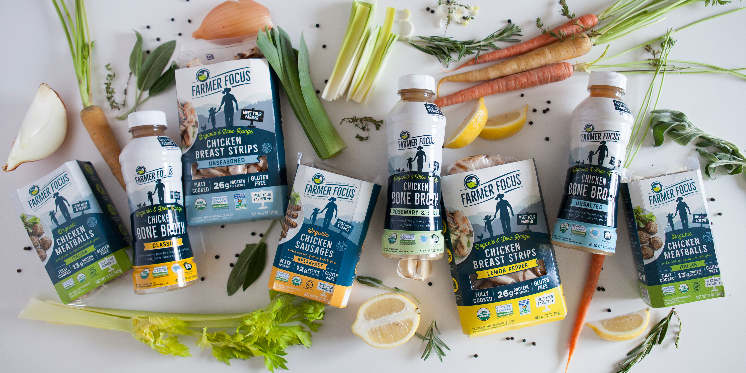
Portfolio of Products
Our promise to consumers is that all Farmer Focus products will always be organic, high-quality, and clean-label, with meat as the #1 ingredient.
Offering a full line of chicken products: fresh and fully cooked.
Expanding into other meat categories in the near future!

Slide 9
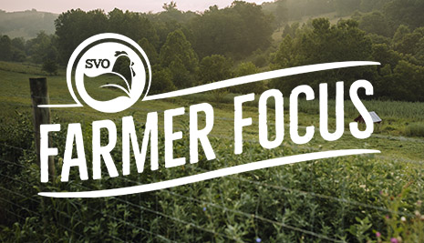
In Conclusion - Purpose is Key
Our mission-based, values-driven brand was founded with the sole purpose of protecting family farms, allowing them to be profitable and sustainable for generations.
Our deep commitment to farmers, animals, and environmental stewardship ensures a healthy source of nutrition through the most humane, clean, and safe processes possible.

Slide 10
When consumers purchase the Farmer Focus brand, not only are they getting an exceptional product, but also the satisfaction of knowing they’re directly impacting the welfare of a generational family farmer.
THANK YOU!

