Slide 1
Nontraditional Finance in U.S. Agriculture
Jennifer Ifft, Assistant Professor
2020 USDA Agricultural Outlook Forum
Thursday February 20, 2020

Slide 2





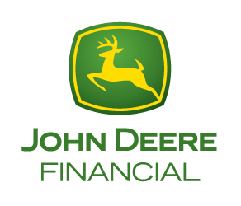





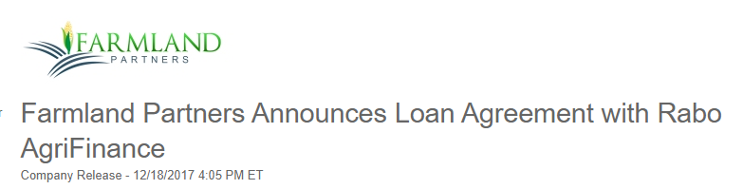
What is nontraditional finance?
“Nontraditional credit suppliers or lenders…are those whose primary contacts with producers historically have been for goods and services other than credit” (Sherrick, Sonka, & Monke, 1994)
Traditional finance
Nontraditional finance
My definition: lenders working outside of the (“traditional”) local branch-loan officer model
Notes:
Nontraditional finance – in effect, we are looking at (1) vendor credit (2) non-bank lenders – (a) agile/modern aimed at low risk- modern – large segment and (b) aimed at financially stressed segment
Ultimately – these are lenders that are working outside of the traditional local branch-lender model
Conterra

Slide 3
2 stories about nontraditional finance
Financial distress
Modern agricultural credit markets
Lender of last (second?) resort
“Financial bridge to struggling farmers”
“Prolonging the agony and potentially building up [farm] losses instead of cutting the pain, cauterizing the wound and stanching the flow of financial blood now”
Almost everyone that *sells something* to farmers sells credit too
Increasing competition
Segmentation
Differentiation by:
  Convenience
  Service
  Bundling
  Standards
  Source of collateral
https://www.wsj.com/articles/farmers-in-crisis-turn-to-high-interest-loans-as-banks-pull-back-11573381801
https://www.wsj.com/articles/americas-farmers-turn-to-bank-of-john-deere-1500398960
Notes:
What drives the growth in nontraditional finance?
The answer to this is yes – in the extreme case they are charging higher rates – taking on more risk

Slide 4

Ag lending 101
Requires
  Overcoming serious information barriers (moral hazard)
  Collateral *and* the ability to collect collateral
Not “easy money”
  Competitive market facing same risks as production agriculture

Slide 5

What drives the growth in nontraditional finance?
Supply side factors
Demand factors
Outside capital
Innovation
Lending standards
Financial stress
Diverse U.S. farm business
  Large and small
  Complex
  Fast-growing
  Increased appetite for risk?
Notes:
The answer to this is yes – in the extreme case they are charging higher rates – taking on more risk

Slide 6
Nontraditional lenders rival largest Farm Credit lenders
Farm Credit Services of American: $28.4 billion loan volume in 2018
Farm Credit Mid-America: $20.9 billion loans (owned) in 2018
Metlife: $19.4 billion agricultural loan portfolio (Sept 30 2019)
Compeer: $18.7 billion net loans in 2018
Rabo Agrifinace: $15 billion loan volume reported in 2019 (estimate, not based on regulatory reports)
  Rabobank N.A. had ~$4.7 billion in non-real estate & real-estate ag production loans on Dec. 31 2018
Deere Financial: $2.4 billion in non-real estate ag loans on Dec. 31 2018
Farm loans holdings of the largest 30 U.S. banks declined 17.5% between Dec 2015 and March 2019 ($18.3 billion held in March 2019)
2020 USDA farm sector debt forecast: $425 billion
https://www.fcsamerica.com/about/newsroom/financial-reports
https://e-farmcredit.com/getmedia/aeed4072-21d0-43ec-8e1b-56f78dc733a5/2018-Annual-Report.pdf.aspx
https://www.compeer.com/getattachment/Utility/Support/About/Financials/Financial-Reports/722918-Compeer-2018-Annual-Report-(1).pdf.aspx?lang=en-US
https://www.bankingdive.com/news/rabobank-us-agriculture-lending-gap/559142/
https://investments.metlife.com/financing-solutions/agricultural-finance/
https://www.reuters.com/article/us-usa-farmers-lending-insight/wall-street-banks-bailing-on-troubled-u-s-farm-sector-idUSKCN1U618F
https://www.ers.usda.gov/topics/farm-economy/farm-sector-income-finances/highlights-from-the-farm-income-forecast/
Notes:
Regulatory data
Count Met-life and Rabo as nontraditional: get to a 10% estimate . Maybe 10 to 15 range

Slide 7
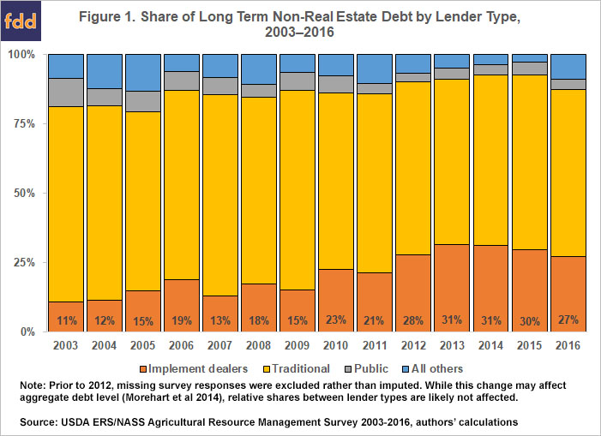
Nontraditional finance: what do we know?
Implement dealer-financing has gained market share
It is challenging to directly learn much more about nontraditional lenders from USDA farm survey data
Source: Kuethe, Ifft, and Patrick (2018)
Notes:
Farm survey data
Difficult to learn much more about nontraditional lenders farm survey data

Slide 8
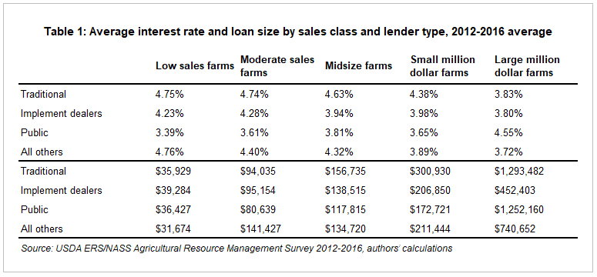
Some nontraditional finance providers have competitive interest rates
Interest rates not consistent across type of nontraditional lender
  Can be higher, same, or lower
Commercial farms report better rates in general
  92 basis points
Implement dealer financing may be more competitive for smaller farms
  52 vs 3 basis points
But what about input costs?
Average equipment* interest rates and loan volume, 2012-2016
*Non-real estate long term loans, typically equipment or machinery
Source: Ifft, Kuethe, and Patrick (2018)
Notes:
The answer to this is yes – in the extreme case they are charging higher rates – taking on more risk

Slide 9
Vendor credit may come with higher effective input costs
Cash price often lower than effective financed price
Seed corn discount case study
  Due to loss of early cash pay discount, promotional financing will usually be more expensive than ‘traditional financing’
Difference between early pay cash and financing discounts with traditional finance
Assumptions:
Early Pay Cash Discount of 12%
Early Financing Discount of 7%
Volume Discount of 6%
  Fiechter & Ifft, farmdoc daily series, October 2019
Notes:
The answer to this is yes – in the extreme case they are charging higher rates – taking on more risk

Slide 10
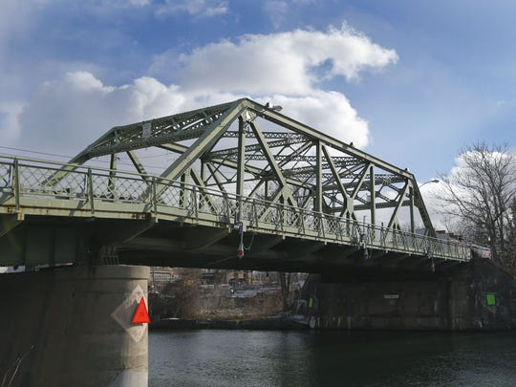
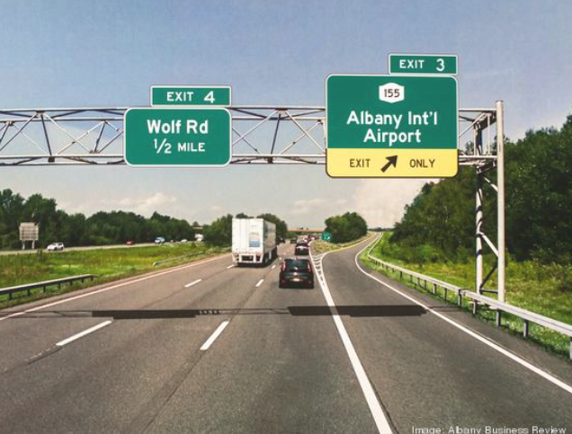
Nontraditional finance and farm financial stress
OR
Bridge
Off-ramp?
Source https://www.democratandchronicle.com/story/news/2016/12/09/its-a-wonderful-life-seneca-falls-george-bailey-frank-capra/94825632/
https://www.bizjournals.com/albany/news/2019/07/12/exit-3-northway-changes-commute-albany.html
Notes:
The answer to this is yes – in the extreme case they are charging higher rates – taking on more risk

Slide 11
Nontraditional finance: what do we know?
Risk profile varies regionally and by institution
Farm Credit System Lenders
Commercial Banks

Slide 12
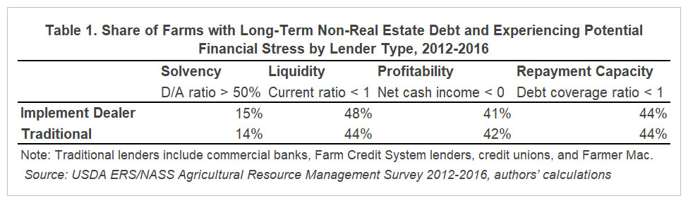
Nontraditional finance: what do we know?
Nontraditional finance is not necessarily related to farm stress
For implement financing: no observable differences
Source: Patrick, Kuethe, and Ifft (2018)

Slide 13
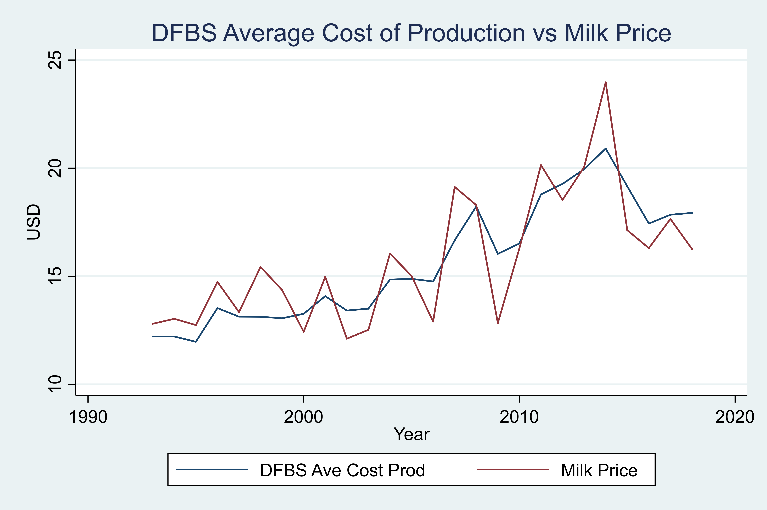
Demand for financing driven by milk prices
NE Case Study: financial stress and milk prices
Partnership with NEAFA
Feed manufacturer accounts receivable
  >70% of market
  Delinquencies ~4x higher than Farm Credit East, ~3x higher than Deere Financial
  Loan volume equivalent to large community bank with multiple branches
25 years of dairy farm survey data
  Long-term countercyclical relationship of accounts payable & milk prices
  More so in recent years, for midsize, higher-leveraged farms
  Source: Fiechter and Ifft, 2019; Data: Cornell Dairy Farm Business Summary
Notes:
Survey of feed manufacturers, representing > 70% of NE feed industry
Goals: establish industry norms, estimate feed supplier credit volume, compare to lenders

Slide 14
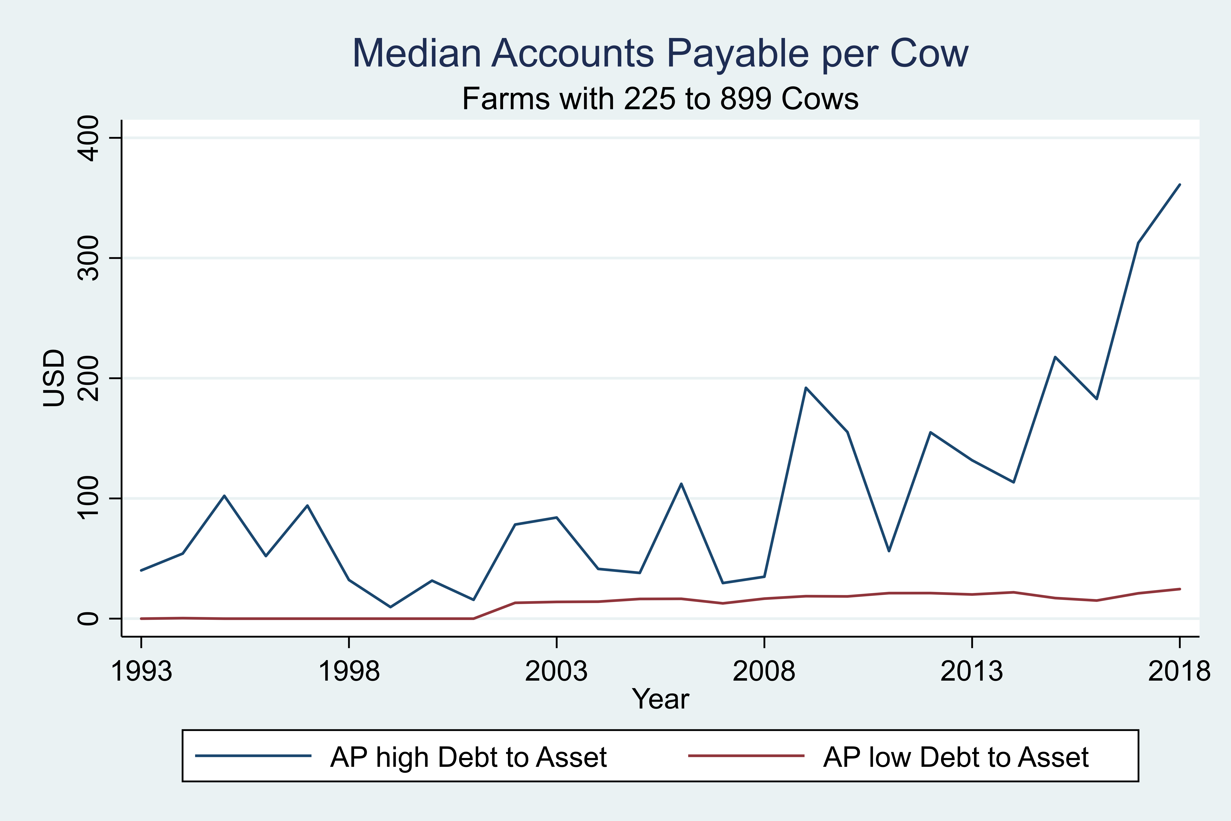
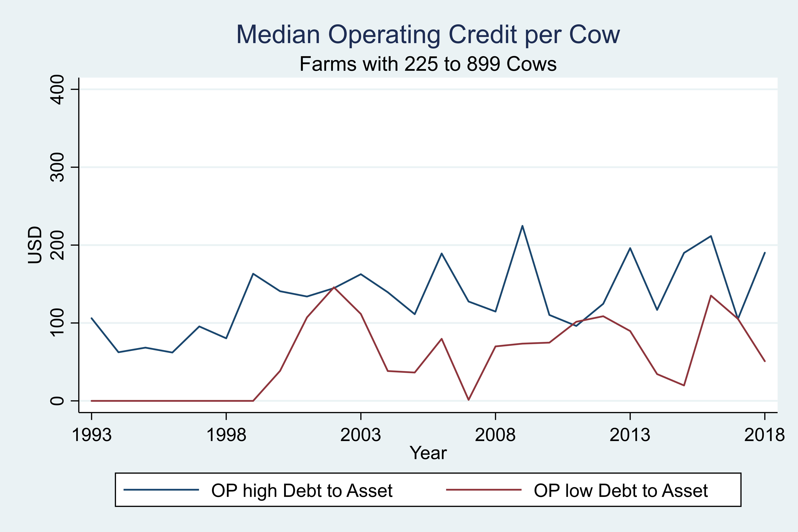
Nontraditional finance: research NE feed supplier credit
NE case study: vendor financing plays important role during periods of financial stress
  Source: Fiechter and Ifft, 2019; Data: Cornell Dairy Farm Business Summary
Notes:
Note: farm survey data might capture this if info on accounts payable balances
What is the important point here: extended downturn – feed suppliers played an important creditor role. NE is unique historically
Note

Slide 15

Takeaways: nontraditional lenders….
Create additional value and risk in agricultural credit markets
Make farm management more interesting
May partially be motivated by strategies to maintain or increase market share (applies to vendor credit)
Make tracking financial stress in agricultural more challenging

Slide 16
Open questions
Bridge or off-ramp? Can be yes to both, but not the whole story
Do vendors/suppliers fully account for downside and collateral risk?
  Vendor partnerships with nontraditional lenders growing
Does “who gets paid first” matter?
Does financial regulation developed post-80s farm crisis make sense today?
How to measure and track farm debt from nontraditional sources?
  Bellwether for farm stress?

Slide 17
References and resources
Fiechter, C. and J. Ifft. "Seed Corn Costs: Cost of Seed Company Financing vs. Traditional Financing." farmdoc daily (9):194, Department of Agricultural and Consumer Economics, University of Illinois at Urbana-Champaign, October 16, 2019.
Patrick, K., T. Kuethe and J. Ifft. "Implement Dealer Financing and Farm Financial Stress." farmdoc daily (8):96, Department of Agricultural and Consumer Economics, University of Illinois at Urbana-Champaign, May 25, 2018.
Ifft, J., T. Kuethe, and K. Patrick. “Nontraditional Lenders in the U.S. Farm Economy.” Presentation at the 2017 Agricultural and Rural Finance Markets in Transition, October 2-3, 2017, Minneapolis, Minnesota.
Brewer, B. E., Bergtold, J. S., Featherstone, A. M., & Wilson, C. A. (2019). Farmers’ Choice of Credit among the Farm Credit System, Commercial Banks, and Nontraditional Lenders. Journal of Agricultural and Resource Economics, 44.
Sherrick, Bruce J., Steven T. Sonka, and James D. Monke. (1994) Nontraditional lenders in agricultural credit markets. Agribusiness 10:4.

Slide 18
Jennifer Ifft
Assistant Professor
Mueller Family Sesquicentennial Faculty Fellow in Agribusiness and Farm Management
Phone: 607-255-4769
Email: jifft@cornell.edu
Website: https://dyson.cornell.edu/people/jennifer-ifft
Twitter: @jeifft

