Slide 1
The World and U.S. Cotton
Outlook for 2022/23
Interagency Commodity Estimates Committee
Presented by
James Johnson
USDA/FAS
98th USDA Agricultural Outlook Forum
February 25, 2022
Notes:
Done

Slide 2
USDA Global Cotton Outlook Highlights
2021/22 Review:
  World consumption continues recovery to a record level
  Production recovers from 2020/21 low
  World trade down from 2020/21 record
  China’s reserve stocks largely stable
  A-Index up 47 % yty, averaging 125 cents
Notes:
Done

Slide 3
USDA Global Cotton Outlook Highlights
2022/23 Outlook:
  Global consumption continues recovery (1.7% growth)
  World production rises to highest level in 11 years, helped by recent price strength
  Global stocks dip, prices retreat from historic highs
  Macro and trade policy uncertainty
Notes:
Done

Slide 4
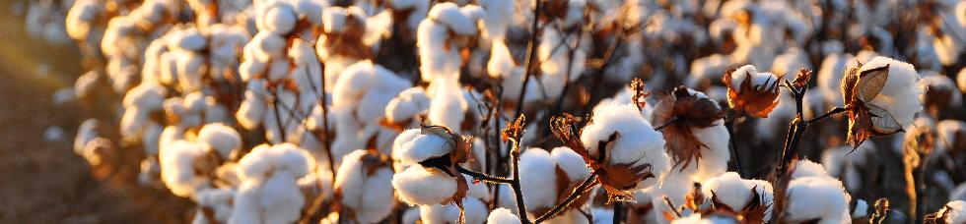
2021/22 World Cotton Situation
Notes:
Done

Slide 5
World Prices Soar, Consumption Continues to Grow
Sources: USDA, Interagency Commodity Estimates Committee and Cotlook.
Notes:
Done

Slide 6
Global Cotton Production Changes in 2021/22:
Source: USDA, Interagency Commodity Estimates Committee.
Notes:
Global 2020/21 cotton production is up 7.5 percent from the previous year to 120.2 million bales, as most major producing countries witnessed increases, excluding China and India. The United States saw a 20.6 percent increase with significantly higher area harvested, especially in Texas. U.S. 2021/22 area harvested was up roughly 21 percent to 4.0 million hectares, and recorded a yield of 951 kg/hectare, practically unchanged from the previous year’s 950. Pakistan’s production climbed 28.9 percent to 5.8 million bales, owing to higher yields which recovered from the previous year’s lowest in nearly 40 years. Australia and Brazil production are projected higher on greater area harvested, with Australia projected at a record-tying 5.5 million bales set in 2011/12.
China’s 2021/22 crop is estimated at 27.0 million bales, down 2.5 million bales from the previous year and the lowest level in 5 years. Area harvested is estimated down on lower plantings in Eastern China, where cotton production continued on its downward trend as producers there exit the sector. Yield is estimated down to 1,896 kg/hectare from a record 1,976 but still the second-highest level.
India’s 2021/22 production is estimated at 27 million bales, down roughly 2 percent from the preceding year on lower area harvested despite higher yields.

Slide 7
Cotton Consumption
Recovery Continues
Cotton consumption estimated at 124 million bales.
Above average (2.8%) increase
  Record level, higher than pre-global economic crisis level
  Led by gains in India and Turkey
  Pipeline filling
Notes:
World cotton consumption in 2021/22 is expected to reach a record 124.4 million bales, up 2.8 percent. Consumption growth is forecast for all major consuming countries, except China. Mexico and Turkey are expected to see growth rates above 10 percent as proximity to the United States and the EU benefited operations in those countries in light of the global logistics challenges

Slide 8
China Consumption Slips
Source: USDA
Notes:
Done
China’s 2021/22 consumption is expected to decline slightly to 39.5 million bales after rebounding more than 20 percent in the previous season.

Slide 9
China Cotton Supply and Demand 2020/21 and 2021/22
Attribute | Unit | 2020/21 | 2021/22 | Change (%)
Beginning Stocks | mil. bales | 36.9 | 39.3 | 6.4
Area Harvested | mil. HA | 3.3 | 3.1 | -4.6
Production | mil. bales | 29.5 | 27.0 | -8.5
Imports | " | 12.9 | 9.5 | -26.1
Total Supply | " | 79.3 | 75.8 | -4.4
Exports | " | 0.0 | 0.1 | n/a
Use | " | 40.0 | 39.5 | -1.3
Total Use | " | 40.0 | 39.6 | -1.1
Ending Stocks | " | 39.3 | 36.2 | -7.8
State Reserve | " | 10.5 | 9.5 | -9.5
Stock to Use % | % | 98.1 | 91.4 | -6.7
Notes:
China’s 2021/22 consumption is expected to decline slightly to 39.5 million bales after rebounding more than 20 percent in the previous season. Imports are forecast at 9.5 million bales down sharply from the previous season. A portion of the decline is due to a drawdown of non-customs cleared cotton (NCCC) from port warehouses. It is estimated that the inventory of NCCC will decrease by roughly 1.5 million bales during 2021/22. A buildup of NCCC inventory during 2020/21 inflated the volume of imports relative to demand, either mill demand or demand for inclusion in the State Reserve. Likewise, the drawdown of NCCC inventory in 2021/22 will mean that the import volume will under-represent the demand in China for imported cotton.
China’s stocks are expected to decline by 3.1 million bales. State Reserve levels are estimated lower in 2021/22 on an international marketing year (Aug.-Jul.) basis.

Slide 10
Global Cotton Stocks Down Y-O-Y
Slightly lower stocks (outside of China)
Estimated level remains high
Source: USDA, Interagency Commodity Estimates Committee.
Notes:
Done
World ending stocks are estimated at 84.3 million bales, down 4.4 million from the previous year. India stocks are down sharply on lower production, higher use, and relatively strong exports. Australia and Brazil are both expected to see higher ending stock as the Southern hemisphere producers’ late season production increases. As noted earlier U.S. stocks are projected to increase marginally.

Slide 11
China Ending Stocks Down,
Both Reserve and Free Stocks
Mil. Bales
%
Sources: USDA
Notes:
China’s stocks are expected to decline by 3.1 million bales. State Reserve levels are estimated

Slide 12
2021/22 U.S. Cotton Situation
Notes:
U.S. all-cotton production in 2021/22 is estimated at 17.6 million bales, 21 percent above last season’s crop. Cotton planted acreage in 2021—at 11.2 million acres—decreased 7 percent, as relative prices favored alternative crops over cotton. Planted area to cotton was the lowest in 5 years, but the abandonment rate was a relatively low 11 percent in 2021—compared with the previous 3-year average of nearly 26 percent. As a result, U.S. harvested area reached 10.0 million acres in 2021, one of the highest of the previous decade, while the yield was marginally above last season’s level at 849 pounds per harvested acre. Upland production is estimated at approximately 17.3 million bales—3.2 million above 2020—with an average yield of 841 pounds per harvested acre, similar to the 3-year average. Extra-long staple (ELS) cotton production is estimated at 367,000 bales, as the lowest area in 35 years helped reduce the ELS crop to its lowest since 1995.

Slide 13
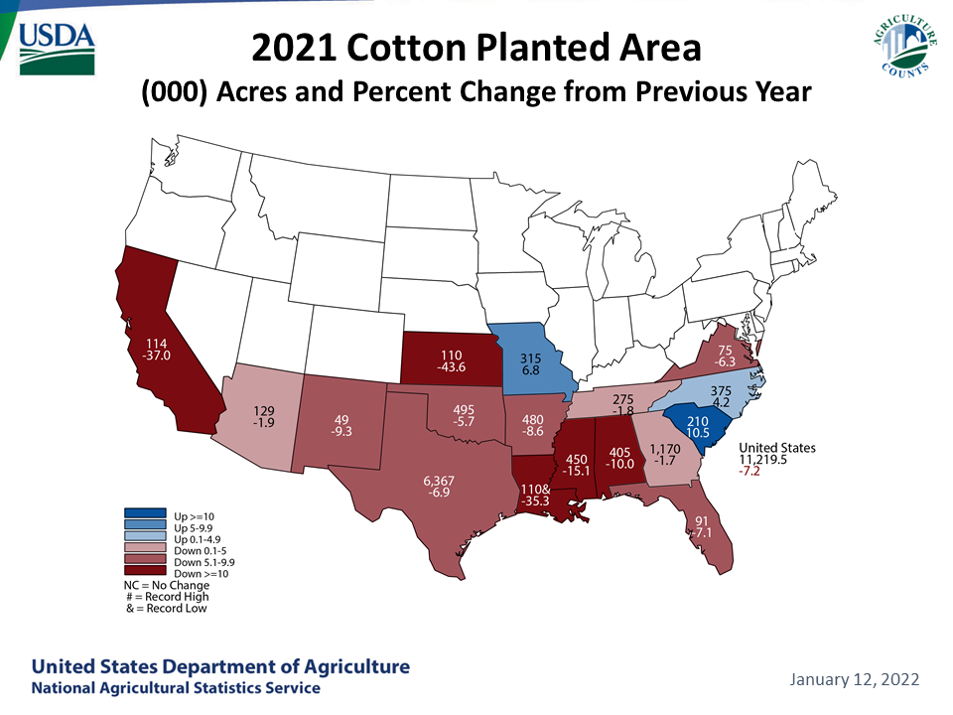
Notes:
Done
While planted area was down 7% harvested area was up 20% as abandonment fell from 32% in 2020 to 11 %, resulting a 21% increase in production as yields were stable.
Compared with last season, 2021 upland cotton production was larger in two of the four Cotton Belt regions.
In the Southwest, the upland cotton crop was 3 million bales higher at 8.5 million bales, the largest in 4 years, accounting for 49 percent of the total U.S. upland production. Dry conditions followed by rains and cooler temperatures slowed planting and crop progress early in the season. However, conditions into harvest improved, keeping 2021 abandonment at a relatively low 17 percent for the region, compared with the 3-year average of 40 percent. The Southwest accounted for about 59 percent of the U.S. upland harvested acreage in 2021, one of the highest on record. Meanwhile, the Southwest yield rose above last season and the 3-year average to 706 pounds per harvested acre.
Southeast cotton production increased 12 percent in 2021 to nearly 4.5 million bales, slightly below the 3-year average and contributing 26 percent of the U.S. upland crop.
Meanwhile, Delta cotton production in 2021 decreased about 7 percent from the previous year to 3.8 million bales, the region’s lowest crop in 5 years and accounting for only 22 percent of the total U.S. upland production.
Upland area and production in the West declined for the fourth consecutive season in 2021. Planted area totaled 182,000, the lowest in 6 years. The region’s yield increased to 1,339 pounds per harvested acre, the highest in 3 years. Despite the West’s yield rebound, upland production totaled only 477,000 bales—the lowest in more than 8 decades—accounting for less than 3 percent of the U.S. upland crop in 2021.

Slide 14
U.S. Cotton Supply & Demand Estimates:
Production, Ending Stocks Higher; Exports Lower
Attribute | Unit | 2020/21 | 2021/22 | Change (%)
Beginning Stocks | mil. bales | 7.3 | 3.2 | -56.6
Area Harvested | mil. HA | 3.3 | 4.0 | 20.5
Production | mil. bales | 14.6 | 17.6 | 20.6
Imports | " | 0.0 | 0.0 | 0.0
Total Supply | " | 21.9 | 20.8 | -4.9
Exports | " | 16.4 | 14.8 | -9.9
Use | " | 2.4 | 2.6 | 6.3
Total Use | " | 18.8 | 17.3 | -7.8
Ending Stocks | " | 3.2 | 3.5 | 11.1
Stock to Use % | % | 16.8 | 20.2 | 3.4
Farm Price | cents/lb. | 66.3 | 90.0 | 35.7
Source: USDA, Interagency Commodity Estimates Committee.
Notes:
U.S. cotton mill use in 2021/22 is forecast at 2.55 million bales, a moderate increase from last season’s 2.4 million bales. Mill use is expected to rise this season as economic activity continues to recover from the pandemic and despite cotton prices that have risen significantly making polyester fiber potentially more competitive. During the first 5 months of 2021/22, cotton mill use surpassed 1 million bales, 7 percent above a year earlier. Likewise, the pace of U.S. cotton mill use during the remaining months of this season is expected to exceed last year, with 2021/22 mill use reaching the highest in 3 years.

Slide 15
U.S. Cotton Export Seasonality Altered
COVID-19 Impacts Start
Data Source: U.S. Export Sales
Notes:
COVID and the resulting logistics issues have dramatically affected the seasonality of US cotton exports. The Phase one agreement with China has also impacted the seasonality of US shipment.

Slide 16
U.S. Cotton Export Seasonality Altered
Onset of global pandemic was negative shock to U.S. cotton exports during the latter half of marketing year 2019/20
Early season U.S. cotton exports were elevated from normal seasonal pattern in marketing year 2020/21
Data Source: U.S. Export Sales
Notes:
We can see here that in the early part of MY20/21 shipments were above the normal seasonal pattern, likely influenced by the implantation of the Phase One agreement, but then fell below the normal pattern.
For MY21/22 shipments have been well below the normal pattern for most of the year so far. Most likely due to a combination of logistics issues developments in China import demand.

Slide 17
2022/23 World Cotton Outlook
Notes:
Done
Let’s begin with the latest estimates for the current marketing year.

Slide 18
USDA’s 2022/23 Outlook
Continuation of current policy
Normal weather assumed
World GDP growth remains favorable (4.4% and 3.8% vs average 3.4%)
Global consumption growth continues, near long-term average
Higher China imports (State Reserve’s role)
Production rises in response to price surge in 2021/22
World and U.S. cotton prices fall back from very high levels

Slide 19
Higher World Cotton Consumption
Forecast for 2022/23
Global consumption projected at 126.5 M bales
  Up from 2021/22 record level
  Global consumption growth near long-term average
  GDP growth above long–term averages
  Concerns about inflation and logistics issues
China’s consumption growth at less than 2%
  Remains largest global cotton fiber consumer
  Apparel production for export shifting elsewhere
  Domestic consumer market increases share

Slide 20
World Cotton Consumption Often Follows Economic Growth
Sources: USDA and International Monetary Fund (IMF).

Slide 21
Cotton/Polyester Price Ratio
Source: USDA calculations based on data from Cotlook Ltd., Cncotton, National Cotton Council, and International Cotton Advisory Committee.

Slide 22
Higher World Cotton Consumption
Forecast for 2022/23
Consumption outside China:
  Mexico, Turkey, and Pakistan expand use (once again)
  Growth in India, Vietnam, and Bangladesh
Cotton’s projected share of world fiber market potentially at risk with high price relative to MMF

Slide 23
Global Production Projected Higher in 2022/23:
Harvested area gains in some countries
Million bale change
China and India Higher
Harvested area rises in U.S., Turkey, and Pakistan
Source: USDA, Interagency Commodity Estimates Committee.
Notes:
World cotton production is expected to rise about 3 percent or 3.8 million bales from the year before in 2022/23, to 124 million bales. This would be the largest global cotton crop since 2017/18, a crop of equivalent size, and would be only 3 percent smaller than the record crop of 2011/12. Cotton area is expected to rise in most cotton producing regions as high cotton prices encourage expansion, tempered by relatively high prices for some competing crops and higher input prices.
In India production is also projected to rise 1 million bales to 28.0 million bales, and China and India will again be tied for the ranking as the world’s large cotton-producing country. Cotton prices in India have gained significantly relative a range of competing crops compared with a year ago, by 25-30 percent as of January according to data from India’s Department for Promotion of Industry and Internal Trade. Area could rise more than 5 percent in 2022/23 from the year before, and while projecting the yield using the median of the previous 5 years means that a slightly lower yield is predicted, larger area means production is expected to rise.
Similarly, in Pakistan, producers have indicated plans to increase area devoted to cotton, and with indications of favorable supplies of water for irrigation in 2022/23, cotton production is expected to increase 600,000 bales. Pakistan’s yields have been quite variable in recent years, but the estimated yield for 2021/22 matched the 5-year median level, so the yield forecast for 2022/23 is unchanged from the year before.

Slide 24
World Cotton Supply & Demand Projections:
Consumption Exceeds Production, Stocks Dip; Trade Up
Attribute | Unit | 2021/22 | 2022/23 | Change (%)
Beginning Stocks | mil. bales | 88.7 | 84.3 | -4.9
Area Harvested | mil. HA | 32.3 | 33.6 | 4.2
Production | mil. bales | 120.2 | 124.0 | 3.2
Imports | " | 46.4 | 48.5 | 4.4
Total Supply | " | 208.8 | 208.3 | -0.2
Exports | " | 46.4 | 48.5 | 4.4
Use | " | 124.4 | 126.5 | 1.7
Total Use | " | 124.5 | 126.6 | 1.7
Ending Stocks | " | 84.3 | 81.7 | -3.1
Stock to Use % | % | 67.8 | 64.6 | -3.2
Source: USDA, Interagency Commodity Estimates Committee.
Notes:
World cotton consumption is expected to rise for the third consecutive year in 2022/23, but grow more slowly than during the previous 2 years. World cotton consumption grew at a 1.7 percent annual rate over 1960-2021, but marketing years 2020/21 and 2021/22 saw consumption increases 17 percent and 3 percent, respectively, as first the recovery from the initial shock of the COVID pandemic supported the year-to-year expansion, and then as changes in consumers’ clothing preferences and a sustained shift from spending on services to spending on goods sustained and above-average rate of consumption growth through 2021/22. At 124.4 million bales, USDA’s forecast for global consumption in 2021/22 is marginally higher than the previous record level of 124.2 million bales achieved more than a decade earlier in 2006/07. In 2022/23 world consumption is projected to be 2.1 million bales higher than the year before, at 126.5 million bales.
Considerable uncertainty surrounds all economic projections that reach into calendar year 2023 as both the course of COVID pandemic and the resulting developments in the world economy have confounded many well-grounded forecasts over the last 2 years. Most forecasts incorporate assumptions that a mix of more effective medical technology and a rising degree of global immunity will limit the magnitude and impact of future waves of COVID infection. This suggests there are downside risks to these forecasts if new variants prove more dangerous. Similarly, there is clearly a heightened risk that military conflict in Eastern Europe has a negative impact on global economic growth, and therefore on cotton consumption. The forecasts here assume that no extensive conflict occurs.

Slide 25
Global Cotton Stocks Projected Slightly Lower…
…and world prices fall
Million bales
Source: USDA, Interagency Commodity Estimates Committee.

Slide 26
China Cotton Supply & Demand Projections:
Consumption Growth Slows, Imports Steady, Stocks Lower
Attribute | Unit | 2021/22 | 2022/23 | Change (%)
Beginning Stocks | mil. bales | 39.3 | 36.2 | -7.8
Area Harvested | mil. HA | 3.1 | 3.1 | 0.0
Production | mil. bales | 27.0 | 28.0 | 3.7
Imports | " | 9.5 | 11.0 | 15.8
Total Supply | " | 75.8 | 75.2 | -0.8
Exports | " | 0.1 | 0.1 | 0.0
Use | " | 39.5 | 40.0 | 1.3
Total Use | " | 39.6 | 40.1 | 1.3
Ending Stocks | " | 36.2 | 35.1 | -3.0
State Reserve | " | 9.5 | 10.5 | 10.5
Stock to Use % | % | 91.4 | 87.5 | -3.9
Source: USDA, Interagency Commodity Estimates Committee.
Notes:
USDA’s China outlook is based on the policies outlined in the Appendix. Production and use are forecast up slightly, while stocks are expected to decline to the lowest level since 2011/12. China’s production is projected to increase slightly, with slightly higher area in and yields in Xinjiang. Xinjiang yields are expected to increase from 2021 crop on the assumption of average weather conditions. China’s consumption is projected to increase, but at a rate slower than the world average.
China’s State Reserve are believed to have sold off nearly all of its stocks of 2011, 2012, and 2013 domestic cotton. Remaining stocks are predominantly imported cotton, primarily U.S. and Brazilian, from the 2018 through 2020 crops and some 2019 domestic cotton. Foreign cotton is expected to be acquired by the State Reserve during the remainder of CY 2022. With the projected price ratios between internal and world prices State Reserve purchases of domestic cotton during the 2022/23 marketing year are likely to be limited at best. The State Reserve is likely to both buy and sell cotton during the 2022/23 season as it implements its stated policy of rotating cotton through the State Reserve, although the overall volume is expected to remain in the range observed in recent years.

Slide 27
China’s State Cotton Reserves:
SR stocks continue steady
Source: USDA, Interagency Commodity Estimates Committee.

Slide 28
2022/23 U.S. Cotton Outlook
Notes:
Let’s begin with the latest estimates for the current marketing year.

Slide 29
Outlook for 2022/23 U.S. Cotton Area
Planted acreage expected to rise.
  Total plantings at 12.7 M acres—13% increase.
  NCC survey indicated 12.0 M acres.
  Drought conditions could play key role in Southwest.
Cotton prices began gaining ground on corn and soybeans starting in April 2021.
  December 22 cotton contract has been 20-30 percent above year-earlier in February. Highest since 2011.
  Corn and soybean prices showing recent strength with weather and geopolitical problems.
Notes:
The early USDA projection for 2022 U.S. cotton planted acreage is 12.7 million acres, 13 percent above 2021’s 11.2 million acres and the highest in 3 years. Historically, the relationship between expected harvest prices for cotton relative to corn and soybeans has played a key role in the cotton area planted. Cotton harvest futures prices from mid-January through mid-February 2022 averaged about 22 cents (28 percent) above price expectations in early 2021; for the same period, price increases were also seen for corn (+28 percent) and soybeans (+18 percent), indicating that alternative crop prices are relatively similar or slightly less competitive this year.
Additional contributing factors to acreage decisions include the cotton farmers’ experiences during the previous season and the soil moisture conditions heading into planting season. Cotton yields in 2021 were above the year before in each of the Cotton Belt regions, with the Delta experiencing near-record yields. In the Southwest—where nearly 60 percent of the upland cotton area was harvested—yields were the highest in 3 years. Additionally, dry conditions this winter in the Southwest provide additional uncertainty as the 2022 spring planting season approaches.

Slide 30
U.S. Cotton Planted Area:
A Historical Perspective
Million acres
Area in 2022 near long run average
Source: USDA, National Agricultural Statistics Service.

Slide 31
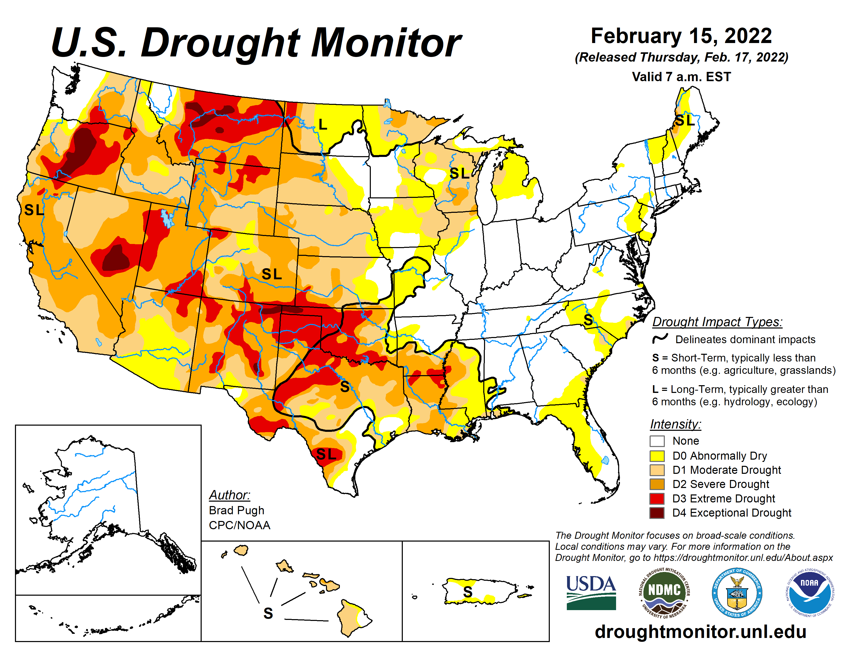

Slide 32
U.S. Cotton Area, Yield, and Production
Southwest to account for more than 60% of planted area
 | Unit | 2021/22 | 2022/23 | Change(%)
Planted area | Mil. acres | 11.22 | 12.7 | 13.2
Harvested area | " | 9.97 | 10.2 | 2.2
Abandonment rate | % | 11.1 | 19.7 | 8.6
Yield/harvested acre | Lbs. | 849 | 856 | 0.8
Production | Mil. bales | 17.62 | 18.2 | 3.3
Key Factor Includes Adequate Soil Moisture
Source: USDA, Interagency Commodity Estimates Committee.
Notes:
For the purposes of this analysis, 2022 cotton plantings of 12.7 million acres (+13 percent) are estimated to result in harvested acreage of 10.2 million acres, about 2 percent above 2021. The projected national abandonment rate of approximately 20 percent is based on regional long-run averages, except for the Southwest, where 2022 abandonment is projected at 30 percent. Southwest abandonment rates are highly variable and conditions there later this spring will have a considerable impact on acreage planted and the U.S. crop. However, the latest NOAA seasonal outlook for the Southwest indicates that drought is forecast to remain or develop over the region’s cotton growing area at least through May.
USDA is forecasting a national average yield—based on regional average yields—of 856 pounds per harvested acre, up from the 2021 yield of 849 pounds. The 2022 U.S. cotton crop is projected at 18.2 million bales, as a slightly larger harvested area and the highest yield in 4 years is expected to boost production 3 percent (approximately 575,000 bales) above 2021. Similar crops to 2021 are anticipated for most of the Cotton Belt, except for the Delta, where 2022 cotton production could rise to its highest in 3 years. Based on higher U.S. carry-in stocks of 3.5 million bales for 2022/23 and larger production, the total supply—21.7 million bales—would increase modestly but would remain the second lowest level in 5 years.

Slide 33
Larger U.S. Export Forecast:
Contingent Upon…
U.S. weather situation; size and quality of U.S. crop
Global Economic Growth; Consumer demand
China consumption-production gap, crop quality, policy
Brazil crop prospects in calendar 2022

Slide 34
U.S. Cotton Supply & Demand Projections:
Production, Exports, and Stocks Rise
Attribute | Unit | 2021/22 | 2022/23 | Change (%)
Beginning Stocks | mil. bales | 3.2 | 3.5 | 11.1
Area Harvested | mil. HA | 4.0 | 4.1 | 2.3
Production | mil. bales | 17.6 | 18.2 | 3.3
Imports | " | 0.0 | 0.0 | 0.0
Total Supply | " | 20.8 | 21.7 | 4.5
Exports | " | 14.8 | 15.5 | 5.1
Use | " | 2.6 | 2.7 | 3.9
Total Use | " | 17.3 | 18.2 | 4.9
Ending Stocks | " | 3.5 | 3.6 | 2.9
Stock to Use % | % | 20.2 | 19.9 | -0.3
Farm Price | cents/lb. | 90.0 | 80.0 | -11.1
Source: USDA, Interagency Commodity Estimates Committee.

Slide 35
Global WILDCARDS
Weather – what is normal?
COVID-19 – will consumer spending shift toward purchasing services as risk declines?
Polyester, Viscose, and other MMFs
Policy issues in important consuming and producing countries: Belt & Road, MSP, Withhold Release Order (WRO) by U.S. Customs & Border Protection
Disruption from military conflict in Eastern Europe
Notes:
Indeed, the stage is set for another interesting season in the world of cotton. Stay tuned!

Slide 36
THANK YOU!
Interagency Commodity Estimates Committee (ICEC) for Cotton, USDA

