Slide 1
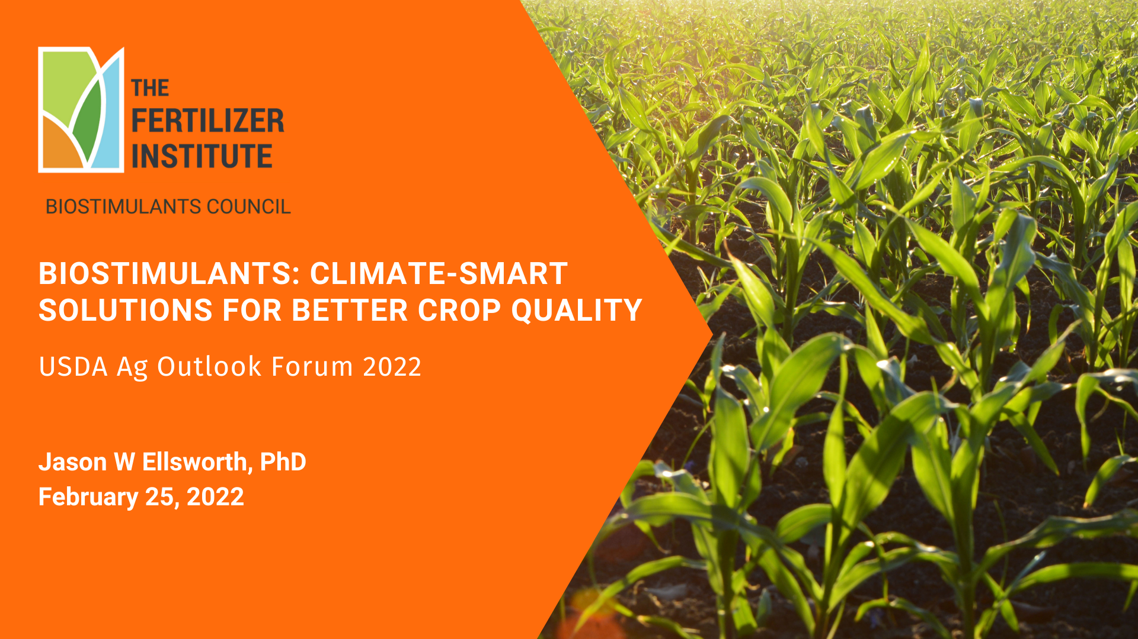

Slide 2
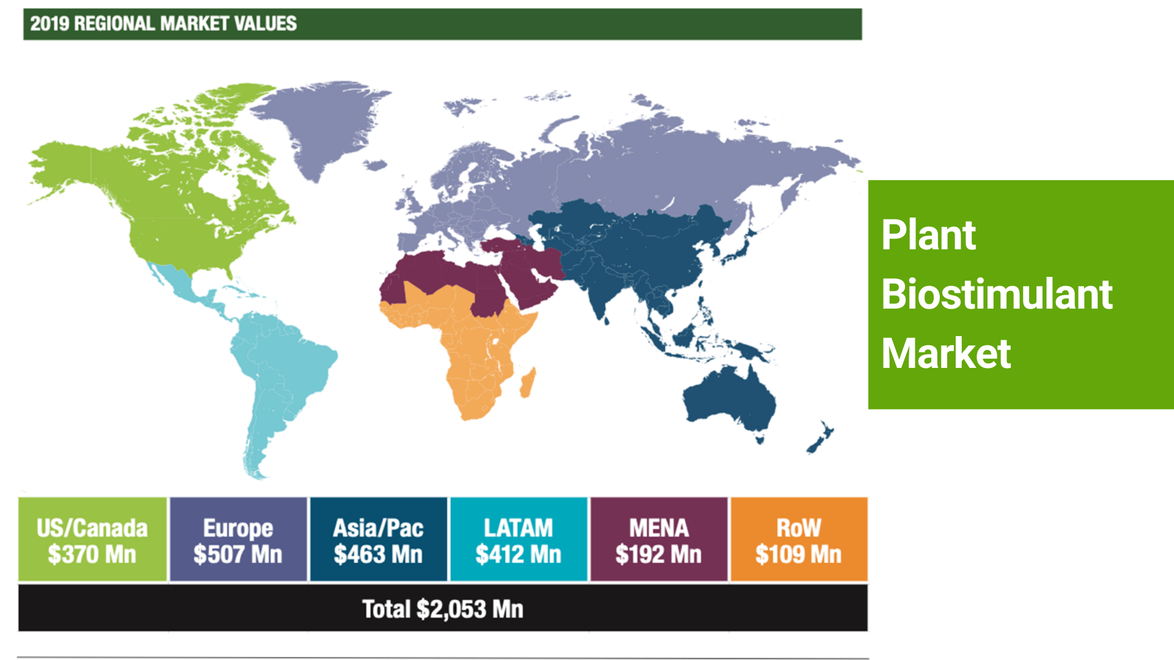

Slide 3


Slide 4
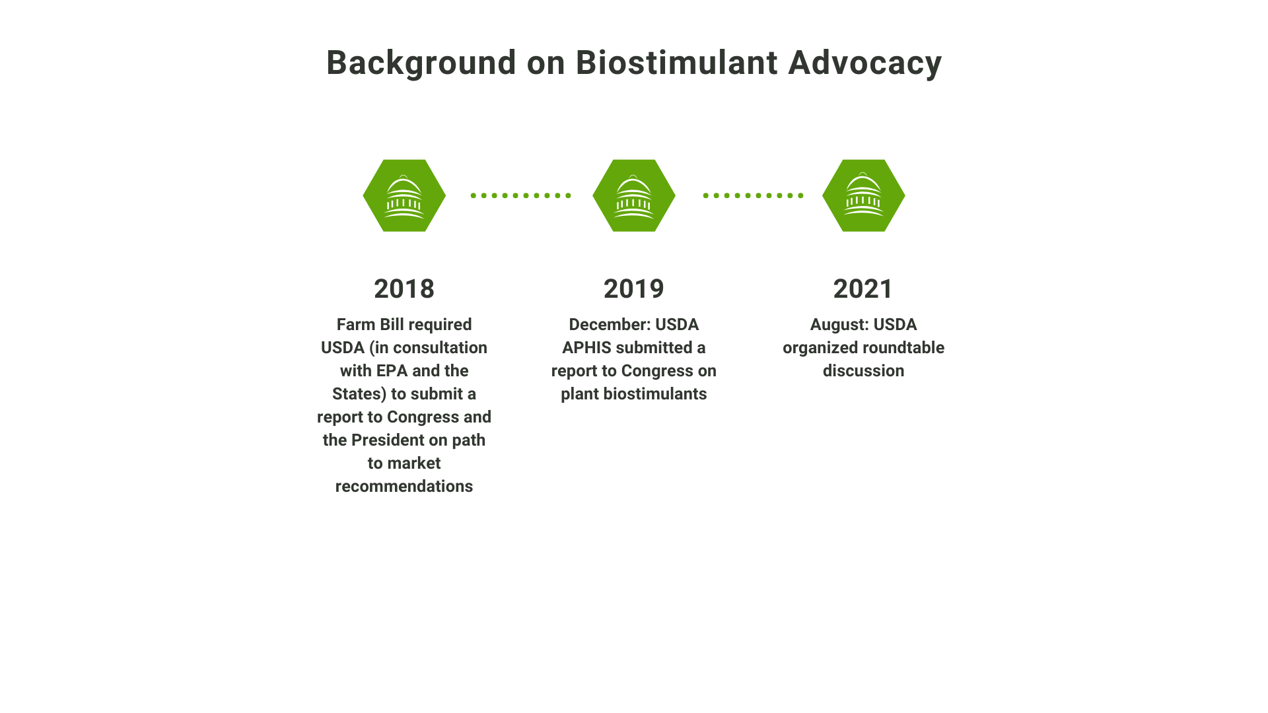

Slide 5
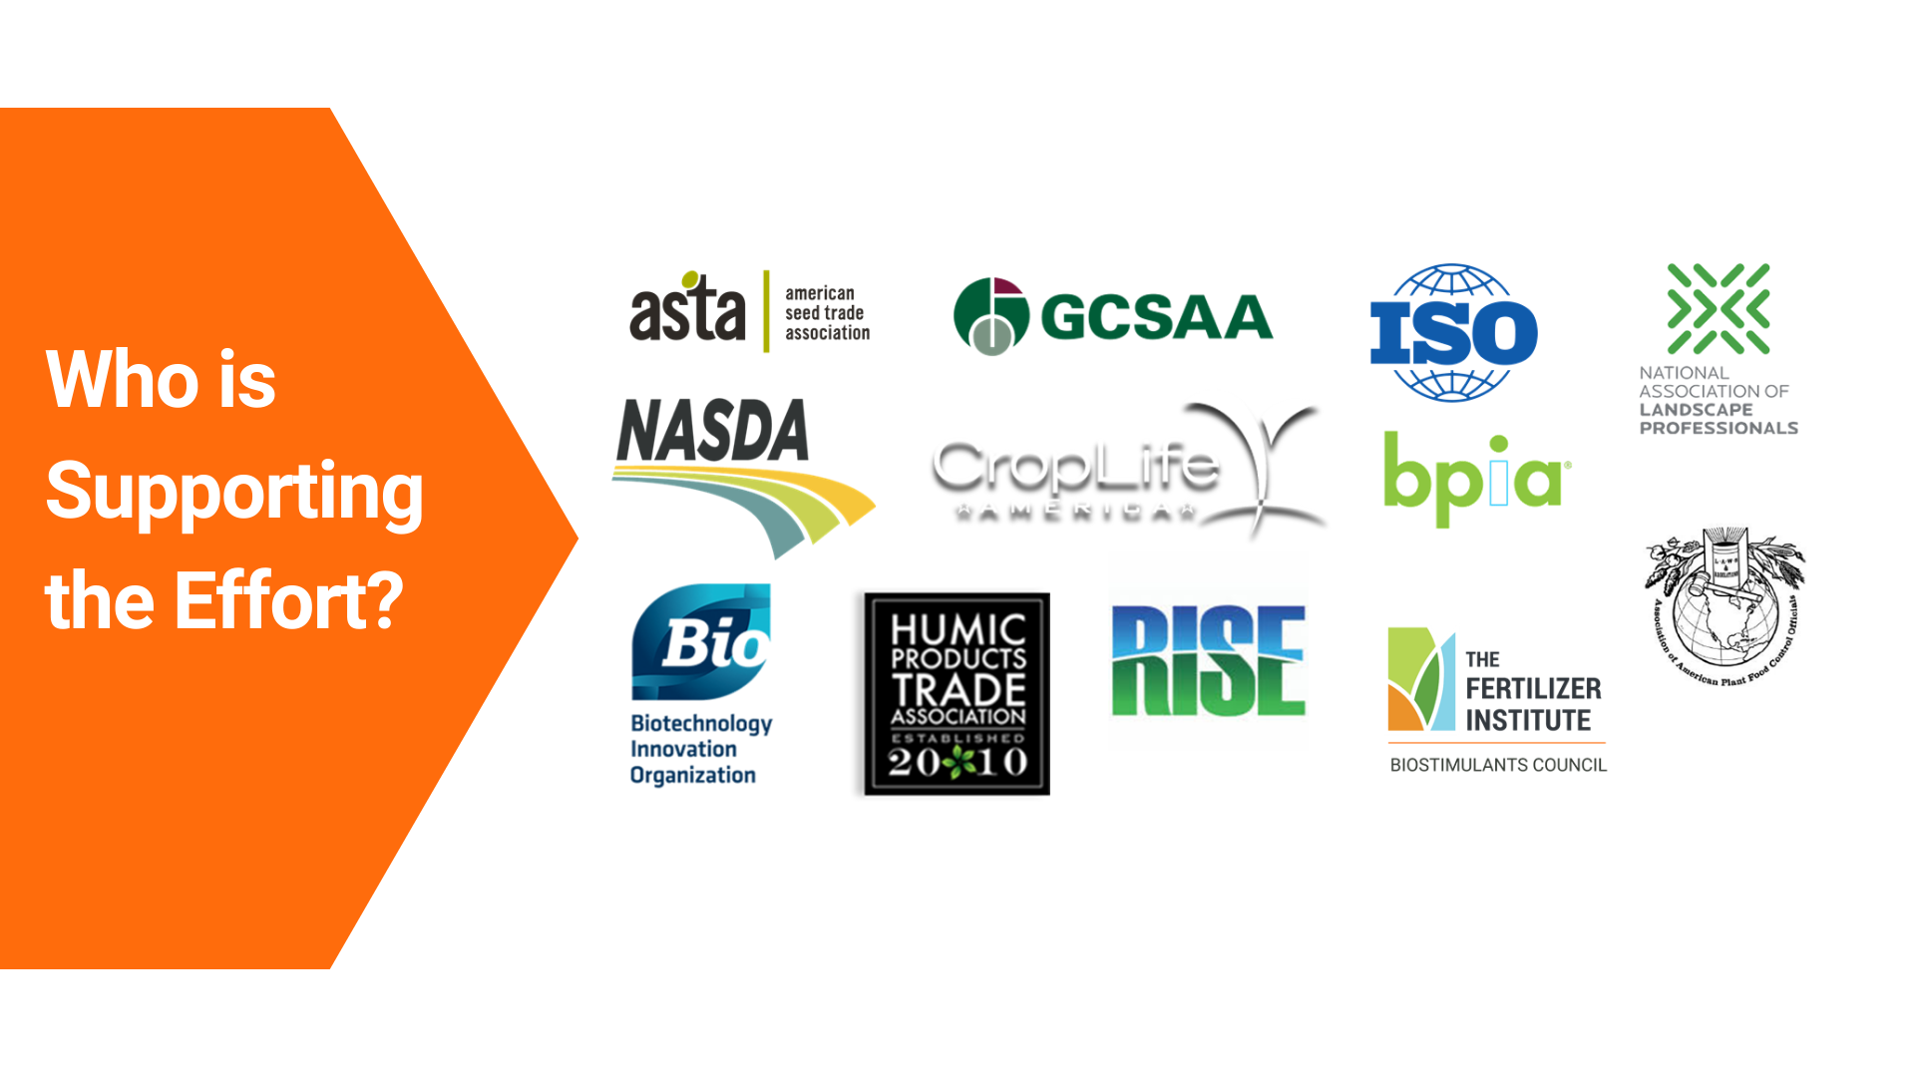

Slide 6
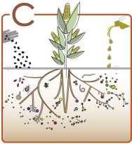
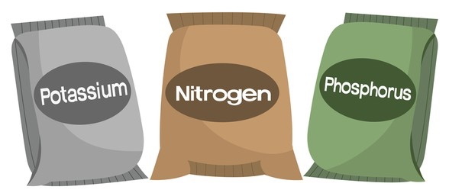
A plant biostimulant is a:
a.) substance(s),
c.) or mixtures thereof,
b.) or microorganism(s)
that, when applied to
act to support a plant's natural nutrition processes independently of the biostimulant's nutrient content.
seeds,
plants,
the rhizosphere,
soil or
other growth media,
Wallenstein, 2017
The plant biostimulant thereby improves nutrient availability, uptake or use efficiency, tolerance to abiotic stress, and consequent growth, development, quality or yield.
2019 USDA Report Alternative Definition 2
Notes:
6 Steps to this slide.
2019 USDA Report Alternative Definition 2, This is also the definition proposed by ISO TC/134 and is anticipated to be published as a standard in late Q1.

Slide 7
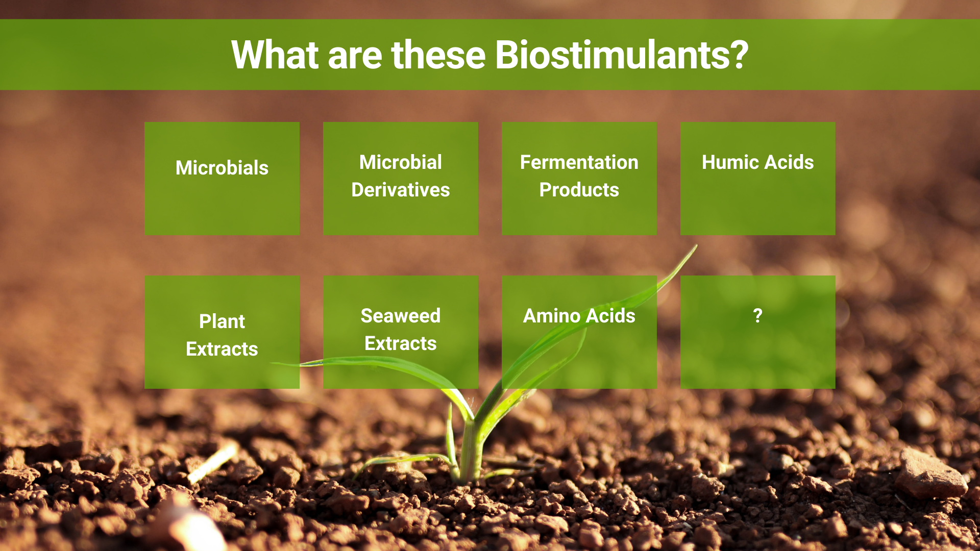

Slide 8
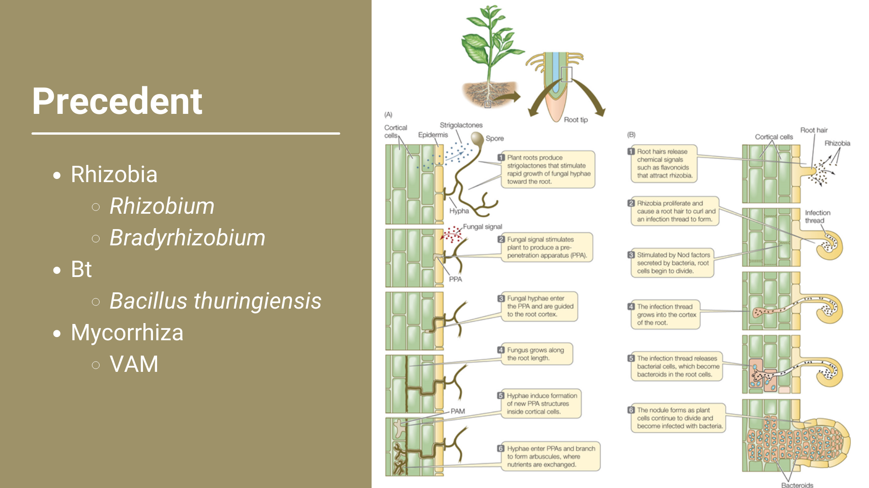

Slide 9


Slide 10
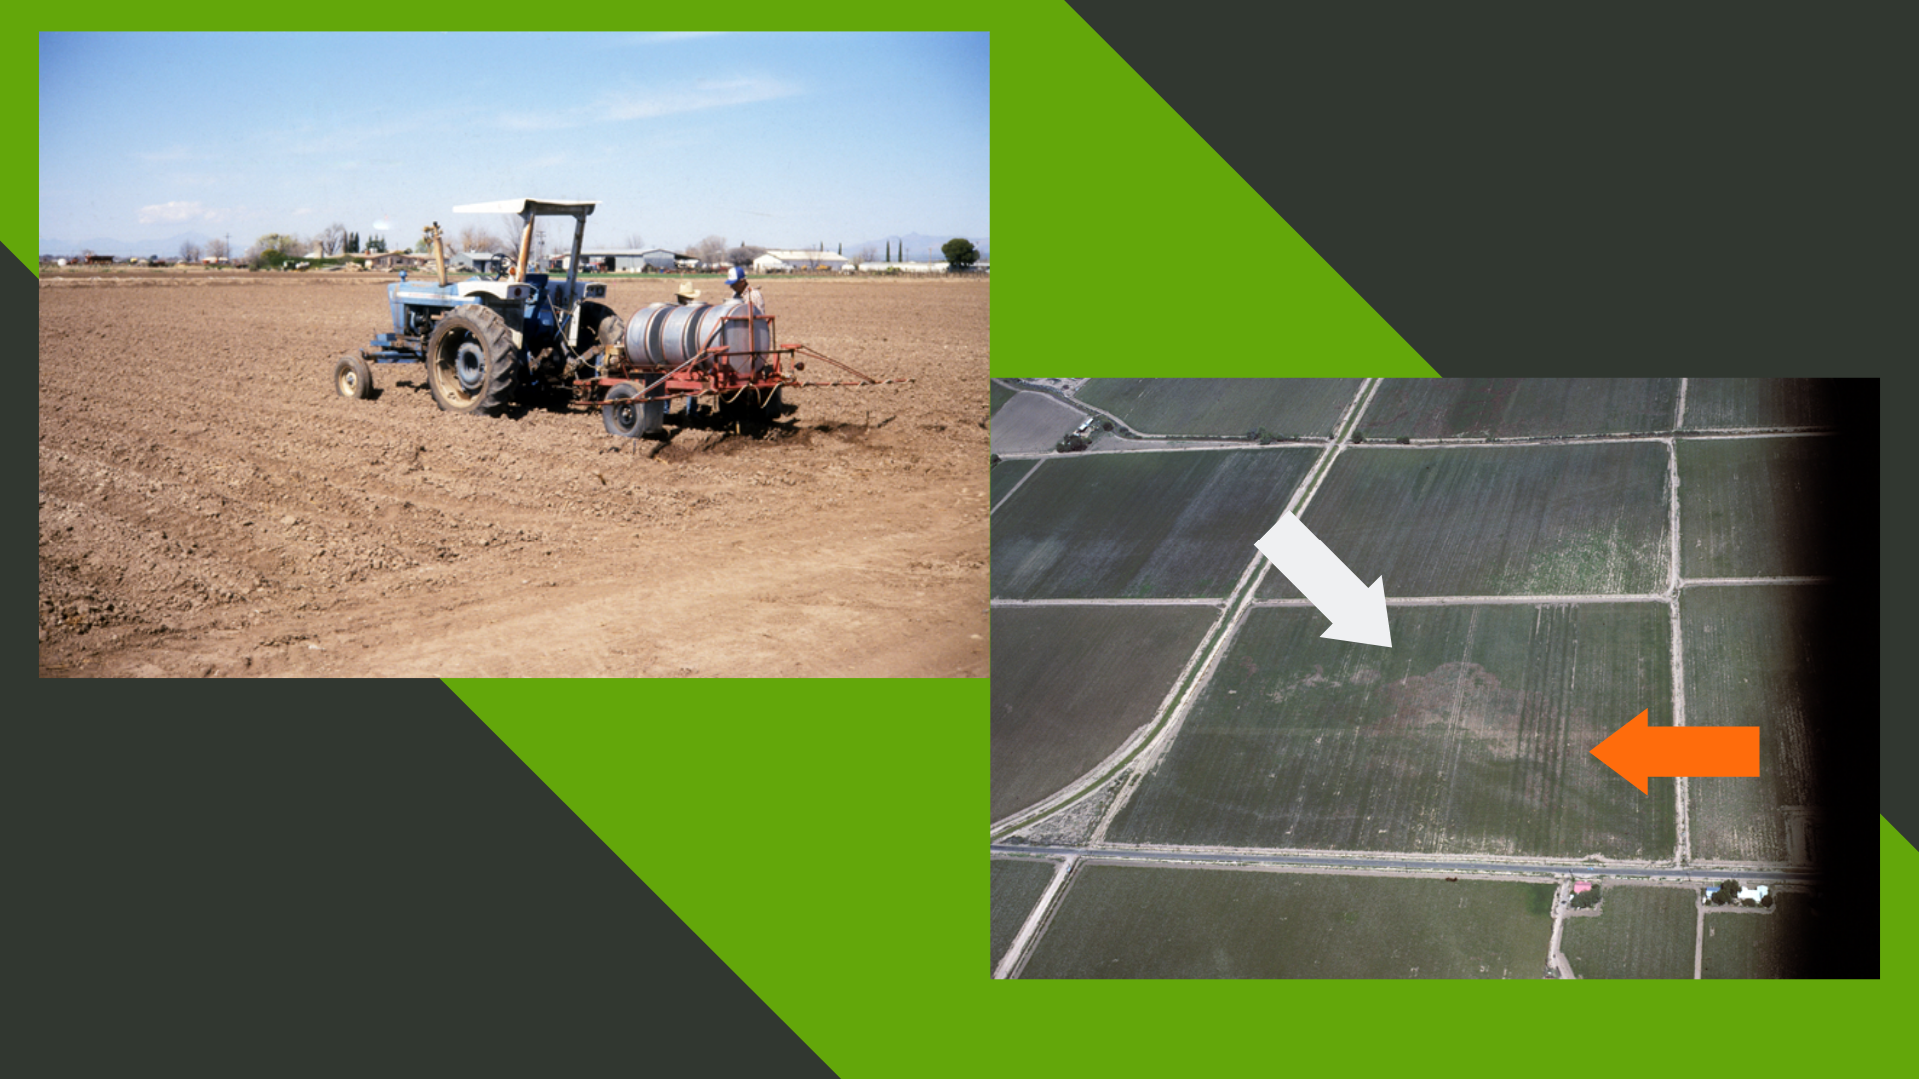

Slide 11
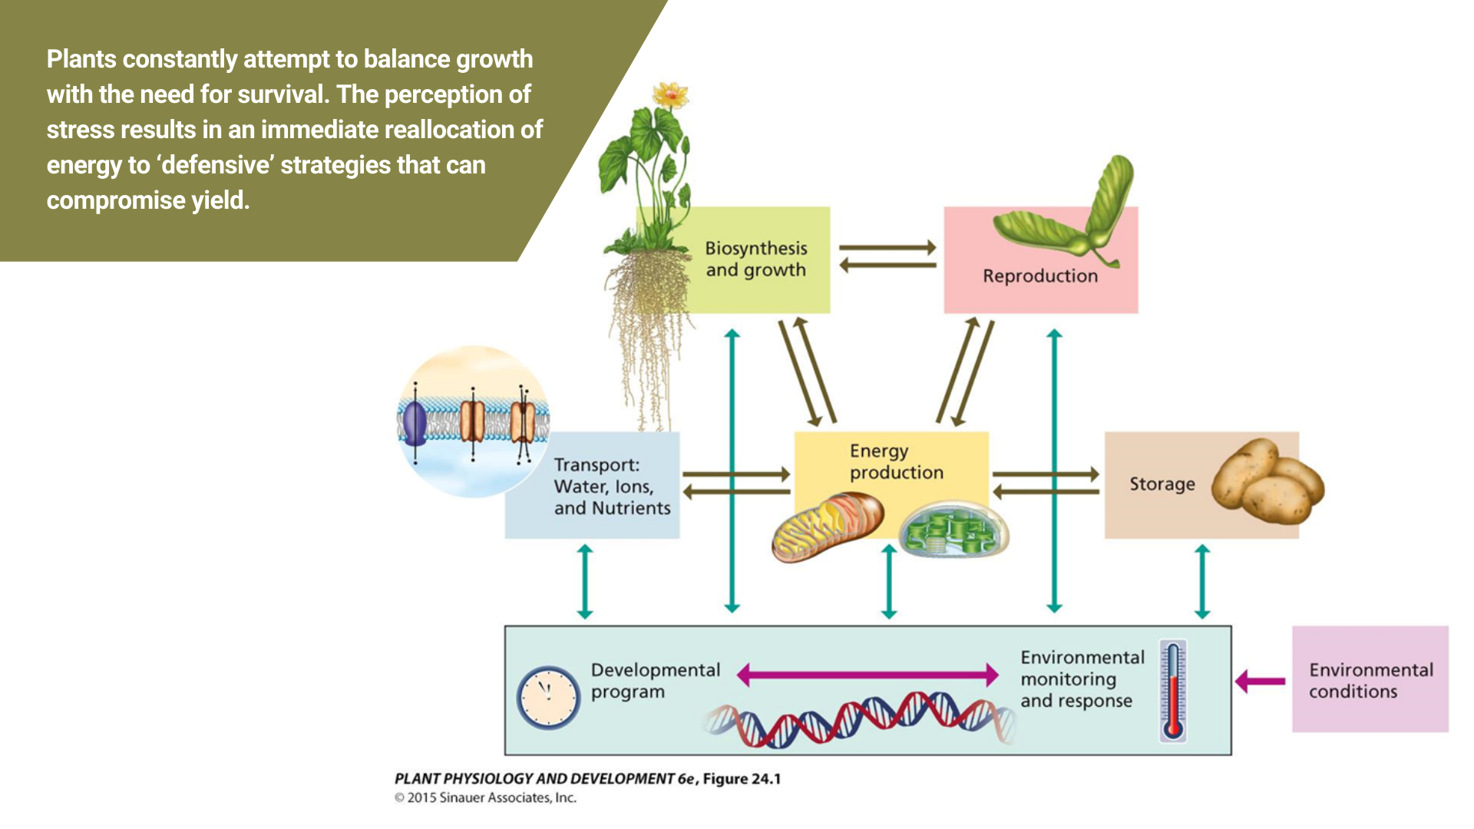

Slide 12
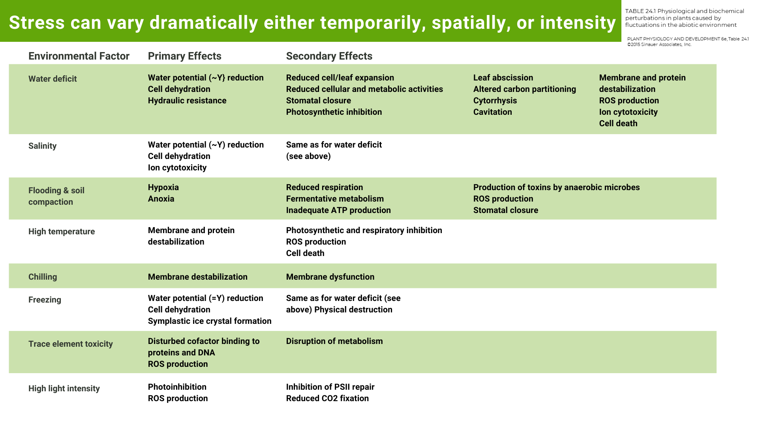

Slide 13

Yield and Quality
Nutrients, Water, Sunlight
Loss
Yield loss due to stress response and genetically determined biomass partitioning
Yield and Quality
Biostimulant
Nutrients, Water, Sunlight
Loss
Yield loss reduced due to diminished stress responses and favorable biomass partitioning
Notes:
This simple figure illustrate the value of a biostimulant using our analogy of the plant being a factory or group of many factories.
We plant a seed in the soil and the factory starts up. Nutrients, air, water and sunlight are added and the factory begins production. However, there are all the stresses mentioned earlier that limit the output or the function of the factory. Drought, high heat, this past summer in the west, to be sure, early, or late, frosts. Hence, yield and quality are limited.
We had a biostimulant to the crop, we increase the efficiiecy of the factory(ies). It doesn’t make it perfect, but we can significantly reduce loss caused by abiotic stresses.

Slide 14
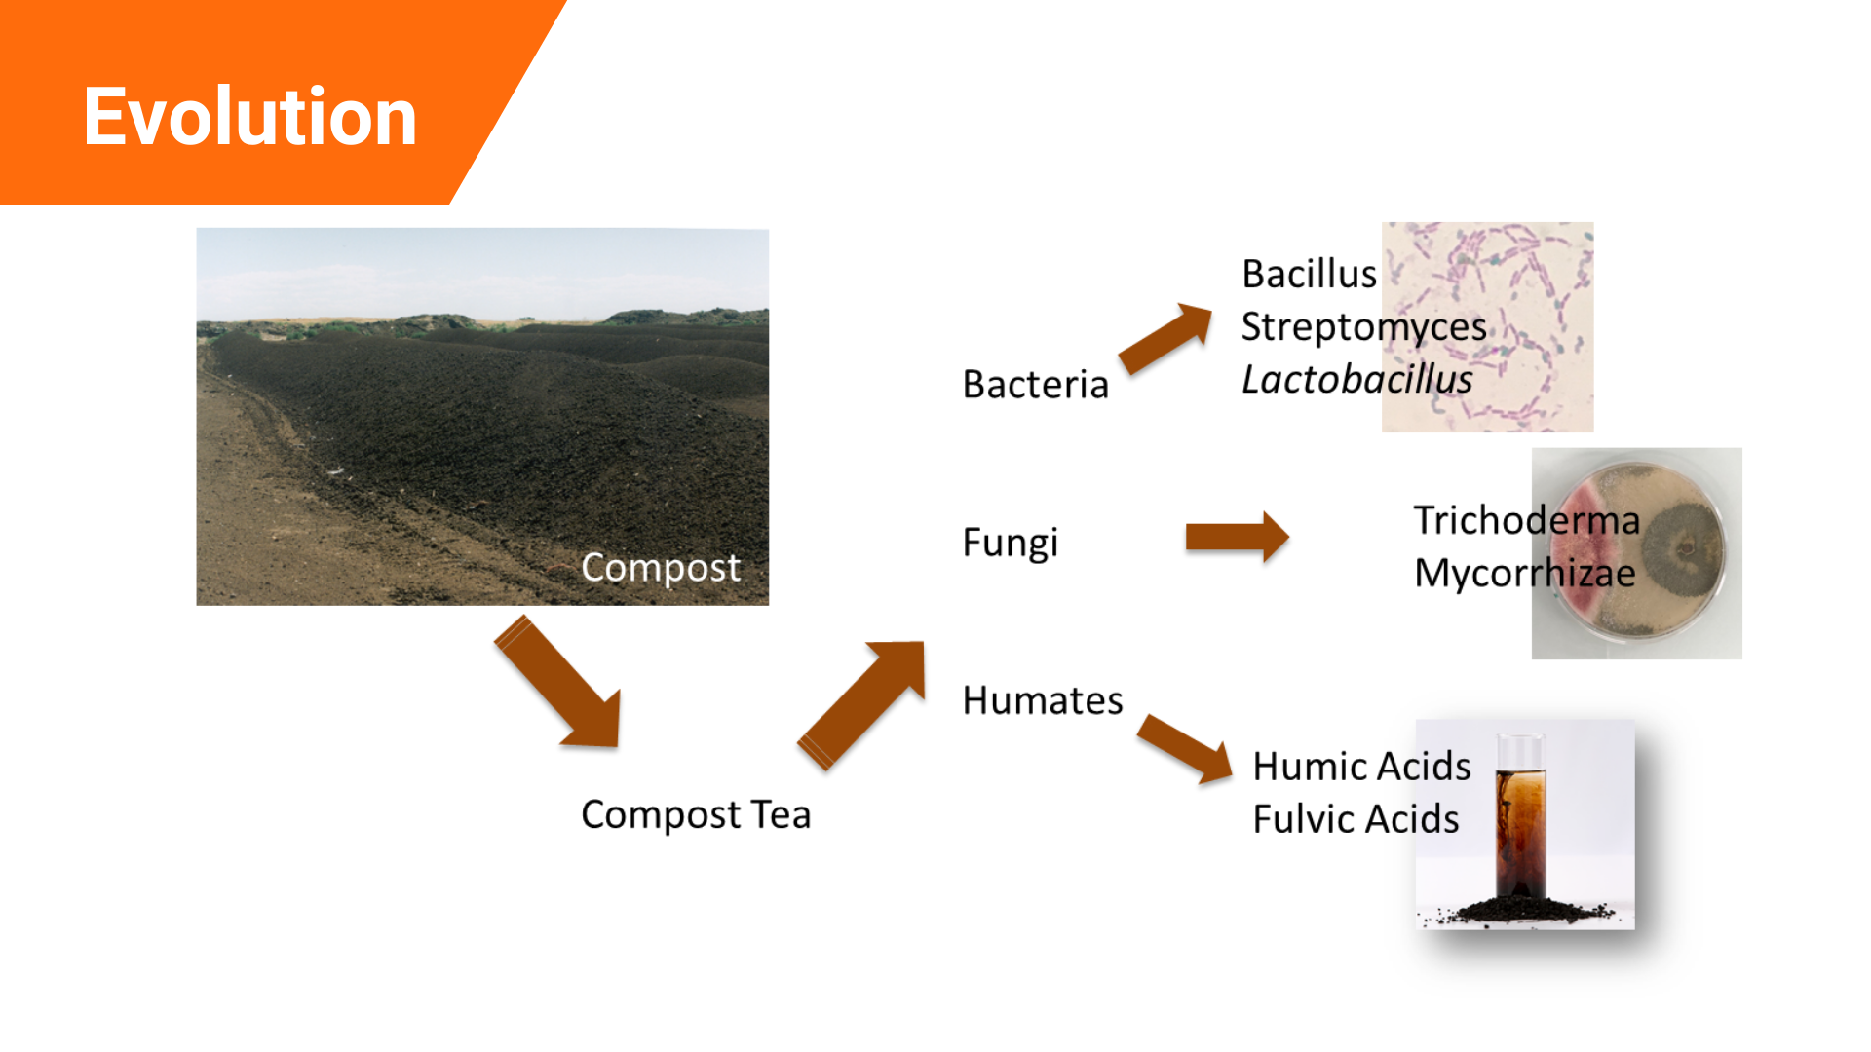

Slide 15
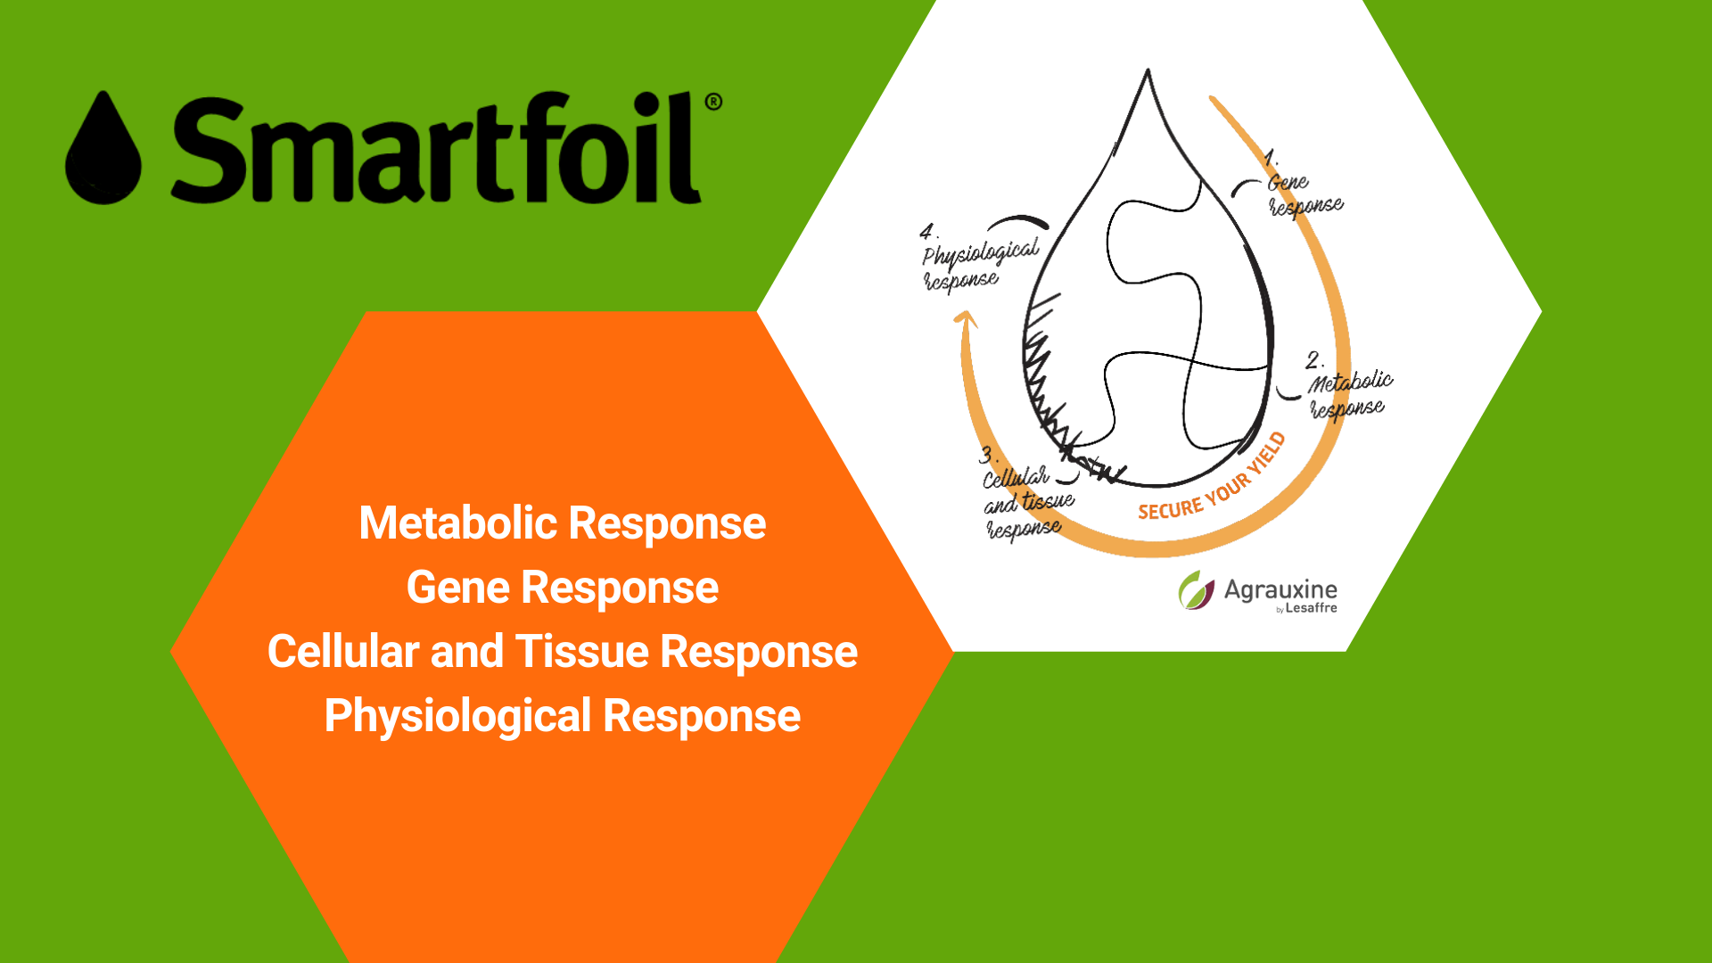

Slide 16
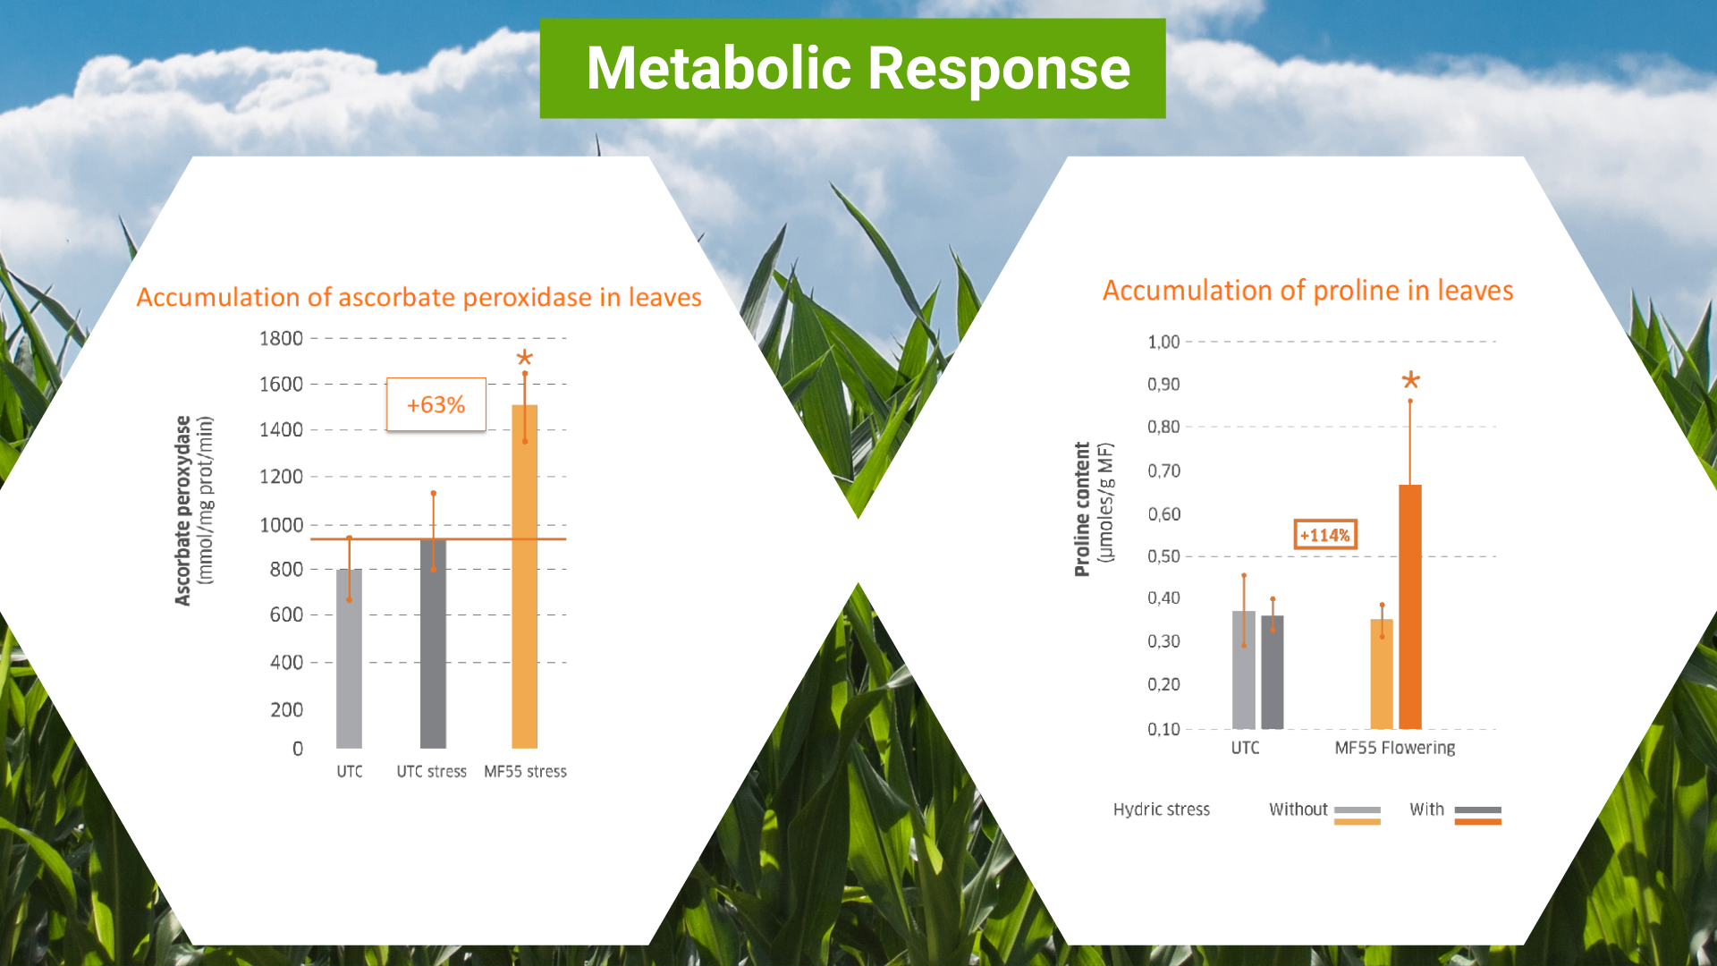

Slide 17
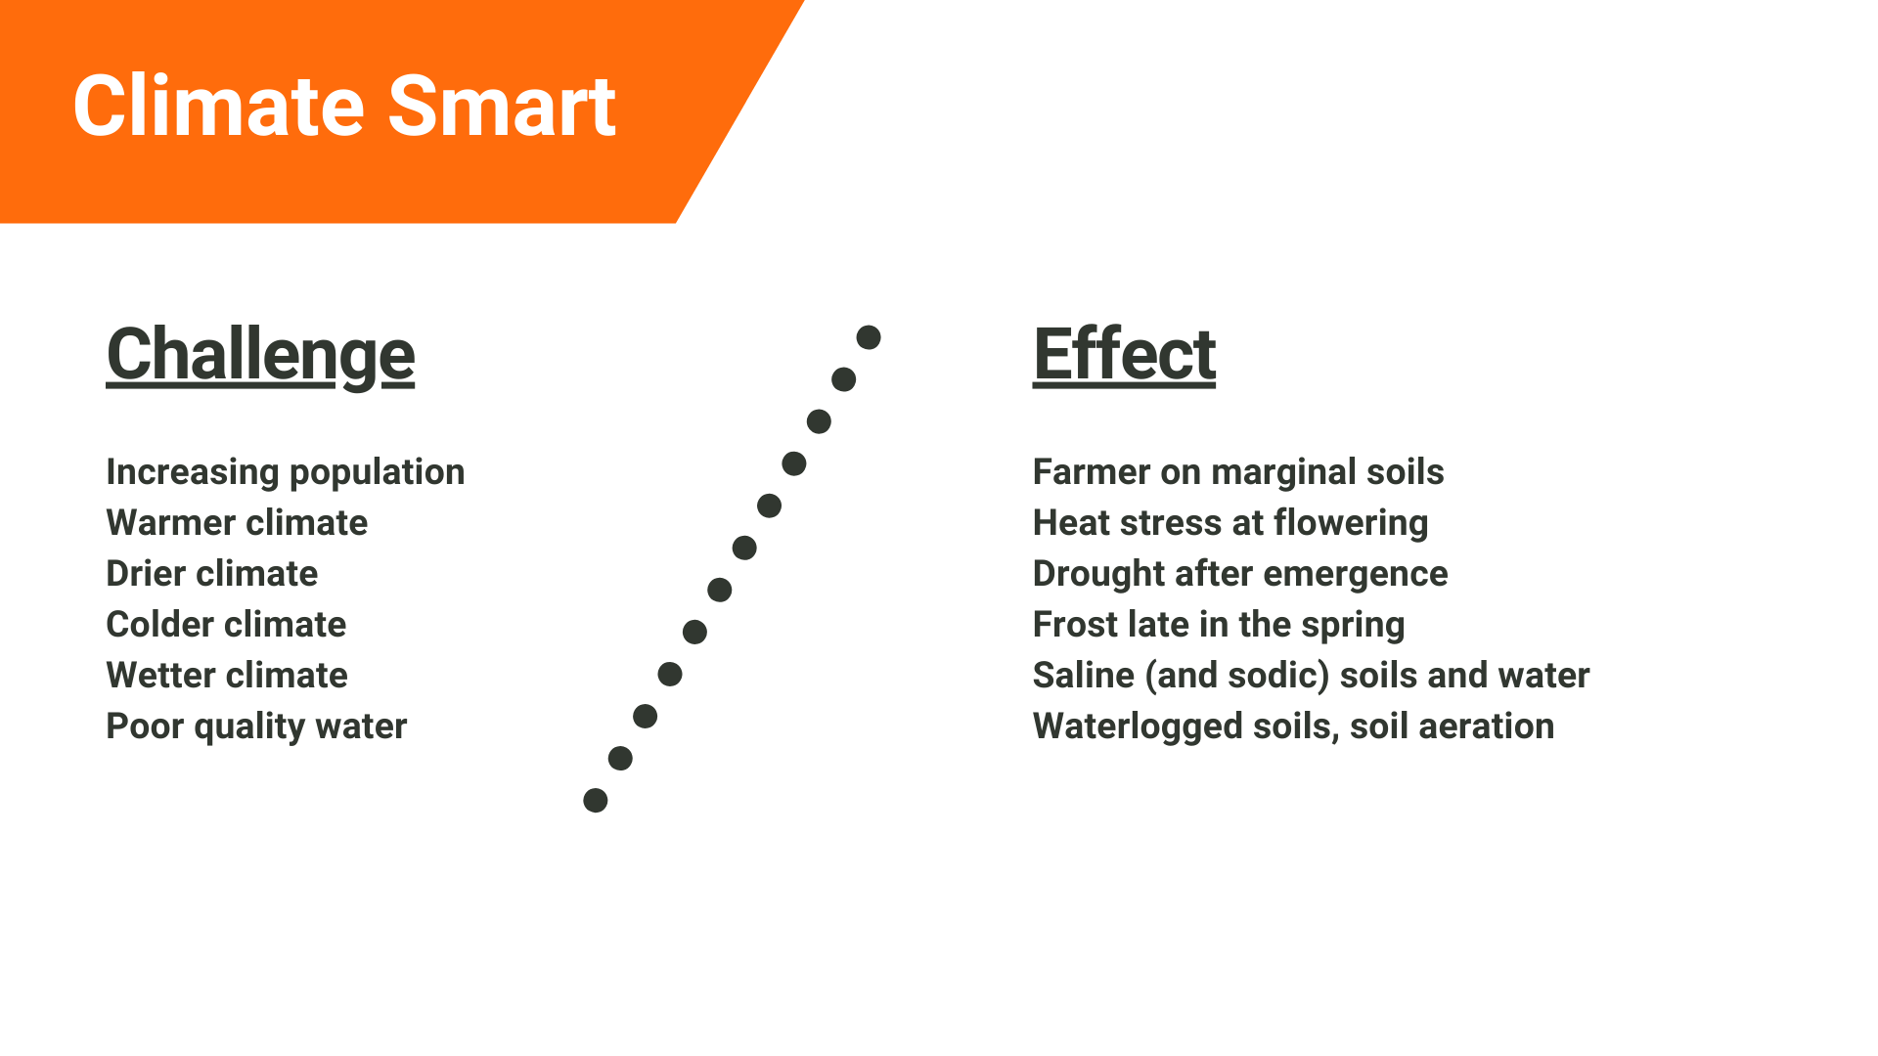

Slide 18
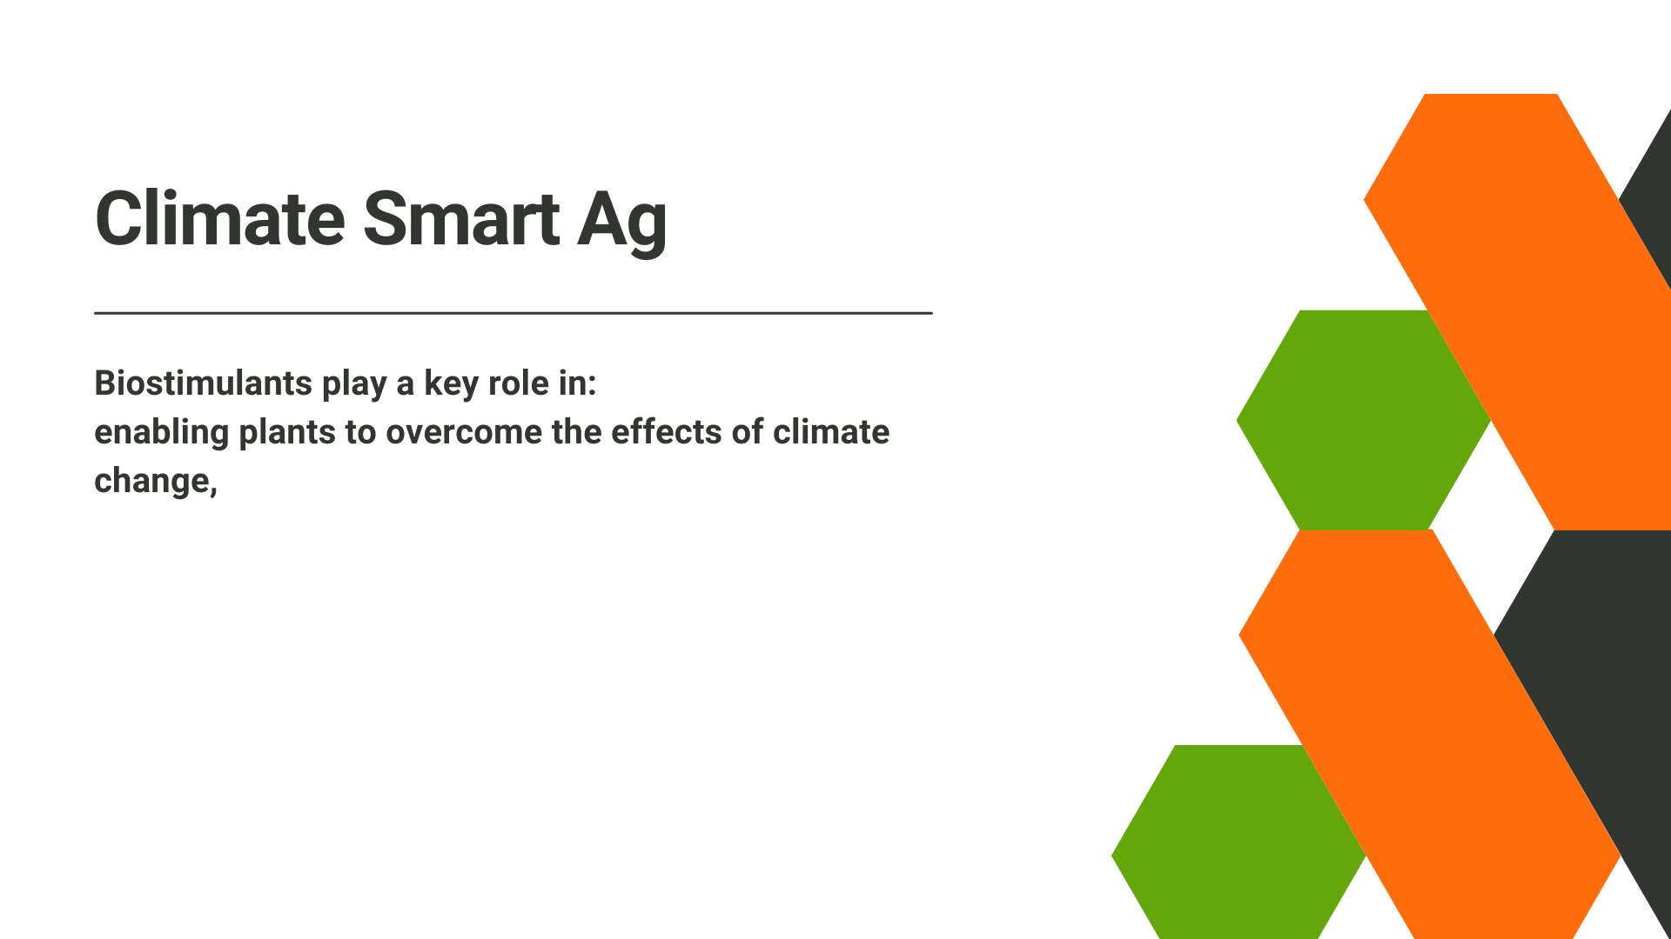

Slide 19
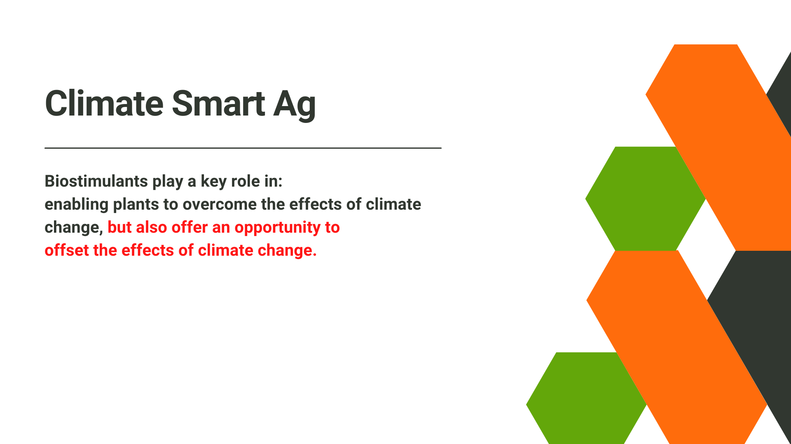

Slide 20
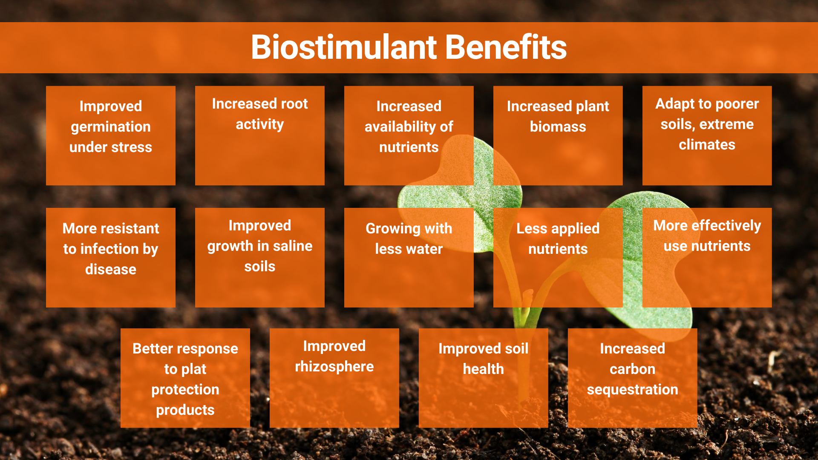

Slide 21


Slide 22


