Slide 1

U.S.-China Agricultural Trade: Present State of Affairs
Jason Grant
Professor and director, Center for agricultural trade
DEPARTMENT OF AGRICULTURAL AND APPLIED ECONOMICS
Virginia Tech
USDA Agricultural Outlook Forum, Washington, D.C., February 24, 2022

Slide 2
Outline
Global Trade – A Roller Coaster Decade+ (and last 2 years)
U.S.-China Agricultural Trade: Where Do We Stand?
Multilateral Perspective of China’s (growing) Agricultural Trade Influence
Conclusions & Headwinds facing U.S. Agriculture

Slide 3
A Rollercoaster Decade+ of Global Trade
Great Recession: 2008/09 marked largest collapse from very high quarterly growth rates (30% nonag; 20% ag)
2015-2016 Trade slowdown: Commodity prices fell from recent highs; US dollar appreciated; lower global growth forecasts (IMF 2016)
2018/19 Trade War: Significant escalation in applied tariffs; global trade declines only slightly
2020/21 Pandemic: significant decline in nonag trade growth; ag trade growth steady
2021 Recovery: rapid recovery of trade; faster than 08-09 financial crisis; driven (in part) by massive a surge in “durable goods” spending (and lower spending on services)
Bush
Obama, 1st Term
Obama, 2nd Term
Trump
Biden
US-China Trade War
Falling prices,tariff increases, declining global ag/nonag trade
Pandemic
Non-ag trade down almost 20%, but quickly recovered
Ag-trade positive growth in 2020
2008/09 Global Financial Crisis
Non-ag trade down 20-25%
Ag trade down 10-12%
2015/16 Trade Slowdown
Non-ag trade down 10%
Ag trade down 10%

Slide 4
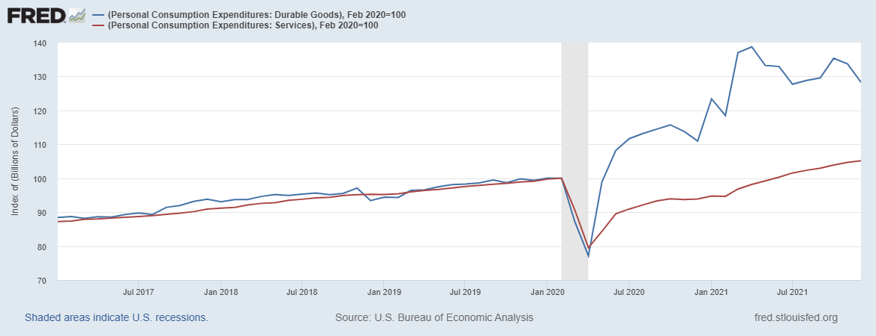
Record Recovery of U.S. Durable Goods Spending
Blue line: durable goods spending
Red line: services spending
Both lines indexed to February 2020 = 100
Prior to pandemic, durable goods and services rising on similar trend
Covid-19 Pandemic: Goods and services exp. declined > 20% of trend through April 2020
By April 2021, however, durable goods expenditure exploded ~ 1.4 times above trend
Spending on services has only recently recovered close-to trend
Apr 2021
Dec 2021

Slide 5
Demand Surge and a Global Supply Chain Backlog

Slide 6
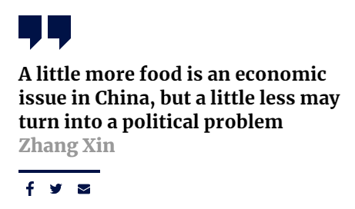
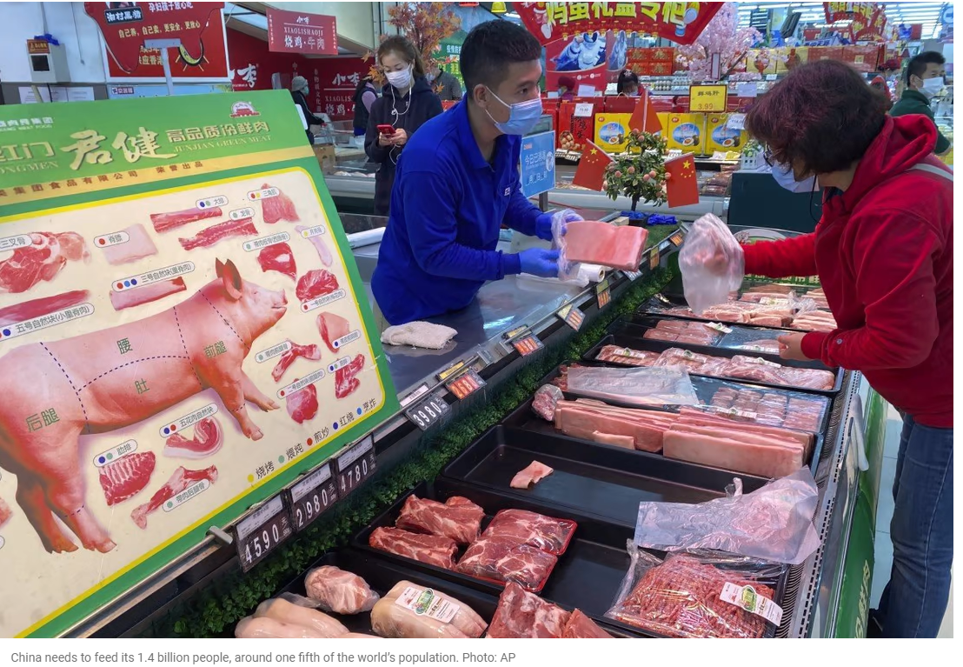
China Food Security
Agritech Co-Innovation Institute
Source: South China Morning Post
“Bread comes first” highlights the value Chinese citizens place on food security.
China needs to feed 1.4 billion people; 20% of world’s population
Recent events created more uncertainty around China’s food security
  African swine fever
  Coronavirus pandemic
  Increasingly variable climate (2020 floods)
China’s Ministry of Commerce, Nov. 1, 2021:
  “Families are encouraged to store a certain amount of daily necessities to meet the needs of daily life and emergencies,” the ministry said.
  Reduce food waste
Source: South China Morning Post

Slide 7
China’s Ag. & Total Merchandise Imports, 1995-2021
2021 Ag. Trade Deficit: $142 Bil.
Author’s calculations based on Trade Data Monitor, WTO Definition of Agricultural Products
Since joining the World Trade Organization (WTO) in 2001, China has become the largest importer of food and agricultural trade.
The value of China’s agricultural imports has risen from $10.3 billion in 2002 to over $200 billion in 2021, representing an average annual growth rate of 16.0%.
China’s share of global agriculture imports increased from 11% in 2012 to a projected 16% in 2021.
China’s agricultural exports are just 30% of imports in 2021 resulting in China being the largest net importer of agri-food products.

Slide 8
U.S.-China Agricultural Trade

Slide 9
U.S. Ag. Exports Hampered by “On-Again, Off-Again” Trade relationship with China
“China remains a difficult and unpredictable market for U.S. agricultural exporters, largely because of inconsistent enforcement of regulations and selective intervention in the market by China’s regulatory authorities.” (USTR, 2021)

Slide 10
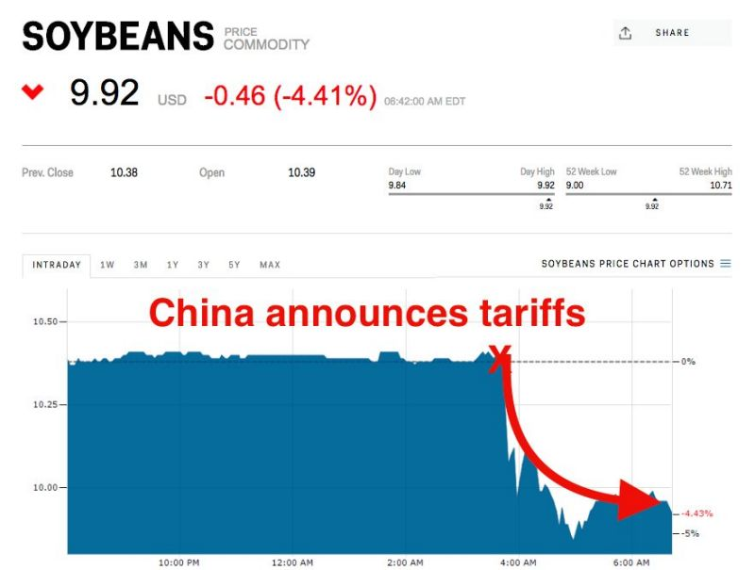
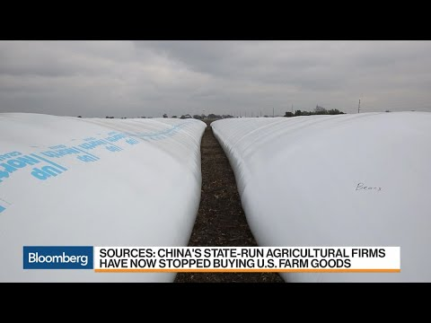
In 2018/19, the U.S.-China Trade Relationship
Came Under Strain

Slide 11
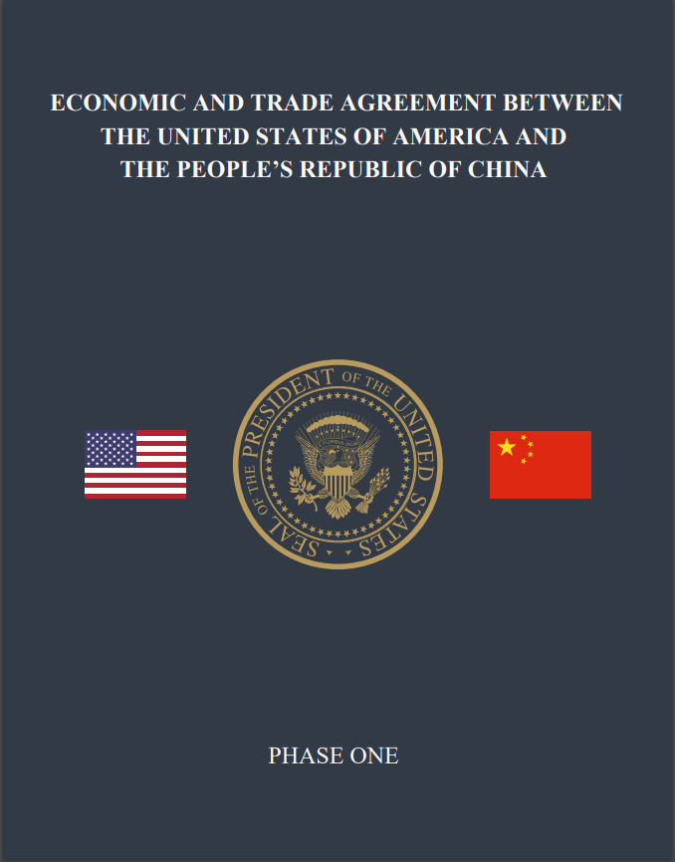
U.S. China Phase One Trade Deal
 | (1) | (2) | (3) | (4) | (5)
Phase One Product Category | Example Products | 2017 China Imports from U.S. | 2020 Phase 1 Increase | 2021 Phase 1 Increase | Two-Year Total Purchase Increase
 |  | ---------------------------------------------$ Billion-------------------------------------------
Agricultural + Seafood | Soybeans, corn, wheat, sorghum, cotton, meat, dairy, seafood, fruit, vegetable, jams, jellies, flour, prepared food | $24.1 | $12.5 | $19.5 | $32.0
Manufactured Goods | Industrial machinery, Electronic equipment, pharmaceutical products, aerospace, vehicles and automotive, optical and medical instruments, iron and steel | $77.2 | $32.9 | $44.8 | $77.7
Energy Products | Liquified natural gas (LNG), crude oil, refined products | $6.8 | $18.5 | $33.9 | $52.4
Services | Business travel, tourism, financial, insurance, telecom, data, etc. | ------- | $12.8 | $25.1 | $37.9
All Covered Goods | All of the above | ------- | $76.7 | $123.3 | $200
Source:
https://ustr.gov/sites/default/files/files/agreements/phase%20one%20agreement/Phase_One_Agreement-Ag_Summary_Long_Fact_Sheet.pdf
* Note: 2017 uncovered total = $45.1 billion

Slide 12
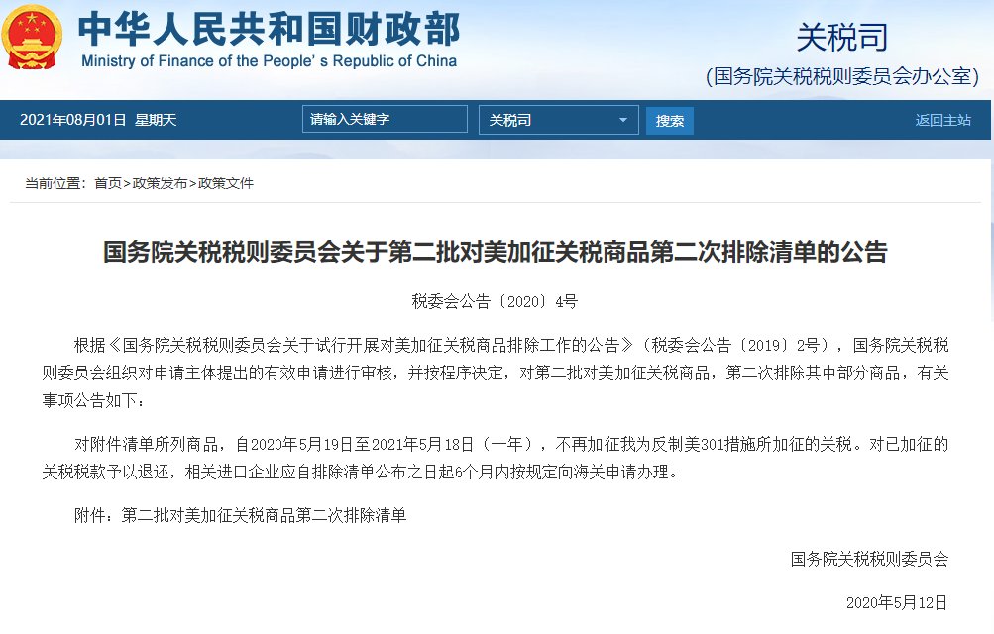
How Did China Facilitate Import Purchases with Retaliatory Tariffs Still in Place?
Feb. 2020, China’s State Council Customs Tariff Commission issued a 696 list of retaliatory tariff exemptions
Exclusions were intended for “market-based procurement of commodities”
Importing firms could begin submitting their applications on March 2, 2020
The notice also stated that “applications for products not on the list may also be approved”
China provided subsequent announcements throughout 2020 extending the application deadline on a rolling basis.
China’s Effective Tariff on Imports from U.S., Inclusive of Retaliation & 696 Exclusions
Tariff Exclusion period

Slide 13
A Look at China’s Imports from the U.S. and Competing Suppliers

Slide 14
China’s Agricultural Imports from U.S., Brazil, EU and Australia, 2017-2021
Trade war
Phase-One
2021: a record year of values (but not
necessarily volumes)
China relaxed some non-tariff measures
Beef, poultry, corn exports set new volume records
Strong exports, tighter supplies, & rebuilding China’s hog herd/feed conversions
Led to a surge in commodity prices
Resulted in the phase one trade deal’s ag. purchases looking strong in the 2nd year (2021)
~ 89% of commitment
(83% if using US export statistics (Bown 2022)

Slide 15
China Soybean and Corn Imports, 2017-2021
Note: US export statistics:
2020 U.S. soybeans to China: 34.2 mmt
2021 U.S. soybeans to China: 27.4 mmt

Slide 16
China Wheat and Beef Imports, 2017-2021

Slide 17
∆ U.S. Market Share in China vs. ∆ China’s Imports from U.S. (2021 vs. 2017)
Corn ($5.7 Bil, +43%)
Not all products fared well
Fruit, veg., dairy, seafood
Other product categories lost market share in China
Overall:
The size of China’s agricultural import “pie” grew, but the U.S. got a smaller “slice”
Implication: China is diversifying its portfolio of export suppliers

Slide 18
Caught in the Crossfire: A Global View of China’s Growing Market Power Impacts on Agricultural Trade

Slide 19
Selected Case Studies
Incident | Affected Country | Timeframe | Products Impacted
Opening of Taiwan Embassy | Lithuania/EU | Ongoing | Beef, dairy, beer, fish
Covid-19 origins (5G technology) | Australia | 2020-2021 | Barley, wine, coal, beef, cotton, sugar
Arrest of Huawei CFO | Canada | 2019-2020 | Beef, pork, canola
Ban on 5G technology (Huawei) | New Zealand (and others) | 2019 | Certain dairy products
Awarding rights prize to Swedish dissident under detention in China | Sweden | 2019 | Prepared fruit/nuts
Scarborough Shoal standoff, South China Sea | Philippines | 2012-2013 | Tropical fruit (bananas, pineapples, coconut, etc.)
Deployment of U.S. missile defense system | Korea | 2017 | Beverages, spirits, vinegars
Hosting Dalai Lama | Mongolia | 2016-2017 | Rapeseed, nuts
Nobel Peace Prize awarded to Chinese dissident, Liu Xiaobo | Norway | 2010-2012 | Atlantic Salmon
2010 Senkaku boat collision incident (East China sea) | Japan | 2010-2011 | Rare earth products
Sources:
- Global Trade Alert https://www.globaltradealert.org/
- Center for Strategic and International Studies (CSIS) https://www.csis.org/
- WTO SPS Information Management System: http://spsims.wto.org/
- WTO Dispute Settlement Gateway: https://www.wto.org/english/tratop_e/dispu_e/dispu_e.htm
- Transcripts of spokesman’s remarks

Slide 20
China’s Economic Influence Can Have Significant Agricultural Trade Impacts
6.5 mmt
1.3 mmt

Slide 21
Conclusions & Headwinds Impacting U.S Agricultural Exports
U.S.-China Trade Relationship
  China is number one market for US, Brazil, Australia, New Zealand, Uruguay, and # 2 market for Canada, EU, Argentina
  US producers depend on the Chinese market for the sale of their output, just as Chinese consumers depend on U.S. imports for food and feed use (symbiotic relationship)
Headwinds
  US/China elevated tariffs remain – will China continue its system of tariff exclusions?
  China’s TRQ compliance issues with (wheat, corn, rice) – WTO compliance panel formed August 2021
  Geo-political tensions/stability (RUS-UKR; CHN-TWN)
    Ukraine’s most productive agricultural land is located in eastern regions; those regions most vulnerable to a conflict with Russia
  Food Security: will China’s expansion of maize-soybean intercropping reduce its reliance on imports?
  More Broadly: U.S. needs an FTA “Blitz”
    China concluded RCEP and request to join CPTPP
    EU creating region-to-region FTAs with Mercosur and ASEAN members

Slide 22

Thank you!
Contact Info:
  Jason Grant, Email: jhgrant@vt.edu | Ph: +1-540-231-7559
  Center for Agricultural Trade (CAT)
  https://aaec.vt.edu/extension/Agricultural-Trade-Center.html

Slide 23
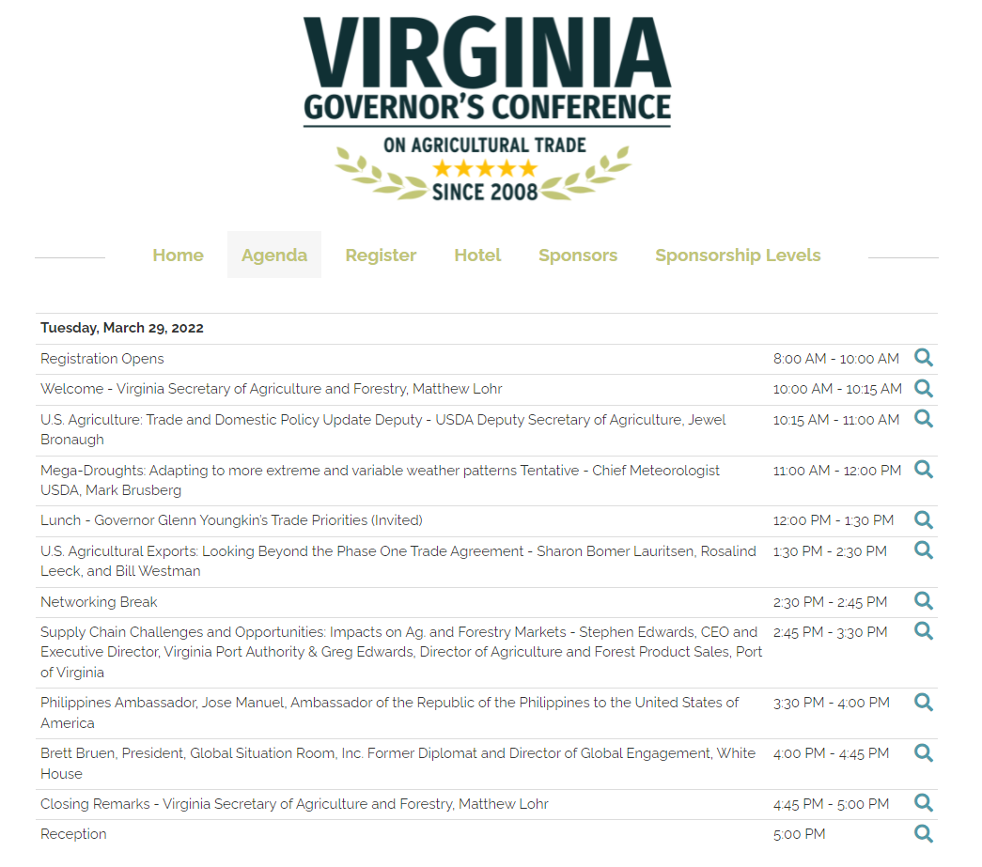
Registration (Live and Virtual option):
https://vafb.swoogo.com/govag2022

