Slide 1


China is that way
Ag Outlook: China
Jason Hafemeister
Acting Deputy Under-Secretary
February 24, 2022

Slide 2

Market Prospects for U.S. Agriculture in China
U.S. Export Performance to China in Context
Thoughts on Market Potential
Perspectives on Diversification
The view from behind my parents’ place

Slide 3
U.S. Export Performance to China in Context
U.S. China trade in goods is highly unbalanced.
  China is the largest supplier of good to the United States.
  Reducing imports from China had no effect on the trade deficit.
  Reducing U.S. exports to China had a big impact on U.S. agriculture.
China accounted for 40% of the increase in U.S. ag exports from 2014 to 2021

Slide 4
U.S. – China Bilateral Trade: All Goods

Slide 5
U.S. Total Merchandise Annual Trade Balance
Total Trade Balance and Oil & Gas Trade Balance (2002-2021)
Source: USA Trade Online, Foreign Trade Division, U.S. Census Bureau

Slide 6
U.S. Ag Export Growth to China and World Less China
Source: United States Census Bureau & Trade Data Monitor LLC

Slide 7
U.S. Agricultural Trade Situation
Exports at record $177 billion; Imports at record $171 billion
Source: United States Census Bureau & Trade Data Monitor LLC

Slide 8
China Agriculture and Seafood Imports From the U.S.
Source: Trade Data Monitor LLC

Slide 9
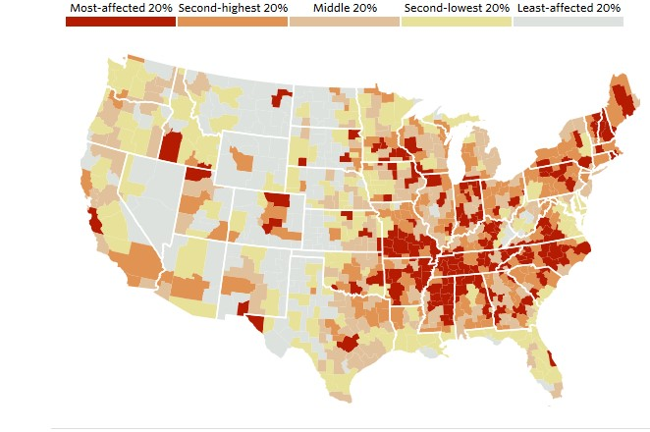
China Shock!
Regional impacts from increased imports from China: 1990 - 2007

Slide 10
U.S. Merchandise Imports by Top 8 Partners
China’s rise as the dominant import supplier stagnated or slowed import growth from others
Source: USITC Dataweb, Imports for consumption by partner, customs value

Slide 11
2. Market Potential in China
China is a big market – how much further can it grow?
Comparators
  Products
  Markets
Some PSD updates

Slide 12
U.S. Market Share in China
Source: Trade Data Monitor LLC

Slide 13
U.S. Ag Exports to China
& U.S. Share of China Ag Imports
Market Share
Source: United States Census Bureau & Trade Data Monitor LLC

Slide 14
China Relative to Other Top Markets
China Rank
3
Other – 1: Soybeans, Sorghum, Hay, Hides/Skins 3: Peanuts 4: Ethanol 5: Pet Food
Source: United States Census Bureau

Slide 15
China v. India
India
Source: Trade Data Monitor LLC

Slide 16
Top U.S. Ag Markets
China
Mexico
Canada
EU

Slide 17
Policy Constraints on Additional Export Growth
Retaliatory tariffs
AD/CVD on distillers dried grains
Ethanol policy
Slow biotech approvals
Decrees 248/249
External factors

Slide 18
U.S. Soybean Exports

Slide 19
U.S. Corn Exports

Slide 20
U.S. Wheat Exports

Slide 21
U.S. Sorghum Exports

Slide 22
U.S. Cotton Exports

Slide 23
U.S. Beef & Beef Product Exports

Slide 24
U.S. Pork & Pork Product Exports

Slide 25
U.S. Poultry & Poultry Product Exports

Slide 26
U.S. Dairy Product Exports

Slide 27
U.S. Tree Nut Exports

Slide 28
U.S. Fruit & Vegetable Exports

Slide 29
U.S. Ethanol Exports

Slide 30
2021 China Imports from U.S.
& Top Competitors
2021 China Imports
(Million Dollars, Phase One Agreement Groups)
Source: Trade Data Monitor LLC

Slide 31
China: Top Importer of Coarse Grains
Source: USDA/FAS Production, Supply and Distribution

Slide 32
China: Soybean Imports Contract
Source: USDA/FAS Production, Supply and Distribution

Slide 33
China: Cotton and Wheat Down in 2021/2022
Source: USDA/FAS Production, Supply and Distribution

Slide 34
China: Mixed Outlook on Meat
Source: USDA/FAS Production, Supply and Distribution

Slide 35
U.S. Sales to China
*cotton in million bales
Source: USDA/FAS Export Sales Reporting as of 2/10/2022

Slide 36
4. Thoughts on Diversification
International engagement and new market opportunities
Trade and Sustainability
Trade and Climate

Slide 37
U.S. Ag Exports by Destination
Source: United States Census Bureau

Slide 38
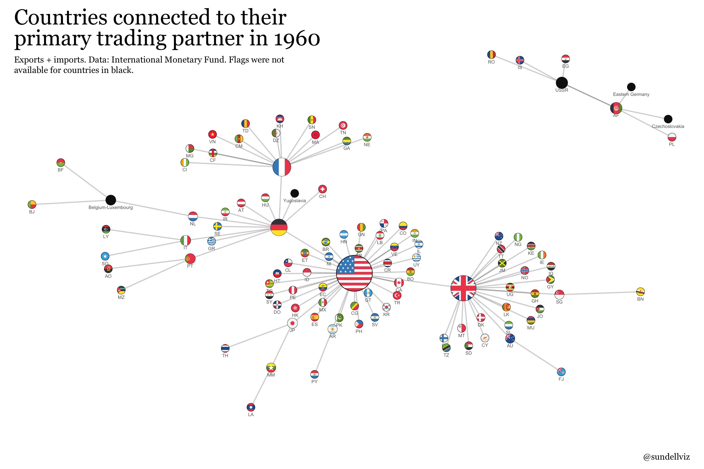
38

Slide 39
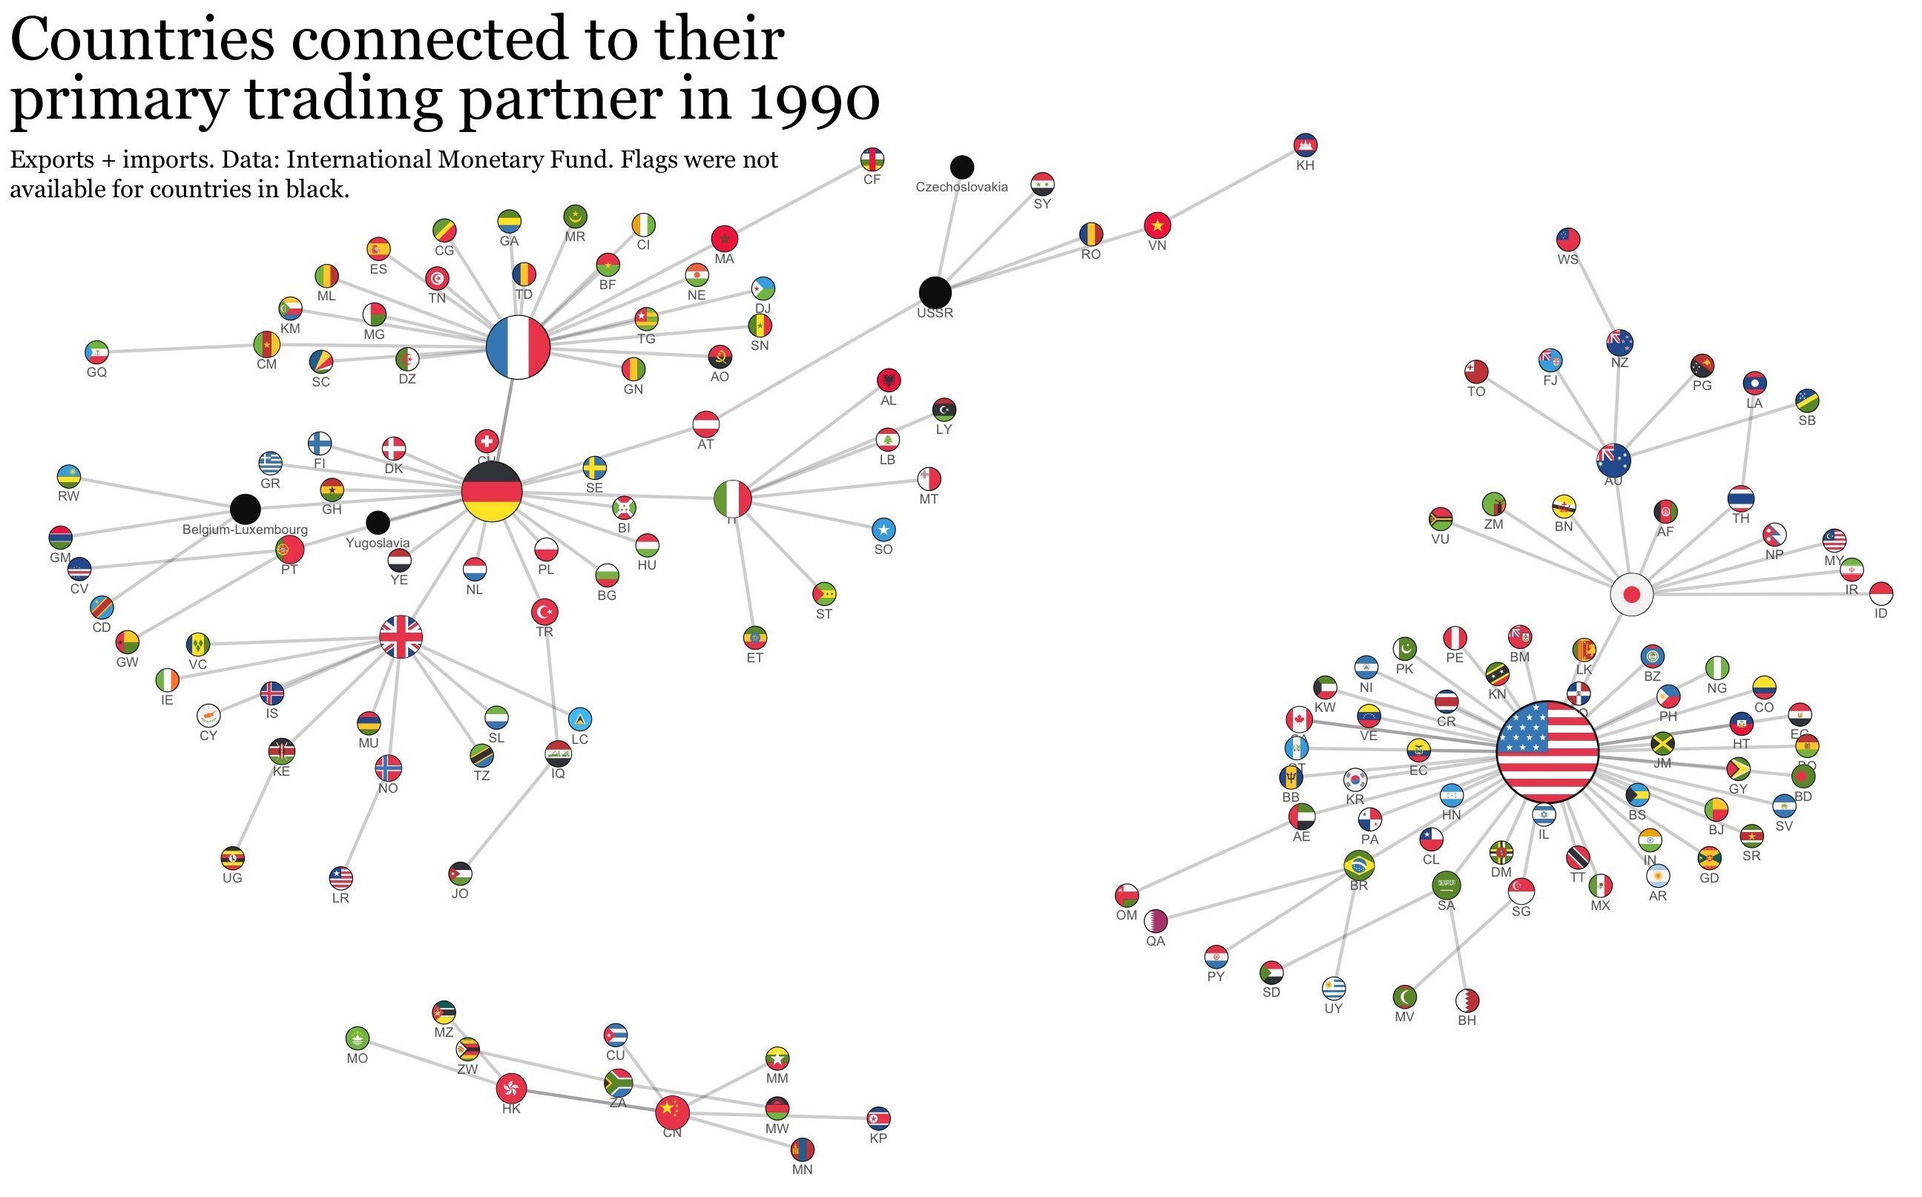
39

Slide 40
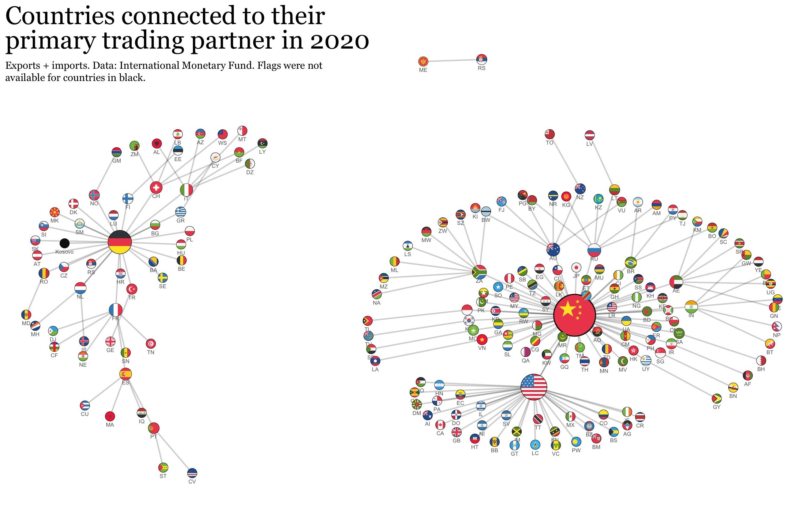
40

Slide 41
A Better Way
Clean Production
Food Availability
Farm Income
New ways of doing things (i.e., technology) can deliver increased productivity (more output per input) that is necessary to meet the need for more food at less environmental cost (sustainability).
Open markets are fundamental to creating the enabling environment for technology development and adoption. (If the fruit of the crop cannot be sold, the technology will not be commercialized or implemented)

