Slide 1


FSIS’ Role in Verifying Truthful Labeling
Labeling and Program Delivery Staff
February 9, 2022
Notes:
Good Afternoon, or Good Morning to those of you on the west coast. The Labeling and Program Delivery Staff at FSIS would like to welcome you all to our generic labeling webinar. My name is Mindy Mallon and I am a staff officer with the labeling and program delivery staff and I will be presenting today’s webinar. (((PAUSE))) In order for all attendees to be able to easily hear the entire webinar we’ve placed all listeners on mute. If you’d like to ask a question you may do so online by submitting your inquiry electronically to the Moderator. At the end of the presentation we will review as many questions as time permits. I would like to address one question that we are ALWAYS asked, and that’s if we will post this webinar online. The answer is yes, the webinar will be posted on the FSIS website within the next couple of weeks. Towards the end of this presentation we will show you where on the website the webinar will be posted once it’s been cleared for posting.

Slide 2

Required Labeling Features - PDP
Required Labeling Features – IP
1. Product name
9 CFR 317.2(e)/381.117(a)
2. Handling Statement (on perishable products)
9 CFR 317.2(k)/381.125(a)
Inspection Legend/Est. number
9 CFR 312.2(b)/381.96 &381.123(b)(2)
Net weight for product sold at retail (except variable net weight products)
9 CFR 317.2(h)/381.121
Name and place of business of the manufacturer, packer or distributor
9 CFR 317.2(g)(2)/381.122
6. Ingredient statement
9 CFR 317.2(c)(2)/381.118
Nutrition labeling (unless an exemption applies) 9 CFR 317.300-400/381.400-500
8. Safe Handling Instructions* (on not ready-to eat products)
9 CFR 317.2(l)/381.125(b)
* May appear on any panel
Notes:
That said, we will now go through the 8 basic required labeling features. The four features listed on this slide must be displayed on the principal display panel.
Product name – there might be a regulatory standard for the product name – such as a “pork sausage” or “ground beef”. For some non-standardized products this will be a descriptive name, such as “Breaded Chicken Breast and Pasta in an Alfredo Sauce”
A Handling Statement is required if the product is perishable, common handling statements are “Keep Refrigerated” or “Keep Frozen”
Third is the Inspection legend and Est number – of course the legend is specific to either meat or poultry, and only one is permitted on retail labels, even if both meat and poultry are in the product.
4. And the fourth feature required on the principal display panel is net weight, which is required on retail labels. It is NOT required for Products shipped to another federal establishment for further processing, or shipped to hotels, restaurants and other institutions . Net weight may be applied at the retail establishment.
The following four features may be located on the information panel OR the principal display panel.
5. Name and address are required – this can be the name and address of the manufacturer, packer or distributor, however if the name and address is not that of the establishment that prepared the product, then the name must be preceded by language such as “packed for” or “distributed by” This is also called the signature line.
6. For Products with more than one ingredient, they must list all ingredients in descending order of predominance, and any multi ingredient items in the product such as cheese, soy sauce, enriched flour, must have all ingredients sublisted on the label. This is called an ingredients statement
7. A Nutrition Facts Panel is required unless an exemption applies, – some common exemptions are the small business exemption based on the volume of product sold and the number of employees at the establishment, and there’s also an exemption for product not intended for retail sale
8. And our 8th required feature is the Safe Handling Instructions, which are required on products that are not ready-to-eat. Safe Handling Instructions are different from and sometimes confused with the Handling statement. SHI are set inside a box or border, with specific regulatory text and they have 4 graphics or icons, you will see an example of this on an upcoming slide. Safe Handing Instructions are required on products that are not ready to eat, while a Handling Statement such as “keep refrigerated” or “keep frozen” is required on those products that are not shelf stable.

Slide 3
Prior Label Approval Overview
Only certain types of labeling requires submission for evaluation by LPDS
  labels for temporary approval (9 CFR 412.1(c)(4))
  labels for products produced under religious exemption (9 CFR 412.1(c)(1))
  labels for products for export with labeling deviations (9 CFR 412.1(c)(2))
  labels with special statements and claims (9 CFR 412.1(c)(3))
ALL OTHER labels that do not fit into one of the four categories do not require sketch approval by LPDS
Notes:
Those four categories of labels, which again are described in 9 CFR 412.1, which require LPDS approval, are:
labels for temporary approval
labels for products produced under religious exemption
labels for products for export with labeling deviations
labels with special statements and claims
Now we are going to go through each of the four categories in greater detail as well as provide some examples of labels that fit into each category.

Slide 4
Temporary Label Approval - 9 CFR 412.1(c)(4)
A temporary label approval may be granted for labels with a regulatory deviation that does not pose any potential health, safety or dietary problems to the consumer
Temporary approval not to exceed 180 days
  Plant transfers are granted for up to 60 days
  Additional 60-day extensions may be granted
Granted on a case-by-case basis
Four conditions for temporary approval described in the regulations (9 CFR 412.1(f)(1)) must be met
Notes:
When a label bears a regulatory deficiency, the establishment would typically correct the deficiency by reprinting the label, or by the use of a pressure sensitive sticker to either cover up incorrect information or to add required information. There are instances when using pressure sensitive stickers or reprinting the label is not possible, or the establishment has labels already printed with the deficiency, so in these cases if the establishment wishes to use up these labels which do not meet regulatory requirements, they must request approval from LPDS. Temporary approval may be granted if the deficiency does not pose any potential health, safety or dietary problems to the consumer.
Temporary approval is granted for up to 180 days, although an additional extension may be granted for another 180 days.
Plant transfer is a specific type of temporary approval described in FSIS Directive: 7000.4. A plant transfer is granted for up to 60 days, with a one-time only additional 60-day extension granted under limited circumstances.
All temporary approvals are granted on a case-by-case basis
There are four conditions for temporary approval described in the regulations in 9 CFR 412.1(f)(1)) and all four conditions must be met and addressed in the label application in order for temporary approval to be granted.
The Approval process for temporary labels is unchanged by the generic labeling rule

Slide 5
Temporary Label Approval - Examples
Incorrect legend on label (e.g., poultry legend on a meat label)
Order of predominance of ingredients has changed
Specific multi-ingredient item has changed resulting in incorrect sublisting of some ingredient (e.g., spice mix)
New ingredient has been added to formulation but is not on the label
Address of the establishment has changed
Incomplete product name (e.g., “smoke flavor added” qualifier missing)
Notes:
Here are some examples of situations in which a temporary label approval would be requested, and of course as we have discussed, because temporary approval is being requested, the establishment would be required to send in this request to LPDS for approval.
Read examples

Slide 6
Religious Exemption - 9 CFR 412.1(c)(1)
Religious-exempt product (poultry) does not receive the mark of inspection and, therefore, deviates from the general labeling requirements for meat and poultry products
Poultry processed in accordance with:
  Buddhist religious beliefs (head and feet remain on eviscerated poultry)
  Confucian religious beliefs (poultry is not eviscerated, head and feet intact)
  Islamic (or Halal) religious beliefs (poultry is eviscerated, head-on, with or without the feet intact, in ready-to-cook form)
Notes:
Religious exempt poultry is exempt from certain specific provisions of the Poultry Products Inspection Act and the exemption is necessary for the product to meet religious dietary laws.
Now, Religious-exempt poultry does NOT receive the mark of inspection and, therefore, deviates from the general labeling requirements for poultry products. Labels for religious-exempt poultry have certain labeling requirements in FSIS Directive 6030.1 Revision 1, and therefore these labels must be submitted to LPDS for sketch approval
And to clarify, when we refer to “religious exempt” poultry products, we are talking about poultry products produced in accordance with specific religious dietary laws that DO NOT receive the federal mark of inspection. It’s poultry with head on, or feet on, or viscera intact, for example. This is different from what FSIS refers to as “Ritually-slaughtered meat and poultry products” – which DO receive the mark of inspection.
For more information about Religious exempt poultry please see 9 CFR 381.11 through 381.14 and FSIS Directive 6030.1

Slide 7
Export Labels with Deviations - 9 CFR 412.1(c)(2)
Exports of U.S. meat and poultry products occur under agreements between the U.S. government and foreign governments
Includes ensuring that any changes made to labels on meat and poultry products are allowed per the importing country’s laws (9 CFR 317.7 and 381.128)
Labels deviating from FSIS requirements except for net weight in metric units and foreign language need to be submitted for approval
Notes:
These two specific deviations would NOT be considered a labeling deviation that would require the label to be sketch approved by LPDS, however all other deviations from FSIS labeling regulations WOULD be required to be submitted to LPDS for approval.

Slide 8
Export Labels with Deviations - Examples
Nutrition Facts Panels in formats not permitted on domestic labels
Ingredient statement deviations
Not sublisting of certain standardized foods, e.g., cheeses or enriched flour
No retained water statement
Notes:
Here are some common examples of labeling deviations on Export labels that would require LPDS approval
Read em….

Slide 9
Special Statements and Claims - 9 CFR 412.1(e)
Detailed list of special statements and claims requiring LPDS approval and examples of claims eligible for generic approval is available on FSIS website
List includes commonly used special statements and claims
List will be periodically updated to reflect commonly asked questions regarding special statements and claims
FSIS Compliance Guideline for Label Approval was last updated in July 2020
Notes:
LPDS has a detailed list online on our website which lists special statements and claims requiring LPDS prior approval in the Compliance Guidance for Label Approval published in August 2017.
LPDS is continually updating this list with additional examples of special statements and claims that must be submitted to LPDS for prior approval. LPDS is currently working on an update to that document. There are additional sections in that document for other information about special statements and claims and what is permitted to be done to a label with special statements and claims once the label is initially approved. The link to that document is on the slide here. The last published update to the Compliance Guideline was in July 2020.

Slide 10
Special Statements and Claims - Examples
Natural claims, e.g. “All Natural”, “100% Natural”
Negative Claims, e.g., “no milk,” “no preservatives”
Statements that identify a product as “organic”
Front of Pack (FOP) nutrition statements, e.g., “0 grams trans fat per serving”
Claims of the use of non-genetically engineered ingredients
Claims regarding meat and poultry production practices (e.g., claims regarding the raising of animals such as “no antibiotics administered” or “vegetarian fed”)
Notes:
I’m not going to read all the special statements and claims since these are also listed on the FSIS website – but some that we commonly see and get A LOT of questions about are:
Natural
Front of Pack nutrition statements
Claims of the use of non-genetically engineered ingredients
animal production practices such as no antibiotics administered,
Generally any claim that is undefined in FSIS regulations or the Food Standards and Labeling Policy Book is considered a “special Statement or claim”. (But please do Note that natural and negative claims are an exception, as these claims ARE defined in the policy book but are required to be submitted to LPDS for approval).

Slide 11
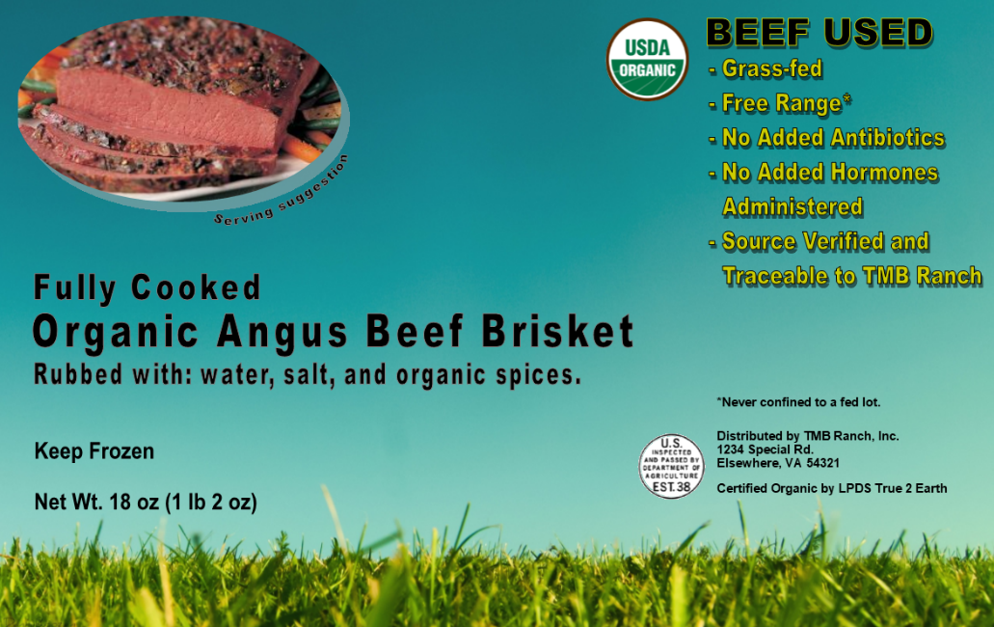

Special Statements and Claims: Sketch Approval Required
Notes:
This label has the following special statements and claims: beef used is grass fed, free range, no added antibiotics, no added hormones administered, source verified and traceable to TMB ranch, USDA Organic symbol. Certified organic by LPDS True 2 Earth and has the breed claim- Angus. Any one of those claims alone would require submission to LPDS with support for the claim following the information provided in the Labeling Guideline on Documentation Needed to Substantiate Animal Raising Claims for Label Submissions last updated in December 2019. This label is not eligible for generic approval.

Slide 12
Regulatory Considerations for New Claims
Claims must be truthful and not misleading (9 CFR 317.8 and 381.129)
Establishments should:
  Reach out to LPDS through askFSIS to confirm the acceptability of proposed language for a new claim before submission.
  Explain the meaning and intent of the new claim
  If applicable, provide documentation to support that the new claim is truthful and not misleading
Notes:
By our regulations, all claims are required to be truthful and not misleading, If you are considering putting a claim on your label that is new and novel, reach out to LPDS prior to label submission. This can be done via ASKFSIS to confirm that the proposed claim would be acceptable per the regulations and allow for a discussion about the proposed new claim. It will also allow for the ability to determine what type of supporting documentation would be needed for the new claim and what would be required once the label is submitted for approval. This allows for smoother approval process when the label is submitted for approval.

Slide 13
Factual Statements and Claims: Generic Approval Permitted
Some statements do not require submitting for approval and are approved generically under 9 CFR 412.2(b)
Examples include:
  Allergen or contains statements “contains: (name of ingredient)”
  AMS Grading (USDA Prime, Choice, Select)
  Flavor profiles (e.g., teriyaki flavored)
  Foreign language on domestic products
  Geographic claims (refer to 9 CFR 317.8(b)(1))

Slide 14
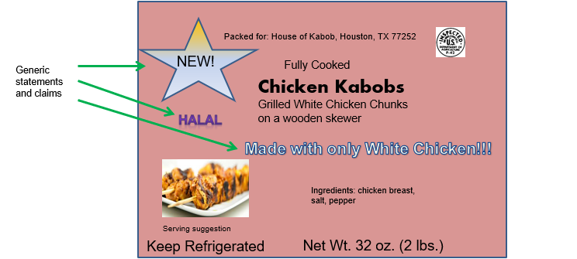
Statements and Claims: Generic Example

Slide 15
Points of Clarification
FSIS Inspectors do not generically approve labels
FSIS in-plant inspection personnel will continue to conduct in-plant label verification activities
Labels will be generically approved if they meet the criteria listed in 9 CFR 412.2(b)
Establishments do not generically approve labels Generically approved labels are approved by FSIS and display all applicable mandatory features in compliance with federal regulations

Slide 16
Compliance Guideline for Label Approval
FSIS Compliance Guideline for Label Approval available on FSIS website. Compliance Guide for Label Approval includes information and examples about:
  Appendix 1: Special statements and claims
  Appendix 2: Factual statements and claims that can be generically approved
  Appendix 3: Changes to labels approved with special statements and claims without additional FSIS review
  Appendix 4: Changes to labels approved with special statements and claims that require FSIS review
  Appendix 5: Blanket approvals (product lines or multiple products with identical claims)
  Appendix 6: Special statements and claims that FSIS only needs to review for only one label

Slide 17
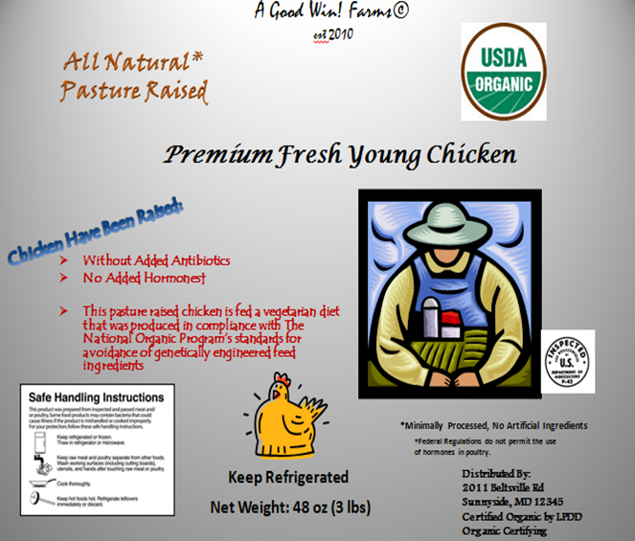
Animal Production Raising Claims
On October 5, 2016, FSIS announced the availability of and requested comments on its Labeling Guideline on Documentation Needed to Substantiate Animal Raising Claims for Label Submission
FSIS published the guideline to assist establishments in preparing their label approval application and to facilitate LPDS’s review of these labels; we received over 4,600 comments. Separately, we received three related petitions from animal welfare organizations
FSIS published a Federal Register Notice and the guideline in final form on December 27, 2019
https://www.fsis.usda.gov/guidelines/2019-0009

Slide 18
Points of Clarification on Guidance
Raised Without Hormones (No Hormones Administered or No Steroids Administered): Updated information to clarify that a qualifying statement is no longer required on pork products labeled as having been raised without hormones because Federal law permits the use of certain hormones in swine, e.g., for gestation
“100% grass-fed” claims are not permitted for animals raised on feedlots; animals can only be fed grass or forage, with the exception of milk consumed before weaning. When less than 100% percent access to grass/forage, claim must accurately reflect circumstances, e.g., “Made from cows fed 85% grass and 15% corn
FSIS has updated the guideline to clarify why qualifying information is necessary on certain products and to emphasize that this information must be prominently- and conspicuously-displayed on the label for FSIS to approve the claim

Slide 19
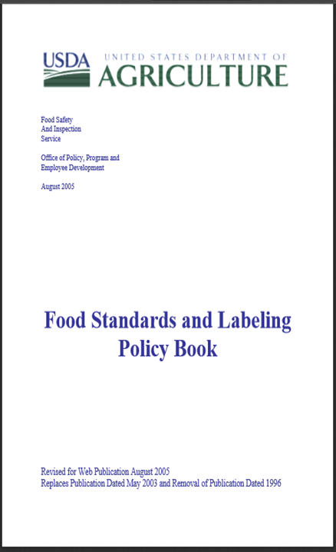
Food Standards and Labeling Policy Book
FSIS has decided to stop adding policy guidance to the Food Standards and Labeling Policy Book
FSIS will continue to amend or remove existing items in the book, as necessary, but it will no longer add new material to it
The Agency will convey new labeling policy by other means, such as compliance guidelines
https://www.fsis.usda.gov/wps/wcm/connect/7c48be3e-e516-4ccf-a2d5-b95a128f04ae/Labeling-Policy-Book.pdf?MOD=AJPERES

Slide 20
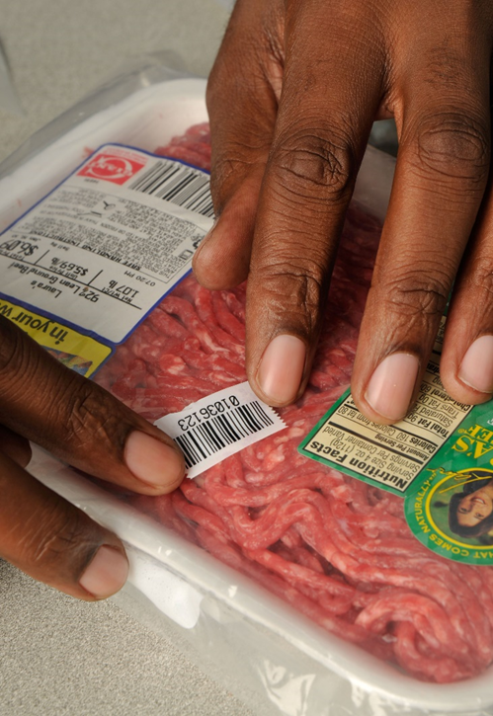
New Labeling Focus on Claims Verification
December 2010 Final Rule, “Nutrition Labeling of Single-Ingredient Products and Ground or Chopped Meat and Poultry Products” (75 FR 82148) (Effective March 2012)
  FSIS to collect samples of raw ground beef products for nutrient analysis in order to verify compliance with nutrition labeling requirements
  Project goal: Surveillance sampling to identify if certain nutrient content information on labels is accurate or if further testing and enforcement by FSIS is warranted
  Criteria for sample selection:
    Must be in consumer ready packaging with nutrition facts panel

Slide 21
New Labeling Focus on Claims Verification
In FY2018, FSIS expanded its exploratory sampling program to include verification of labeling claims for:
  Raw, ground beef products with negative/no hormone claims
  Raw chicken parts with negative/no antibiotics claims
  Ready-to-eat products with negative/no soy claims
Sampling programs have continued since FY2018
  https://www.fsis.usda.gov/sites/default/files/media_file/2021-04/15-21.pdf
Purpose of the sampling: To verify industry’s compliance with the Agency’s labeling regulations and policies to ensure such claims are truthful and not misleading and to protect consumers from misbranded and economically adulterated meat and poultry products

Slide 22
Labeling of Products Made Using
Animal Cell Culture Food Technology
Animal cell culture food technology refers to the controlled growth of animal cells from livestock, poultry, fish, or other animals, their subsequent differentiation into various cell types, and their collection and processing into food
Notes:
FSIS is working to develop labeling requirements for meat and poultry products made using animal cell culture technology.
Animal cell culture technology is a novel process that can be used to make human foods. First, cells are collected from a live animal, screened, and stored in a “cell bank” for later use. Later, some of the stored cells are retrieved and placed in controlled environmental with nutritional other factors necessary to promote cell multiplication. Next, additional factors are introduced into the controlled environment to encourage the differentiation of the cells into, for example, fats or proteins. This biological material is then harvested and used to make human food products and may be packaged and labeled much like conventional products. Products made using this technology and derived from cell lines of livestock or poultry fall under FSIS jurisdiction. All other types of products, including seafood and animal food products, fall exclusively under the jurisdiction of our partners at the U.S. Food and Drug Administration.

Slide 23
Labeling of Products Made Using
Animal Cell Culture Food Technology
FSIS will preapprove all labeling of human food products derived from the cultured cells of livestock and poultry, including labeling claims
FSIS inspectors will verify labeling accuracy during inspection
FSIS intends to use a public process to develop regulatory requirements to ensure the truthful labeling of food products derived from the cultured cells of livestock and poultry
FSIS is working with FDA to develop joint principles for the labeling of cell-cultured food products under their respective jurisdictions
FSIS Roles and Responsibilities
Notes:
As with conventional products, FSIS will require that the labeling of human food products derived from the cultured cells of livestock and poultry be preapproved and then verified through inspection, as required by existing FSIS regulations. FSIS also intends to develop additional regulations to ensure the accurate labeling of human food products derived from the cultured cells of livestock and poultry subject to the FMIA and PPIA. FSIS is committed to ensure that a public process, allowing for stakeholder comments, is used in the development of such regulations.
Moreover, to prevent consumer confusion and ensure transparency, FSIA and FDA are actively working together to develop joint principles for the labeling of products that fall under their respective jurisdictions.

Slide 24
FDA Request for Information
FSIS Advance Notice of Propose
Rulemaking
Published October 7, 2020
Published September 3, 2021.
Solicited comments on the labeling of FDA-regulated seafood products.
Solicit comments to inform the development of regulatory requirements for the labeling of cultured meat and poultry products
Comment period is closed.
Comment period closed.
Labeling of Foods Comprised of or Containing Cultured Seafood Cells; Request for Information; 85 FR 63277.
Labeling of Foods Comprised of or Containing Cultured Animal Cells; Advance Notice of Proposed Rulemaking; 85 FR 49491.
Notes:
In that vein, FSIS recently published an Advance Notice of Proposed Rulemaking, soliciting public comments pertaining to the labeling of cultured meat and poultry. The comment period closed on December 3, 2022, and we’re in the process of analyzing the approximately 1200 comments we received. FDA similarly received several comments on a request for information it recently published pertaining to the labeling of cultured seafood. These comments will help guide FSIS’s future rulemaking in this area as well as FDA’s and FSIS’s efforts to develop joint labeling principles for these products.

Slide 25


Submit a Question to askFSIS
https://www.fsis.usda.gov/wps/portal/fsis/topics/regulatory-compliance/svsp/askfsis-form
Call:
Main: 301.504.0878
Distribution Unit: 301.504.0883
Labeling Procedures
https://www.fsis.usda.gov/policy/fsis-guidelines
Questions are sent to a main portal, triaged, and assigned to the correct expert based on subject matter.
fsis.usda.gov

