Slide 1
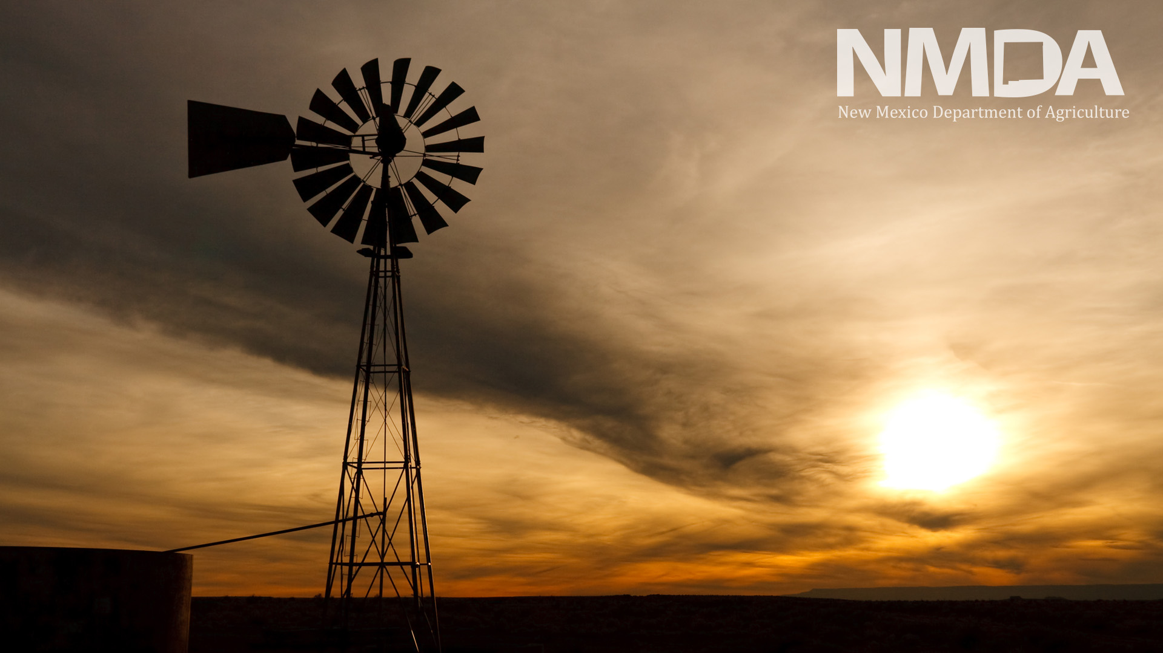
Goliath, Little Bear, and Uri
It’s not the plan, but the planning that matters!
Jeff Witte
Secretary – New Mexico Department of Agriculture
2022 Agriculture Outlook Forum

Slide 2


Southwest climate hub
The Southwest Climate Hub serves Arizona, California, Hawaii, Nevada, New Mexico, Utah and the US Affiliated Pacific Islands.
The Climate Hubs are science-driven, stakeholder-centered, efficient, cooperative partnerships with federal, state and local organizations.
The Climate Hubs work to help increase knowledge and preparedness in the face of climate-related disruptions that can affect supply chains, including drought, extreme heat and hurricanes.
NEW MEXICO DEPARTMENT OF AGRICULTURE

Slide 3
Factors Affecting Supply Chains
Labor
Land
Capital
Entrepreneurship
Weather
Markets
Regulations
Pests/Disease
Climate
Changes in natural disaster frequency and intensity:
  Winter Storm
  Flood
  Tornado
  Hurricane
  Earthquake
  Wildfire
  Drought
NEW MEXICO DEPARTMENT OF AGRICULTURE

Slide 4
Parts of the Supply Chain
Supply
Strategy
Source
Manufacturing
Logistics
Return
Each can be impacted by a disaster:
The plan or strategy
The source (of raw materials or services)
Manufacturing (focused on productivity and efficiency)
Delivery and logistics
The return system (for defective or unwanted products)
NEW MEXICO DEPARTMENT OF AGRICULTURE

Slide 5
Natural Disaster Impact
According to the Federal Emergency Management Agency:
  58 Presidential Disaster Declarations were made in 2021.
  104 Presidential Disaster Declarations were made in 2020.
The American Farm Bureau estimates 2020 natural disasters created $6.5 billion in crop losses alone.
Agricultural impacts from natural events and disasters most commonly include:
contamination of water bodies,
loss of harvest or livestock,
increased susceptibility to disease, and
destruction of irrigation systems and other agricultural infrastructure.
NEW MEXICO DEPARTMENT OF AGRICULTURE
Notes:
https://www.securitymagazine.com/articles/95670-agriculture-companies-and-farmers-faced-at-least-36-billion-in-uncovered-losses-in-2020-due-to-natural-disasters

Slide 6
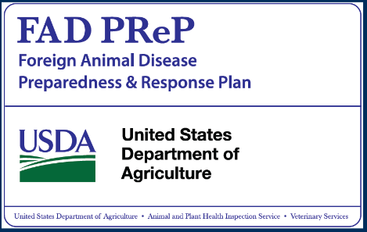
Animal Disease Impacts
Some studies estimate that the direct economic impacts of a FMD outbreak could reach $188 billion, with government disease control and management costs of $11 billion.
It was also estimated that a high-capacity emergency vaccination program could reduce consumer and producer losses to $56 billion, while holding government costs to $1 billion.
NEW MEXICO DEPARTMENT OF AGRICULTURE
Notes:
https://econpapers.repec.org/article/cupjagaec/v_3a47_3ay_3a2015_3ai_3a01_3ap_3a47-76_5f00.htm
(Schroeder, Pendell, Sanderson, & McReynolds, 2015).

Slide 7
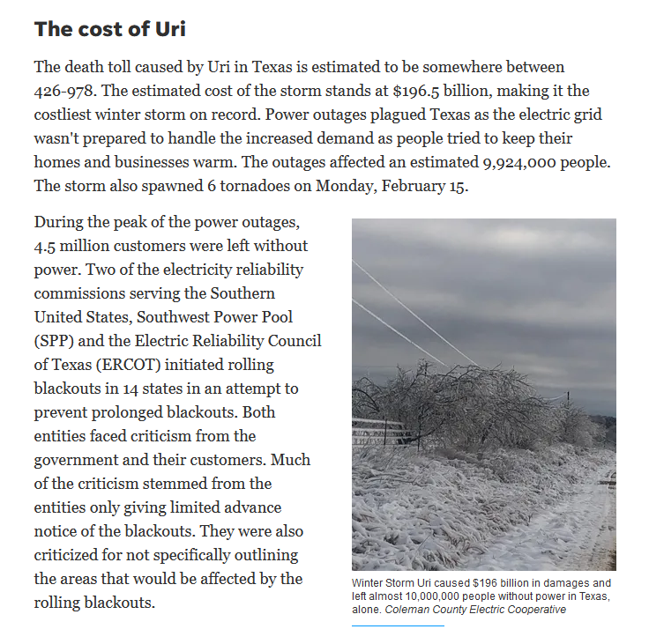
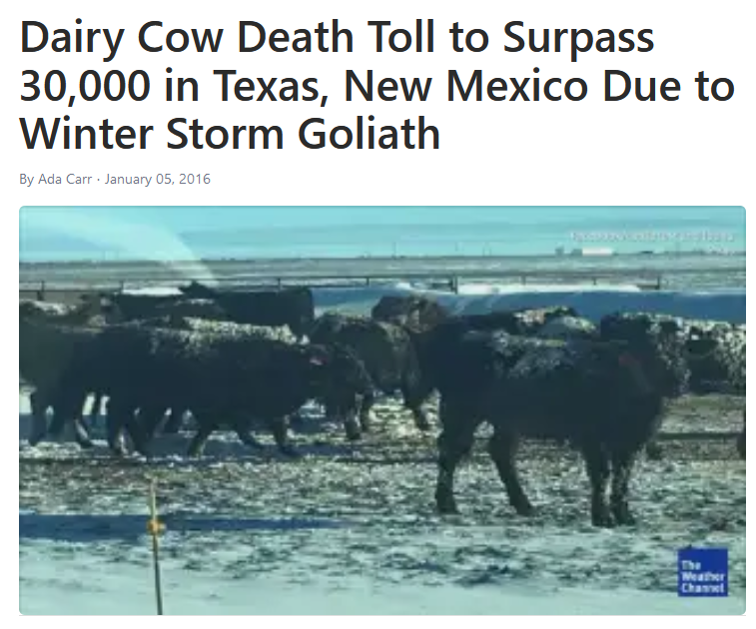
Preparedness is a state of mind
NEW MEXICO DEPARTMENT OF AGRICULTURE
Notes:
Millions of farm animals culled as US food supply chain chokes up
https://www.theguardian.com/environment/2020/apr/29/millions-of-farm-animals-culled-as-us-food-supply-chain-chokes-up-coronavirus
Dairy Cow Death Toll to Surpass 30,000 in Texas, New Mexico Due to Winter Storm Goliath - https://weather.com/news/news/dairy-cows-winter-storm-goliath-texas-new-Mexico
The storm resulted in the need to dispose of over 11,913 dairy animal mortalities and 511 other livestock mortalities in four New Mexico counties.
FMD - https://www.nao.org.uk/press-releases/the-2001-outbreak-of-foot-and-mouth-disease-2/
2001 FMD outbreak in the United Kingdom
Resulted in the depopulation of over 6 million animals
Cost the public sector over £3 billion and the private sector more than £5 billion.
Showed the need for more robust contingency planning in consultation with all stakeholders
Converts to a little over 9 million dollars in today’s exchange rate

Slide 8
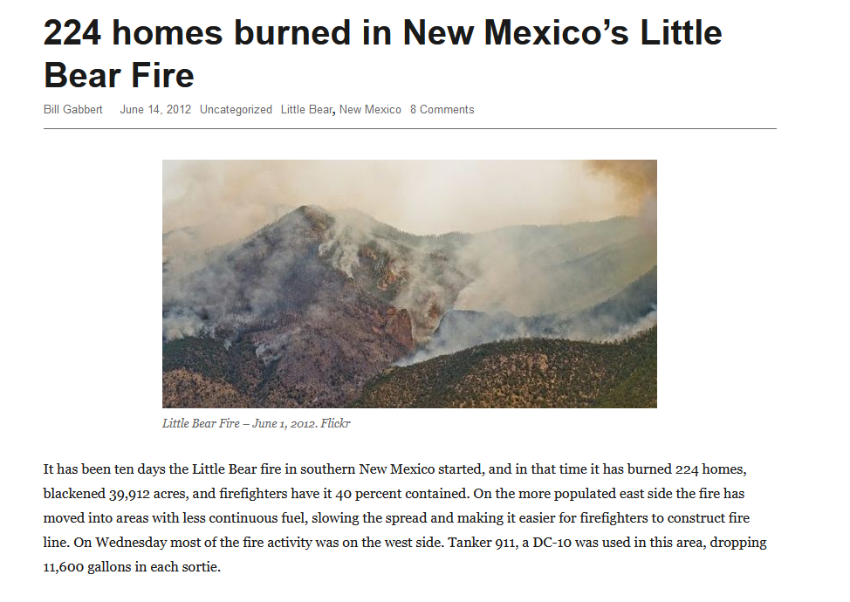
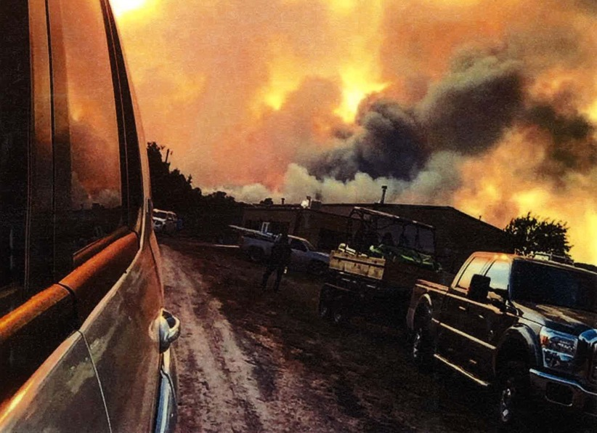
Preparedness is a state of mind
NEW MEXICO DEPARTMENT OF AGRICULTURE
Notes:
https://wildfiretoday.com/tag/little-bear/

Slide 9
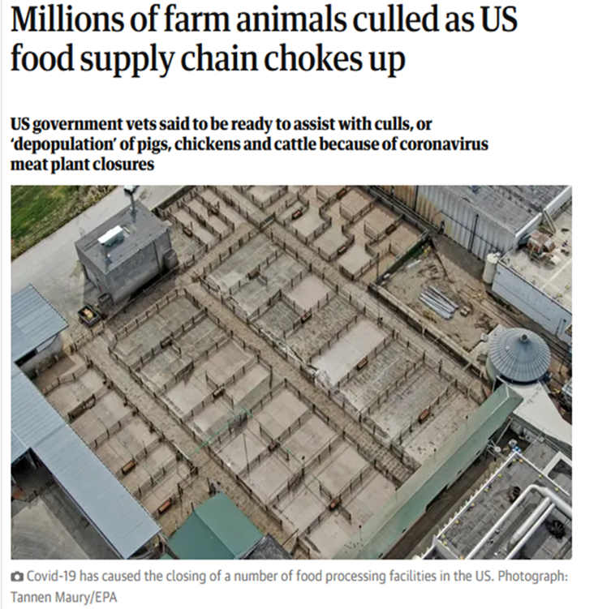
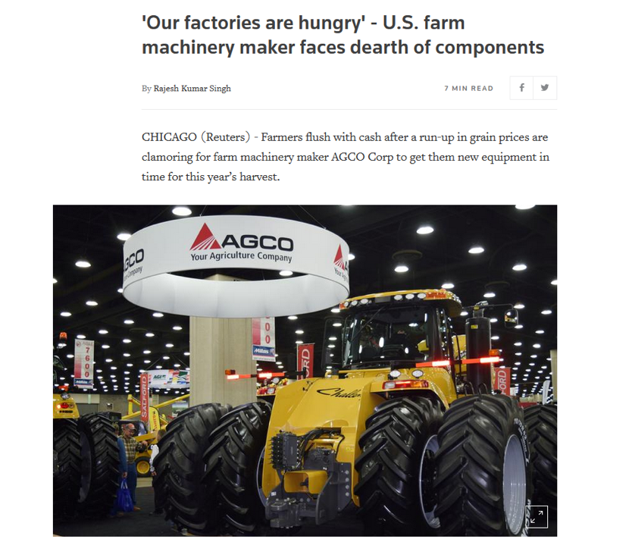
Preparedness is a state of mind
NEW MEXICO DEPARTMENT OF AGRICULTURE
Notes:
Millions of farm animals culled as US food supply chain chokes up
https://www.theguardian.com/environment/2020/apr/29/millions-of-farm-animals-culled-as-us-food-supply-chain-chokes-up-coronavirus
Our factories are hungry
https://www.reuters.com/article/us-agco-supplychain-idUSKBN2C6170

Slide 10
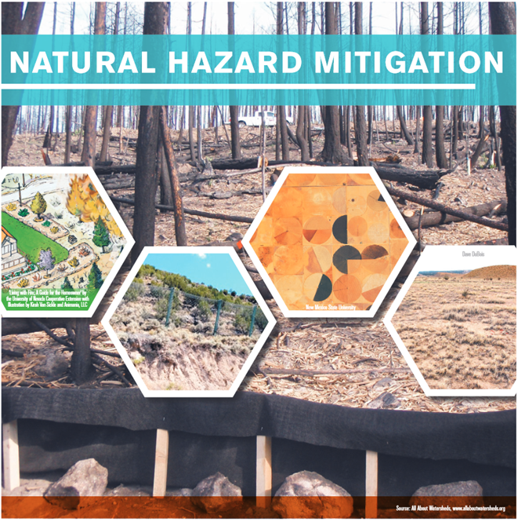
Plan: All-Hazards
All-Hazards Approach: Not the Kitchen Sink
All-hazards planning does not specifically address every possible
threat but ensures the capacity to
address a broad range of related emergencies.
The people involved in the planning process matter just as much as the plan itself.
Exercise the plan!
NEW MEXICO DEPARTMENT OF AGRICULTURE

Slide 11
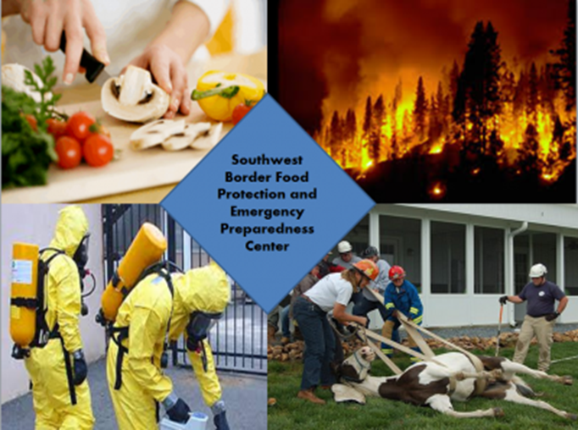
Respond
Know who to contact.
Those who have trained and exercised together tend to be better prepared for handling an emergency situation.
Recovery begins the moment a response is initiated.
NEW MEXICO DEPARTMENT OF AGRICULTURE

Slide 12

Jeff Witte: Secretary – New Mexico Department of Agriculture
2022 Agriculture Outlook Forum
NEW MEXICO DEPARTMENT OF AGRICULTURE

