Slide 1
USDA Agricultural Marketing Service (AMS)
National Organic Program (NOP)
Growing Organic through Transition, Standards Development, Oversight, and Enforcement
Presented by
Jennifer Tucker, Ph.D.
February 2022

Slide 2
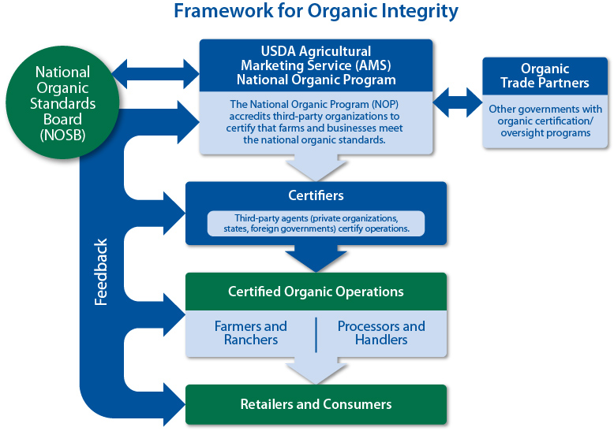
The Public-Private Partnership of Organic Certification and Oversight

Slide 3
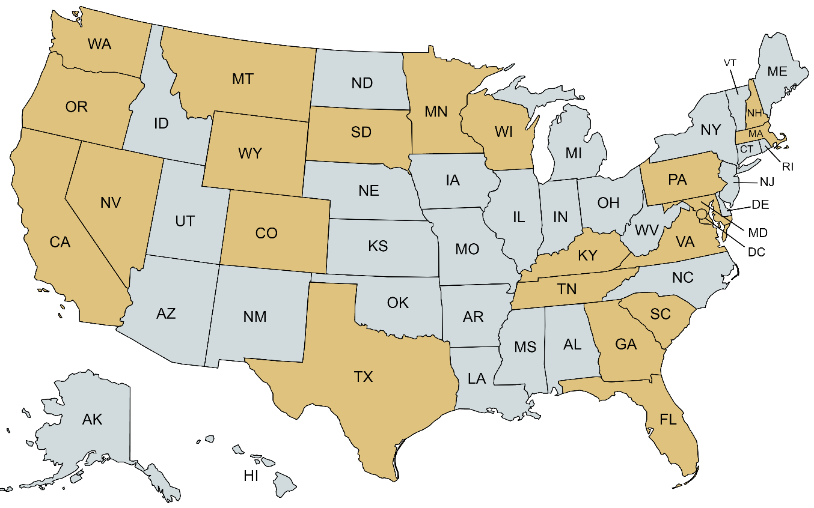












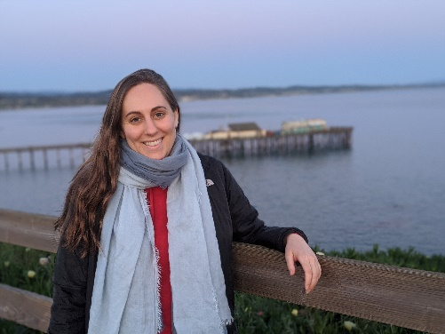
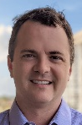


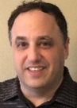



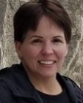




























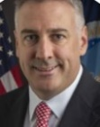





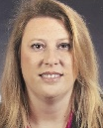
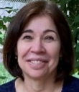


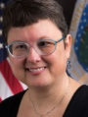
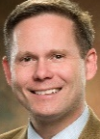








Hello from the NOP Team!
Compliance & Enforcement Team
Standards Team
Accreditation Team
Trade Systems Team
International Team
Office of the Deputy Administrator Team
Notes:
Last updated for ACA Training, January 2022

Slide 4
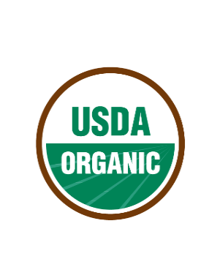
National Organic Program Goals
1
Strong Organic Control Systems | Trusted People, Processes, and Rules
Robust Enforcement | Consistent and Fair Market for All
Develop Standards | Open, Transparent, Collaborative Processes
Engage Partners and Stakeholders | Advance Initiatives & Clarify Requirements
2
3
4

Slide 5
Global Organic Control Systems and Oversight
Standards
Accreditation
Certification
Enforcement
Supported by Education and Outreach for Existing and Candidate Organic Farms and Businesses

Slide 6
NOP Standards: A Public Resource
Organic Foods Production Act (OFPA)
USDA Organic Regulations
NOP Handbook
https://www.ams.usda.gov/
rules-regulations/organic

Slide 7
Priorities for Standards
Final Rule: Strengthening Organic Enforcement
Final Rule: Origin of Livestock
National List Rules (Including Inerts Project)
Collaborate with National Organic Standards Board
Organic Livestock and Poultry Standards

Slide 8
Accredited Certifiers: A Critical Role
Complaint Investigations
Noncompliances, Suspensions, Revocations
Mediation and Settlement Agreements
Annual and Unannounced Inspections
Residue Testing
Organic System Plan Reviews, Certification

Slide 9
Oversight, Compliance and Enforcement
Scale
Broad-Based,
Industry-Country Level
Certifier Level
Operation Level
Training Programs Webinars and Fact Sheets Enforcement Updates New Rules and Policy (Standards) | Region-Country-Commodity Activities Trade Arrangement Oversight
Regional Directives Surveillance Activities Company-Specific Alerts (Letters) | Certifier Non-Compliances, Settlements, Suspensions Operation Level Non-Compliances, Settlements, Suspensions/Revocations Civil Penalties/Prison
Evidence
Information
Capability Development Enforcement Goal

Slide 10
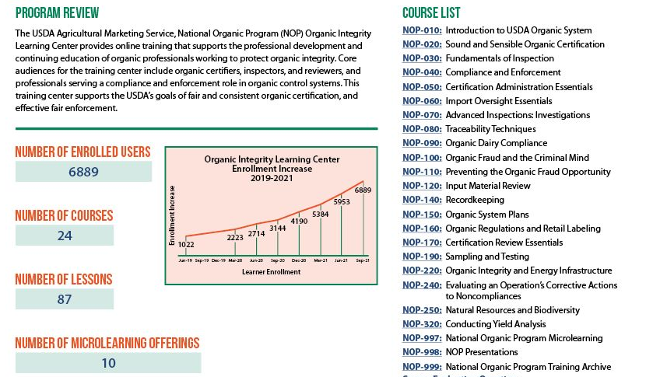
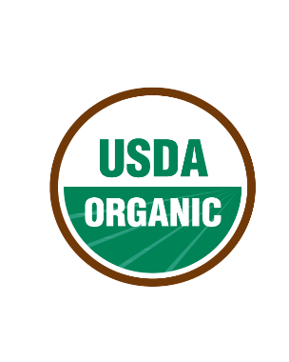
Organic Integrity
Learning Center

Slide 11
Human Capital Capacity Building Projects
Nine projects to improve the long-term capacity of the organic industry.
Goal: Support and expand the pool of qualified inspectors, reviewers, and other professionals who oversee organic production.
The funded projects provide support across the human capital pipeline.
Together, we are building
tools to strengthen today’s organic inspectors, and to develop the next generation of diverse,
well-qualified organic professionals.

Slide 12
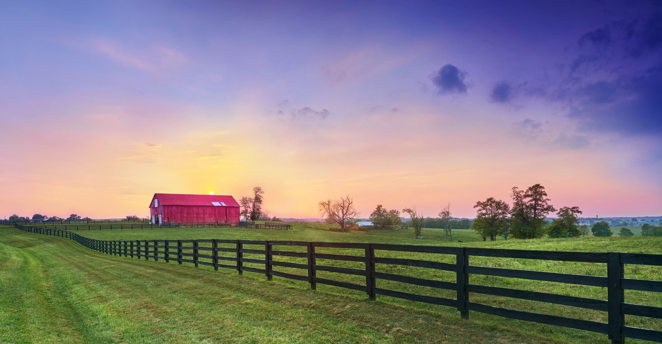
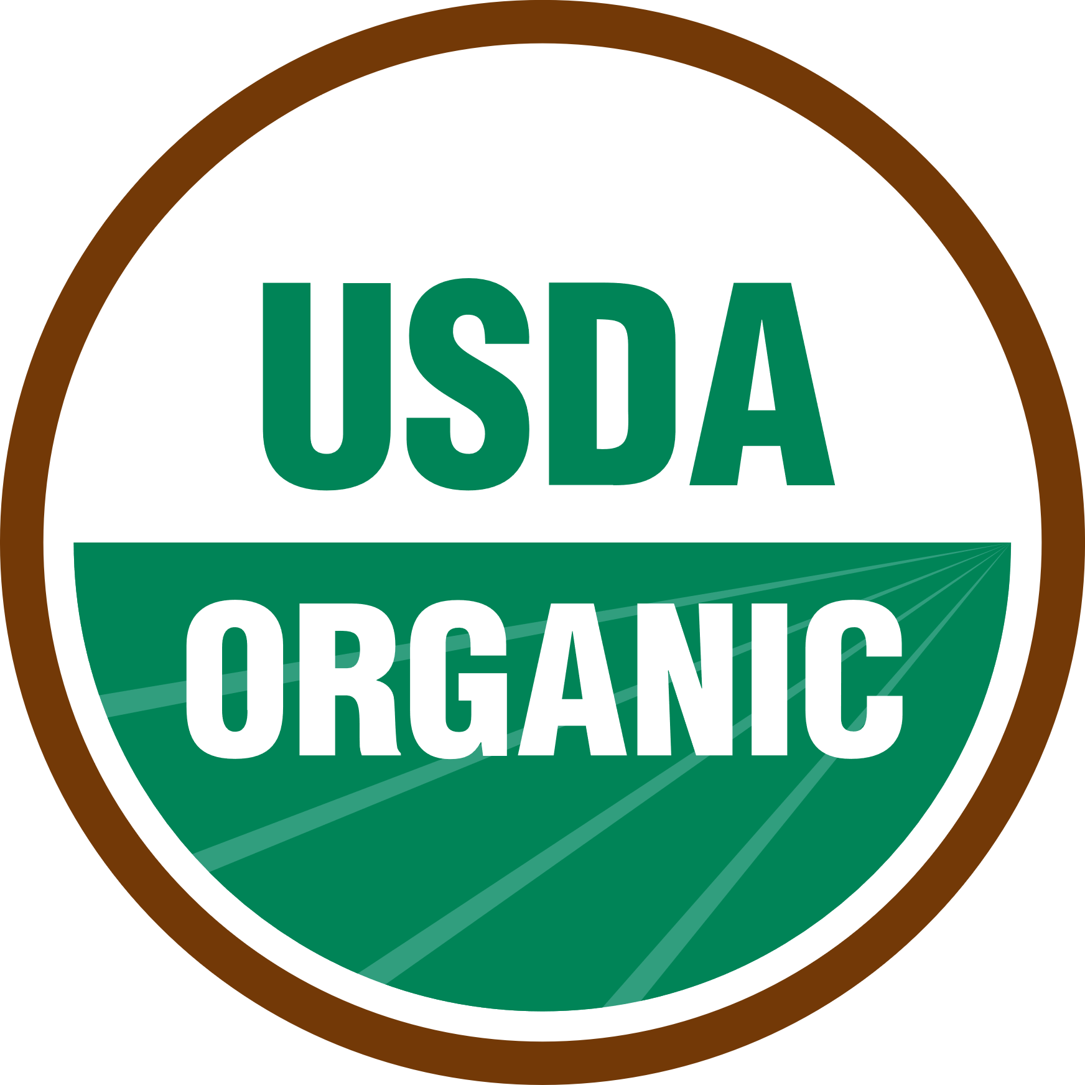
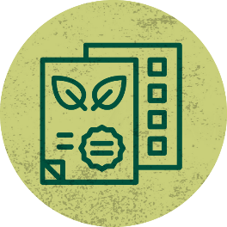




How does USDA support organic farms & businesses?
USDA helps farmers with organic certification guidance, biodiversity and natural resource conservation, financial and production assistance and marketing. Whether you’re already certified organic, considering transitioning, or working with organic producers, we have resources for you.
Visit: www.usda.gov/organic
Certification
+ Oversight
Transitioning to Organic: NOP
Get Certified: NOP
Organic Certification Cost Share Assistance: FSA
Find an Organic Operation/Ingredient: NOP
Learn About USDA Organic: NOP
Conservation Resources
Conservation for Soil Health, Pest and Weed Management, and Pollinators: NRCS
Conservation Management and Practice Assistance: NRCS
Conservation Reserve Program: FSA
Climate Resources: USDA
Data +
Research
Statistical Surveys and Data: NASS
Commodity-Specific Production and Price Data: AMS Market News
Research to Advance Organic Farming: USDA
Trade and Export Data Analysis: FAS
Farming
Resources
Farm Loans: FSA
Crop Insurance: RMA
Business Loans and Grants for Rural Communities: RD
High Tunnels: NRCS
Farmers.gov Online Community: USDA
Market
Promotion
Local Food, Farmers Market, and Market Access Programs: AMS
Local and Regional Food Sector: AMS
Urban, Indoor, and Emerging Ag Grant Programs: NIFA
12
Notes:
NOP is just one of many programs at USDA that provide support for organic farms and businesses. Here’s a snapshot of other programs that research, fund, or promote organic.

