Slide 1


Using economics to design better incentives for soil‐health policy
Joshua M. Duke
Department Head and Professor
Agricultural Economics and Rural Sociology
Auburn University
February 25, 2022
*All of Duke’s research herein was completed with various collaborators, who are acknowledged on each slide with a publication, including: Robert Johnston, Amy Shober, Josh McGrath, Lori Lynch, Zhongyuan Liu, Hongxing Liu, Kent Messer, Steve Dundas, Tyler Monteith, Nicole Fiorellino, Tongzhe Li.

Slide 2
Many Government Programs on Soil Health Already Have Economic Design Elements
Voluntary and Incentive-Based
Budget Constrained (with Reverse Auctions)
Internalizing Externalities/Corrects a Market Failure
Can we do better?
*Qualification: Some programs have more advanced economic designs than others.

Slide 3
What does “better” mean to an economist?
Recruitment & Education Efforts
Program Rules
Program Budget
Population
of Farmers
Selection Process
From Pool of Applicants
Improving cost effectiveness
Getting more for the same budget
Off-farm benefits lead to the following framing:
Governments procure services from farmers
How can governments procure off-farm benefits cost effectively?
Pursue BMP
without Cost-Share
Cost-Share Awarded
True Change
Monitorable
Change
Change in Off-Farm
Benefits
Change in On-Farm
Soil Health &
Farm Profitability
Future Farmer
Behavioral Change

Slide 4
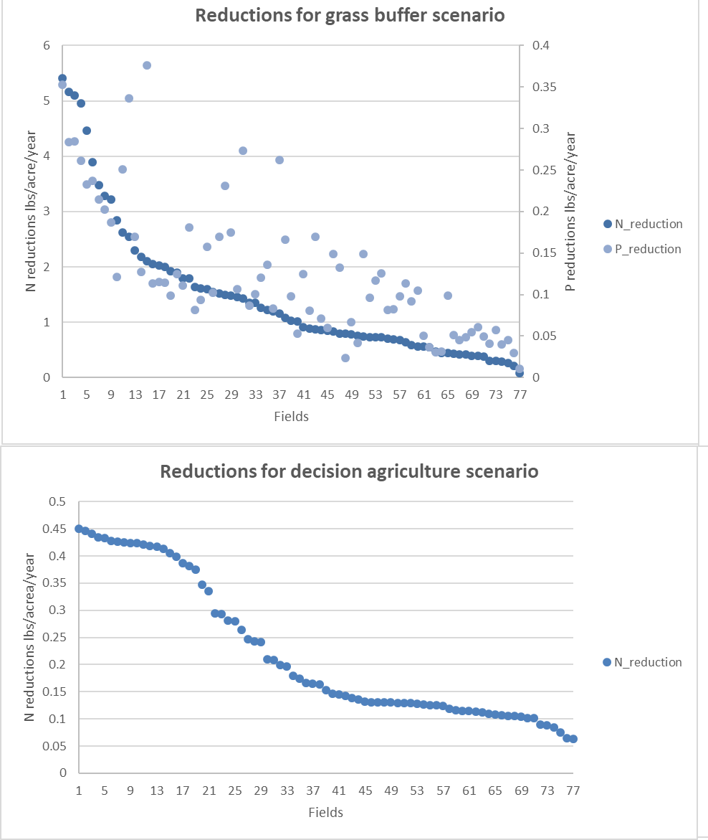
Benefit heterogeneity: More extensive than you might think
Predicted Net Benefit Range of Grass Buffer
More heterogeneity lets market-based solutions outperform regulatory solutions
Figures show modeled heterogeneity
  Field-level N and P reductions in Eastern Shore Maryland
  BMP off-farm productivity varies tremendously within and between BMPs
Qualification: the setting is water quality trading and not cost-share
Predicted Net Benefit Range Decision Agriculture
Source: Duke, Liu, Monteith, McGrath, Fiorellino. 2020. A method for predicting participation in a performance-
based water quality trading program. Ecological Economics 177:106762.

Slide 5
Topic: Lower Payments, Targeting, and Contract Flexibility
Q: Can programs be made more attractive to some farmers?
  A: Yes, by taking advantage of information on heterogeneity
Q: If the programs are more attractive, can we lower the required participation incentive?
  A: Yes, and this allows for more participation from the same budget

Slide 6
Tailoring programs to farmer needs in different regions
Some heterogeneity between regions can be picked up through surveys
Offering region-specific education ought to lead to lower concerns about cover crops when compared to national-level education
Farmers’ reported barriers to cover crop adoption from Northwest Ohio and Maryland
Duke, Joshua M., Robert J. Johnston, Amy L. Shober, and Zhongyuan Liu. 2022. Barriers to cover crop adoption: Evidence from parallel surveys in Maryland and Ohio.
Forthcoming in May issue at Journal of Soil and Water Conservation

Slide 7
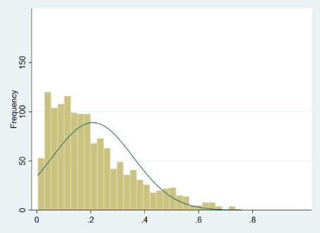
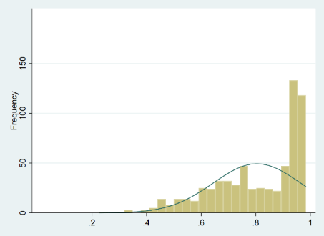
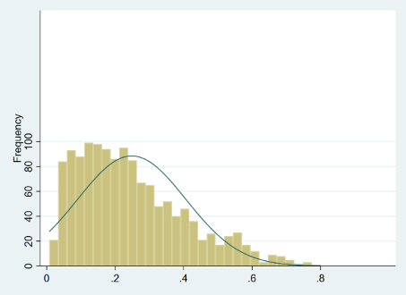
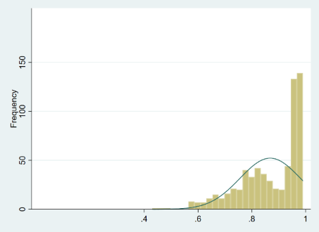
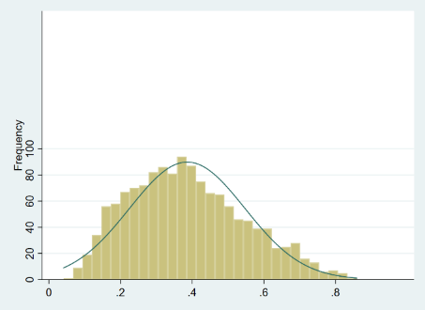
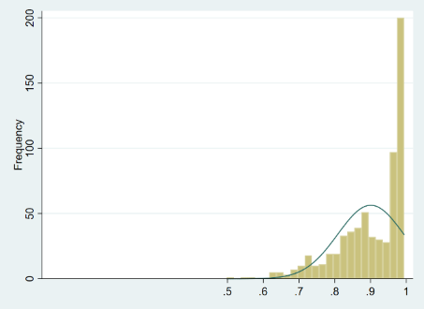
Recognize farmers’ portfolio approach
Prob (CC)
Soil health programs are organized around their sponsoring governmental units
However, farmers look across many programs when optimizing participation
Farmers ought to see economies of scale in participating
  The marginal cost of the second signup ought to be lower than the first signup
This means that analysis of participation of any one program might overestimate the costs needed to attract a participant
Prob (CC|CRP)
Ohio
Predictions
Maryland
Predictions
Prob (CC|CRP,
Commodity, Other)
Duke, Johnston, Shober, and Liu. 2022. Improving targeting of farmers for enrollment in Agri-Environmental Programs. Forthcoming at Applied Economic Perspectives & Policy.

Slide 8
Flexible contract design
Eg 1: Planting cover crops 2 weeks early
MD already offers bonuses ($5-$20)
Our data show that on average, MD farmers do indeed require roughly $17
However, the heterogeneity is so large that some farmers might need much more than $17 to enroll and others might need far less or even $0
The flat incentive thus overpays some and completely misses others
Economic point: Accommodate heterogeneity
More options for farmers
Some options won’t produce the highest off-farm benefit
But these options may be cheaper
Our data show that farmers think about contracts in complex and sophisticated ways
Eg2: MD offers 1-year contracts
On average, this option was roughly $17 worse than a more flexible option we invented—a 5-year contract where the farmer must plant only for 2 years
However, the estimates of heterogeneity were extreme
  Some farmers would accept far less for a 1-year contract and the 2 of 5 option was also available
  Others would need far more incentive
Heterogeneity in preferences for contract length roughly 3X greater than heterogeneity for early planting
*All values are per acre
Preliminary results (not for citation until peer review process completes) from cover crop survey in MD run by Duke, Johnston, and Shober. Preliminary analysis by Mahmood.

Slide 9
Flexible contract design (continued)
Eg4: Targeting on farmer age and experience
Our results show how much more incentive ($) on average that older and more experienced farmers need relative to younger farmers for the exact same contract
Eg3: Contract-required seed types and seeding rates
On average, barley required the same incentive as rye
  But wheat was preferred more than twice as much
However, average preferences for each seed type interact with preferences for seeding rates and each of these options has significant heterogeneity
This means that program managers might
  Get higher participation if more options are offered
  Target contracts to specific farmers such that it is so attractive to them, they accept a lower payment
Can non-monetary incentives be used?
Eg5: With free seed, how much lower would the payment be on average (per acre)?
Rye seed on average is worth roughly $50
Radish seed on average is worth roughly $20
However, preference heterogeneity is large. Some might value free seeds while others would never accept them
Eg6: What if farmers could harvest the cover crop in the spring rather than killing it?
On average spring harvest is worth roughly $23 acre
Once again, significant heterogeneity on this
One size does not fit all for contracting—we knew this, but it is even more heterogeneous than existing programs allow
Preliminary results (not for citation until peer review process completes). From survey run by Duke, Johnston, and Shober. Preliminary analysis by Mahmood.

Slide 10
Topic: Refining Program Eligibility Rules and Auction Design
Q: Can capping years of cost-share increase overall adoption?
  A: Maybe. New evidence suggests “yes” with cover crops
Q: Can reverse auctions be refined to further lower procurement cost?
  A: Yes

Slide 11

Limited Contract Renewability?
Blue: Maryland farmers in MD State CC program
Orange: Ohio farmers in EQIP—CC incentive
Message: For some farmers, limited-term cost share (say, 3-5 years) might be enough for self adoption
More-permanent funding on year-to-year contracts might either create dependence or lessen the incentive to gain experience
How much will cover crop plantings drop
if Cost-Share Ends?
CCEXP in years
Source: Duke, Liu, Johnston, Shober. 2021. Does farmer experience or cost share lead to more sustained adoption of cover crops. Manuscript and AAEA presentation.

Slide 12
What auction design characteristics reduce procurement costs?
There is some research evidence:
Which has the lowest procurement cost?
  Fixed price cost share, Uniform price auctions, Discriminatory price auctions
  Even though UP is incentive-compatible
What happens when respondents participate in the same type of auction year after year?
  Per-unit procurement cost goes up or down
How much information should be provided in a discriminatory price auction?
  None, some, all
  Many experiments with information and participant communication
Will larger budgets increase per-unit procurement costs, all else equal?
  Yes or no
Extensive research literature on auction design from experimental economics
See Schilizzi (2017) for a broad review and more details; also recent work by Boxall and collaborators and Palm-Forster and collaborators. These sources point you to many other works.
Qualification: Most of this research literature assumes cost heterogeneity and benefit homogeneity
Duke, Messer, Lynch, and Li. 2017. The effect of information on discriminatory-price and
uniform-price reverse auction efficiency. Strategic Behavior and the Environment 7:41-71.

Slide 13
Topic: Increase Effectiveness By Using Benefit and Cost Information for Targeting
Q: Should programs procure (select applicant farms) using a least-cost approach?
  A: No, unless the off-farm benefits are homogeneous. Also, additionality should be considered

Slide 14
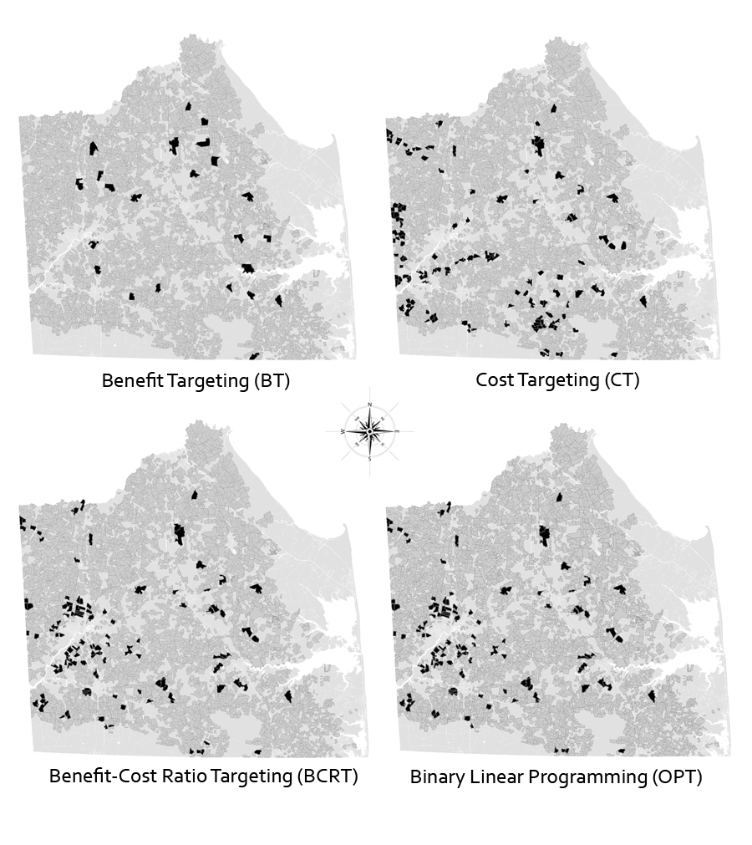
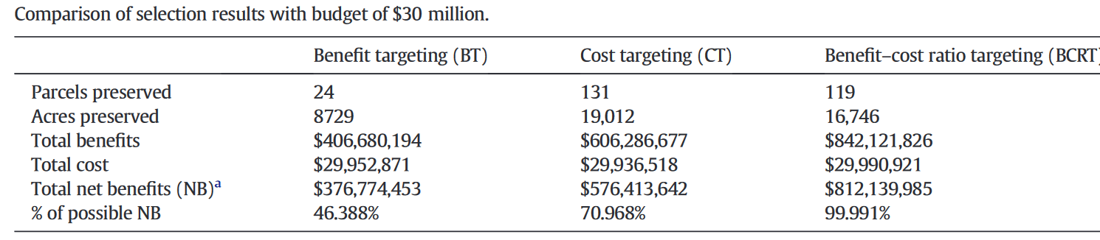
Targeting for off-farm benefits
Selecting Farms for Conservation Easements with Different Targeting Strategies and $30 Million Budget
Source: Duke, Dundas, Johnston, Messer. 2014. Prioritizing payment for environmental services: Using nonmarket benefits and costs for optimal selection. Ecological Economics 105:319-29.

Slide 15
Topic: Many Other Considerations for Cost-Effectiveness
Q: Would a farmer adopt a practice without cost share? Can we sort on this?
  A: Some would and, yes, but it is difficult
  Research: Use mechanism design to create sorting contracts. This means farmers who are most likely to adopt without cost share voluntarily select a low-payment contract and farmers least likely to adopt without cost share select a high-payment contract (Arnold, Duke, Messer 2013)
  These contracts can be designed without knowing an individual farmer’s type
Q: Even if nonadditionality exists, is it a big deal?
  A: Maybe not, but mixed evidence
  Research: With cover crops, no, maybe, yes
  See Lichtenberg, Fleming et al., Sawadgo and Plastina, and others
  Yes, under water quality trading (Duke et al.)
Others: Agglomeration economies, transaction costs, off-farm benefits also depend on policy instrument, conservation incentives of renters vs owners, etc.

Slide 16
Conclusion: Economic Results Generalized
This presentation reviews some recent economic research results on improvements to procurement of off-farm benefits using soil health programs
Here are the general types of economic problems and solutions:
Programs should select participants using on-farm cost and off-farm benefit information when possible
Information asymmetry prevents program managers from knowing the true costs for a farmer to adopt a BMP
  This means that it will not be possible to take advantage, fully, of the cost heterogeneity that warrants the use of markets in the first place
  Some farmers may be paid for BMPs that they would adopt without cost-share (nonadditionality)
  There is a related argument for information costs in monitoring the off-farm effectiveness of BMPs
Farmer soil health program decisions are typically more complicated than whether to enroll or not in a single program
If permitted, farmers are likely to adjust their broader land management decisions after enrolling, which often will reduce the anticipated off-farm benefits (leakage)

