Slide 1
Assessing the Risk of Climate Change Using Extreme Event Models
Julia Borman, PhD

Slide 2
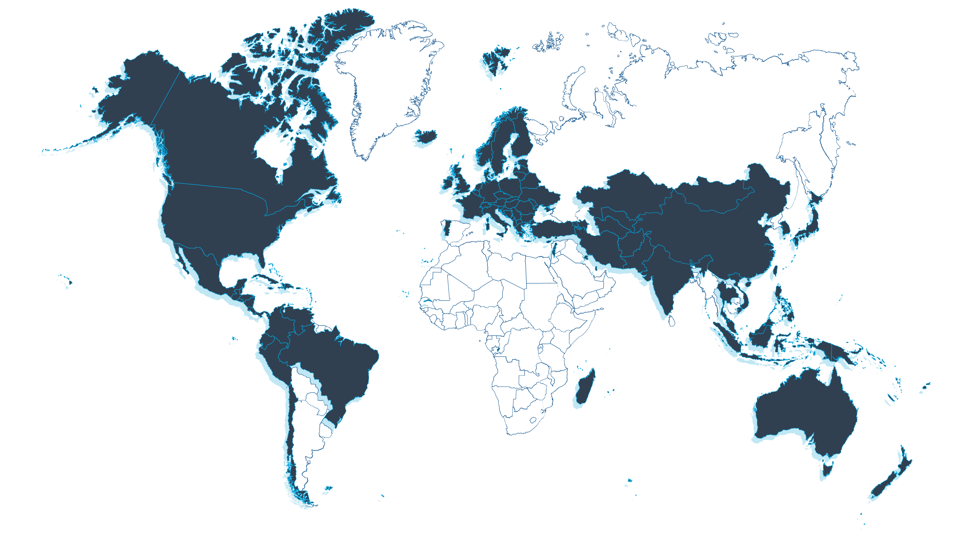













Extreme Event Models in 110+ Countries
AIR Worldwide is now Verisk

Slide 3
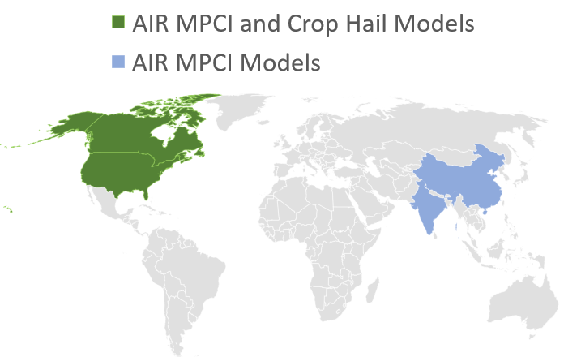
Strong Portfolio of Agricultural Models and Services in Largest Markets
Leading Models
(Touchstone Re™)
  Canada Crop Hail (2017 release)
  Canada MPCI* (2018 release)
  China MPCI** (2020 update)
  India MPCI (2019 release)
  U.S. Crop Hail (2022 update)
  U.S. MPCI (2021 update)
  *MPCI — multiple peril crop insurance
  **China model Includes MPCI, forest, and livestock
Consulting Service
  U.S. MPCI fund designation

Slide 4
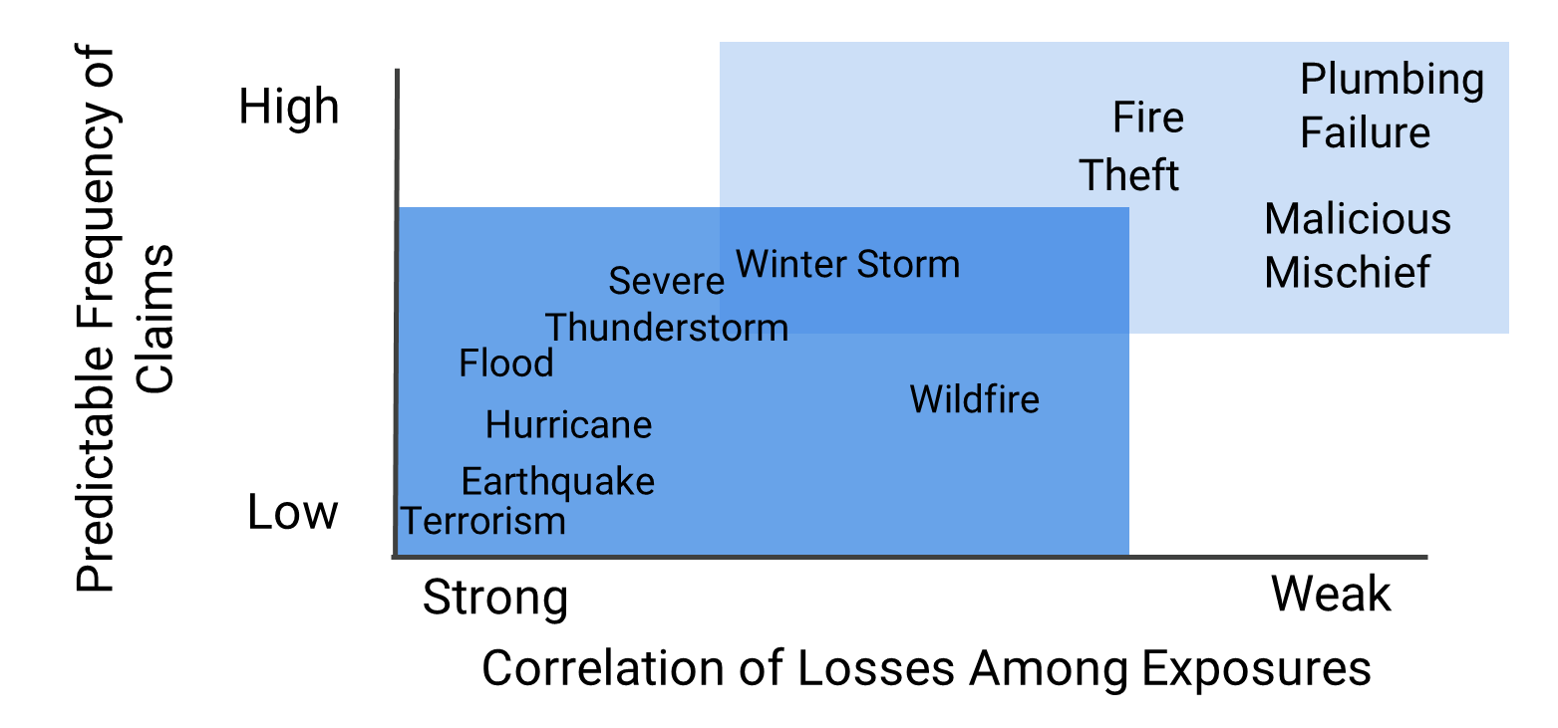
Traditional Methods of Estimating Loss Ineffective For Catastrophe Risk Management
“Catastrophe Events Violate the Two Major Conditions Needed to Apply the Law of Large Numbers” - American Academy of Actuaries

Slide 5
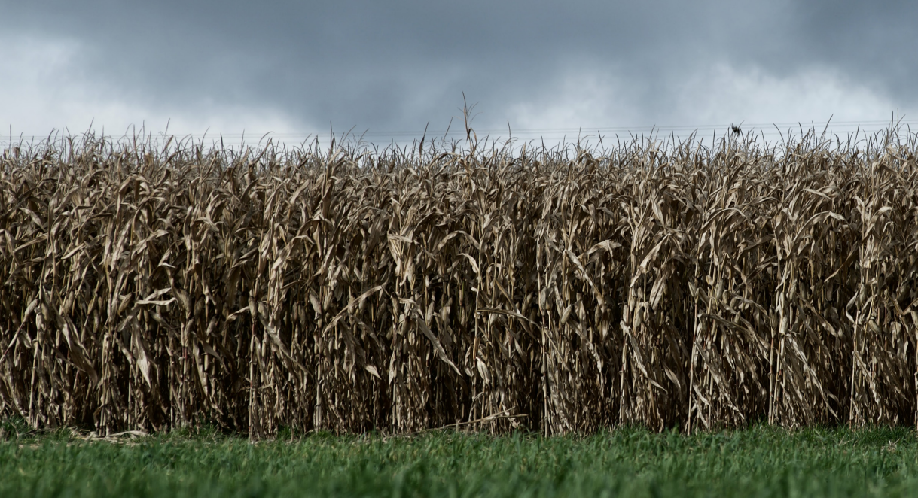
What Questions Are Extreme Event Models Designed to Answer?
What is the probability of a given level of loss for my book in a wide range of catastrophe scenarios?
How intense are they likely to be?
Where are future events likely to occur?
For each potential event, what is the estimated range of damage and insured loss?
How frequently are they likely to occur?

Slide 6
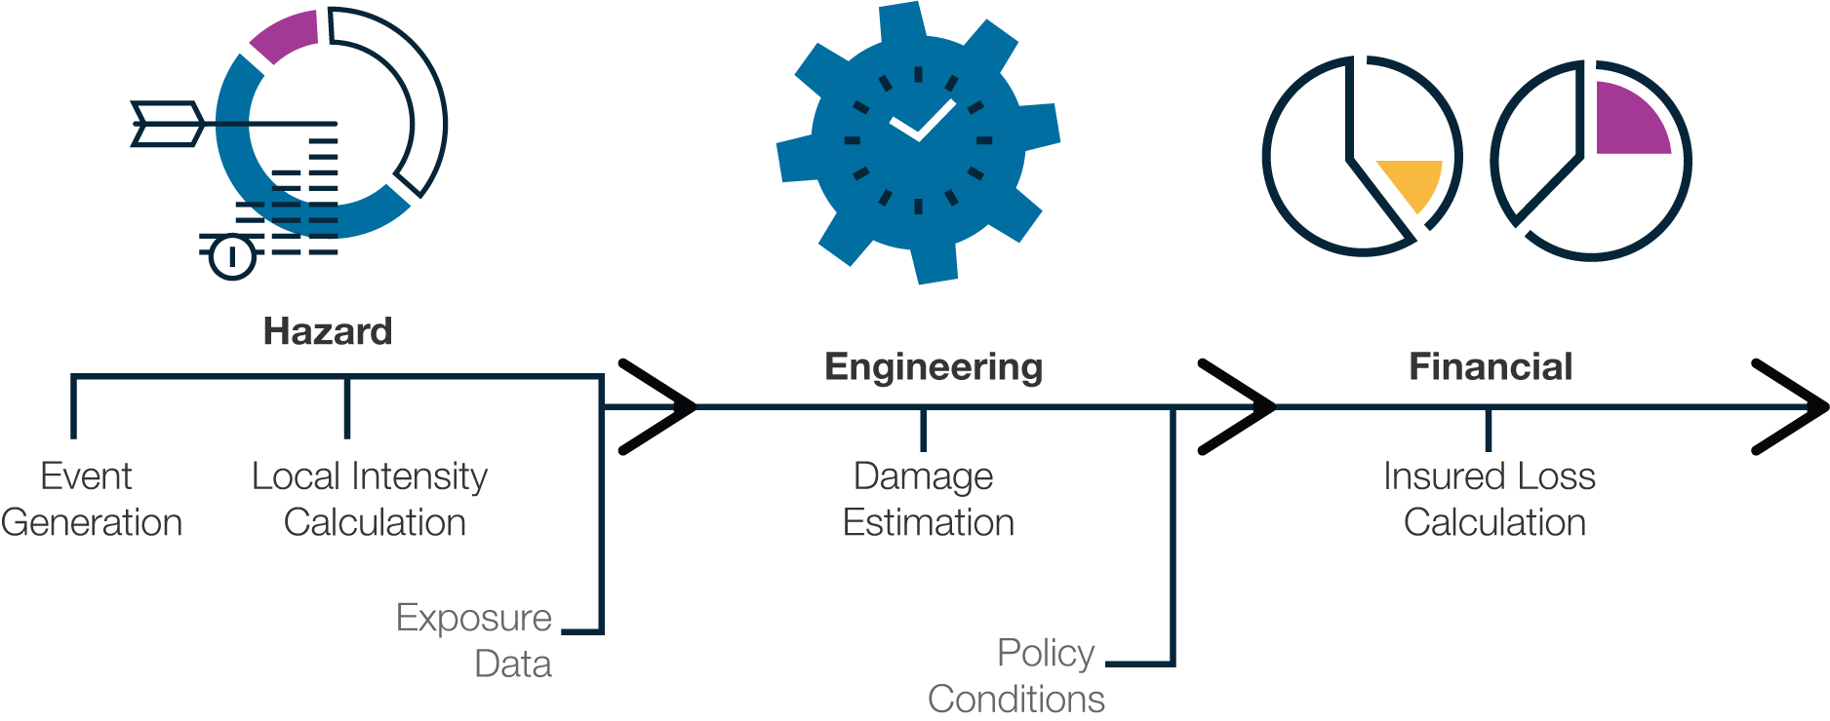
Extreme Event Modeling Framework

Slide 7
Clients Face Multiple Questions on Climate Change
How is climate change included in the models I use today?
Forward-looking projections (e.g., climate as of 2050) are not actively being used to manage today’s physical climate risk
How can I respond to my stakeholders?
  Regulators: disclosure
  Internal: portfolio management
  Investors: Environmental, Social, and Governance (ESG)
Use Cases for
Climate Change Tools
Climate Regulatory Disclosures
Stress Testing
ESG Response

Slide 8
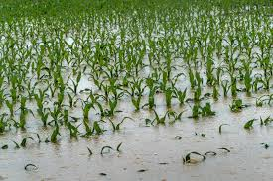
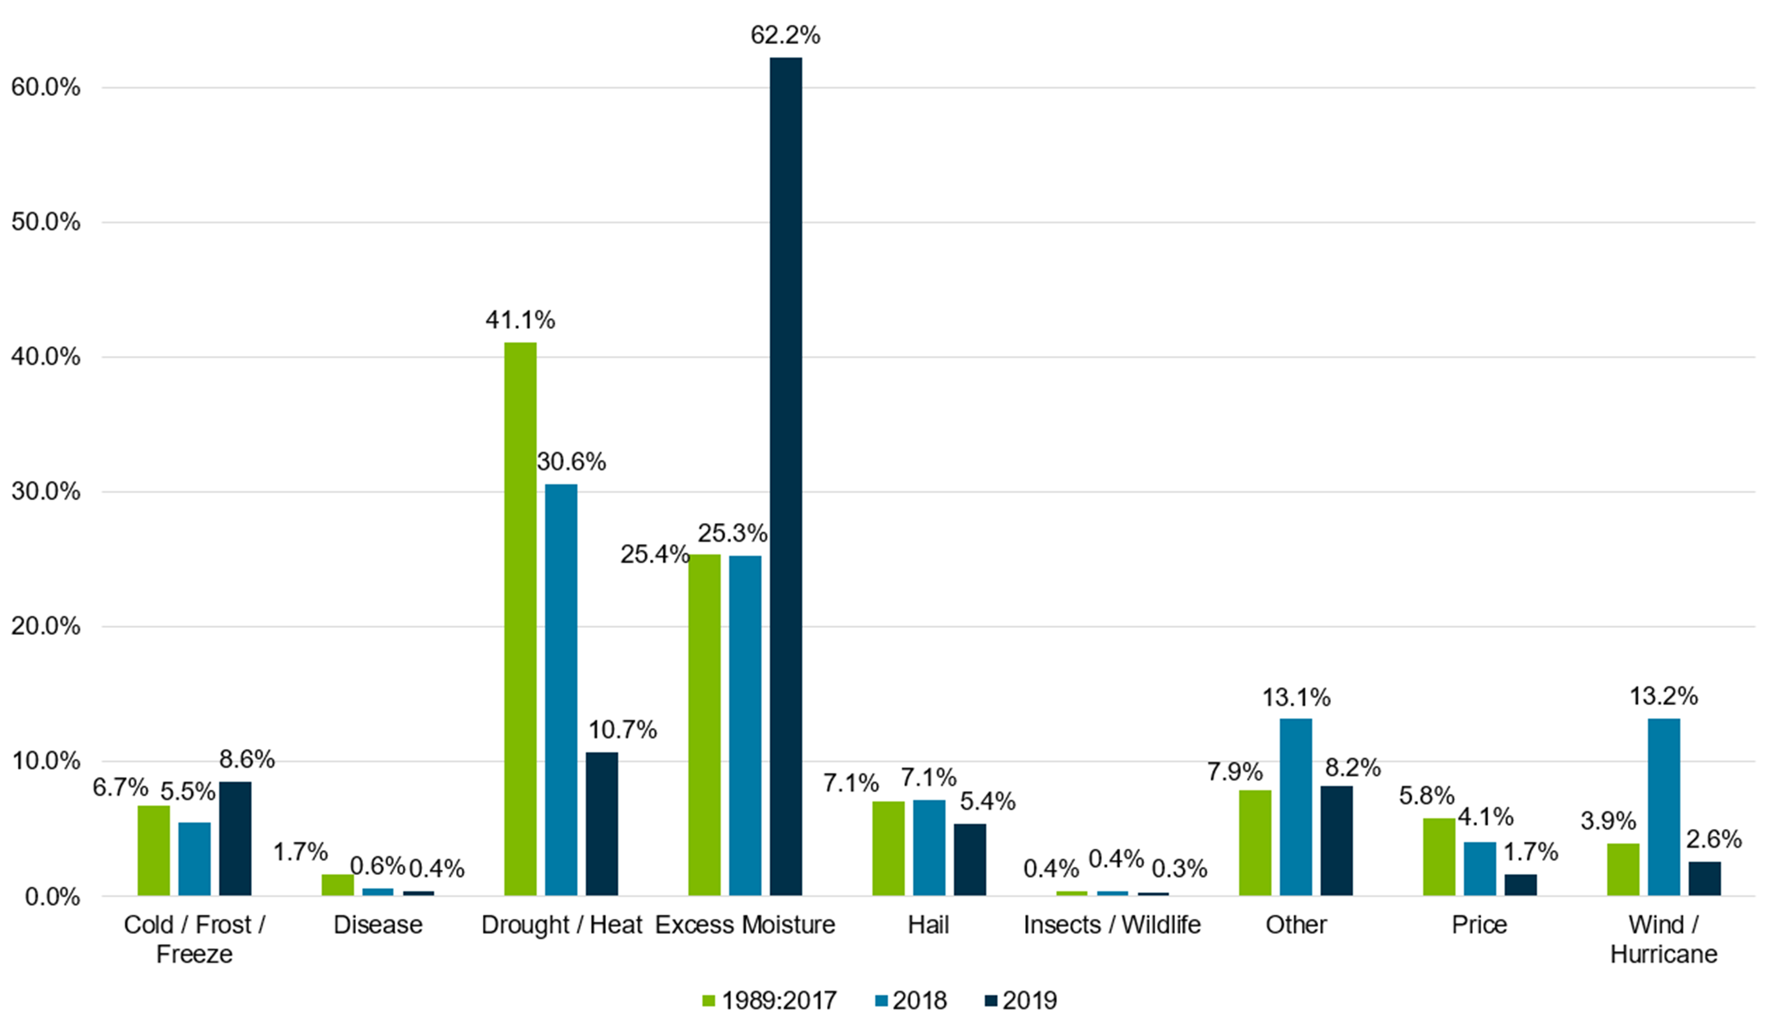
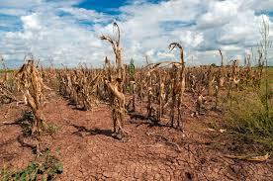
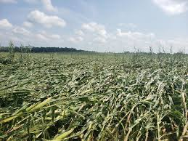
Extreme Weather Is a Big Reason for Crop Failure
Excess Moisture
Drought/Heat
Source: USDA RMA Cause of Loss
Wind

Slide 9
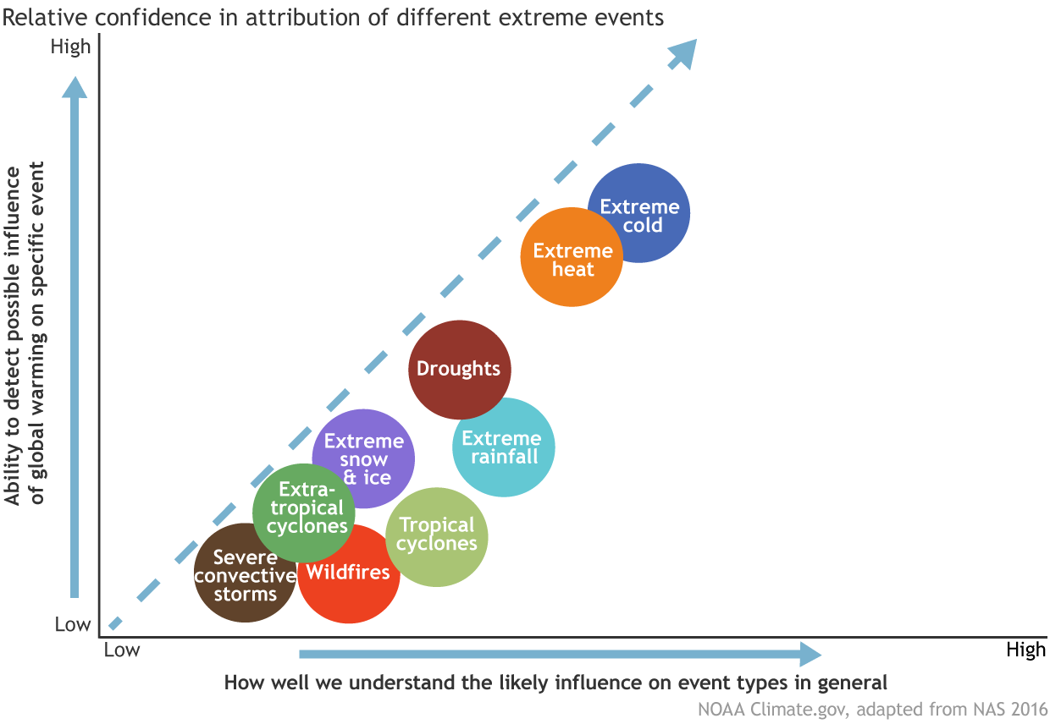
There Is High Confidence in How Climate Change Is Impacting Some Extremes
Overall confidence in event attribution is strongest for extreme event types that:
are adequately simulated in climate models
have a long-term historical record of observations
are linked to human-caused climate change through an understood and robustly simulated physical mechanism

Slide 10







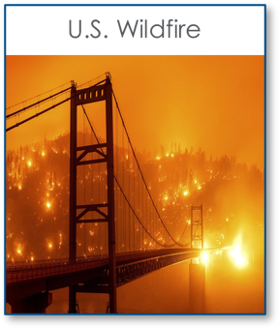
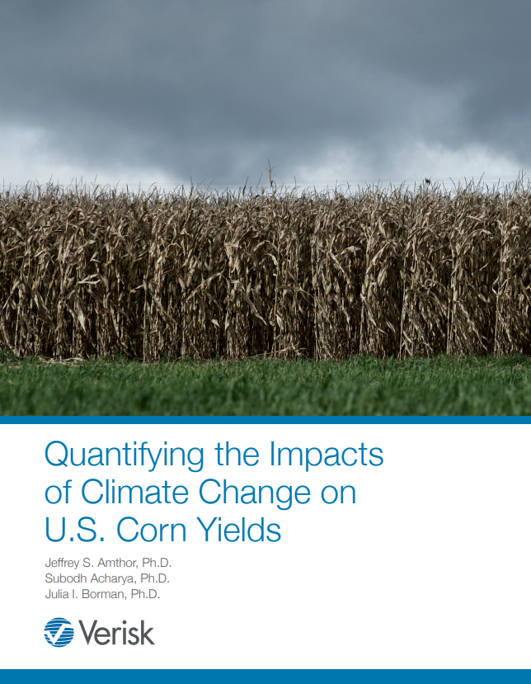
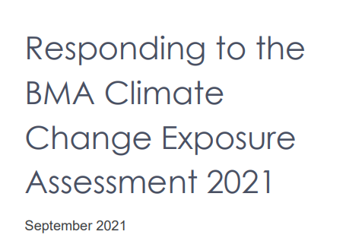

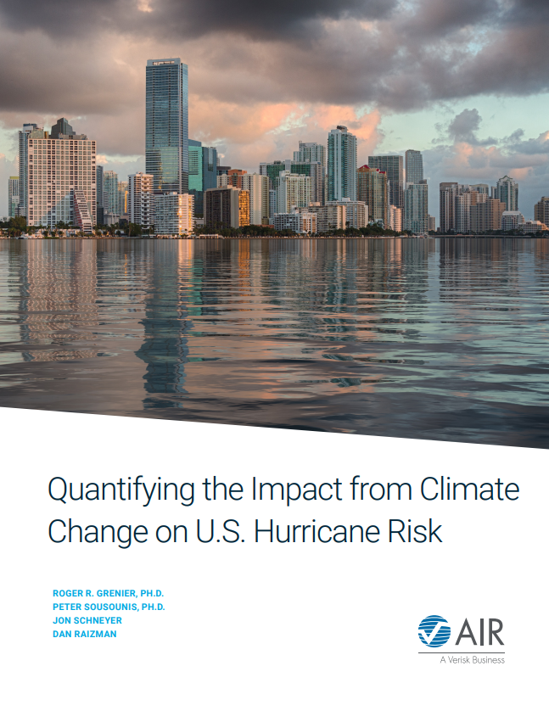
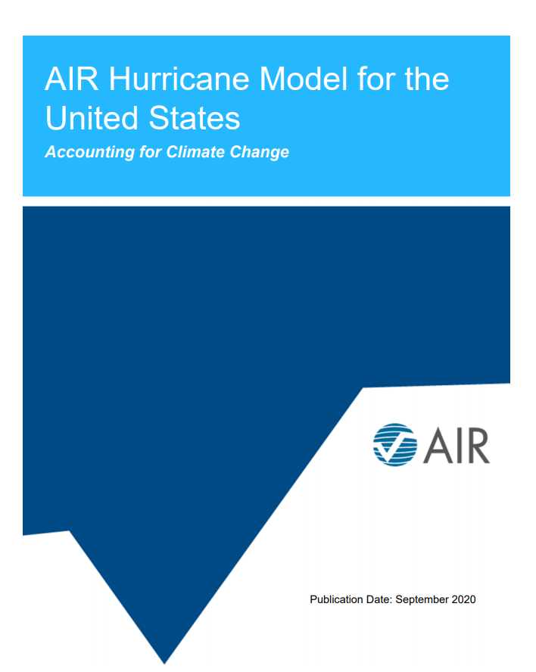
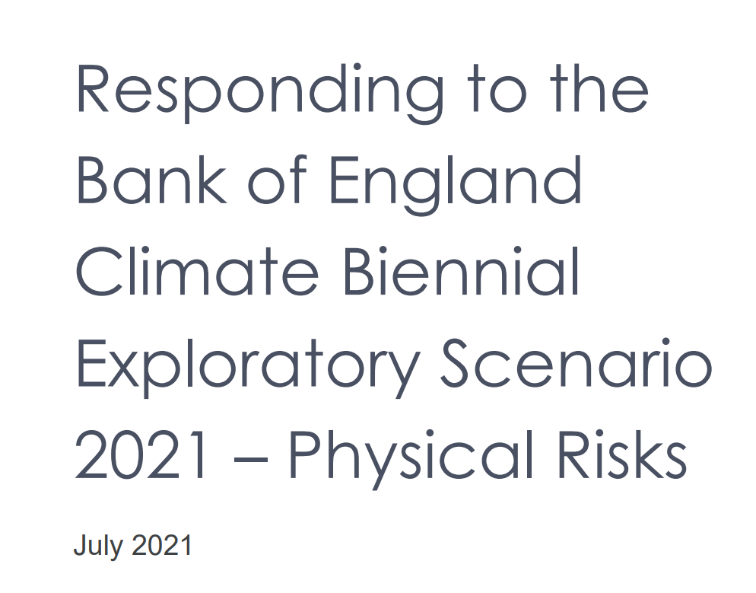
Climate Change Activities
Accounting for Climate
Change in Our Models
Consulting Services and Regulatory Support
Research and Communication
www.air-worldwide.com/models/Climate-Change

Slide 11











Creating Climate Change–Conditioned Catalogs
Inventory
Climate Change Target
Conditioned Catalog
100K current climate
10K future climate
More heavy rain years
Temperature increase by 2˚C
Randomly draw events from current climate catalog in a way to meet the climate change target
Hail
Tropical Cyclone
Wildfire
Agriculture

Slide 12
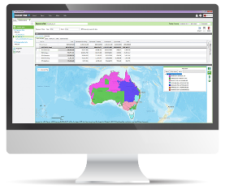
Crop Model Solutions
  Builds weather-based models to assess agricultural risk
  Historical weather records and understanding the past
    Recent U.S. Midwestern climatic changes may have been beneficial
    Climatic changes in other U.S. regions were sometimes detrimental
  Future climatic changes
    Climatic changes have the potential to limit future crop yield and increase yield variability
  "What-if" scenarios
    For example: What if the Dust Bowl droughts were repeated in the next few years?

Slide 13
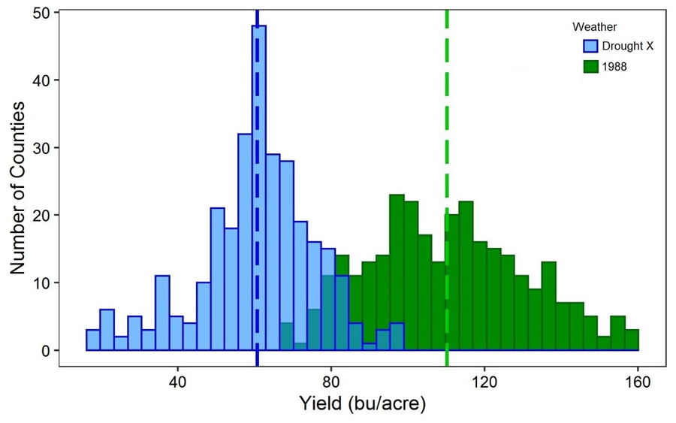
Corn Drought Simulation: 550 Corn Belt Counties
Comparing two droughts
1988 drought:
1988 daily weather
national yield loss = 27%
Drought X:
Jan–May 1988 daily weather
Jun–Aug 1936 weather
yield loss relative to 1988 drought = 45%

Slide 14
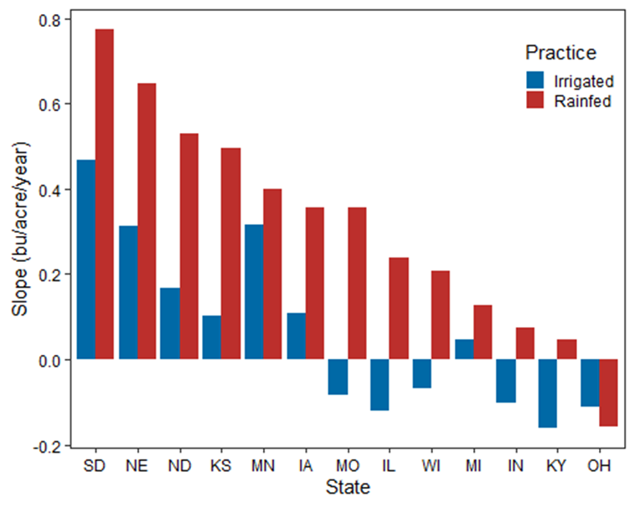
Recent Climatic Changes (1974–2019)
Change in corn yield across 13 Corn Belt states due to historical (1974–2019) weather (bushels/acre/year)
Crop genetics held at 2019 levels; the only variable is weather

Slide 15
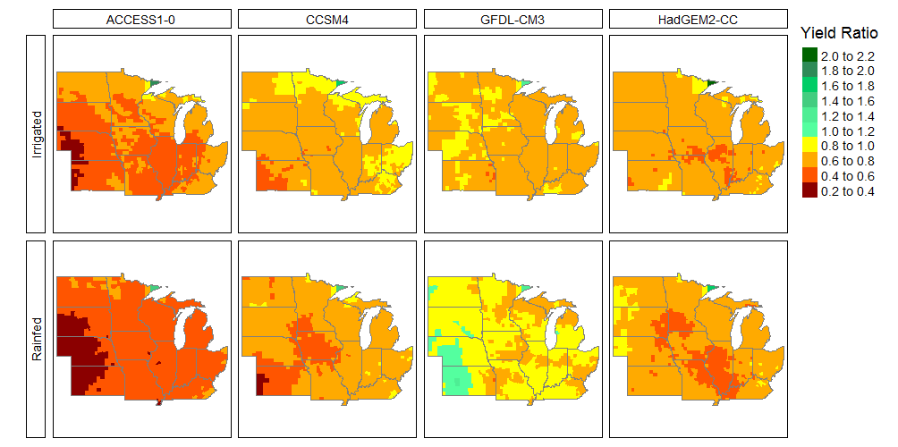
County Corn Yield in 2046–2055 Relative to 1991–2000
Four CMIP5 (RCP 8.5) Downscaled Climate Projections
Yield ratio
yield 2046–2055
────────────
yield 1991–2000
Crop genetics held at 2019 levels; only variable is weather
Irrigated – top
Rainfed – bottom

Slide 16
Summary Points
Founded the catastrophe modeling industry in 1987 and now serve more than 400 clients with modeling in 110+ countries
High-resolution agricultural modeling in place for the U.S., China, Canada, and India markets
Insurance industry balancing immediate concerns with long run concerns
Climate change enters the discussion in many ways:
    regulators, internal risk assessment, ESG
Verisk's extreme event solutions team provides guidance for clients today and research for the future across multiple perils

Slide 17
Thank You
Agriculture@Verisk.com

