Slide 1
Bob Kirchoff CEO
Notes:
- History and your background

Slide 2
Organic Valley Organic Marketing Cooperative
Dairy, Meat, Eggs, Produce, Feedstuffs
Founded 1988
Brick and mortar facilities in WI, OR, MN
91 co-packers/processing partners
Over 1,400 SKUs
$1.1 billion in sales and nationwide distribution

Slide 3
Notes:
Talking point: “More than 1,600 dairy farm families nationwide“

Slide 4
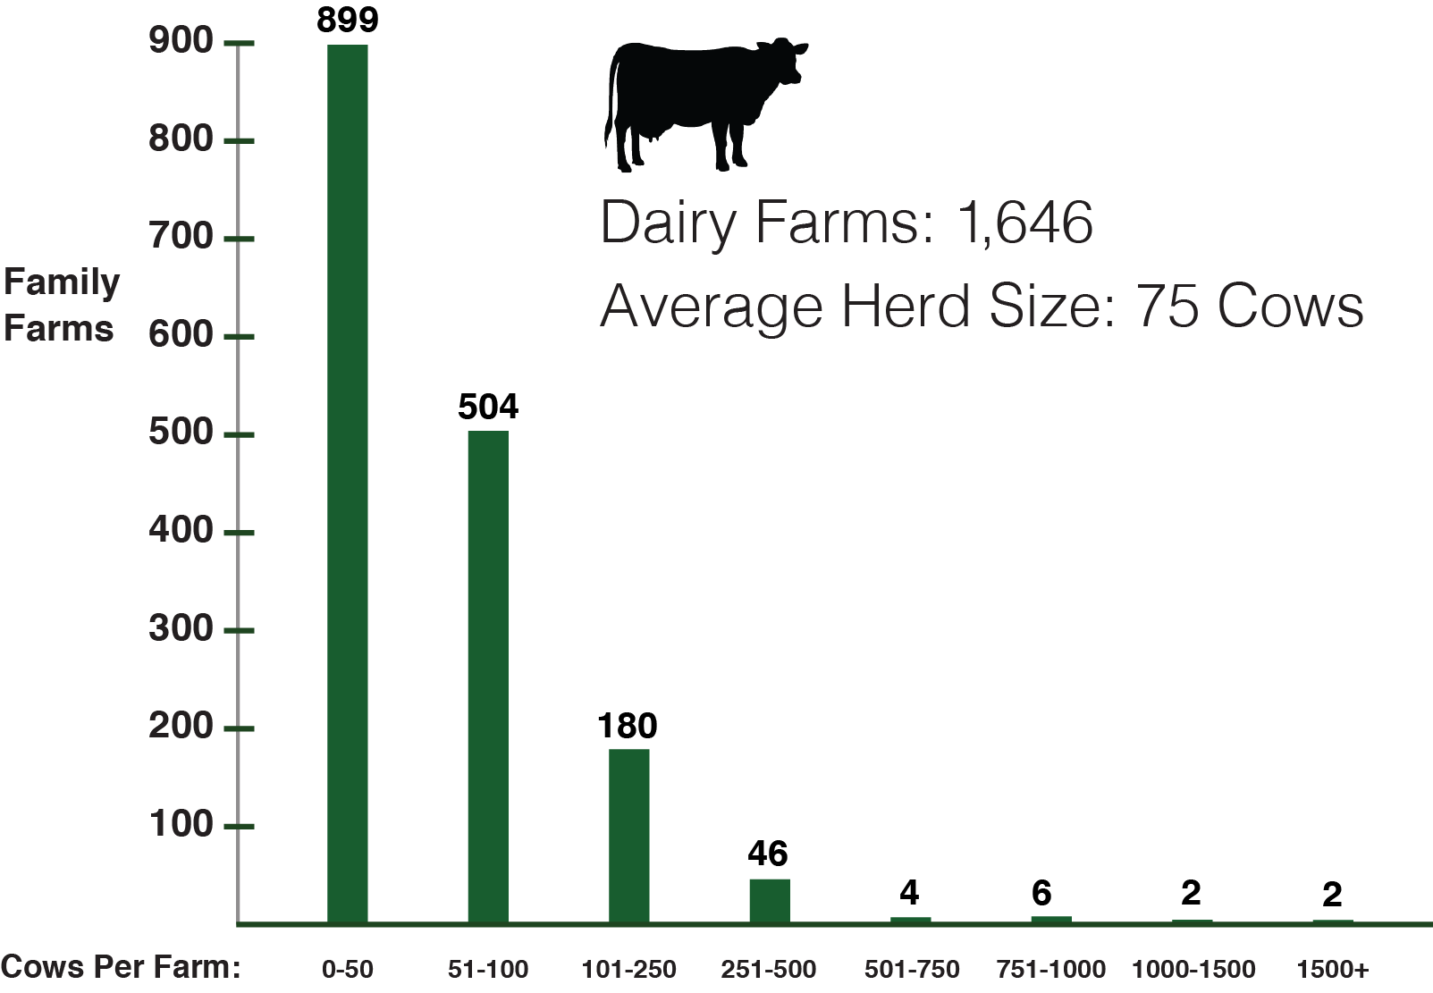
Organic Valley Dairy Herd Sizes

Slide 5
Dairy Challenges Organic Opportunities
negative press
around dairy production & consumption
consumer confusion
on organic label claims
undifferentiated & not motivating
innovation & growth on non-dairy alt.
delivering on promise for authenticity and transparency
moving beyond functional benefits to the emotional connection
drive innovation
to excite consumers with flavor and form
Notes:
The dairy category (organic and conventional alike) is at a critical point.
Bob talking points
The dairy industry as a whole has faced some headwinds over the past few years, and organic has felt that pressure as well.
There are tailwinds as well, and organics are posed to excel in the years to come as we deliver the right offerings that address our consumers evolving motivations.
There has been negative press around dairy production and consumption. How animals are treated, concerns around digestion and concerns around diary methane & environmental sustainability are topics that have been surfacing. Our industry has been both reactive and proactive to address these concerns, and it is a challenge because many of the claims are misleading.
There are a proliferation of claims (grass-fed, non-GMO, etc) that are also creating confusion and mistrust. More labeling regulations need to made to win our consumers trust and drive awareness of our efforts to meet the highest organic standards available.
As of late, a lot of innovation and new products have been classified as fast followers, particularly in the non-dairy alternative space where excitement has been generated by the new innovation around flavor and form.
We know our organic consumers want quality and are willing to pay for premium. We see this not only in the dairy space, but other parts of the store as well … Take pet care for example. There is increasing demand for premium pet food and snacks that is driving the overall growth for the category.
Consumers want transparency and authenticity in the products they choose to buy and support. A key motivator of consumer behavior is supporting brands that resemble their values.
We also know we need to reach our consumers and build an emotional connection. This again speaks to the need to understand what they value and why, and meet those needs from a product development and messaging opportunity.
While this Non-Dairy category is on trend, household penetration has plateaued, and consumers continue to tell us that the taste and mouthfeel fall flat to the dairy offerings. That’s a real opportunity for dairy innovation.

Slide 6
Positioning Organic Valley for the Future
Business fundamentals
Continuous organic improvement
Consumer focus
Enhanced claims
Product innovation

Slide 7
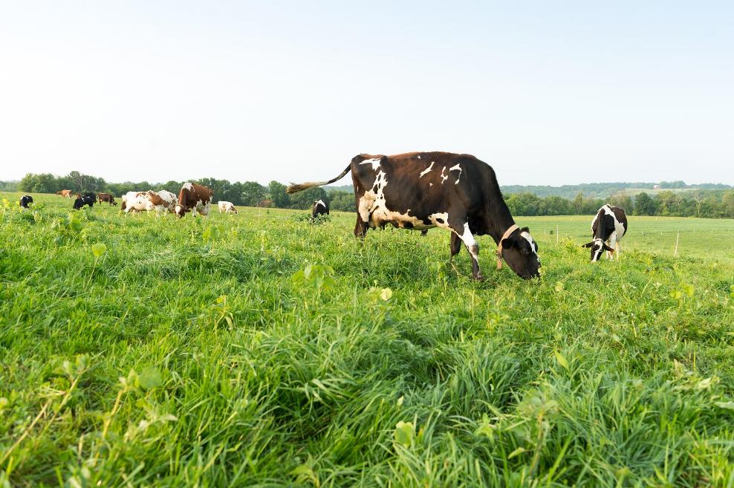
Enhanced Claims: Certified Grass-Fed Organic Dairy

Slide 8
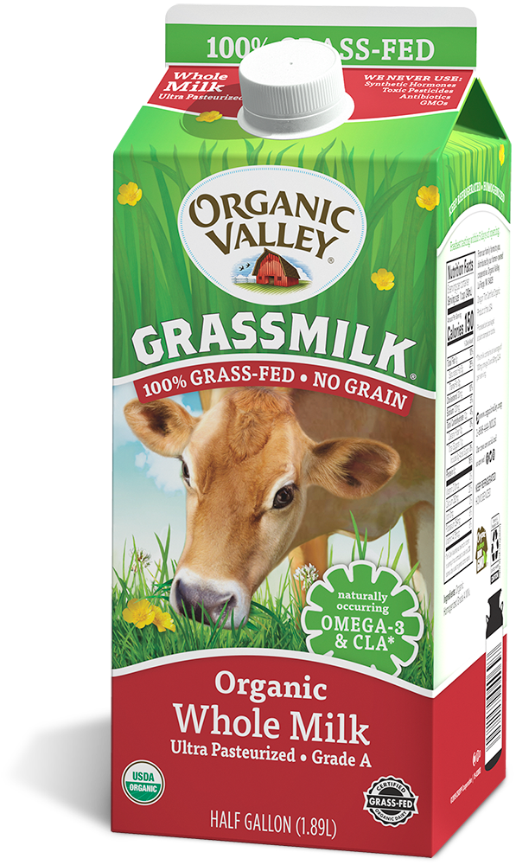
Certified Grass-Fed Organic Dairy Grassmilk
Notes:
Our farms were some of the first in the country to be certified.

Slide 9
Product Innovation Ultra – 2019 Release
Notes:
We were the first organic, ultra-filtered milk on the market when it launched.
(Note: Horizon has a high-protein milk, but theirs is a fortified milk, not ultra-filtered)

Slide 10
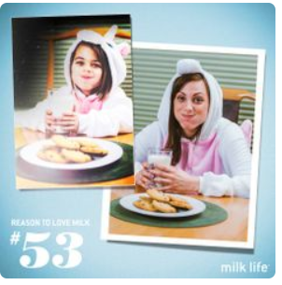
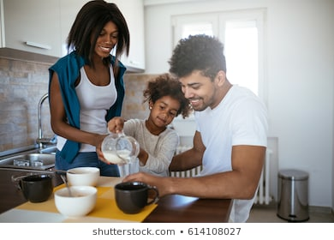
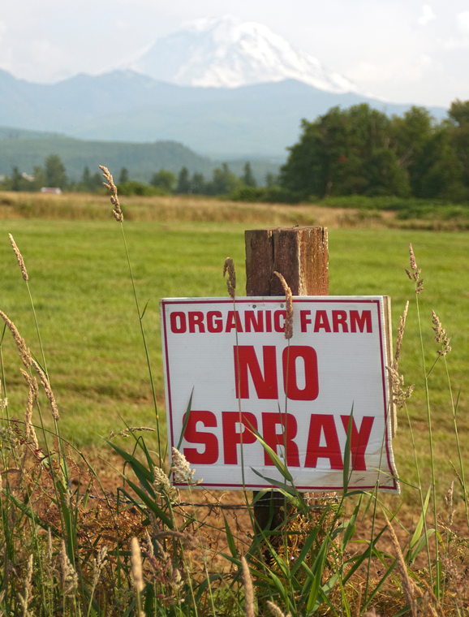
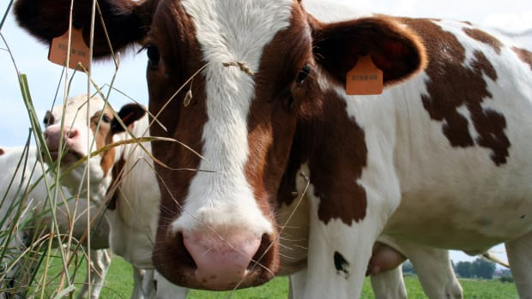
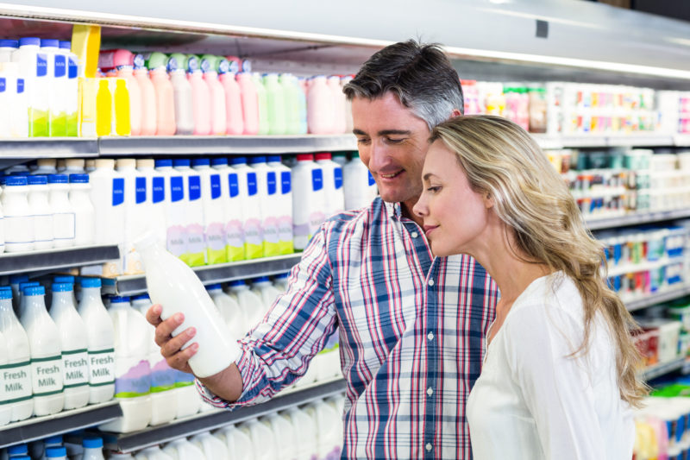
Organic dairy has been and continues to be a staple category
Commitment To Our Consumers
Organic Dairy HH Penetration +3pts v YA (33%)
Consistent buyer repeat >60% in light of negative press
Increasing nutritional, functional, and ethical focus
Source: SPINS/IRI Panel, Annual Panel 2019, Organic – Dairy Category
Notes:
Bob Talking Points
We are excited about how the organic dairy category has evolved over the last thirty years.
It is a staple is many households and is consumed on a daily basis, if not multiple times a day. Dairy is used as ingredient, a single source, and an enhancer. Consumers want the very best for themselves, and their families, and organic dairy meets that need.
Consumers are also telling us that they want more out of their organic dairy. They want not only the best possible milk and cheese available, but they also want transparency and trust that the brands they support are meeting their high standards for ethics and values.
While milk has flattened, other segments like cheese and cream continue to grow.
Organic – Dairy Category: Organic Cream, butter, eggs, cheese, milk and all other dairy

Slide 11
We Are…
Committed to organic and dairy
Committed to our farmer-members
Committed to offering consumers exciting and innovative food choices

