Slide 1
U.S. Cotton Export Estimates:
Census Data vs USDA Data
Chris Kramedjian
Director of Risk Management
Plains Cotton Cooperative Association

Slide 2
Big Revisions in Export Estimates on September 2019 WASDE
Exports Estimates (000’s of Statistical Bales)
Marketing Year | August '19 Report | September '19 Report | Change
2017/18 | 15,847 | 16,279 | 432
2018/19 | 14,217 | 14,763 | 546
2019/20 | 17,200 | 16,500 | -700

Slide 3
What Motivated the Revisions?
Difference Unaccounted (“Loss”) estimates were large and growing.
“Loss” = Supply – Demand – ICEC Ending Stock
Loss Estimates (Statistical Bales)
Marketing Year | August '19 Report
2017/18 | 304,000
2018/19 | 205,000
2019/20 | 271,000
Notes:
Not the weather. These were lost bales not lost production.
Beginning stock is carried over.
NASS data is used for production.
We also have excellent data on monthly domestic use through the economic adjustment program.
For the past 10 years, export shipments as reported to the USDA have governed the export estimate.
The Interagency Commodity Estimates Committee used a combination of the BMAS report, Cotton Consumption and Inventory, NASS survey of private stocks, and estimated in-transit data to form an ending stocks estimate.
Given the exports reported to USDA, we should have had a very strong estimate of bales left in Ending Stocks as well, but the estimate kept falling short.

Slide 4
What the Loss Could Have Been
Implied September ‘19 Loss Estimate
Beginning Stock | 4,300,000
Production | 18,367,000
Total Supply | 22,667,000
Domestic Use | 3,000,000
Exports (FAS, converted to SB) | 14,217,000
ICEC Ending Stock Estimate | 4,850,000
Total Distribution | 22,067,000
Implied Loss | 600,000
Notes:
Not the weather. These were lost bales not lost production.
Beginning stock is carried over.
NASS data is used for production.
We also have excellent data on monthly domestic use through the economic adjustment program.
For the past 10 years, export shipments as reported to the USDA have governed the export estimate.
The Interagency Commodity Estimates Committee used a combination of the BMAS report, Cotton Consumption and Inventory, NASS survey of private stocks, and estimated in-transit data to form an ending stocks estimate.
Given the exports reported to USDA, we should have had a very strong estimate of bales left in Ending Stocks as well, but the estimate kept falling short.

Slide 6
Expected Sources of Variation
2019 Government Shutdown
Gross Weight vs Running Bales
Technical Counting and Timing Differences
Weekly vs Monthly Reporting
Data Entry Error

Slide 8
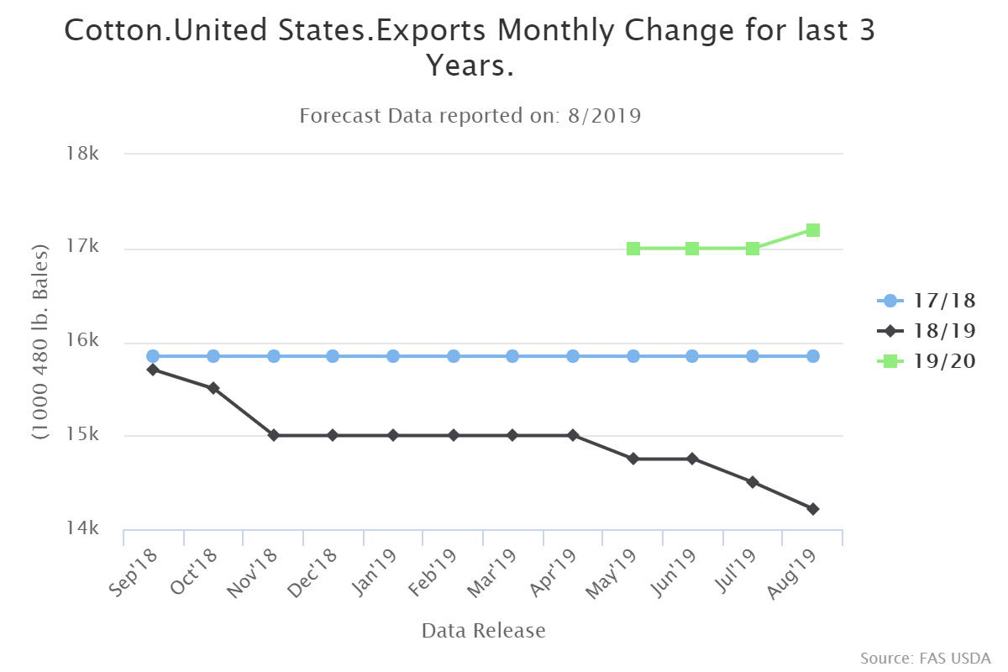

Slide 10
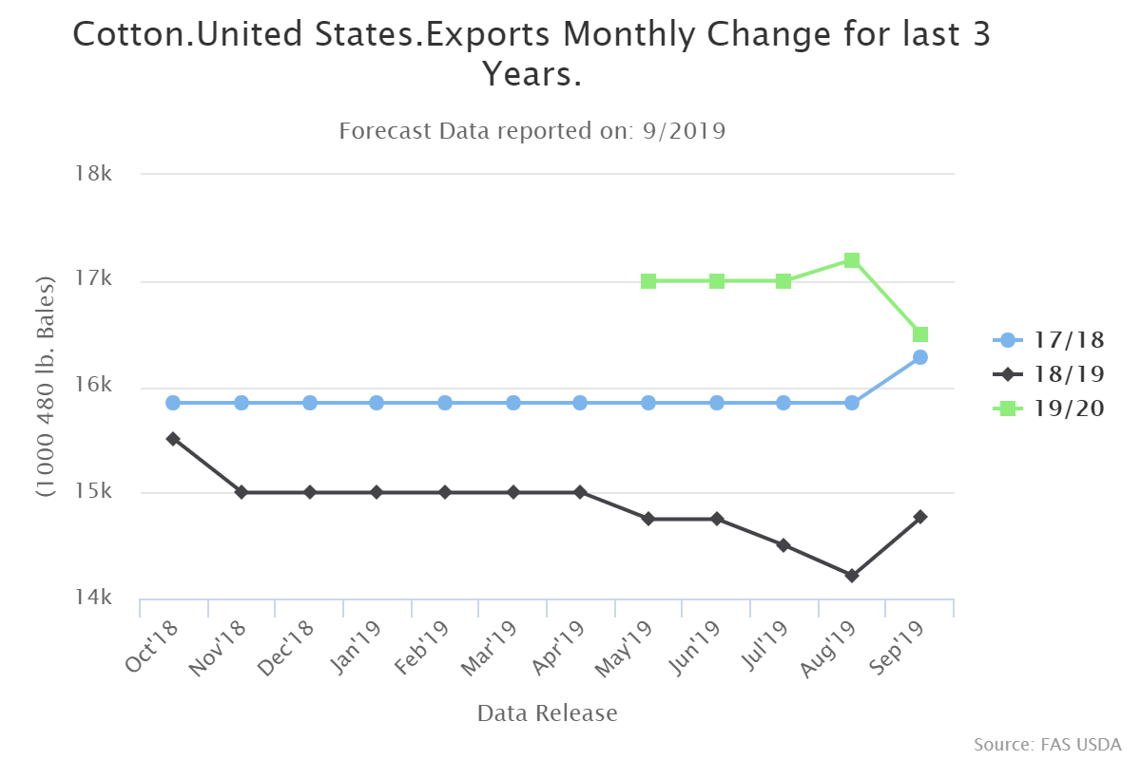

Slide 11
September 2019 Revisions to US Balance Sheets
Exports Estimates (000s of Statistical Bales)
Marketing Year | August '19 Report | September '19 Report | Change
2017/18 | 15,847 | 16,279 | 432
2018/19 | 14,217 | 14,763 | 546
2019/20 | 17,200 | 16,500 | -700
Loss Estimates (000s of Statistical Bales)
Marketing Year | August '19 Report | September '19 Report | Change
2017/18 | 304 | -28 | -332
2018/19 | 205 | -18 | -223
2019/20 | 271 | 17 | -254
Ending Stocks Estimates (000s of Statistical Bales)
Marketing Year | August '19 Report | September '19 Report | Change
2017/18 | 4,300 | 4,200 | -100
2018/19 | 5,250 | 4,850 | -400
2019/20 | 7,200 | 7,200 | 0

Slide 12
Other Possible Sources of Error
Failure to Report
  Ignorance of legal obligation
  Misunderstanding of requirements
  Negligence or Inability
Misreporting

Slide 13
Improvement
Incorporating census bureau data reinforces the integrity of the USDA’s export estimates.
What else could be done?
  Clarify and communicate reporting obligations & definitions.
  Identify and reach out to non-reporting entities.
  Ease the reporting burden with digital submission.
  Compliance programs.

