Slide 1
USDA RESOURCES FOR HEIRS
J. Latrice Hill, USDA Farm Service Agency National Director of Outreach

Slide 2
Resolving Barriers to Participate in FSA Programs
Eligibility
  Farm numbers allow access to USDA programs
  2018 Farm Bill allows for alternative documentation for heirs property operators
Obtaining a Farm Number (in Uniform Partition of Heirs Property Act States):
  Proof that recorded order is deceased
  Agreement amongst all landowners on rights and responsibilities for the land, and specific owner who is granted authority to manage and control land

Slide 3
Survey Results

Slide 4
What is the Heirs’ Property Relending Program?
Eligible entities will provide loans to assist heirs to:
Resolve ownership issues on farmland with multiple owners
Resolve succession issues on farmland with multiple owners
Note: These are loans that must be repaid to the intermediary lender.

Slide 5
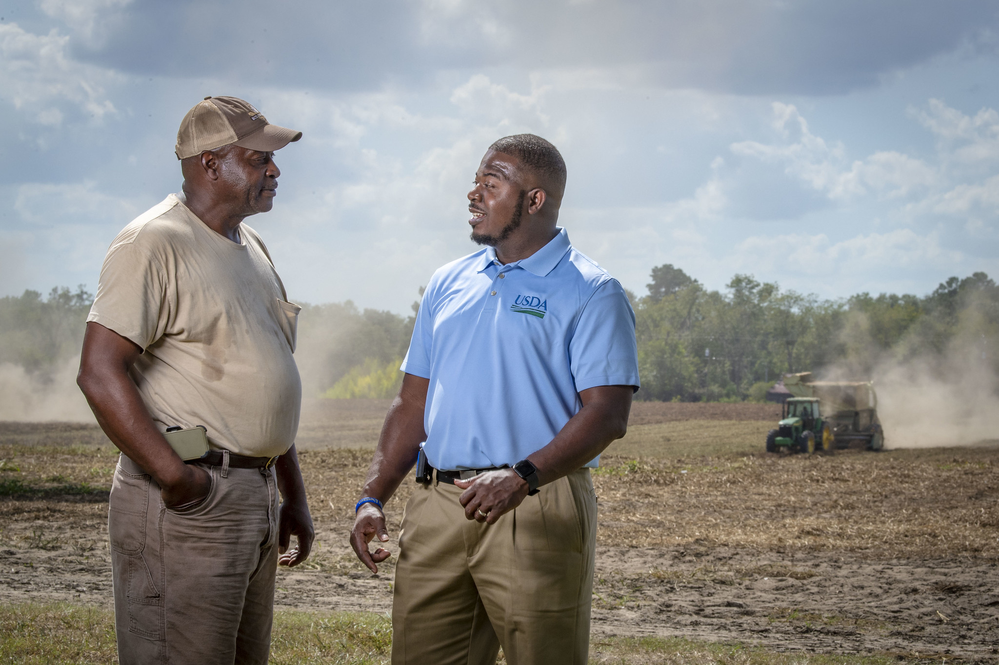
Why a Relending Program?
Address barriers to accessing USDA farm programs
Support economic viability
Protect family farm legacies

Slide 6
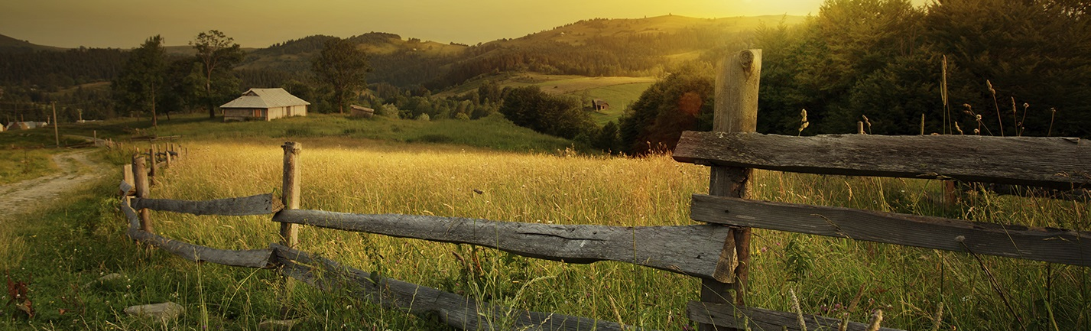
Benefits of Resolving Heirs Property Issues
Establishing control of property
Accessing USDA programs
Creating generational wealth

Slide 7
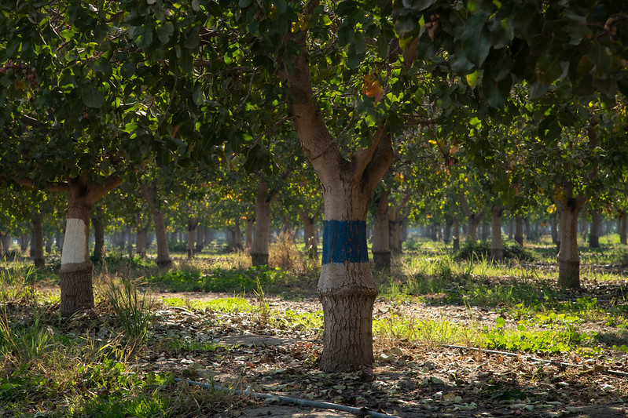
Intermediaries
Relend funds from USDA to heirs.
Cooperatives
Credit unions
Nonprofit organizations

Slide 8

Eligible Uses of Funds
To buy out fractional interests held in tenancy in common by other heirs in jointly-owned property, and
To pay for costs associated with developing and implementing a succession plan (such as closing costs, appraisals, title searches, surveys, preparing documents, mediation, and legal services).

Slide 9
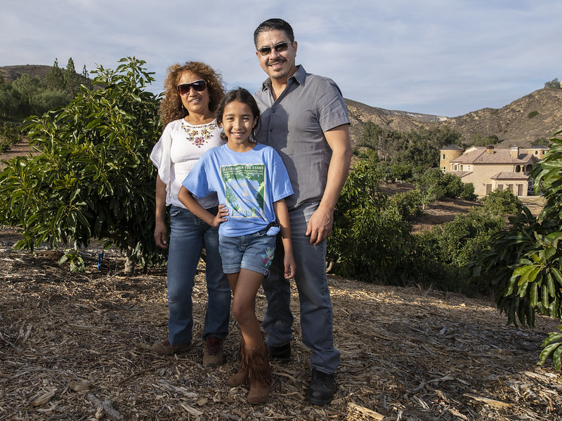
Loan Amounts & Eligibility for Ultimate Recipients
Eligibility requirements of the ultimate recipient are:
Ultimate recipients may be individuals or legal entities, with authority to incur the debt and to resolve ownership and succession of a farm owned by multiple owners; and
Must agree to complete a succession plan as a condition of receiving a loan form the intermediary.

Slide 10
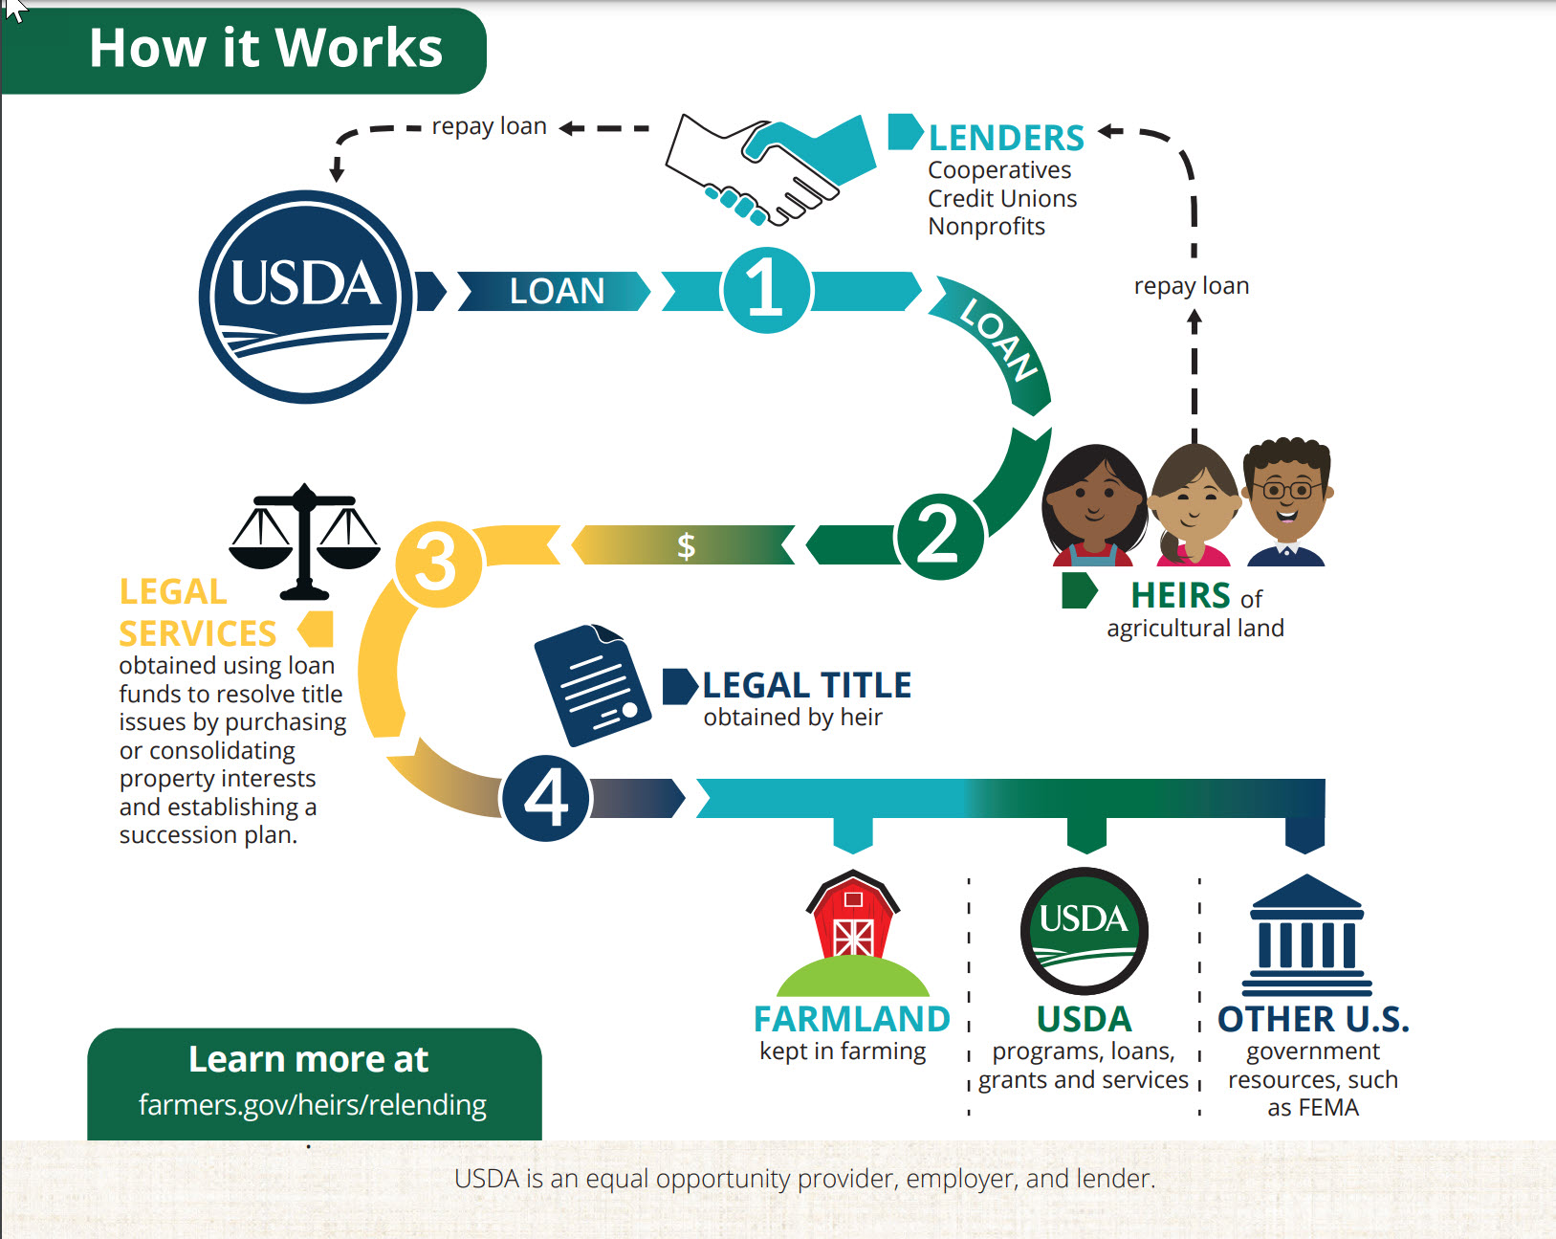
Loan Amounts & Eligibility for Ultimate Recipients
Eligibility requirements of the ultimate recipient are:
Ultimate recipients may be individuals or legal entities, with authority to incur the debt and to resolve ownership and succession of a farm owned by multiple owners; and
Must agree to complete a succession plan as a condition of receiving a loan form the intermediary.

Slide 11
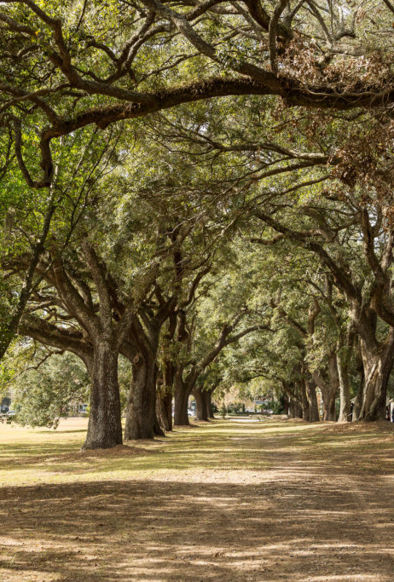
Partner Organizations
Outreach and Technical Assistance Cooperative Agreements
WEBSITE:
https://www.fsa.usda.gov/cooperativeagreements
Center for Heirs Property Preservation
TX Small Farmers & Ranchers Community Based Organization
North South Institute
University of Arkansas-Pine Bluff
Africulture
American Farmland Trust
Community Farm Alliance
Intertribal Ag Council, Inc.
New South Development & Training
OH Ecological Food & Farm Association
Stag Vets, Inc.
UGA Research Foundation, Inc.
Univ. of MA

Slide 12
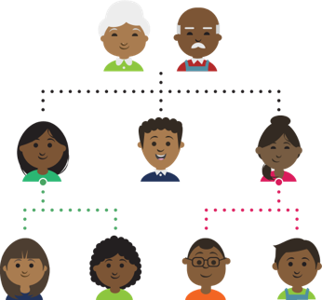
Heirs Property: Available Resources
WEBSITE:
https://www.farmers.gov/heirs
Includes info on:
Establishing a farm number
Heirs Property Relending Program
Fact Sheets:
  Heirs property operators on getting a farm number
  What is Heirs Property?
  Heirs’ Property Relending Program

Slide 13
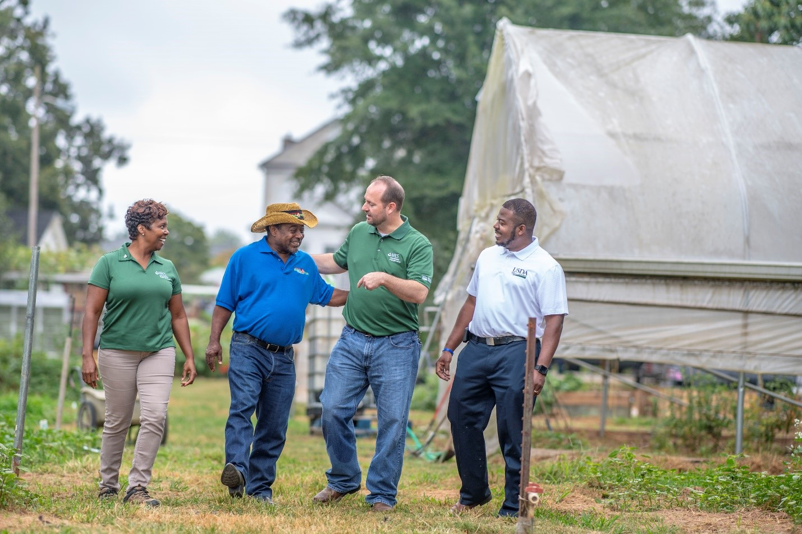
USDA Programs and Resources
WEBSITE:
www.nrcs.usda.gov
  Regional Conservation Partnership Program (RCPP)
  Environmental Incentives Program (EQIPP
WEBSITE:
www.rd.usda.gov
  Microentrepreneur Assistance Program
  Value Added Producer Grants
  Socially Disadvantaged Groups Grant
WEBSITE:
www.usendowment.org
  Sustainable Forestry and African American Land Retention Network (SFLR)

Slide 14

USDA Farm Service Agency
Subscribe
Subscribe to FSA and FSA Outreach news & alerts: www.fsa.usda.gov/subscribe
Contact & Connect
With State Beginning Farmer & Rancher Coordinators and USDA Partners in your state.
Coordinators: https://www.farmers.gov/your-business/beginning-farmers/coordinators
Partners: www.fsa.usda.gov/cooperativeagreements
Share
Barriers and obstacles faced at the county office level with your State Outreach Coordinators. https://www.fsa.usda.gov/programs-and-services/outreach-and-education/state-outreach-coordinators/index
ASK USDA:
https://askusda.gov/s

