Slide 1
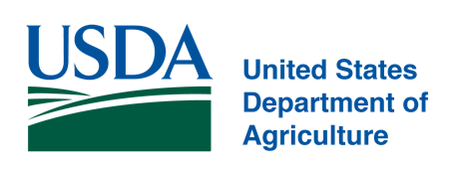
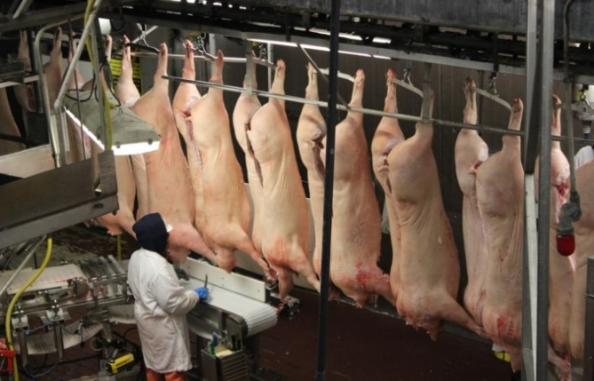
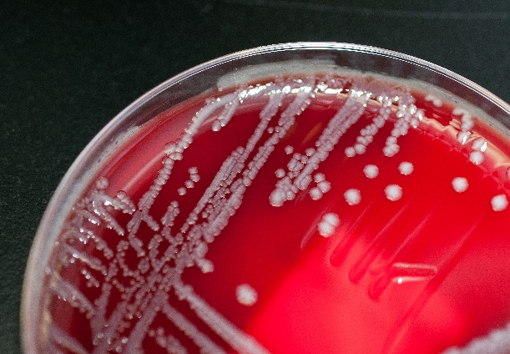

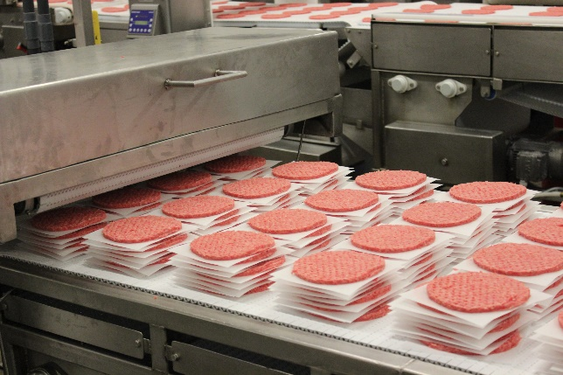
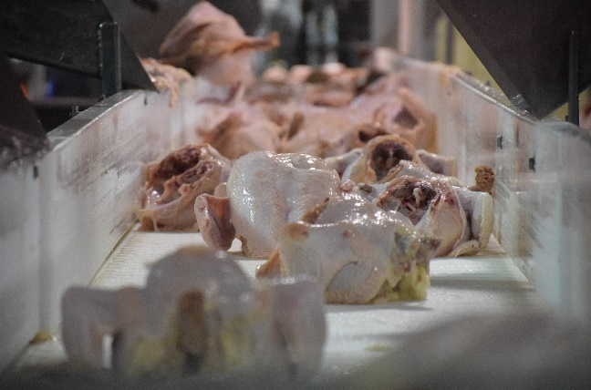
Food Safety and Inspection Service
Protecting Public Health and Preventing Foodborne Illness

Slide 2
New Technologies And Labeling for Meat, Poultry and Egg Products
  Food Safety and Inspection Service:
Matthew Michael
Director, Issuances Staff
Office of Policy and Program Development

Slide 3
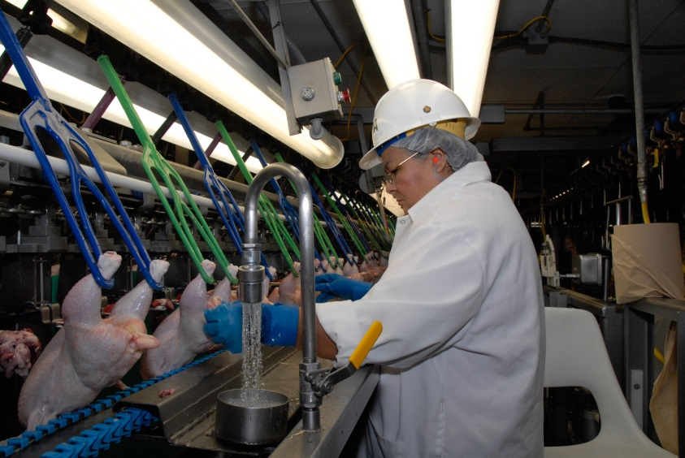
  Food Safety and Inspection Service
  USDA-FSIS: Who We Are
We are the public health agency in the USDA that is responsible for ensuring meat, poultry, and processed egg products are safe, wholesome, and accurately labeled.
Our Authority
Through a series of Acts, Congress empowers FSIS to inspect all meat, poultry, and processed egg products in interstate commerce.
Federal Meat Inspection Act (FMIA), 1906
Egg Products Inspection Act (EPIA), 1970
Humane Methods of Slaughter Act (HMSA), 1958
Poultry Products Inspection Act (PPIA), 1957

Slide 4
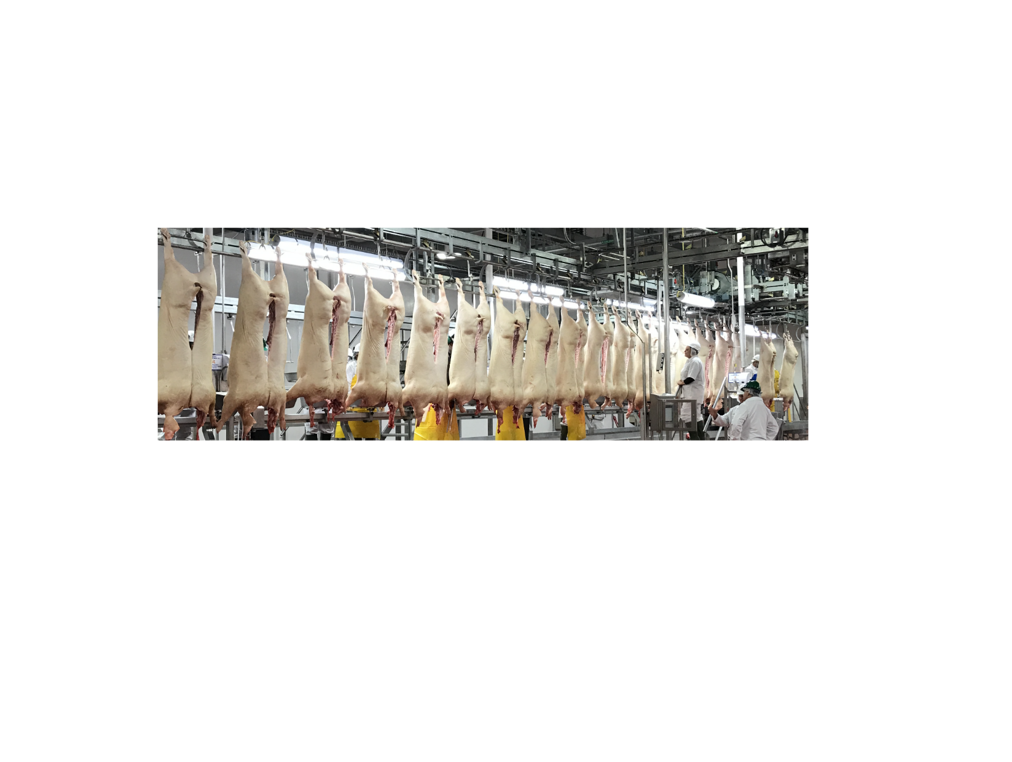
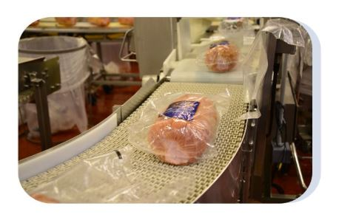
  Food Safety and Inspection Service
  USDA-FSIS Inspection
6,433
Total Slaughter and Processing Establishments
4,287
Further Processing only Establishments
Continuous inspection - inspection during all hours of operation - is conducted at slaughter operations.
Inspection of establishments that further process meat and poultry is conducted at least once every production shift.
100% re-inspection of imported products.

Slide 5



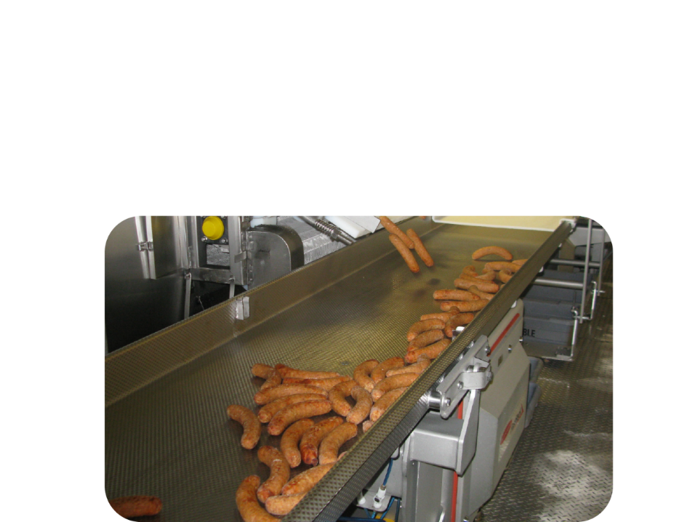
  Food Safety and Inspection Service
  USDA-FSIS: Inspection of Complex Technologies
  Canning
  Irradiation
  High Pressure Processing
  Fermenting
  Enzyme-Based Processing
  Advance Meat Recovery

Slide 6
  Food Safety and Inspection Service
  New Technologies and Product Labeling
FSIS reviews new technologies prior to use in meat and poultry slaughter and meat, poultry and egg product processing.
FSIS reviews and pre-approves all meat, poultry and egg product labels, unless they have been generically approved.
New technologies may result in new product labeling

Slide 7
  Food Safety and Inspection Service:
  How does FSIS Define a New Technology?
New applications of equipment, substances, methods, processes, or procedures affecting the slaughter of livestock and poultry or processing of meat, poultry, or egg products.
Recent examples include high pressure processing, steam vacuums, steam pasteurization, and antimicrobial substances.
Federal Register notice FSIS Procedures for Notification of New Technology (68 FR 6873)

Slide 8





  Food Safety and Inspection Service:
  What are the Phases of the Review Process?
Submission
Technical Review
No Objection Letter*
Directive 7120.1*
Multidisciplinary Approach
Microbiologists, toxicologist, chemists, biologist, meat scientists, food technologists, laboratory scientists, pathologists, epidemiologists, economists, statisticians.
Evaluate to determine if the technology:
Affects product safety;
Violates FSIS regulations;
Interferes with inspection procedures;
Jeopardizes the safety of inspection program personnel; or
Is deemed suitable for use in meat, poultry or egg products
*Other types of letters will be described later
*Only Ingredients, OLRs, and OFLRs are listed on the 7120.1

Slide 9
  Food Safety and Inspection Service:
  What is Suitability?
The effectiveness of the process or substance in performing the intended purpose of use, and the assurance that the conditions of use in a FSIS regulated establishment will not result in an adulterated product or one that misleads consumers.

Slide 10
  Food Safety and Inspection Service:
  Substance Suitability
Substances reviewed are those intended for use in producing, manufacturing, packing, processing, preparing, treating, packaging, transporting, or holding meat, poultry, and egg products.
New substances or new uses of already approved substances are reviewed by FDA for safety and FSIS for suitability.
FSIS and FDA coordinate review of substances under an MOU.

Slide 11
  Food Safety and Inspection Service:
  Meat, Poultry, and Egg Products Labeling
Meat, poultry, and egg product labeling must be truthful and may not be misleading.
Certain features are required on all labels.
Under the FMIA, PPIA, and EPIA, FSIS prior approves all labels, unless they are “generically approved.”

Slide 12
  Food Safety and Inspection Service:
  Labeling: Prior and Generic Approval
Labels with required features and meeting other requirements are generically approved and do not require prior approval
Labels requiring prior approval
  labels for temporary approval
  labels for products produced under religious exemption
  labels for products for export with labeling deviations
  labels with special statements and claims

Slide 13
  Food Safety and Inspection Service:
  Special Statement and Claims Examples
Negative Claims, e.g., “no milk,” “no preservatives”
Statements that identify a product as “organic”
Front of Pack (FOP) nutrition statements, e.g., “0 grams trans fat per serving”
Claims of the use of non-genetically engineered ingredients
Claims regarding meat and poultry on-farm production/raising practices (e.g., claims regarding the raising of animals such as “no antibiotics administered,” “pasture raised,” or “vegetarian fed”)

Slide 14
  Food Safety and Inspection Service:
  Labeling and new technologies
Use of new technologies may result in:
  New ingredient or product names and standards of identity
  Labeling claims
  Additional labeling statements and disclosures

Slide 15

  Food Safety and Inspection Service:
  New Technology and Labeling: Example #1
Packed for: House of Kabob, Houston, TX 77252
NEW!
Chicken Franks
Ingredients: mechanically separated chicken, water, salt, corn syrup, 2% or less of: dextrose, potassium lactate, sodium phosphate, flavorings, sodium erythorbate, sodium nitrate
Keep Refrigerated
Net Wt. 32 oz. (2 lbs.)

Slide 16

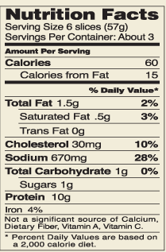
  Food Safety and Inspection Service:
  New Technology and Labeling: Example #2
Made in New Hampshire
Keep Refrigerated
Black Forest Ham
High-Pressure Processed
97% Fat Free
Cured with water, salt, contains 2% or less of dextrose, sodium nitrite, sodium erythorbate, sodium lactate, sodium phosphate, sodium diacetate
Special Claim
Distributed by Birchwood Farms, Nashua, NH 03060
Net Wt. 6 oz.

Slide 17



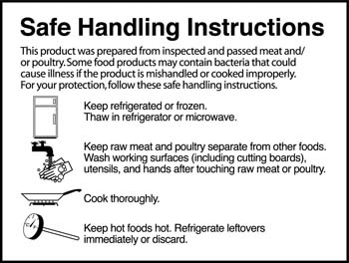
  Food Safety and Inspection Service:
  New Technology and Labeling: Example #3
A Good Win! Farms©
est 2010
Irradiated Ground Beef
Distributed By:
20101Beltsville Rd
Sunnyside, MD 12345
Certified Organic by LPDD Organic Certifying
Keep Refrigerated
Net Weight: 48 oz (3 lbs)

Slide 18
  Food Safety and Inspection Service:
  Animal Cell Culture Food Technology
Animal cell cultured food technology refers to the controlled growth of animal cells from livestock, poultry, fish, or other animals, their subsequent differentiation into various cell types, and their collection and processing into food.
Notes:
So, to wrap up, I’ll talk a little bit about cell-cultured meat and poultry. This slide includes a description of a the technology used to create cell-cultured food, developed by FDA.
As per the slide - animal cell cultured food technology refers to the controlled growth of animal cells from livestock, poultry, fish, or other animals, their subsequent differentiation into various cell types, and their collection and processing into food.
This encompasses cell-cultured products made from any and all animals, whether amenable to the meat and poultry statutes or to the Federal Food, Drug and Cosmetic Act which provides for FDA’s jurisdiction over fish and seafood products other than fish of the order Siluriformes fish.
USDA and FDA are aware of a number of firms developing this technology to produce cell-cultured meat, poultry and fish products.

Slide 19

Joint Oversight
Food Safety and Inspection Service:
  Food Safety and Inspection Service:
  Animal Cell Culture Food Technology: Oversight
FSIS
FDA
Harvest
Cell collection, banking, growth and differentiation
Product processing, packaging, and labeling

Slide 20
Future Plans
Food Safety and Inspection Service:
  Food Safety and Inspection Service:
  Animal Cell Culture Food Technology: Future Plans
FDA pre-market consultations
Continued FDA-USDA coordination on oversight
No new FSIS inspection regulations anticipated
New FSIS labeling requirements developed through a public process, in coordination with FDA

Slide 21
Food Safety and Inspection Service:
  Food Safety and Inspection Service:
  Cell-Cultured Meat: Suggested Product Names
Cell Cultured Meat
meat substitute
CELL BASED MEAT PRODUCT
Non-Slaughtered Meat
Animal Free Meat
ARTIFICIAL MEAT
Synthetic Meat
clean meat
Fake Meat
KIND MEAT
HAPPY MEAT
PETRI-DISH MEAT
lab-grown meat
Manufactured Meat-Like Protein
cell-based meat
Cultured Meat

Slide 22
  Food Safety and Inspection Service:
  Questions and Contact Information
Questions?
Contact Information
Matthew Michael
Director, Issuances Staff
Office of Policy and Program Development
USDA Food Safety and Inspection Service
matthew.michael@usda.gov

