Slide 1
Outlook:
Grains and Oilseeds
Michael McConnell
USDA, Economic Research Service
Data approved by the World Agricultural Outlook Board. Estimates and forecasts are from the February 2022 WASDE. The findings and conclusions in this presentation are those of the author and should not be construed to represent any official USDA or U.S. Government determination or policy.

Slide 2
Overview
Factors affecting 2022/23 outlook for U.S. grains and oilseed markets.
Acreage outlook for 2022/23.
Commodity balances for 2022/23.

Slide 3
Factors framing the forecast
Volatility and uncertainty beyond the crop balance sheets:
  Global pandemic
  Global inflationary and supply chain pressures
  Geopolitical conditions across the globe
Normal weather assumed for the outlook
Current policy remain in place
Notes:
To start, let’s look at the factors that start outside the balance tables, but will affect the grains and oilseed markets…
Pandemic – It has affected and changed so many aspects of day-to-day lives and behaviors– how we work, live, and spend. Some of those changes will likely dissipate with time, while other are expected to lead to lasting structural changes to markets. Additionally, events related to the COVID virus can still potentially inject disruptions to markets.
Geopolitical and macroeconomic conditions are always factors in our projections, but heading into 2022/23 there are some particularly heightened factors that could affect trade flows and markets. As always, they will be closely monitored and future projections will incorporate new developments, if warranted..
“Normal weather” is always the underlying assumption for USDA projections. So the current projections are predicated on the assumption that future weather conditions revert to their historical and normal levels.
And finally, another fundamental assumption of our USDA projections: All current policies remain in place moving forward.

Slide 4
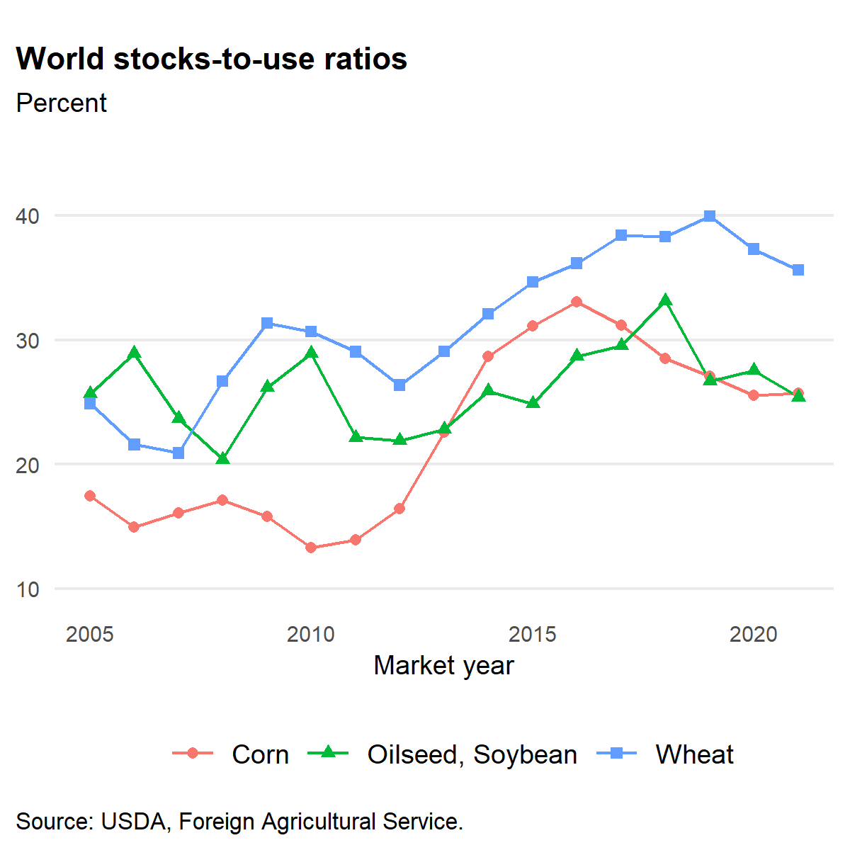
Global markets tighter in recent years
Global corn, wheat, and soybean markets are all several years past their recent stocks-to-use highs.
Tighter markets are due to a combination of consumption growth and production disruptions.
Overall, this has been supportive of global prices for grains and oilseeds.
Notes:
There has been a lot to digest in the global crop markets, but if I had to summarize it with one picture…
Each line represents multiple narratives running through the respective commodity markets: Weather conditions in South America, Eastern Europe, and North America affecting supplies; Increased imports of energy feed into China; continued demand growth in developing markets; Trade policies and disruptions and the markets’ reactions.
Main takeaway: all three major markets are several years removed from their recent stocks-to-use highs
Global balance sheet fundamentals are supportive of U.S. crop values.

Slide 5
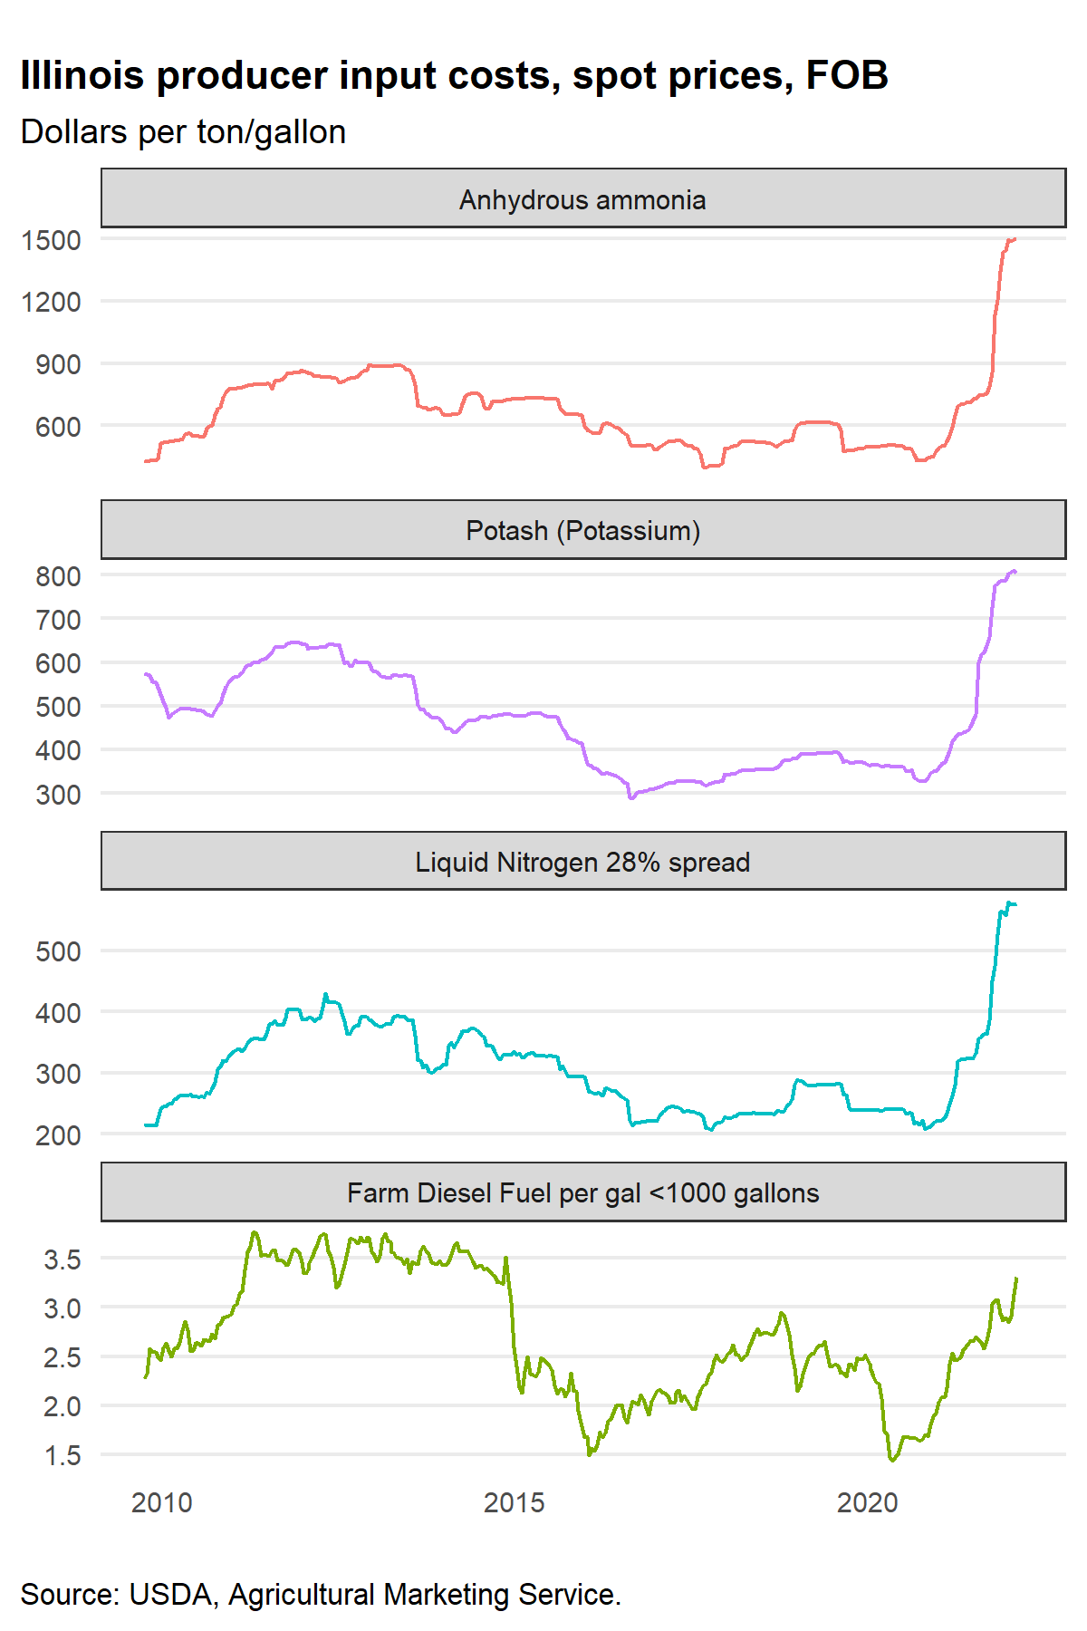
Higher input costs a key factor facing U.S. producers in 2022/23
Input costs, and particularly fertilizer, have seen higher prices.
Reports of availability constraints for fertilizer and other chemical inputs.
Comes after prolonged period of relatively lower-cost input markets.
Notes:
Turning to the domestic side of the market…
A lot of attention on fertilizer prices in recent months, and rightly so. Fertilizer prices have increased considerably since the summer of 2021.
While the scale of the recent increase is noteworthy, it’s also important to note that we had a lower-cost-input market for an extended period of time: 2015 to 2020. We are coming out of a prolonged period of relatively lower-cost chemical input markets.
Finally, it’s also important to keep in mind that what is occurring in fertilizer and chemical markets is not necessary fully indicative of all producers’ input costs. While many products are becoming more expensive to procure, they all are not experiencing the rate of increase seen in fertilizer markets. Diesel Fuel trends illustrate that not all inputs are increasing at same rate as fertilizers.
That being said, overall trends point toward higher production costs in 2022 compared with recent years.

Slide 6
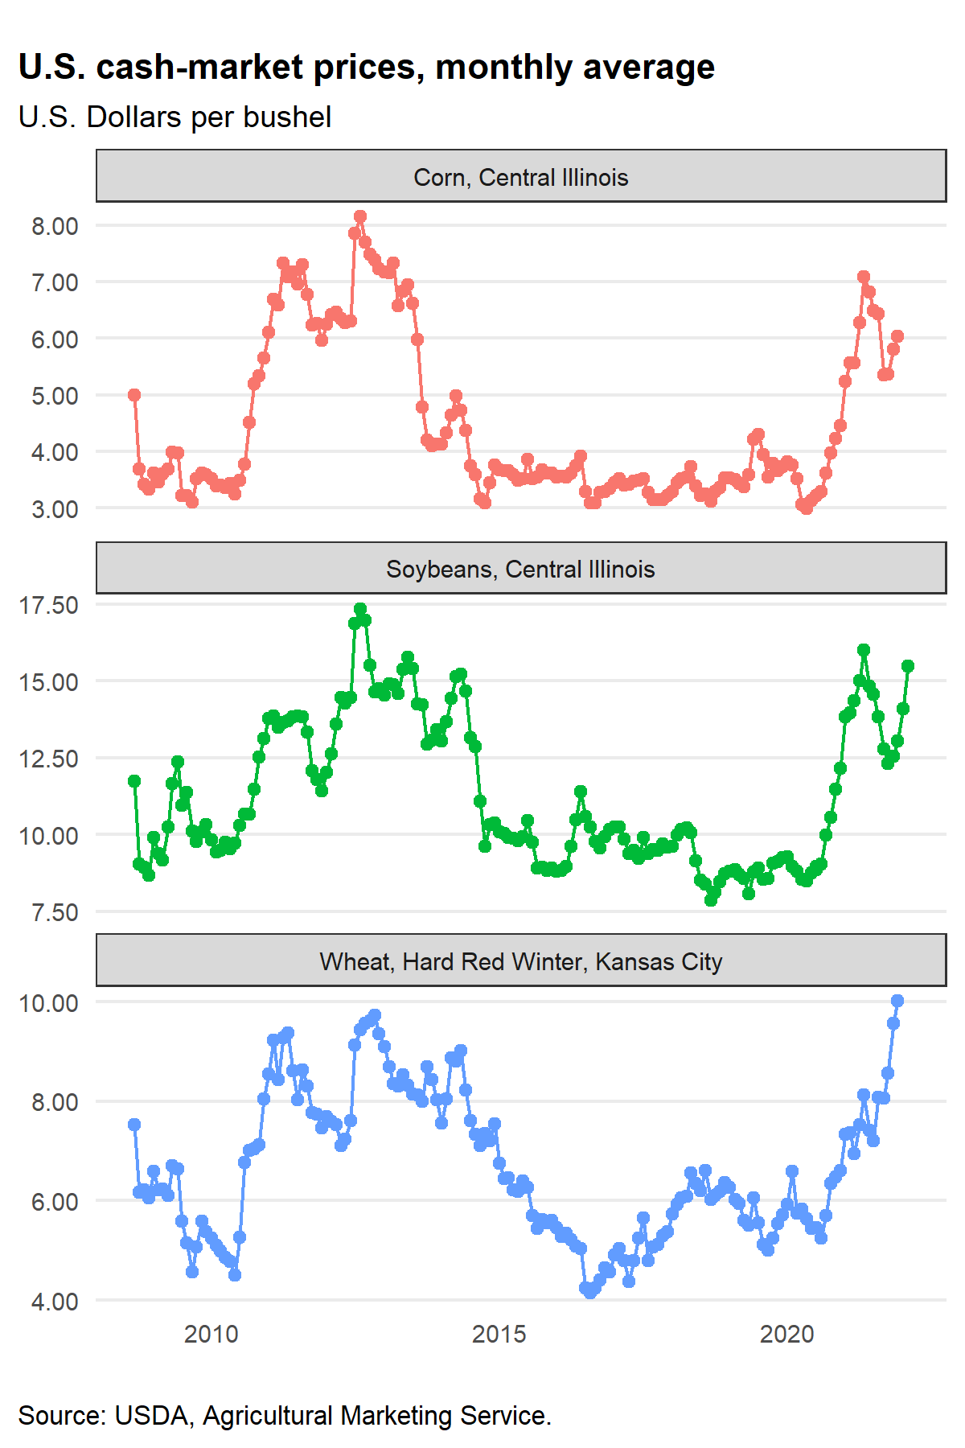
Crop prices remain at elevated levels
Cash prices remain at higher levels since fall of 2020, compared with 2015 to 2019 prices.
Futures markets for 2022/23 crops remain elevated.
Illinois 2022 fall delivery cash prices in February (AMS):
  Corn: $5.33 to $5.78
  Soybeans: $13.40 to $14.60
Costs of production are rising, but so have crop values.
Notes:
Producer decisions are not going to be solely driven by costs, but by margins…
Ultimately producer decisions will largely be driven by expected margins.
Cash market prices have also been at higher levels than relatively lower levels that began in 2014 and 2015.
Based on current futures market prices and reported cash bids for post-harvest delivery, price levels remain at those elevated levels for the upcoming crop.
While costs are increasing, so are crop values.

Slide 7
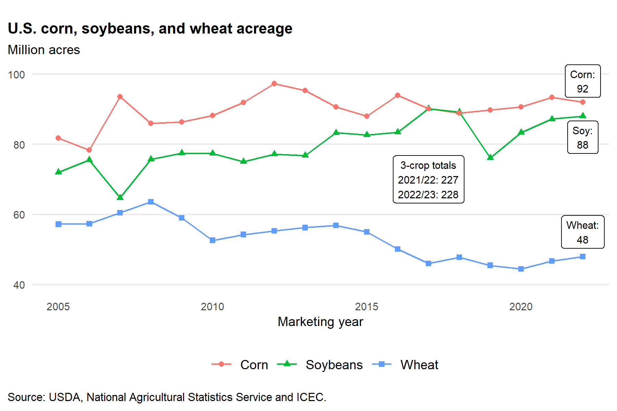
2022/23 3-crop acreage outlook
Notes:
That leads us to the outlook for 2022/23…
Expecting more acreage, overall
Each crop is within historical ranges– not unprecedented levels for corn, soybeans, or wheat
Higher soybean and wheat area, with corn acreage declining
Wheat area incorporates the 34.4 million acres from the Seeding report, with the remaining 13.6 million acres for spring classes (up 0.6 million acres).
Also strong incentives to plant other grains and oilseeds, like barley, oats, canola, flaxseed, pulses, etc.
Competition for acreage, not just amongst these three crops, but across the broad portfolio of crops grown in the United States

Slide 8
Corn Market Outlook
 | 2021/22 | 2022/23 | Difference
Area planted (mil. acres) | 93.4 | 92.0 | -1.4
Yield (bu/acre) | 177.0 | 181.0 | 4.0
 | Million bushels
Production | 15,115 | 15,240 | 135
Imports | 25 | 25 | 0
Exports | 2,425 | 2,350 | -75
Feed and residual | 5,650 | 5,650 | 0
Food, seed, and industrial | 6,760 | 6,840 | 80
Ethanol for fuel | 5,325 | 5,400 | 75
Ending stocks | 1,540 | 1,965 | 415
Farm average price ($/bu.) | $5.45 | $5.00 | -$0.45
Notes:
We’ll turn to the commodity balance sheets. Historically speaking, corn prices are still projected at strong levels, but relative to the current 2021/22 outlook, ending stocks are projected to be larger…
Production projected to grow- weather-adjusted trend yield, assumption of normal weather
FSI- Ethanol at 5,400. Growth predicated on domestic gasoline demand, primarily.
Feed and residual- flat primarily due to relatively fewer cattle on feed for the upcoming marketing year.
Exports – Expect to see continued competition from Brazil, Ukraine, and Argentina. (2020-Ukraine shortfall, 2021-Brazil shortfall)
Prices – larger stock levels will translate into lower prices, year-over-year, but still relatively high by historical standards

Slide 9
Sorghum Market Outlook
 | 2021/22 | 2022/23 | Difference
Area planted (mil. acres) | 7.3 | 6.5 | -0.8
Yield (bu/acre) | 69.0 | 69.2 | 0.2
 | Million bushels
Production | 448 | 401 | -47
Imports | 0 | 0 | 0
Exports | 310 | 300 | -10
Feed and residual | 115 | 95 | -30
Food, seed, and industrial | 10 | 10 | 0
Ending stocks | 33 | 29 | -8
Farm average price ($/bu.) | $5.45 | $4.90 | -$0.55
Notes:
The sorghum market follows a similar outlook to corn…
Lower planted area due to increased plantings of wheat and cotton.
Overall market outlook is largely driven by export demand (particularly Chinese market).
Sorghum producers are expected to face increased global competition from Argentina and Australia.

Slide 10
Wheat Market Outlook
 | 2021/22 | 2022/23 | Difference
Area planted (mil. acres) | 46.7 | 48.0 | 1.3
Winter Wheat area planted | 33.6 | 34.3 | 0.7
Yield (bu/acre) | 44.3 | 49.1 | 4.8
 | Million bushels
Production | 1,646 | 1,940 | 294
Imports | 100 | 120 | 20
Exports | 810 | 850 | 40
Feed and residual | 110 | 100 | -10
Food and seed | 1,023 | 1,027 | 4
Ending stocks | 648 | 731 | 83
Farm average price ($/bu.) | $7.30 | $6.80 | -$0.50
Notes:
If realized, the projected planted area of 48 million acres would be the second-consecutive annual increase in planted area for wheat.
In addition, yields are projected to rebound assuming normal weather
Price competitiveness will constrain the outlook for growth domestic feed use and further annual growth in expected exports
Exports- foreign suppliers are expected to be better positioned in many import markets
Feed- wheat prices are likely going to be uncompetitive to corn and sorghum in many local feeding markets
Season-average farm price forecast at $6.80– down from 2021/22, but still high compared to recent history

Slide 11
Soybean Market Outlook
 | 2021/22 | 2022/23 | Difference
Area planted (mil. acres) | 87.2 | 88.0 | 0.8
Yield (bu/acre) | 51.4 | 51.5 | 0.1
 | Million bushels
Production | 4,435 | 4,490 | 55
Imports | 15 | 15 | 0
Exports | 2,050 | 2,150 | 100
Crush | 2,215 | 2,250 | 35
Seed and residual | 118 | 124 | 6
Ending stocks | 325 | 305 | -20
Farm average price ($/bu.) | $13.00 | $12.75 | -$0.25
Notes:
The evolving outlook for Southern Hemisphere soybean production in 2021/22 should provide additional value for U.S. exports in the 2022/23 soybean market.
Production- The production forecast is increased 55 million bushels from 2021/22 due to added area and weather-adjusted trend yield.
Exports- Should benefit from higher prices that have resulted from production shortfalls in certain key growing regions in South America during the harvest that is currently in progress.
Crush- Projected continued growth in the domestic crush as due to demand pull, although important to distinguish between long-term capacity expansion and potential for the next marketing year.
Price- Bean/corn ratio slightly higher than historical levels due to the weather in South America having a bigger effect on soybean prices than corn at present.

Slide 12
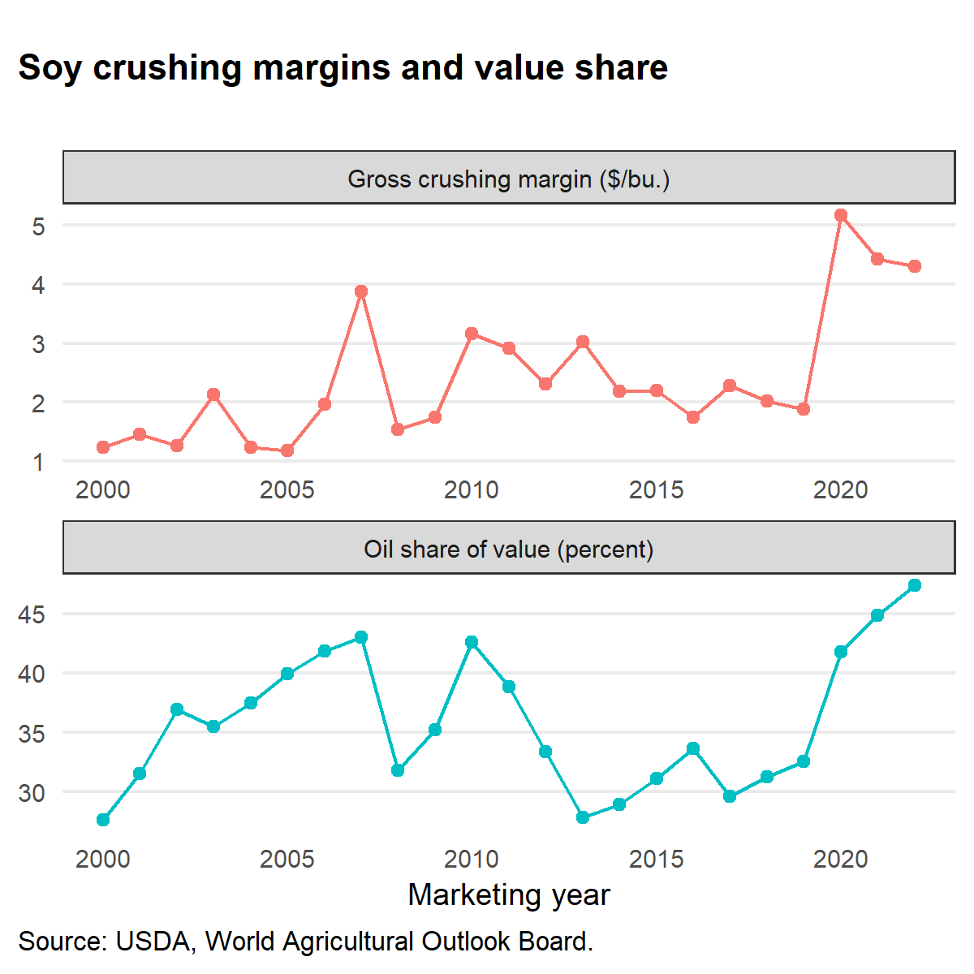
Soybean Oil and Meal Market Outlook
 | 2020/21 | 2021/22 | 2022/23 | Diff.
Soybean Oil | Million pounds
Production | 25,023 | 26,205 | 26,325 | 120
Domestic use | 23,323 | 25,285 | 26,000 | 715
Biofuels | 8,850 | 11,000 | 12,000 | 1,000
Exports | 1,723 | 1,425 | 1,200 | -225
Average Price ($/lb) | $0.569 | $0.66 | $0.68 | $0.02
Soybean Meal | Thousand short tons
Production | 50,565 | 51,909 | 53,050 | 1,141
Domestic use | 37,580 | 37,900 | 38,600 | 700
Exports | 13,768 | 14,400 | 14,800 | 400
Average price ($/st) | $392 | $410 | $375 | -$35
Notes:
In addition to the soybean market, there are important developments taking place in the whole soybean complex for 2022/23…
Higher crush means more soybean oil and meal production.
Crush margins expected to continue to be strong. Not as high as the previous 2 years, but still strong by historical levels.
Expecting more oil to be used for biofuel production. This growth has been remarkable since 2020/21.
Meal use is expected to grow domestically and for exports.
Oil market continues to account for a higher share of the crush value, continuing the recent trend seen in the crush market.

Slide 13
Concluding remarks
Increase in total number of corn, soybean, and wheat acres planted in 2022.
Operating margins likely tighter than 2021/22, but economic incentives are in place for additional grains and oilseeds production.
Wheat: Higher production and relatively high farm prices, but increasing price competition in export and domestic feed markets.
Corn: Lower prices from 2021/22 primarily due to increased global competition for exports.
Soybeans: Lower South American production in 2021/22 provide an opportunity for U.S. exports in 2022/23. Domestic crush margins expected to remain strong and tilted toward the value of the oil market.

Slide 14

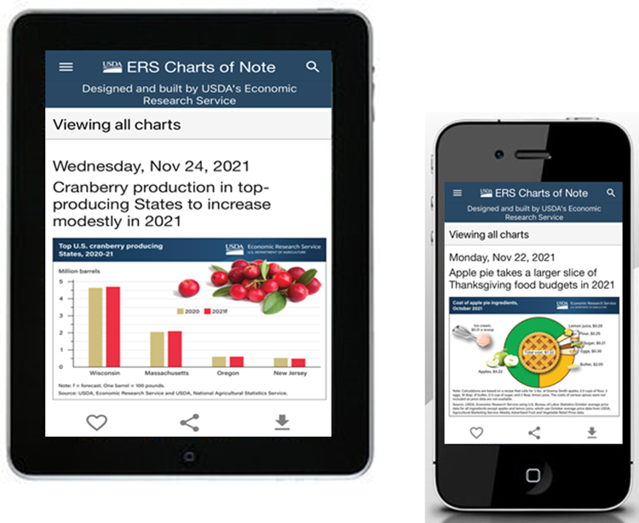


Like, Share, & Follow
Coming Soon!
Charts of Note Mobile App
@USDA_ERS
linkedin.com/company/USDA-Economic-Research-Service
ERS.USDA.gov/subscribe
ERS.USDA.gov/multimedia
ERS.USDA.gov/about-ers/careers-at-ers/

