Slide 1
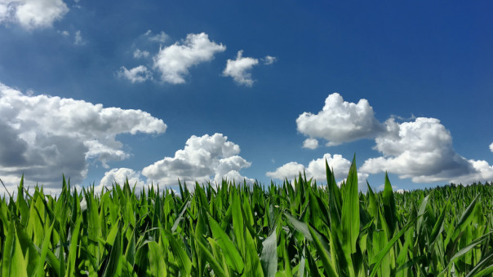

Adapting Agricultural Planning and Production to Prepare for Extreme Weather Uncertainties
Prepared by Stephen P. Nicholson
Vice President – RaboReasearch Food & Agribusiness
Senior Analyst/Grains and Oilseeds
January 2020
1

Slide 2
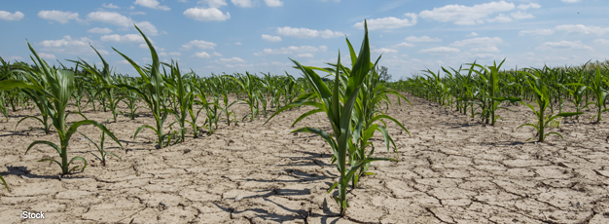
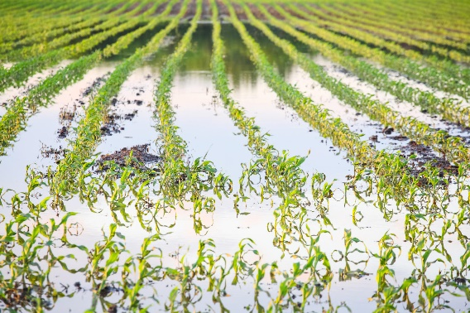
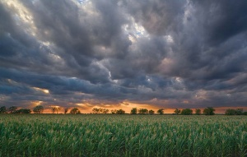
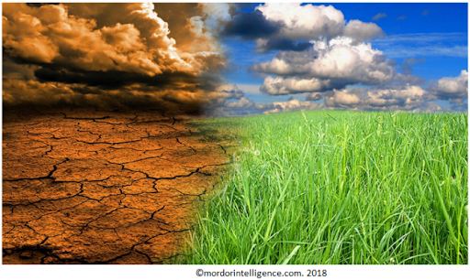
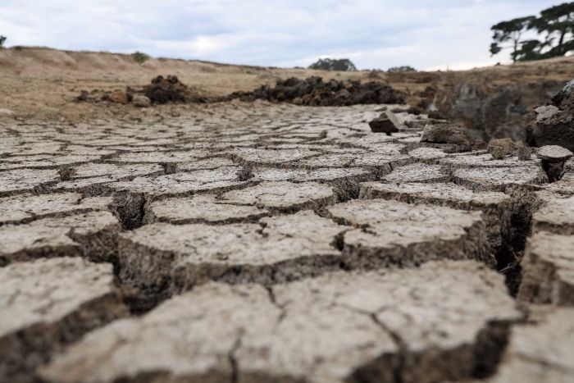
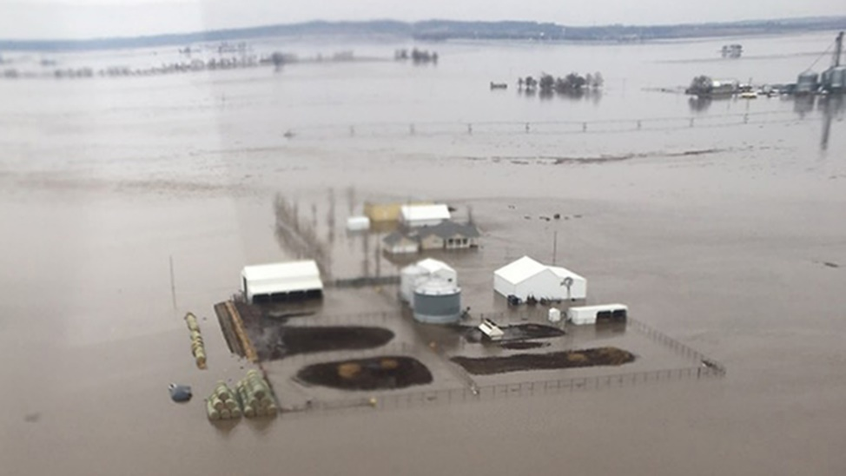
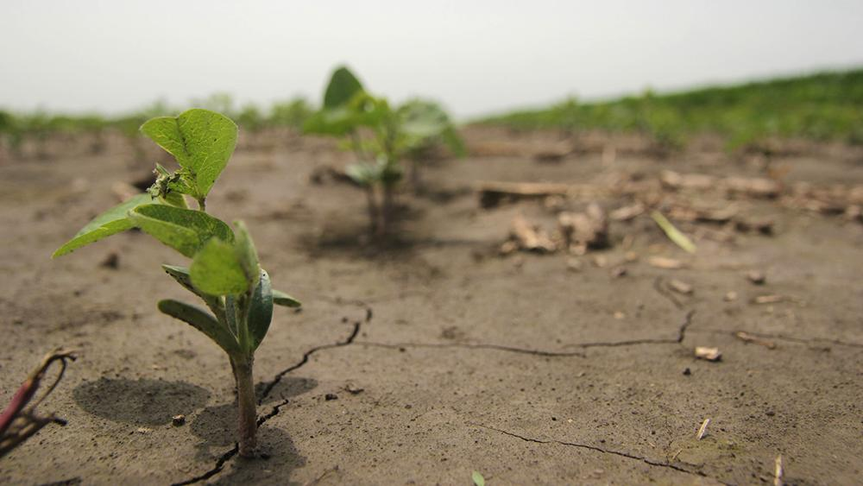
Since the Beginning of Agriculture Farmers & Ranchers have had to Adapt to Changing Climate Conditions

Slide 3
U.S. Corn Yields
Over time U.S. corn yield deviation from trend has decreased. Producers have continued to increase productivity in the face of more difficult weather and climate conditions
Bushels per Acre
Bushels per Acre
Note: Shaded bar indicate major U.S. droughts

Slide 4
Still Struggling over Definitions of Overused Terms
Sustainability
  Capable of bring sustained
  2.a of, relating to, or being a method of harvesting or using a resource so that the resource is not depleted of permanently damaged; sustainable techniques, sustainable agriculture
  b. of or relating to a lifestyle involving the use of sustainable methods, sustainable society
Stewardship
  the office, duties, and obligations of a steward
  The conducting, supervising, of managing or something especially: the careful and responsible management of something entrusted to one’s care, stewardship of natural resources.
Conservation
  1: a careful preservation and protection of something especially: planned management of a natural resource to prevent exploitation, destruction, or neglect
  2: the preservation of a physical quantity during transformations or reactions
Preservation
the act, process, or result of preserving something: such as
  a: the activity or process of keeping something valued alive, intact, or free from damage or decay
  b: the preparation of food for future use (as by canning, pickling, or freezing) to prevent spoilage
Resilience
  1: the capability of a strained body to recover its size and shape after deformation caused especially by compressive stress
  2: an ability to recover from or adjust easily to misfortune or change

Slide 5

Multi-Dimensional Issue—Not an Either/Or Proposition
  Environmental
  Economic
  Community and Society

Slide 6
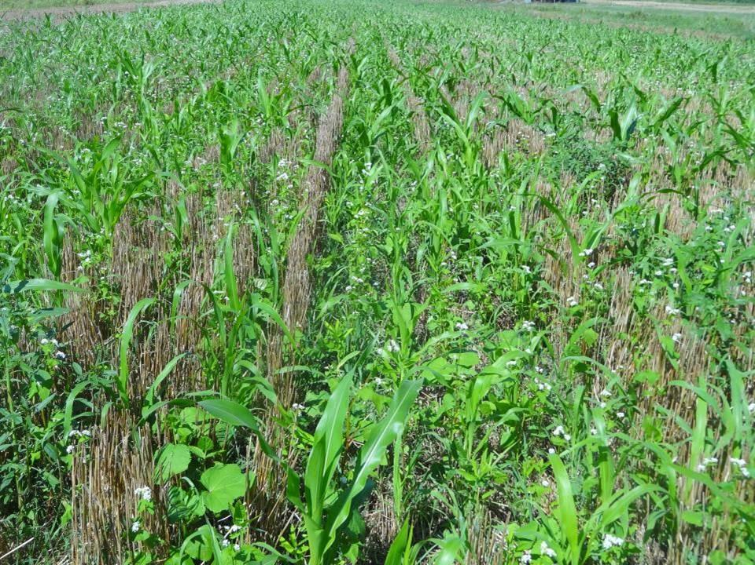
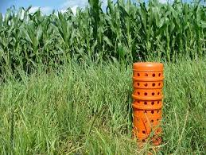
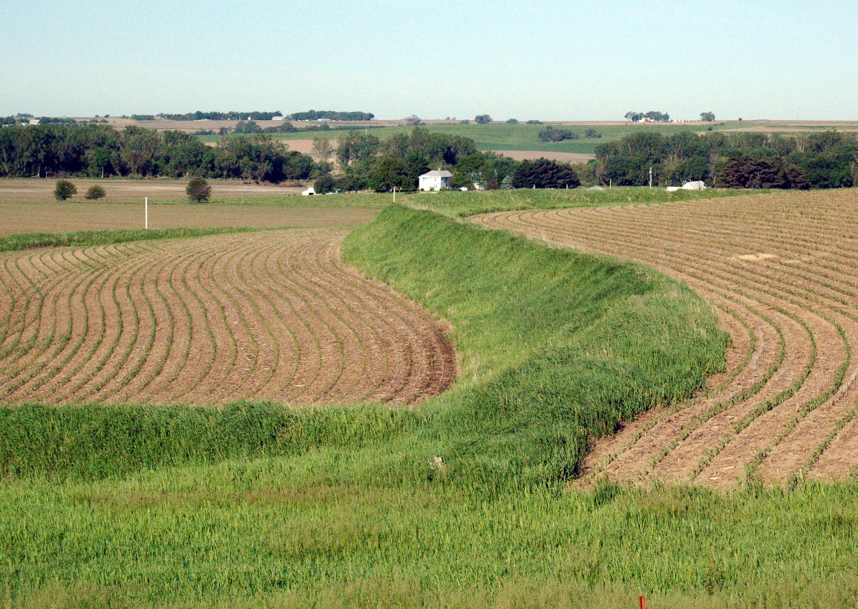
Short-term Adjustments by Producers
Cover Crops
Two schools of thought on expansion
  Tight geographic footprint
  Wide geographic footprint
Tillage practices
  No-Till
  Minimal-Till
  Strip till
Purchasing farmland that drains well
Crop insurance
Rotational grazing

Slide 7
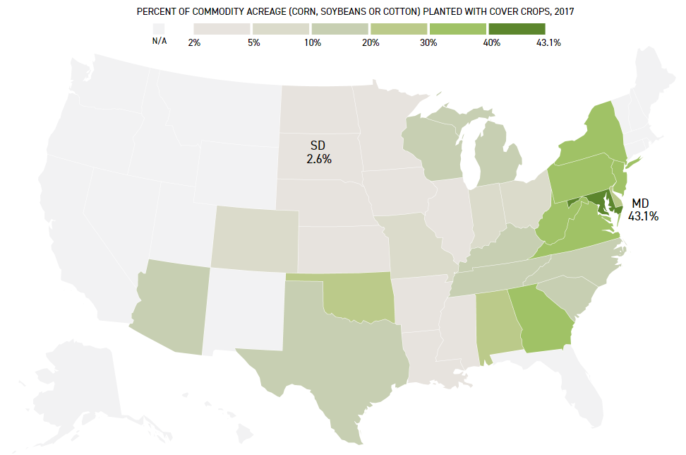
Percent of Commodity Acreage with Cover Crops, 2017
Maryland leads the Nation due Chesapeake Bay Restoration
Source: Census of Agriculture; Rob Meyers, University of Missouri and NCR-SARE Program; Patterson Clark, Politico Pro DataPoint

Slide 8
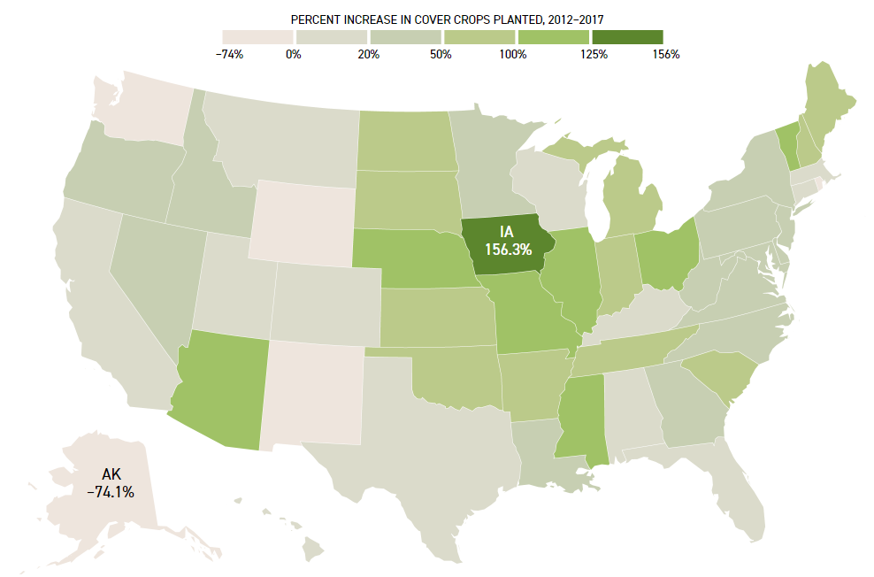
Growth in Cover Crop Adoption is Lead by the Corn Belts States, 2012-2017
Source: Census of Agriculture; Rob Meyers, University of Missouri and NCR-SARE Program; Patterson Clark, Politico Pro DataPoint

Slide 9
Farmers Used Conservation Tillage Methods on Nearly 75% of U.S. cropland in 2017

Slide 10
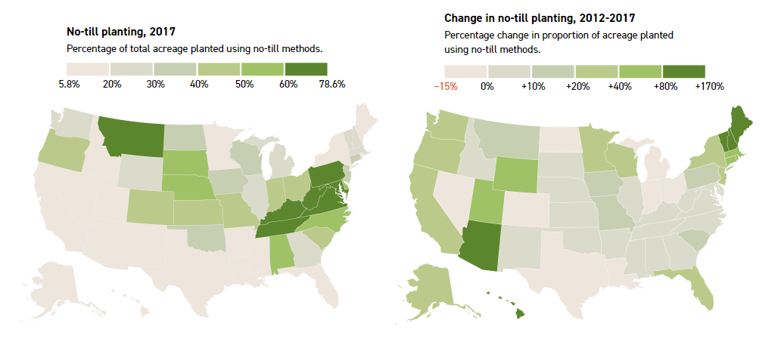
Long-term Adjustments by Producers
Source: National Agricultural Statistics Service, Purdue University, Agricultural Sustainability Institute, Patterson Clark, Politico Pro DataPoint

Slide 11
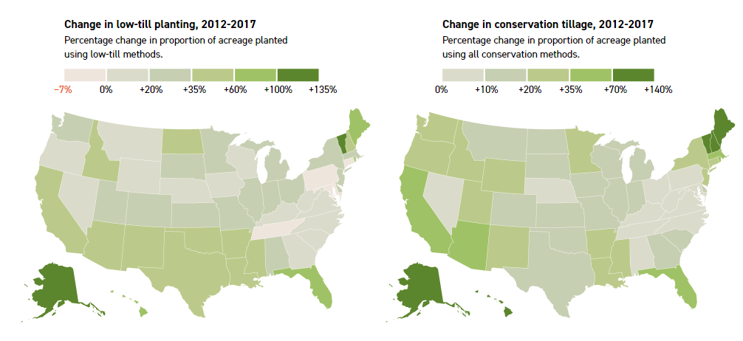
Long-term Adjustments by Producers
Source: National Agricultural Statistics Service, Purdue University, Agricultural Sustainability Institute, Patterson Clark, Politico Pro DataPoint

Slide 12
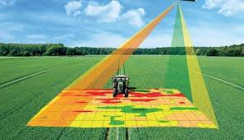
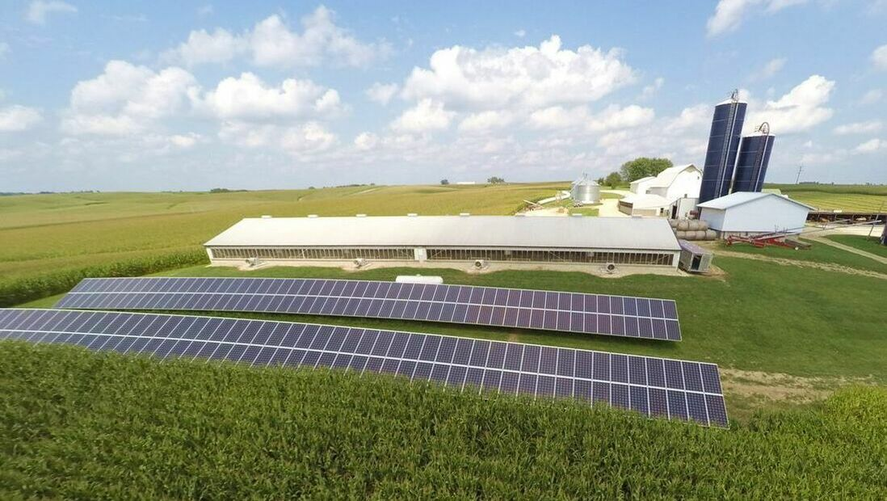
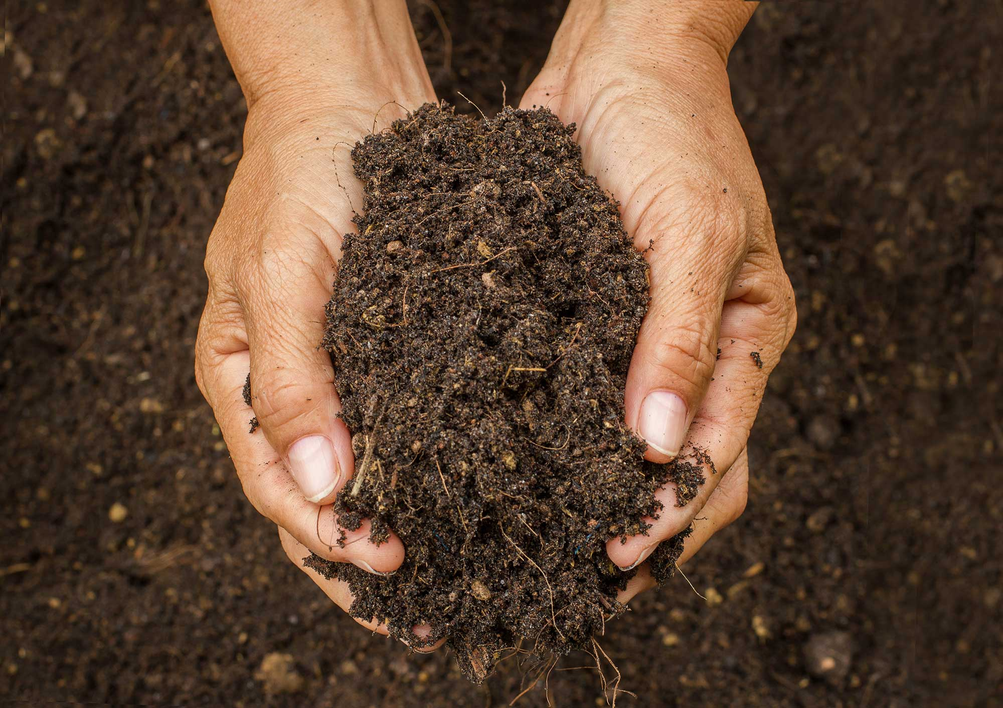
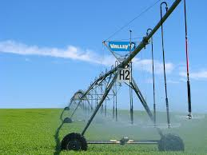
Long-term Adjustments by Producers
Precession agriculture
  Managing inputs
  Optimize yields
Farmland improvement
  Cover Crops
  Tiling
  Buffer Strips
  Terraces
  Re-establishment of waterways
Improving Soil Health
Renewable Energy
  Solar Panels
  Methane Digesters
Repurposing Farmland
  Return to Permanent Pasture
  Return to natural state—wetlands, timber, e.g. hunting
Diversifying Farming Operation
  Integrating livestock with crop production systems
  Increasing crop rotations—less mono-culture cropping system
Water Reclamation in Livestock Operations
Minimizing Water Use in Irrigation

Slide 13
Concluding Thoughts and Observations
Long-Term Profitability Challenges and Tight Margins for Row-Crop Production
  Producers will be stretched to make investment
  Investment in sustainability, conversation etc. will need to show positive economic returns.
Support of Grassroots Farm Groups—Peer Conversation
  Farmers and ranchers know their weather is changing
  Farmers are more concerned about moving forward than assigning blame.
  Knowledge and idea exchange
We Need Data
  Data is needed to measure progress
  What data do we need to collect
  How do we collect
  What are producers’ conservation practices
Research and Resource Support
  Air, water, soil conversation programs; i.e. EQUIP)
  Conservation Reserve Program (CRP)
  Rural infrastructure, e.g. internet needed to access technology
  Continue support of crop insurance
Public/Private collaboration and education
  In some cases this is already taking place, e.g. NCRS, food companies, producers
  The environment is there to make forward progress
All stakeholders must realize there is a cost

Slide 14
Contact Information
Stephen P. Nicholson
Rabo-AgriFinance
Vice President-RaboResearch Food & Agribusiness
Senior Grains and Oilseed Analyst
14767 N. Outer Road, Suite #400
Chesterfield, MO 63017 U.S.A.
314-317-8278 (office)
314-452-2479 (cell)
Stephen.Nicholson@raboag.com

Slide 15
Banking & Securities Disclosure
This document has been prepared exclusively for your benefit and does not carry any right of publication or disclosure other than to Coöperatieve Rabobank U.A. (“Rabobank”), registered in Amsterdam. Neither this document nor any of its contents may be distributed, reproduced or used for any other purpose without the prior written consent of Rabobank. The information in this document reflects prevailing market conditions and our judgement as of this date, all of which may be subject to change. This document is based on public information. The information and opinions contained in this document have been compiled or derived from sources believed to be reliable, without independent verification. The information and opinions contained in this document are indicative and for discussion purposes only. No rights may be derived from any potential offers, transactions, commercial ideas et cetera contained in this document. This document does not constitute an offer or invitation. This document shall not form the basis of or cannot be relied upon in connection with any contract or commitment whatsoever. The information in this document is not intended and may not be understood as an advice (including without limitation an advice within the meaning of article 1:1 and article 4:23 of the Dutch Financial Supervision Act). This document is governed by Dutch law. The competent court in Amsterdam, The Netherlands has exclusive jurisdiction to settle any dispute which may arise out of or in connection with this document and/or any discussions or negotiations based on it. This report has been published in line with Rabobank’s long-term commitment to international food and agribusiness. It is one of a series of publications undertaken by the global department of Food & Agribusiness Research and Advisory.
©2016 - All Rights Reserved.

