Slide 1
The Cost of a Healthy Diet:
Accounting for Nutrition and Food Spending
Goals and Constraints
Session:
USDA Modernizes the Thrifty Food Plan
USDA Agricultural Outlook Forum
February 24-25, 2022
Parke Wilde

Slide 2
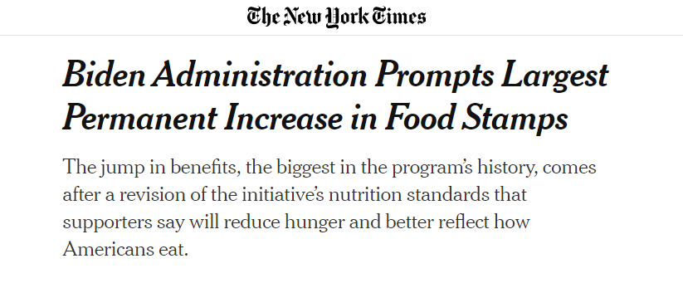

Slide 3
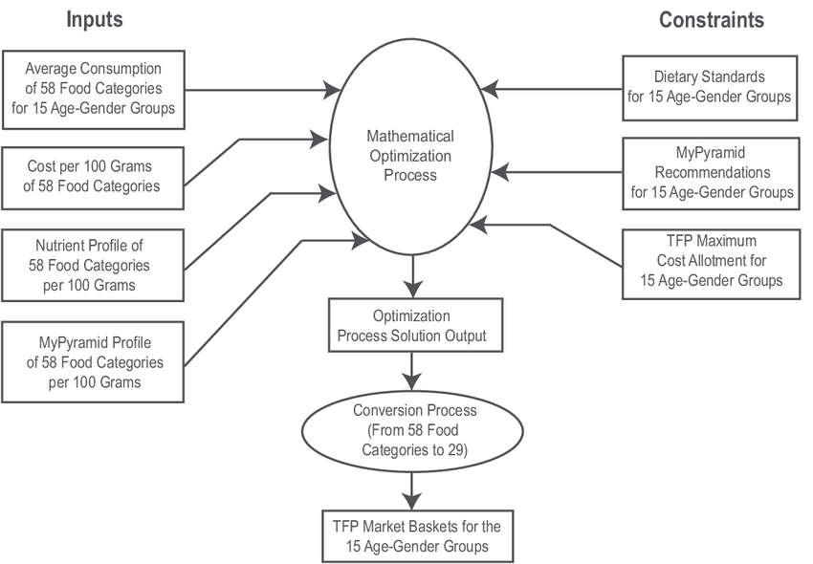
What is the cost of a healthy diet?
Carlson et al. (2006)
Wilde and Llobrera (2009)
Drewnowski (2007)
Caswell and Yaktine (2013)
Ziliak (2016)
Waxman, Gundersen, Thompson (2018)
Carlson, Llobrera, Keith-Jennings (2021)
New Thrifty Food Plan (2022)

Slide 4
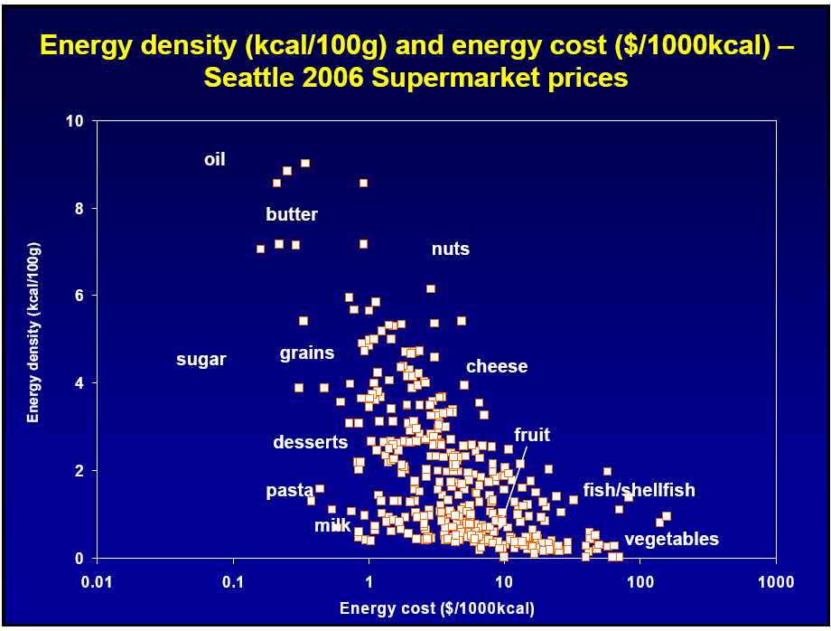
What is the cost of a healthy diet?
Carlson et al. (2006)
Wilde and Llobrera (2009)
Drewnowski (2007)
Caswell and Yaktine (2013)
Ziliak (2016)
Waxman, Gundersen, Thompson (2018)
Carlson, Llobrera, Keith-Jennings (2021)
New Thrifty Food Plan (2022)

Slide 5
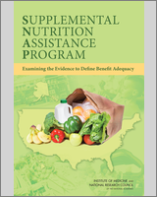
What is the cost of a healthy diet?
Carlson et al. (2006)
Wilde and Llobrera (2009)
Drewnowski (2007)
Caswell and Yaktine (2013)
Ziliak (2016)
Fan, Baylis, Gundersen, Ver Ploeg (2018)
Waxman, Gundersen, Thompson (2018)
Carlson, Llobrera, Keith-Jennings (2021)
USDA (August, 2021)

Slide 6
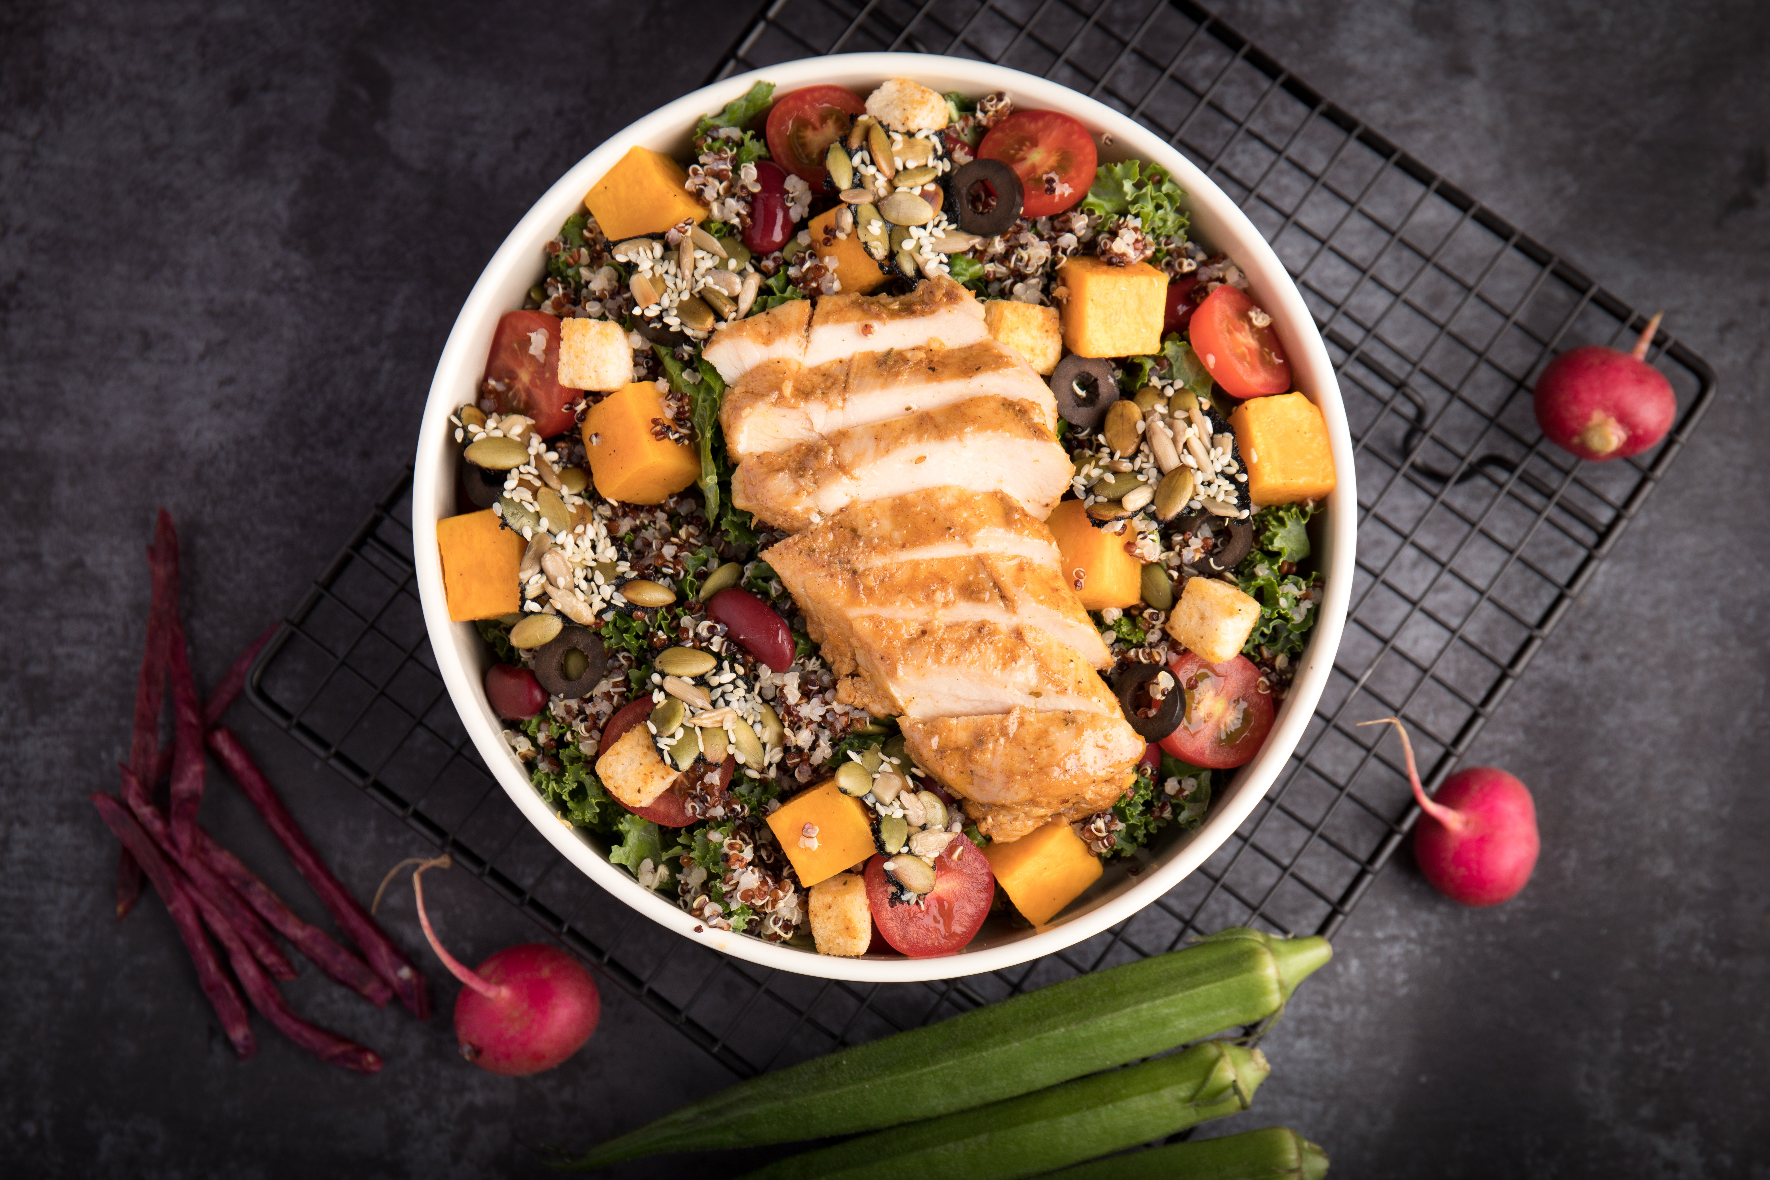
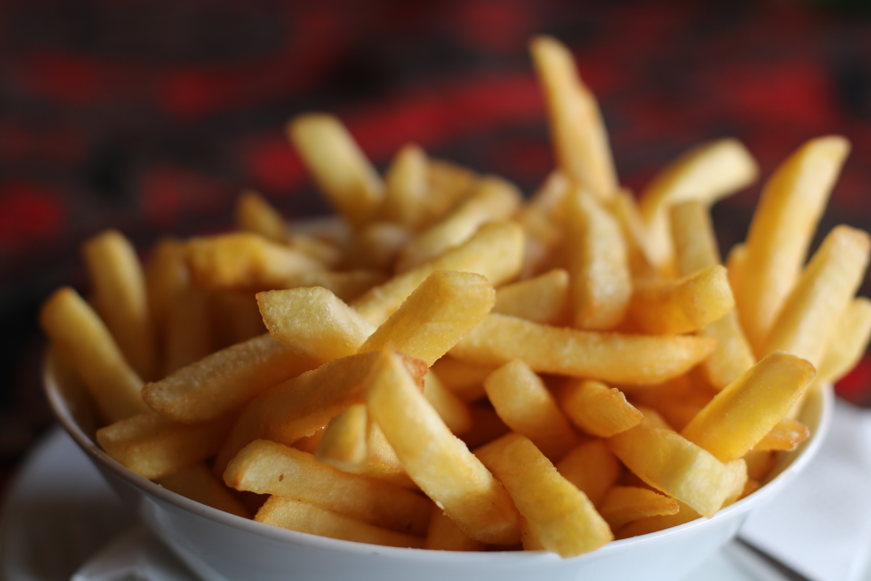
More healthy
More occasional
Less expensive
More expensive
Notes:
VERSION 4 – up arrow to More Healthy
Possible title: The Four Quadrants of Diet: Measuring Healthfulness and Cost
Images:
Turkey Tacos picture: Cooking Matters website: https://cookingmatters.org/recipes/turkey-tacos
French fries: FRIES_pexels-dzenina-lukac-1583884.
Salad with chicken: pexels-kei-photo-2741448
Steak: Powerpoint Images collection (searchword: Steak)

Slide 7
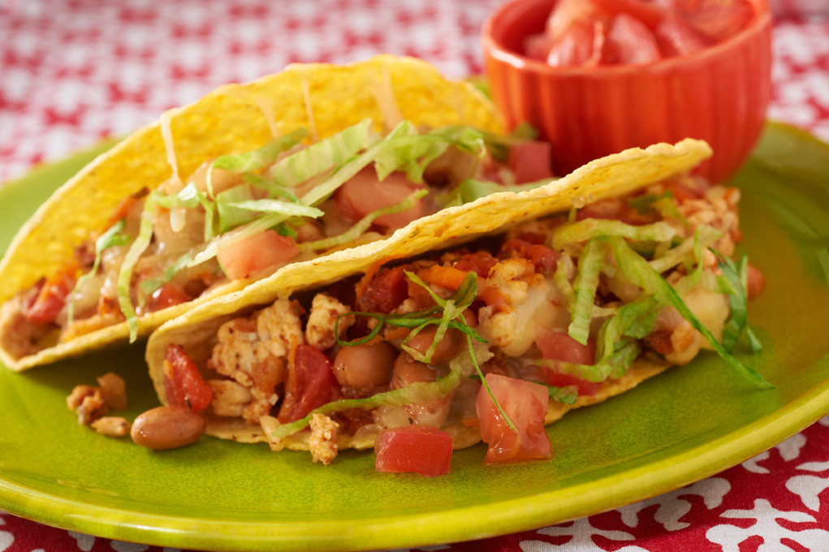
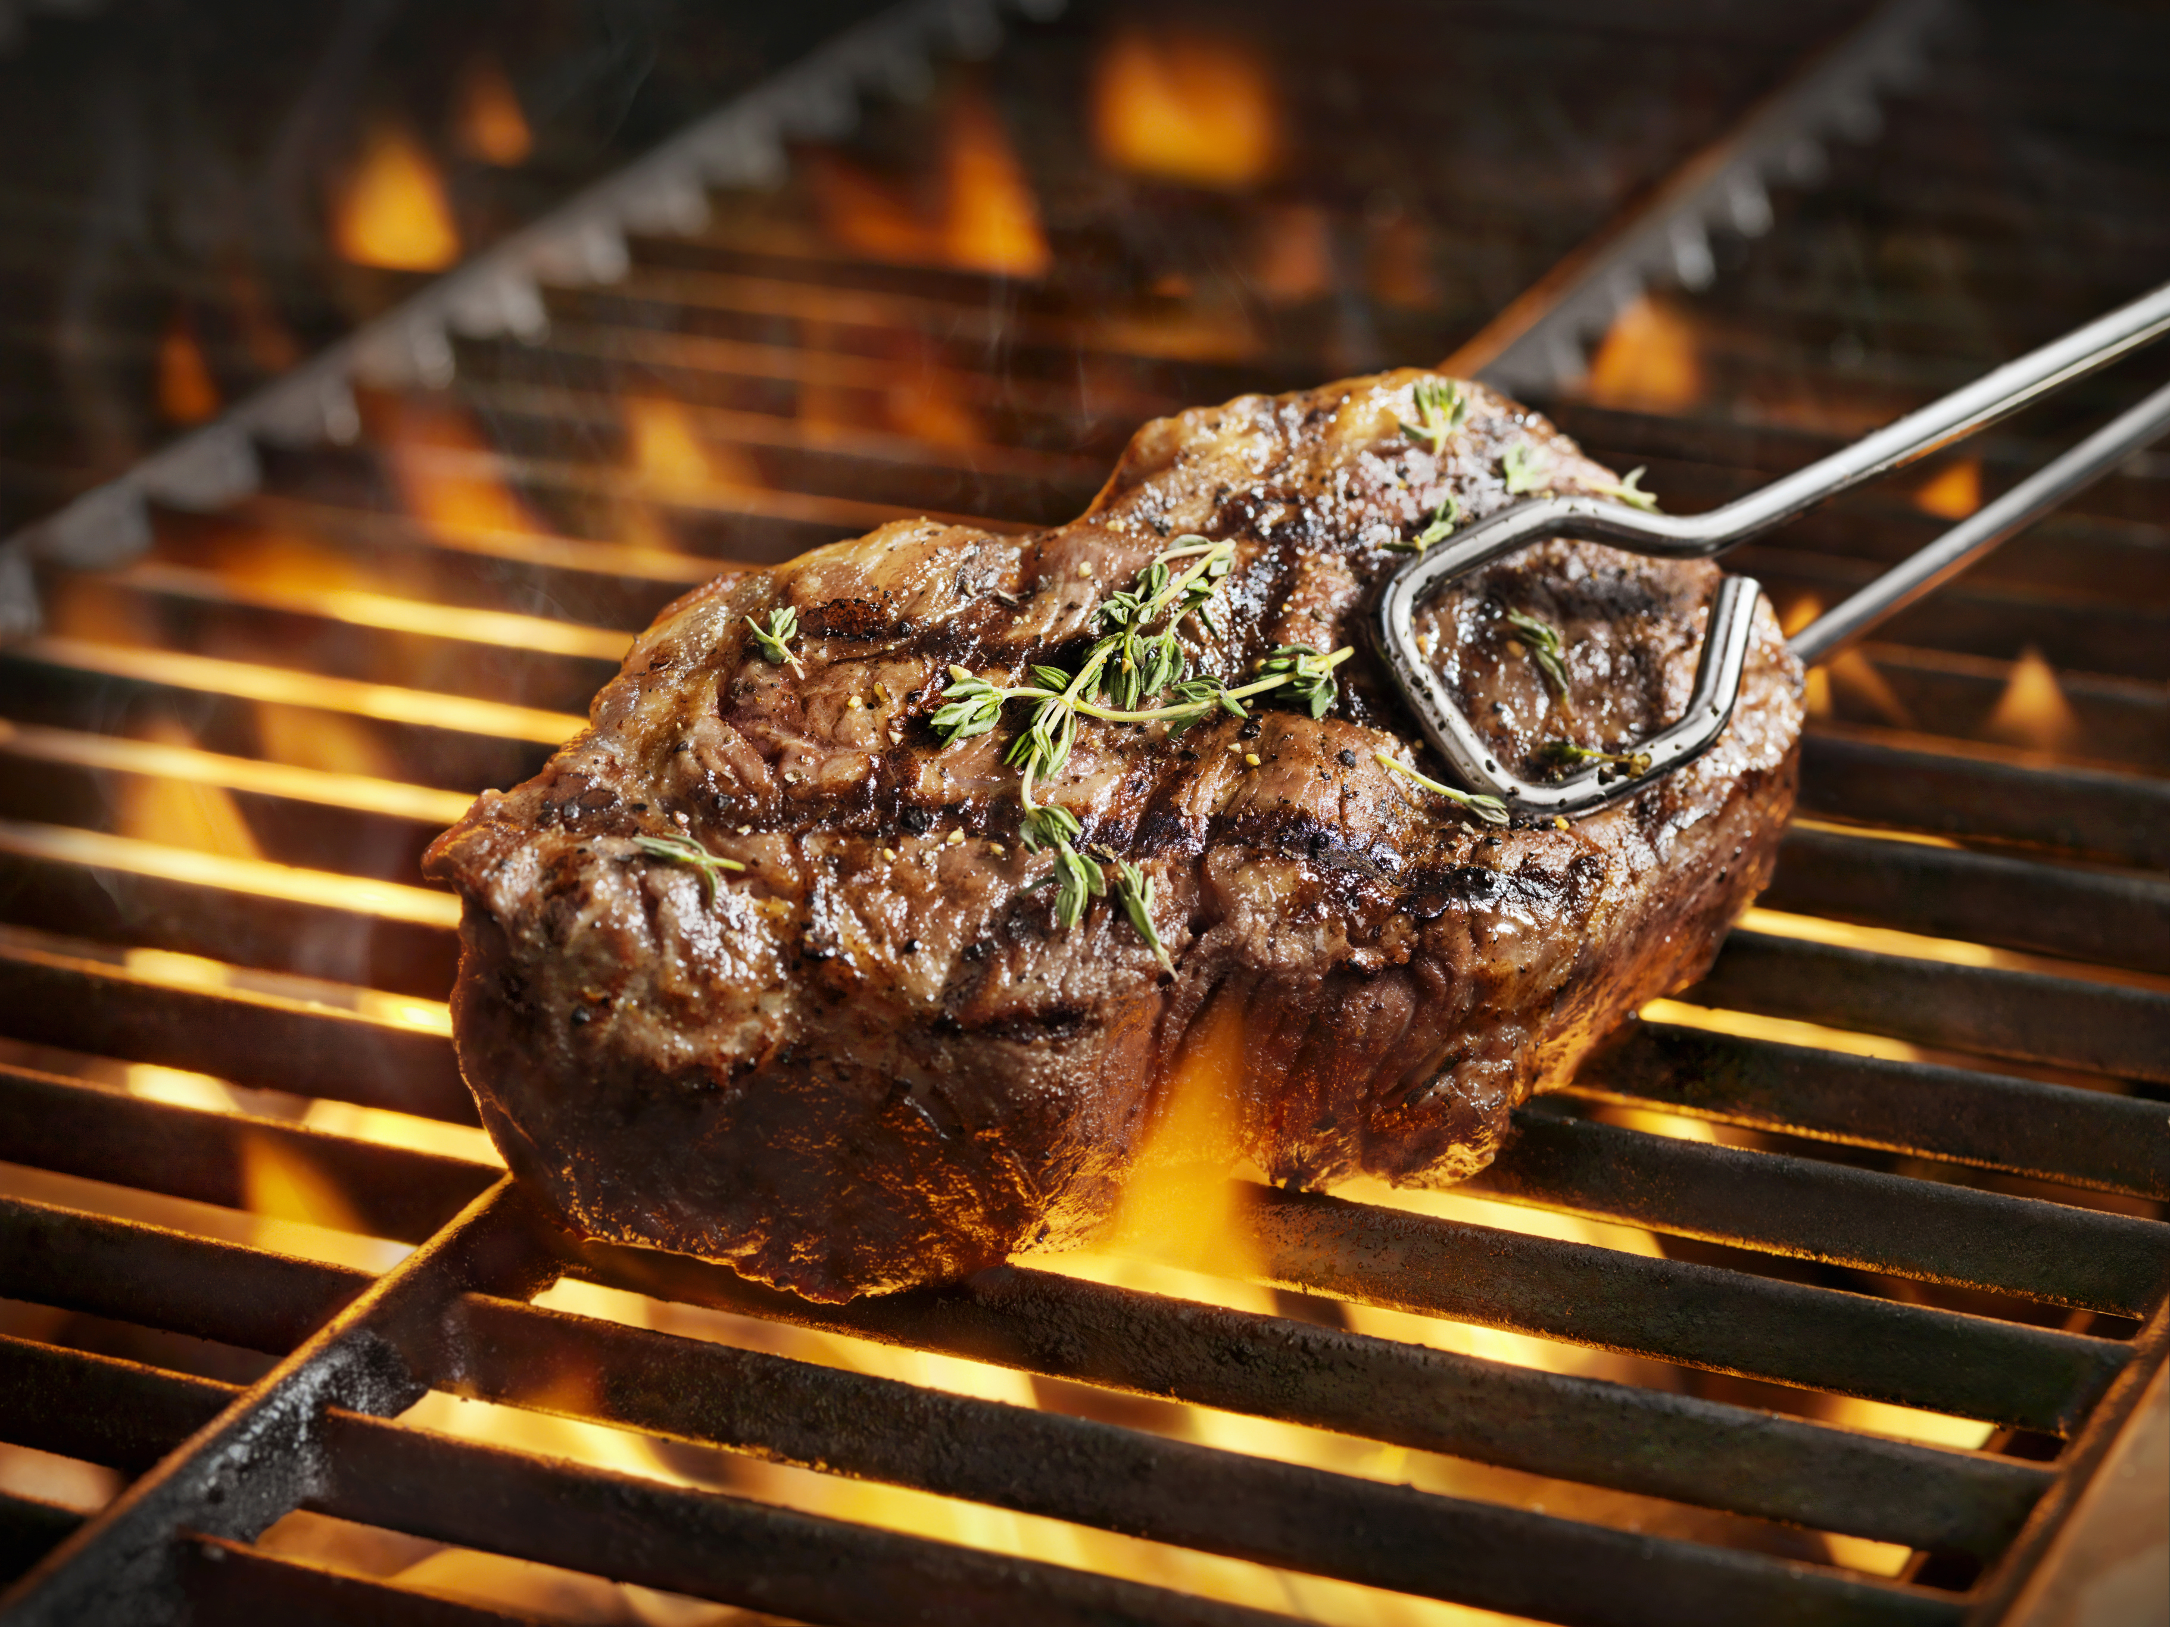
More healthy
More occasional
Less expensive
More expensive
Notes:
VERSION 4 – up arrow to More Healthy
Possible title: The Four Quadrants of Diet: Measuring Healthfulness and Cost
Images:
Turkey Tacos picture: Cooking Matters website: https://cookingmatters.org/recipes/turkey-tacos
French fries: FRIES_pexels-dzenina-lukac-1583884.
Salad with chicken: pexels-kei-photo-2741448
Steak: Powerpoint Images collection (searchword: Steak)

Slide 8
From Scarcity to Prosperity:
Nutrition and Food Spending Goals and Constraints for Low-Income Americans
Investigators: Parke Wilde, Linlin Fan, Norbert Wilson, Sara Folta
Managers: Katrina Sarson, Jada Wensman
Students: Yiwen Zhao, Elena Martinez, Aiden Gildea, and Angélica Valdés Valderrama
Advisors: Tatiana Andreyeva, Andrea Carlson, Will Masters, food bank/pantry partners

Slide 9
Optimization framework in the spirit of the Thrifty Food Plan (TFP)
Choose a plan (123 category quantities in our case):
Not too different from current intake (quadratic objective function)
Meeting constraints:
  Cost and food energy
  Nutrients from the Dietary Guidelines 2020-2025
  Broad food categories from MyPlate
  Practicality constraints

Slide 10
Choice of constraints → estimated cost.
Source: Wilde and Llobrera (2009).

Slide 11
Insights
Easier to meet nutrient constraints than food group constraints
Expectations for fruits, vegetables, and protein foods matter
Strict or more feasible sodium constraint
Interaction of constraints and aspirations

Slide 12
Preliminary: 10 most-consumed categories

Slide 13
Preliminary: 10 most-consumed categories
Candy
Cake
White potato chips, fries
Pizza
Caloric bev

Slide 14
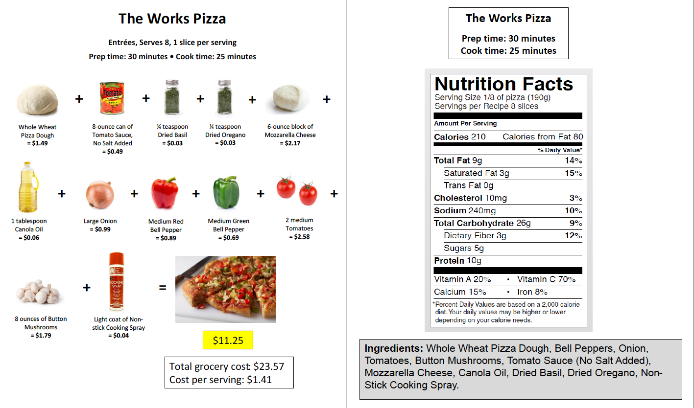
Recipe courtesy Cooking Matters/Share Our Strength

Slide 15
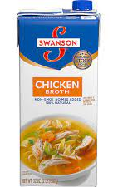
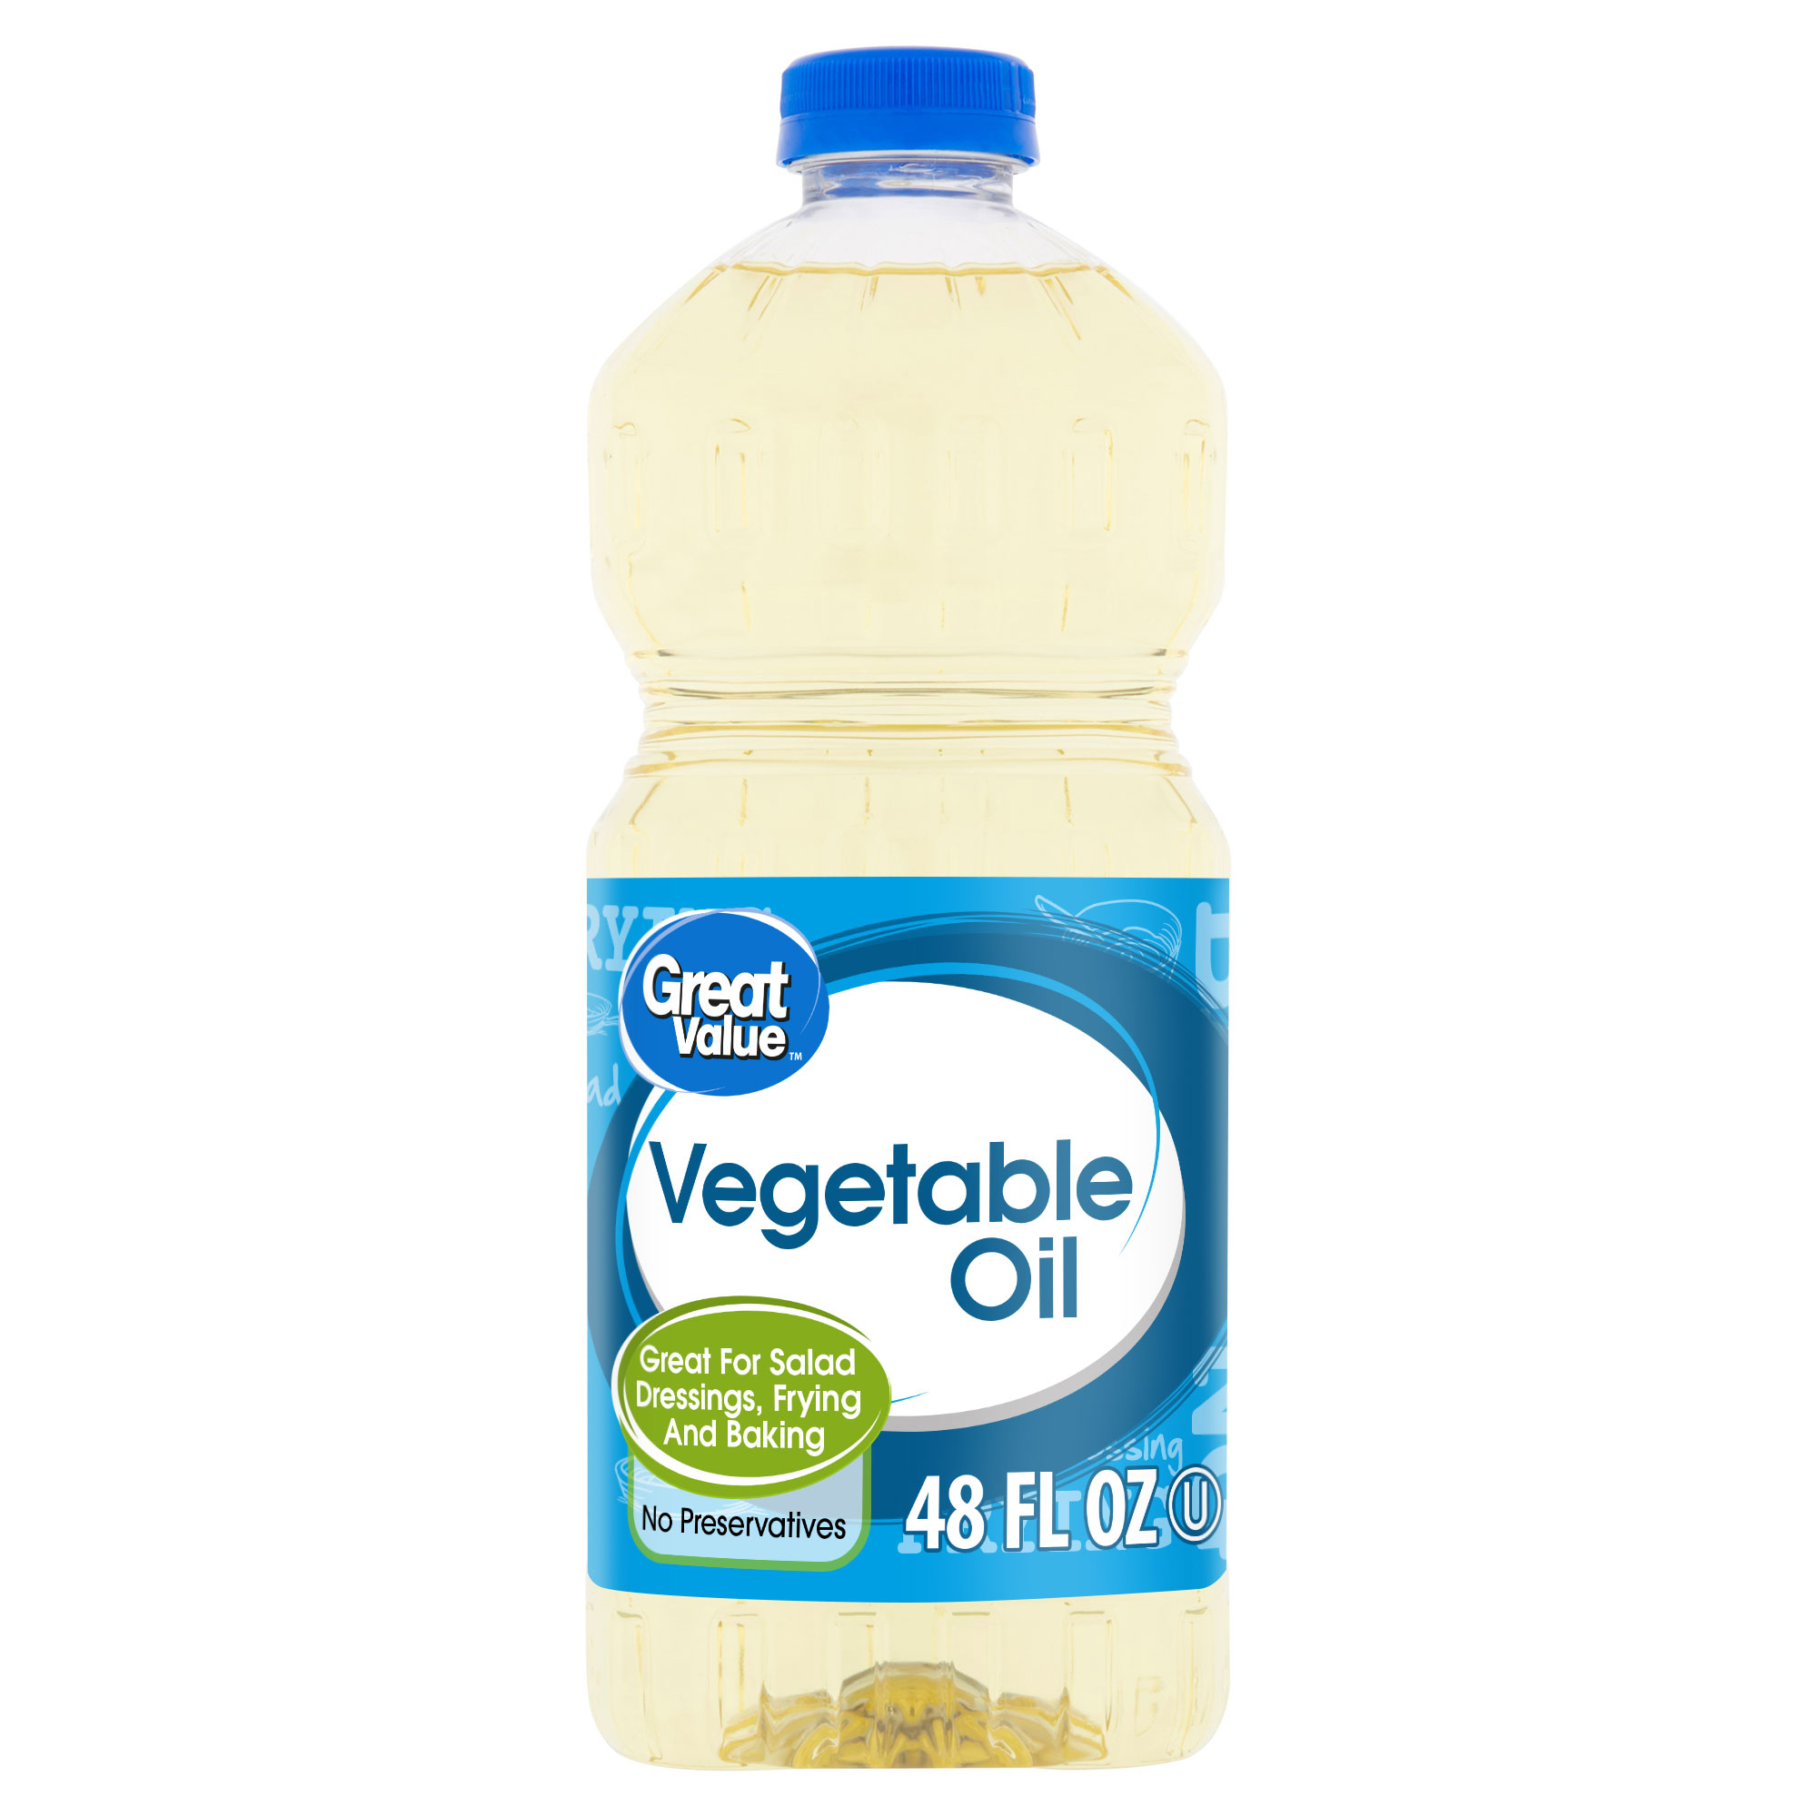
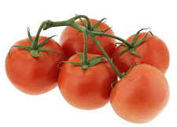
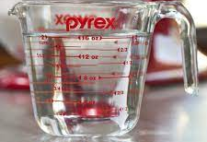
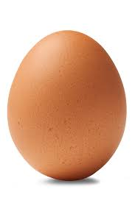

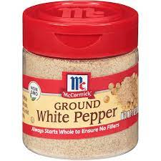

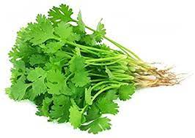
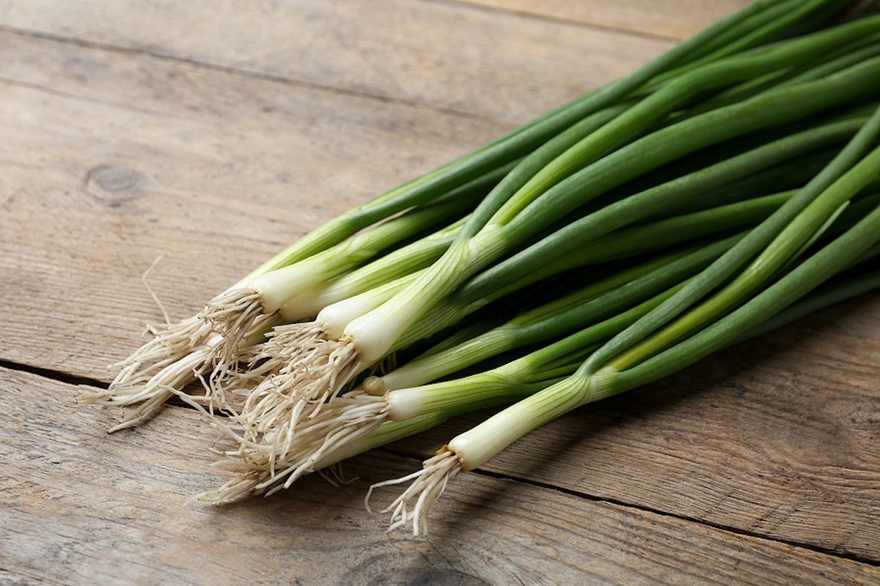
Tomato Egg Drop Soup
Entrée. Serves 4
1 cup per serving
Prep time = 5 minutes Cook time = 10 minutes
+
+
+
+
Vegetable oil 2 TBS = $0.06
Tomatoes
2 small = $1.18
Water
2 cups = free
Chicken broth
1 cup = $0.33
+
+
+
+
Sesame oil
1 tsp = $0.10
White pepper
¼ tsp = $0.16
Cornstarch
1 ½ tsp = approx. $0.07
Egg
1 egg = $0.11
Ingredients: Tomatoes, egg, water, chicken broth, vegetable oil, scallions, sesame oil, white pepper, cornstarch, cilantro
+
=
Total for recipe = $2.20
Cost per serving = $0.55
Scallions
1 scallion = $0.15
Cilantro
2 TBS = $0.11
*Prices from Walmart website January 2022

Slide 16
The Cost of a Healthy Diet:
Accounting for Nutrition and Food Spending
Goals and Constraints
Session:
USDA Modernizes the Thrifty Food Plan
USDA Agricultural Outlook Forum
February 24-25, 2022
Parke Wilde

