Slide 1
Feed Ingredients and Ration Composition Can Reduce Environmental Impact
Paul Davis, Ph.D. – Director of Quality, Animal Food Safety & Education

Slide 2

Reducing Environmental Impact
A hallmark of sustainability
Multifaceted, many components
Crosses professional disciplines
Together, we can make great strides

Slide 3
Reducing Environmental Impact Via
What we choose
How we combine
How we present
How we enhance
Offered>Ingested>Digested>Metabolized
Nutrient Utilization
Environmental Impact

Slide 4
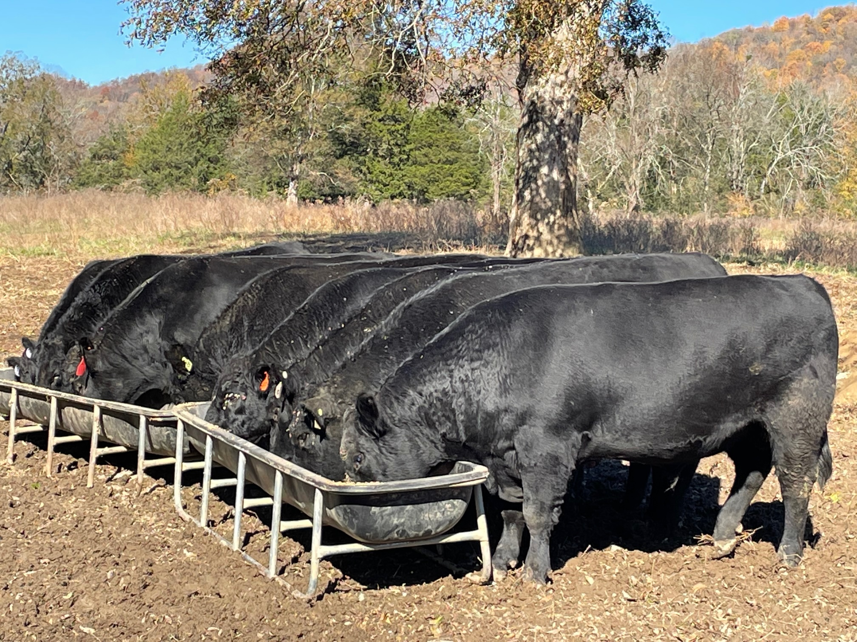
Established Concepts
Feed ingredients
Feed compounding or formulation
Animal husbandry & f feeding systems
Approved feed additives
“Don’t discard the basics”

Slide 5

Emerging Technologies
Additives containing seaweed and/or other components created to reduce enteric methane emissions in ruminants
Expanded knowledge through research
Feed lifecycle assessment database
  Quantify
  Compare

Slide 6
Global Feed LCA Institute
Key Attributes
Feed-specific LCA tool using a harmonized methodology
Uniform calculation of 15 impact categories:
  Emissions of GHG at cultivation, transport and processing
  Water usage, water quality impact
  Land use change
Software neutral to facilitate uptake of data by LCA practitioners
Submitted data quality and integrity assured by independent review
“ I can’t manage, what I can’t measure”
“Awareness empowers me”
“When there is a benchmark for current CO2 output, the reduction of CO2 can be made visible in the future.”

Slide 7
What We Choose
Selection and inclusion of feed ingredients can reduce environmental impact
  Byproducts and Coproducts
    Divert material from landfills and ‘upcycle’
  Increased bioavailability
    e.g. Phosphorus comparative values of 40 to 100
  Selection of a commodity ingredient based on content of a specific nutrient for specific application
    e.g. High lysine corn
Focus on net utilization by the animal
Offered>Ingested>Digested>Metabolized

Slide 8
How We Combine
Once feed ingredients are chosen, processing and formulation can also reduce environmental impact
Particle size-minimum, maximum, optimum
  Affects palatability (ingestion) and utilization
Respect nutrient ratios “responsible nutrition”
Don’t subject nutrients to antagonists or fail to account for them
  Cu:Mn:Zn and N:S
Offered>Ingested>Digested>Metabolized

Slide 9
How We Present
Ingredients selected and compounded must next be offered to animals in production
  Basic animal husbandry can environmental impact!
    Managing “like kinds together”, so there is not a lowest common denominator and subsequent waste
  Feeding systems
    Designed, adjusted properly; optimal number of animals per feeder; frequency of feeding
    Historic examples: waste efficiency impact
Offered>Ingested>Digested>Metabolized

Slide 10
How We Enhance
Approved feed ingredients
  Varied and numerous feed ingredients available to enhance palatability, increase digestibility and even reduce environmental impact
    However, many times such claims cannot be made nor marketed, leaving much value “on the table”
    Our industry needs help in expanding label claims and expediency in ingredient approvals
Emerging feed ingredients-specific to reducing enteric methane emissions
  Cannot yet be claimed, nor marketed adoption/use
Offered>Ingested>Digested>Metabolized

Slide 11
Climbing to Peak Efficiency (and Reduced Environmental Impact)
Research
  Feed additives as a strategic approach to reduce enteric methane production in cattle: modes of action, effectiveness and safety
    Honan et al, Animal Production Science, February 2021
  “Hold off — for now — on feeding seaweed to cows to reduce methane” Joe McFadden Hold off — for now — on feeding seaweed to cows to reduce methane | TheHill
    Sees the need to evaluate
      Environmental impact potential due to production
      Processing and distribution
      Effects on total diet acceptability, digestibility, gut microbiome, growth and production

Slide 12
Climbing to Peak Efficiency (and Reduced Environmental Impact)
Urgency
  In the headlines:
    Rep. Feenstra wants faster FDA approval of feed additives Feed Strategy Feb. 4th, 2022
  Quotable:
    "It is time to broaden the regulatory roadway for animal food marketing claims to accommodate the expanded understanding of the physiology of the gastrointestinal tract. The CVM is long overdue in revisiting its narrow path for regulatory approval of animal food ingredients, and food companies are starting to take notice.” - Louise Calderwood, AFIA
      Agripulse, December, 2021
  An expanded body of knowledge is waiting to be implemented

Slide 13

Climbing to Peak Efficiency (and Reduced Environmental Impact)
Teamwork
  Innovators, Inventors, Entrepreneurs
  Research Scientists
  Nutritionists
  Geneticists
  Manufacturers
  Engineers
  Animal Behaviorists
  Farmers
  And More!

Slide 14

Climbing to Peak Efficiency (and Reduced Environmental Impact)
“It will take a village?”
“It will take an industry!”

Slide 15
Climbing to Peak Efficiency (and Reduced Environmental Impact)
Emerging Technologies and Knowledge
Established Concepts
Reduced Impact
Support
Established Concepts
Emerging Technology
Reduced Impact
Support

Slide 16




THANK YOU

