Slide 1

U.S. Sugar Program Administration
Randy Green
Watson Green LLC

Slide 2

Which number doesn’t fit with the rest?
NE cane 52¢
Midwest beet 41-42¢
MI beet not offered
May #16 35.25¢
Stocks-to-use ratio 14.7%
Source: Sosland Publishing (2/15/22); USDA/WAOB

Slide 3
Answer: They all fit, according to WASDE
But …
“It sure doesn’t feel like 14.7%”
-- Sugar buyer for major public co.
“As you have noted, raw sugar prices are at a 9-year high. However, the recent World Agricultural Supply and Demand Estimates reflect that the market is adequately supplied, according to the traditional stocks-to-use ratio metrics.”
-- Official USDA letter to Members of Congress

Slide 4
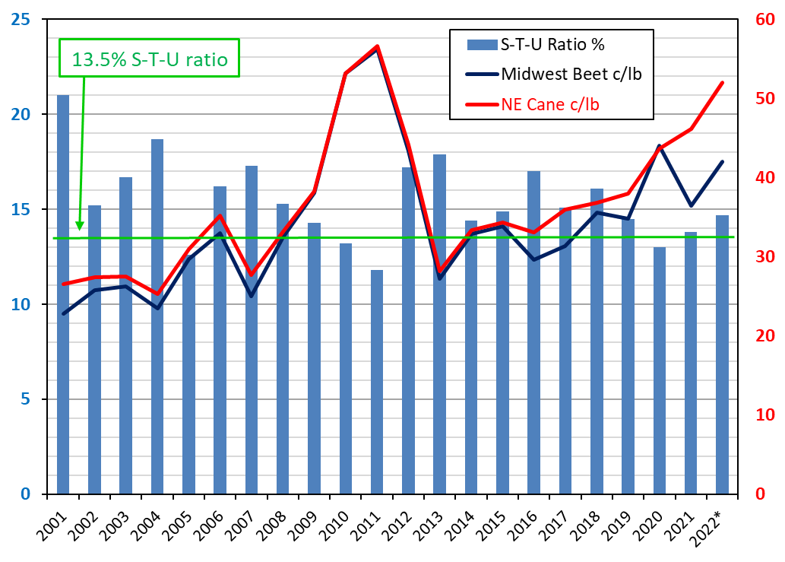

Slide 5
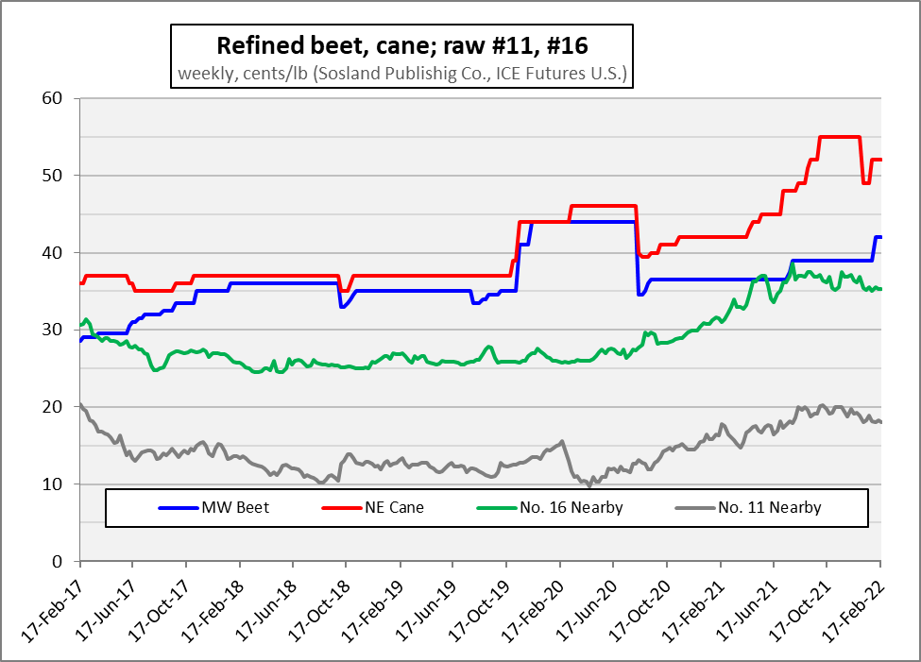

Slide 6
Analog Years?
Fiscal years (not just months) when NE cane price averaged >50¢
NE cane data series goes back to 1999 in ERS yearbook tables
Only 2 years – 2009/10 & 2010/11
By month, show …
  Quoted price (current year)
  WASDE S/U projection for current year
  WASDE S/U projection for following year (starting May)

Slide 7
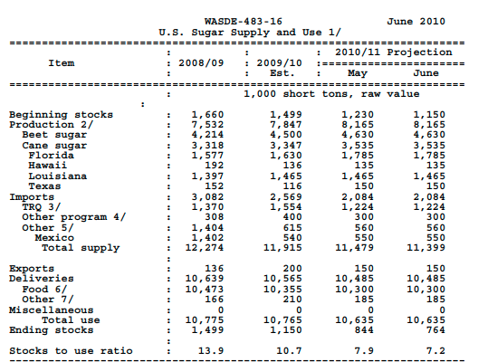
Bottom-Line Results?
Both prior years …
  WASDE S/U forecasts at very low levels
  <10% in several cases

Slide 8
2009/10
Month | NE Cane Px | S/U – 2009/10 | S/U – 2010/11 | Month | NE Cane Px | S/U – 2009/10 | S/U – 2010/11
Oct | 42.60 | 7.9 |  | Apr | 48.20 | 11.6
Nov | 45.00 | 9.6 |  | May | 46.00 | 11.6 | 7.9
Dec | 45.00 | 9.6 |  | Jun | 50.00 | 10.7 | 7.2
Jan | 50.50 | 10.8 |  | Jul | 53.40 | 11.8 | 9.0
Feb | 53.00 | 10.0 |  | Aug | 59.50 | 13.7 | 11.6
Mar | 52.00 | 10.3 |  | Sep | 59.00 | 13.7 | 9.8

Slide 9
2010/11
Month | NE Cane Px | S/U – 2010/11 | S/U – 2011/12 | Month | NE Cane Px | S/U – 2010/11 | S/U – 2011/12
Oct | 54.40 | 9.3 |  | Apr | 56.80 | 10.4
Nov | 56.50 | 11.3 |  | May | 54.00 | 14.1 | 7.7
Dec | 57.00 | 13.4 |  | Jun | 55.00 | 14.1 | 9.2
Jan | 54.50 | 12.6 |  | Jul | 56.20 | 13.3 | 11.1
Feb | 54.00 | 11.8 |  | Aug | 59.00 | 15.5 | 11.7
Mar | 57.25 | 10.4 |  | Sep | 59.40 | 15.2 | 9.8

Slide 10
What’s Different Now?
?? High-polarity raws imported to fill specialty sugar tranches
?? Louisiana raws in excess of capacity for timely refining
Record forecast domestic sugar production … high-tier pricing
High-tier imports … traditionally seen as program failure
Regardless of cause …
  Simple S/U ratio in WASDE no longer serving as reliable guide for USDA policy making

Slide 11
Is it Just the Supply Chain?
Quoted prices used by USDA are FOB, not delivered … so don’t reflect many supply-chain issues
What ASA says: “America’s sugar supply chain proved resilient in the face of immense challenges in 2019 and 2020, in large part due to the stability provided by U.S. farm and trade policies, the American Sugar Alliance (ASA) stated in a report submitted to the U.S. Department of Agriculture (USDA).” (6/21/21)
ASA also says: “The strong supply chain for sugar built by American sugarcane and sugarbeet farmers and workers allowed refined sugar supply streams to meet the new demands for retail sugar driven by COVID-19.” (2/14/22)

Slide 12
Recognize Reality
Temporarily abandon use of S/U targets outside MX suspension agreement
Recognize that Additional U.S. Needs can take ratio above 13.5%
Estimate stocks included in S/U that are not available to markets
Increase U.S. Needs, potentially TRQ by like amount
Institute policy of reallocating “never-ship” TRQ holders immediately after Oct. 1

Slide 13
Increase Transparency
Policy statement that USDA seeks to avoid high-tier imports, supply adjustments necessary when prices approach these levels
Use existing authority to require sugar entered against refined quotas, including specialty quotas, be for final consumption – not require further processing
Establish regular, published schedule for TRQ reallocations

Slide 14
Plan for the Future
Study potential replacement metrics for supply decisions
Reassess 13.5-15.5% S/U target range in light of recent history
Analyze whether TRQ shares can be permanently reallocated if countries no longer produce or export sugar
Explore use of CQEs for specialty quota

Slide 15

Thank You!
Randy Green
rgreen@watsongreenllc.com

