Slide 1
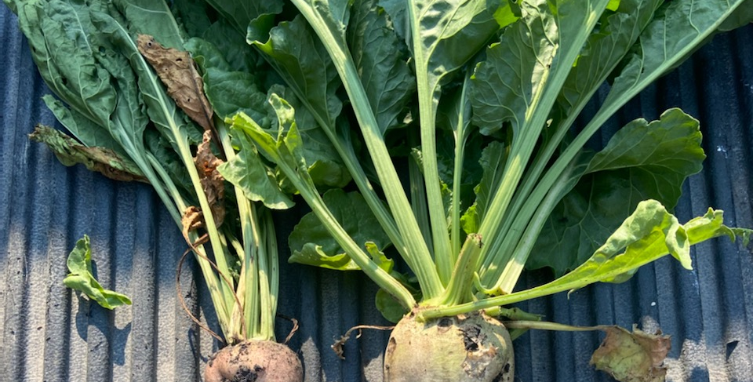

SUGAR SITUATION & OUTLOOK FOR 2022
Rob Johansson
Director of Economics and Policy Analysis
American Sugar Alliance
Ag Outlook Forum – USDA
Washington, DC
February 2022

Slide 2



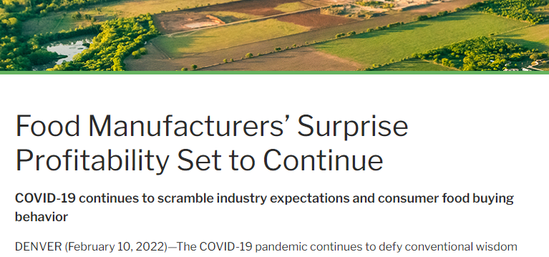

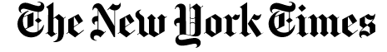
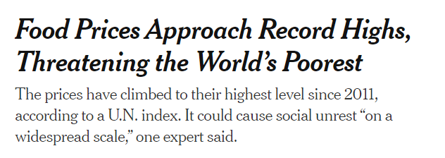
Lots of discussion about adjusting to the pandemic --- what it means for farm production and prices of food and returns.
Farmers Feel the Squeeze
of Inflation
https://www.wsj.com/articles/farmers-feel-the-squeeze-of-inflation-11644921180
https://www.cobank.com/corporate/news/2022/food-manufacturers-surprise-profitability-set-to-continue
https://www.nytimes.com/2022/02/03/business/economy/food-prices-inflation-world.html

Slide 3

American sugar farmers are increasingly efficient; produce safe and reliable product; & meet high labor and environmental standards
Macroeconomy --- inflation resulting from recovery
Farm situation --- improved receipts offset by increased costs of production
Sugar outlook --- tightening stocks-to-use
Summary --- prices falling in real terms

Slide 4
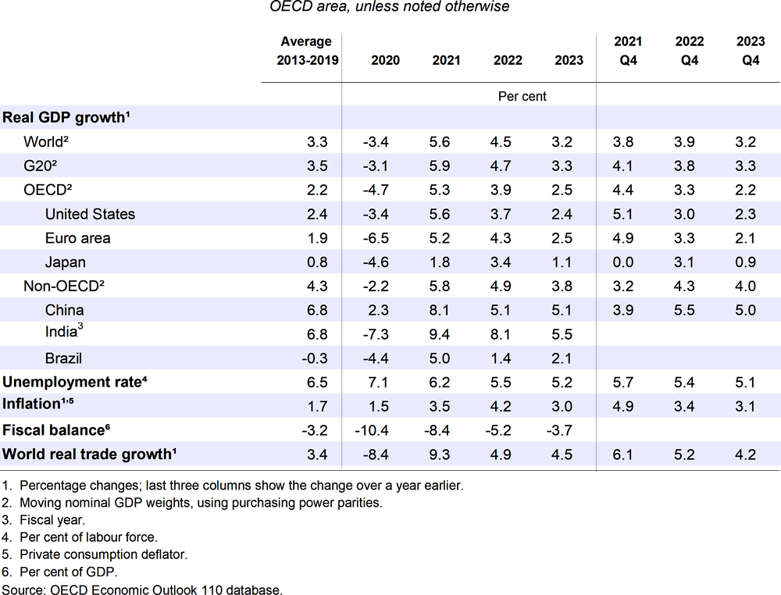
GDP growth rebounding from 2020
Current estimates of U.S. growth suggest return to
< 3% by the beginning of 2023

Slide 5
The producer price indices for transportation (sea, rail, truck) are still rising (up 10%-40% since Mar 2020)
March 2020 = 100
March 2020 = 100
Data: BLS.

Slide 6
Annual inflation --- a 40- year high (7.5% y-o-y)
CPI (1982 = 100)
% change Y-O-Y
Data: BLS.

Slide 7
Retail food prices --- past 10 years
Contributing to the CPI, we also see that inflation has been ticking up for some food items in US grocery stores as well.
Data: BLS.

Slide 8
Prices for other commodities are elevated as well
We can see year-over-year increases in other global food and energy commodities
Data: BLS, IMF.

Slide 9

Farm Situation and Outlook

Slide 10
Real farm sector profits grew in 2021,
Expect a drop in 2022
-2.1% from ’21
-7.9% from ’21

Slide 11
Nominal receipts up in 2022, but govt payments down and expenses up
Lower Government payments and higher expenses outweigh expected increases in livestock and crop receipts.
Even with smaller govt payments, it is critical to have stable program to count on --- allows improvements on farms and in our facilities = more efficient production.
F= Forecast. Component changes may not sum to total because of rounding.
Source: USDA, Economic Research Service, Farm Income and Wealth Statistics
Data as of February 4, 2022.

Slide 12
Fertilizer costs are the largest item up in 2022
2020-22F % change
2021F-22F % change
+12.0%
+30.6%
+10.4%
+18.6%
+6.8%
+24.3%
+6.1%
+21.1%
+5.9%
+9.1%
+2.1%
+35.3%
+1.8%
+4.2%
+1.4%
+8.9%
-0.3%
+1.4%
-6.6%
-1.9%
F= Forecast.
Source: USDA, Economic Research Service, Farm Income and Wealth Statistics
Data as of February 4, 2022

Slide 13
New AFPC report documents jump in fertilizer prices
Feb 10th (% y-o-y)
Anhydrous = $1498 (+187%)
Urea = $897 (+125%)
DAP = $860 (+66%)
MAP = $877 (+66%)
www.ams.usda.gov/mnreports/gx_gr210.txt
https://afpc.tamu.edu/research/publications/files/711/BP-22-01-Fertilizer.pdf

Slide 14
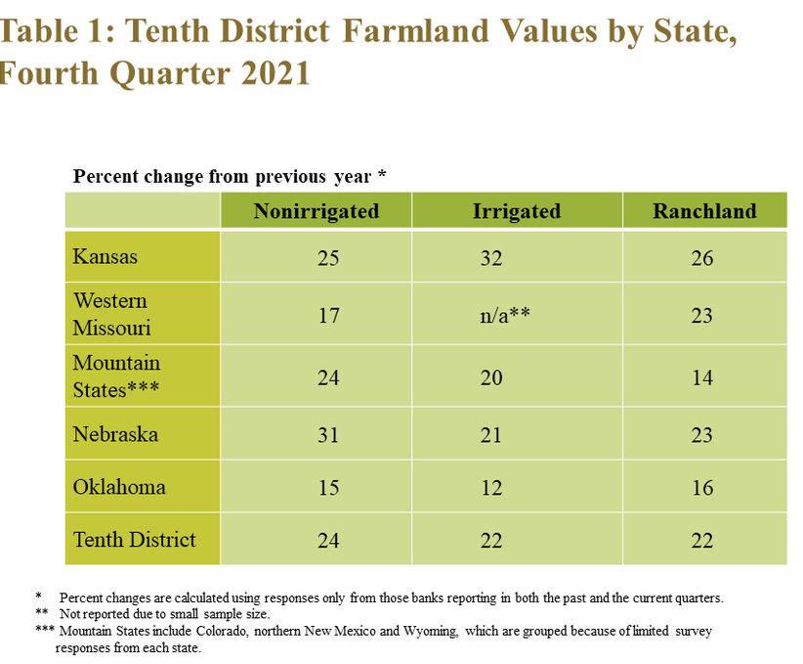
https://www.kansascityfed.org/agriculture/ag-credit-survey/rise-in-farm-real-estate-values-accelerates/
Land values and rent continue to increase as well.
Investments in land (before interest rates rise) is driving up prices.

Slide 15
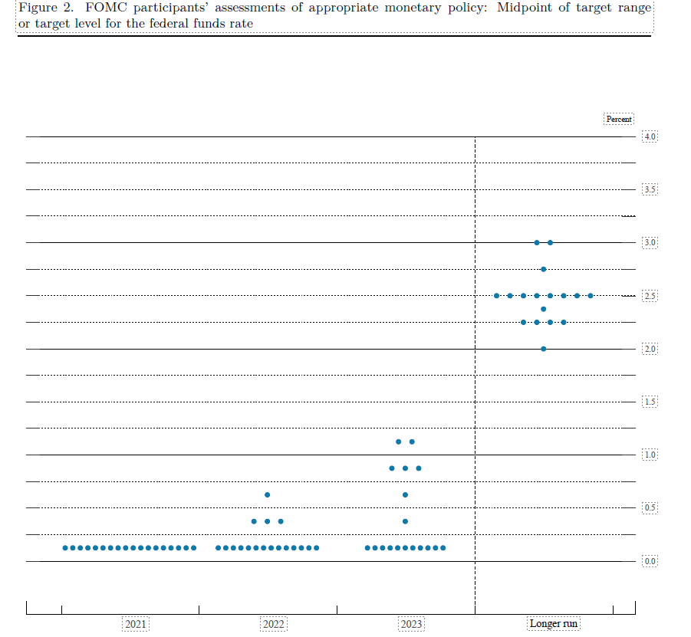
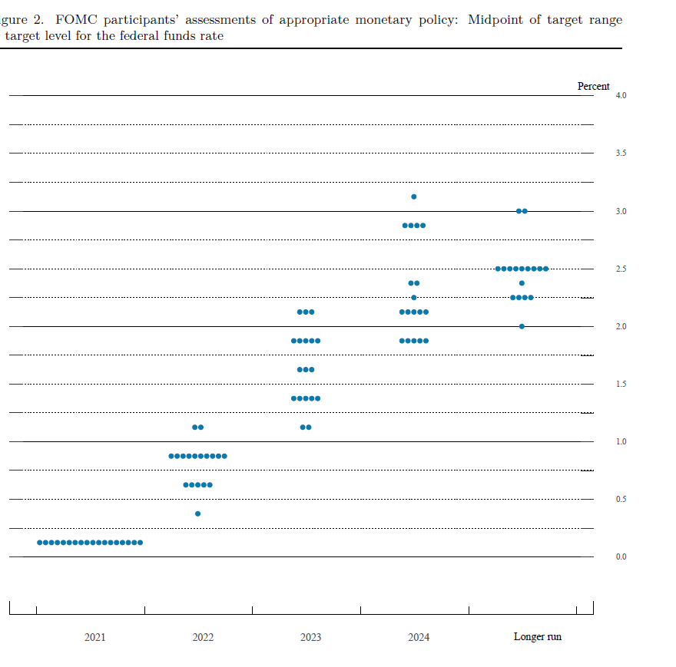
Federal Reserve moving towards a tighter monetary policy
https://www.federalreserve.gov/monetarypolicy/
Source: FOMC March 2021 projections
Source: FOMC December 2021 projections

Slide 16
Recent events in Ukraine are likely to boost energy and agricultural prices
In 2021/22
7th largest producer of beet sugar ~1.4 million MT
6th largest corn producer
~42 million MT
Data: USDA.

Slide 17
Since Jan 2022
Diesel up by 11.2%
Gas up by 7.4%
Data: EIA.

Slide 18
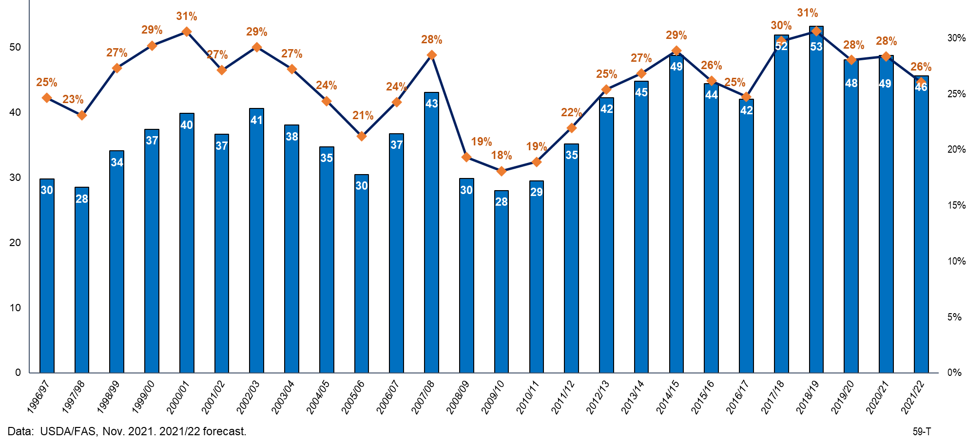
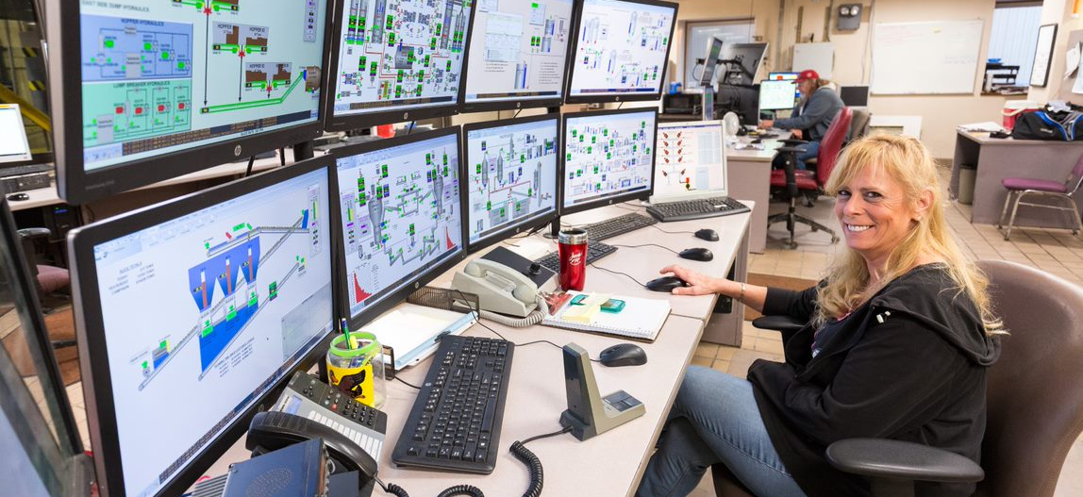
Sugar Outlook
World Sugar: Ending Stocks and Stocks-to-Use Ratio

Slide 19
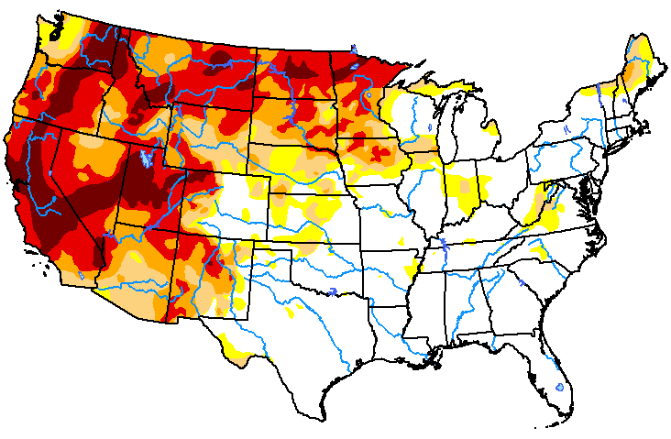
Record domestic sugar production despite growing season challenges and inflationary pressures
Most recent estimate of production is up by almost 400,000 STRV from the July estimate
1,000 STRV
9.4 million STRV
Source: USDA.

Slide 20
U.S. Sugar and HFCS Per Capita Consumption
-- kilograms per person, refined basis, 1974 - 2020 --
Total sweetener use has fallen by 4% since 2000, but…
Sugar consumption has grown by about 23%, but remained flat on a per capita basis.

Slide 21

Sustainability --- 16% increase in production on 11% less land

Slide 22
STU has stabilized after removing uncertainty regarding Mexican imports
Important to have stable program to count on --- allows improvements on farms and in our facilities = more efficient production.
Thanks to the sugar program and USDA administration of it.
U.S. sugar: ending stocks/use ratio*
--- since modified 2017 SAs < 15.5%

Slide 23
U.S. Raw Sugar Prices, Nominal and Real
Cents/lb
Looking over time, real prices for sugar have been falling due to inflation. Raw prices have fallen by 34%, while nominal prices have risen by 65%

Slide 24
Refined sugar prices are also down by 35% over the past 40 years
U.S. Wholesale Refined Sugar Prices:
Real Price Down by 35% Since 1985
Cents/lb

Slide 25
With flat nominal to declining real prices, the industry has been forced to consolidate to adjust to tighter margins.

Slide 26
2020 survey found Americans think sugar is reasonably priced
-and-
7-in-10 prefer U.S. produced sugar even if foreign-produced sugar were cheaper (ASA 2020)
U.S. Retail Sugar Prices,
Nominal and Real
Cents/lb

Slide 27
Wholesale-Retail Gap Widening
Cents/lb
Since 2010:
Producer prices down 34%
Consumer prices up 12%
Increasing gap captured by the retailer

Slide 28
Since 2020, sugar price down 34%, but SCP’s and retail sugar up
Perhaps it is not surprising that there is this dichotomy…
Sugar is a relatively small % of SCP costs.
Recent analysis by Utenn* finds sugar companies do not change SCP prices when U.S. sugar prices rise/fall.
*DeLong and Trejo-Pech. 2022 “Does United States Sugar Policy Affect Sugar-Containing-Product Prices?” Southern Agricultural Economics Association Annual Meeting. New Orleans, LA. February 12-15, 2022.

Slide 29
Supply Chains
The costs of storage are covered by the sugar producers --- approaching 3 mil STRV in Feb/Mar.
And we have about 90 domestic sugar factories, mills, refineries, and storage facilities around the country that are able to deliver sugar when customers need it.
For example, an additional 50 million, 4-lb bags were supplied to support household purchases during the beginning of the pandemic.

Slide 30
Bottomline, costs of production in these major categories have pushed up input costs more than prices have risen.
We need a strong safety net in the Farm Bill and appreciate the administration of the program by USDA.
Stability in price expectations is important for long-term capital investments, needed to improve productivity and efficiency.
Since 1980's: Farmers' Input Costs Have Risen Far More than Sugar Prices
-- 2021 average compared with 1980s average --

Slide 31
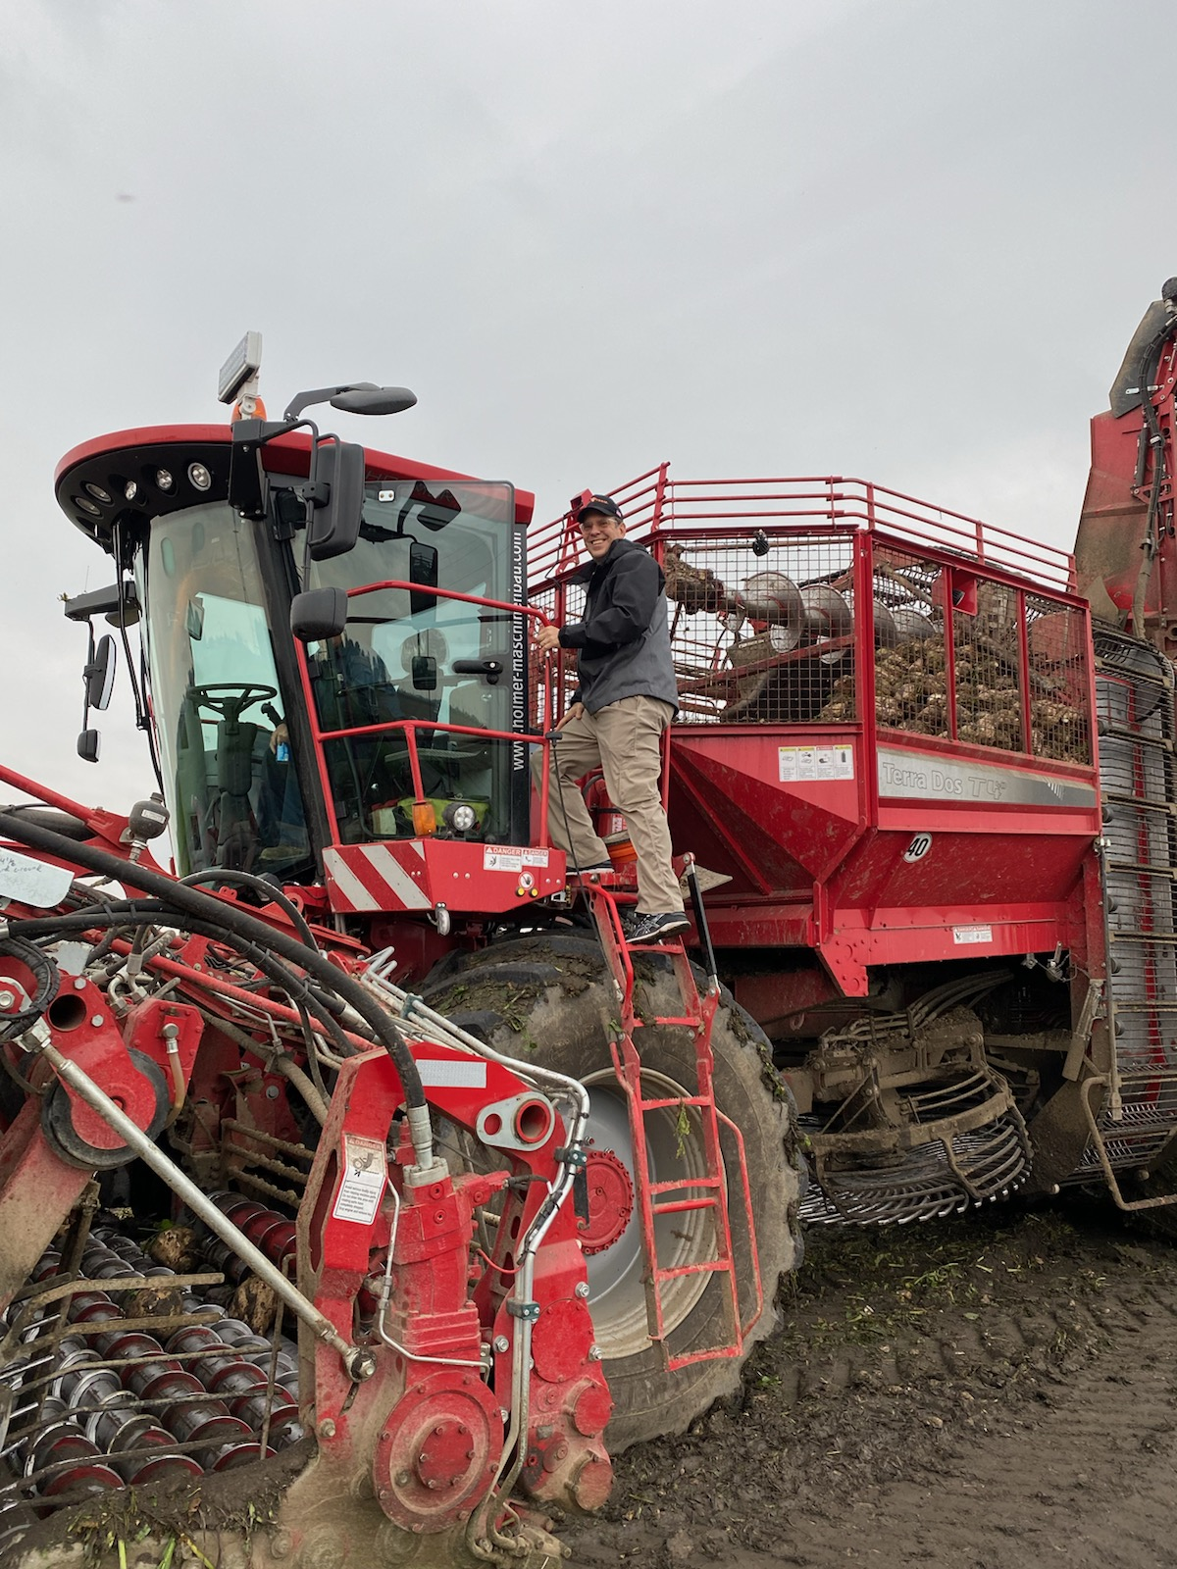
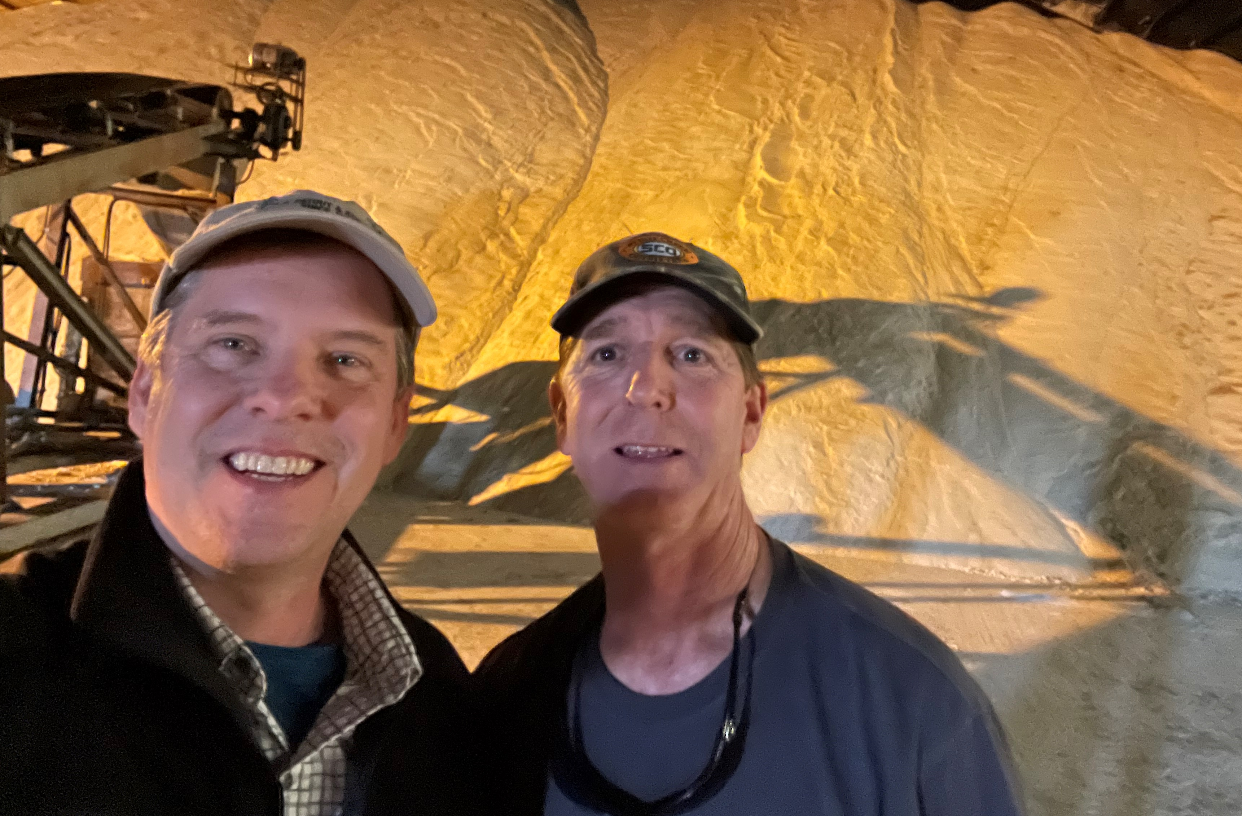
Rob Johansson
Director of Economics & Policy Analysis
rob@sugaralliance.org
703-768-6731
31
Notes:
So, where do we go from here? We plan to continue to focus on ASA’s members and the good you are doing in the community…not just during this pandemic, but all the time. The investments in sustainability, the job training programs, the community service. We also want to highlight the strength of our supply chain, which has been resilient during these difficult times. All of it comes together to rightly paint a positive picture of this incredible industry and the policies that keeps it strong and functioning.
That brings me to the big finale of this presentation. ASA’s PR efforts will only work if we know what’s happening on the ground. If you have story ideas or want to share something special that’s happening in your local community, please contact us. My contact information is provided here. We’d love to hear from you. Thanks, and I’ll now turn things over to my esteemed colleague XXXX

